Slide 1
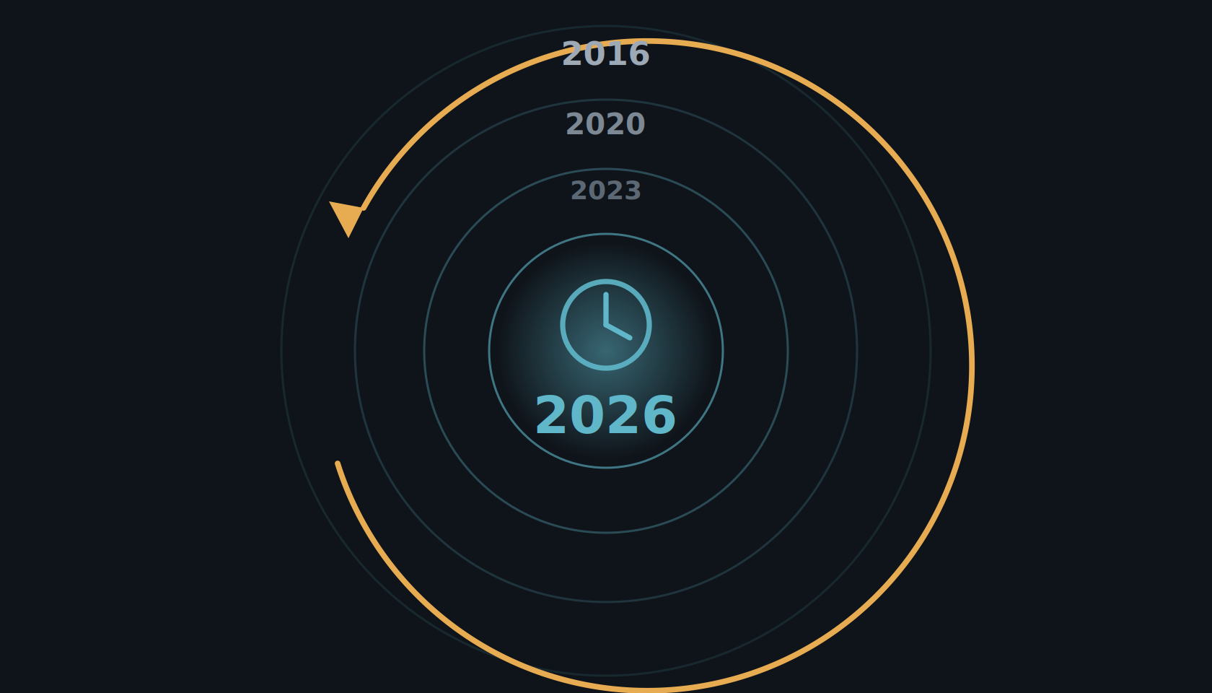
ERA II · 2026
The year is 2026.
Ten years on, the early promise has been put to the test — prospectively, in real screening programs.
Notes:
So step back into the time machine and come forward ten years, to 2026. The early promise we just saw was retrospective and lab-based. By 2026 that has changed: AI screening has been tested where it counts — prospectively, in real screening programs — and the picture is much clearer.

Slide 2
ERA II · 2026
2026: two prospective studies show AI screening works.
MASAI · SWEDEN · RCT (~105,000)
PRAIM · GERMANY · REAL-WORLD (463,000)
Interval cancers non-inferior (ratio 0.88)
+17.6% cancers detected
Sensitivity 80.5% vs 73.8% at matched specificity · ~44% less reading workload.
Recall non-inferior · 6.7 vs 5.7 CDR per 1,000 · 12 sites, 119 radiologists.
Gommers/Lång et al., Lancet 2026;407:505–514
Eisemann et al., Nature Medicine 2025
A third is underway: PRISM — the first large randomized trial of screening AI in the United States (Transpara; $16M PCORI; 7 sites; announced Sept 2025, recruiting). Results are years away, but it tests the US single-reader workflow directly.
Notes:
And here is where it stands in 2026: there are now two large prospective studies showing AI works in a real screening program. MASAI, the Swedish randomized trial of about 105,000 women, reported its interval-cancer result — non-inferior, with a ratio of 0.88, at a sensitivity of 80.5 versus 73.8 percent for the same specificity, and it cut reading workload by about 44 percent. PRAIM, a real-world German deployment of 463,000 women across twelve sites and 119 radiologists, found 17.6 percent more cancers detected with AI support and no increase in recall. Two prospective studies, two countries, the same direction. And a third is underway: PRISM, the first large randomized trial of screening AI in the United States — a sixteen-million-dollar PCORI-funded, seven-site study using Transpara, announced in September 2025 and recruiting now. Results are years away, but for the first time the US single-reader workflow will be tested directly.

Slide 3
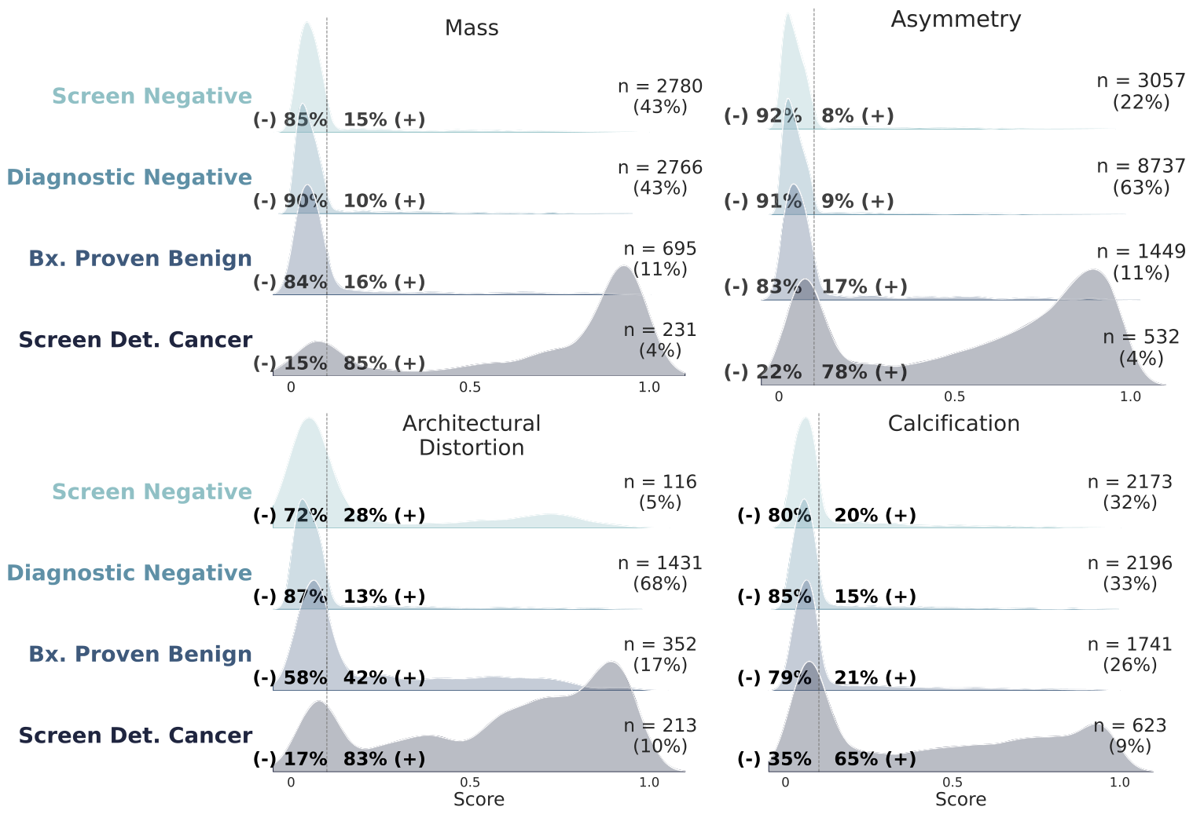
ERA II · 2026
The averages look strong — so where do these models still fail?
Overall AUC 0.91 — but performance depends on the imaging feature. Masses, asymmetries, calcifications are called negative in 60–81% of exams; architectural distortions behave erratically.
Exam-level model-score distributions by imaging feature · [your group], Nat Commun 2026 (DOI 10.1038/s41467-026-70637-3), Fig. 6.
Notes:
So it is 2026 — where do we actually stand? The averages look strong, but a single AUC says nothing about where a model fails. In our audit of a commercial DBT model across 163,000 exams from EMBED, the overall AUC was 0.91 — but look at how the scores break down by imaging feature. Masses, asymmetries, and calcifications are correctly predicted negative in 60 to 81 percent of exams. But architectural distortions behave very differently: even screen-detected cancers split into a bimodal high-and-low distribution, and many benign distortions score high — so the model both misses cancers and over-flags benign findings in that one category. Performance depends on what the finding looks like, not just the headline AUC. The two gaps that remain: subgroup performance, and explainability.

