Slide 1
International Workshop on Breast Imaging · 2026
Thirty Years,
Three Eras.
AI in Breast Imaging — from CAD to Clinical Intelligence
Hari Trivedi, MD · Emory University
Notes:
[Title card] Thirty Years, Three Eras: AI in Breast Imaging, from CAD to Clinical Intelligence. — Hari Trivedi, Emory University.

Slide 2
DISCLOSURES
Disclosures
Founder
Avera AI
Lightbox AI
Associate CMIO
HOPPR
Advisor
croviz.ai
Solis Mammography
Sirona Medical
Flatiron Health
Coefficient
Verily Life Sciences
Biodata Consortium
Industry / Foundation Support
Simbiosys
HOPPR
Clairity
Lunit
DeepLook Medical
Kheiron Medical
GE
IBIS
Radicait
Voio
Appelai
Georgia CTSA
RSNA
SIR
Nightingale Open Science
Lacuna Fund
Meridian Foundation
Gates Ventures
Notes:
Quickly, my disclosures. I'm a founder of Avera AI and Lightbox AI, Associate CMIO at HOPPR, and I advise croviz.ai, Solis Mammography, Sirona Medical, Flatiron Health, Coefficient, Verily Life Sciences, and the Biodata Consortium. My research and the work in this talk have received industry and foundation support from the organizations listed on the right. None of these relationships dictated the content of this talk.

Slide 3
A normal screening mammogram — read as normal.
Notes:
As you all know, this is a screening mammogram. In fact, a normal one — and it was read as normal. This is a real, de-identified exam from Emory. This is what we do today.

Slide 4
What are we not seeing?
AI reads this same mammogram and her biopsy slide — not just the lesion, but the patient.
Notes:
Two radiologists read this and were right — there is no cancer to see today. So the question I want to pose is: what are we not seeing? What I want to describe by the end of this talk is how AI models — past, present, and future — read this same mammogram, and her eventual biopsy slide, and extract information that is not visible to us. The first estimates a high probability of breast cancer within about five years — which she did develop. The second quantifies calcification in her breast arteries — an independent cardiovascular risk marker, with a measurable dose-response. The third, applied to the slide from her eventual biopsy, estimates a recurrence score we currently send to a genomics lab for about four thousand dollars. None of these is hypothetical. Each is published and externally validated, and one is already in this year's screening guidelines.

Slide 5
From lesions to patients.
01
PAST
Lesion
find & characterize
02
PRESENT
Image
risk & opportunistic signal
03
FUTURE
Patient
pathology + integration
Notes:
So over the next thirty minutes or so, I want to take you on a short journey of how we got here and where we can expect to go: from the lesion, to the image, to the patient. And I'll start with a cautionary tale, because this field has overpromised before.

Slide 6
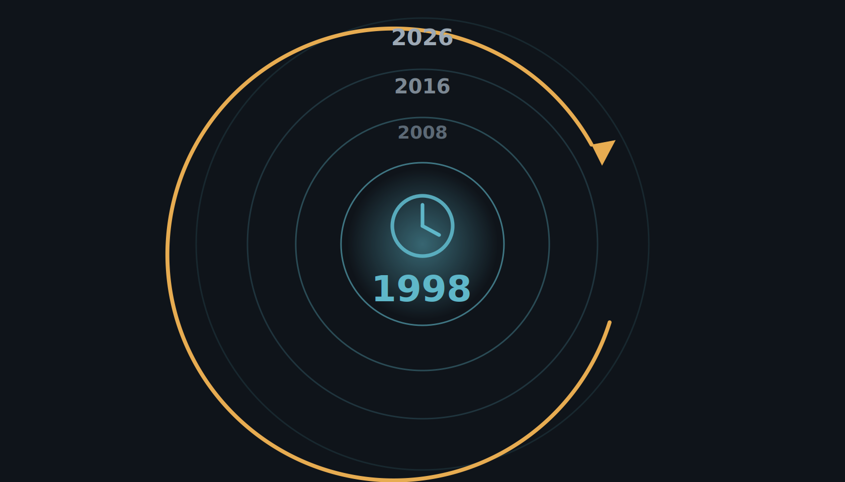
Let's step into a time machine.
This field has overpromised before. Let's start there — in 1998.
Notes:
To understand where this is going, we have to start with where it has been — because this field has overpromised before. So let's step into a time machine and go back to the beginning, to 1998.

Slide 7
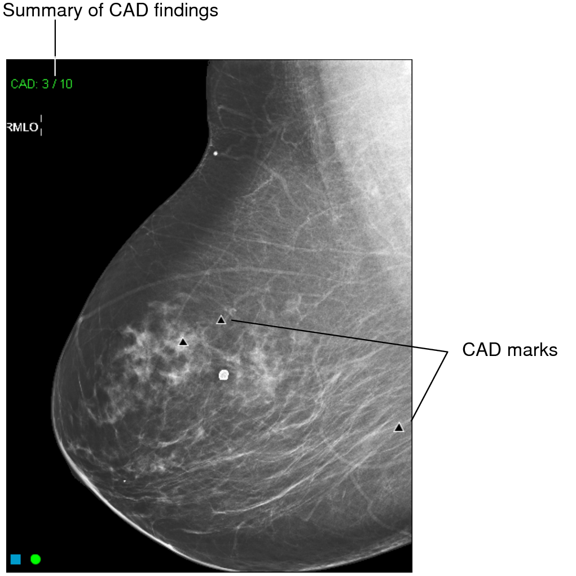
Era I · 1998 · Lesion→Image→Patient
The year is 1998.
Computer-aided detection has just arrived — a mark on every mammogram flagging a possible cancer. A second set of eyes, automatically. It feels like the future.
Notes:
The year is 1998 — the year the FDA cleared the first CAD system for mammography. Computer-aided detection has just arrived: software that puts a mark on every mammogram to flag a possible cancer. A second set of eyes, automatically. It feels like the future.

Slide 8
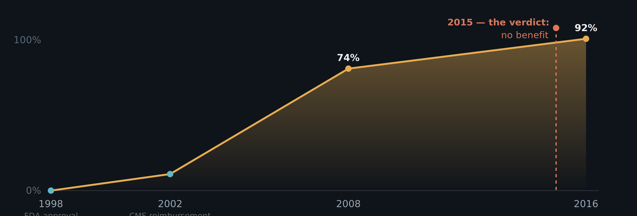
ERA I
Within a decade, CAD was used on most US mammograms.
A 2002 reimbursement code drove adoption — not evidence of benefit.
The definitive study landed in 2015 — after CAD already ran on ~9 in 10 mammograms.
Notes:
And within a decade, it is everywhere. A reimbursement code in 2002 — not an outcomes trial — drove adoption from nothing to about 74% of US screening mammograms by 2008, and 92% by 2016. We adopted it on a billing code, not a clinical trial.

Slide 9
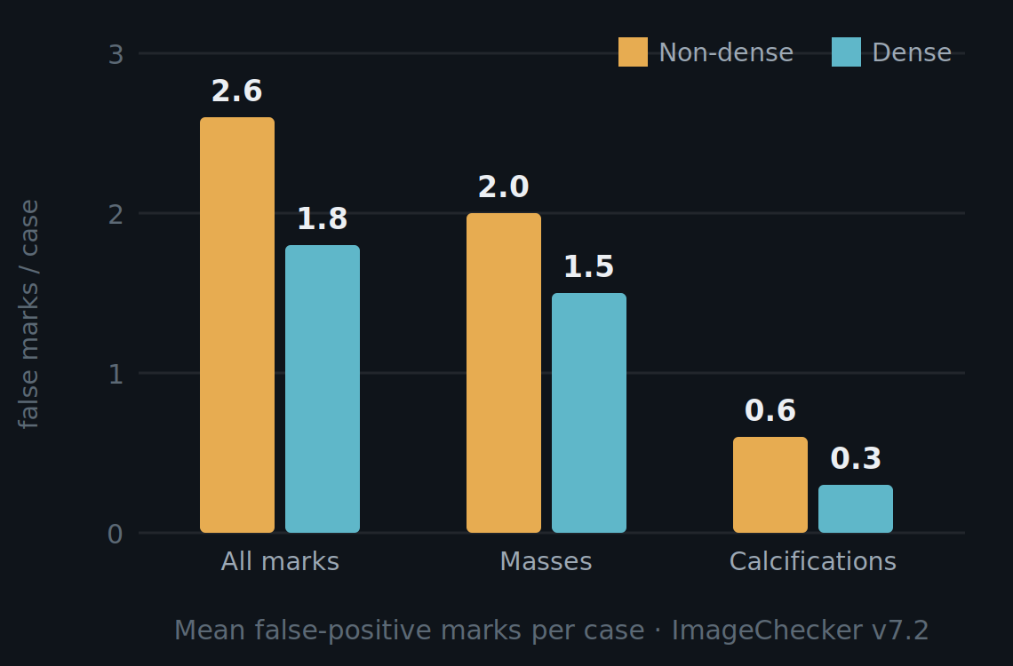
ERA I
Conventional CAD put a false-positive mark on most normal exams.
70–85%
of normal mammograms had ≥1 false positive
0.5–1.5
false positives per image — about 2–4 per 4-view case
Kim 2009 · Mahoney 2011 · Watanabe 2019 · Leon 2009
~2–3 false marks on a normal case; more on non-dense breasts. Mahoney & Meganathan, J Digit Imaging 2011 (Table 4) · PMC3180536.
Notes:
And the reading room is not convinced — because conventional CAD produced false positives constantly. Across independent series, seventy to eighty-five percent of normal mammograms carried at least one false-positive mark: Kim seventy, Mahoney up to eighty-five, Watanabe eighty-three — versus fifty-two percent for an AI-based CAD. In per-image terms that is roughly half a mark to one and a half false marks on every image. Mahoney measured about two to three false marks on a normal case — and more on non-dense breasts, where there is more to flag. After enough false alarms, radiologists learned to tune the marks out.

Slide 10
ERA I
$400M/yr
U.S. spend ≈ $1 of every $10,000 in health care
−47% odds
odds of detecting a malignant lesion — CAD on vs off, same readers (OR 0.53)
When the definitive study finally ran, CAD added cost and, for the same readers, lowered the odds of catching a cancer.
Lehman et al., JAMA Internal Medicine 2015 · 323,973 women · 271 radiologists
Notes:
Then the data came in. The United States was spending over four hundred million dollars a year — roughly one dollar of every ten thousand in US healthcare. And among radiologists who read both with and without CAD, the odds of detecting a malignant lesion were 47 percent lower with CAD on — same readers, same images. That is quite remarkable. For the radiologists in the audience: every breast radiologist I have spoken with essentially ignores the CAD marks, or finds them disruptive — so this paper was not much of a surprise.

Slide 11
ERA I
Computer-aided detection does not improve diagnostic accuracy of mammography. These results suggest that insurers pay more for CAD with no established benefit to women.
— Lehman et al., JAMA Internal Medicine 2015
85.3% vs 87.3%
sensitivity — with vs without CAD
4.1 = 4.1 /1,000
cancer detection — identical
0.871 vs 0.919
AUC — with vs without (Fenton, NEJM 2007)
Notes:
The conclusion is worth reading verbatim. It had been foreshadowed years earlier — Fenton, in the New England Journal in 2007, already showed CAD lowered accuracy and raised the biopsy rate.

Slide 12
ERA I
What went wrong.
01It flagged only what we can already describe.Hand-tuned features are limited to what we can design — so it added marks, not new information.
02Readers learned to ignore it.70–85% of normal exams carried at least one false-positive mark — eroding trust.
03It was deployed at scale before it was ever validated.Reimbursed in 2002 and run on ~92% of US screening mammograms by 2016; the definitive accuracy study didn't arrive until 2015 — and found no benefit.
Lehman CD, et al. JAMA Intern Med 2015;175(11):1828–1837 · Keen JD, et al. J Am Coll Radiol 2018 (adoption ~92%)
Notes:
Why did it fail? Three reasons. First, it could only flag what we already know how to describe — the features were hand-tuned, so it was limited to what we could design, and it added marks rather than new information. Second, it marked most normal studies — 70 to 85 percent carried at least one false-positive mark — so readers learned to ignore it, and trust eroded. And third, the deeper problem: it was deployed at scale, reimbursed and run on nearly every screening mammogram in the country, before it was ever validated. The definitive accuracy study didn't arrive until 2015 — and found no benefit.

Slide 13
ERA I
A paradigm shift.
TRADITIONAL CAD
Programmed
We wrote the rules for what cancer looks like. It pointed at spots for a human to check.
MODERN DEEP LEARNING
Trained
The model learns the patterns from the images themselves. It can read the image — as a second reader, or on its own.
→
Notes:
The lesson from Era I is that CAD was reimbursed before it was proven, and was never shown to help. Around 2012 the technology changed. Traditional CAD was programmed — we wrote the rules. Modern deep learning is trained — it learns the patterns from the images. Traditional CAD pointed at spots; modern models can read the image. Sixteen years later.

Slide 14
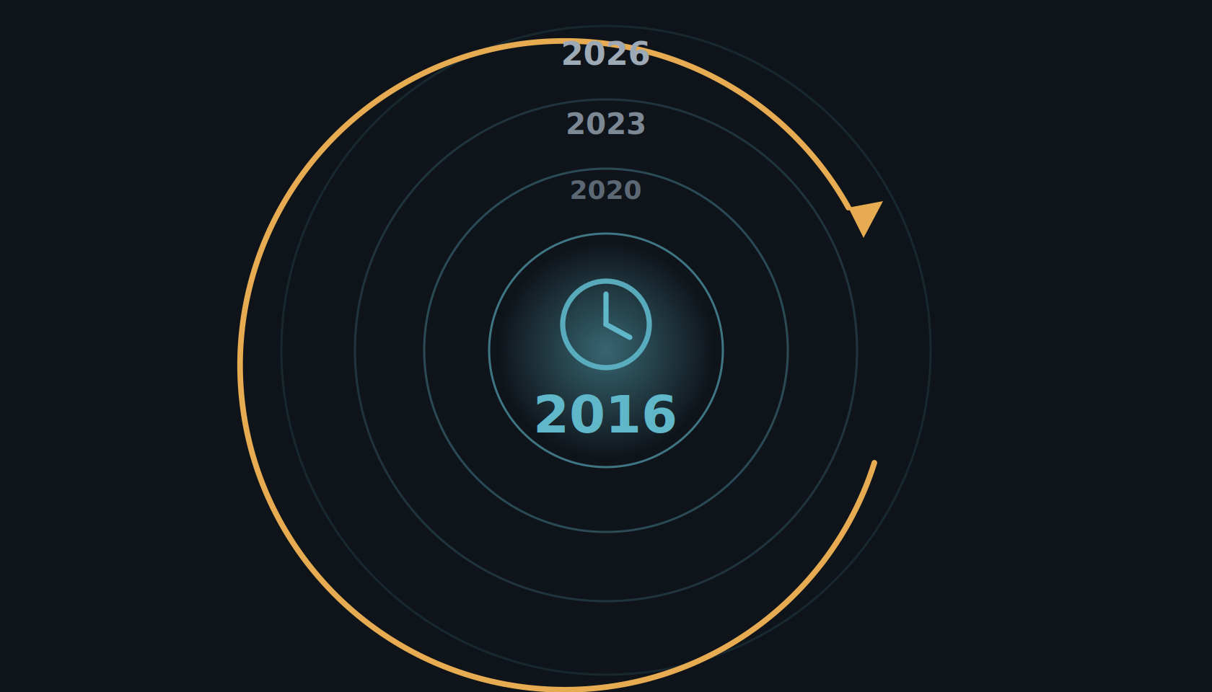
Era II
The year is 2016.
You're beginning to hear about AI — but still feeling the burn from CAD.
Notes:
The year is 2016. You're a radiologist, you're just beginning to hear about AI for breast imaging — and the reading room is still feeling the burn from CAD. So what does mammography AI actually look like, and what is the evidence?

Slide 15
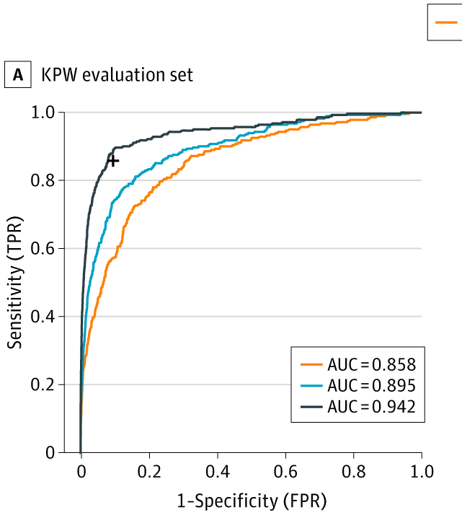
ERA II
2016: the first large-scale push — and a surge of optimism.
The Digital Mammography DREAM Challenge was the first large-scale effort to build breast-cancer AI — and we took part. The hope was that a crowdsourced competition would simply solve it.
1,000+ participants · 126 teams · 44 countries
~640,000 mammograms
Schaffter et al., JAMA Network Open 2020;3(3):e200265.
Notes:
The optimism wasn't new in 2020. Back in 2016 came the first large-scale effort to build breast-cancer AI: the Digital Mammography DREAM Challenge. Over a thousand participants, 126 teams from 44 countries, on roughly 640,000 mammograms; we took part. There was an incredible surge of optimism that this would simply solve breast AI. On the held-out evaluation set, the best single model reached an AUC of 0.858; the ensemble of the eight best models reached 0.895; and the ensemble plus a single radiologist reached 0.942.

Slide 16
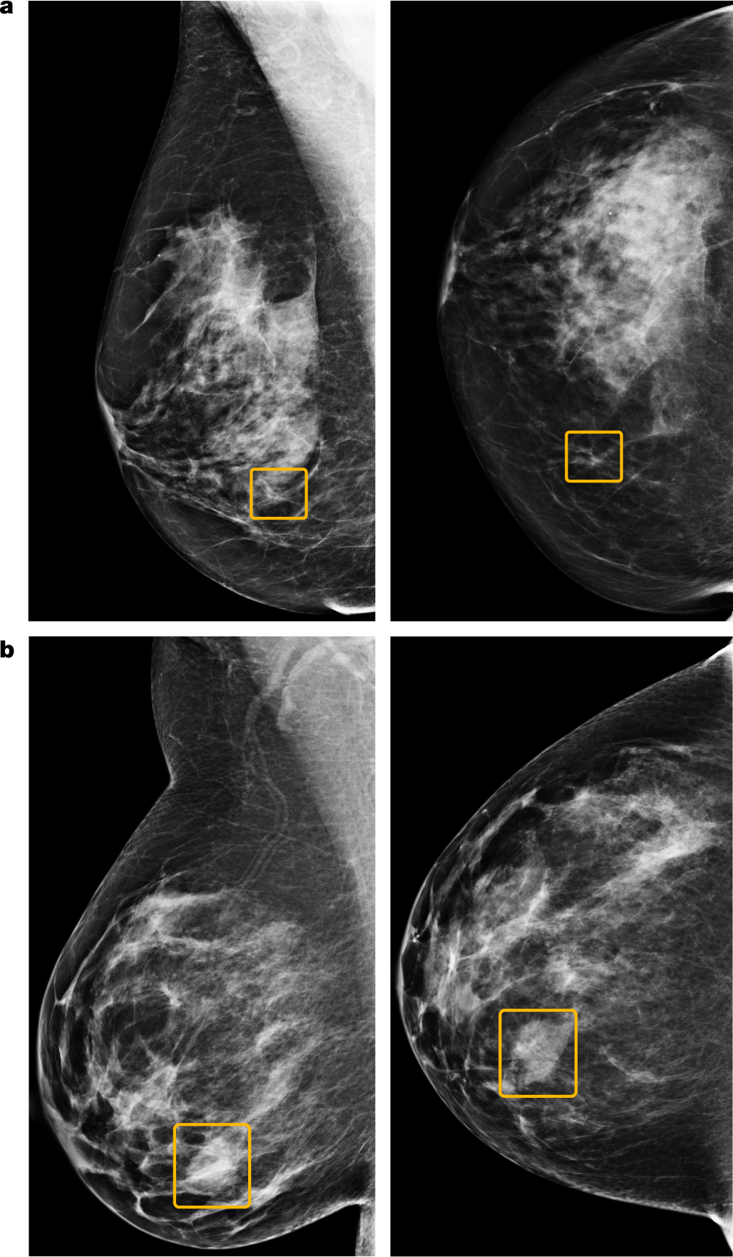
ERA II
2020: Google publishes its breast-cancer AI model.
McKinney et al., Nature 2020 (Google Health, UK + US) — a deep-learning system read screening mammograms stand-alone.
false positives −5.7% US / −1.2% UK
false negatives −9.4% US / −2.7% UK
AUC +11.5% vs avg radiologist
2nd-reader workload −88%
Results are promising — but again, only on clean, curated data.
Notes:
So what was the early evidence? In 2020, McKinney and colleagues at Google Health, in Nature, reported an AI that on US data cut false positives by 5.7% and false negatives by 9.4%, exceeded the average radiologist's AUC by over 11 points, and could cut a second reader's workload by 88%. The figure shows example cases the model localized. On paper, superhuman — but only on clean, curated data.

Slide 17
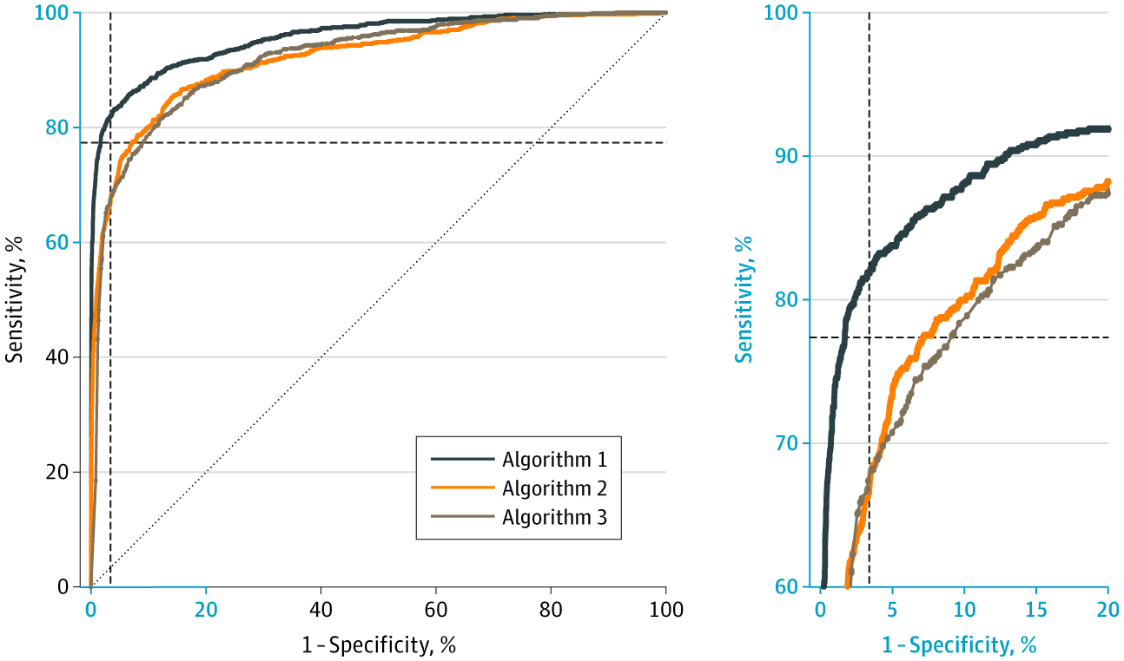
ERA II
2020: three commercial models, independently validated on 8,800 women.
Salim et al., JAMA Oncology 2020 tested three commercial algorithms on an external Stockholm cohort.
AUC — AI-1 0.956 · AI-2 0.922 · AI-3 0.920
at radiologists' specificity (96.6%): AI-1 81.9% sens vs readers 77.4%
AI + reader: +77% abnormal calls for +8% detection
The combination's recall cost is the operating-point tension in miniature.
Notes:
And it held up independently. Salim and colleagues, in JAMA Oncology, took three commercial AI algorithms and tested them on an external Stockholm cohort of about 8,800 women. The AUC for cancer detection was 0.956 for AI-1, 0.922 for AI-2, and 0.920 for AI-3. To compare against radiologists fairly, they fixed the decision threshold at the radiologists' own level — the mean specificity of the first-reader radiologists, 96.6%. At that matched specificity, AI-1 reached 81.9% sensitivity, against the first readers' mean of 77.4%, in a simulated population of 113,663 screening examinations derived from the original 8,805 women. Combining AI with a first reader added detection, but at a cost: roughly 77% more abnormal calls for about 8% more cancers detected. That recall cost is the operating-point tension in miniature.

Slide 18
ERA II
2023: MASAI publishes its safety analysis.
A randomized trial, ~80,000 women (≈40,000 per arm) — AI-supported reading vs standard double reading.
6.1 vs 5.1CDR per 1,000 · ratio 1.2 (95% CI 1.0–1.5)
Measure | AI | Control
Recall rate | 2.2% | 2.0%
False-positive rate | 1.5% | 1.5%
PPV of recall | 28.3% | 24.8%
Invasive cancers | 75% | 81%
Lång et al., Lancet Oncology 2023 — above the lowest acceptable detection limit for safety
Notes:
In 2023, MASAI published its clinical safety analysis — a randomized trial of about eighty thousand women, roughly forty thousand per arm. Cancer detection was 6.1 per thousand with AI versus 5.1 in controls, a ratio of 1.2, above the lowest acceptable safety limit. Recall was essentially identical, 2.2 versus 2.0 percent; the false-positive rate was 1.5 percent in both; and the positive predictive value of recall was higher with AI, 28 versus 25 percent. Three-quarters of detected cancers were invasive. So: safe, and detecting more — the green light to continue.

Slide 19
ERA II
Data isn't enough to drive adoption.
Enriched cases, lab conditions, no real workflow — CAD had good numbers too. The bar is prospective deployment, and real-world uptake has been slow.
48%
European radiologists use AI (2024) — up from 20% in 2018
13.7%
of them, for breast imaging — about 1 in 8
~2%
of US practices, by one estimate
ESR EuroAIM/EuSoMII survey, Insights Imaging 2024 (n=572) · US estimate: industry report
Notes:
But here is the discipline this talk runs on. Reader studies have well-known limits: enriched case sets, lab conditions, no real workflow. CAD had good numbers too. That kind of data is not enough to drive adoption. And it shows: a 2024 European survey found about 48% of radiologists use AI, but of those only 13.7% use it for breast imaging, about one in eight. In the US, by one estimate, only around 2% of practices use it at all.

Slide 20
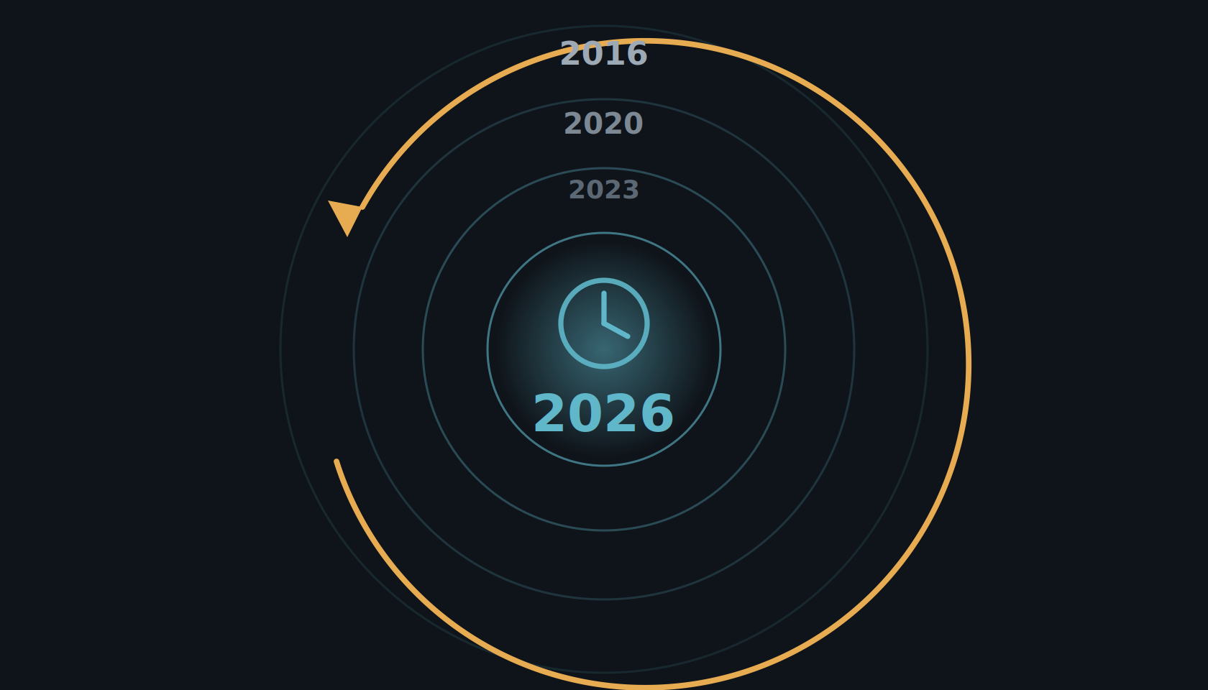
Era II · 2026
The year is 2026.
Ten years on, the early promise has been put to the test — prospectively, in real screening programs.
Notes:
So step back into the time machine and come forward ten years, to 2026. The early promise we just saw was retrospective and lab-based. By 2026 that has changed: AI screening has been tested where it counts — prospectively, in real screening programs — and the picture is much clearer.

Slide 21
ERA II · 2026
2026: two prospective studies show AI screening works.
MASAI · Sweden · RCT (~105,000)
Interval cancers non-inferior (ratio 0.88)
Sensitivity 80.5% vs 73.8% at matched specificity · ~44% less reading workload.
Gommers/Lång et al., Lancet 2026;407:505–514
PRAIM · Germany · real-world (463,000)
+17.6% cancers detected
Recall non-inferior · 6.7 vs 5.7 CDR per 1,000 · 12 sites, 119 radiologists.
Eisemann et al., Nature Medicine 2025
A third is underway: PRISM — the first large randomized trial of screening AI in the United States (Transpara; $16M PCORI; 7 sites; announced Sept 2025, recruiting). Results are years away, but it tests the US single-reader workflow directly.
Notes:
And here is where it stands in 2026: there are now two large prospective studies showing AI works in a real screening program. MASAI, the Swedish randomized trial of about 105,000 women, reported its interval-cancer result — non-inferior, with a ratio of 0.88, at a sensitivity of 80.5 versus 73.8 percent for the same specificity, and it cut reading workload by about 44 percent. PRAIM, a real-world German deployment of 463,000 women across twelve sites and 119 radiologists, found 17.6 percent more cancers detected with AI support and no increase in recall. Two prospective studies, two countries, the same direction. And a third is underway: PRISM, the first large randomized trial of screening AI in the United States — a sixteen-million-dollar PCORI-funded, seven-site study using Transpara, announced in September 2025 and recruiting now. Results are years away, but for the first time the US single-reader workflow will be tested directly. — MASAI detail, for reference: the population was 80,033 women aged 40 to 80 screened at four sites in southwest Sweden, randomized one-to-one between April 2021 and July 2022 to AI-supported reading versus standard double reading by two radiologists without AI. There were 244 screen-detected cancers, 6.1 per 1,000 participants, from 46,345 screen readings in the intervention group of 39,996 participants, versus 203 in the control group — detection went up, not down, the opposite of the feared scenario. The widely quoted framing is a roughly 20 percent relative increase in detection, 6.1 versus about 5.1 per 1,000, at this interim stage; the Lancet Digital Health companion analysis later reported a 29 percent increase in cancer detection without an increase in false positives. The workload number: AI support reduced radiologists' screen-reading workload by 44 percent — nearly halving the reading burden while detection held up or improved. — PRAIM detail, for reference: PRAIM was embedded in Germany's national program, so the existing standard was already a two-reader system. For each woman, four 2D mammograms are taken — CC and MLO of each breast — read independently by two radiologists, sometimes with a third supervising. If at least one radiologist deems the case suspicious, a consensus conference is held, attended by at least the two initial readers plus a head radiologist, and that consensus step decides recall. This matters because both arms of PRAIM kept this double-reading-plus-consensus structure — the only variable being whether AI was present. Cancer detection rate: 6.7 per 1,000 in the AI arm versus 5.7 per 1,000 in control — a 17.6 percent relative increase, 95 percent CI plus 5.7 to plus 30.8 percent, statistically superior. Recall rate: 37.4 per 1,000 in the AI arm versus 38.3 in control — a minus 2.5 percent difference, 95 percent CI minus 6.5 to plus 1.7 percent, noninferior and numerically lower. PPV of recall: 17.9 percent in the AI arm versus 14.9 percent in control. PPV of biopsy: 64.5 percent versus 59.2 percent.

Slide 22
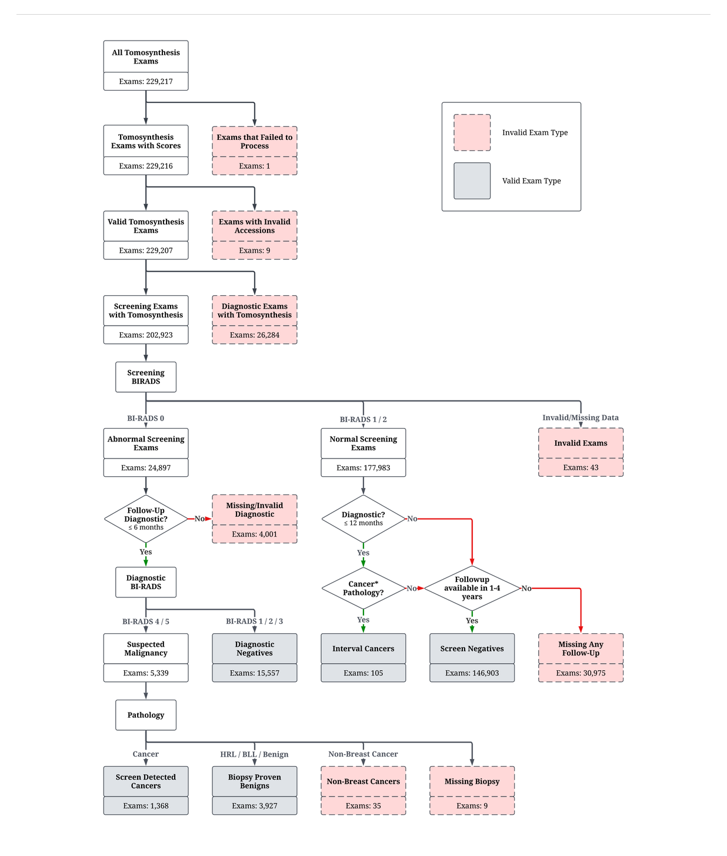
ERA II · 2026
The averages look strong — but what counts as the truth?
The label is not in the image — it comes from follow-up and pathology. Assigning it is a cascade of judgment calls (~163,000 EMBED exams, AUC 0.91), and it sets the denominator for every downstream number.
Notes:
Before we ask where the model fails, we have to ask a harder question: what are we even measuring against? A screening mammogram carries no label in the image — the ground truth comes from what happens next. We link each exam to follow-up imaging and to pathology, and only then assign an outcome. But that assignment is full of judgment calls. How long do you follow a woman before you are willing to call an exam truly negative? A high-risk lesion — atypical ductal hyperplasia, LCIS, a papilloma — is neither clearly benign nor cancer; which bucket does it go in? Do you pool DCIS, which is non-invasive, with invasive cancer, when their clinical meaning is so different? Every one of these choices changes the denominator, and therefore every AUC, every sensitivity, every subgroup number that follows. Defining the outcome is the hard part — and it is rarely shown.

Slide 23
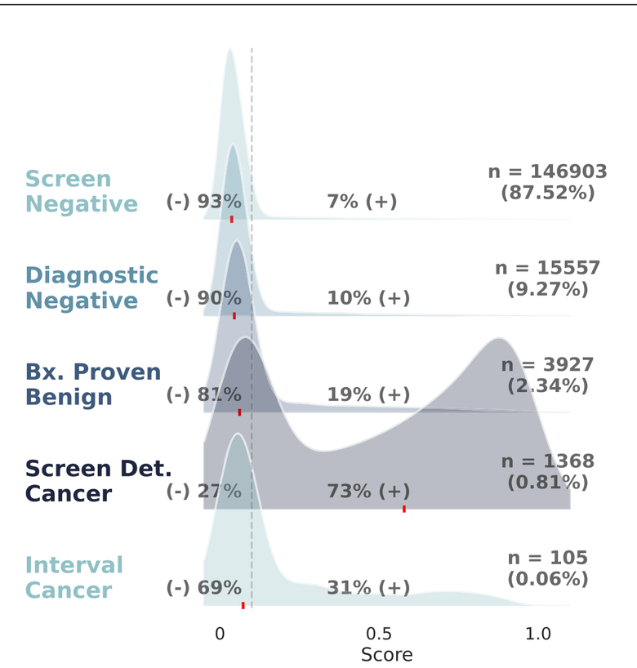
ERA II · 2026
Performance across outcomes and cancer types.
By clinical outcome (Fig. 2)
By pathology (Fig. 3)
[your group], Nat Commun 2026 (DOI 10.1038/s41467-026-70637-3), Figs. 2–3.
Notes:
Once the labels are set, the average breaks down by outcome and by cancer type. On the left, by clinical outcome: the model scores screen-detected cancers positive about 73 percent of the time, but interval cancers — the ones that surface between screens — only 31 percent. On the right, by pathology: positive-score rates climb from benign lesions at 16 percent, borderline at 26, high-risk lesions at 30, DCIS at 55, to invasive cancer at 82 percent. So non-invasive disease and high-risk lesions are flagged far less often than invasive cancer — a single headline AUC averages over categories the model handles very differently.

Slide 24
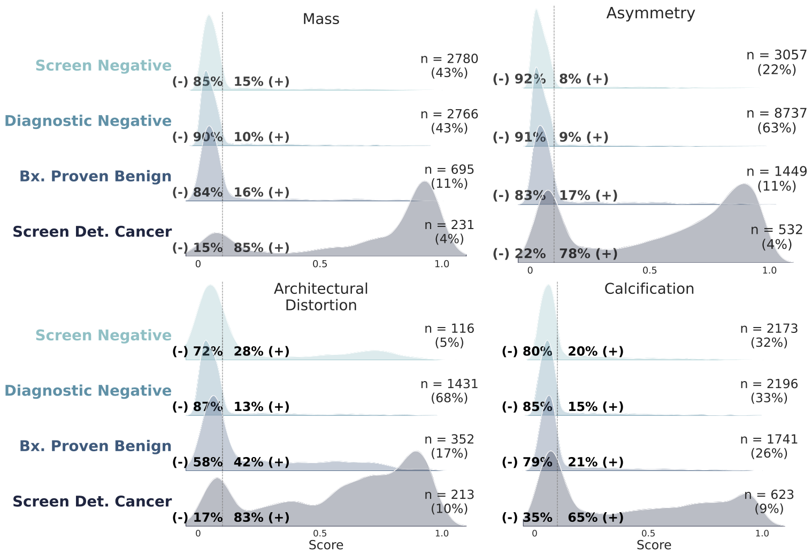
ERA II · 2026
Performance across imaging findings.
Exam-level model-score distributions by imaging feature, across clinical outcome. [your group], Nat Commun 2026 (DOI 10.1038/s41467-026-70637-3), Fig. 6.
Notes:
The second breakdown is by imaging feature. Look at how the same model's scores split by what the finding looks like. Masses, asymmetries, and calcifications are correctly predicted negative in 60 to 81 percent of exams. But architectural distortions behave very differently: even screen-detected cancers split into a bimodal high-and-low distribution, and many benign distortions score high — so the model both misses cancers and over-flags benign findings in that one category. Performance depends on what the finding looks like, not just the headline AUC.

Slide 25
ERA II · 2026 · NOT ONLY BREAST
Head CT: intracranial hemorrhage.
A commercial ICH detector looked strong overall — but sensitivity collapsed for subacute and chronic bleeds, and fell in the outpatient setting.
82.2%
Overall sensitivity
45.5%
Subacute bleeds
54.8%
Chronic bleeds
72.2%
Outpatient setting
[your group], npj Digital Medicine 2025.
GIF
[ to be added ]
Notes:
First, intracranial hemorrhage on head CT. A commercial detection model looked strong overall — 82.2 percent sensitivity. But broken down by the age of the bleed, it collapsed: subacute hemorrhages were caught only 45.5 percent of the time, chronic ones 54.8 percent. And in the outpatient setting, where bleeds are subtler, sensitivity fell to 72.2 percent. The same shape as breast: strong average, weak where it matters.

Slide 26
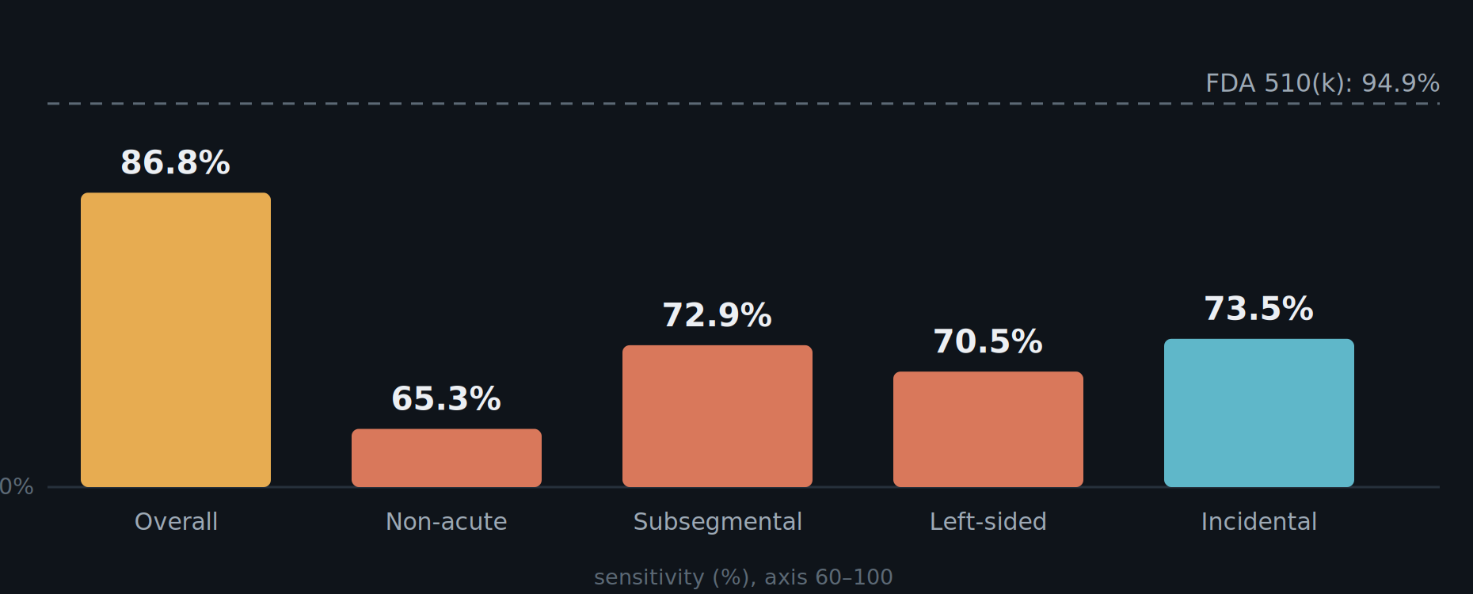
ERA II · 2026 · NOT ONLY BREAST
Chest CT: pulmonary embolism.
An FDA-cleared model (510(k): 94.9% sens) on two years of real-world CTPA: 86.8% overall — but far lower for non-acute, small (subsegmental), left-sided, and incidental clots.
Sensitivity vs FDA 510(k) clearance. [your group], unpublished — Aidoc PE / iPE triage evaluation, 30,678 CTPA + 37,272 routine CT (2023–2025).
Notes:
Second, pulmonary embolism on chest CT — our own evaluation, not yet published. An FDA-cleared model was cleared at 94.9 percent sensitivity. Across two years of real-world data — about thirty thousand dedicated CT angiograms — it reached 86.8 percent overall. But again it fell apart in the hard cases: non-acute clots 65.3 percent, the small subsegmental clots 72.9 percent, left-sided 70.5 percent. And on routine CTs done for other reasons, incidental PE was caught only 73.5 percent of the time — 354 of 538. Same story, different organ: the clearance number is not the number you get on the cases that are easy to miss.

Slide 27
ERA II · 2026 · OPEN DATA
Emory Breast Imaging Dataset (EMBED).
Free to researchers through the AWS Open Data Program.
EMBED v2 — in progress
~300,000 patients
~1M exams (2D · DBT · US · MRI)
Free-text reports
Patient risk data
Outcomes registry-harmonized
v1: [your group], Radiology: Artificial Intelligence 2023 (Fig. 1). — aws.amazon.com/opendata
Map — EMBED users by country
[ drop in PNG ]
opt: EMBED v1 schematic — Radiology: AI, Fig. 1
Notes:
Before we cross into Era III, one plug. All of this work runs on EMBED — the Emory Breast Imaging Dataset — which we have made free to researchers worldwide through the AWS Open Data Program. The first release is described in our Radiology: Artificial Intelligence paper. And we are finishing EMBED version two: nearly 300,000 patients, about a million exams, both 2D and tomosynthesis, 50,000 ultrasound and 25,000 MRI studies, outcomes harmonized with state and local cancer registries, the free-text radiology reports, and patient risk data. The map gives a sense of the reach — researchers on every continent are already using it.

Slide 28
ERA II · 2026 → ERA III
We are at the brink of Era III.
Detection is proven. But the same 2026 image — and the tissue that follows it — already tells us more than "is there cancer today?"
From one screening mammogram and its biopsy: a future-risk estimate, a cardiovascular signal, and a molecular recurrence score. The shift from finding the lesion to characterizing the patient — and much of it is available now.
Notes:
So detection works — we now have the prospective evidence. But here is what is striking: it is still 2026, and the very same mammogram — and the tissue that follows it — already tells us far more than whether there is a cancer today. From this one screening image we can read a woman's future risk and a cardiovascular signal; from her biopsy slide, a molecular recurrence score. We are standing at the brink of Era III — the shift from finding the lesion to characterizing the patient — and, remarkably, much of it is available right now.

Slide 29
ERA III · 2026
For 40 years, the only risk signal we could read off the image was density. The clinical models layered on top — Gail and Tyrer-Cuzick — were hardly better than a coin flip.
Gail · Tyrer-Cuzick · BCSC — questionnaire + density models
~0.62
Tyrer-Cuzick v8 · 5-yr AUC
~0.55–0.58
Gail model · 5-yr AUC
Coin flip is 0.50.
For the woman in front of you, barely above it.
Notes:
For forty years, the only risk signal we could read off the image was breast density — coarse and subjective. The clinical models we layered on top, Gail and Tyrer-Cuzick, were weak: Tyrer-Cuzick predicts five-year risk at an AUC around 0.62, barely better than chance at the level of the individual.

Slide 30
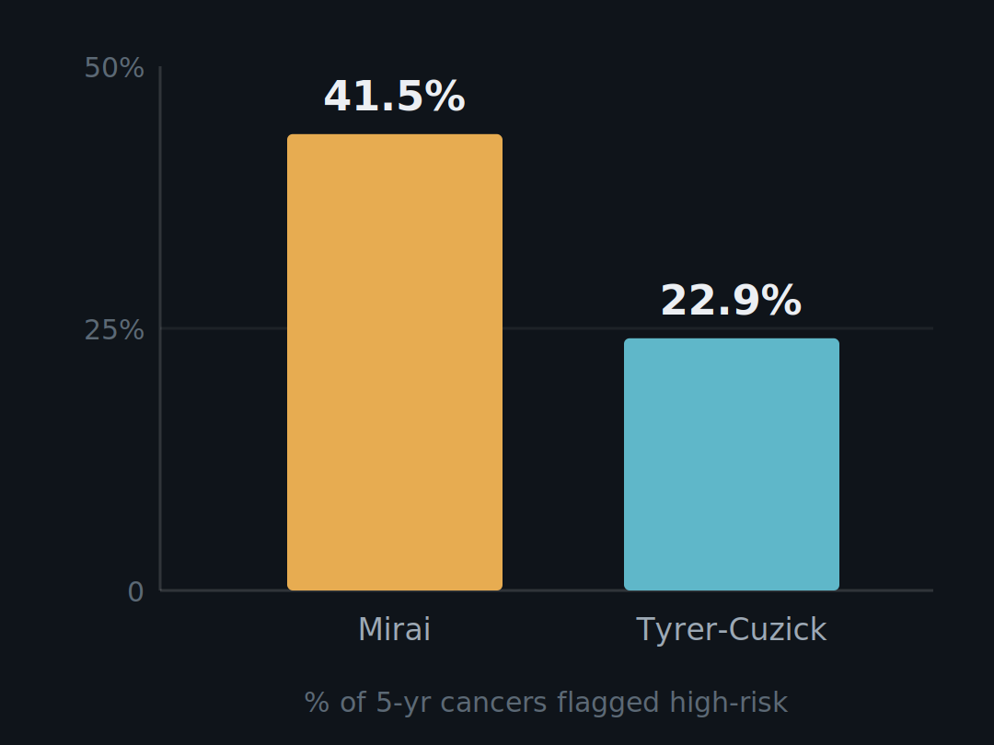
ERA III · 2026
Image-based risk — Mirai and a de novo FDA clearance.
0.76–0.81
Mirai C-index · 3 countries
< 5 yr
research → cleared → guideline
Notes:
The image itself carries risk. Yala and colleagues at MIT and MGH showed a deep network reading the mammogram out-predicts the questionnaire models — Mirai, externally validated across three countries at a C-index of 0.76 to 0.81. Among women who developed cancer within five years, it flagged 41.5 percent as high-risk versus 22.9 percent for Tyrer-Cuzick. And this is no longer just research: in June 2025 Clairity received FDA De Novo authorization — the first tool to predict five-year breast-cancer risk from a routine screening mammogram alone, and it was added to the 2026 NCCN guidance. Research model to cleared product to guideline in under five years. There is not yet a primary peer-reviewed validation paper for Clairity.

Slide 31
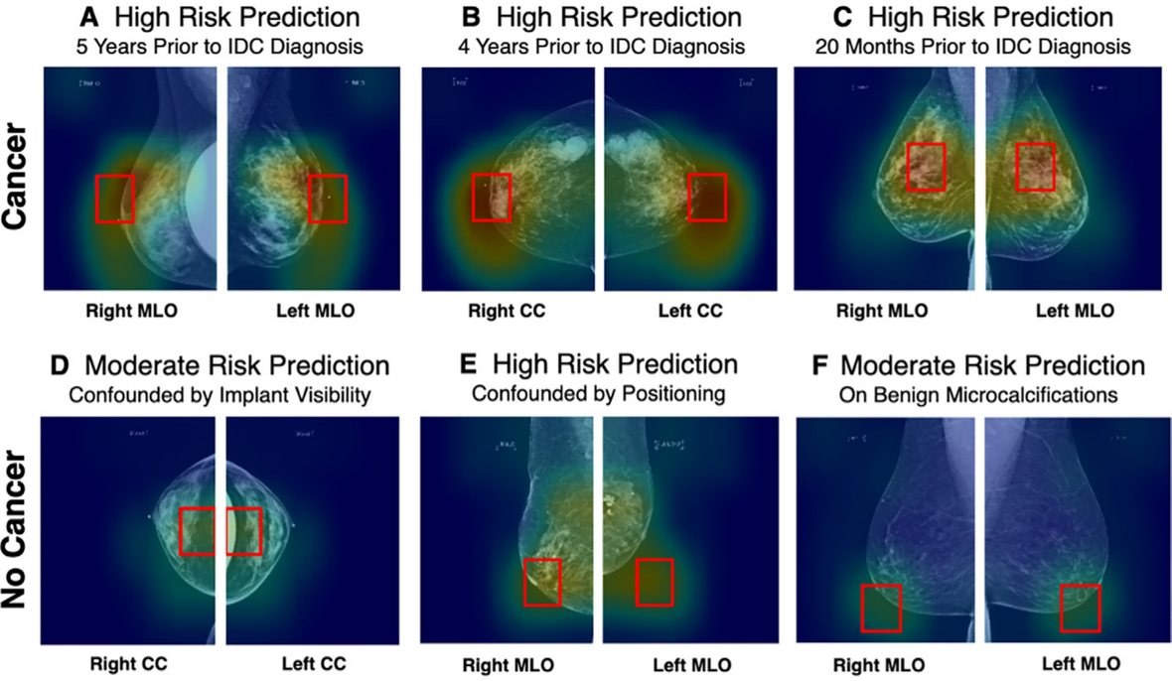
ERA III · 2026
AsymMirai — an explainable risk model.
1-yr AUC 0.79 vs Mirai 0.84 · 3-yr AUC 0.92 (stable tissue)
Notes:
Here is explainability done right, and it is our group's work with Duke. We asked what Mirai was actually keying on. The answer was surprisingly simple: local bilateral dissimilarity — the difference between left and right breast tissue in the same region. A transparent model built only on that asymmetry nearly matched the black box: one-year AUC 0.79 versus 0.84, and in stable-tissue subgroups three-year AUC 0.92. A risk signal you can point to on the image, and audit for where it fails.

Slide 32
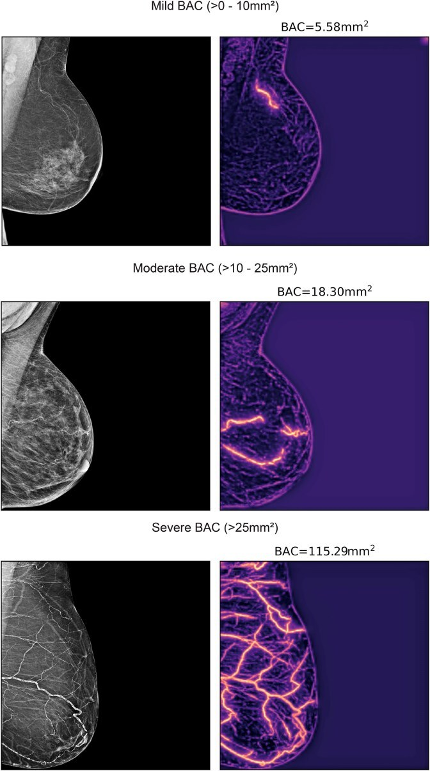
ERA III · 2026
Breast Arterial Calcification (BAC) as a continuous measurement (mm²).
A transformer segments breast arterial calcification on the routine mammogram and quantifies its area — turning an incidental finding into a graded, quantitative risk marker.
Segmentation: SCU-Net (your group). Dapamede et al., Eur Heart J 2026;47(18):2206–2220.
Notes:
Here is what the model does. A transformer segments the breast arterial calcification on the routine mammogram and reports its burden as an area, in square millimeters — the original image on the left, the model's segmentation on the right. You can see it scale, from mild calcification at about five square millimeters, to moderate at eighteen, to severe at over a hundred. That continuous number is what turns an incidental finding into a graded, quantitative risk marker. Our group built the segmentation model behind this, SCU-Net.

Slide 33
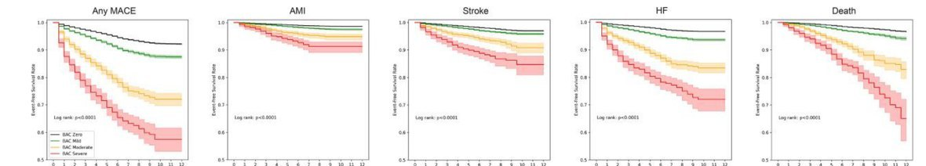
ERA III · 2026
BAC predicts MACE — more calcium, more risk.
~120,000 women, two sites, racially diverse. Dose-response: mild HR 1.18–1.22 · moderate 1.38–1.47 · severe 2.03–2.22.
Event-free survival by BAC severity — Any MACE, AMI, stroke, HF, death. Dapamede et al., Eur Heart J Open 2025.
Notes:
Now the outcomes. In a multi-site cohort of more than 120,000 women across Emory and Mayo, AI-quantified BAC independently predicted major adverse cardiovascular events in a graded, dose-response fashion: mild hazard ratios around 1.2, moderate around 1.4, severe around 2.0 to 2.2. And the risk held across every component endpoint within PREVENT categories — heart attack, stroke, heart failure, and all-cause mortality. Crucially, the signal persists in women under 50, a group traditionally deemed low-risk in whom coronary calcium has usually not yet developed. An age-adjusted nomogram from Nerlekar showed a 17 percent increase in MACE per 10 percentiles of BAC and reclassified about 5 percent of women beyond standard scoring, improving the C-statistic from 0.67 to 0.71. And BAC is dynamic, not static: in 41,621 women with serial mammograms, current BAC stayed predictive throughout 8.6 years of follow-up. The commercial FDA-cleared tool reports only presence or absence; quantification is what turns a weak binary flag into an actionable, graded risk marker.

Slide 34
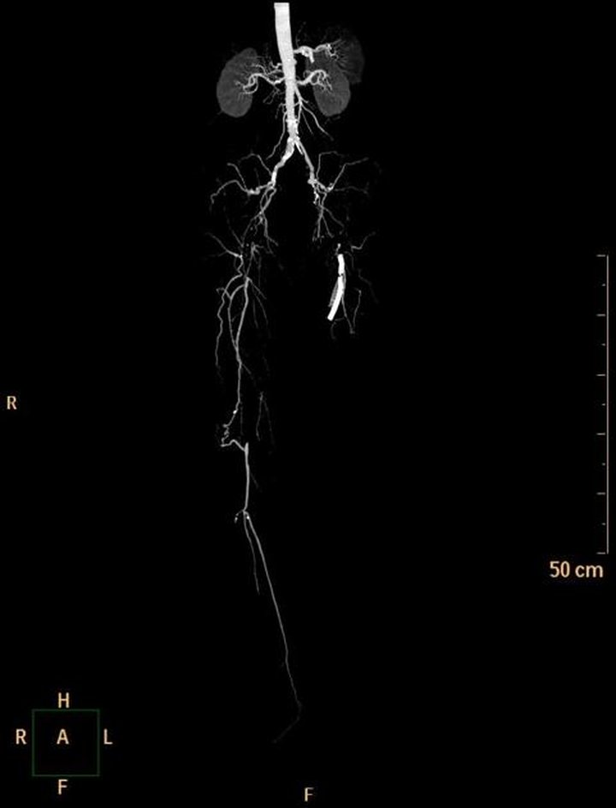
ERA III · 2026
BAC and PAD.
BAC is medial calcification (Mönckeberg's) — the pattern that dominates PAD. In 59,854 women (~8-yr follow-up), it graded the risk of vascular intervention — overall and within every high-risk subgroup (severe BAC vs zero).
[your group], abstract — adj. age, DM, HTN, HLD, CKD, smoking.
Peripheral angiogram (PAD). Source: Radiopaedia.org (CC).
Notes:
The same calcium biology shows up in the legs. BAC is medial arterial calcification — Mönckeberg sclerosis — the dominant pattern in peripheral arterial disease, distinct from coronary intimal atherosclerosis. In 59,854 women over a median eight years, severe BAC versus zero predicted needing a vascular intervention for PAD: overall adjusted hazard ratio 3.62, and it held across risk-factor subgroups — diabetes 6.81, smoking 5.77, CKD 4.29, hyperlipidemia 3.46, hypertension 3.11 though not significant there. In women under 50 the effect was extreme, a hazard ratio over a hundred, off this scale. The point: BAC refines who actually progresses to needing an intervention, on top of the usual risk factors.

Slide 35
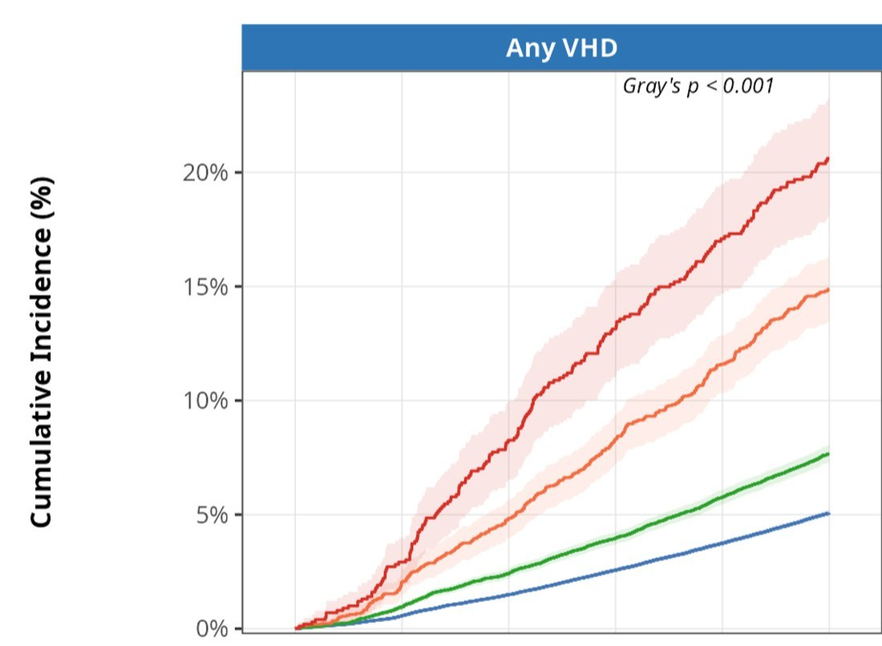
ERA III · 2026
BAC and valvular disease.
122,011 women. Severe BAC vs none — AS 11.4 · AR 3.1 · MR 2.6 · TR 2.3; mitral stenosis null (negative control). 5-yr any-VHD 19.3% vs 4.6% (NNS 7).
Any VHD by BAC severity. Dapamede et al., Fig. 1.
Calcific valve disease, cardiac MRI. Source: ECR 2024 EPOS #166904 (used with permission).
Notes:
It is not only arteries. In 122,011 women, BAC predicted incident valvular heart disease in a dose-response fashion, with strong discrimination — a C-index around 0.80. For severe BAC versus none: aortic stenosis 11.4, aortic regurgitation 3.1, mitral regurgitation 2.6, tricuspid regurgitation 2.3. Mitral stenosis showed no association, p about 0.97 — a built-in negative control, because mitral stenosis is rheumatic, not calcific. Severe BAC carried a five-year incidence of any mild-or-greater valve disease of 19.3 percent versus 4.6 percent — a number-needed-to-scan of seven.

Slide 36
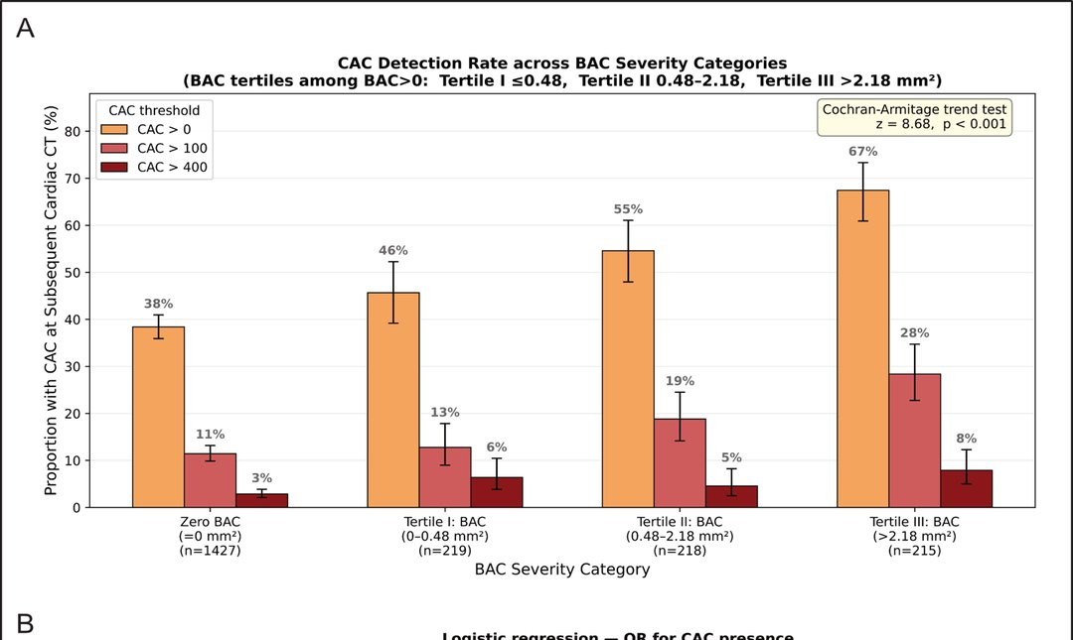
ERA III · 2026
BAC and CAC.
In 2,079 women who later had a cardiac CT, detectable coronary calcium rose 38% → 67% across BAC tiers; CAC>100 up 2.5×. BAC independently predicted CAC, age-adjusted (OR 1.32 / SD).
The mammogram previews the coronary CT.
[your group], RSNA 2026 abstract (BAC–CAC).
CAC detection by BAC tier (n=2,079).
Notes:
Step back, and BAC starts to look like an index of a body-wide calcification tendency. First, coronary artery calcium: in 2,079 women who later had a cardiac CT, the rate of detectable coronary calcium rose stepwise with BAC severity — from 38 percent up to 67 percent — with CAC-over-100 rates two-and-a-half times higher, and BAC independently predicting coronary calcium after adjusting for age. The mammogram is previewing the coronary CT.

Slide 37
ERA III · 2026
BAC and costochondral calcification.
A non-vascular marker — calcification in the costal cartilage on chest CT (n=1,311). Correlated with BAC (ρ=0.089, p=0.001).
High BAC vs zero (ΔCCC)
adj. p
Median (q0.50)
NS · 0.47
75th pct (q0.75) +3,408 mm³
<0.001
Vascular + valvular + skeletal — one free mammographic finding.
[your group], RSNA 2026 abstract (BAC–CCC) · quantile regression, adj. age + DM.
Costochondral calcification
[ drop in — confirm reuse rights ]
Illustrative. Source: Sariyıldız et al., via ResearchGate.
Notes:
And more surprising, a non-vascular marker: costal cartilage calcification. In 1,311 women with both a mammogram and a chest CT, BAC correlated with costal cartilage calcification — and at the 75th percentile, high BAC was associated with about 3,400 cubic millimeters more cartilage calcification, adjusted for age and diabetes; the median effect was not significant. So BAC indexes calcification that is vascular, valvular, and even skeletal — one free finding pointing to a systemic propensity.

Slide 38
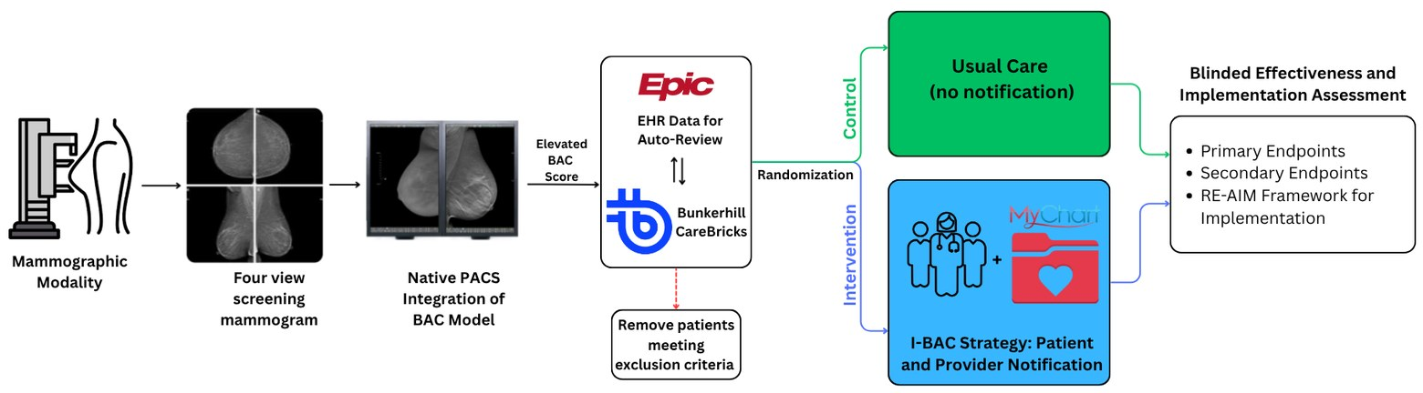
ERA III · 2026
Closing the loop: the I-BAC pragmatic trial.
The gap: <7% (Emory) / 15% (Mayo) of women had the chart data to even compute a PREVENT/ASCVD score — including women with severe BAC. I-BAC (R01HL167811) is a Hybrid Type 1 pragmatic RCT across Emory + Mayo AZ (~225,000 mammograms/yr).
Deployment + pragmatic-trial structure (Aim 2): PACS BAC model → Epic/CareBricks auto-review → randomize → I-BAC notification vs usual care → RE-AIM.
Primary endpoint: 6-month composite of lipid panel · preventive-med change · CAC testing. Precedent: NOTIFY-PICTURE — but BAC has no management guideline yet.
Notes:
So how do we close the loop — from a validated model to changed care? Here is the gap: fewer than 7 percent of women at Emory and 15 percent at Mayo even had the chart data needed to compute a standard PREVENT or ASCVD risk score — including women with severe BAC. Detection without action is a missed opportunity at the scale of four to six million women a year. So we built I-BAC, an NIH-funded pragmatic randomized trial — a hybrid effectiveness-implementation design across Emory and Mayo Arizona, about 225,000 screening mammograms a year combined. Aim 1 is formative work with patients and providers to design the notification. Aim 2 randomizes 6,000 women with moderate or severe BAC to notification versus usual care, with patient filtering automated through our Carebricks agentic-AI pipeline. Aim 3 is a RE-AIM evaluation — reach, adoption, fidelity, and harms like anxiety or low-value testing. The primary endpoint is a six-month composite of lipid-panel completion, preventive-medication change, or CAC testing. Our precedent is NOTIFY-PICTURE for incidental coronary calcium — but BAC is harder, because it has no established management guideline yet.

Slide 39
ERA III · 2026 → 2035
And we are on the verge of multimodal, multi-omics.
Everything so far is still one model, one modality — the image, or the calcium, or the tissue, read separately.
The frontier is to combine them — imaging + pathology + genomics + the clinical record — into a single model of the patient. To see where that goes, we have to leave 2026.
Notes:
Step back and notice what every one of these has in common. Risk from the image, a cardiovascular signal from the calcium, a molecular score from the tissue — each is still one model reading one modality. The real frontier is to stop doing that: to combine the image, the pathology, the genome, and the clinical record into a single model of the patient. We are right at the verge of that — multimodal, multi-omics AI. And to see where it goes, we have to leave 2026.

Slide 40
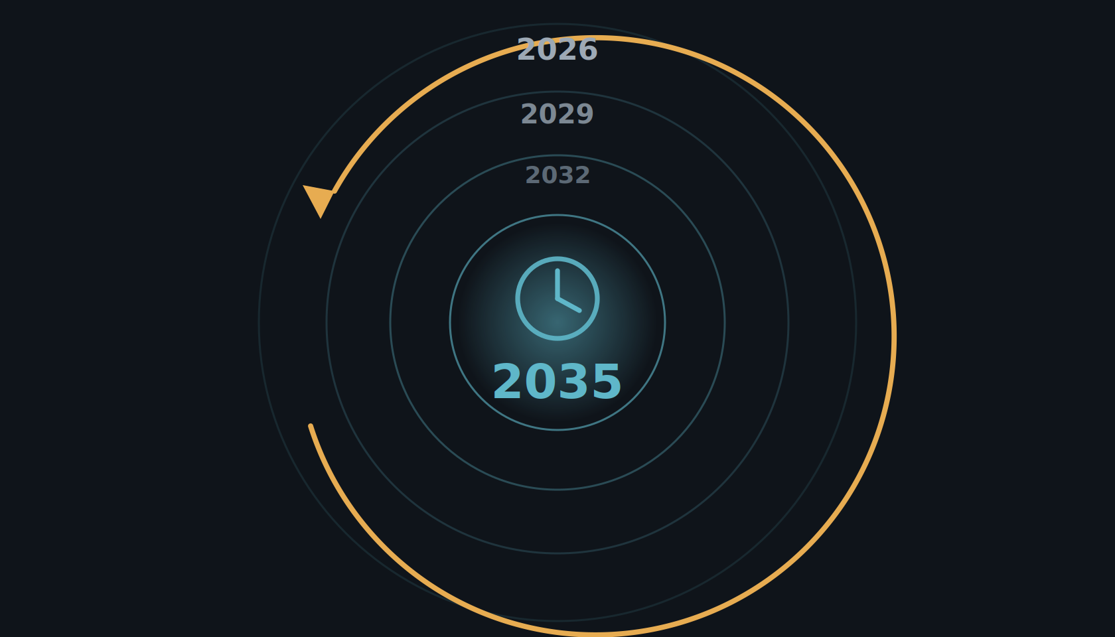
Era III · 2035
The year is 2035.
From here, today's models are a decade old. The real question: what happens when imaging, pathology, and omics finally converge — on one patient.
Notes:
So get back in the time machine, and come forward another ten years — to 2035. From here, everything we just saw — image-based risk, the cardiovascular signal, the molecular score — is a decade old. The question now is what we can do when all of it finally comes together, on one patient.

Slide 41
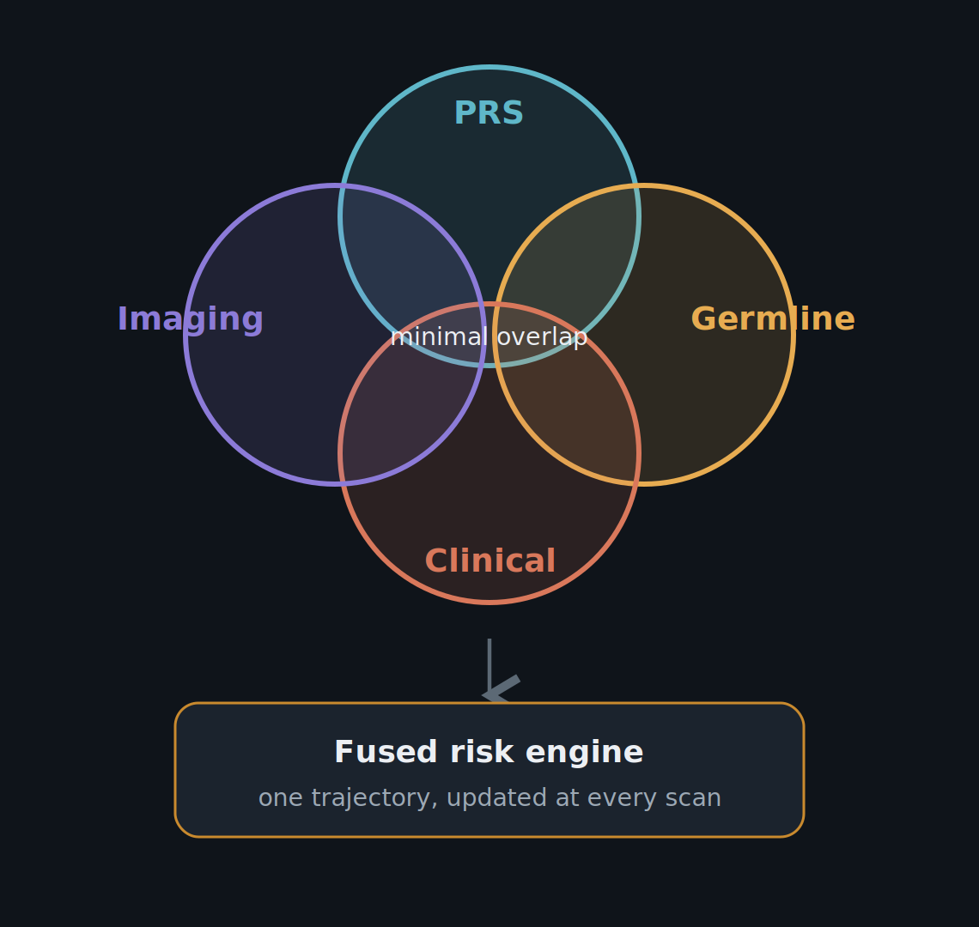
ERA III · 2035 · THE WHOLE PATIENT
She knows her risk before she ever lies down.
Risk in 2035 is built from four independent inputs — polygenic, germline, clinical, and imaging (prior mammograms) — fused into one engine and updated at every scan.
Shieh, JAMA Oncol 2026 · Esserman (WISDOM), JAMA 2025 · Yala (Mirai), Sci Transl Med 2021 · Clairity FDA De Novo 2025
Notes:
PRS alone is not enough, and the evidence is now unambiguous. The PRS313 score established the genomic baseline, and women in the top PRS decile reach the average 50-year-old's five-year risk by their mid-thirties — so a uniform age-40 start is biologically indefensible. But PRS and germline testing measure almost entirely different populations: in a WISDOM secondary analysis (Shieh, JAMA Oncology 2026), only 0.9 percent of high-penetrance pathogenic-variant carriers — BRCA1, BRCA2, PALB2 — would have been correctly assigned to high-risk screening by clinical risk plus PRS alone. PRS catches one population, germline another, clinical risk a third — all three layers are non-negotiable. The PRS architecture itself is being rebuilt: PRS-Net (Li, Genome Research 2025) is a graph neural network modeling gene-gene interactions and epistasis, a fundamental shift from the additive PRS313. And imaging and genomics update each other: Rothwell (Br J Cancer 2026) showed Mirai plus PRS313 beats either alone. WISDOM (JAMA 2025, 46,000 women) was non-inferior on advanced cancers with a one-third reduction in Stage IIB in the personalized arm, and PERSPECTIVE I&I showed risk communication did not raise anxiety. Extrapolated to 2035: at 30, one workup returns a non-linear genomic score, a germline panel, and a clinical integration; at every mammogram the imaging engine updates the genomic baseline and sets the next appointment — 7 months for top-quintile risk, longer for persistently low risk. Never again driven by a calendar. And imaging itself is a fourth, largely independent axis: a deep network reading the mammogram — Mirai, externally validated across three countries at a C-index of 0.76 to 0.81 — flags about 41.5 percent of the women who go on to develop cancer within five years as high-risk, versus 22.9 percent for Tyrer-Cuzick, and Clairity took image-based five-year risk to FDA clearance in 2025. So a woman's prior mammograms and imaging history feed the same risk engine.

Slide 42
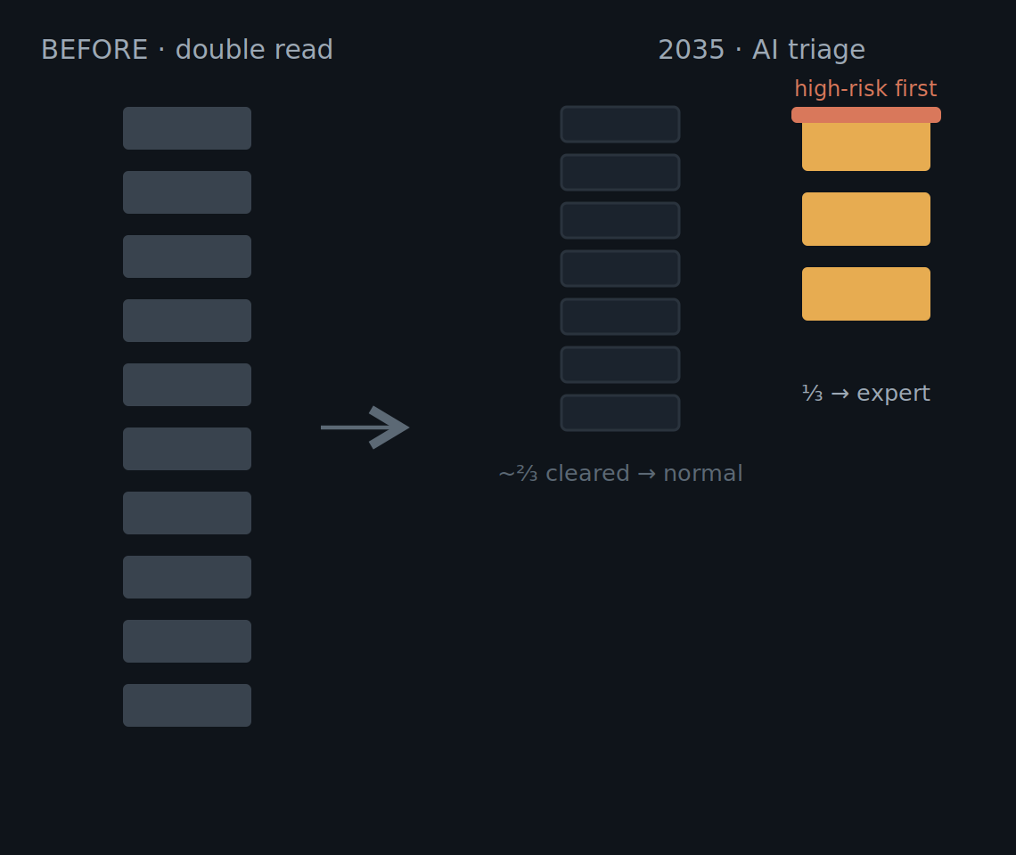
ERA III · 2035 · THE WHOLE PATIENT
The second reader is now software.
Double reading has been replaced — not by one study, but by convergent RCT evidence across four continents. AI clears roughly two-thirds of normal screens; the radiologist takes the rest.
−44% / +29%
workload / cancers detected — MASAI (Lancet 2026)
−63.6%
radiologist workload — Elías-Cabot (Nat Med 2026)
~99.9%
NPV of AI-normal triage at ~6/1,000 prevalence
MASAI, Lancet 2026 · PRAIM, Nat Med 2025 · Elías-Cabot, Nat Med 2026 · AI-STREAM · GEMINI · ScreenTrustCAD
Notes:
Double reading has been replaced by convergent evidence across health systems on four continents. MASAI (Sweden, 105,934 women, Lancet 2026): 44 percent workload reduction, 29 percent more cancers, 12 percent fewer interval cancers. PRAIM (Germany, 463,094, Nature Medicine 2025): 17.6 percent higher detection, lower recall. Elías-Cabot (Spain, 31,301, Nature Medicine 2026): partially autonomous triage, CDR up 15.2 percent, workload down 63.6 percent. Plus AI-STREAM (Korea), GEMINI (Scotland), ScreenTrustCAD (Sweden/Denmark) — independent programs, vendors, and reading cultures, same conclusion. The mechanism: AI triages about two-thirds of cases away from the queue automatically; at a background prevalence near 6 per 1,000 the negative predictive value of AI-normal triage is about 99.9 percent. Combined with Mirai-class risk, high-risk women come back sooner — in a UK triennial program the top 20 percent of Mirai scores captured 42.4 percent of interval cancers. What this gives back to the radiologist is time and focus: she reviews the third the AI flagged, biopsies what AI localized, and consults the high-risk women the system has watched for years. The endgame was never replacement — it was practising at the top of her licence.

Slide 43
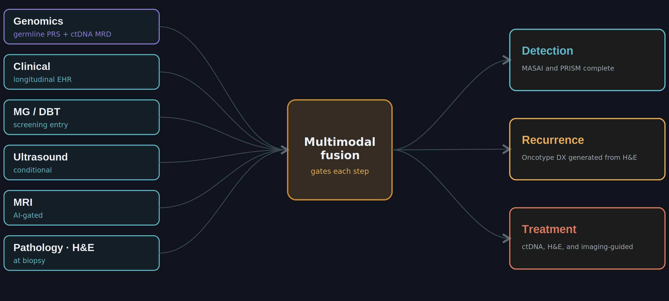
ERA III · 2035 · THE WHOLE PATIENT
From one score to a multimodal detection, treatment, and recurrence engine.
Each layer's 2025 evidence, and where 2035 takes it — no single image makes the call, and no modality is acquired unless the model expects it to change the answer.
Now (2025): the evidence shown → 2035: one unified model gates acquisition and emits detection + recurrence + treatment. MASAI (Lancet 2026) · PRAIM (Nat Med 2025) · ScreenTrustMRI (Nat Med 2024) · BMU-Net (Nat Biomed Eng 2024) · UNI (Nat Med 2024) · BINDS (Nat Biomed Eng 2026) · ctDNA MRD (Ann Oncol 2025).
Notes:
This is the synthesis. On the left, the inputs, each with real 2025 evidence and a 2035 trajectory. Genomics is now an always-on layer: germline polygenic risk as a standing prior, and post-treatment ctDNA detecting molecular recurrence about fifteen months before imaging — by 2035 that triggers pre-emptive therapy, not watchful waiting. Clinical context selects the modality. Mammography is the entry point. Ultrasound is conditional; BMU-Net fuses B-mode, Doppler, and elastography. MRI is AI-gated — ScreenTrustMRI used an AI score, not density, to pick the top seven percent of negative mammograms for MRI and found 64 cancers per thousand versus 16.5. Pathology enters at biopsy, on foundation models like UNI pretrained on a hundred thousand slides. In the center, one multimodal foundation model — BINDS, 27,048 participants across eight centres, where every fusion beat any single modality — and by 2035 it decides which modality to acquire next. On the right, three outputs: detection, where MASAI is the first randomized trial — sensitivity 80.5 versus 73.8 percent, 29 percent more cancers, 44 percent less workload; recurrence, a continuously updated risk fusing imaging, ctDNA, and clinical, with Oncotype-class information coming off routine images; and treatment, with pathologic-complete-response predicted before the first cycle and ctDNA-guided escalation or de-escalation standard. The rule for 2035: no single image makes the call, and no modality is acquired unless the model already expects it to change the answer.

Slide 44
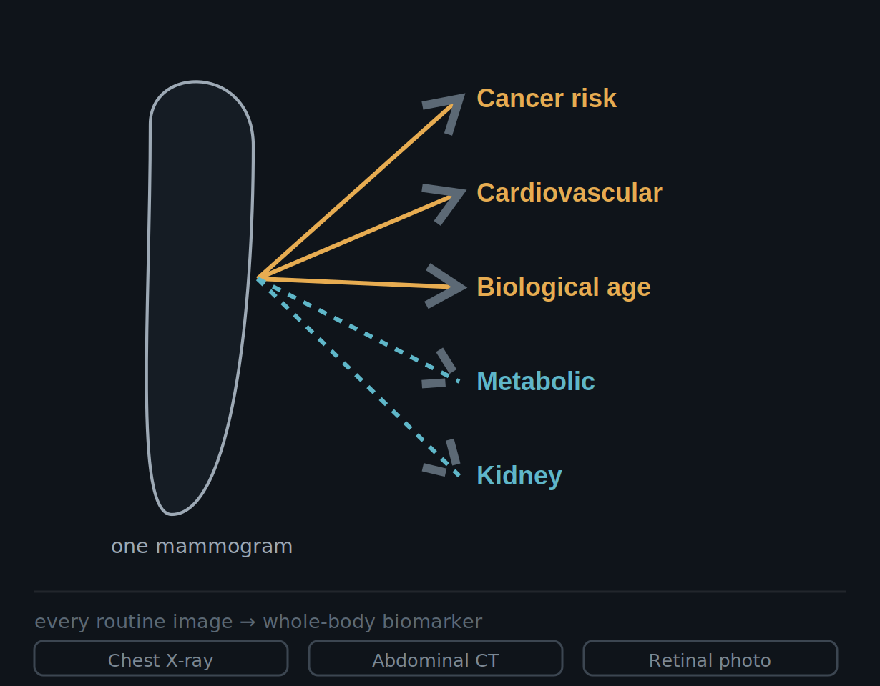
ERA III · 2035 · THE WHOLE PATIENT
The mammogram is now a whole-body health visit.
We built a cancer screen and found a window into the entire body — and we are not the only ones.
2.8×
5-yr mortality, severe BAC — 123,762 (Eur Heart J 2026)
49,196
women: CVD from the image alone (Heart 2026)
biological age
from the mammogram, ±4–6 yr — Mammo-AGE
~40M US mammograms/yr — often her only reliable preventive touchpoint. By 2035 the modality stops mattering: one model, any routine image, one systemic-risk profile.
Dapamede, Eur Heart J 2026 (our paper) · Barraclough, Heart 2026 · Pan (Mammo-AGE), Nat Commun 2025 · Pickhardt (CT), Nat Commun 2025 · RETFound, Nature 2023
Notes:
We built a cancer-screening system and discovered a window into the entire body — and we are not the only ones. The cardiovascular signal was there all along: AI-quantified breast arterial calcification predicts cardiac events and mortality beyond the PREVENT score across 123,762 women at Emory and Mayo, severe BAC carrying a 2.8-fold higher five-year risk of death; and Barraclough predicted cardiovascular events from mammographic features alone in 49,196 women, rivaling the Pooled Cohort Equations. By 2035 a cardiovascular estimate is an automatic, reimbursed output of every mammogram, routing high-risk women into prevention. The image also encodes biological age — Mammo-AGE estimates breast age to within four to six years and the age gap stratifies risk independent of density; by 2035 it personalizes screening intervals. And the mammogram is not alone: the chest X-ray estimates ten-year cardiovascular risk, the abdominal CT yields a longevity model, a retinal photo reads cardiovascular, renal, and neurodegenerative risk. By 2035 the modality stops mattering: one multimodal foundation model ingests whatever images a patient already has and returns one longitudinal systemic-risk profile — Merlin on 3D CT, OCTCube-M predicting seven systemic diseases from an eye scan, MOSCARD fusing chest X-ray and ECG. Metabolic and renal risk are the next frontier — BAC correlates with diabetes, hypertension, and cholesterol, peripheral-artery and kidney disease named as the next targets, but these remain associations, not yet validated. And the equity implication is why it matters: about forty million US mammograms a year, plus mobile units, make it often the only preventive touchpoint a woman reliably gets — so this can close access gaps rather than widen them, if we engineer against demographic shortcuts.

Slide 45
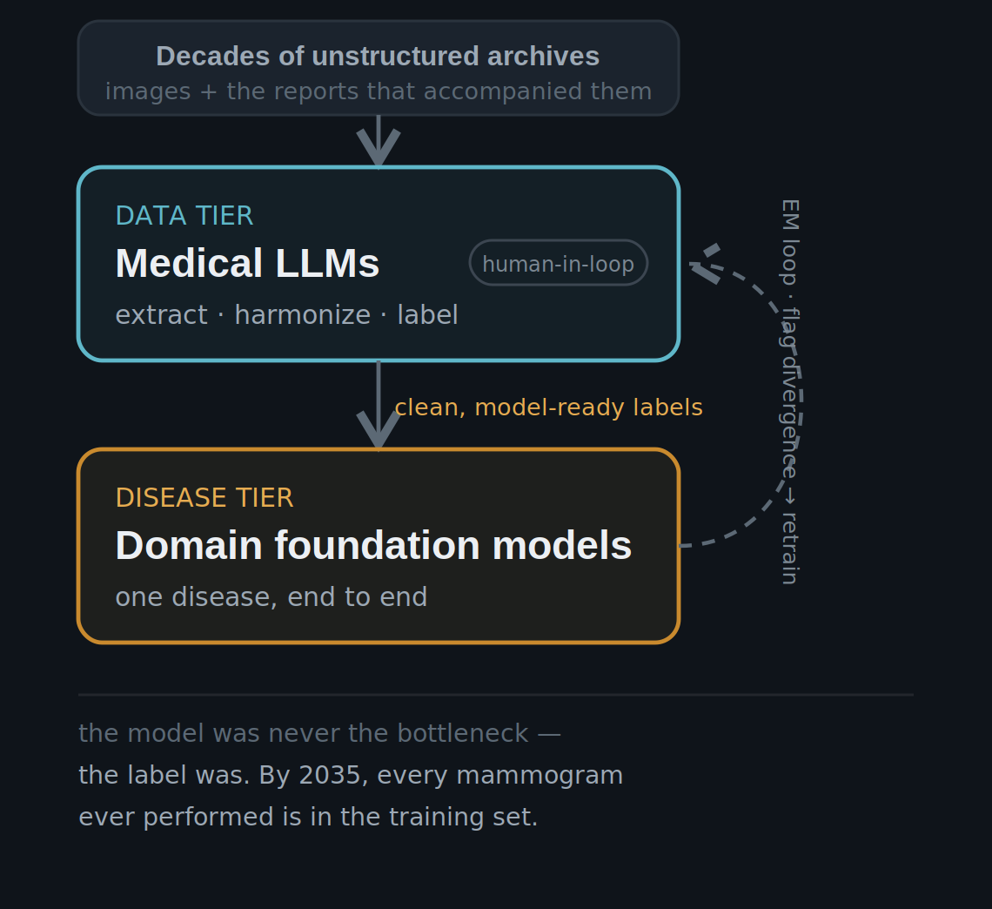
ERA III · 2035 · THE WHOLE PATIENT
The frontier plateaued. The specialists compounded.
Scale was no silver bullet — the failure was architectural.
Frontier models aced the exam, then degraded on real clinical data — a model trained on the whole internet reasons from text priors, not the pixels in front of it. By 2035 that stopped being a footnote and became the market structure: generalists won the data tier (extract, harmonize, label — human signs off); domain models own the disease tier.
Wu, JMIR 2025 (e84120) · Raji/Daneshjou/Alsentzer, NEJM AI 2025 · RadFlag, arXiv:2411.00299 · Abdullah & Kim, JMIR Med Inform 2025 · ScaleMAI, arXiv:2501.03410 · Mammo-CLIP, ECCV 2024
Notes:
Look past the leaderboard. From 2024 to 2026, frontier models posted spectacular exam scores — and then degraded the moment they touched real clinical data. The gap was structural, not cosmetic. A systematic review of 39 medical LLM benchmarks found knowledge-based exam tasks held 85 to 93 percent accuracy, but practice-based real-world tasks collapsed to 45 to 69 percent, and safety-critical scenarios sat at 40 to 50 percent — Wu and colleagues, JMIR 2025; 'it's time to bench the medical exam benchmark' became the field's refrain. Hallucination did not go away — it hid in the findings: about 22 percent of vision-language-model imaging reports still carried factual errors, and high-performing report generators hallucinated findings in roughly 40 percent of sentences, because text-heavy pretraining made them pattern-match priors instead of reading the image. Across 12,197 diagnostic outputs, frontier models omitted relevant clinical guidelines in up to 46 percent of cases and invented non-existent ones up to 9 percent — and the error rate shifted with patient sex, ethnicity, and location. Citation accuracy stayed the worst task family: the models pitched to generate the labels couldn't reliably cite them. So the generalist bubble burst. The one-model-for-everything assumption never survived a health system's budget or a reading room's latency, and a leaner generation of smaller, cheaper, medically-focused models replaced the giants. That shift never made the generalists better doctors — it made them better librarians. Their lasting contribution was turning decades of unstructured reports into clean, structured, model-ready labels at a scale expert annotation could never reach, with a human in the loop holding the floor on quality. The two-tier architecture that won: medical LLMs do the data work — extract, harmonize, and label the archive, reaching average F1 0.90 across 14 thoracic pathologies, human-validated; domain foundation models do the disease work, trained on those labels to understand one disease end to end. The virtuous cycle — ScaleMAI's EM loop, Mammo-CLIP for mammography — trains on current labels, flags divergence for targeted human review, retrains. What we extrapolate to 2035: the benchmark-practice gap never closed by scaling generalists, because the failure was architectural — a model trained on the whole internet reasons from text priors, not from the pixels in front of it. So the labor split hardened. Generalists won the data tier, where retrieval cut their citation errors 75 to 90 percent and a human still signs off. The disease tier went to domain foundation models that genuinely reason over one disease. None of the datasets behind the prior slides — BINDS 27,048; BMU-Net 5,025; Mammo-AGE 95,826; Barraclough 49,196 — existed as clean training sets before the teams built them from archives and the reports that accompanied them; EMBED, 3.5 million exams, is the local example. In 2035, every mammogram ever performed is in the training set — we just needed the medical LLMs to read the labels that were always there.

Slide 46
SpecialistvsGeneralist·an open question
Will the generalists absorb the field?
Every model in this talk was purpose-built. The frontier models from OpenAI, Google, and Anthropic were not built for medicine — yet they improve every few months. Do we still build our own?
Notes:
We have seen what purpose-built models can do — across risk, detection, tissue, and the heart. There is one question left before we close. I have shown you a dozen specialist models — Mirai for risk, Transpara for detection, Virchow for tissue, the breast arterial calcium model. Each was built for one job. The general-purpose frontier models from the large labs — GPT, Gemini, Claude — were not built for radiology, yet they improve faster than any medical model, and each generation handles tasks we assumed required a custom build. So the question to end the body of the talk on: in five years, do we still build our own models, or do we ask the general one? And if it is the latter, who owns it?

Slide 47
FRONTIER MODELS
Where the generalists already perform well.
Medical knowledge: frontier models score ~90%+ on USMLE-style exams (Med-Gemini 91.1%), across the breadth of medicine. Rapid adaptation: fine-tuned on small labeled sets they often exceed bespoke models, and generalize better across sites, scanners, and populations.
USMLE-style: ~91% (Med-Gemini)
2D CXR reports "equivalent or better" in 43–96% of cases
exceeded prior SOTA on 17/20 CXR tasks
Med-Gemini — Yang et al., arXiv:2405.03162, 2024 (preprint)
Notes:
Where do the generalists already perform well? On medical knowledge and text reasoning: frontier models score above ninety percent on USMLE-style exams — Med-Gemini at 91.1 — across the breadth of medicine. On report drafting in two dimensions: domain-adapted frontier models do well. Med-Gemini-2D chest-X-ray reports were rated equivalent to or better than the original radiologist's report in 43 to 96 percent of cases, depending on whether the film was abnormal or normal, and exceeded prior state of the art on 17 of 20 chest-X-ray tasks, in Google's 2024 work. And they adapt rapidly: fine-tuned on a small labeled set, foundation models often exceed bespoke task-specific models, and generalize better across sites, scanners, and populations — which is exactly the brittleness problem that limits the narrow models. I'll frame the current generation by trajectory, not by specific unpublished benchmark numbers.

Slide 48
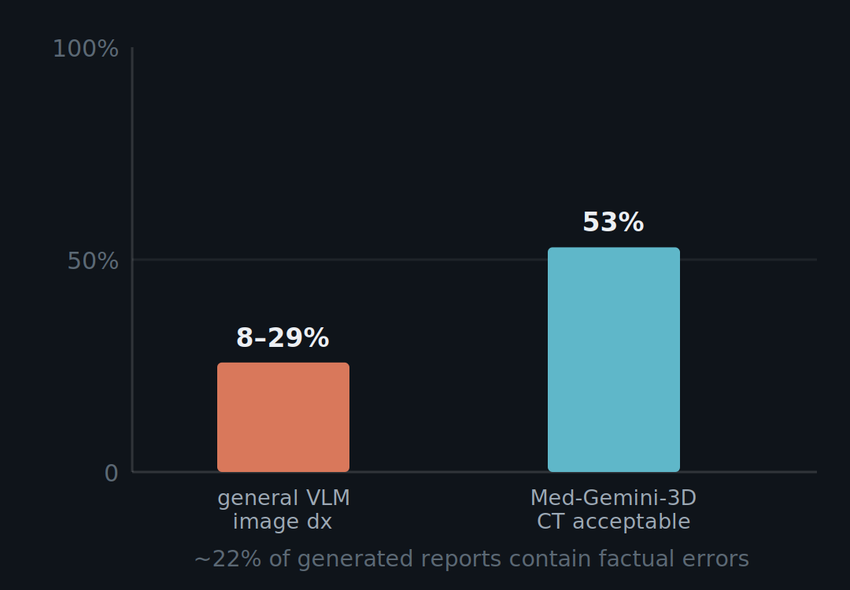
FRONTIER MODELS
Where they still fall short — the image itself.
Their strength is text, not image content. On radiology interpretation, general VLM diagnostic accuracy ranges only ~8–29%, and roughly 22% of generated reports contain factual errors.
Purpose-built RadFM outperforms GPT-4V on radiology tasks. And 3D lags: Med-Gemini-3D CT reports were only 53% clinically acceptable — fine for a 2D film, less so for a volume.
Visual LLMs in Radiology, Life (MDPI) 2026;16(1):66 (PMID 41598221) · RadFM — Wu et al., Nat Commun 2025 · Med-Gemini, 2024
Notes:
Where do they still fall short, for now? Their strength is text, not image content — the general vision-language models' edge comes from text knowledge rather than from actually reading the image. On radiology interpretation, diagnostic accuracy across general vision-language models ranges only about 8 to 29 percent, in a systematic evaluation published in Life this year, and roughly 22 percent of the AI-generated reports contain factual errors or hallucinations. Specialists still perform better on the image itself: the purpose-built RadFM model outperforms GPT-4V on radiology tasks. And three dimensions and localization lag: Med-Gemini-3D CT reports were only 53 percent clinically acceptable — adequate for a 2D chest film, much less so for a CT volume.

Slide 49
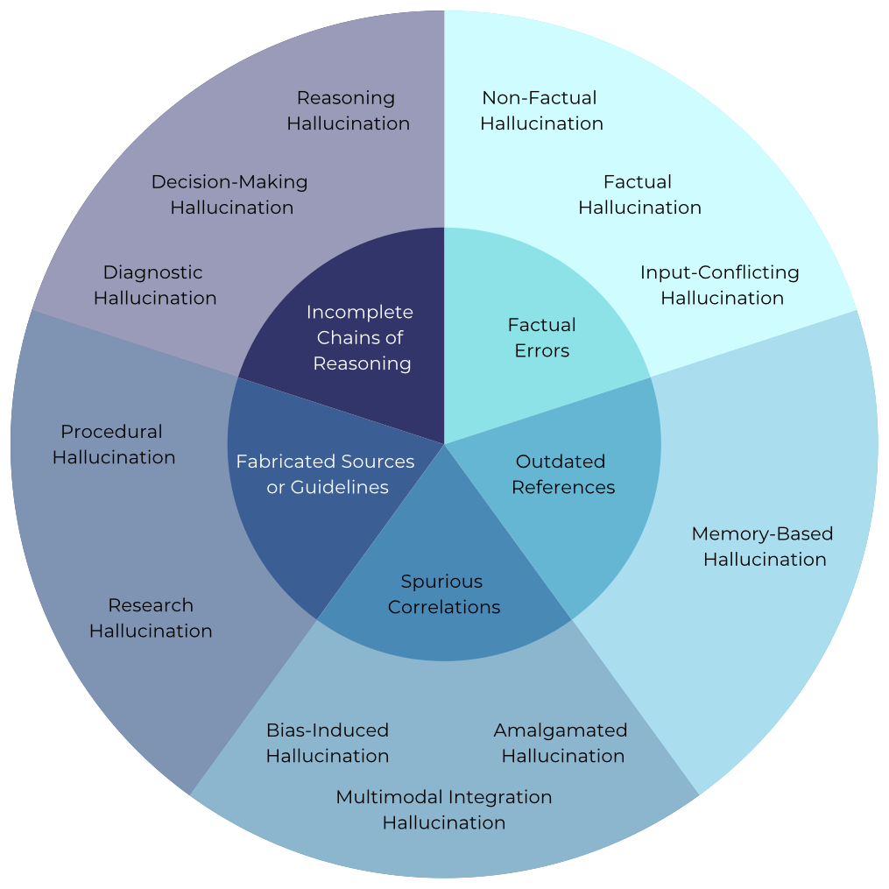
FRONTIER MODELS
Specializing a model does not make it safer.
Medical hallucination is not one failure but many — factual errors, outdated references, spurious correlations, fabricated sources, and broken chains of reasoning — across diagnosis, procedure, and research.
On a hallucination benchmark (Med-HALT, 2025), general-purpose models were hallucination-free 76.6% of the time, versus only 51.3% for medically "specialized" models. Narrowing a model can erode its calibration.
The specialist-versus-generalist question is unsettled — the instinct to buy the medical one may be wrong.
Taxonomy: Kim, Jeong et al., "Medical Hallucination in Foundation Models," arXiv 2503.05777 (2025) · Med-HALT, arXiv 2307.15343
Notes:
And a counterintuitive result that complicates the procurement instinct. First, note that medical hallucination is not a single failure mode — this taxonomy, from Kim, Jeong and colleagues at MIT and Harvard this year, sorts it into five clusters: plain factual errors, outdated references, spurious correlations, fabricated sources or guidelines, and incomplete chains of reasoning — playing out across diagnostic, procedural, and research tasks. Now the counterintuitive part: fine-tuning on medical data does not automatically reduce any of this. On a hallucination benchmark, Med-HALT, in 2025, general-purpose models were hallucination-free 76.6 percent of the time, versus only 51.3 percent for the medically specialized models. Narrowing a model can erode its calibration. So the specialist-versus-generalist question is genuinely unsettled, and the procurement instinct — to buy the medical one — may be wrong.

Slide 50
FRONTIER MODELS
The thesis: the "bitter lesson."
Over decades, general methods that scale with data and compute have repeatedly outperformed systems built on handcrafted domain knowledge — in chess, in vision, in language.
Radiology AI has spent fifteen years handcrafting. The trajectory of other fields suggests the generalists eventually take over perception too. The open question is when — and what we build in the meantime.
Rich Sutton, "The Bitter Lesson," 2019 essay (an argument, not a study)
Notes:
Here is the thesis to pose, Rich Sutton's bitter lesson, from his 2019 essay — and I attribute it as an argument, not a study. Sutton argues that over decades, general methods that scale with data and compute have repeatedly outperformed systems built on handcrafted domain knowledge — in chess, in computer vision, in language. Radiology AI has spent fifteen years handcrafting. The trajectory of those other fields suggests the generalists eventually take over perception as well. The open question is when, and what we should build in the meantime.

Slide 51
FRONTIER MODELS
A likely answer: orchestration.
The probable future is a stack, not a replacement. A frontier model as the reasoning and orchestration layer — it reads the EHR, talks to the patient, writes the report, decides the next step — calling specialist models as instruments: the detector, the risk model, the BAC quantifier, the tissue model.
generalist = reasoning & orchestration
specialists = the instruments it calls
increasingly domain-adapted (Med-Gemini)
Measurement still rewards purpose-built precision and calibration. "Agentic radiology": the generalist conducts; the specialists play.
Notes:
A likely answer is orchestration. The probable future is not a generalist simply replacing the specialist. It is a stack: a frontier model as the reasoning and orchestration layer — it reads the EHR, talks to the patient, writes the report, decides the next step — and the specialist models as the instruments it calls: the detector, the risk model, the breast-arterial-calcium quantifier, the tissue model. Because measurement still rewards purpose-built precision and calibration. Call it agentic radiology: the generalist conducts, and the specialists play. And increasingly the generalists are themselves domain-adapted, like Med-Gemini, rather than raw.

Slide 52
FRONTIER MODELS
What it means for this room.
Value moves to data, validation, integration — not architecture
Concentration is a governance problem: cost, sovereignty, access
The radiologist shifts toward validator & orchestrator
Whether the result is a specialist model or a frontier generalist, built in Palo Alto or in this room, it does not change what makes it safe. The bar is the same one CAD failed and MASAI cleared.
Connects to §6 equity · bridges to §7 — the close
Notes:
So what does this mean for this room? Three things. First, the locus of value moves. If the model becomes a commodity, durable value shifts to what the frontier labs do not have: proprietary, diverse, well-labeled data; rigorous validation; clinical integration; and the care pathway. Compete on data and evidence, not architecture. Second, concentration is a governance problem. A handful of US tech companies controlling the frontier raises issues of cost, dependence, data sovereignty, and access — particularly for Europe and for low- and middle-income countries, which connects back to the equity argument. Who owns the intelligence that reads the world's mammograms? Third, the radiologist's role shifts, from primary detector toward validator, orchestrator, and the source of clinical context and accountability the model cannot supply. And the bridge to the close: whether the result is a specialist model or a frontier generalist, built in Palo Alto or in this room, it does not change what makes it safe. The bar is the same one CAD failed and MASAI cleared.

Slide 53
ADOPTION
One model for everything is the wrong goal.
We chased better detection for three decades. But look at what we ask a single model to do at once:
01Hold up across every scanner and vendor in the field
02Perform in women of all ages, all densities, all risk types
03Serve both the expert breast radiologist and the generalist who reads mammo one day a week
We should seriously reframe how we consider mammography-model deployment.
Notes:
Everything I have shown you works. But working in a paper is not the bar for getting into the clinic. Look at what we ask a single model to do, all at once: hold up across every scanner and vendor in the field; perform in women of all ages, all densities, all risk types; and serve both the expert breast radiologist and the generalist who reads mammography one day a week. Asking one model to do all of this at once is the wrong goal. We should seriously reframe how we consider mammography-model deployment.

Slide 54
ADOPTION
How we should deploy instead.
Not one model imposed everywhere — three reframes:
1Operating points, not one threshold. Sensitivity vs. false positives is a value judgment, not a setting. Let a model run at a range of operating points, tailored to the site and the radiologist — the expert and the once-a-week reader don't want the same one.
2Multimodal — and soon. A model on imaging alone, or imaging plus basic clinical data, will end in user frustration. The model a radiologist trusts pulls in image, clinical context, risk, and history together.
3The integration tax. A perfect model dies if it can't reach PACS. One-off integrations don't scale; onboarding happens through a platform or vendor you already run.
Sharma N, et al. BMC Cancer 2023;23:460 (275,900 mammograms; multi-vendor) · Eisemann N, et al. Nat Med 2025;31:917–924 (PRAIM) · Tejani AS, et al. Radiology 2024;311:e232653 · Allen B, et al. Mayo Clin Proc Digit Health 2024;2(4)
Notes:
So how should we think about deployment instead? Three reframes. First, operating points: there is no single right threshold. Sensitivity versus false positives is a value judgment, not a setting — so a model should be permitted to run at a range of operating points, tailored to the site and to the individual radiologist, rather than one point imposed on everyone. Second, multimodal, and it needs to happen as soon as possible. I will say it plainly: a model that operates only on imaging data — or imaging plus basic clinical data — will end in user frustration. The model the radiologist will actually trust pulls in image, clinical context, risk, and history together. Third, the integration tax: even a perfect model dies if it cannot get into PACS. Custom one-off integrations do not scale, and overloaded IT means onboarding only happens through a platform or vendor you already run. Put those together and the winning system is not the most accurate in a paper — it is the one tuned to the reader, that knows what they know, and that fires inside the workflow.

Slide 55
Lesion→Image→Patient
What thirty years taught us.
Technology is fallible. We keep getting better at looking ahead — but the consequences of what we deploy are not always ones we foresee.
Notes:
So what have thirty years taught us? First, that the technology is fallible — CAD cost us two decades learning it. Second, that we are getting genuinely better at looking ahead: reading a woman's risk, her cardiovascular signal, her tumor biology years before they would declare themselves. And third, a hard-won humility — the consequences of what we deploy are not always the ones we foresee. Hold those together, and the arc of the field comes into focus: lesion, image, patient.

Slide 56
CLOSE
Lesion, image, patient.
Lesion
Find the spot. CAD failed at it; whole-image detection later earned the randomized evidence CAD never had.
Image
Beyond the lesion. The whole image reads a woman's future risk and a cardiovascular signal — from the same mammogram.
Patient
The whole person. Image, tissue, gene, and history together — risk known before she enters the scanner.
Notes:
Look at the arc through the spine of this talk — lesion, image, patient — across the decades. For most of these years the goal was the lesion: find the spot. CAD failed at it, and only later did whole-image detection earn randomized evidence. Then we learned to read the whole image, beyond the lesion — a woman's future risk, and a cardiovascular signal, from the same mammogram. And now the patient: image, tissue, gene, and history combined, with risk known before she enters the scanner. Lesion, image, patient — that is how the field moved.

Slide 57
CLOSE
The discipline, in three lines.
01Prove it before you scale it. Prospective, randomized evidence — MASAI is the bar, not a retrospective AUC.
02Audit the blind spots. Explainability and subgroup performance are release criteria — a headline AUC is a sales number.
03Preserve clinical judgment; guard against de-skilling. Design against automation bias — the clinician should stay a clinician, not a rubber stamp.
Notes:
CAD did not fail because the math was bad. It failed for a lack of evidence, monitoring, and discipline. That is the through-line from the first slide to this one. So if you take one thing away, take the discipline that turns clinical intelligence into better outcomes. First: prove it before you scale it — prospective, randomized evidence; MASAI is the bar, not a retrospective AUC, and this time we have it. Second: audit the blind spots — explainability and subgroup performance are release criteria, not afterthoughts; a headline AUC is a sales number. Third: preserve clinical judgment and guard against de-skilling — design against automation bias; the clinician should stay a clinician, not a rubber stamp.

Slide 58
CLOSE
The image hasn't changed — what we read from it will.
Twenty-five years ago we could barely mark a suspicious spot. From that same image today: a woman's cancer risk years ahead, her cardiovascular risk, and a link to her tissue and genome.
Notes:
Recall the normal mammogram we opened with — the one I said was full of hidden signals. The image has not changed — what we read from it will. Twenty-five years ago we could barely mark a suspicious spot. Today, from that same image, we can forecast a woman's cancer years ahead, flag her cardiovascular risk, and connect it to her tissue and her genome.

Slide 59
Thank you.
EMORY
Radiology & Imaging Sciences
HITI Lab
[ logo to be added ]
Hari Trivedi, MD · Emory University · IWBI 2026
Notes:
Thank you.

