Slide 1
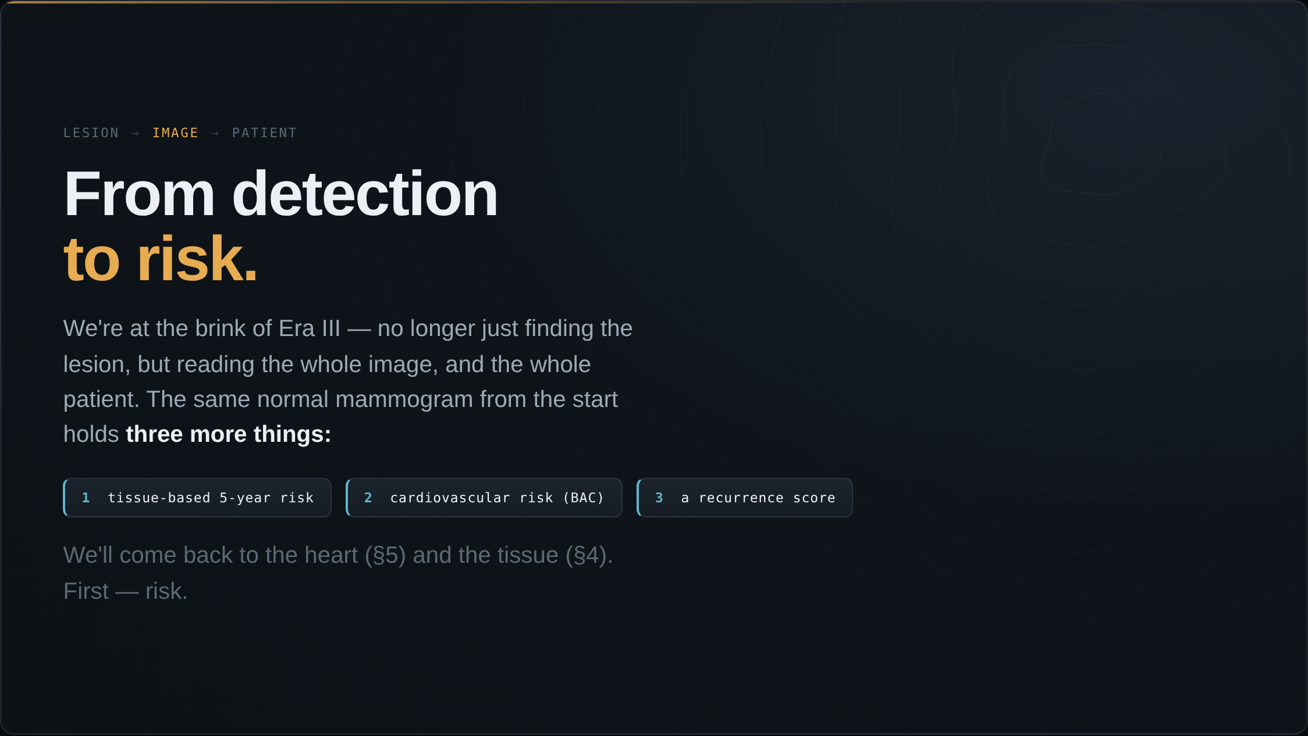
Notes:
We are now at the brink of Era III. Instead of looking for lesions, we start reading the whole image — and even the whole patient. Here is the normal mammogram I showed you at the start. Three more things come out of this one image: a tissue-based estimate of her breast-cancer risk, a cardiovascular signal from breast arterial calcification, and a recurrence score from her tissue. We will get to the heart and the tissue later. First, let's talk about risk.

Slide 2
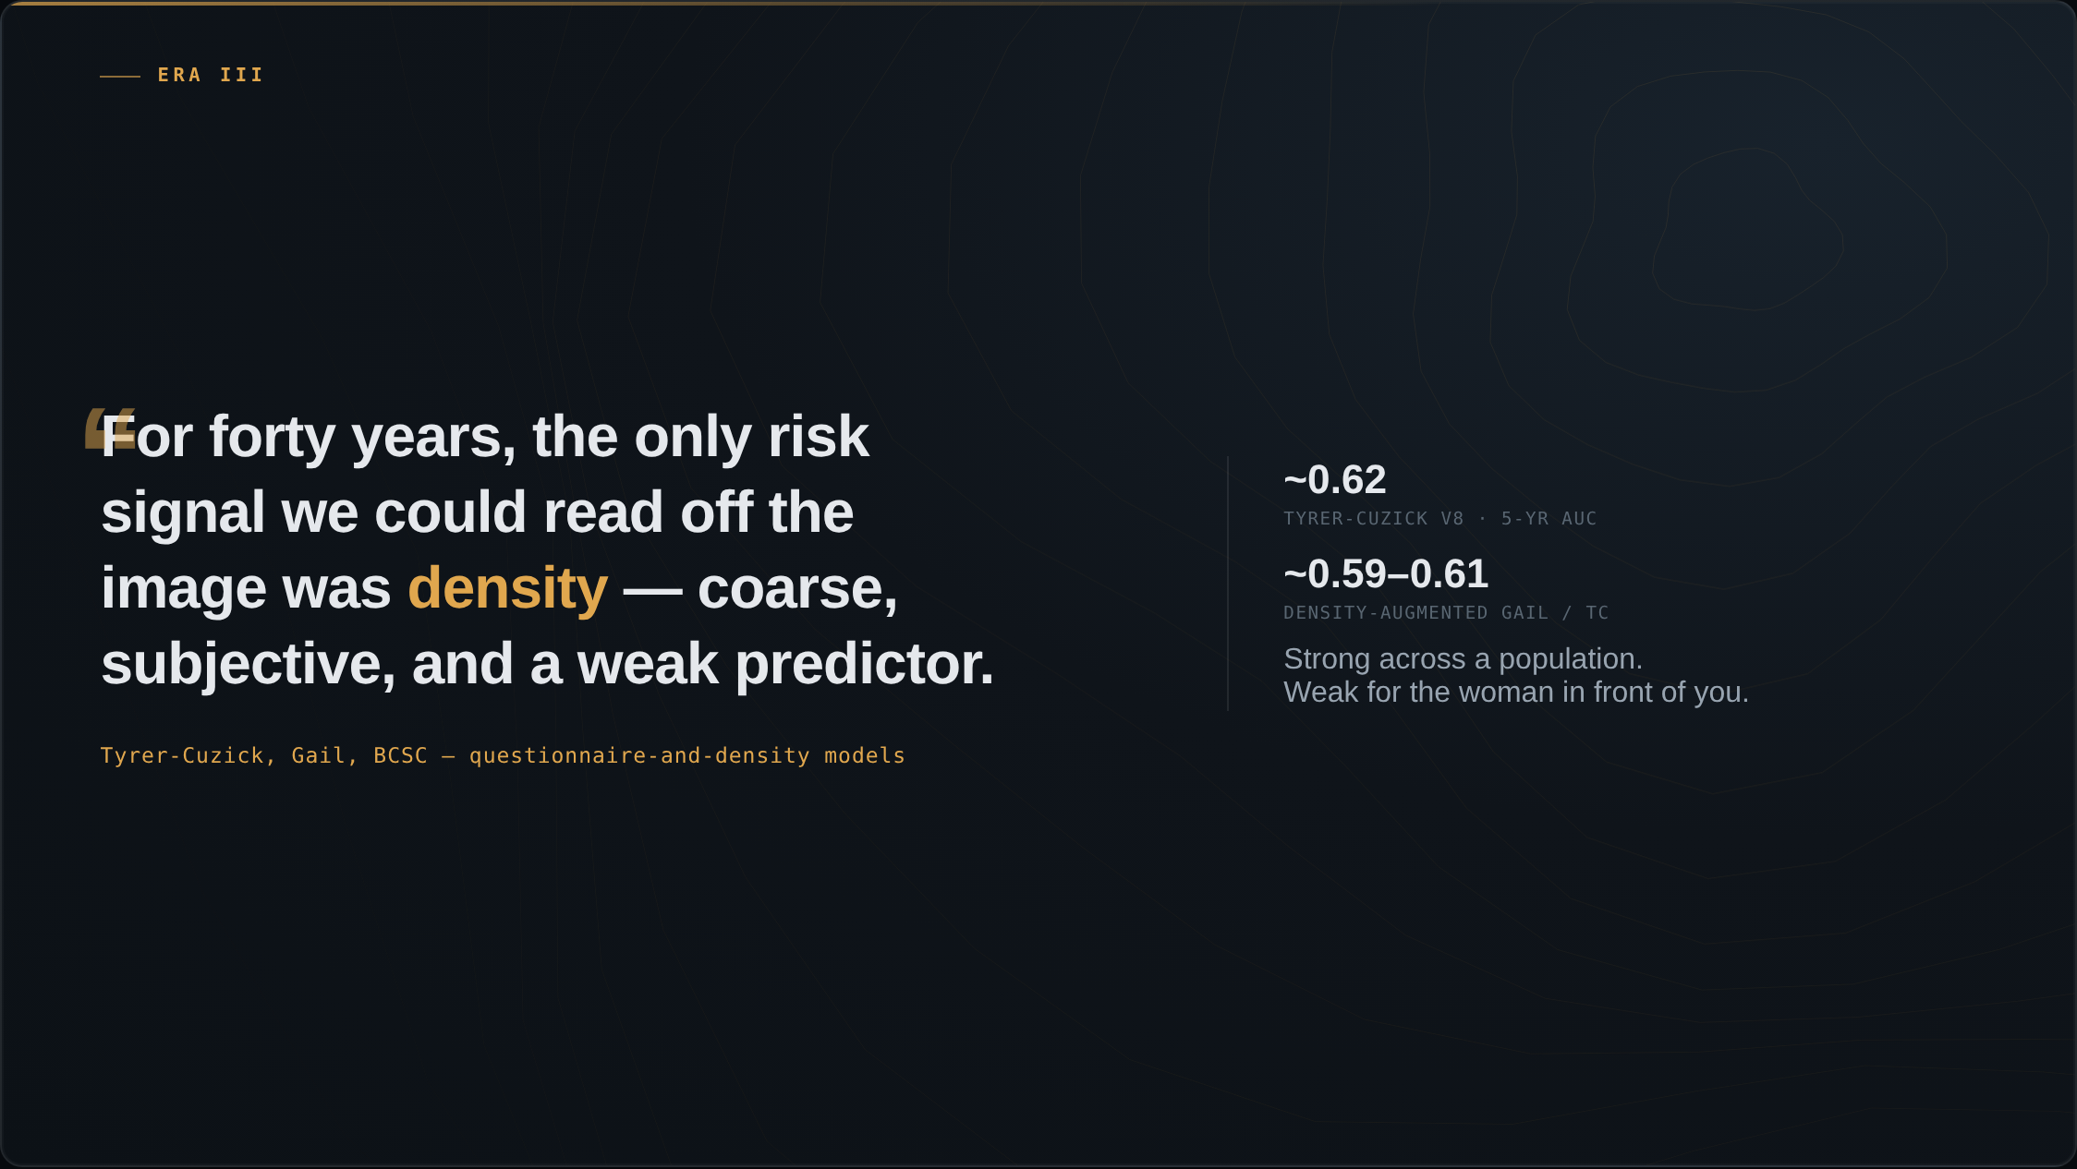
Notes:
For forty years the only risk signal we could read off the image was breast density — coarse and subjective. The questionnaire models we layered on top were weak: Tyrer-Cuzick predicts five-year risk at an AUC around 0.62, barely better than chance at the level of the individual.

Slide 3
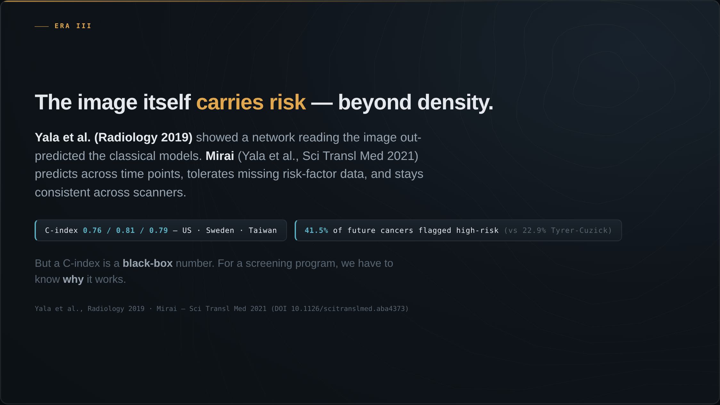
Notes:
Then the image itself turned out to carry risk. Yala and colleagues at MIT and MGH showed a deep network reading the mammogram out-predicted the questionnaire models. Mirai, the next version, was built to predict across time, tolerate missing risk-factor data, and stay consistent across machines. Externally validated in three countries, C-index 0.76 to 0.81. Among women who developed cancer within five years, Mirai flagged 41.5 percent as high-risk, versus 22.9 percent for Tyrer-Cuzick.

Slide 4
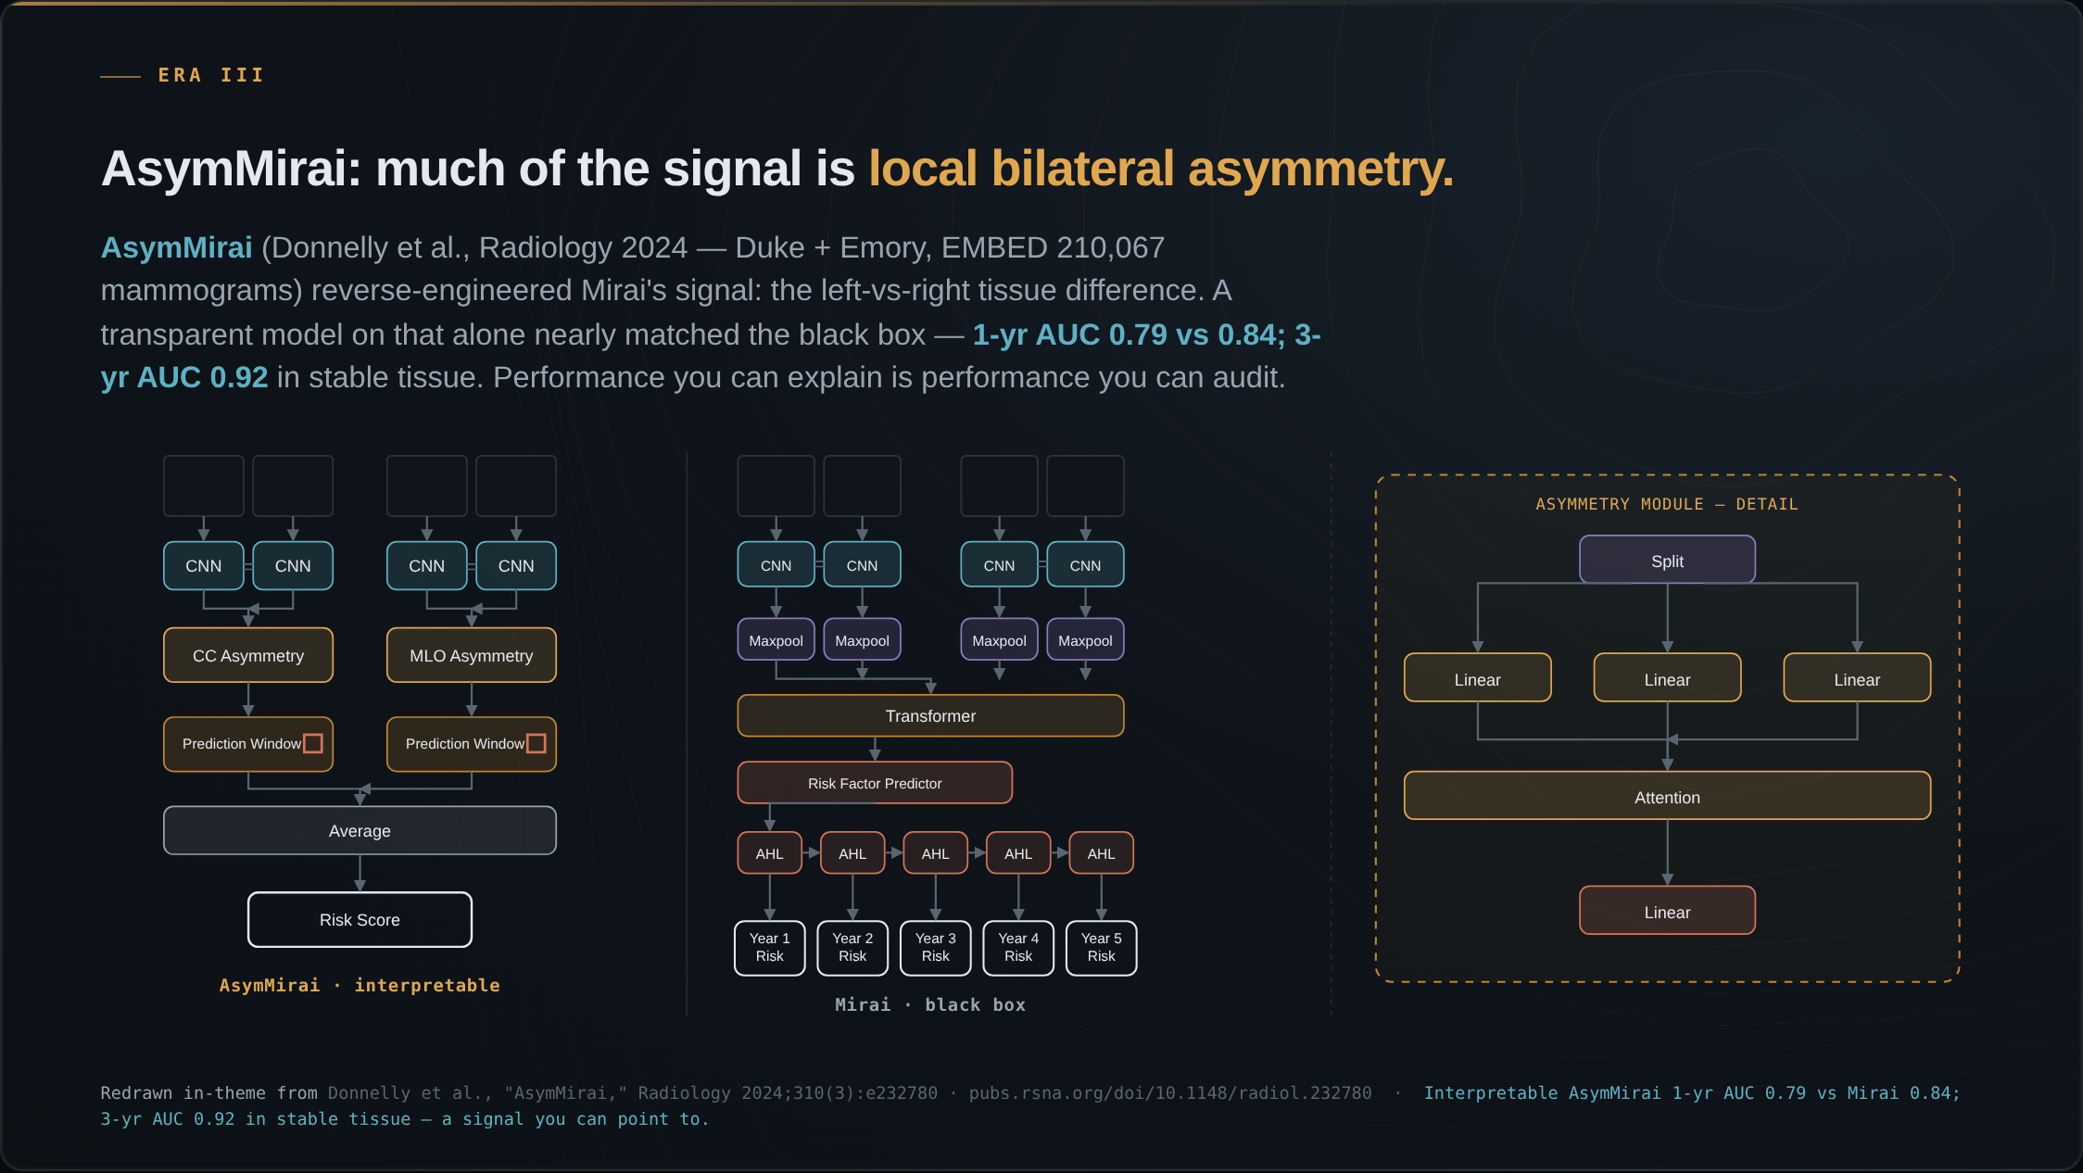
Notes:
Here is explainability done right, and it is our group's work with Duke. We asked what Mirai was actually keying on. The answer was surprisingly simple: local bilateral dissimilarity — the difference between left and right breast tissue in the same region. A transparent model built only on that asymmetry nearly matched the black box: one-year AUC 0.79 versus 0.84, and in stable-tissue subgroups three-year AUC 0.92. A risk signal you can point to on the image, and audit for where it fails.

Slide 5
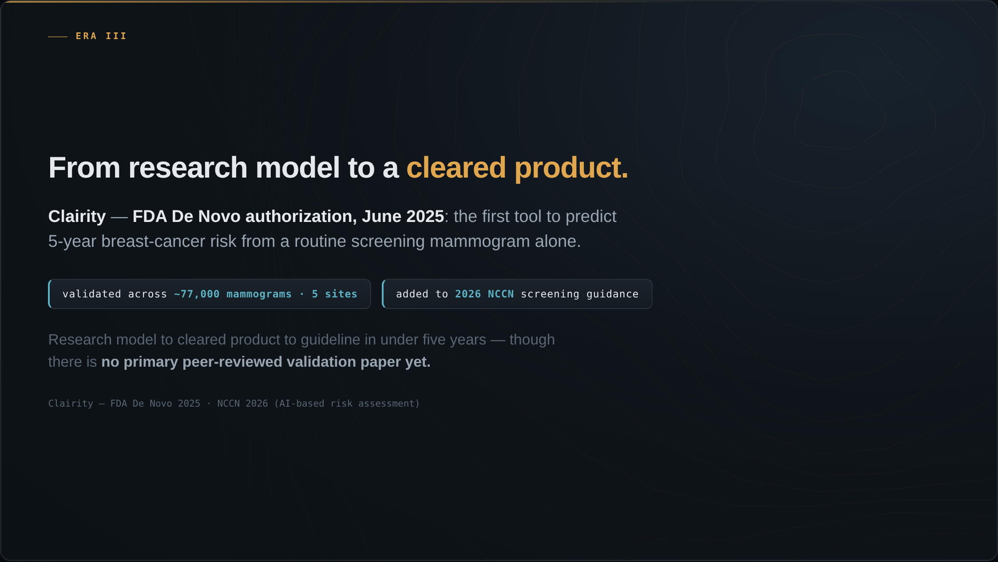
Notes:
And this is no longer research. In June 2025, Clairity received FDA De Novo authorization — the first tool to predict five-year breast-cancer risk from a routine screening mammogram alone, validated across about 77,000 mammograms from five sites, and it was added to the 2026 NCCN screening guidance. The path from research model to cleared product to guideline took under five years. There is not yet a primary peer-reviewed validation paper.

Slide 6
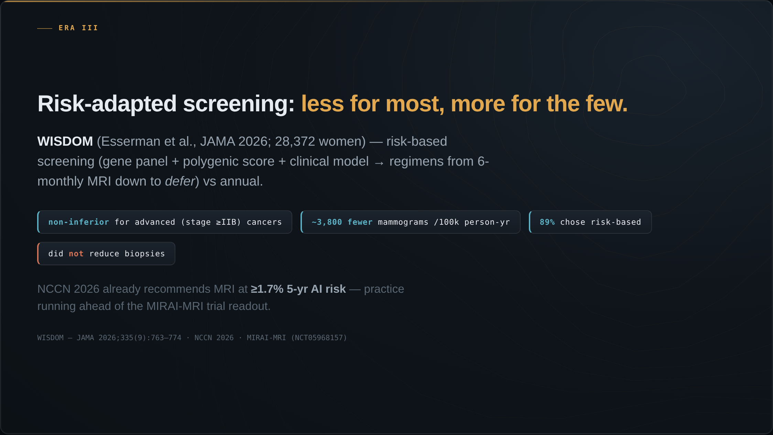
Notes:
This is where risk becomes a screening program. WISDOM, reported in JAMA, randomized about 28,000 women to risk-based screening — a gene panel plus polygenic score plus a clinical model, sorting women into regimens from six-monthly MRI down to deferring — versus annual. Risk-based was non-inferior for advanced cancers, with about 3,800 fewer mammograms per hundred-thousand person-years, and 89 percent of women offered the choice took it. It did not reduce biopsies. Meanwhile the 2026 NCCN guideline already recommends considering MRI at a 1.7 percent five-year AI risk — the practice is running ahead of the prospective trial, MIRAI-MRI, which is still reading out.

Slide 7
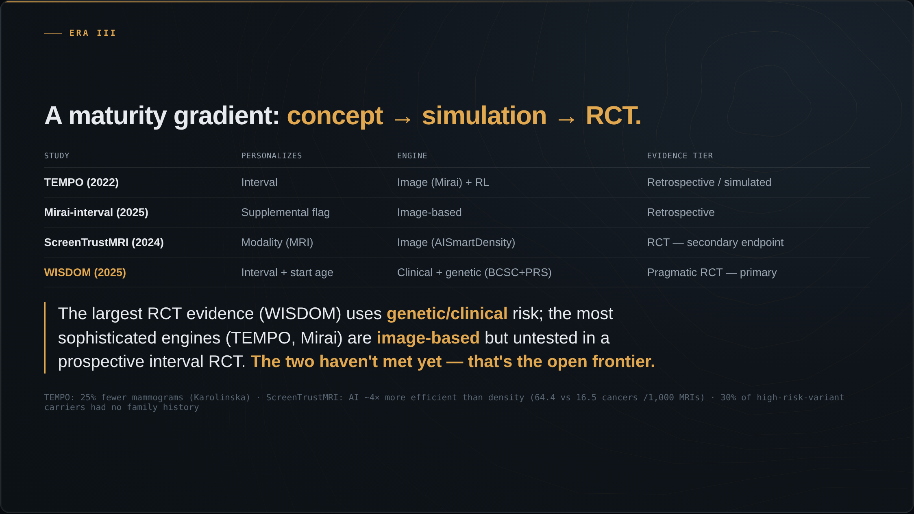
Notes:
Step back and line these up as a maturity gradient — from concept, to simulation, to randomized trial. TEMPO personalizes the interval with an image-based engine, but it is retrospective and simulated. Mirai-interval, also image-based, retrospective. ScreenTrustMRI personalizes the modality and is a randomized trial, but on a secondary endpoint. And WISDOM is the pragmatic RCT with a primary endpoint — but it personalizes on genetic and clinical risk, not the image. So here is the punchline: the largest randomized evidence uses genetic and clinical risk, while the most sophisticated engines are image-based but have never been tested in a prospective interval-modification trial. The two haven't met yet. That's the open frontier.

Slide 8
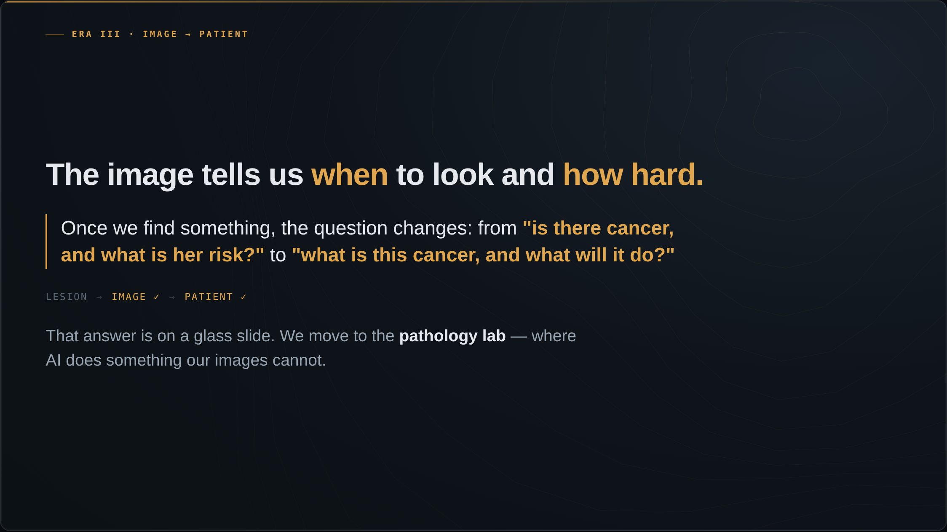
Notes:
So the image can tell us when to look and how hard. But once we find something, the question changes again — from is there cancer and what is her risk, to what is this cancer and what will it do? That answer is not in radiology. It is across the hospital, on a glass slide. To understand the patient, we move to the pathology lab, where AI does something our images cannot.

