Slide 1
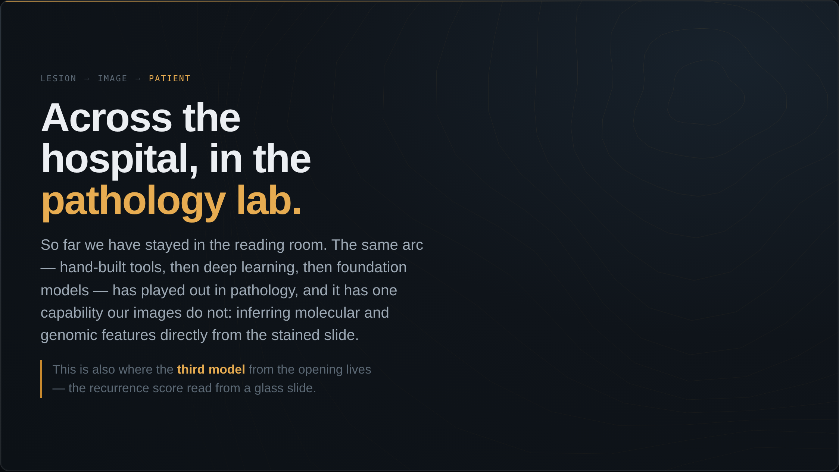
Notes:
For the whole talk we have stayed in the reading room. Now walk across the hospital to the pathology lab — a part of the building a radiology audience rarely sees. The same arc played out here: hand-built tools, then deep learning, then foundation models. But tissue AI can do one thing our images cannot, and it is the reason this matters to you. And remember the third model I opened with — the four-thousand-dollar recurrence score being read off a glass slide across town. We are about to meet it.

Slide 2
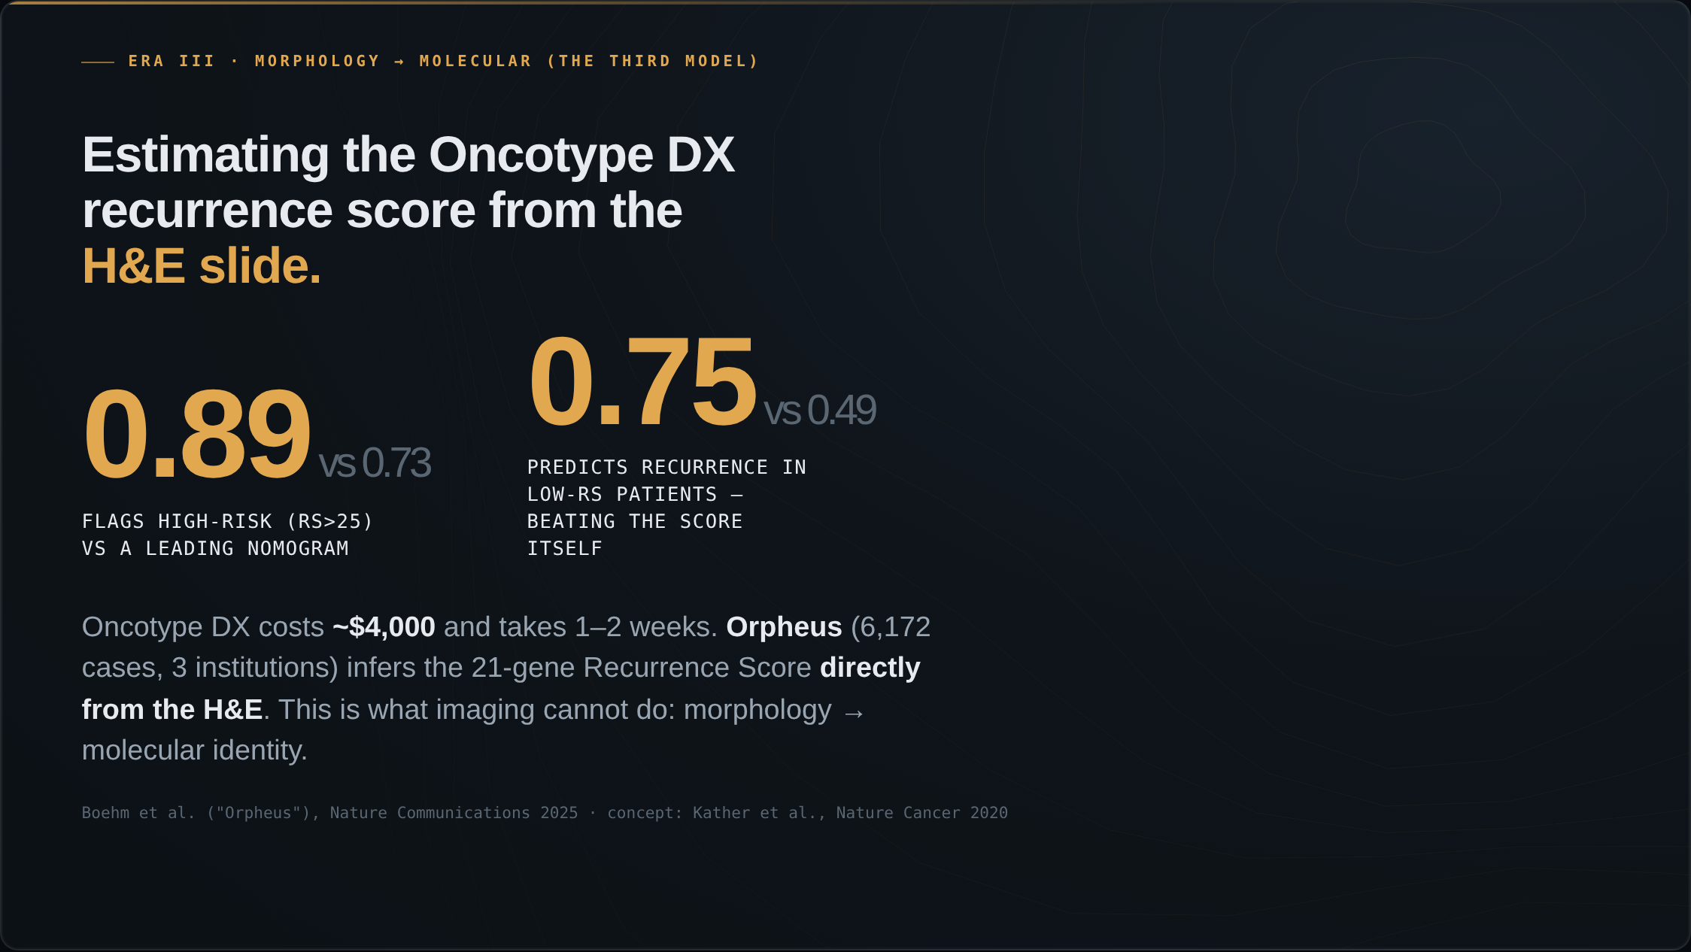
Notes:
And this is the capability imaging simply does not have, and the third model from the opening. Oncotype DX — the 21-gene recurrence score — costs about four thousand dollars and takes one to two weeks. The slide is already on the desk. Orpheus, in Nature Communications this year, infers that recurrence score directly from the H&E across six thousand cases. It flags the high-risk patients at an AUC of 0.89 versus 0.73 for a leading nomogram. And in the low-score patients — the ones the test calls low-risk — it predicts who actually recurs better than the recurrence score itself: 0.75 versus 0.49. Morphology to molecular identity, from a slide we already have.

Slide 3
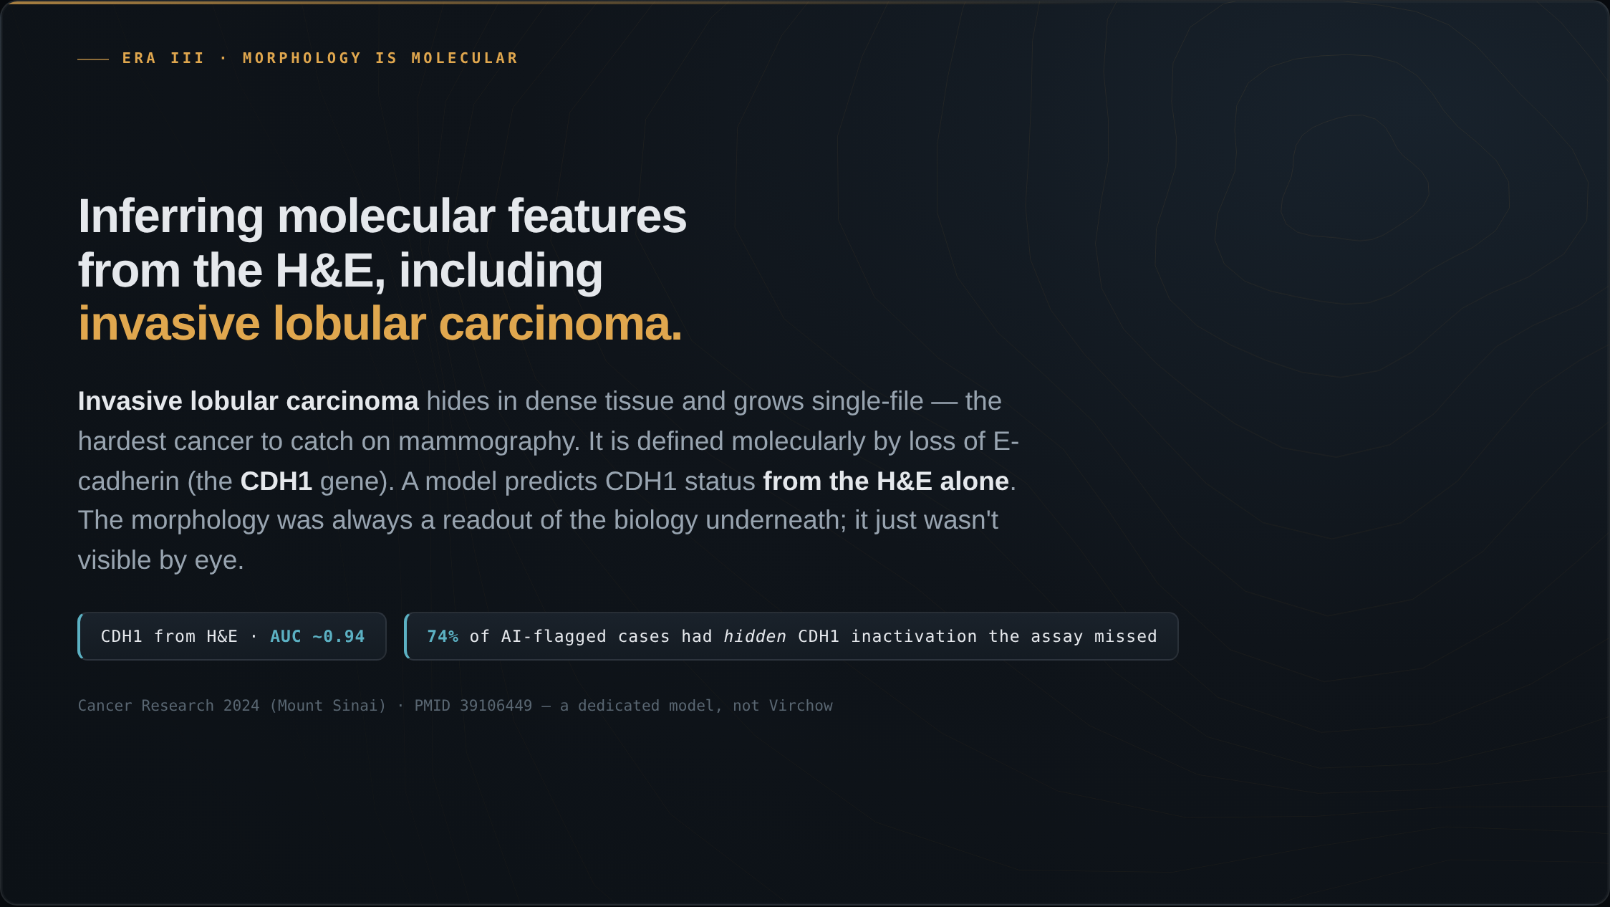
Notes:
And this is directly relevant to breast imaging. These models read features off the H&E that the eye cannot see. Take the cancer hardest to detect on a mammogram — invasive lobular carcinoma. It hides in dense tissue and grows single-file. Lobular cancer is defined molecularly by the loss of one protein, E-cadherin, the CDH1 gene. A model predicts CDH1 status from the H&E alone at an AUC around 0.94. The morphology was always a readout of the molecular biology underneath; it just was not visible by eye. And among cases the model flagged as CDH1-lost where the standard test found nothing, about three-quarters had another mechanism silencing the gene — biology the assay never tested for.

Slide 4
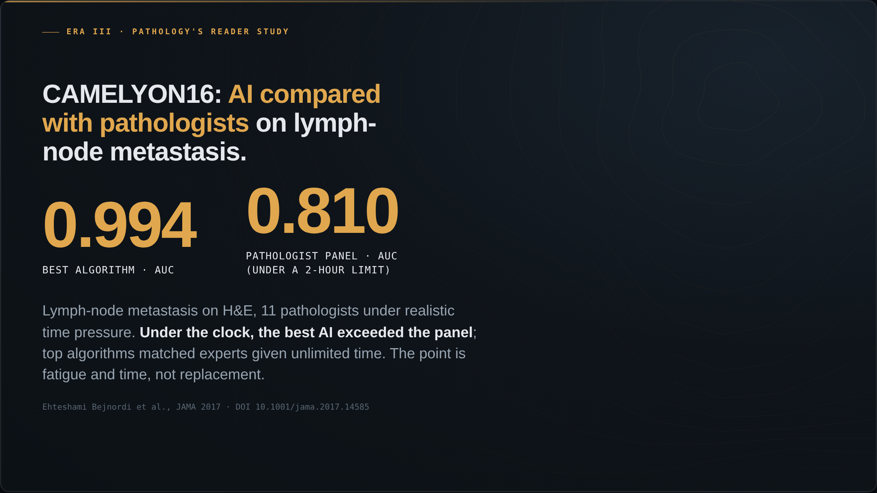
Notes:
Pathology ran the same AI-versus-experts study radiology did. CAMELYON16: detecting lymph-node metastasis on H&E, eleven pathologists reading a test set under a realistic two-hour time limit. The best algorithm scored 0.994; the pathologist panel, under the clock, 0.810. The top algorithms matched experts given unlimited time. The framing is not replacement — it is fatigue and time pressure, which machines do not feel.

Slide 5
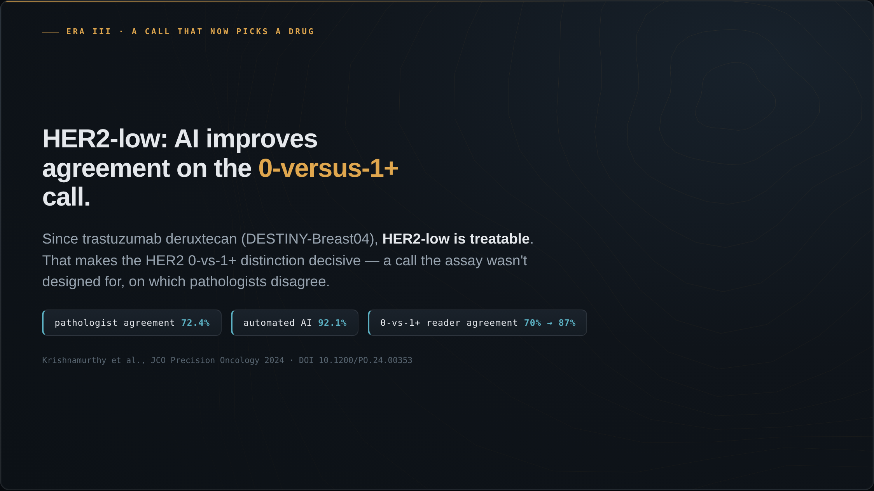
Notes:
Here is AI on a problem that decides treatment today. Since trastuzumab deruxtecan and DESTINY-Breast04, HER2-low disease is treatable. That makes the HER2 zero-versus-one-plus call decisive — and it is a call the assay was never designed to make, on which pathologists disagree. Baseline agreement is about 72 percent. Automated AI reaches 92. And on the hardest call, zero versus one-plus, AI lifts reader agreement from about 70 to about 87 percent. A distinction that now determines who is eligible for a drug that improves survival.

Slide 6
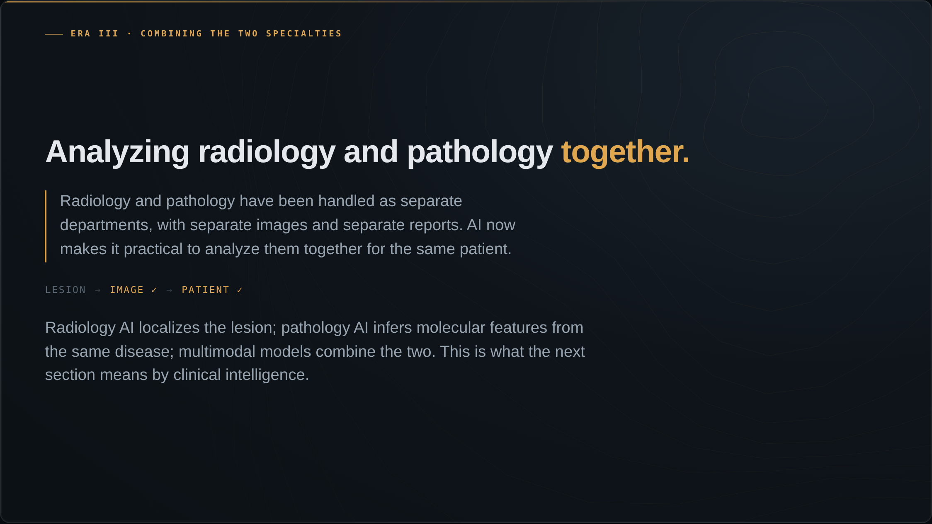
Notes:
For decades, radiology and pathology have been handled as separate departments, with separate images and separate reports. AI now makes it practical to analyze them together for the same patient. Radiology AI localizes the lesion; pathology AI infers molecular features from the same disease; and multimodal models combine the two. That is where the next section goes, and it is what the talk means by clinical intelligence.

