Slide 1
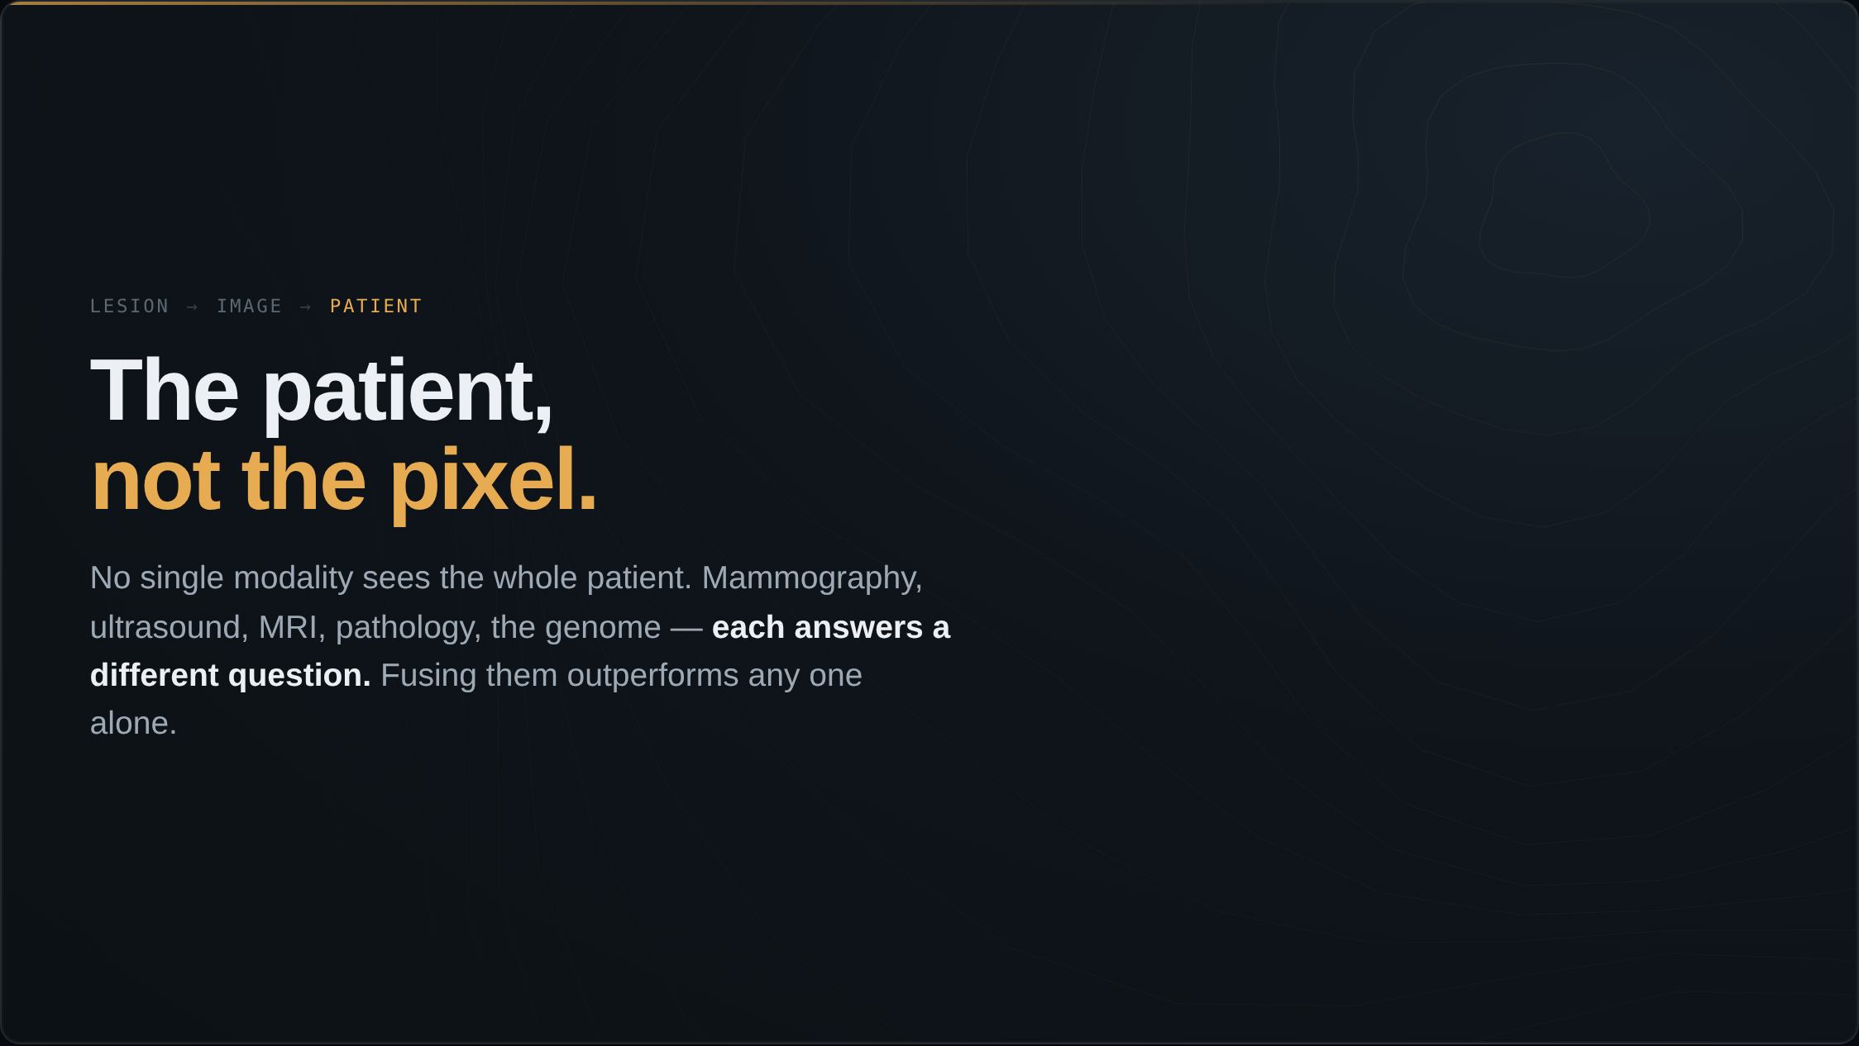
Notes:
No single modality sees the whole patient. Mammography, ultrasound, MRI, pathology, the genome — each answers a different question. The frontier is fusing them into one model of the patient. This is the risk-vector logic from the risk section, generalized: combine the modalities, and you outperform any one of them.

Slide 2
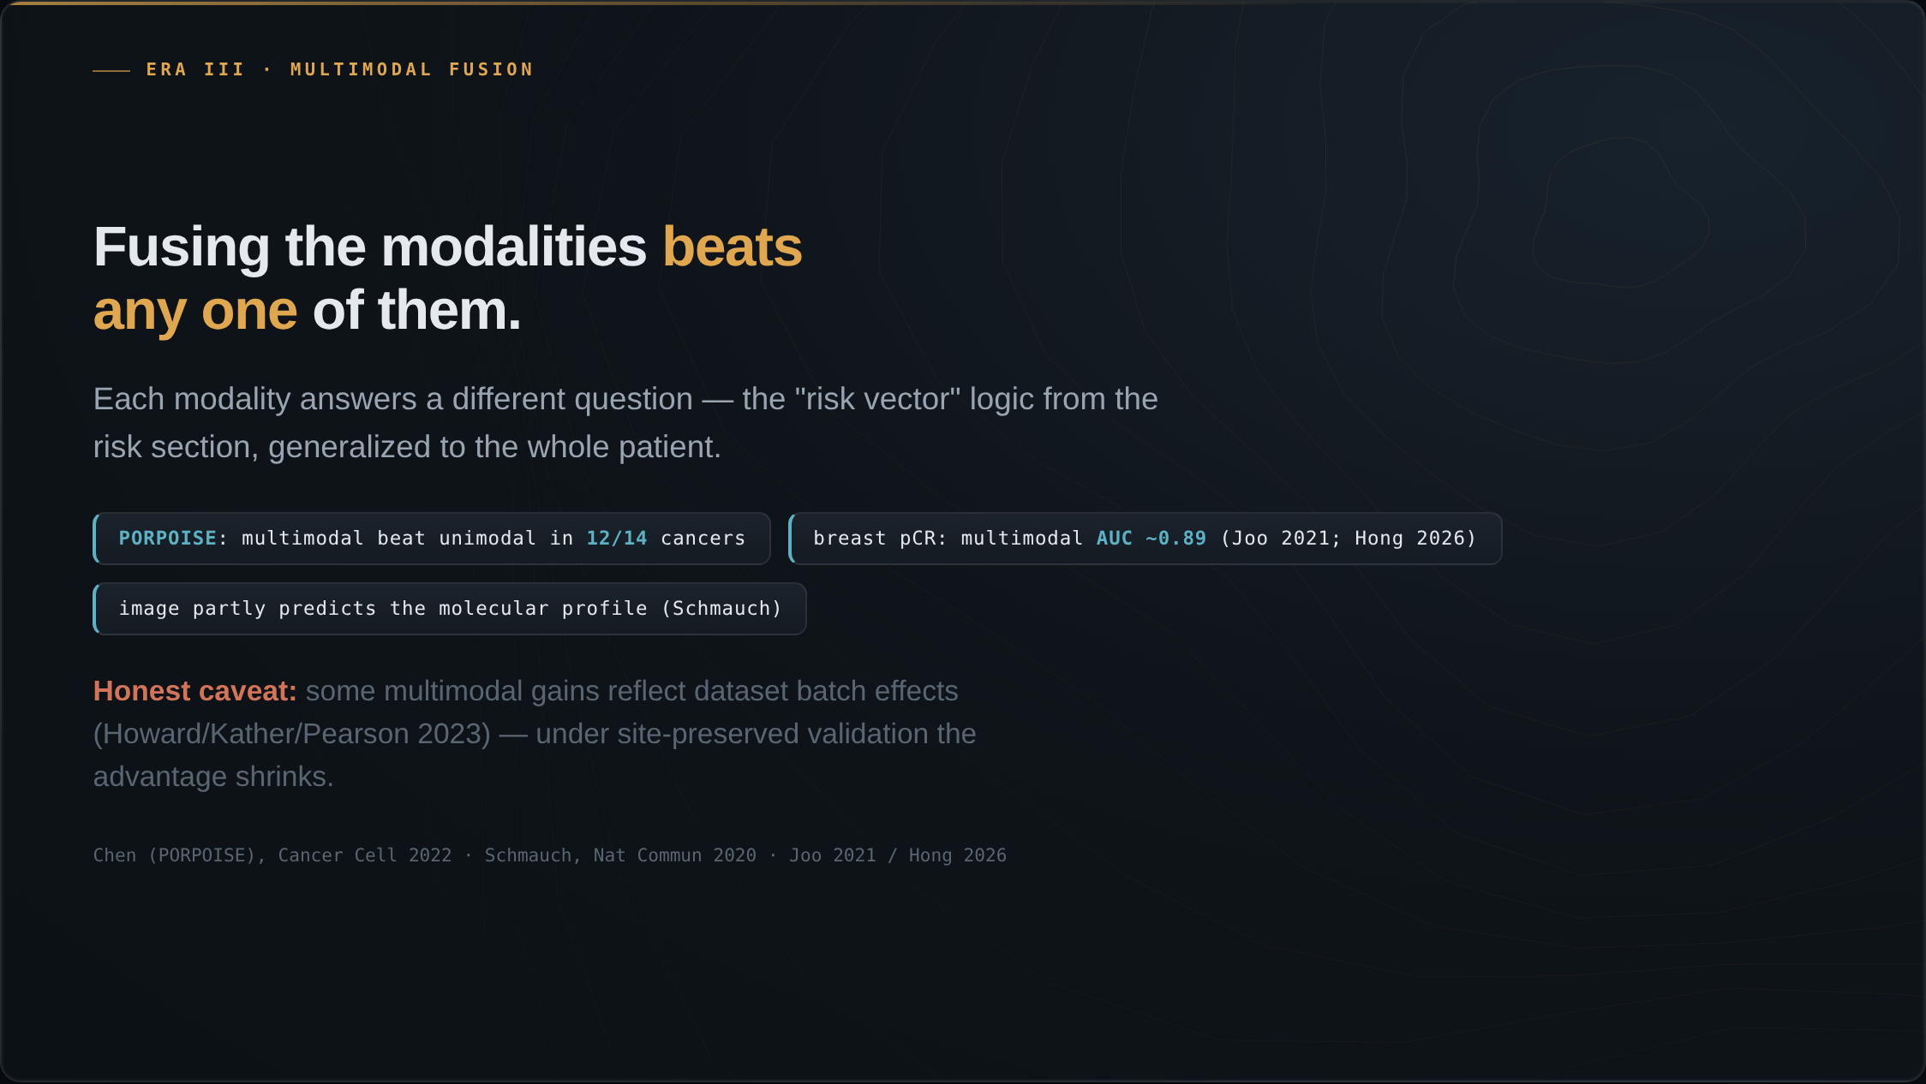
Notes:
The core evidence: fusing modalities beats any single one. Chen and colleagues, in PORPOISE, fused whole-slide images with molecular data across 14 cancers — multimodal beat unimodal in 12 of them. The honest caveat, from Howard, Kather and Pearson, is that some of that gain reflected dataset batch effects; under site-preserved validation the advantage shrinks. Schmauch showed the modalities partly encode each other — you can predict the molecular profile from the H&E alone. And in breast, fusing clinical data with MRI predicts neoadjuvant treatment response at an AUC near 0.89.

Slide 3
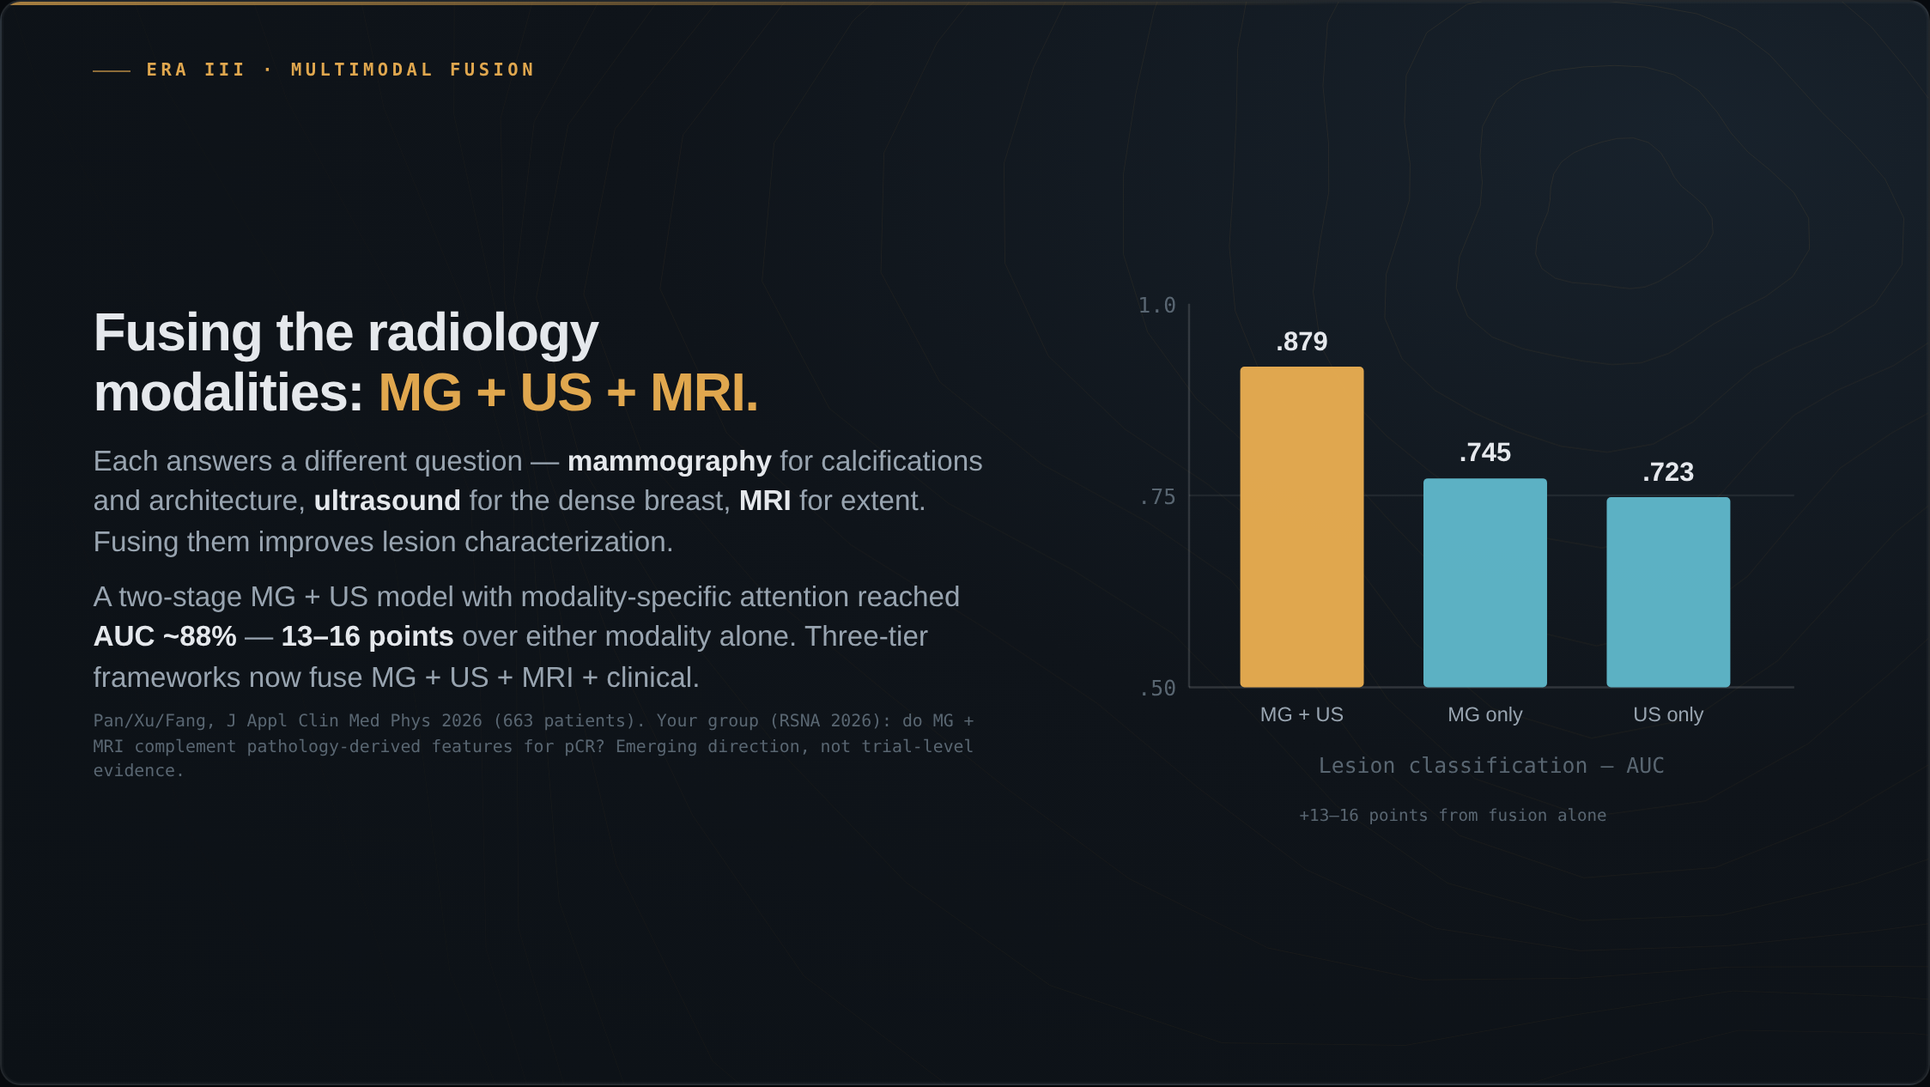
Notes:
A near-term, breast-specific version: fusing the radiology modalities themselves. Today almost all deployed AI reads a single modality, but each answers a different question — mammography for calcifications and architecture, ultrasound for the dense breast, MRI for extent. A two-stage MG-plus-ultrasound model with modality-specific attention reached an AUC of about 88 percent, 13 to 16 points over the mammography-only or ultrasound-only models. The signal one modality misses, another catches.

Slide 4
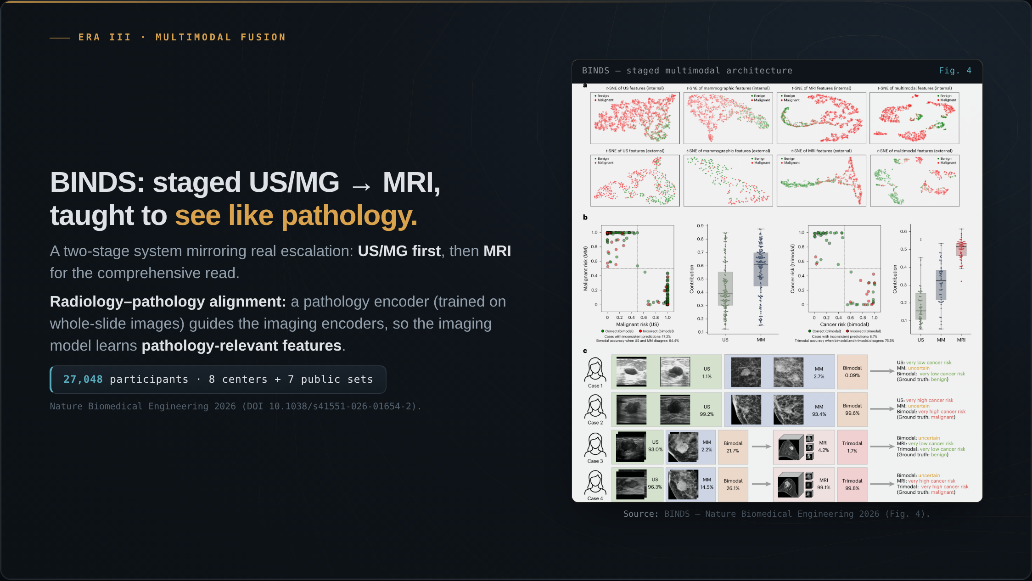
Notes:
The most workflow-faithful system to date is BINDS, in Nature Biomedical Engineering this year. It is a staged ultrasound-or-mammography to MRI system that mirrors the real clinical escalation pathway. Its conceptual novelty is a radiology-pathology alignment mechanism: a pathology encoder is pretrained on whole-slide images, and those features guide the imaging encoders, so the imaging model learns to see like pathology. Validated on 27,000 participants across eight centers, the largest multimodal validation in this space.

Slide 5
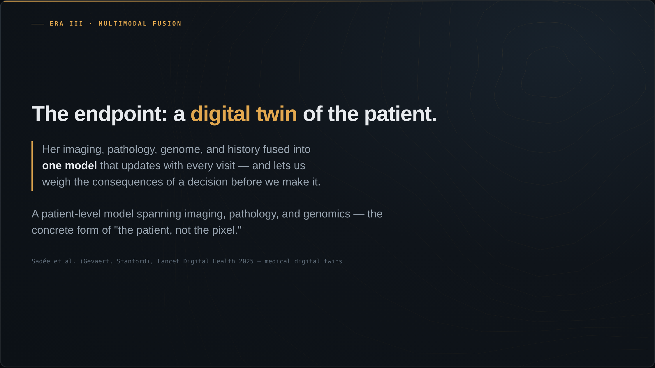
Notes:
Where this is heading is the medical digital twin: the patient's imaging, pathology, genome, and history fused into one model that updates with every visit and lets us weigh the consequences of a decision before we make it. Sadée and colleagues at Stanford laid out the concept in Lancet Digital Health this year. A patient-level model spanning imaging, pathology, and genomics.

