Slide 1
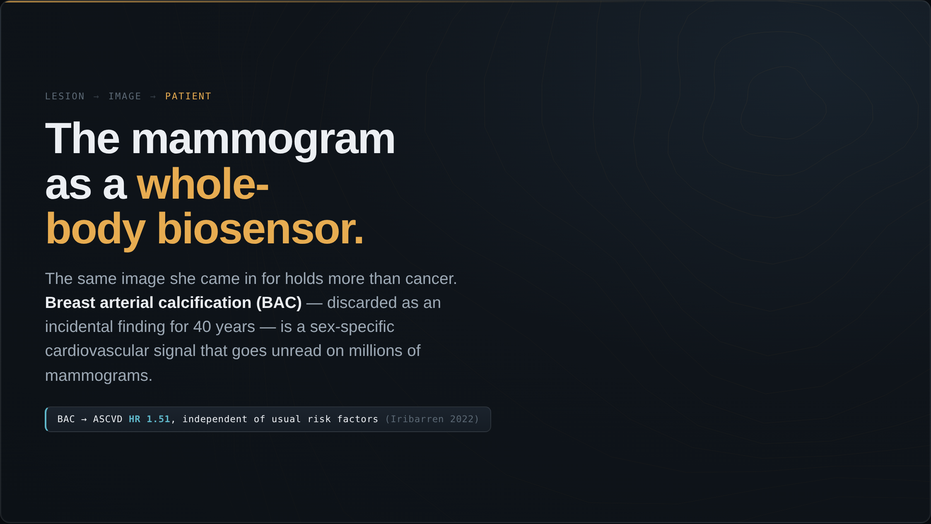
Notes:
Convergence is not only radiology and pathology. The same mammogram a woman gets for cancer is a biosensor for her whole body. Start with the heart — this closes the second model from our opening. Breast arterial calcification, treated as an incidental finding for forty years, is a sex-specific cardiovascular signal that goes unread on millions of mammograms. Iribarren showed it carries a hazard ratio around 1.5 for atherosclerotic disease, independent of the usual risk factors.

Slide 2
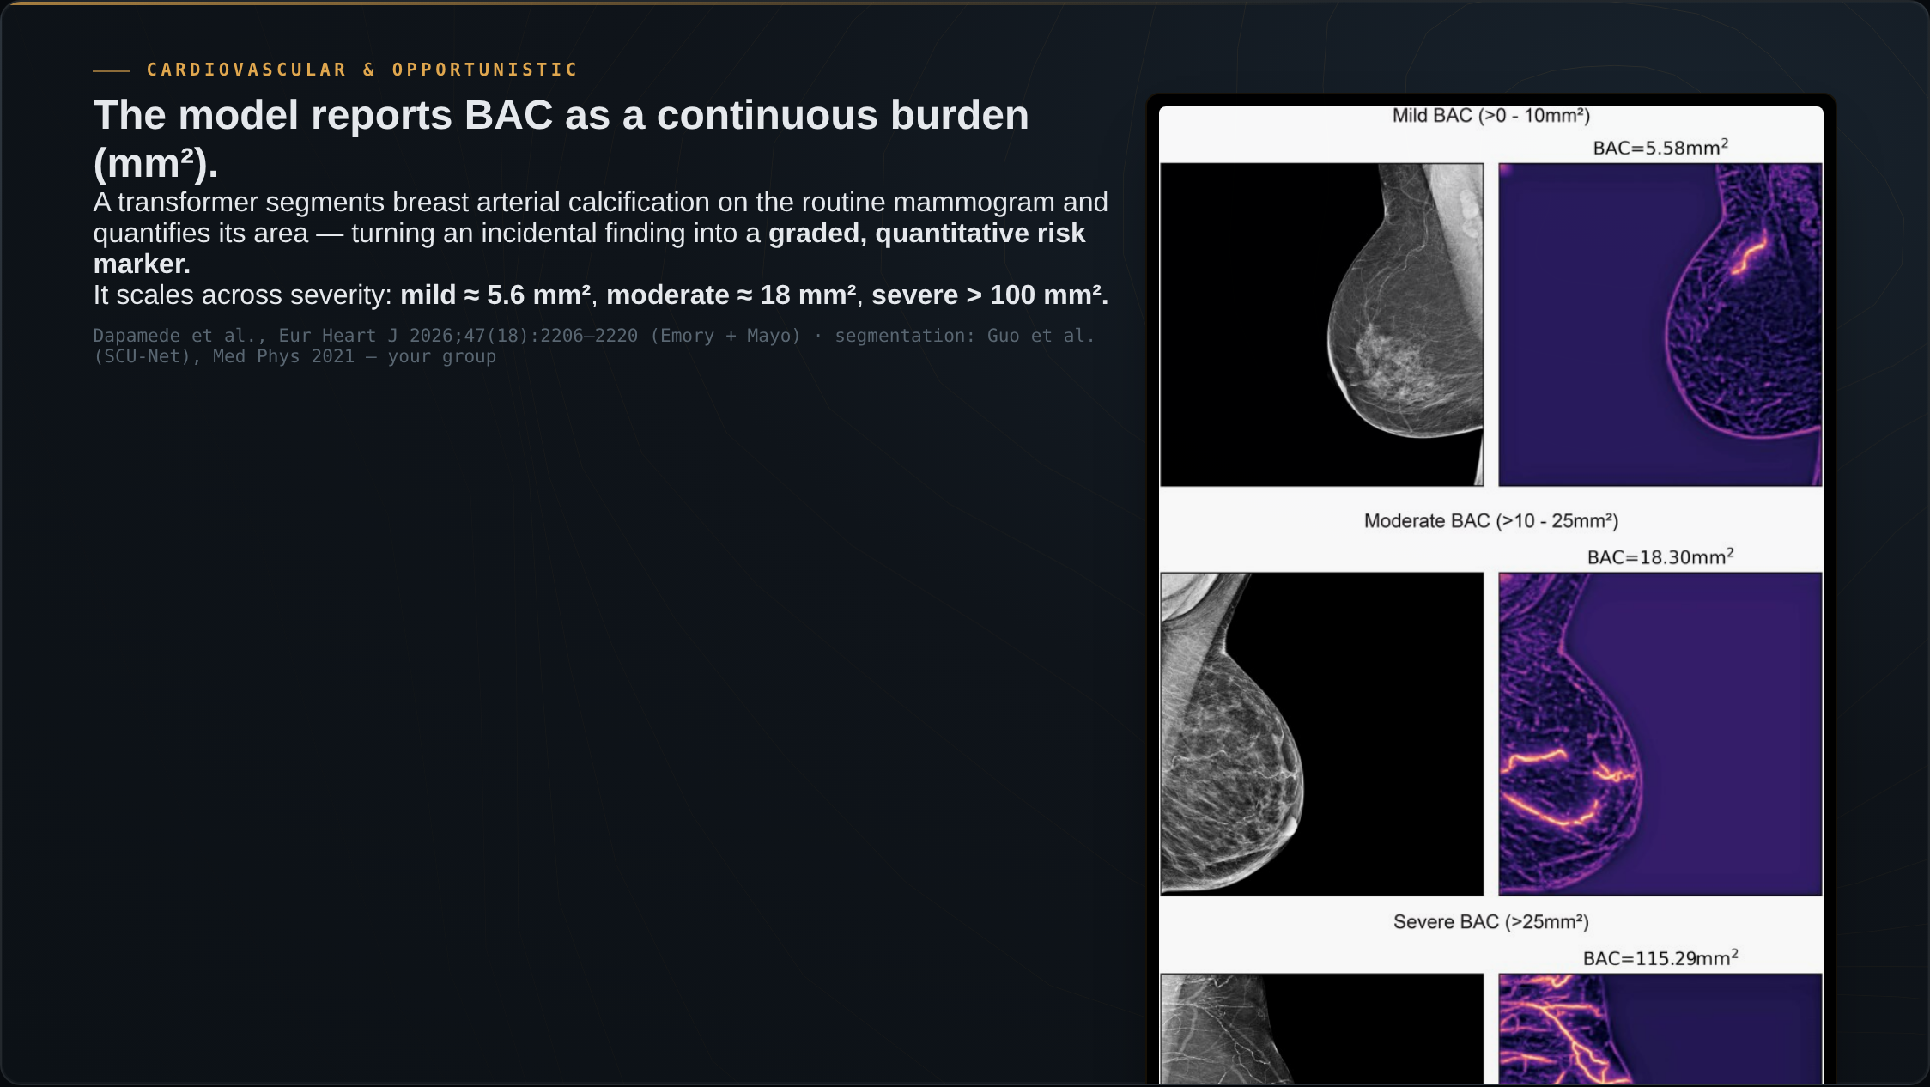
Notes:
Here is what the model does. A transformer segments the breast arterial calcification on the routine mammogram and reports its burden as an area, in square millimeters — the original image on the left, the model's segmentation on the right. You can see it scale, from mild calcification at about five square millimeters, to moderate at eighteen, to severe at over a hundred. That continuous number is what turns an incidental finding into a graded, quantitative risk marker. Our group built the segmentation model behind this, SCU-Net.

Slide 3
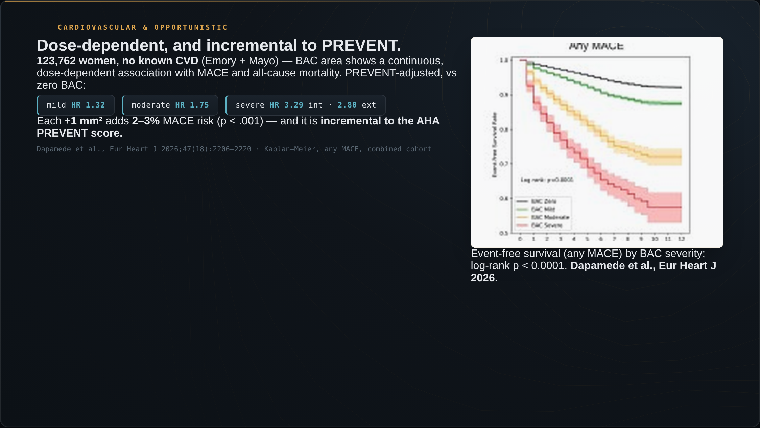
Notes:
And here is the result. Across 123,762 women with no known heart disease — the largest study of its kind — that burden shows a continuous, dose-dependent association with major adverse cardiac events and all-cause mortality. These are the Kaplan-Meier curves for any MACE, stratified by BAC severity: a clean graded separation, log-rank p below 0.0001. Adjusted for the AHA PREVENT score, mild calcification carries a hazard ratio of about 1.3, moderate about 1.75, and severe 3.3 internally and 2.8 in external validation. Each additional square millimeter adds two to three percent of risk. Crucially, this is incremental to PREVENT — it adds information the standard score does not capture.

Slide 4
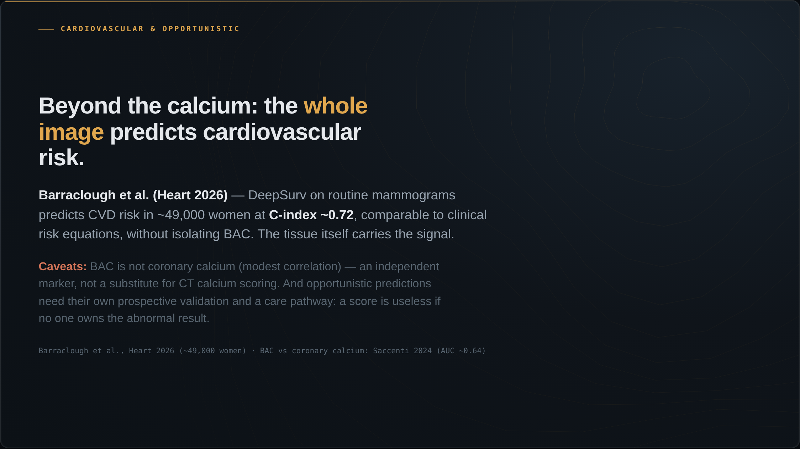
Notes:
And it is not the calcium alone. Barraclough and colleagues, on routine mammograms, predicted cardiovascular risk at a C-index around 0.72 — comparable to established clinical risk equations — without isolating the calcification. The breast tissue itself, not only the calcium, carries the signal. Two honest caveats: BAC is not coronary calcium, the correlation is only modest, so it is an independent risk marker, not a substitute for a CT calcium score. And any opportunistic prediction needs its own prospective validation and a care pathway — a cardiovascular score is useless if no one owns the abnormal result.

Slide 5
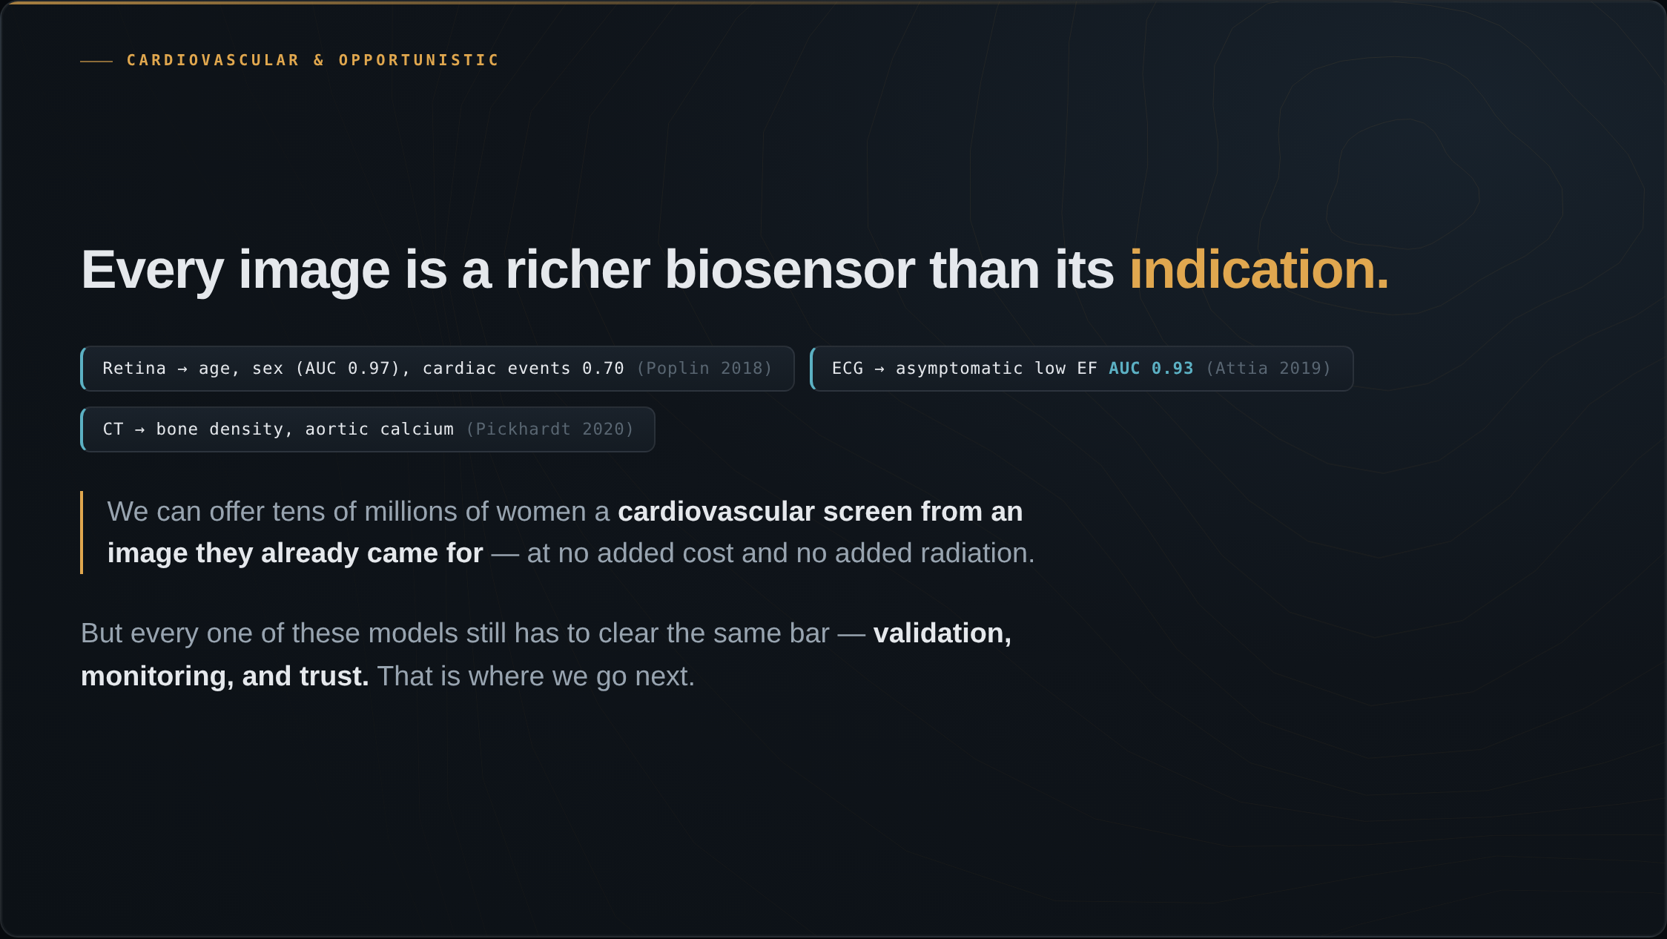
Notes:
And this is not specific to mammography. The same pattern appears across modalities. From a retinal photo, deep learning reads age, sex, blood pressure, and major cardiac events — signals no ophthalmologist reads. A ten-second ECG detects asymptomatic low ejection fraction at an AUC of 0.93. Routine CT yields bone density and aortic calcium. Every medical image is a richer biosensor than the question we ordered it to answer — AI is the first tool that can read the rest of it. We can now offer tens of millions of women a cardiovascular screen from an image they already came for, at no added cost and no added radiation. But every one of these models still has to clear the same bar — validation, monitoring, and trust. That is where we go next.

