Slide 1
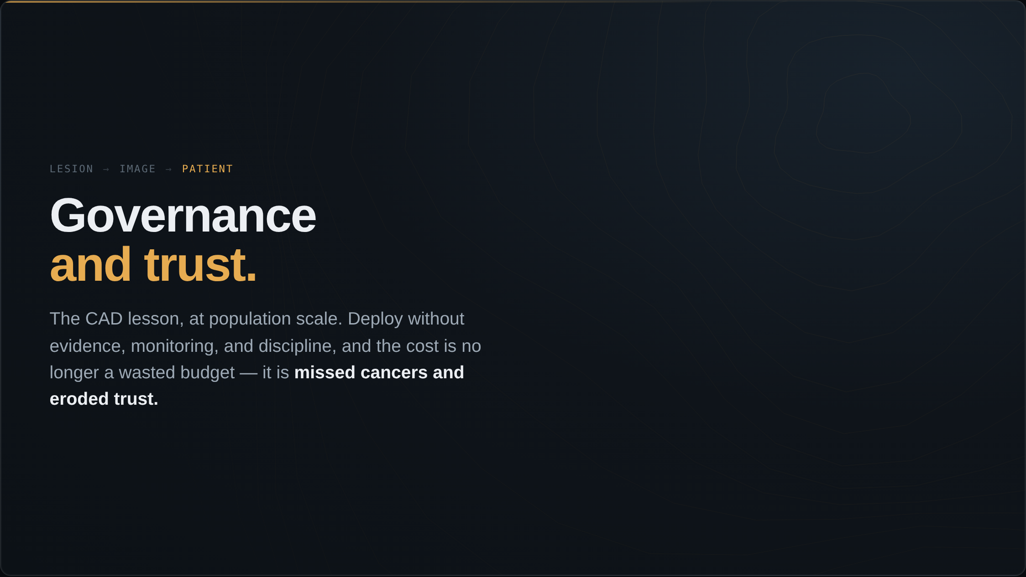
Notes:
I started this talk by noting that this field deployed a technology before it proved it worked, and it cost us twenty years and four hundred million dollars a year. I want to close the future half of the talk with the same point. The next time we make that mistake, the cost will not just be a wasted budget — it will be missed cancers and eroded trust. So this section is about the hard part: governance and trust. What stands between a strong AUC and a tool you can actually rely on.

Slide 2
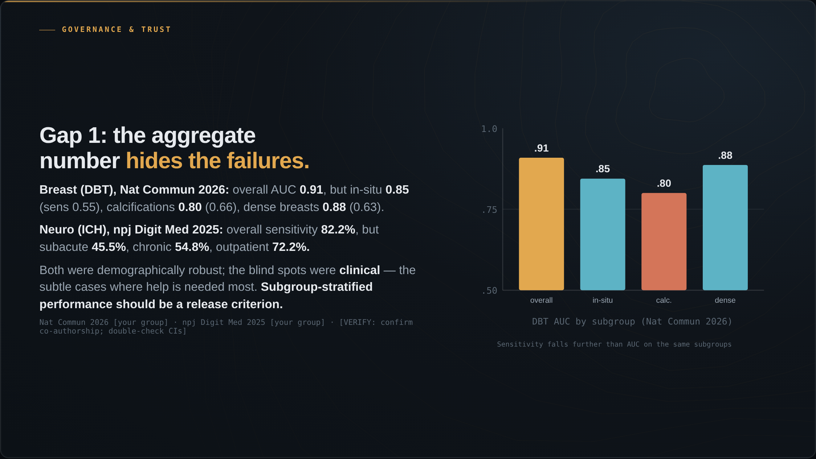
Notes:
Between a strong AUC and a tool you can trust sit two gaps we have not closed. The first is subgroup performance: the aggregate number hides the failures. Our group's audits show this across two domains. In breast tomosynthesis, in Nature Communications this year, the overall AUC was 0.91 — but in-situ disease only 0.85 with sensitivity 0.55, calcifications 0.80 and 0.66, dense breasts 0.88 and 0.63. In intracranial hemorrhage, in npj Digital Medicine last year, overall sensitivity was 82.2 percent — but subacute bleeds 45.5 percent, chronic 54.8, outpatient 72.2. Both models were demographically robust; the blind spots were clinical, on the subtle cases where help is needed most. They are found only by looking. Subgroup-stratified performance should be a release criterion. I should confirm my co-authorship on these papers before I frame them in the first person.

Slide 3
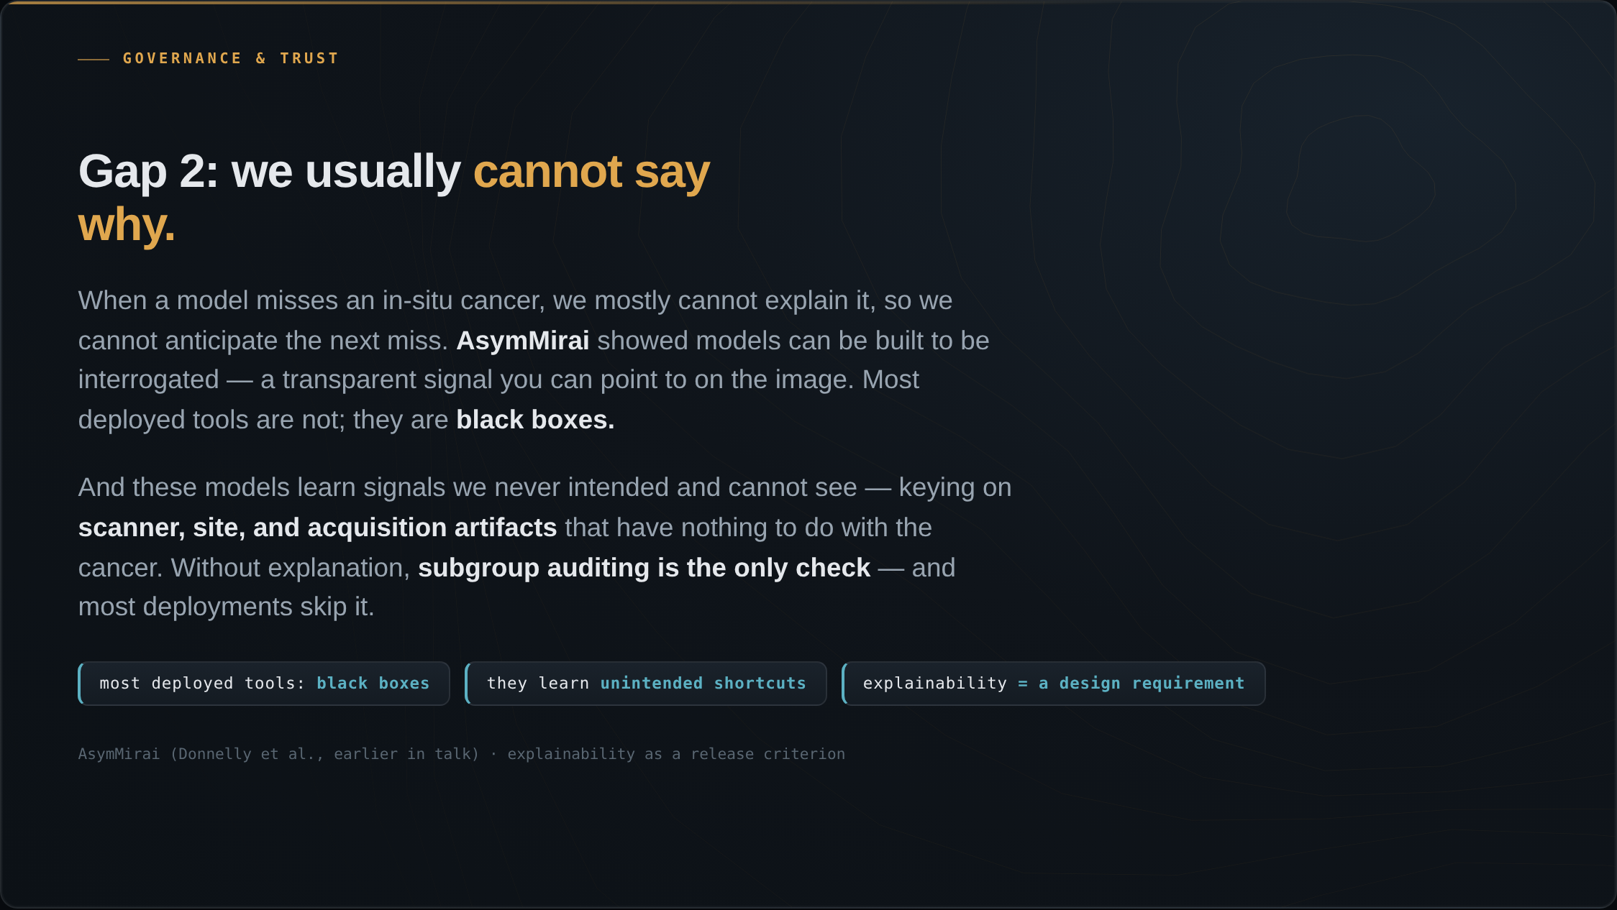
Notes:
The second gap is explainability: we usually cannot say why a model fails. When that tomosynthesis model misses an in-situ cancer, we mostly cannot explain it, so we cannot anticipate the next miss. AsymMirai, from earlier in the talk, showed models can be built to be interrogated — a transparent asymmetry signal you can point to on the image. Most deployed tools are not built that way; they are black boxes. And these models can learn signals we never intended and cannot see — they pick up on scanner, site, and acquisition artifacts that have nothing to do with the cancer. Without explanation, subgroup auditing is the only check available, and most deployments skip it. Explainability should be a design requirement, not an afterthought.

Slide 4
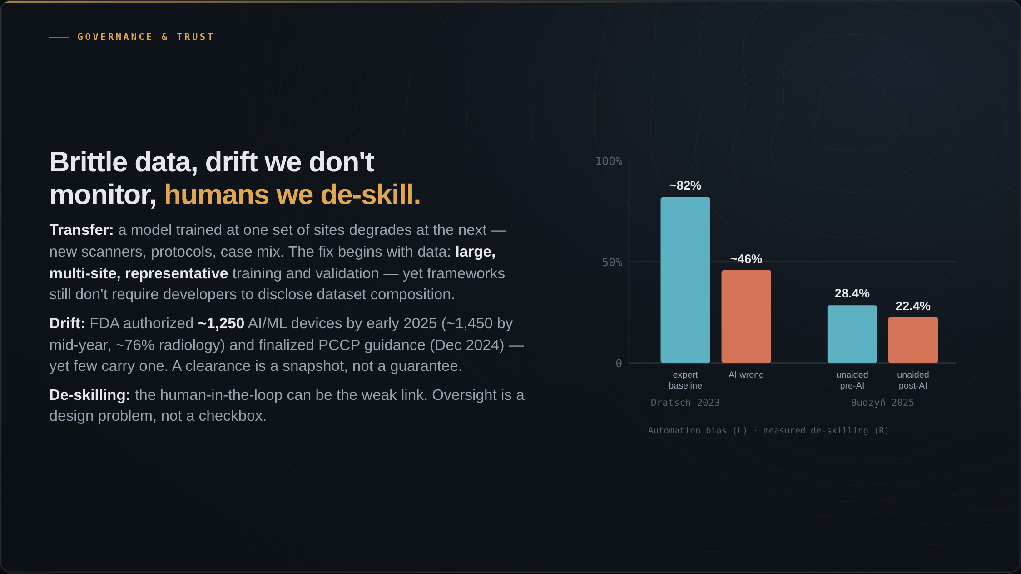
Notes:
Performance also does not transfer cleanly. A model trained at one set of sites degrades at the next — new scanners, new protocols, a different case mix. Models trained on narrow, homogeneous data are brittle. The fix begins with data: training and validation sets need to be large, multi-site, and prospectively representative of where the model will run, and frameworks still do not require developers to disclose dataset composition. Then there is drift we do not monitor. Models are not static — new scanners and protocols, phenotype drift, concept drift all degrade real-world performance. The FDA had authorized about 1,250 AI/ML devices by early 2025, nearing 1,450 by mid-year, about 76 percent of them radiology, and finalized its Predetermined Change Control Plan guidance in December 2024 — yet few cleared devices carry one. A clearance is a snapshot, not a guarantee. And we de-skill the humans meant to be the safeguard. Dratsch and colleagues, in Radiology in 2023, showed that when a sometimes-wrong AI was present and was wrong, even very experienced readers dropped to about 46 percent accuracy, from over 80. Budzyn and colleagues, in Lancet Gastroenterology and Hepatology this year, measured de-skilling directly: after AI was introduced for colonoscopy, endoscopists' unaided detection fell from 28.4 to 22.4 percent. The EU AI Act mandates a human in the loop, but the human can be the weak link. Oversight is a design problem, not a checkbox.

Slide 5
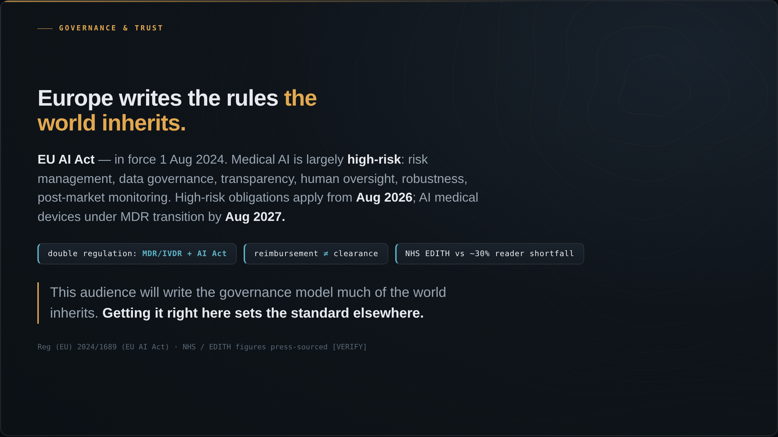
Notes:
Governance: Europe is writing the rules the world inherits. The EU AI Act came into force on the first of August 2024. Medical AI is largely classed high-risk — meaning risk management, data governance, transparency, human oversight, robustness, and post-market monitoring. The high-risk obligations apply from August 2026; AI medical devices under the Medical Device Regulation transition by August 2027. This is the most concrete governance framework relevant to this audience. There is a double-regulation burden: European medical AI must satisfy both the MDR or IVDR and the AI Act, with the compliance cost and the tension with innovation that implies. And reimbursement is not the same as clearance — a cleared model that no one pays for does not reach patients. The US still lacks a dedicated CMS pathway for most diagnostic AI; the NHS is taking a different approach with EDITH against roughly a thirty percent reader shortfall, though those figures are press-sourced. The ownership line, and a bridge toward the close: this audience of European regulators, clinicians, and scientists will write the governance model that much of the rest of the world inherits. Getting it right here sets the standard elsewhere.

Slide 6
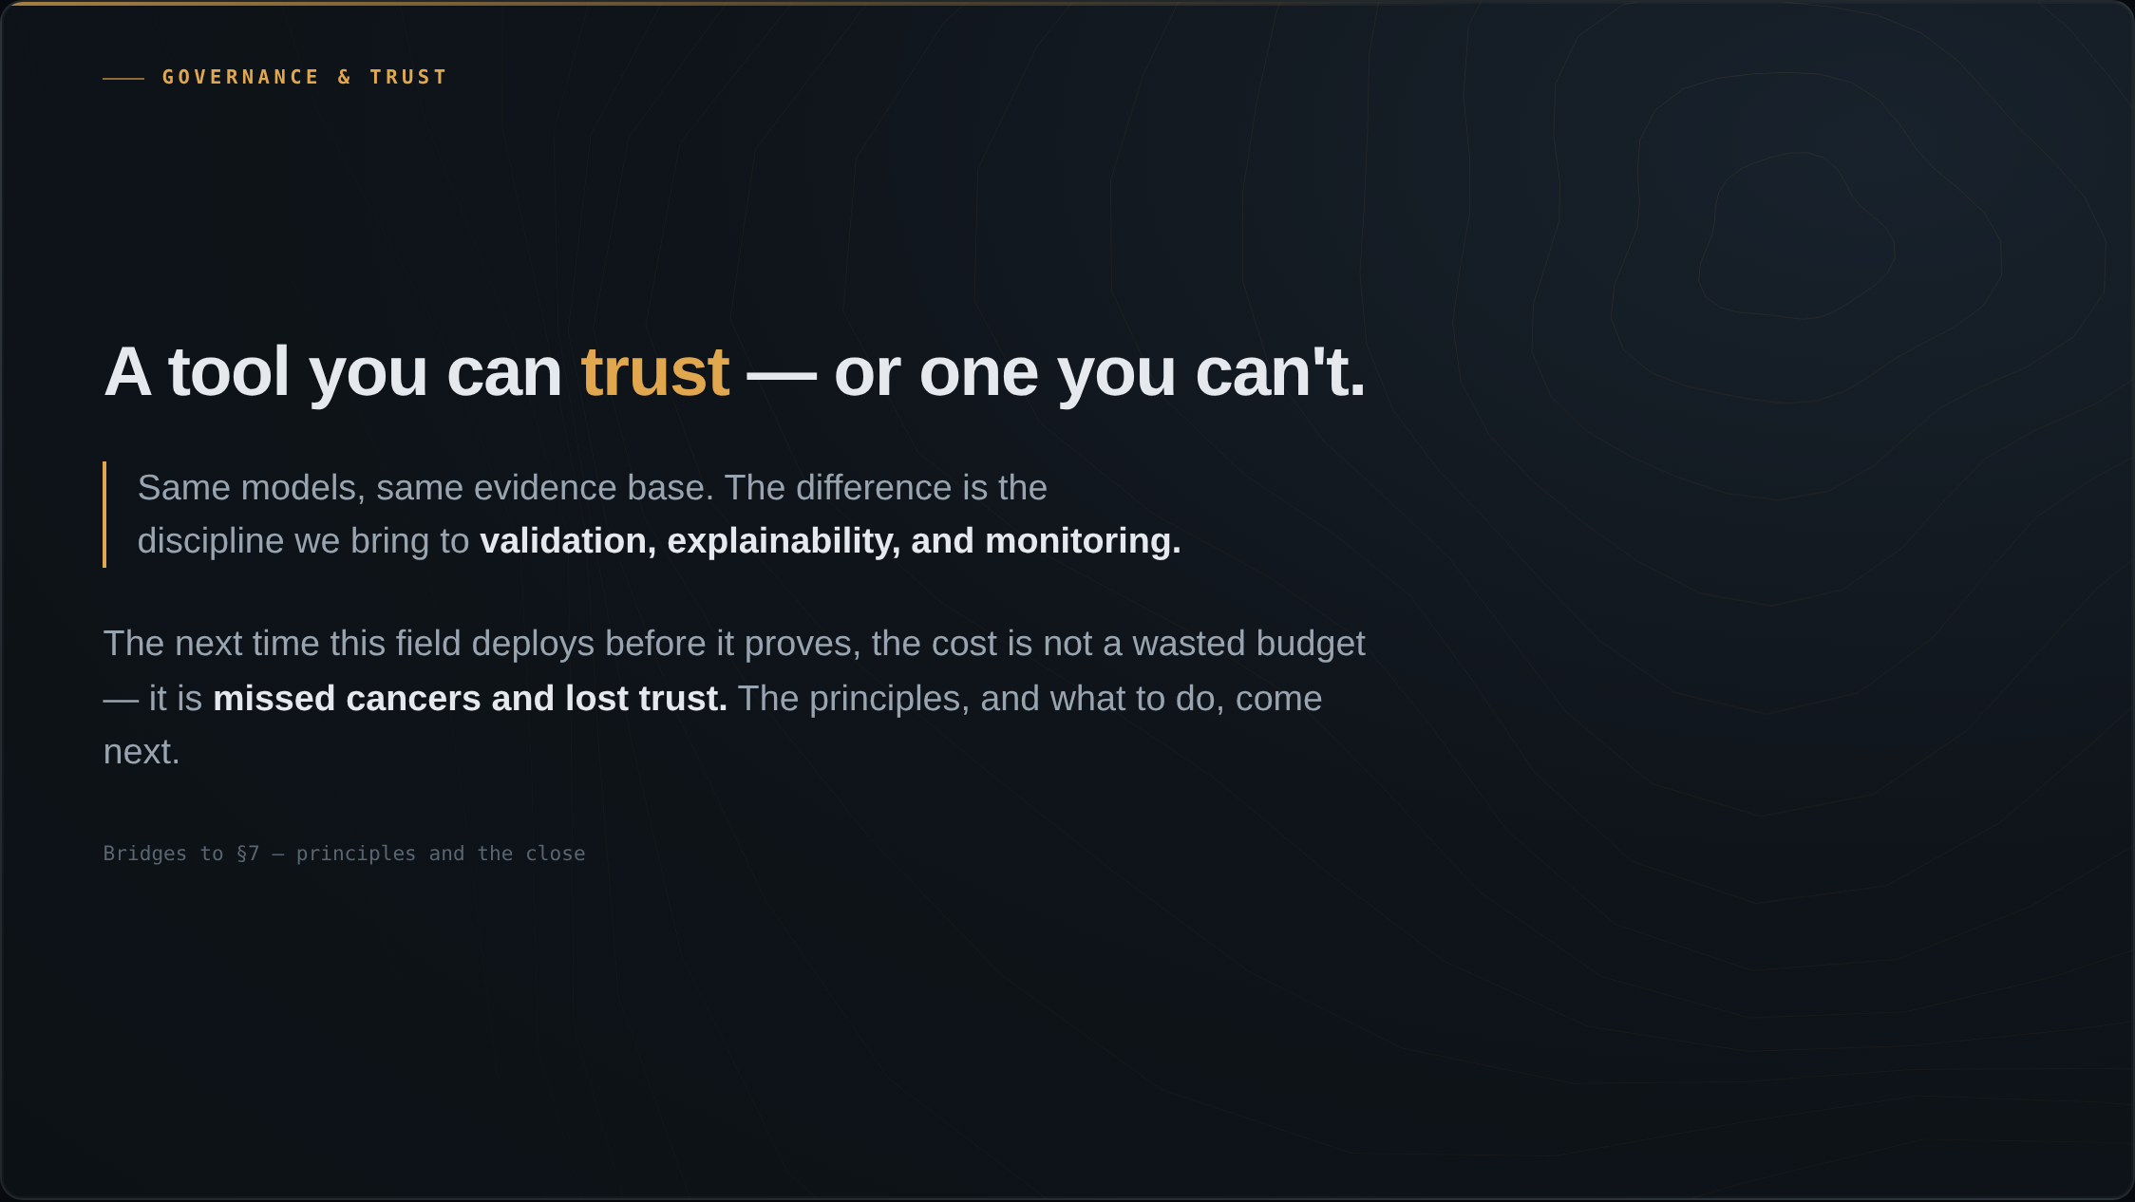
Notes:
So this is the choice, and it is the through-line of the whole section. The same models, the same evidence base, can earn trust or squander it. The difference is entirely in the discipline we bring to validation, explainability, and monitoring. The next time this field deploys before it proves, the cost will not be a wasted budget — it will be missed cancers and lost trust. That brings us to the principles, and to the close.

