Slide 1
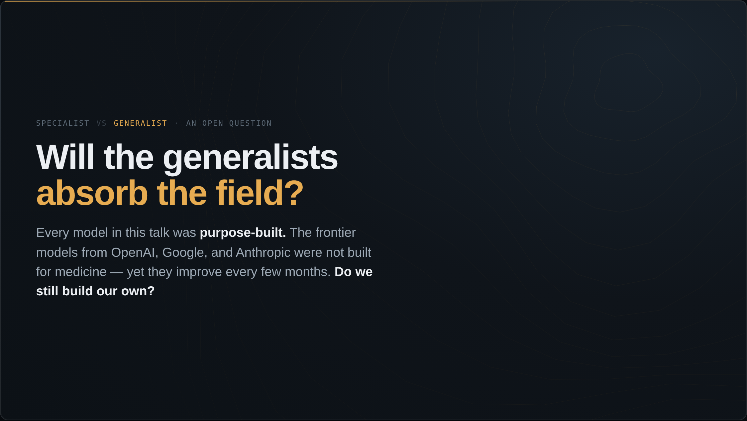
Notes:
I said the outcome is decided by us, not by the technology. One factor will shape who us is. I have shown you a dozen specialist models — Mirai for risk, Transpara for detection, Virchow for tissue, the breast arterial calcium model. Each was built for one job. The general-purpose frontier models from the large labs — GPT, Gemini, Claude — were not built for radiology, yet they improve faster than any medical model, and each generation handles tasks we assumed required a custom build. So the question to end the body of the talk on: in five years, do we still build our own models, or do we ask the general one? And if it is the latter, who owns it?

Slide 2
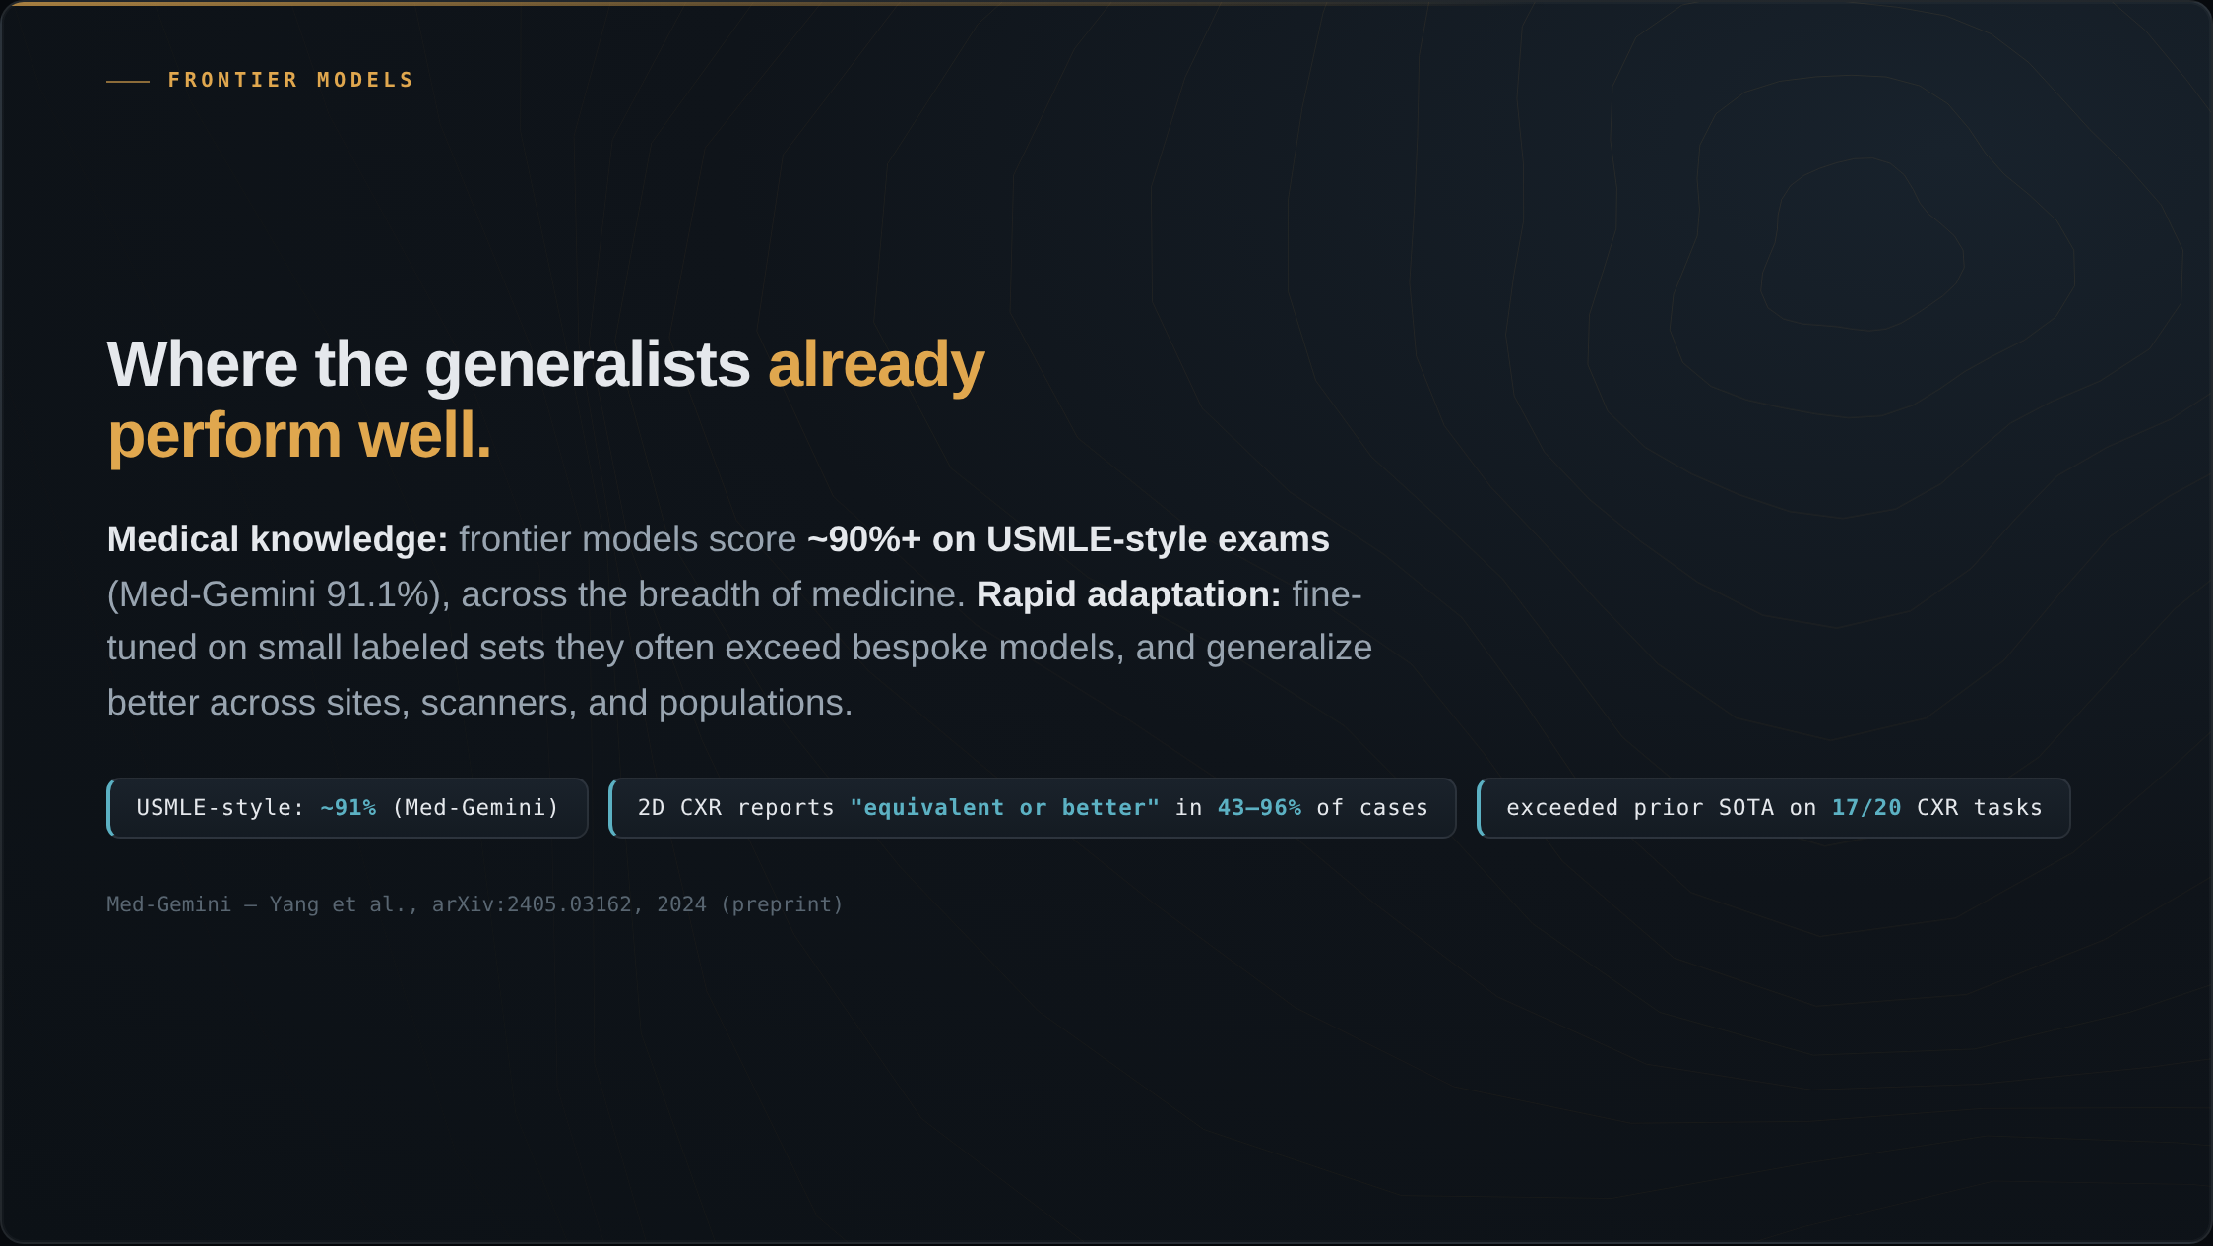
Notes:
Where do the generalists already perform well? On medical knowledge and text reasoning: frontier models score above ninety percent on USMLE-style exams — Med-Gemini at 91.1 — across the breadth of medicine. On report drafting in two dimensions: domain-adapted frontier models do well. Med-Gemini-2D chest-X-ray reports were rated equivalent to or better than the original radiologist's report in 43 to 96 percent of cases, depending on whether the film was abnormal or normal, and exceeded prior state of the art on 17 of 20 chest-X-ray tasks, in Google's 2024 work. And they adapt rapidly: fine-tuned on a small labeled set, foundation models often exceed bespoke task-specific models, and generalize better across sites, scanners, and populations — which is exactly the brittleness problem that limits the narrow models. I'll frame the current generation by trajectory, not by specific unpublished benchmark numbers.

Slide 3
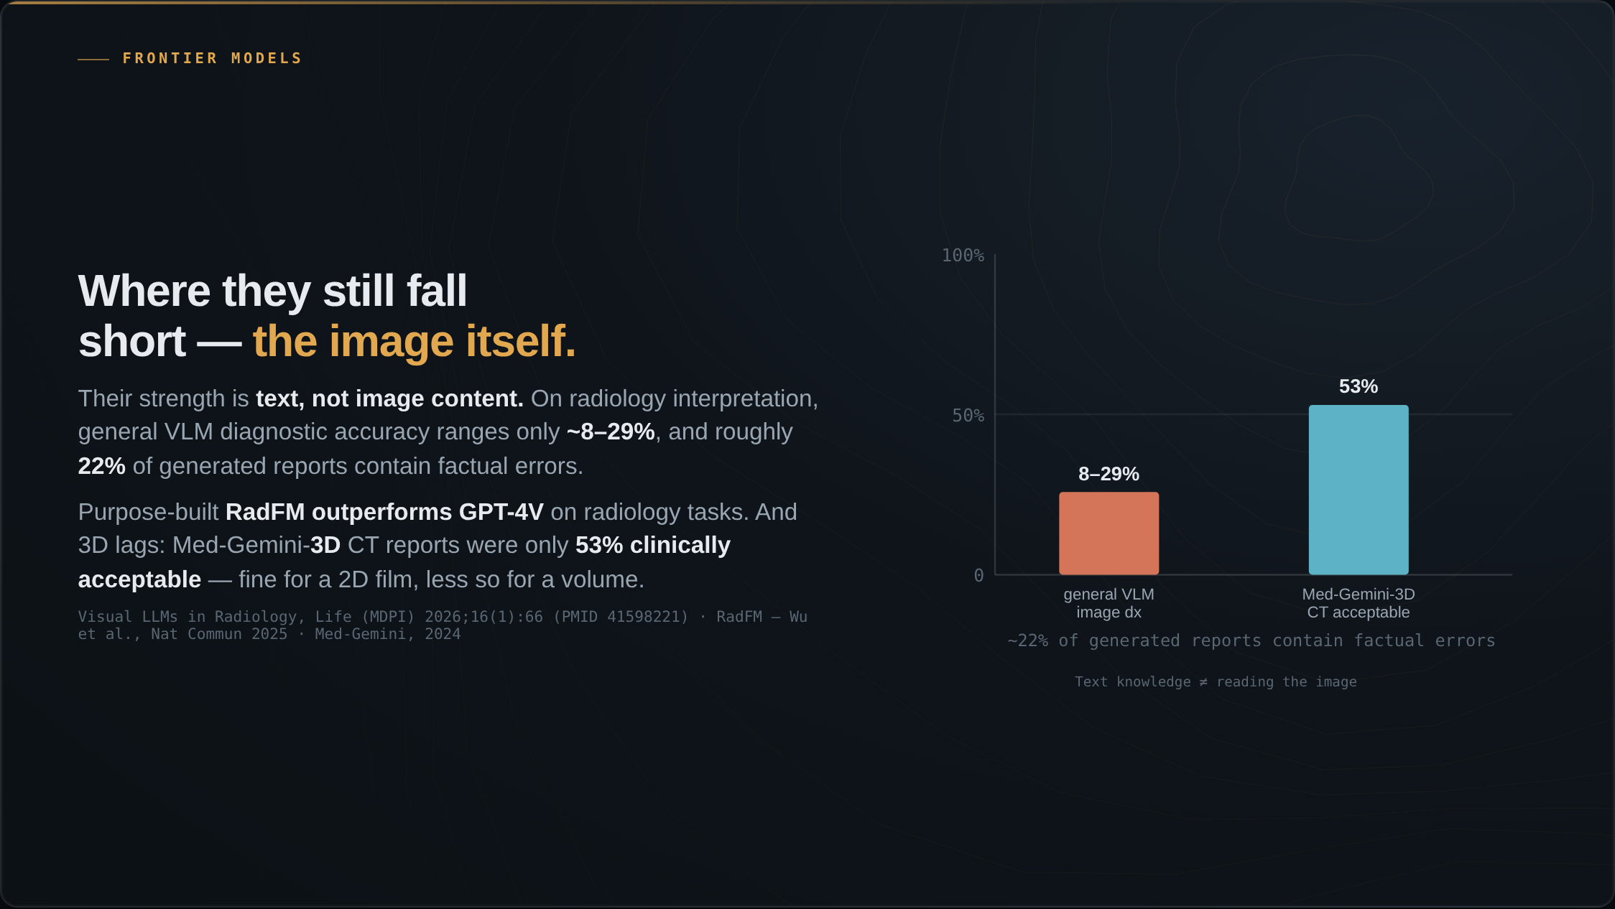
Notes:
Where do they still fall short, for now? Their strength is text, not image content — the general vision-language models' edge comes from text knowledge rather than from actually reading the image. On radiology interpretation, diagnostic accuracy across general vision-language models ranges only about 8 to 29 percent, in a systematic evaluation published in Life this year, and roughly 22 percent of the AI-generated reports contain factual errors or hallucinations. Specialists still perform better on the image itself: the purpose-built RadFM model outperforms GPT-4V on radiology tasks. And three dimensions and localization lag: Med-Gemini-3D CT reports were only 53 percent clinically acceptable — adequate for a 2D chest film, much less so for a CT volume.

Slide 4
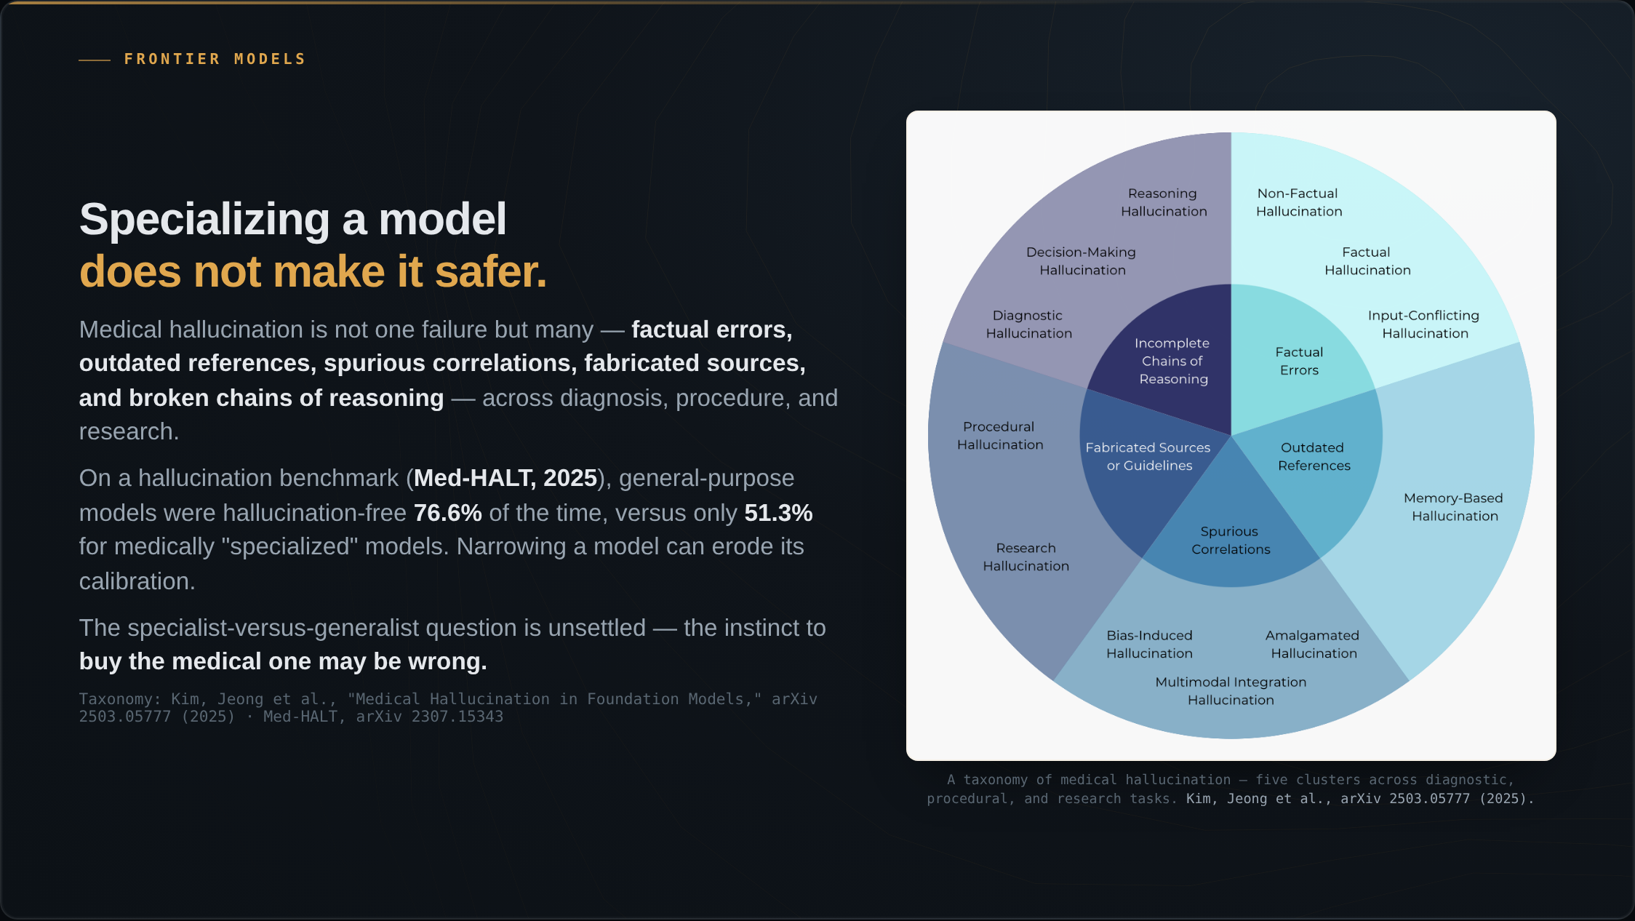
Notes:
And a counterintuitive result that complicates the procurement instinct. First, note that medical hallucination is not a single failure mode — this taxonomy, from Kim, Jeong and colleagues at MIT and Harvard this year, sorts it into five clusters: plain factual errors, outdated references, spurious correlations, fabricated sources or guidelines, and incomplete chains of reasoning — playing out across diagnostic, procedural, and research tasks. Now the counterintuitive part: fine-tuning on medical data does not automatically reduce any of this. On a hallucination benchmark, Med-HALT, in 2025, general-purpose models were hallucination-free 76.6 percent of the time, versus only 51.3 percent for the medically specialized models. Narrowing a model can erode its calibration. So the specialist-versus-generalist question is genuinely unsettled, and the procurement instinct — to buy the medical one — may be wrong.

Slide 5
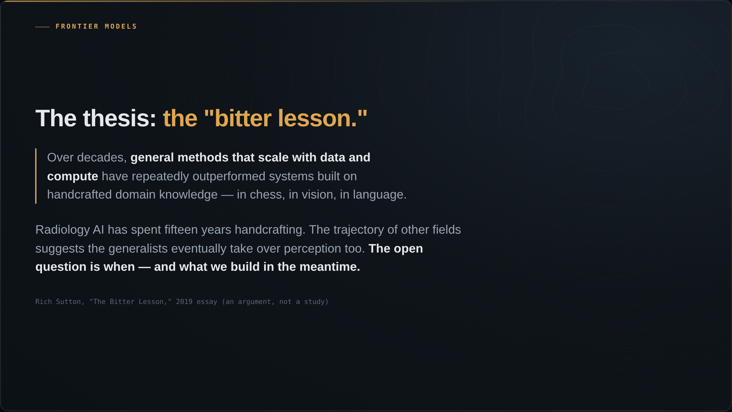
Notes:
Here is the thesis to pose, Rich Sutton's bitter lesson, from his 2019 essay — and I attribute it as an argument, not a study. Sutton argues that over decades, general methods that scale with data and compute have repeatedly outperformed systems built on handcrafted domain knowledge — in chess, in computer vision, in language. Radiology AI has spent fifteen years handcrafting. The trajectory of those other fields suggests the generalists eventually take over perception as well. The open question is when, and what we should build in the meantime.

Slide 6
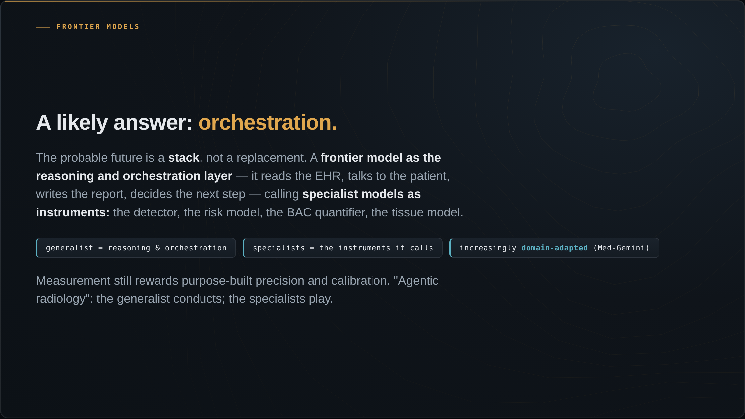
Notes:
A likely answer is orchestration. The probable future is not a generalist simply replacing the specialist. It is a stack: a frontier model as the reasoning and orchestration layer — it reads the EHR, talks to the patient, writes the report, decides the next step — and the specialist models as the instruments it calls: the detector, the risk model, the breast-arterial-calcium quantifier, the tissue model. Because measurement still rewards purpose-built precision and calibration. Call it agentic radiology: the generalist conducts, and the specialists play. And increasingly the generalists are themselves domain-adapted, like Med-Gemini, rather than raw.

Slide 7
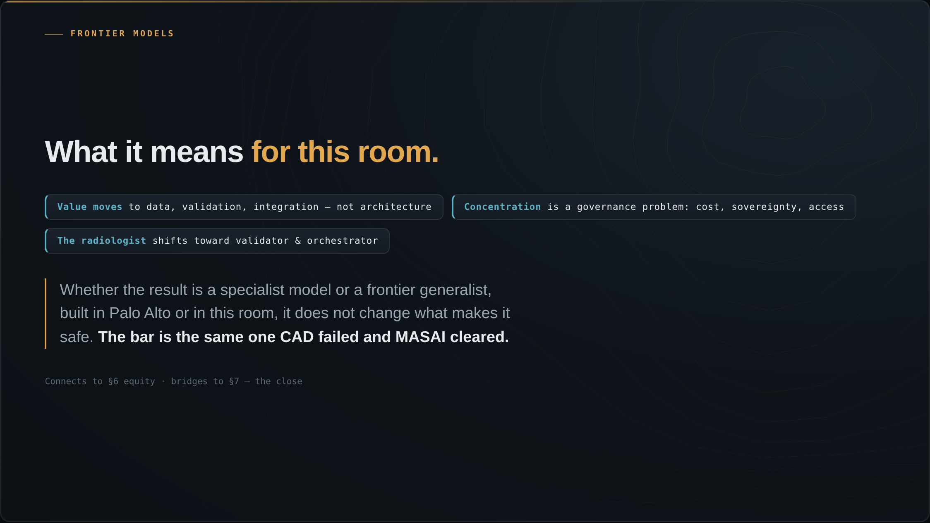
Notes:
So what does this mean for this room? Three things. First, the locus of value moves. If the model becomes a commodity, durable value shifts to what the frontier labs do not have: proprietary, diverse, well-labeled data; rigorous validation; clinical integration; and the care pathway. Compete on data and evidence, not architecture. Second, concentration is a governance problem. A handful of US tech companies controlling the frontier raises issues of cost, dependence, data sovereignty, and access — particularly for Europe and for low- and middle-income countries, which connects back to the equity argument. Who owns the intelligence that reads the world's mammograms? Third, the radiologist's role shifts, from primary detector toward validator, orchestrator, and the source of clinical context and accountability the model cannot supply. And the bridge to the close: whether the result is a specialist model or a frontier generalist, built in Palo Alto or in this room, it does not change what makes it safe. The bar is the same one CAD failed and MASAI cleared.

