Slide 1
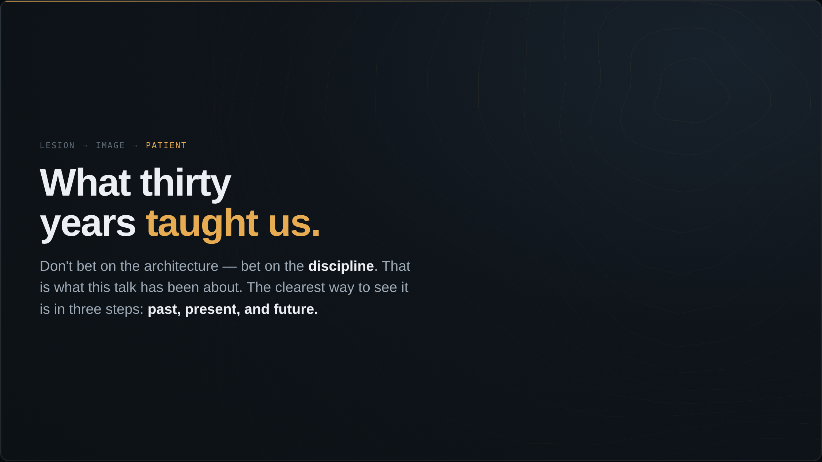
Notes:
I ended the last section on a question — generalist or specialist, the big technology companies or this room — and I answered it by saying: do not bet on the architecture, bet on the discipline. Let me say what that discipline is, because it is what this whole talk has been about. And the simplest way to see it is to look at where we have been, in three steps: the past, the present, and the future.

Slide 2
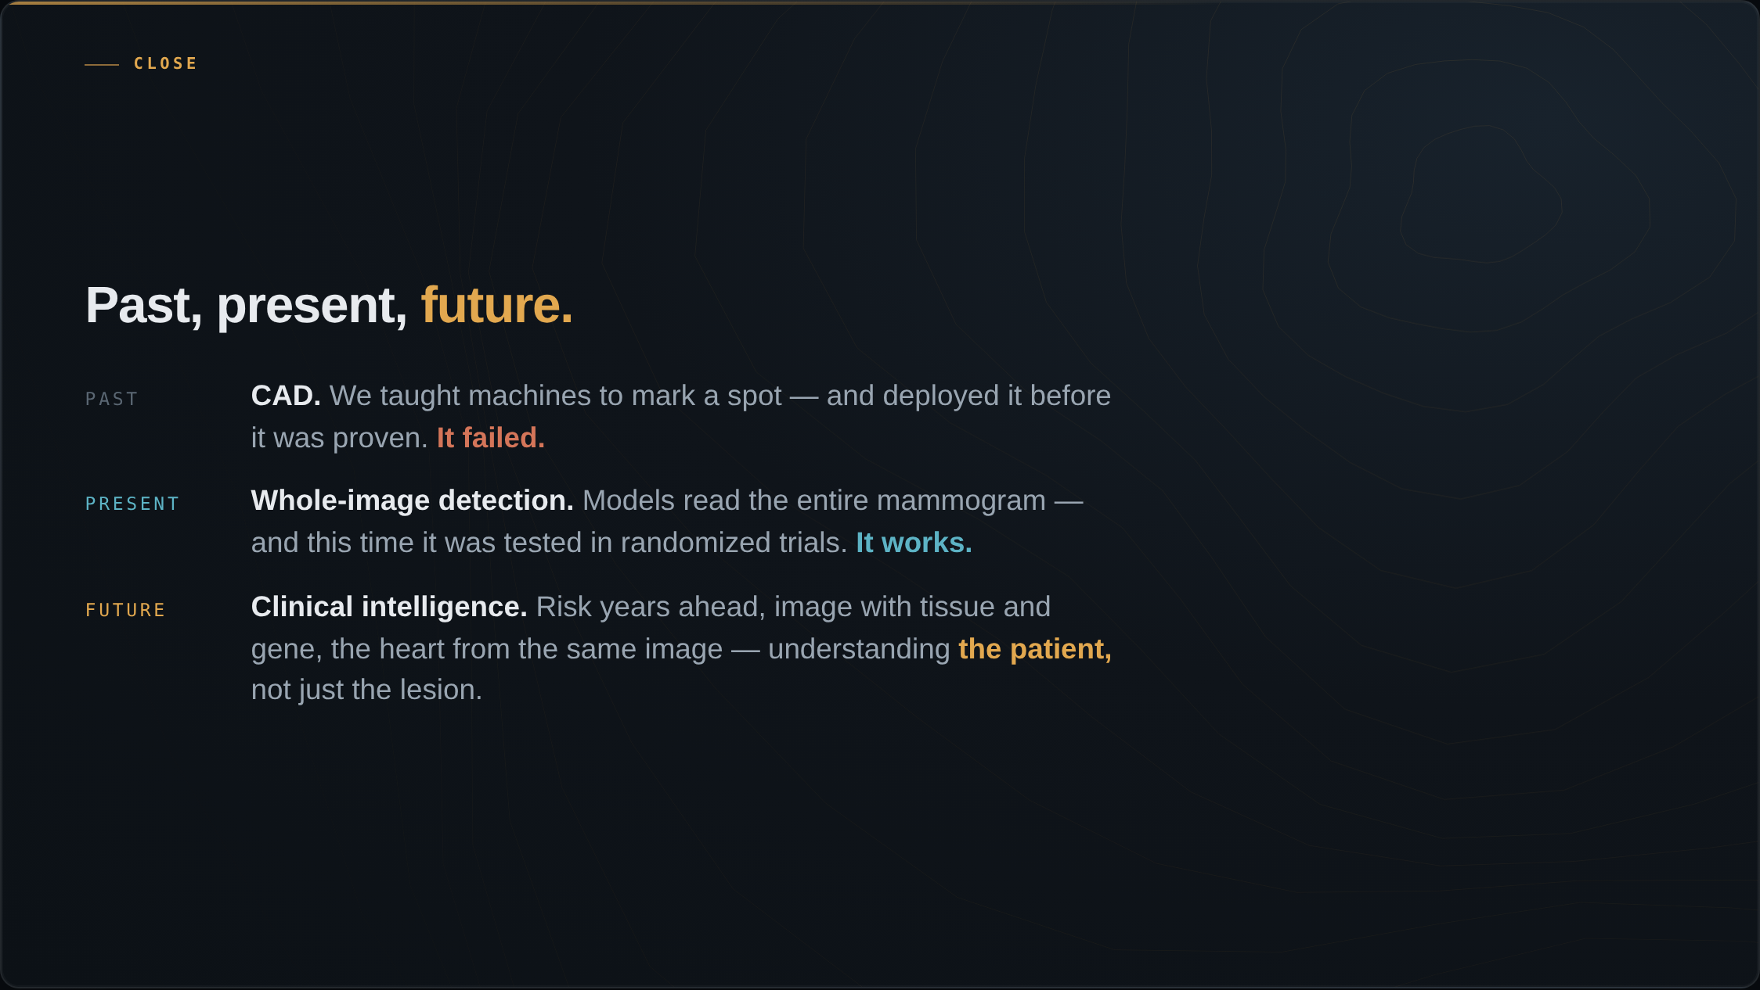
Notes:
Look at the arc in three steps. The past was CAD. We taught machines to find the spot and draw the circle, we deployed it across the country before we had proven it worked, and it failed — about twenty years and hundreds of millions of dollars a year, with no benefit and arguably some harm. The present is whole-image detection. Instead of marking a spot, the models read the entire mammogram, and this time it was tested in large randomized and prospective trials — MASAI, PRAIM — and it works. The future is clinical intelligence. Reading risk years ahead, combining the image with tissue, gene, and history, and reading the heart from the same mammogram. We are learning to understand the patient, not just the lesion.

Slide 3
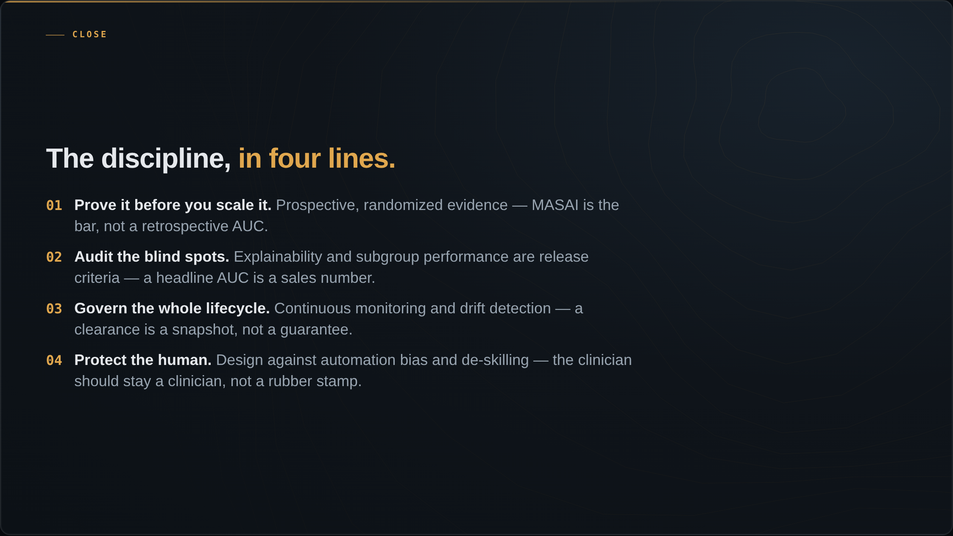
Notes:
CAD did not fail because the math was bad. It failed for a lack of evidence, monitoring, and discipline. That is the through-line from the first slide to this one. So if you take one thing away, take the discipline that turns clinical intelligence into better outcomes. First: prove it before you scale it — prospective, randomized evidence; MASAI is the bar, not a retrospective AUC, and this time we have it. Second: audit the blind spots — explainability and subgroup performance are release criteria, not afterthoughts; a headline AUC is a sales number. Third: govern the whole lifecycle — continuous monitoring and drift detection; a clearance is a snapshot, not a guarantee. Fourth: protect the human — design against automation bias and de-skilling; the clinician should stay a clinician, not a rubber stamp.

Slide 4
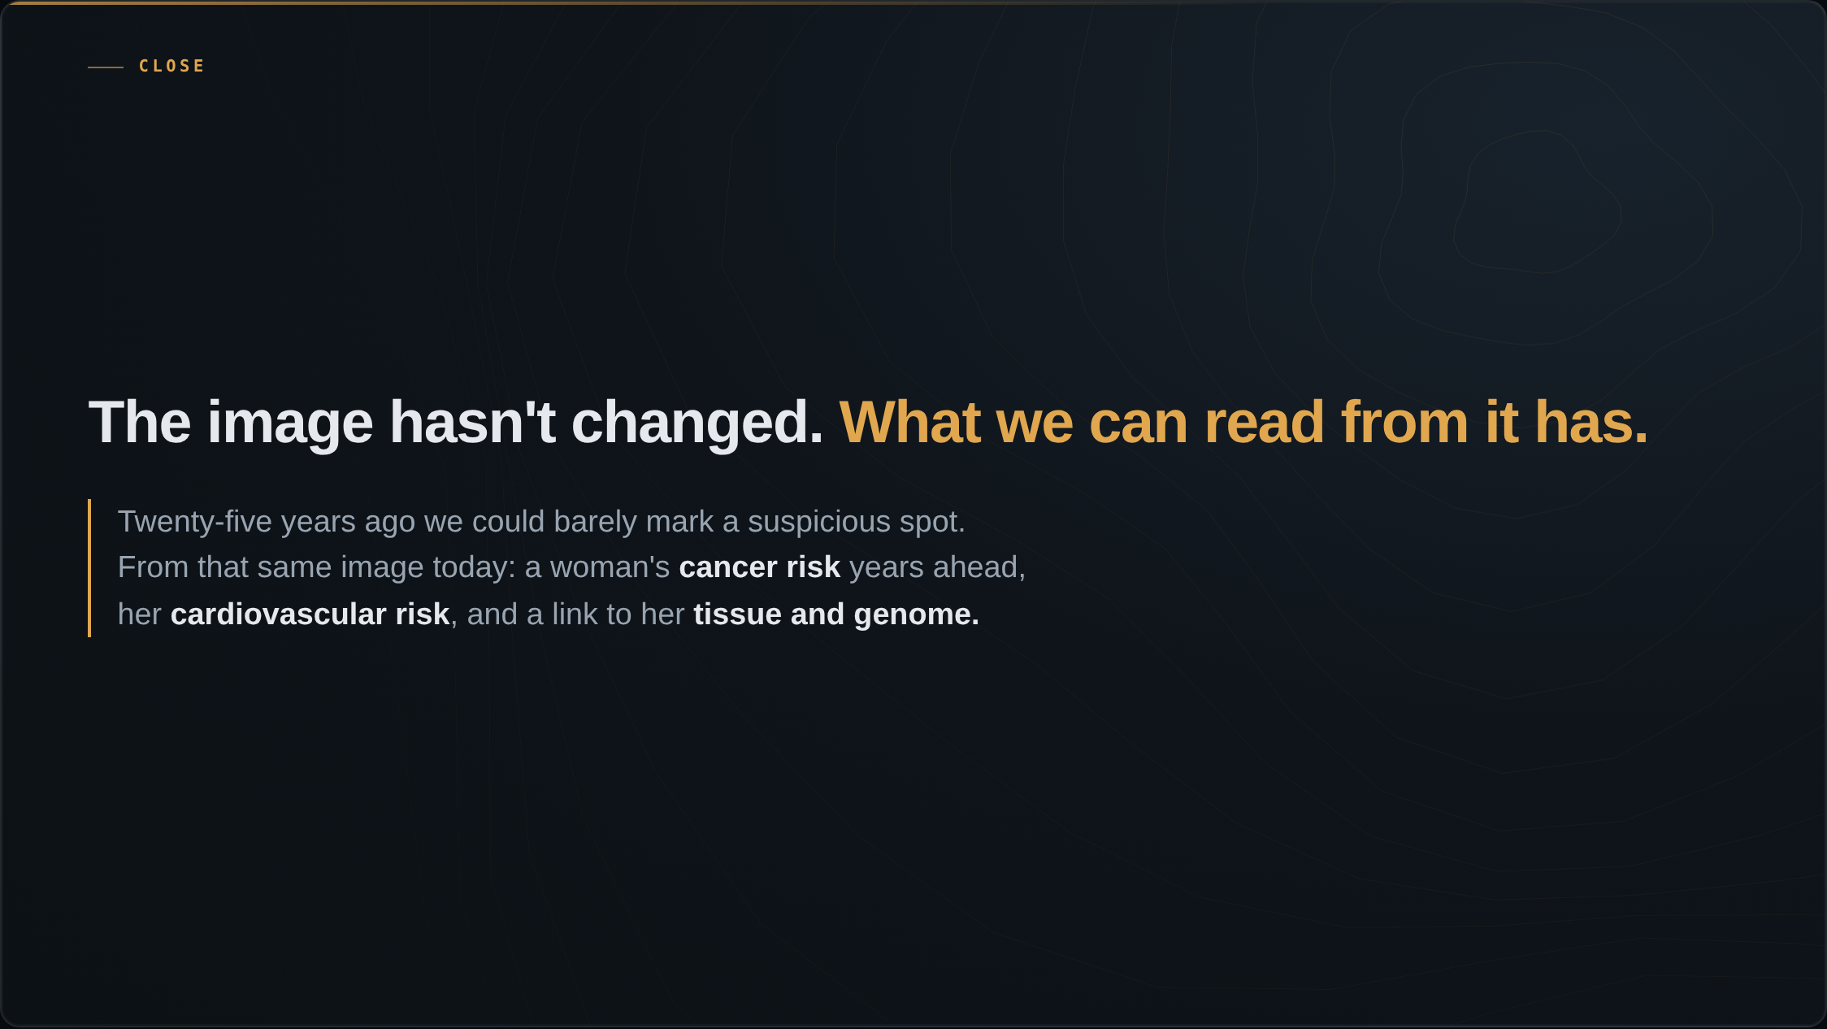
Notes:
Recall the normal mammogram we opened with — the one I said was full of hidden signals. The image has not changed. What we can read from it has. Twenty-five years ago we could barely mark a suspicious spot. Today, from that same image, we can forecast a woman's cancer years ahead, flag her cardiovascular risk, and connect it to her tissue and her genome.

Slide 5
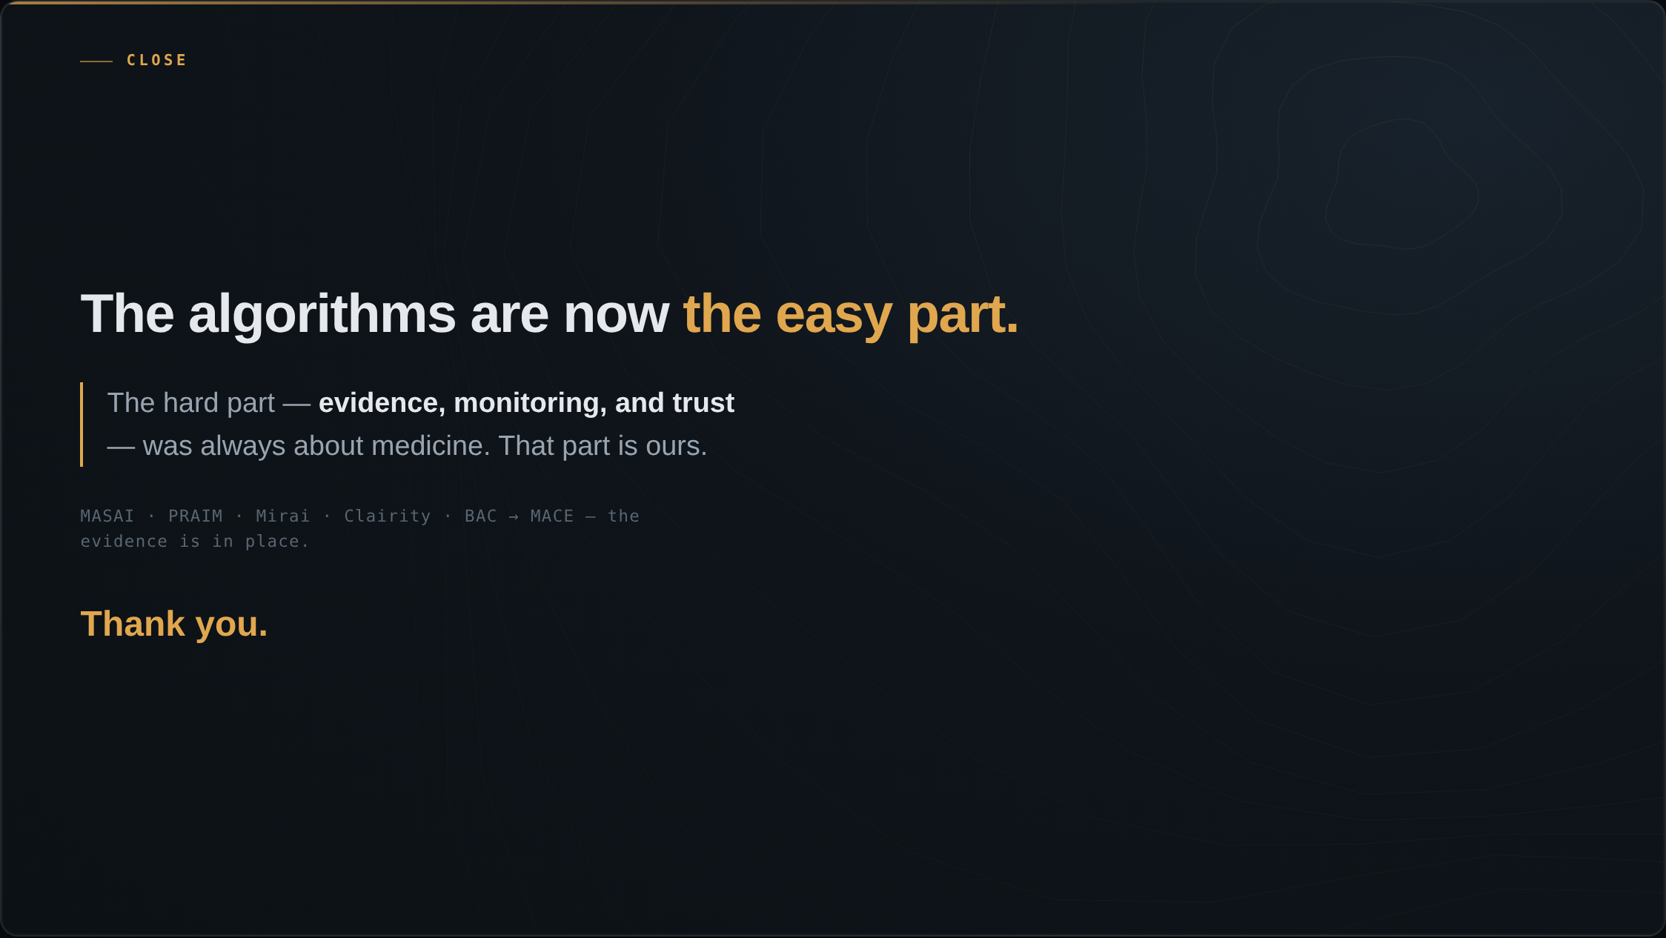
Notes:
Twenty-five years ago we paid for a tool before we proved it worked. Today we have the proof — and a single mammogram that can forecast a woman's cancer, flag her heart disease, and connect to her pathology and her genome. The algorithms are now the easy part. The hard part — evidence, monitoring, and trust — is the part that was always about medicine. That part is ours. Thank you.

