Slide 1
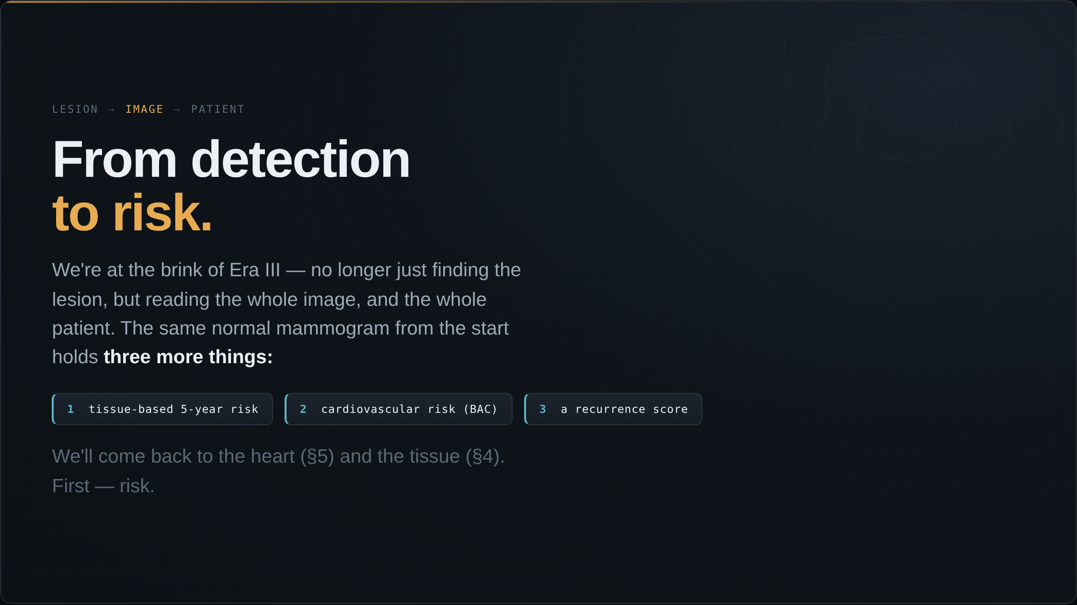
Notes:
We are now at the brink of Era III. Instead of looking for lesions, we start reading the whole image — and even the whole patient. Here is the normal mammogram I showed you at the start. Three more things come out of this one image: a tissue-based estimate of her breast-cancer risk, a cardiovascular signal from breast arterial calcification, and a recurrence score from her tissue. We will get to the heart and the tissue later. First, let's talk about risk.

Slide 2
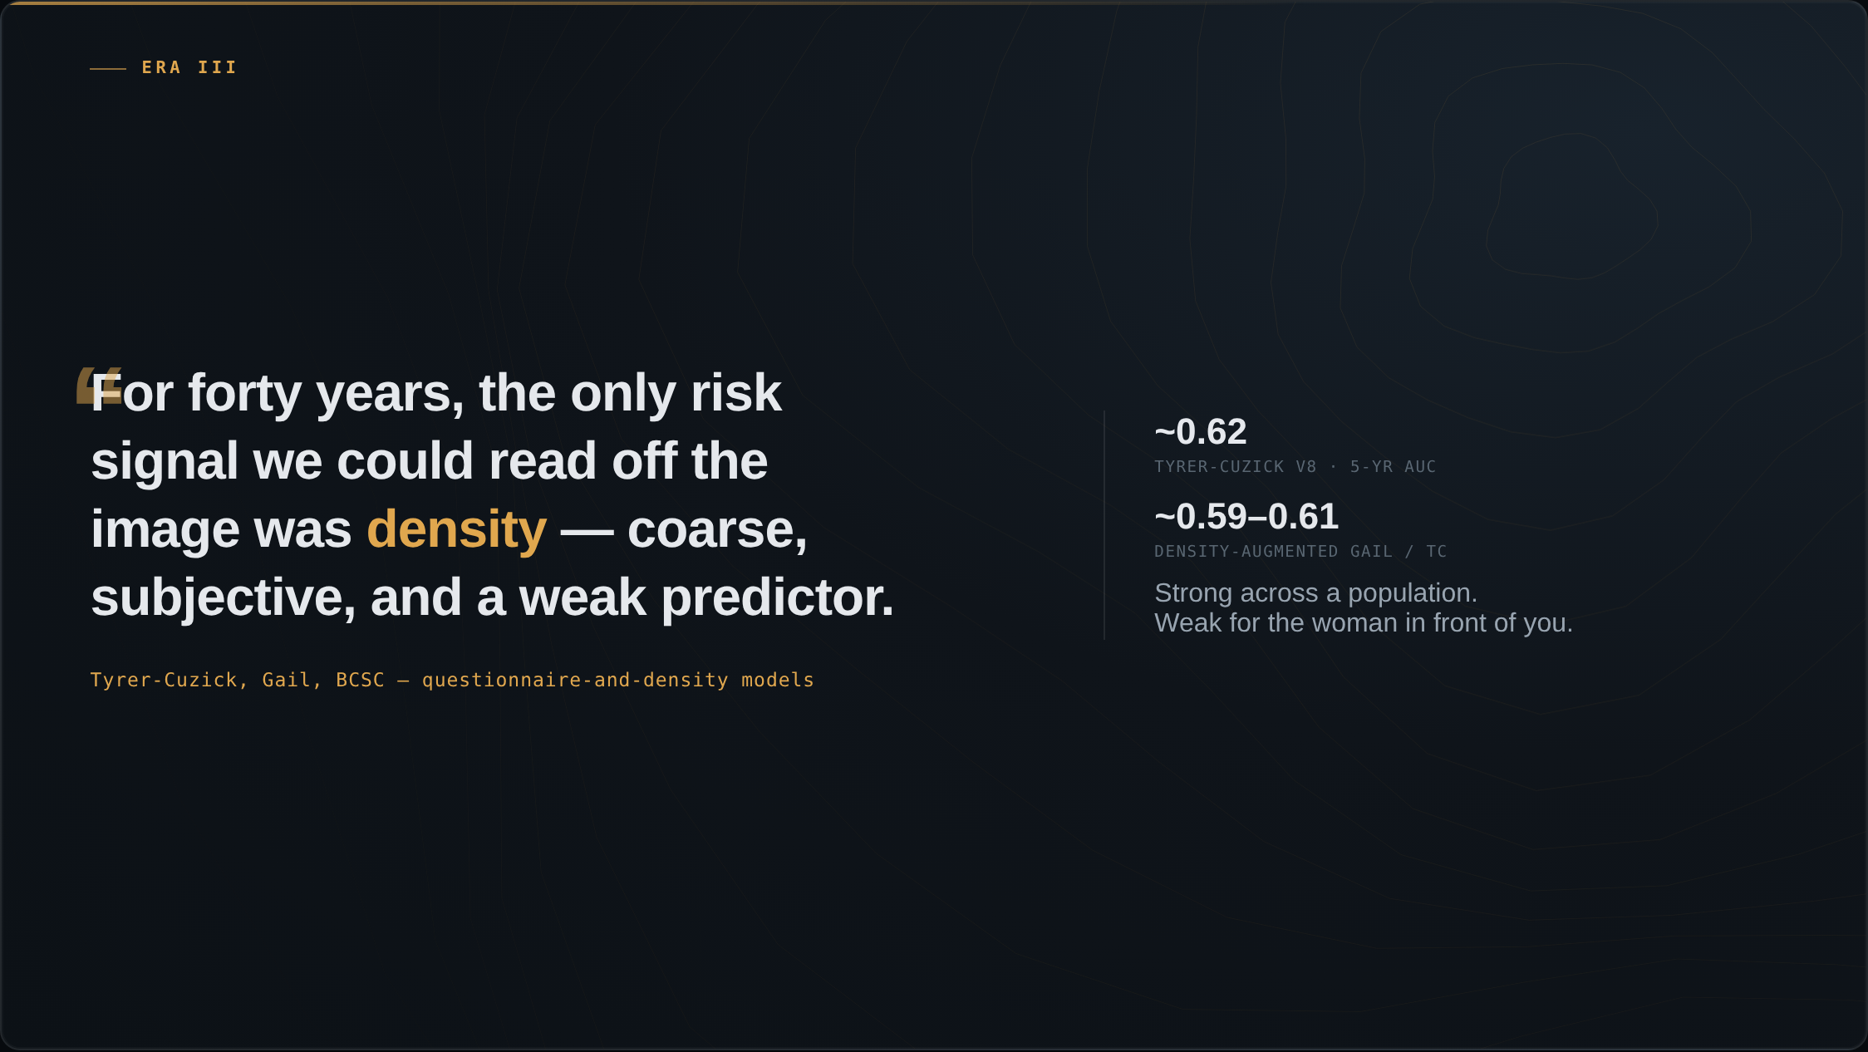
Notes:
For forty years the only risk signal we could read off the image was breast density — coarse and subjective. The questionnaire models we layered on top were weak: Tyrer-Cuzick predicts five-year risk at an AUC around 0.62, barely better than chance at the level of the individual.

Slide 3
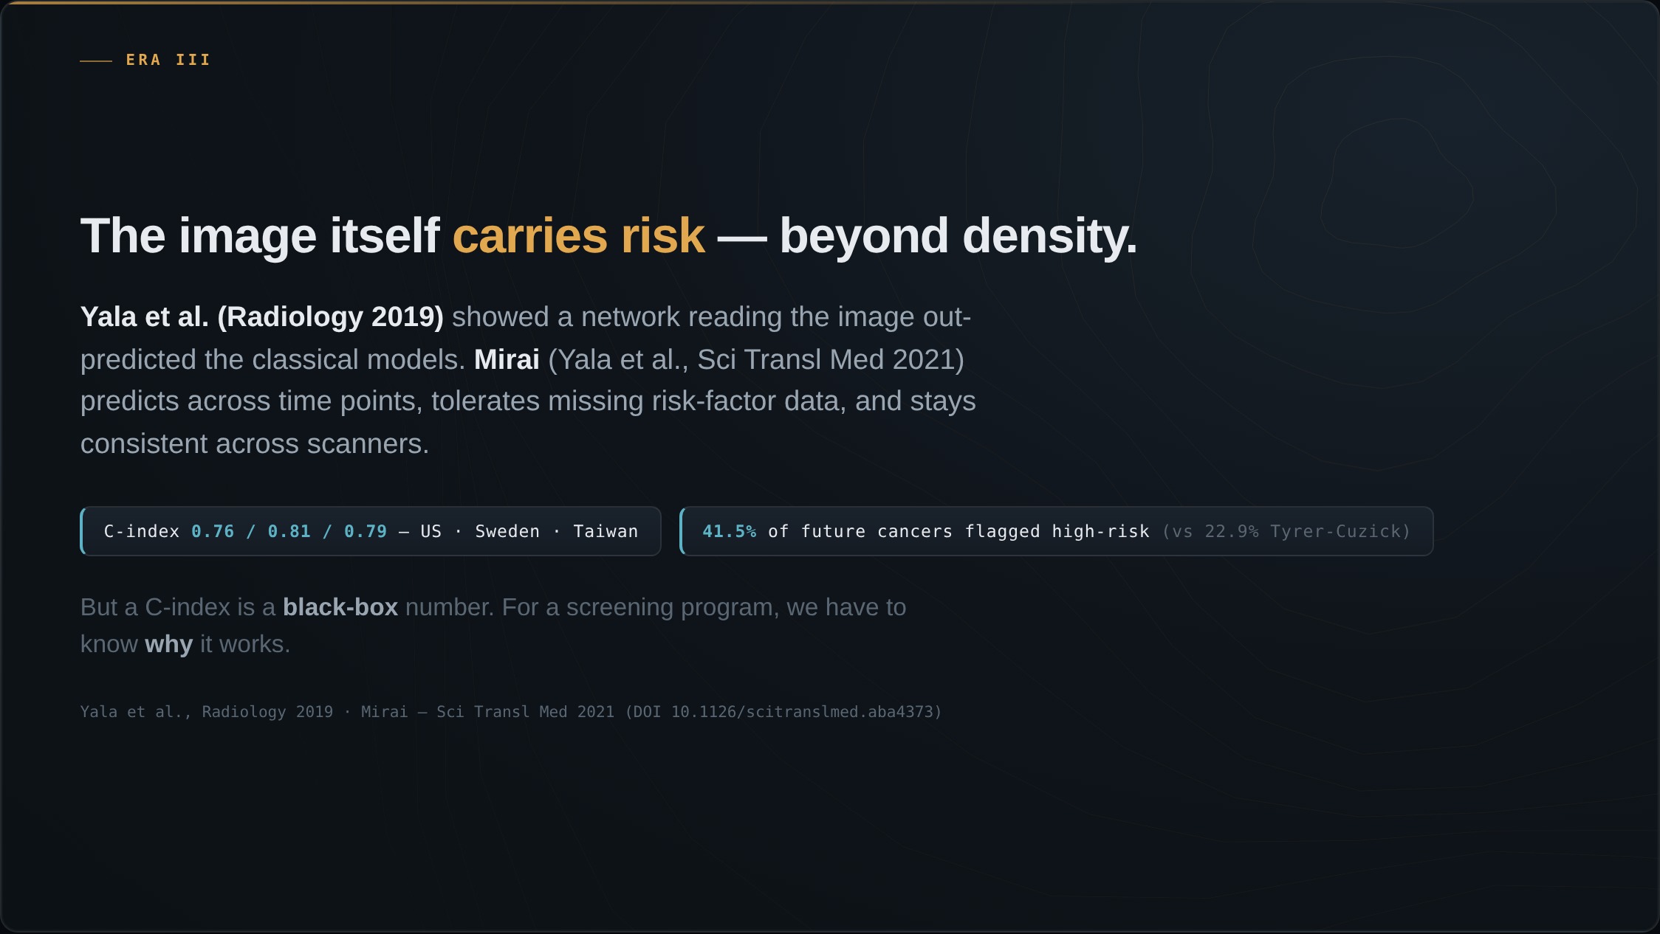
Notes:
Then the image itself turned out to carry risk. Yala and colleagues at MIT and MGH showed a deep network reading the mammogram out-predicted the questionnaire models. Mirai, the next version, was built to predict across time, tolerate missing risk-factor data, and stay consistent across machines. Externally validated in three countries, C-index 0.76 to 0.81. Among women who developed cancer within five years, Mirai flagged 41.5 percent as high-risk, versus 22.9 percent for Tyrer-Cuzick.

Slide 4
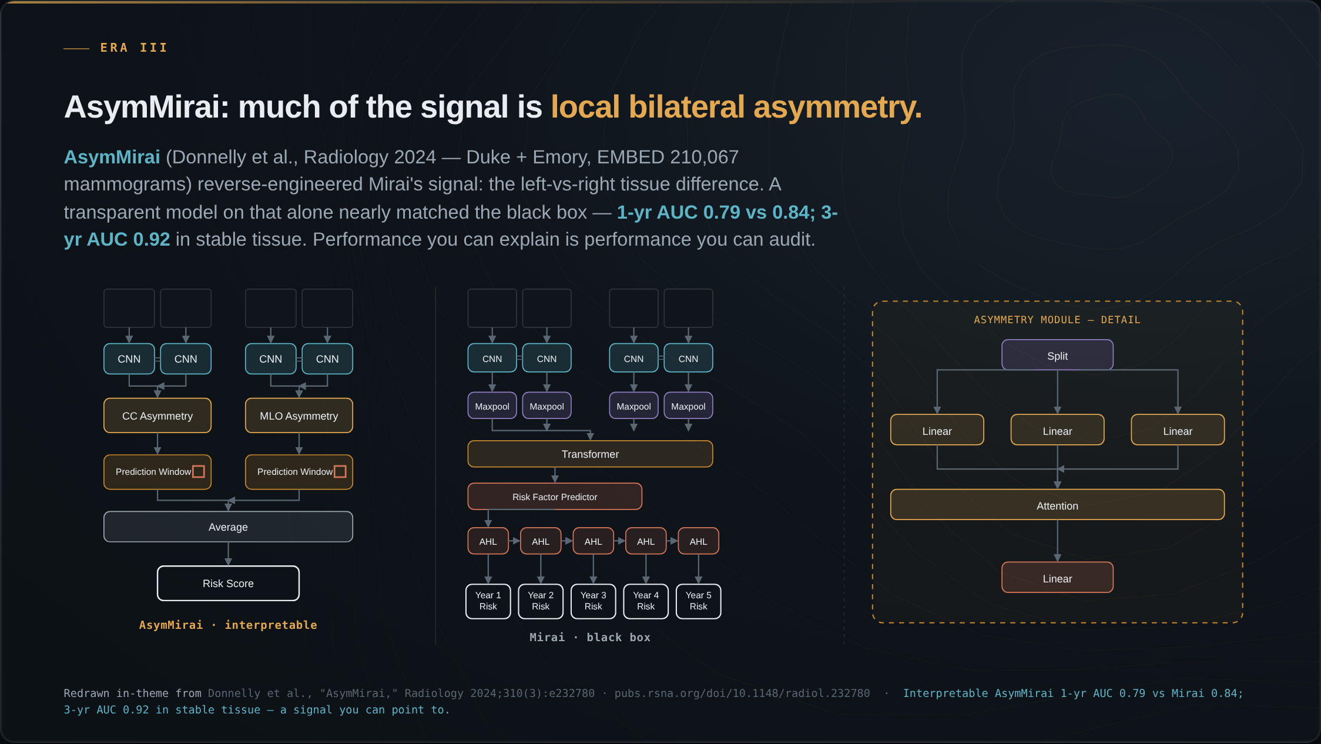
Notes:
Here is explainability done right, and it is our group's work with Duke. We asked what Mirai was actually keying on. The answer was surprisingly simple: local bilateral dissimilarity — the difference between left and right breast tissue in the same region. A transparent model built only on that asymmetry nearly matched the black box: one-year AUC 0.79 versus 0.84, and in stable-tissue subgroups three-year AUC 0.92. A risk signal you can point to on the image, and audit for where it fails.

Slide 5
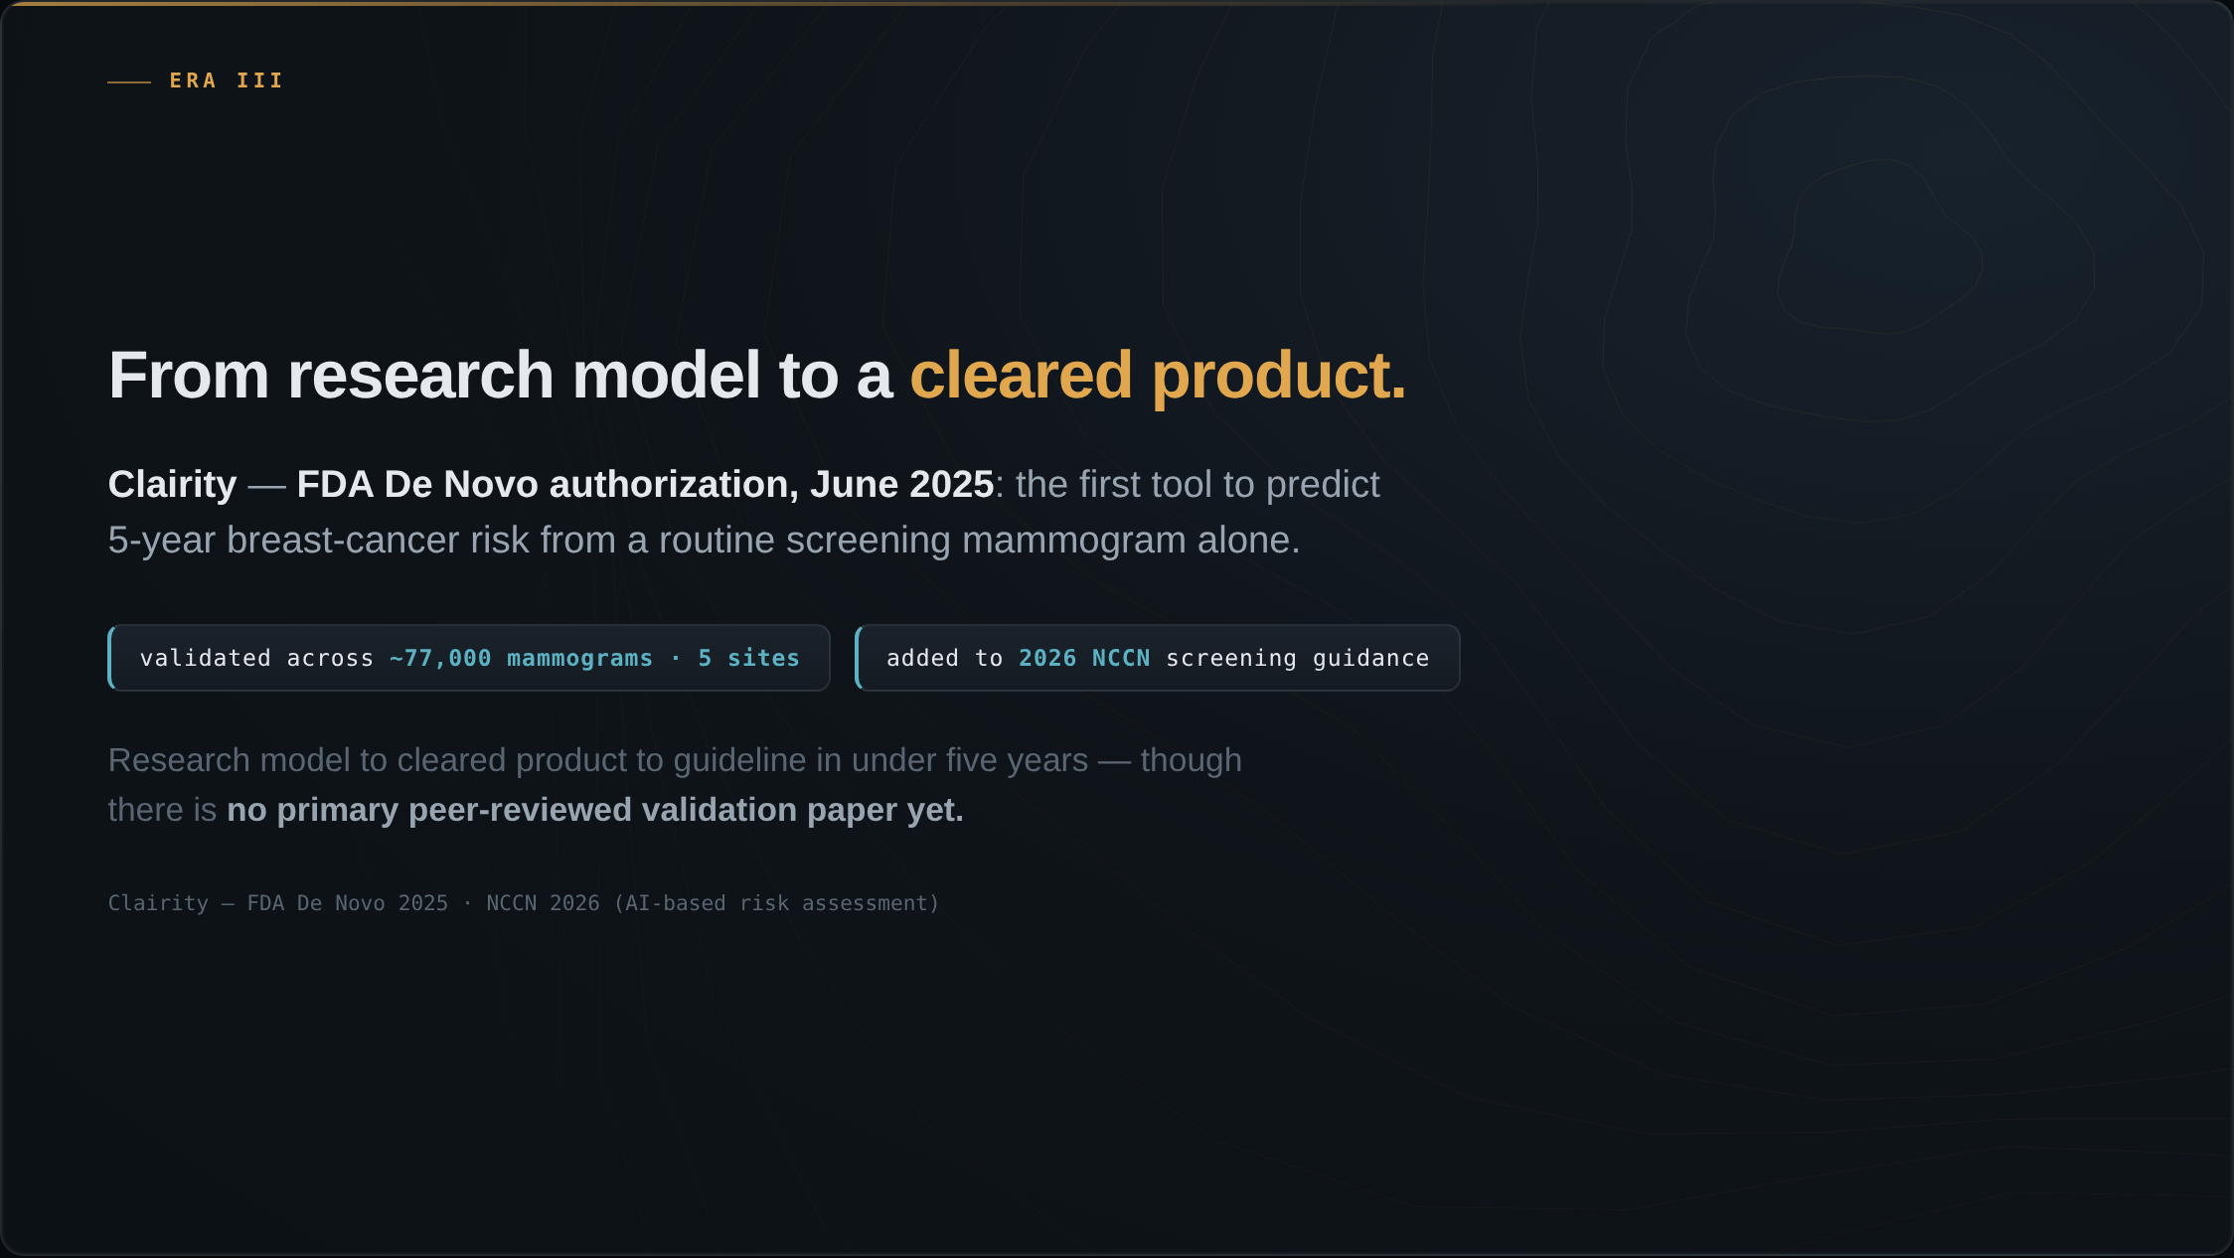
Notes:
And this is no longer research. In June 2025, Clairity received FDA De Novo authorization — the first tool to predict five-year breast-cancer risk from a routine screening mammogram alone, validated across about 77,000 mammograms from five sites, and it was added to the 2026 NCCN screening guidance. The path from research model to cleared product to guideline took under five years. There is not yet a primary peer-reviewed validation paper.

Slide 6
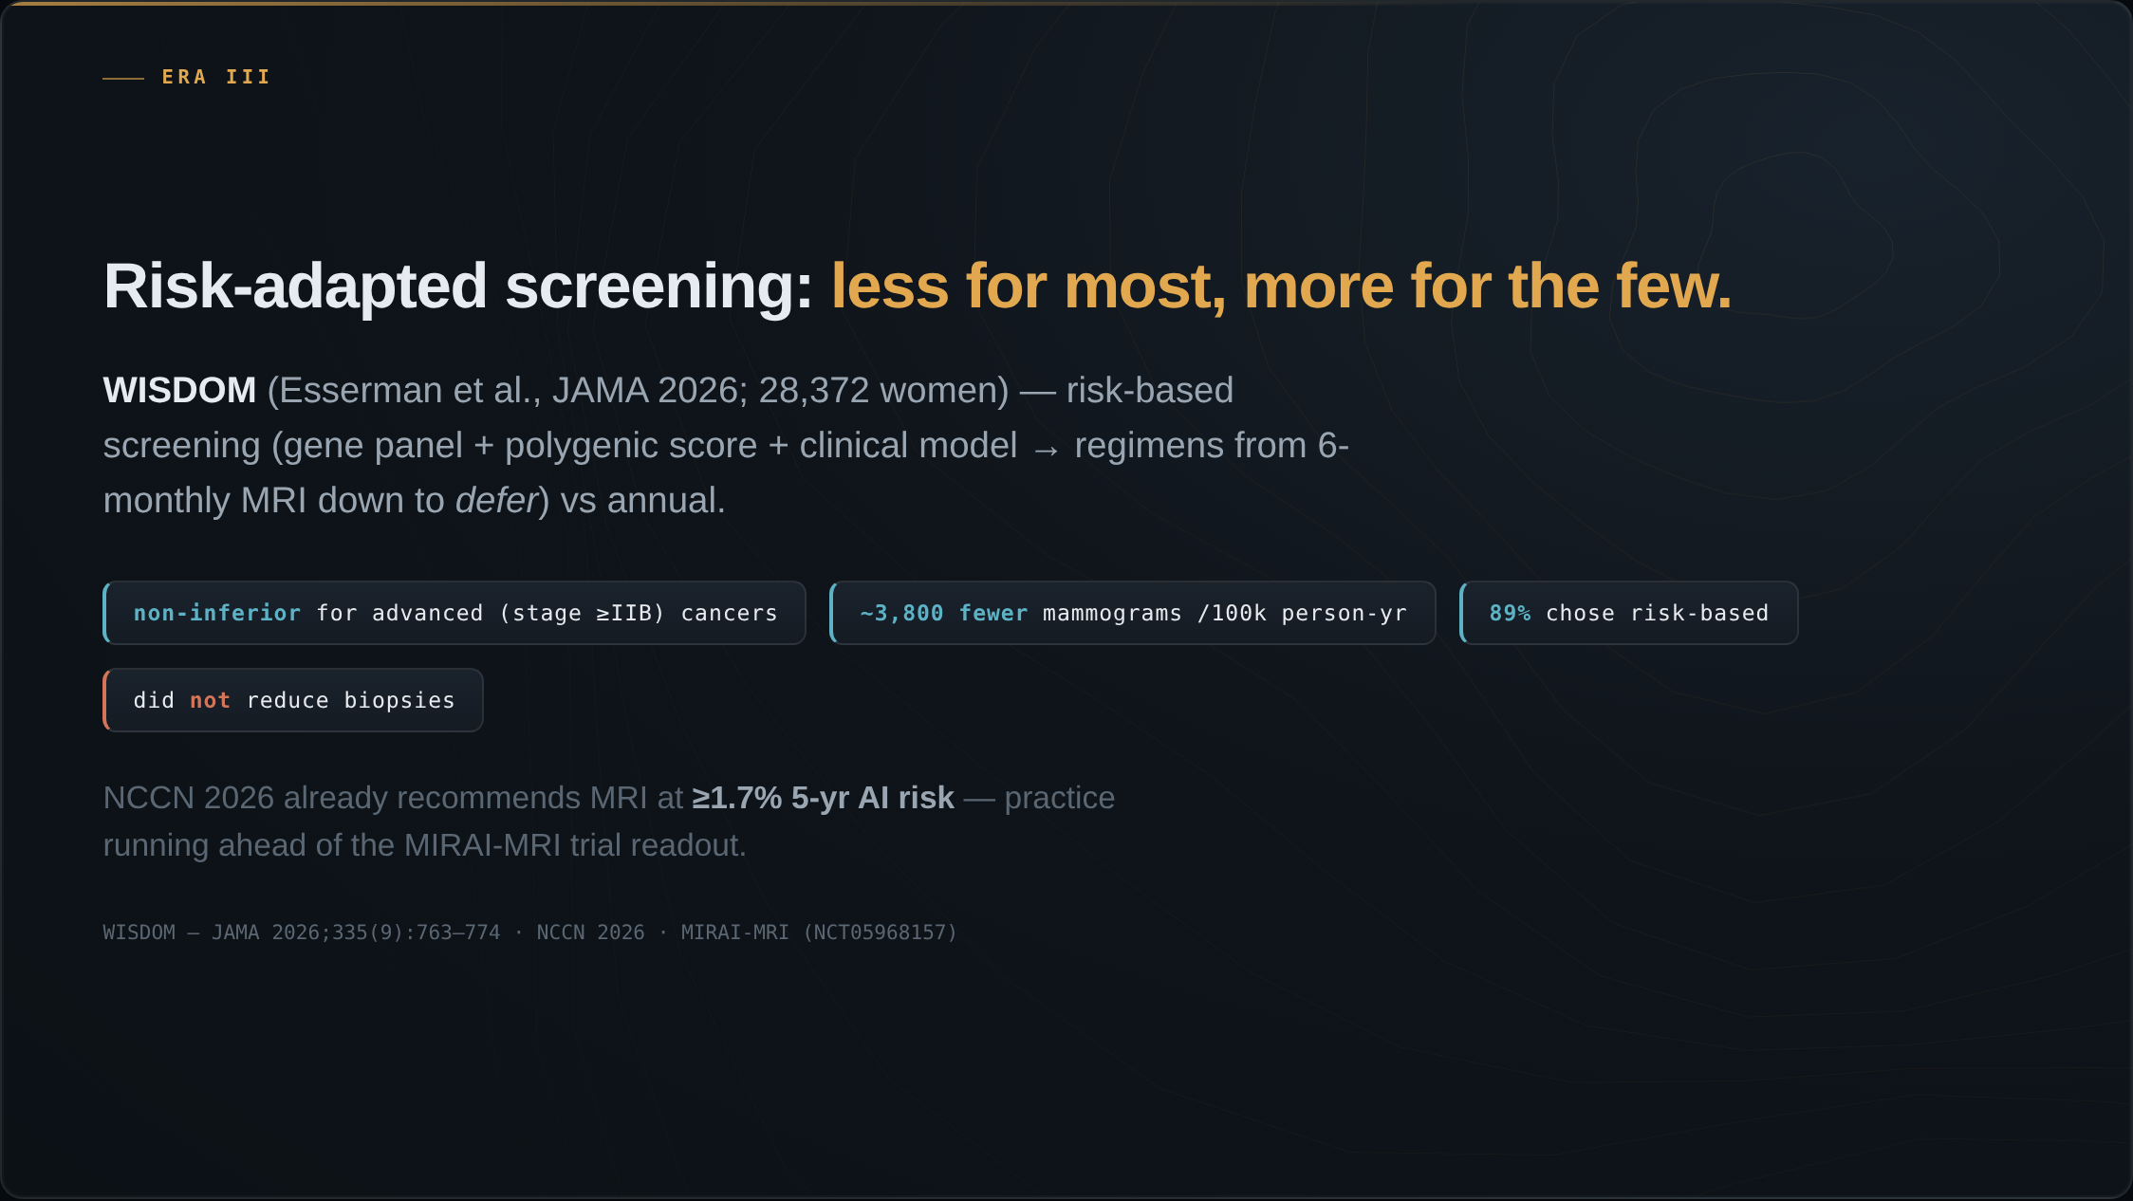
Notes:
This is where risk becomes a screening program. WISDOM, reported in JAMA, randomized about 28,000 women to risk-based screening — a gene panel plus polygenic score plus a clinical model, sorting women into regimens from six-monthly MRI down to deferring — versus annual. Risk-based was non-inferior for advanced cancers, with about 3,800 fewer mammograms per hundred-thousand person-years, and 89 percent of women offered the choice took it. It did not reduce biopsies. Meanwhile the 2026 NCCN guideline already recommends considering MRI at a 1.7 percent five-year AI risk — the practice is running ahead of the prospective trial, MIRAI-MRI, which is still reading out.

Slide 7
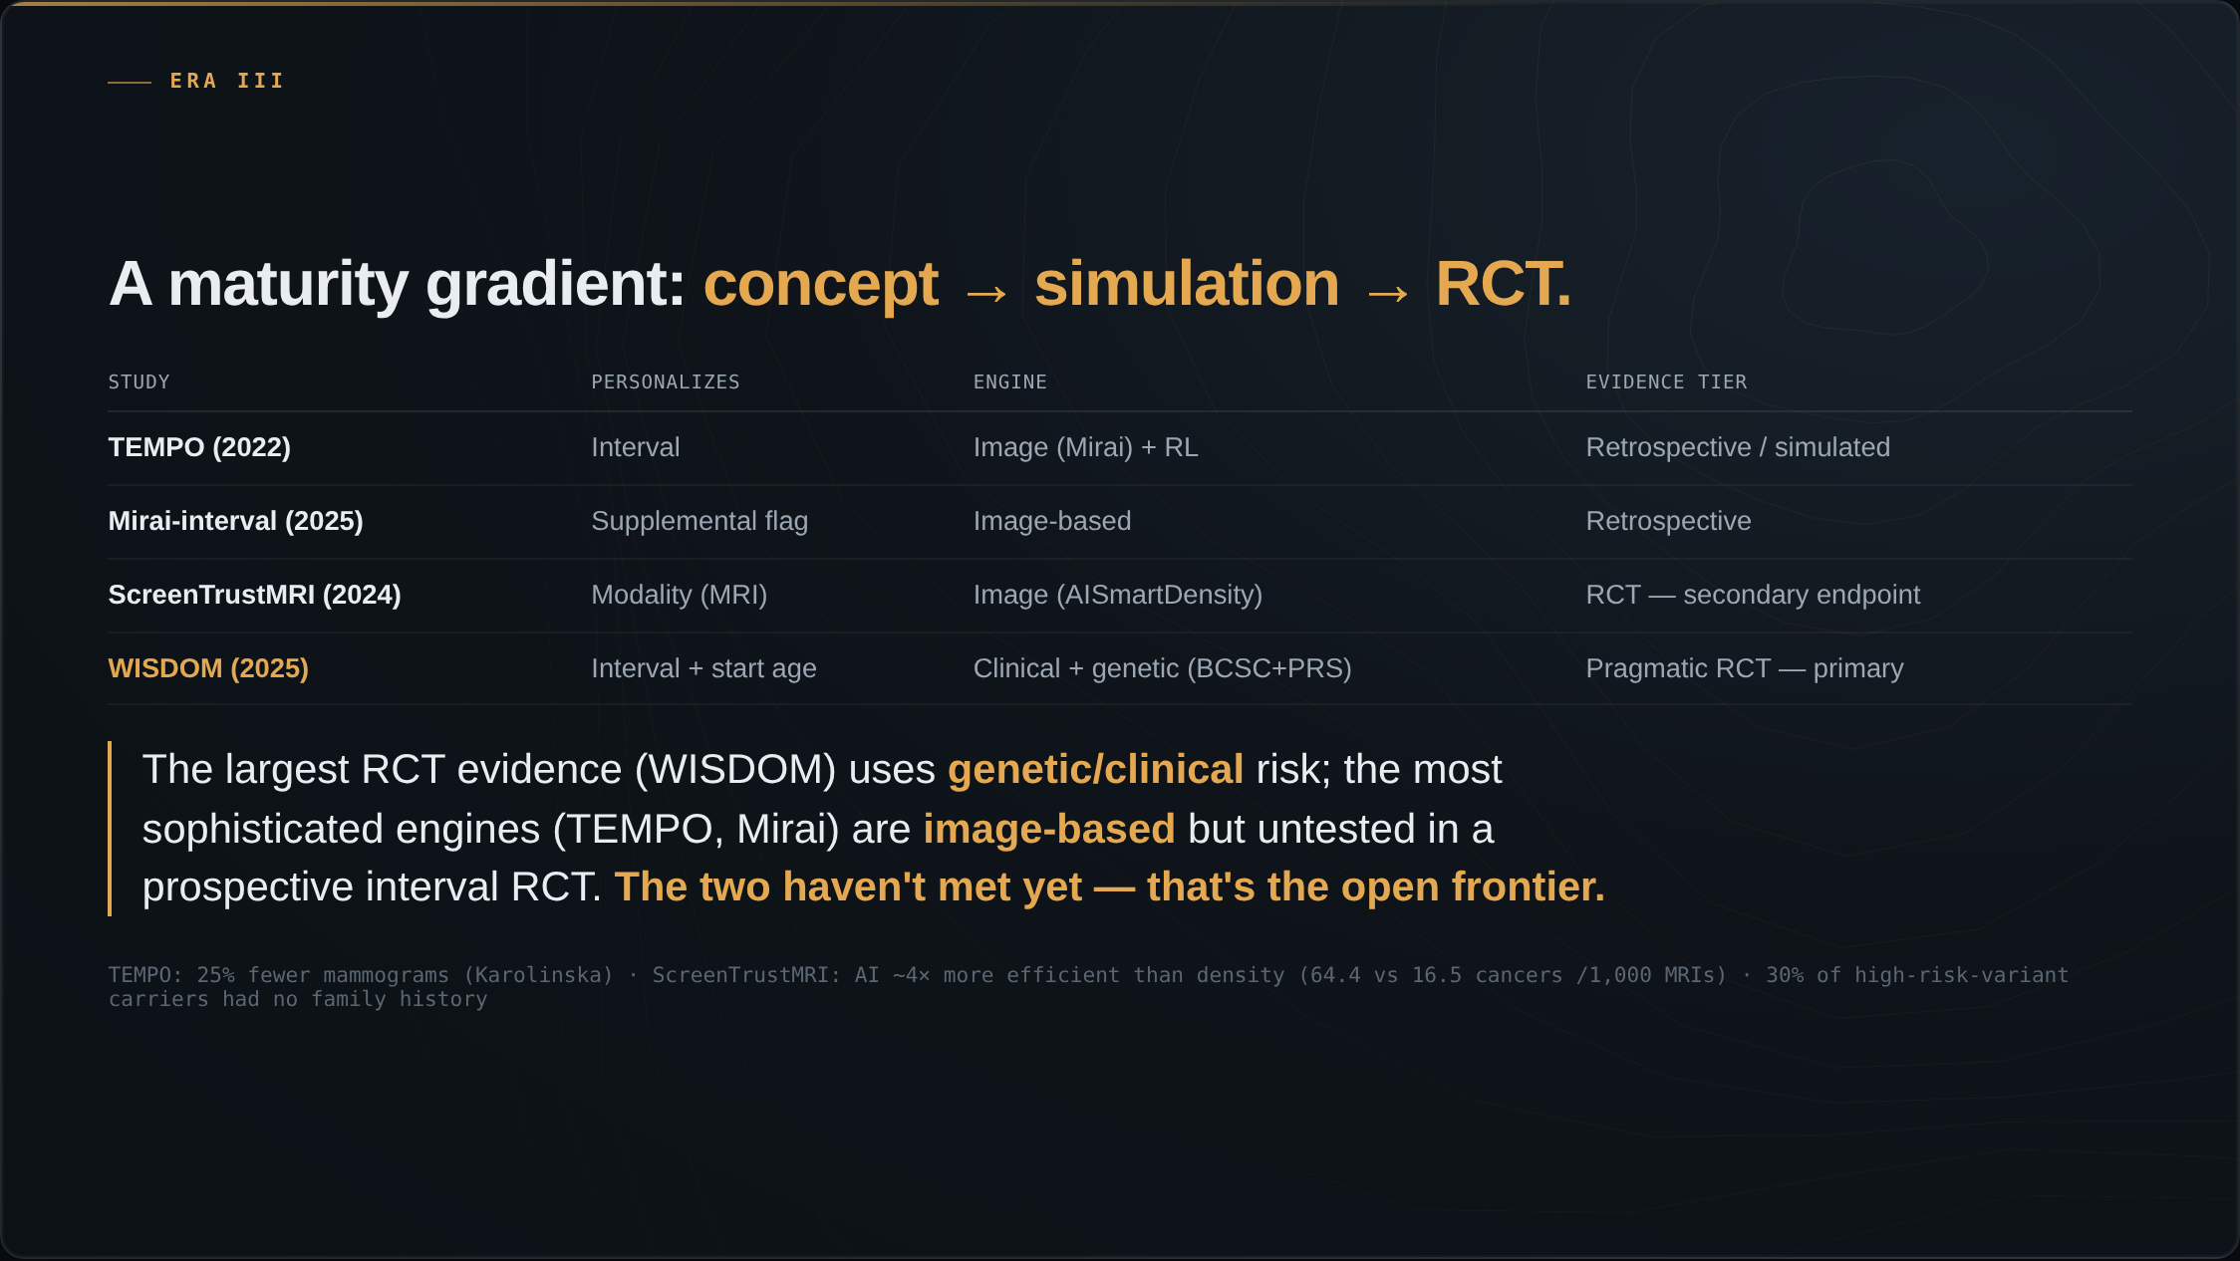
Notes:
Step back and line these up as a maturity gradient — from concept, to simulation, to randomized trial. TEMPO personalizes the interval with an image-based engine, but it is retrospective and simulated. Mirai-interval, also image-based, retrospective. ScreenTrustMRI personalizes the modality and is a randomized trial, but on a secondary endpoint. And WISDOM is the pragmatic RCT with a primary endpoint — but it personalizes on genetic and clinical risk, not the image. So here is the punchline: the largest randomized evidence uses genetic and clinical risk, while the most sophisticated engines are image-based but have never been tested in a prospective interval-modification trial. The two haven't met yet. That's the open frontier.

Slide 8
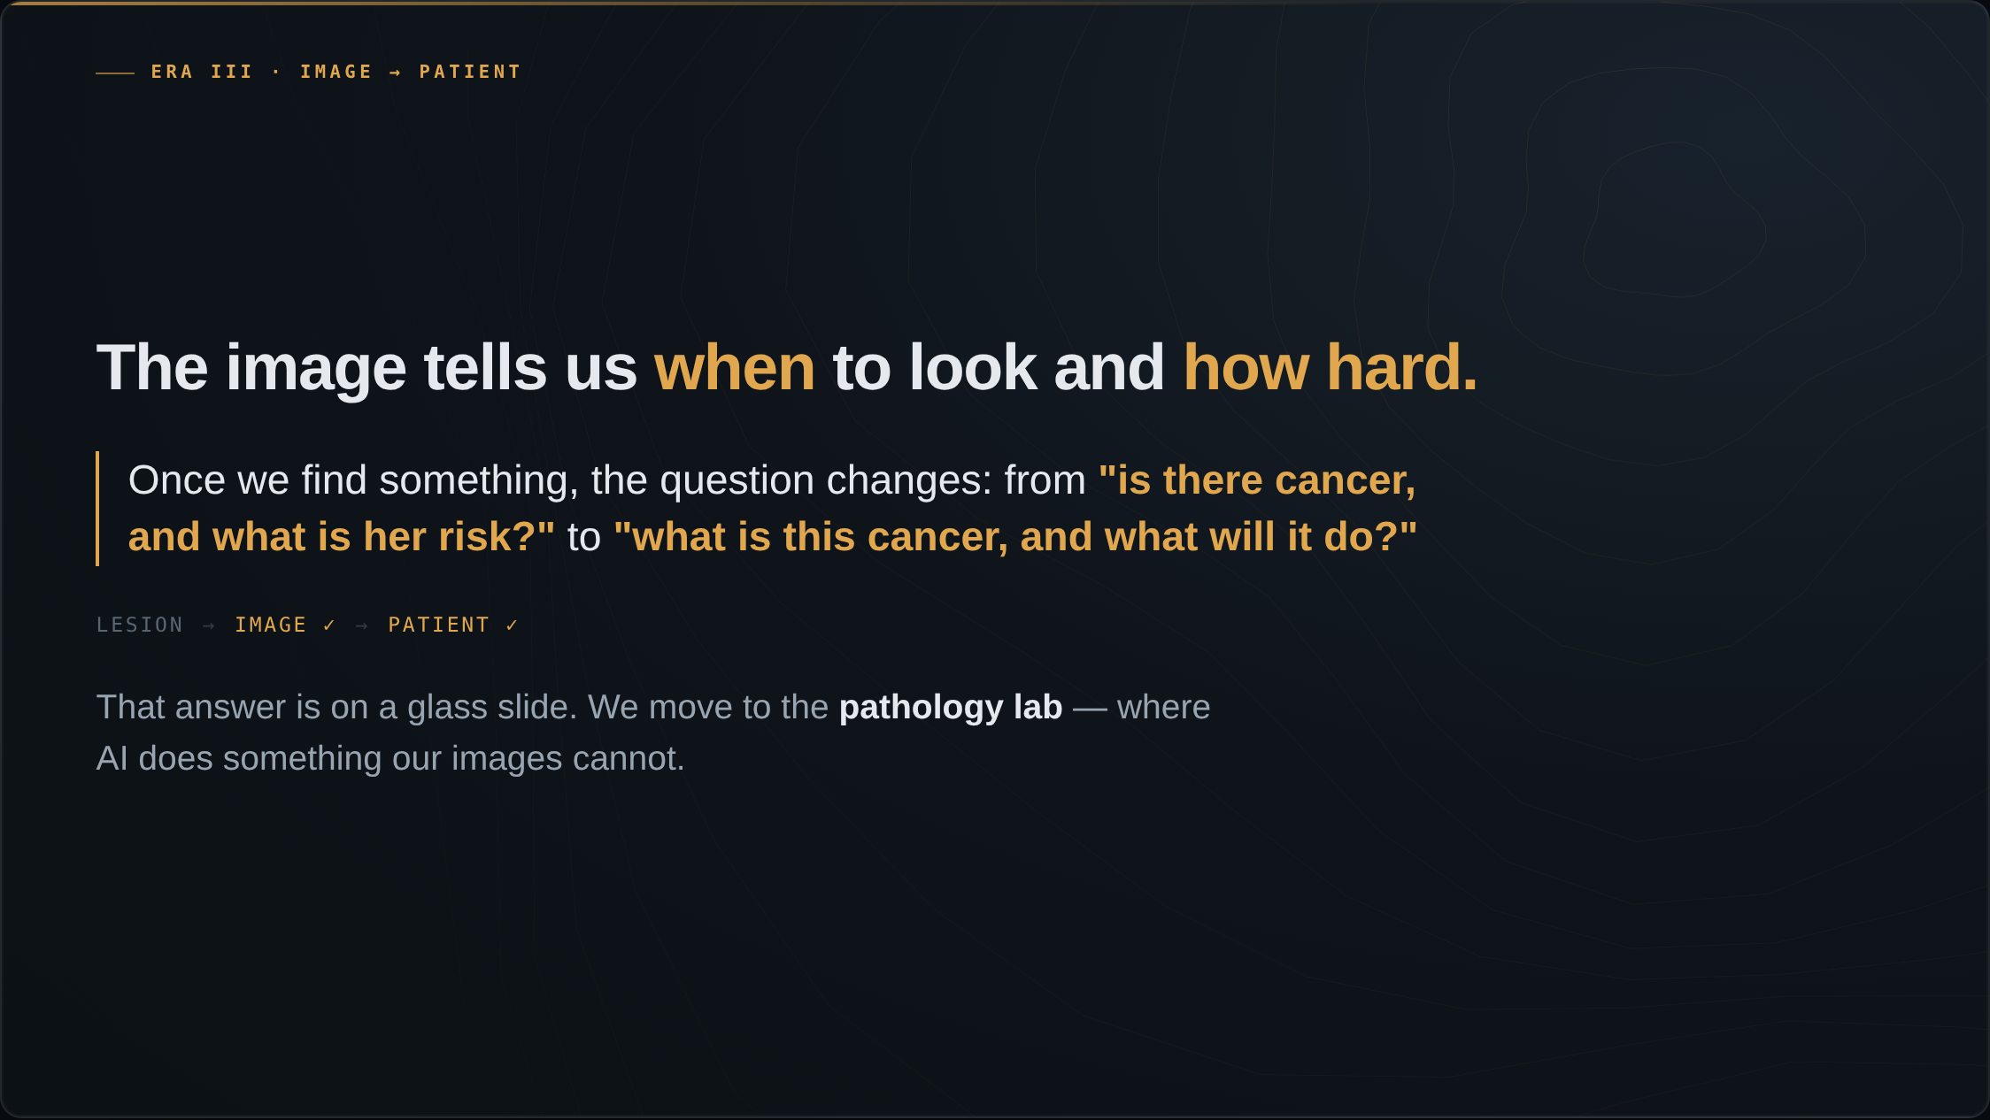
Notes:
So the image can tell us when to look and how hard. But once we find something, the question changes again — from is there cancer and what is her risk, to what is this cancer and what will it do? That answer is not in radiology. It is across the hospital, on a glass slide. To understand the patient, we move to the pathology lab, where AI does something our images cannot.

Slide 9
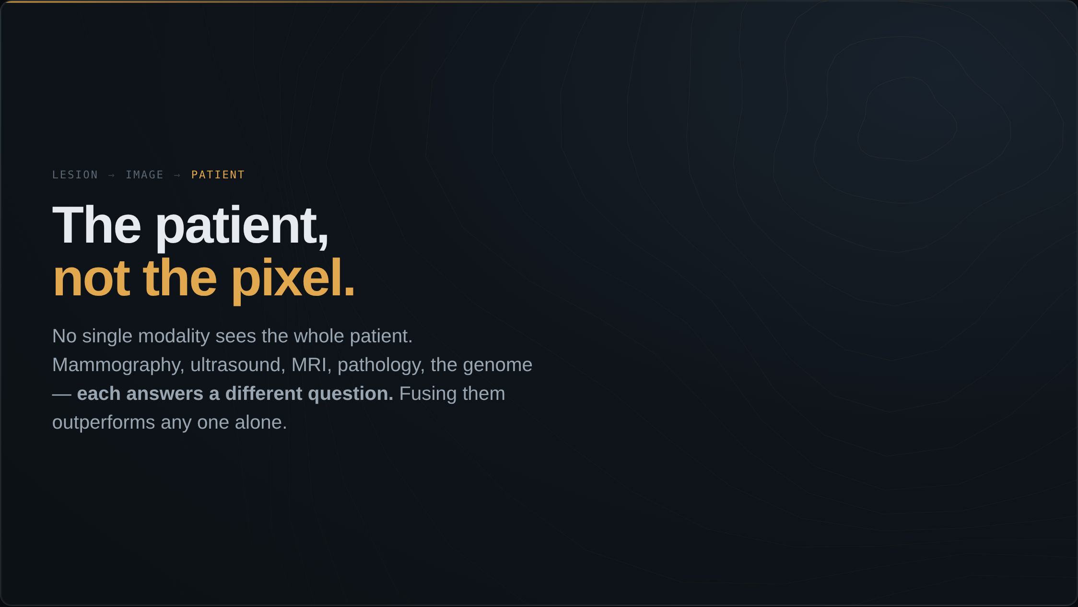
Notes:
No single modality sees the whole patient. Mammography, ultrasound, MRI, pathology, the genome — each answers a different question. The frontier is fusing them into one model of the patient. This is the risk-vector logic from the risk section, generalized: combine the modalities, and you outperform any one of them.

Slide 10
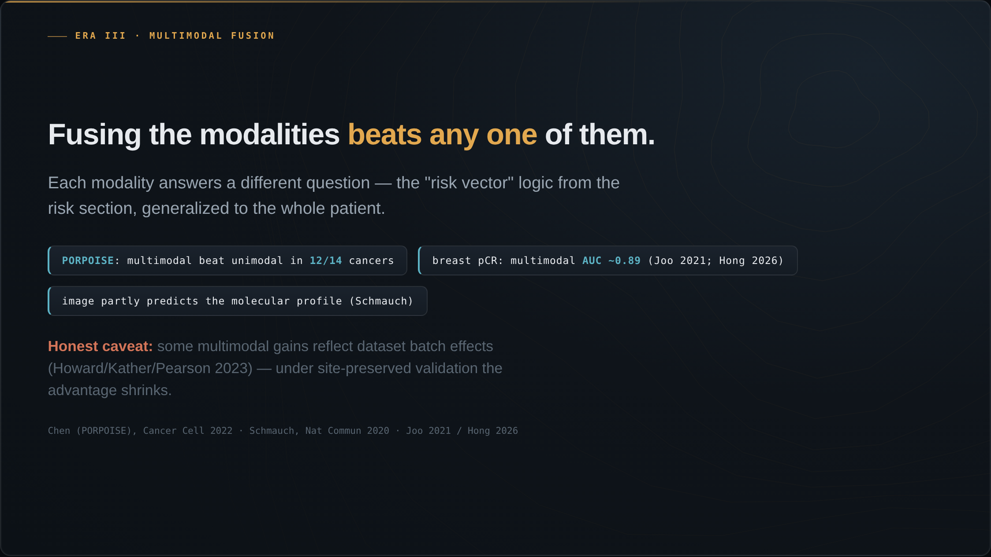
Notes:
The core evidence: fusing modalities beats any single one. Chen and colleagues, in PORPOISE, fused whole-slide images with molecular data across 14 cancers — multimodal beat unimodal in 12 of them. The honest caveat, from Howard, Kather and Pearson, is that some of that gain reflected dataset batch effects; under site-preserved validation the advantage shrinks. Schmauch showed the modalities partly encode each other — you can predict the molecular profile from the H&E alone. And in breast, fusing clinical data with MRI predicts neoadjuvant treatment response at an AUC near 0.89.

Slide 11
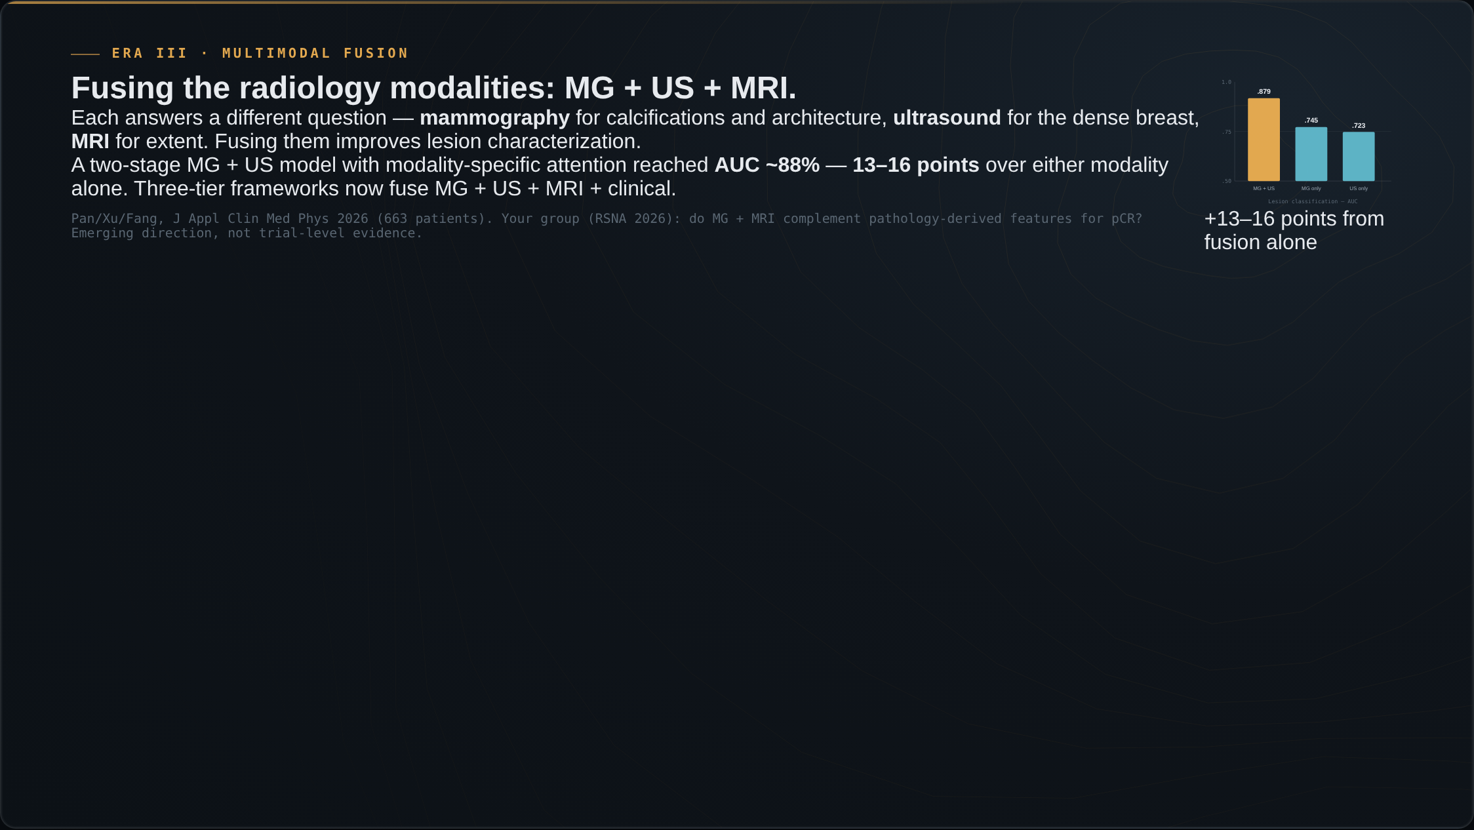
Notes:
A near-term, breast-specific version: fusing the radiology modalities themselves. Today almost all deployed AI reads a single modality, but each answers a different question — mammography for calcifications and architecture, ultrasound for the dense breast, MRI for extent. A two-stage MG-plus-ultrasound model with modality-specific attention reached an AUC of about 88 percent, 13 to 16 points over the mammography-only or ultrasound-only models. The signal one modality misses, another catches.

Slide 12
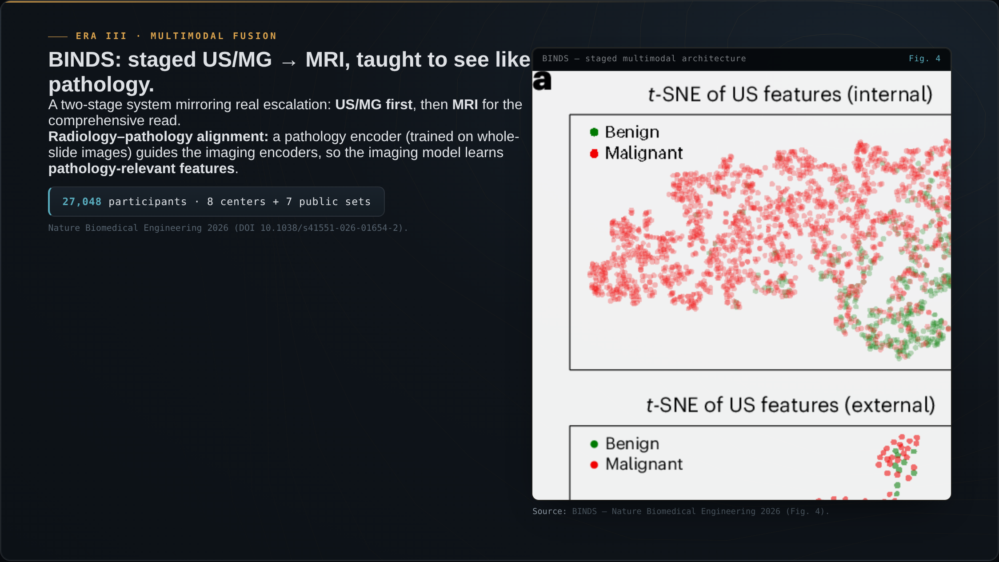
Notes:
The most workflow-faithful system to date is BINDS, in Nature Biomedical Engineering this year. It is a staged ultrasound-or-mammography to MRI system that mirrors the real clinical escalation pathway. Its conceptual novelty is a radiology-pathology alignment mechanism: a pathology encoder is pretrained on whole-slide images, and those features guide the imaging encoders, so the imaging model learns to see like pathology. Validated on 27,000 participants across eight centers, the largest multimodal validation in this space.

Slide 13
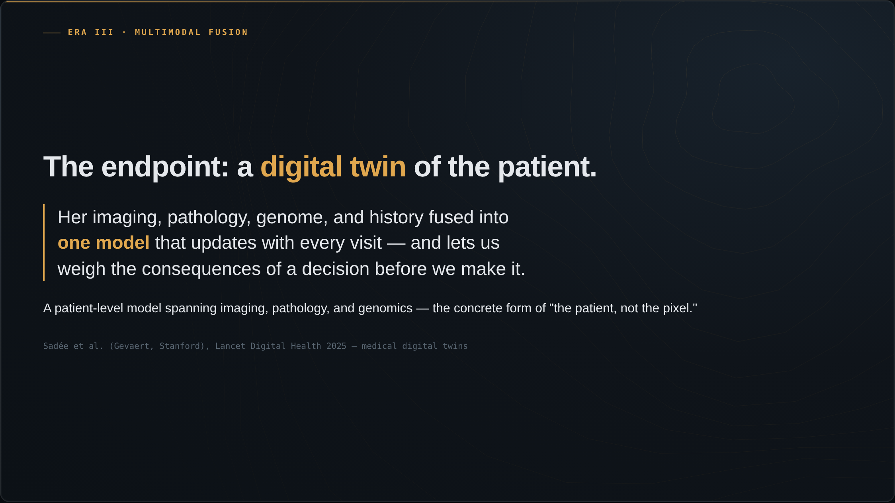
Notes:
Where this is heading is the medical digital twin: the patient's imaging, pathology, genome, and history fused into one model that updates with every visit and lets us weigh the consequences of a decision before we make it. Sadée and colleagues at Stanford laid out the concept in Lancet Digital Health this year. A patient-level model spanning imaging, pathology, and genomics.

Slide 14
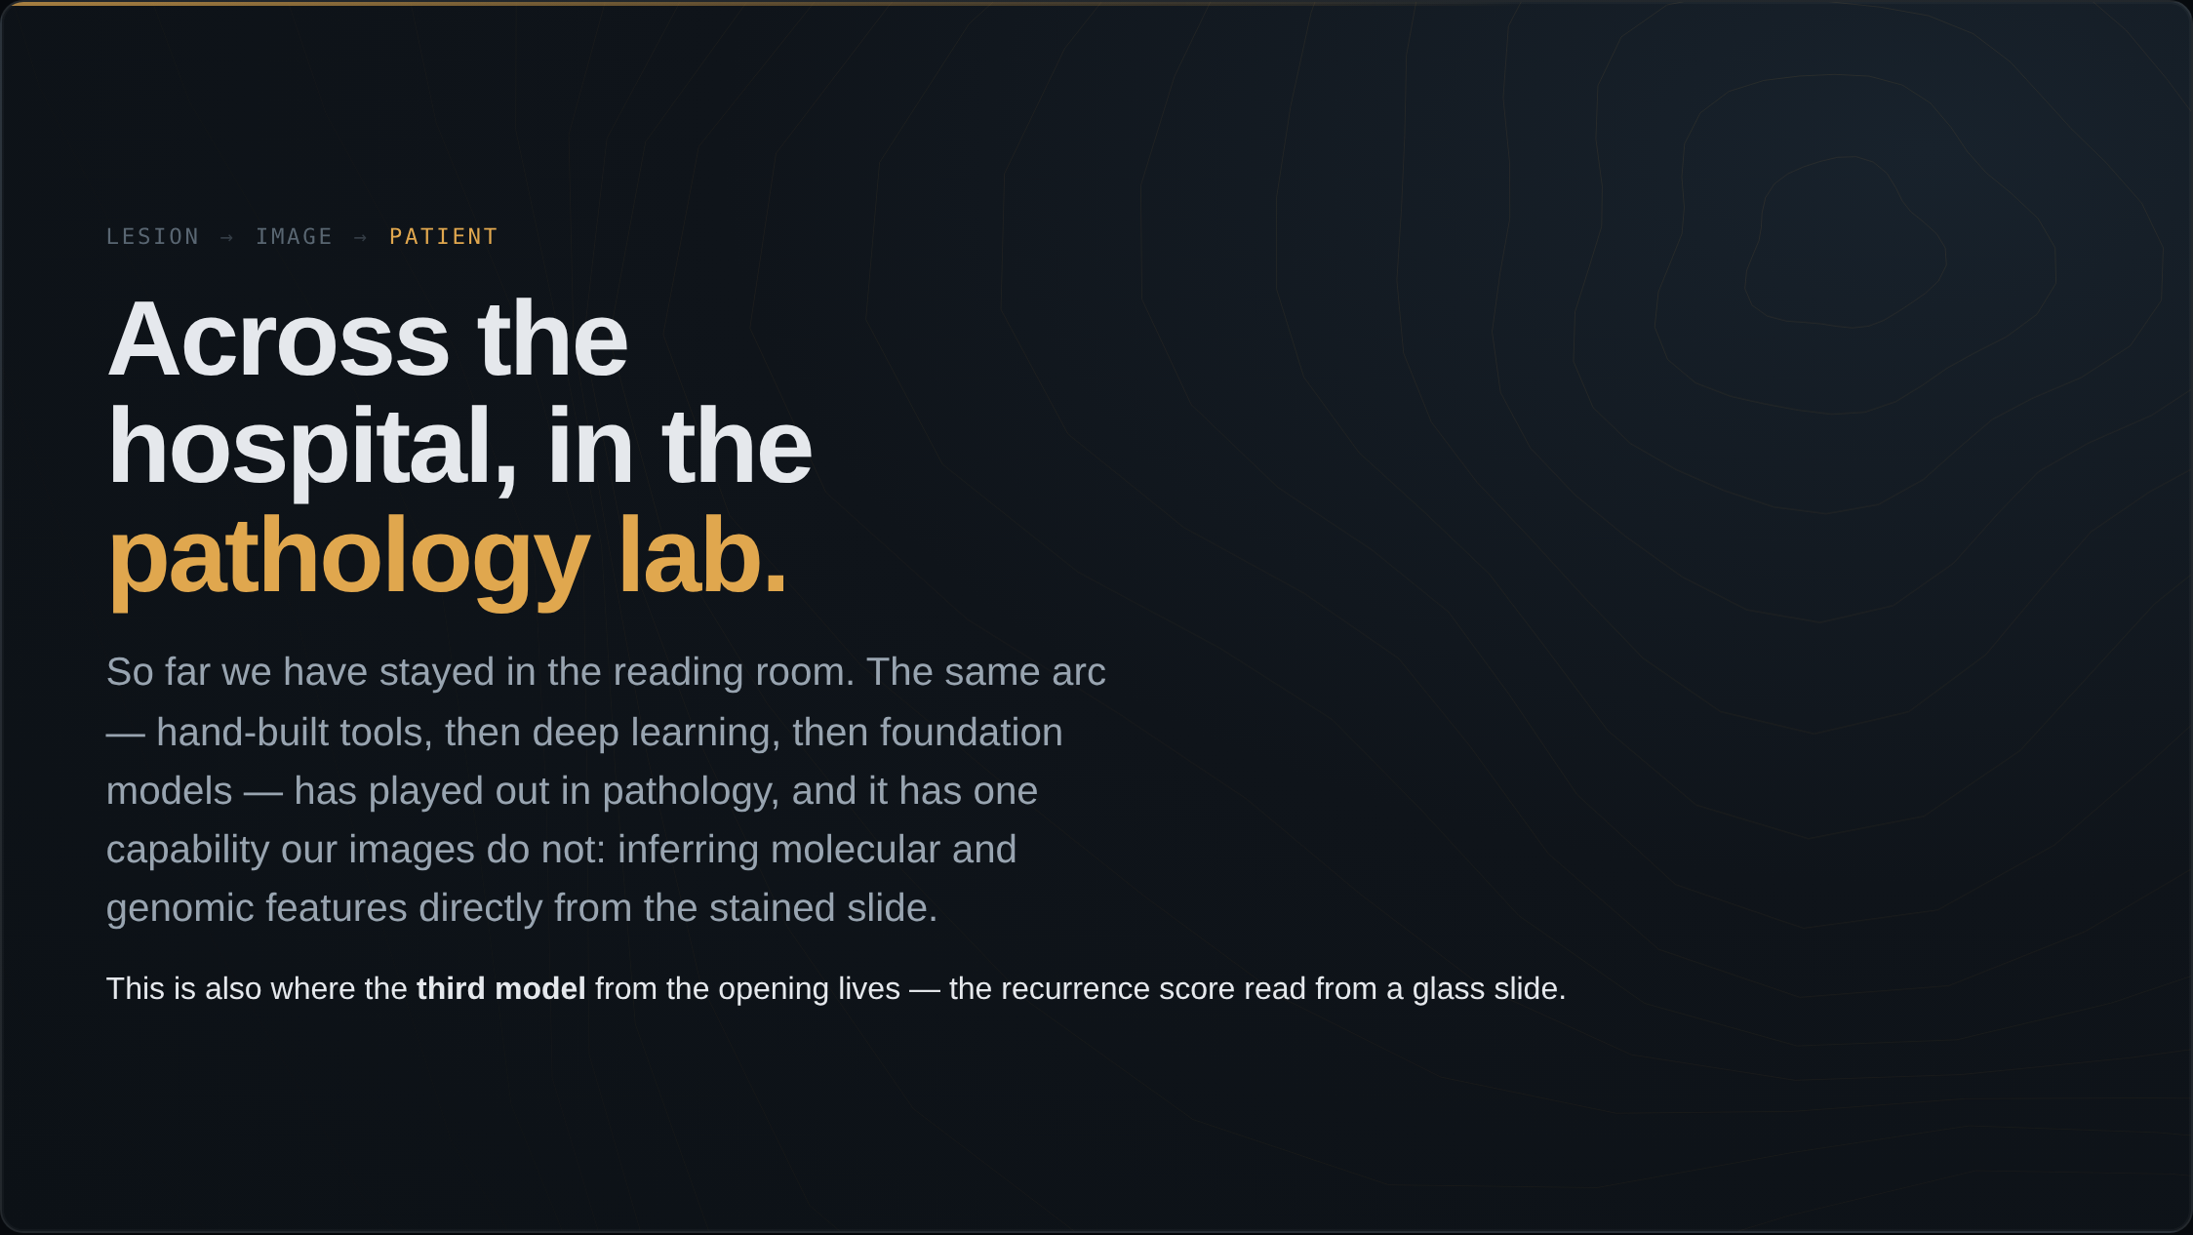
Notes:
For the whole talk we have stayed in the reading room. Now walk across the hospital to the pathology lab — a part of the building a radiology audience rarely sees. The same arc played out here: hand-built tools, then deep learning, then foundation models. But tissue AI can do one thing our images cannot, and it is the reason this matters to you. And remember the third model I opened with — the four-thousand-dollar recurrence score being read off a glass slide across town. We are about to meet it.

Slide 15
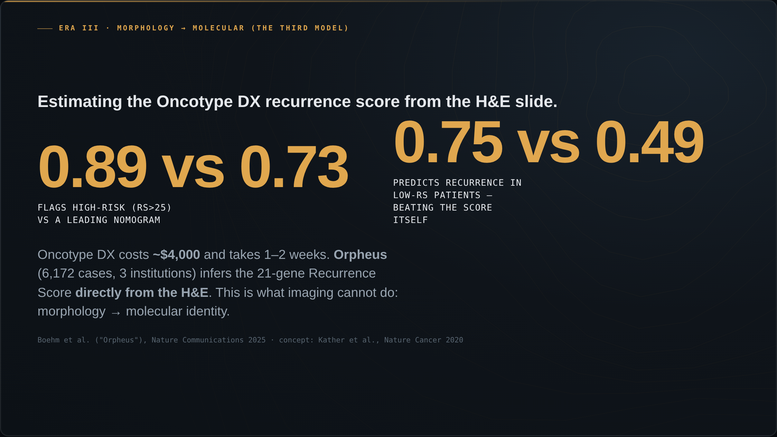
Notes:
And this is the capability imaging simply does not have, and the third model from the opening. Oncotype DX — the 21-gene recurrence score — costs about four thousand dollars and takes one to two weeks. The slide is already on the desk. Orpheus, in Nature Communications this year, infers that recurrence score directly from the H&E across six thousand cases. It flags the high-risk patients at an AUC of 0.89 versus 0.73 for a leading nomogram. And in the low-score patients — the ones the test calls low-risk — it predicts who actually recurs better than the recurrence score itself: 0.75 versus 0.49. Morphology to molecular identity, from a slide we already have.

Slide 16
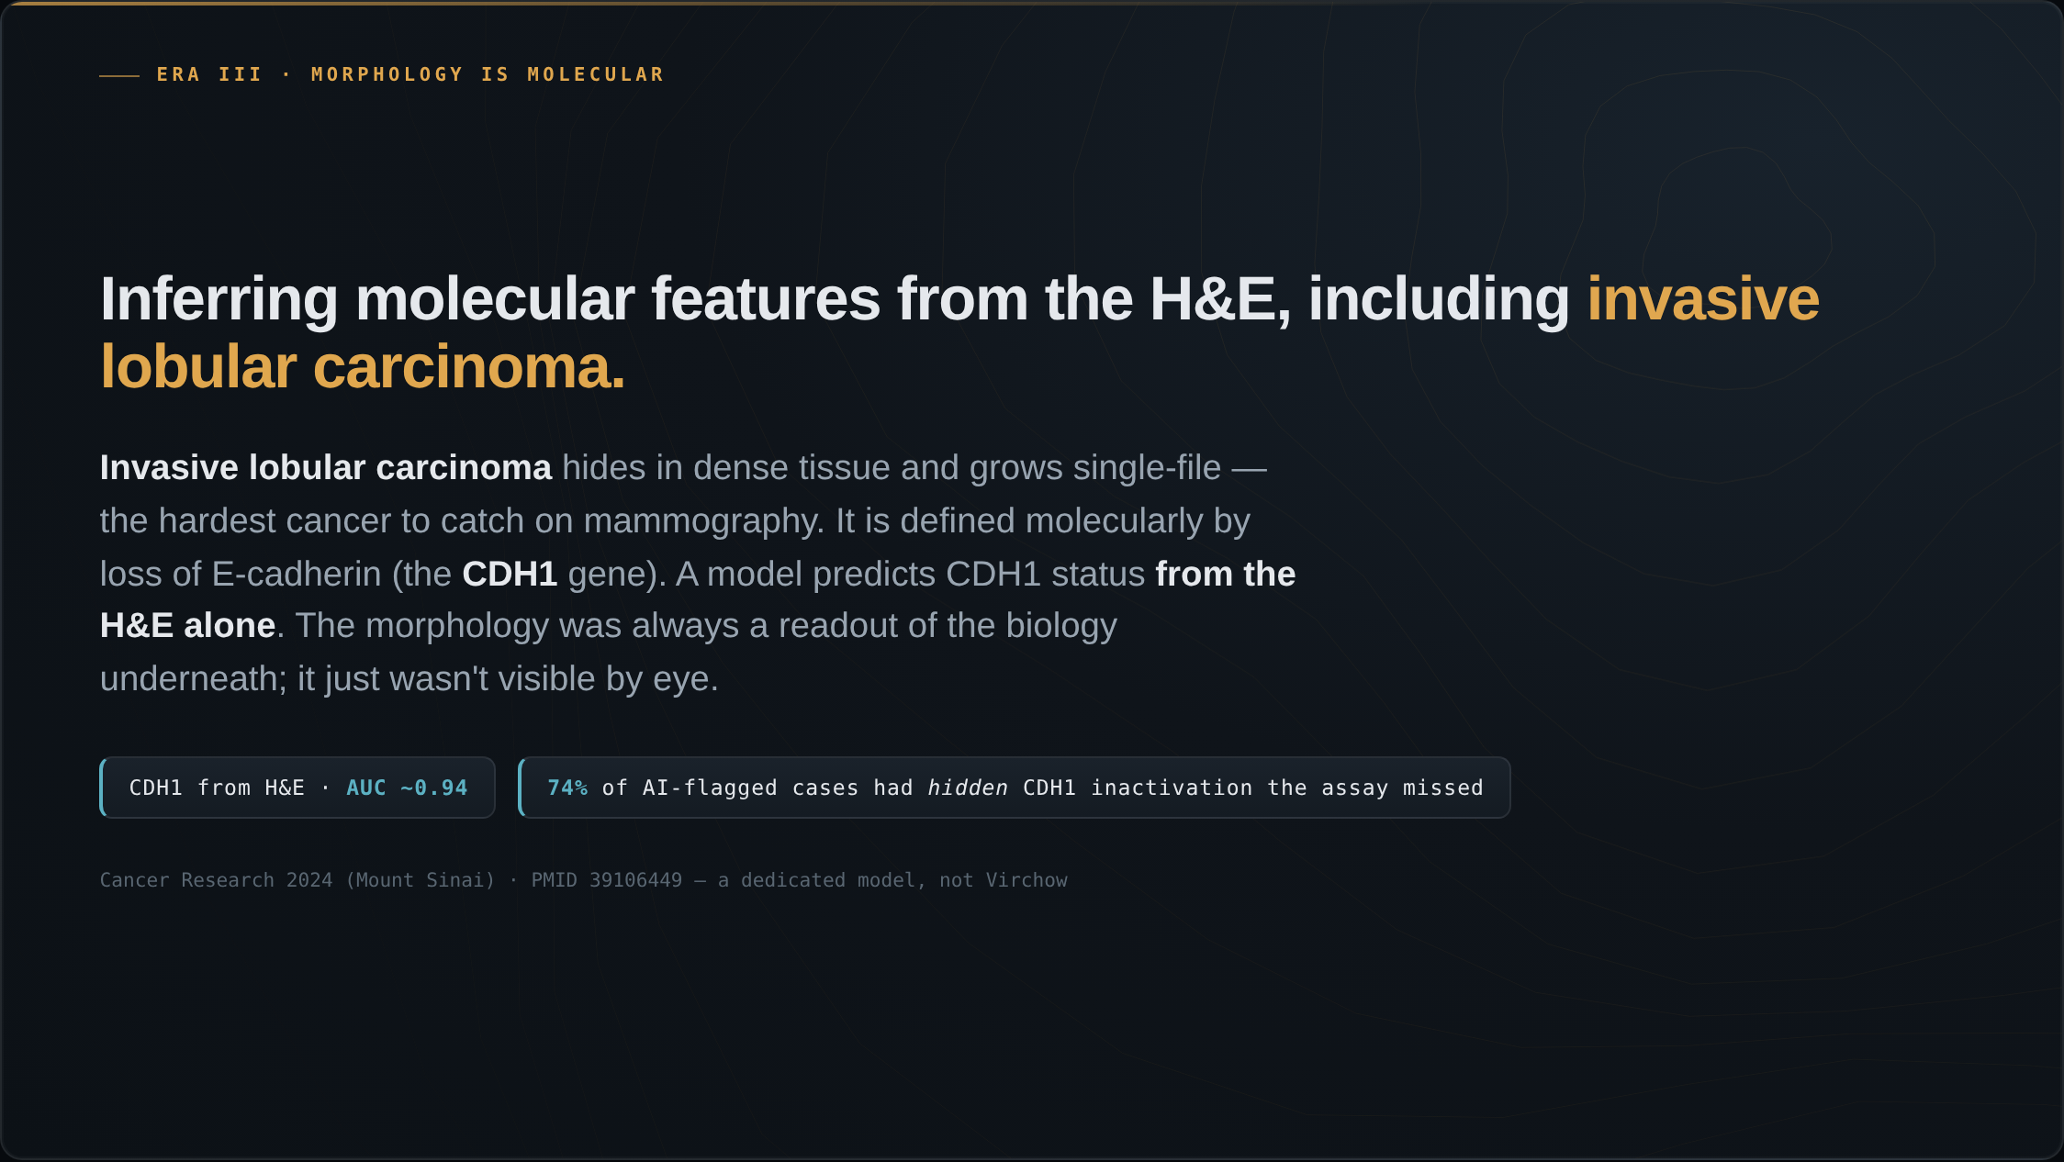
Notes:
And this is directly relevant to breast imaging. These models read features off the H&E that the eye cannot see. Take the cancer hardest to detect on a mammogram — invasive lobular carcinoma. It hides in dense tissue and grows single-file. Lobular cancer is defined molecularly by the loss of one protein, E-cadherin, the CDH1 gene. A model predicts CDH1 status from the H&E alone at an AUC around 0.94. The morphology was always a readout of the molecular biology underneath; it just was not visible by eye. And among cases the model flagged as CDH1-lost where the standard test found nothing, about three-quarters had another mechanism silencing the gene — biology the assay never tested for.

Slide 17
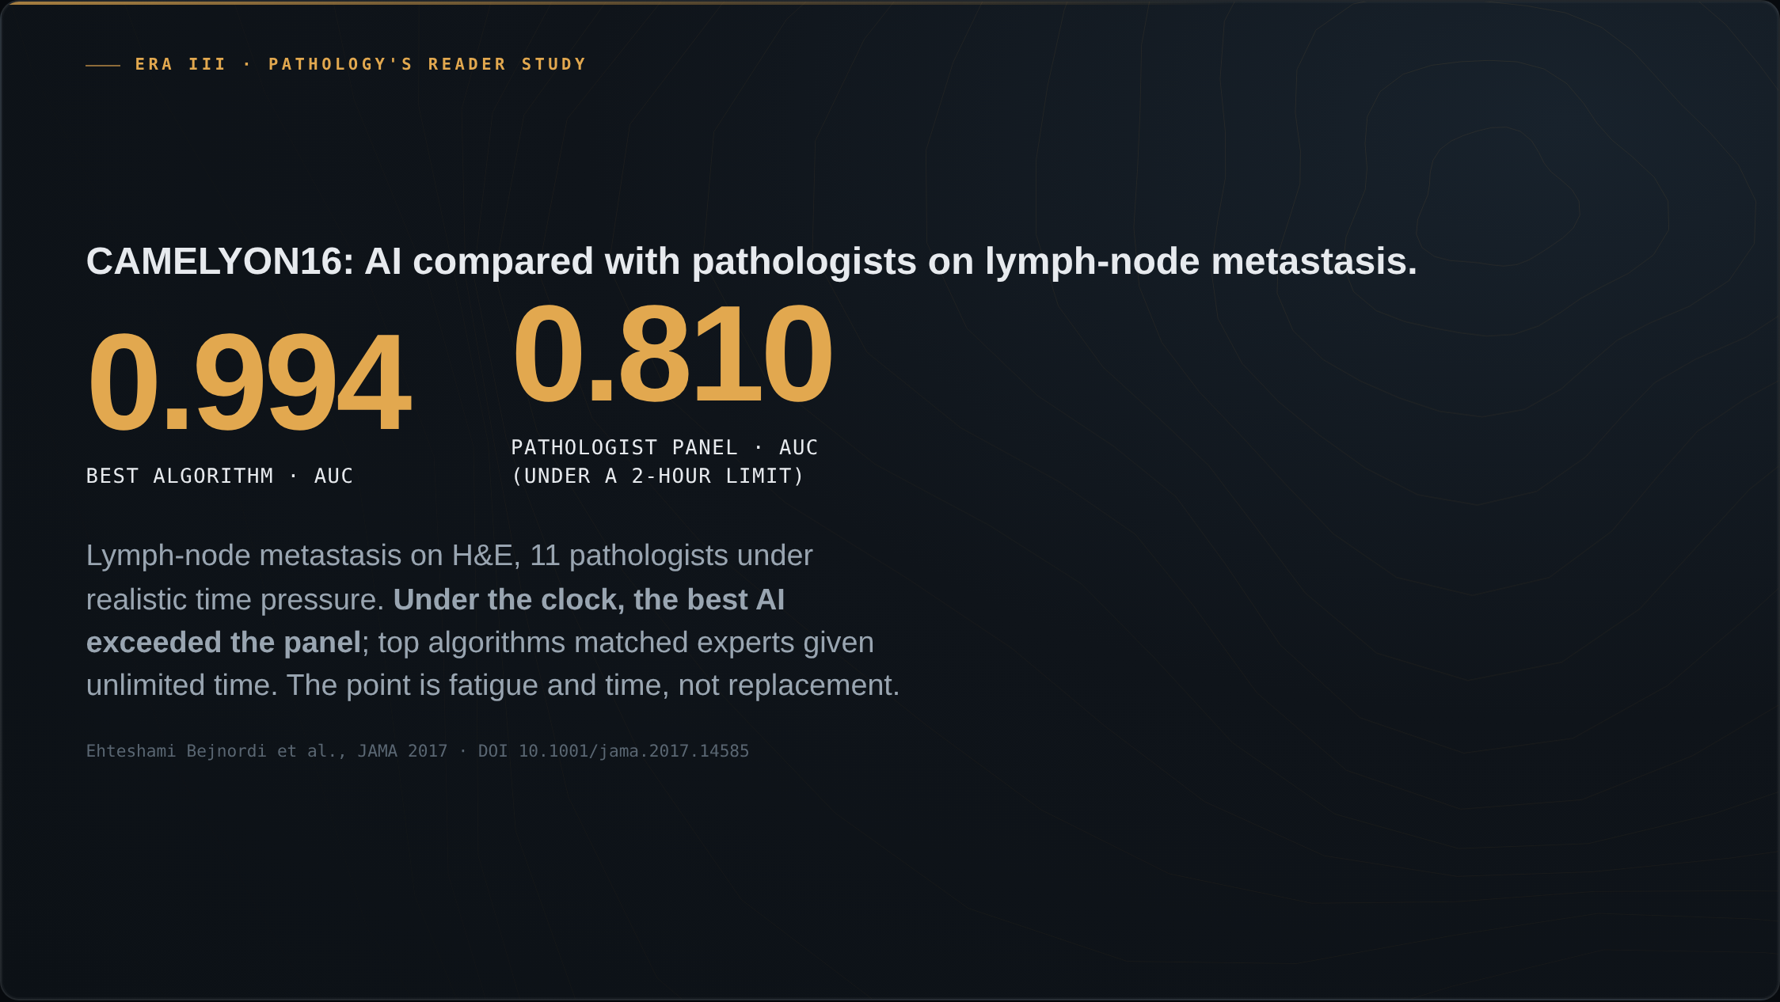
Notes:
Pathology ran the same AI-versus-experts study radiology did. CAMELYON16: detecting lymph-node metastasis on H&E, eleven pathologists reading a test set under a realistic two-hour time limit. The best algorithm scored 0.994; the pathologist panel, under the clock, 0.810. The top algorithms matched experts given unlimited time. The framing is not replacement — it is fatigue and time pressure, which machines do not feel.

Slide 18
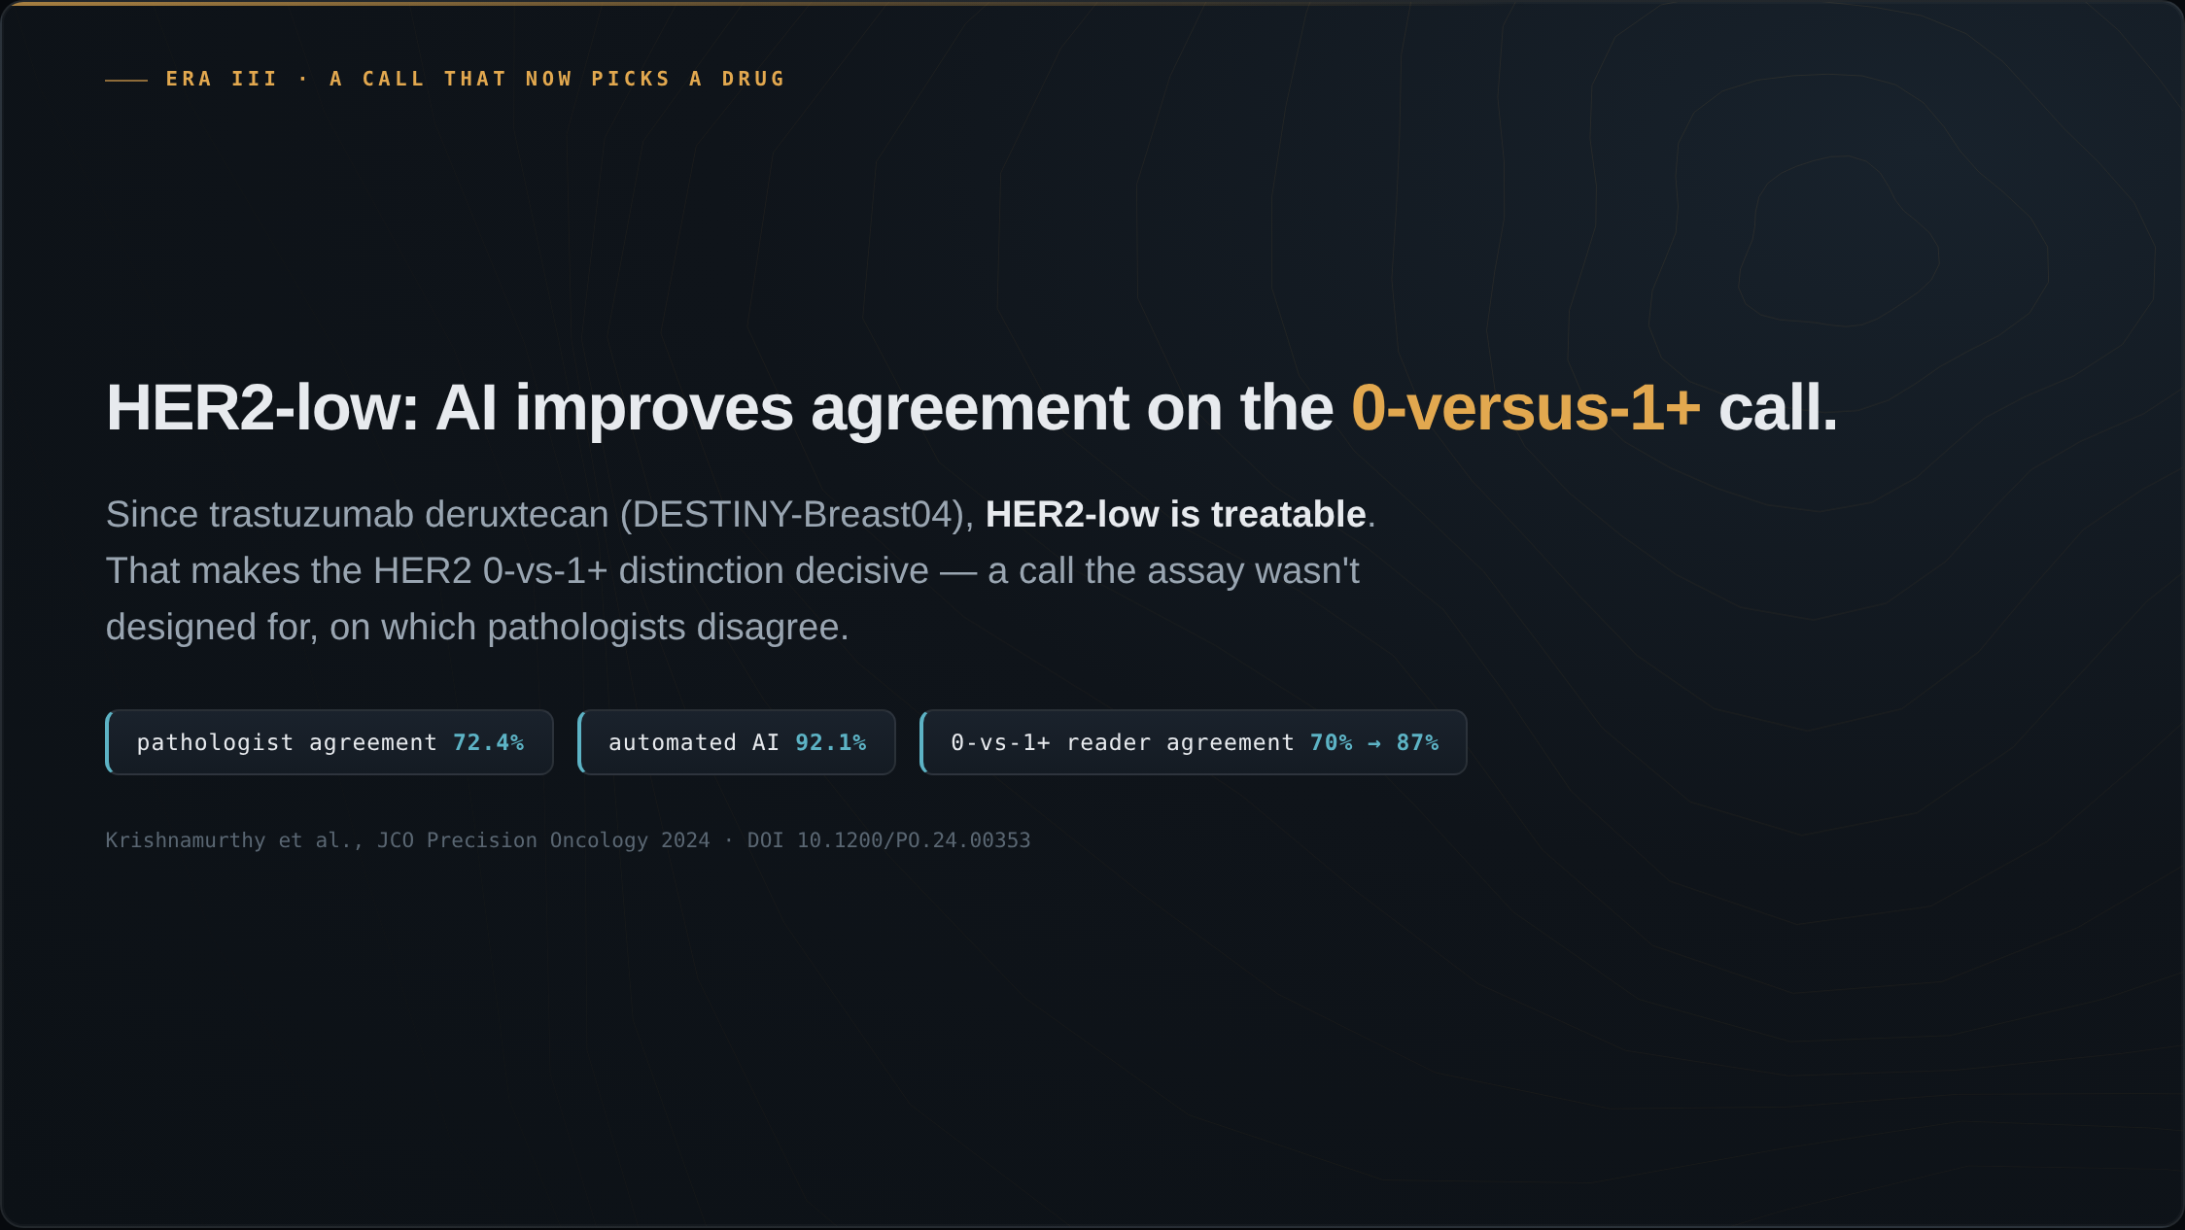
Notes:
Here is AI on a problem that decides treatment today. Since trastuzumab deruxtecan and DESTINY-Breast04, HER2-low disease is treatable. That makes the HER2 zero-versus-one-plus call decisive — and it is a call the assay was never designed to make, on which pathologists disagree. Baseline agreement is about 72 percent. Automated AI reaches 92. And on the hardest call, zero versus one-plus, AI lifts reader agreement from about 70 to about 87 percent. A distinction that now determines who is eligible for a drug that improves survival.

Slide 19
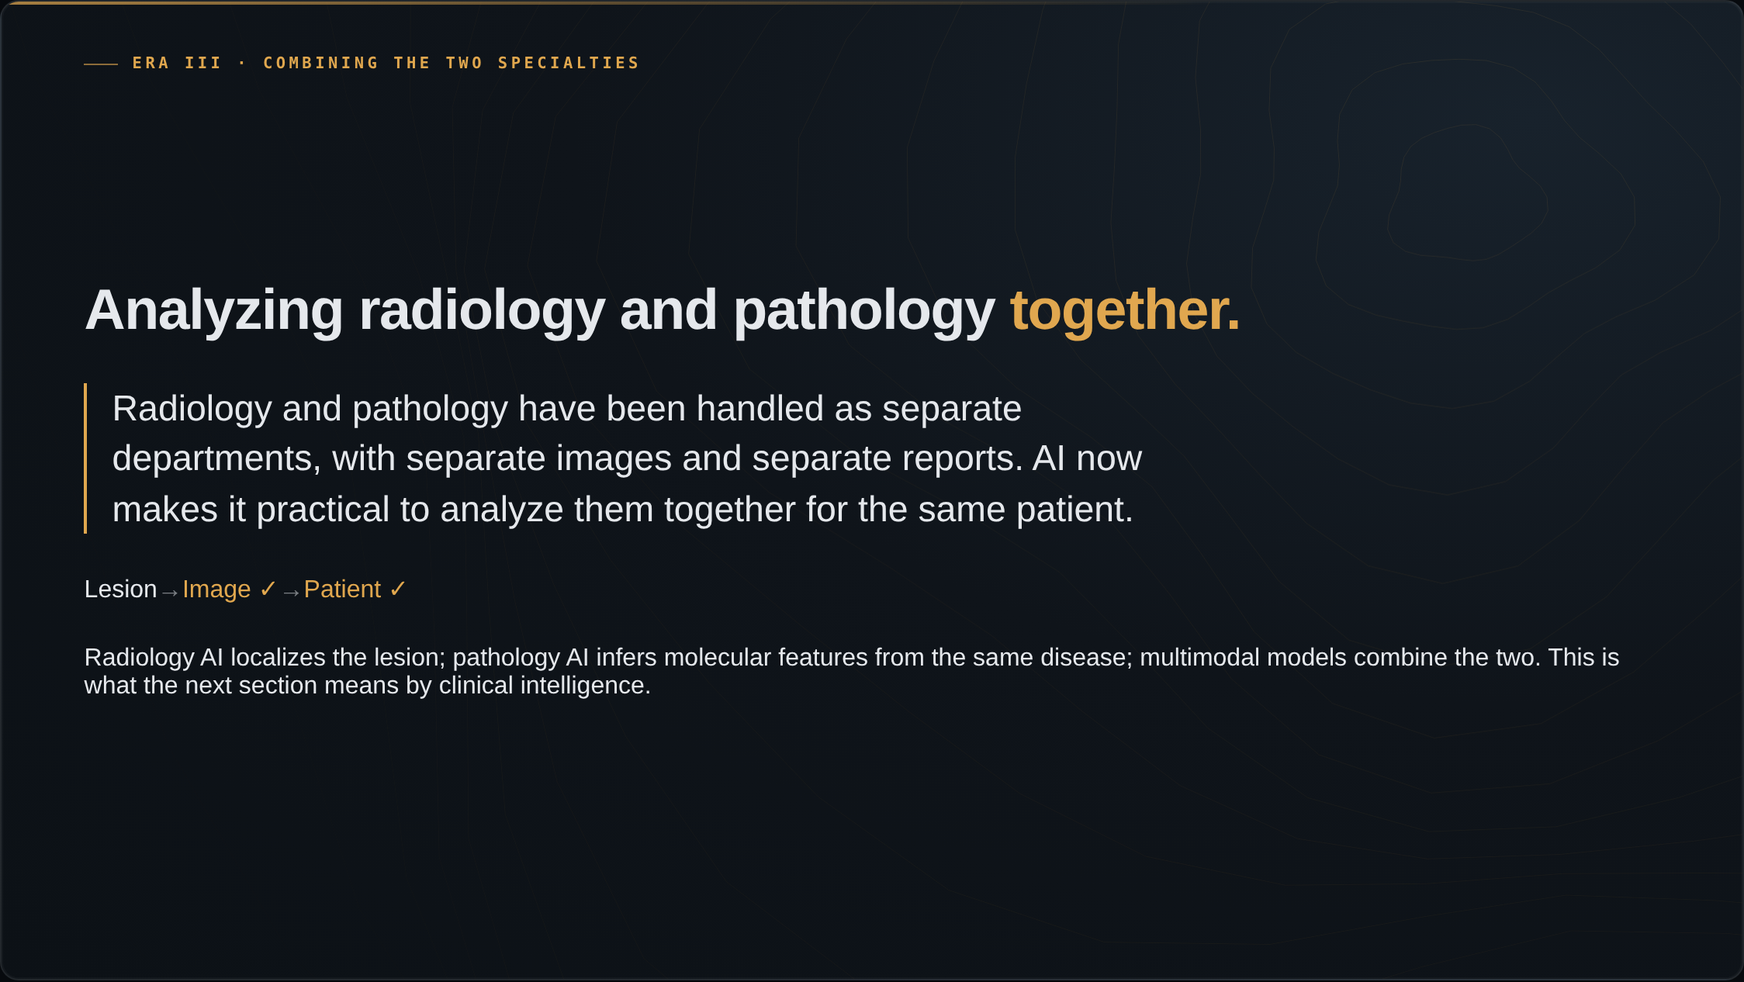
Notes:
For decades, radiology and pathology have been handled as separate departments, with separate images and separate reports. AI now makes it practical to analyze them together for the same patient. Radiology AI localizes the lesion; pathology AI infers molecular features from the same disease; and multimodal models combine the two. That is where the next section goes, and it is what the talk means by clinical intelligence.

Slide 20
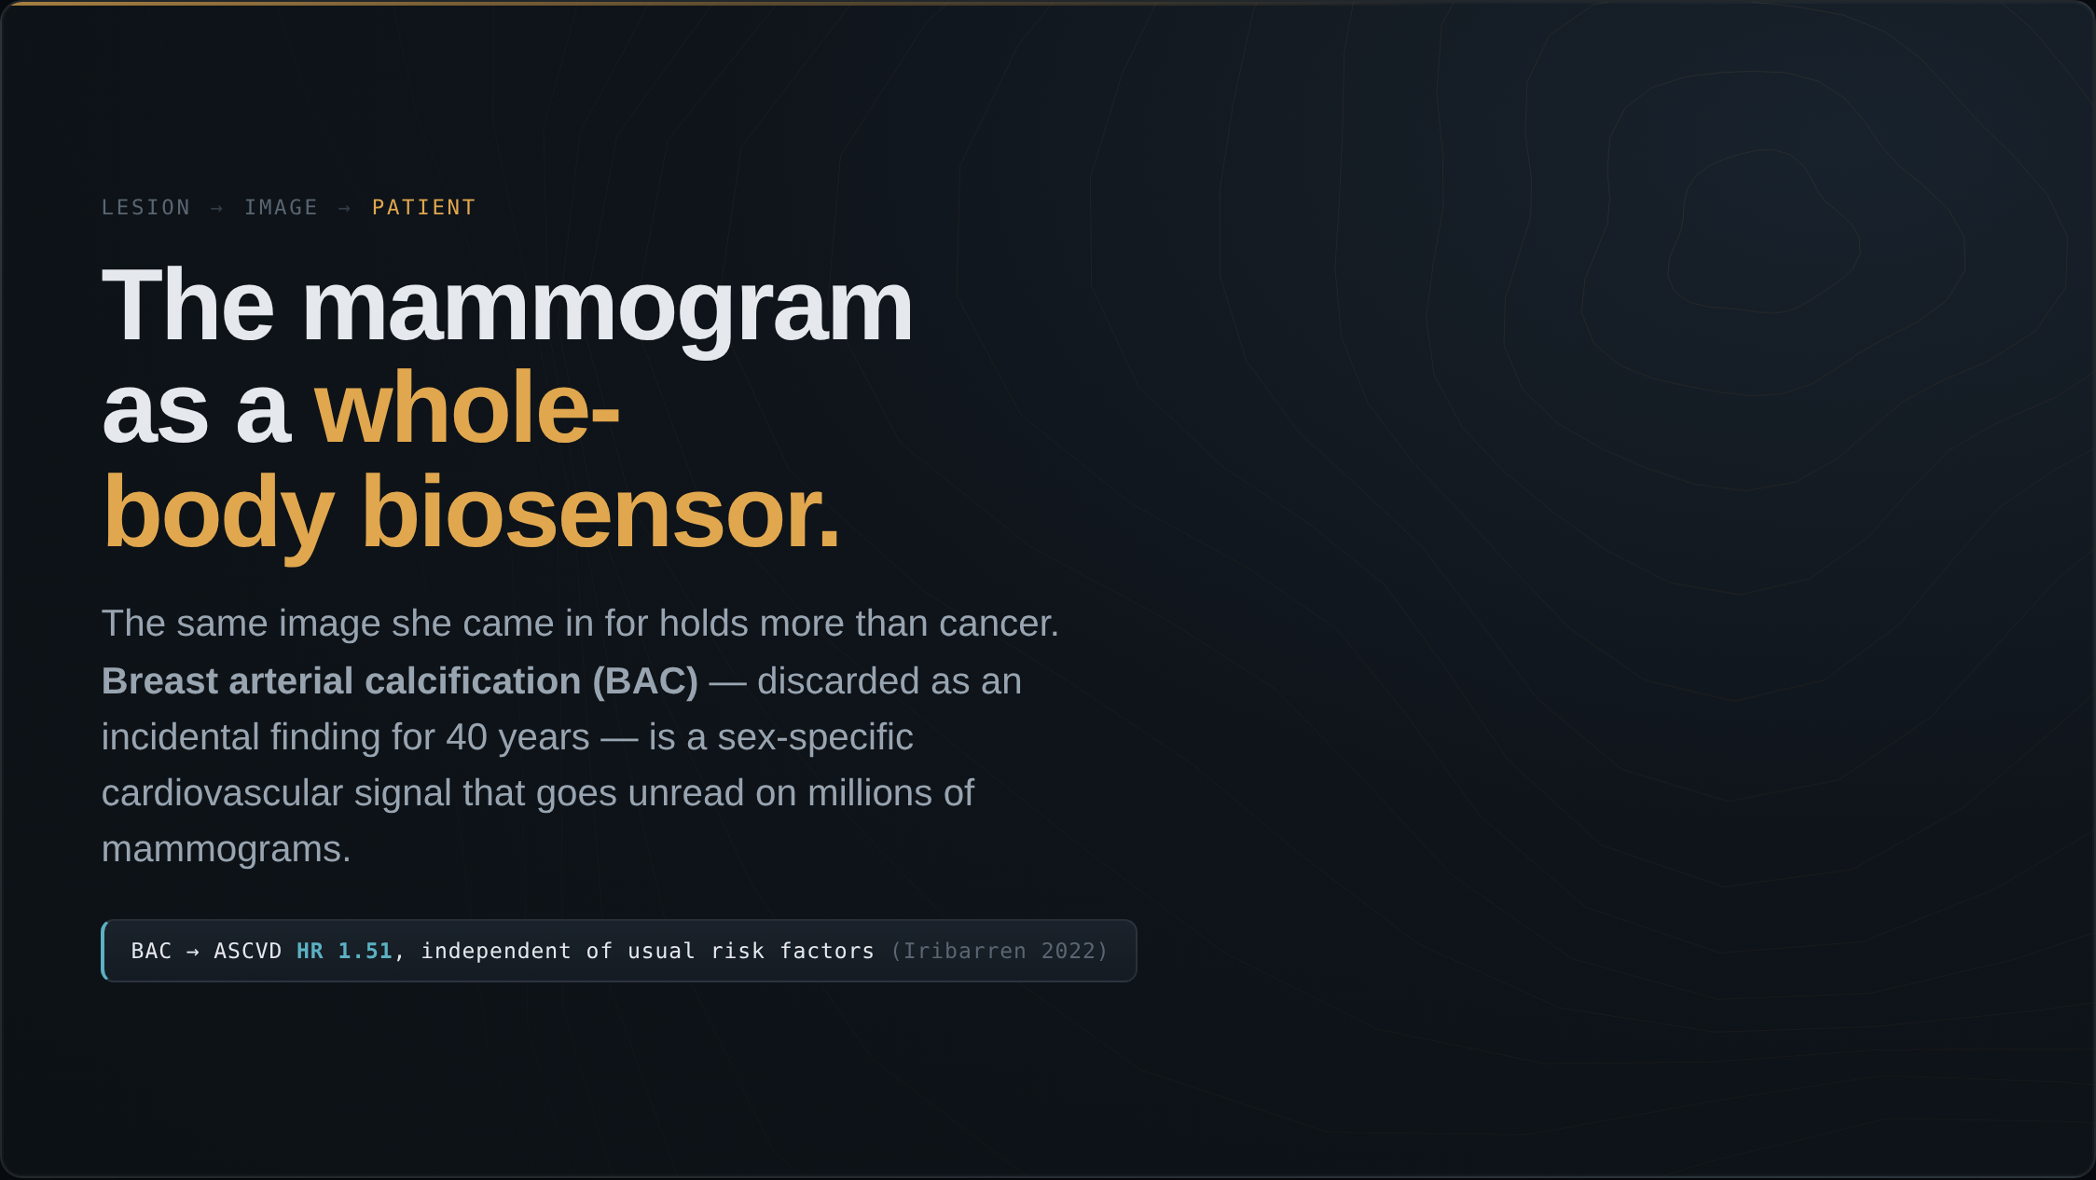
Notes:
Convergence is not only radiology and pathology. The same mammogram a woman gets for cancer is a biosensor for her whole body. Start with the heart — this closes the second model from our opening. Breast arterial calcification, treated as an incidental finding for forty years, is a sex-specific cardiovascular signal that goes unread on millions of mammograms. Iribarren showed it carries a hazard ratio around 1.5 for atherosclerotic disease, independent of the usual risk factors.

Slide 21
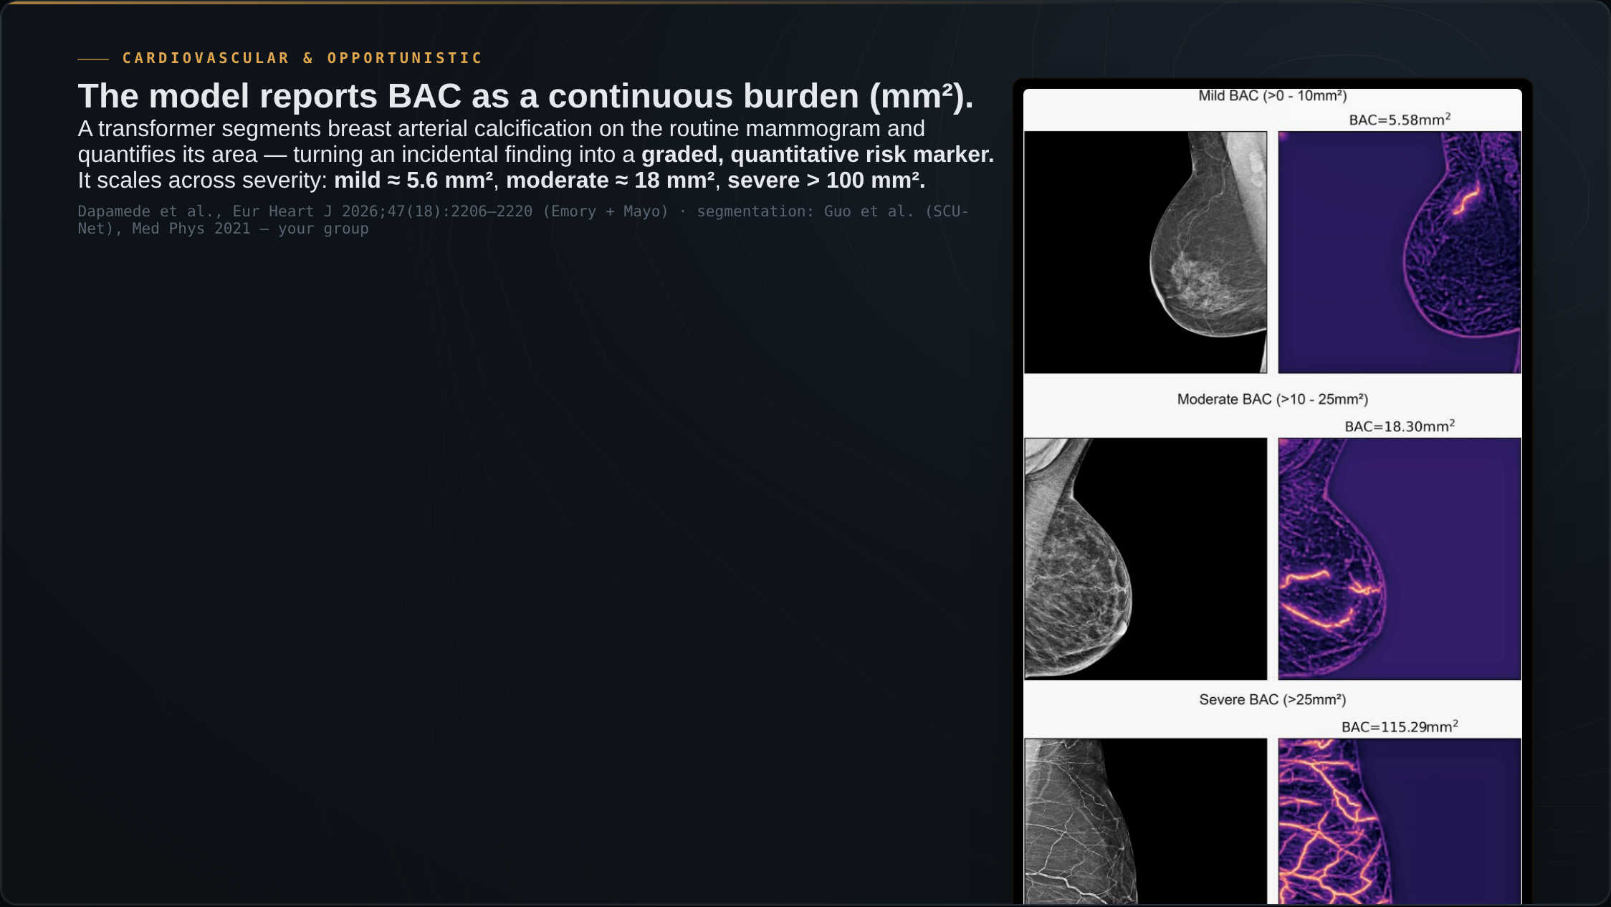
Notes:
Here is what the model does. A transformer segments the breast arterial calcification on the routine mammogram and reports its burden as an area, in square millimeters — the original image on the left, the model's segmentation on the right. You can see it scale, from mild calcification at about five square millimeters, to moderate at eighteen, to severe at over a hundred. That continuous number is what turns an incidental finding into a graded, quantitative risk marker. Our group built the segmentation model behind this, SCU-Net.

Slide 22
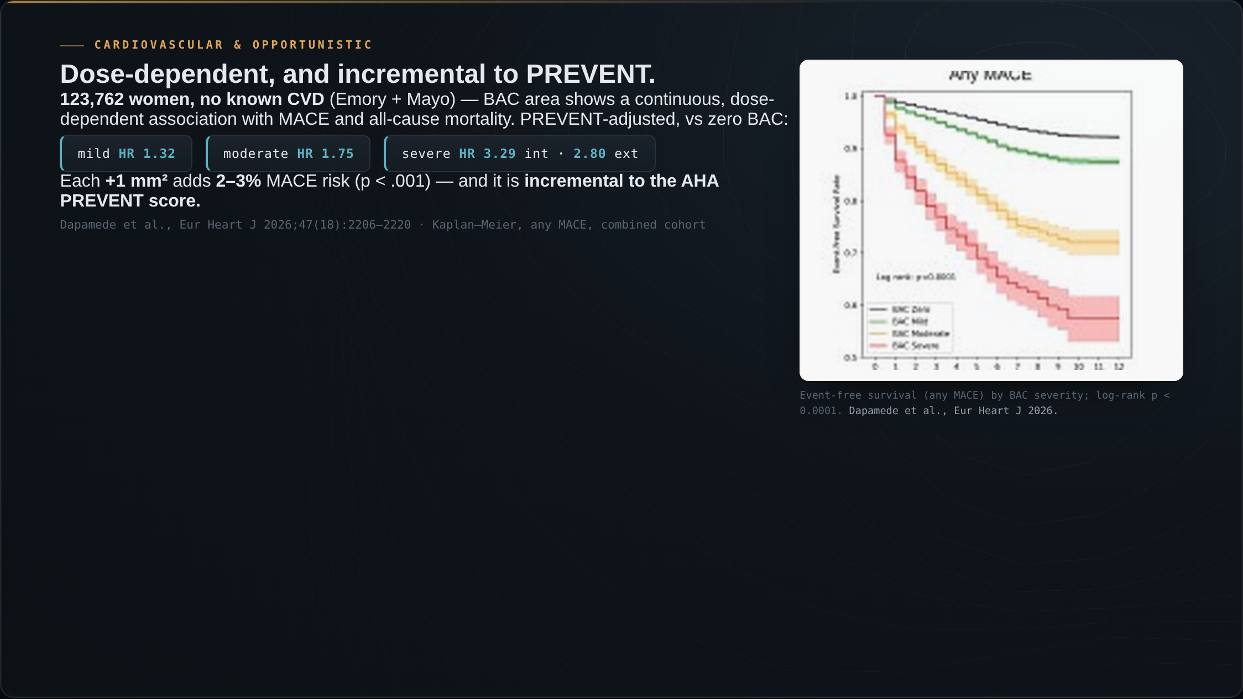
Notes:
And here is the result. Across 123,762 women with no known heart disease — the largest study of its kind — that burden shows a continuous, dose-dependent association with major adverse cardiac events and all-cause mortality. These are the Kaplan-Meier curves for any MACE, stratified by BAC severity: a clean graded separation, log-rank p below 0.0001. Adjusted for the AHA PREVENT score, mild calcification carries a hazard ratio of about 1.3, moderate about 1.75, and severe 3.3 internally and 2.8 in external validation. Each additional square millimeter adds two to three percent of risk. Crucially, this is incremental to PREVENT — it adds information the standard score does not capture.

Slide 23
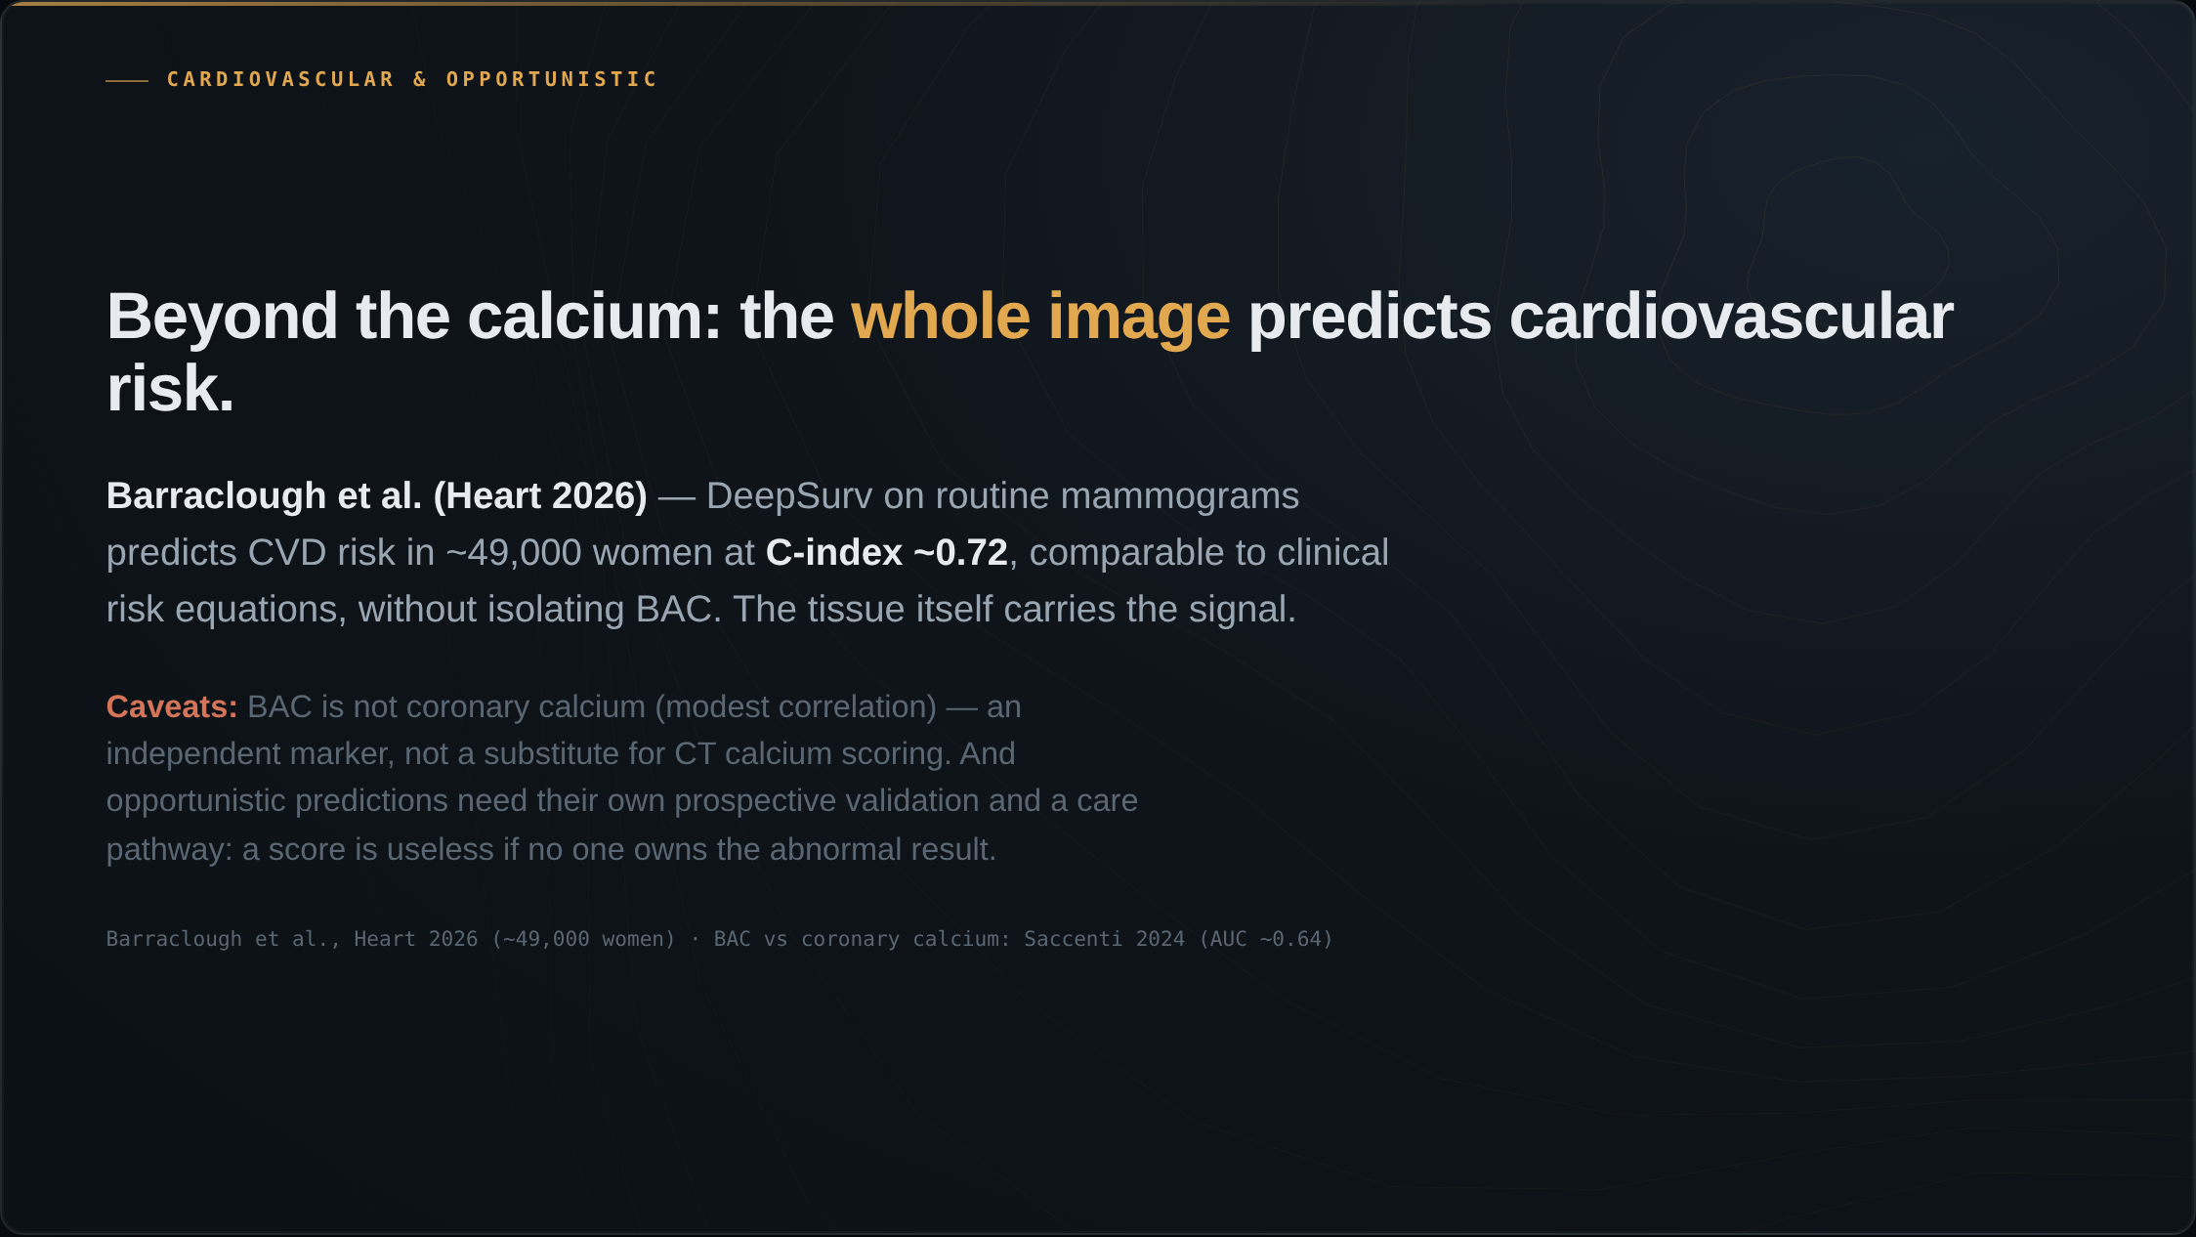
Notes:
And it is not the calcium alone. Barraclough and colleagues, on routine mammograms, predicted cardiovascular risk at a C-index around 0.72 — comparable to established clinical risk equations — without isolating the calcification. The breast tissue itself, not only the calcium, carries the signal. Two honest caveats: BAC is not coronary calcium, the correlation is only modest, so it is an independent risk marker, not a substitute for a CT calcium score. And any opportunistic prediction needs its own prospective validation and a care pathway — a cardiovascular score is useless if no one owns the abnormal result.

Slide 24
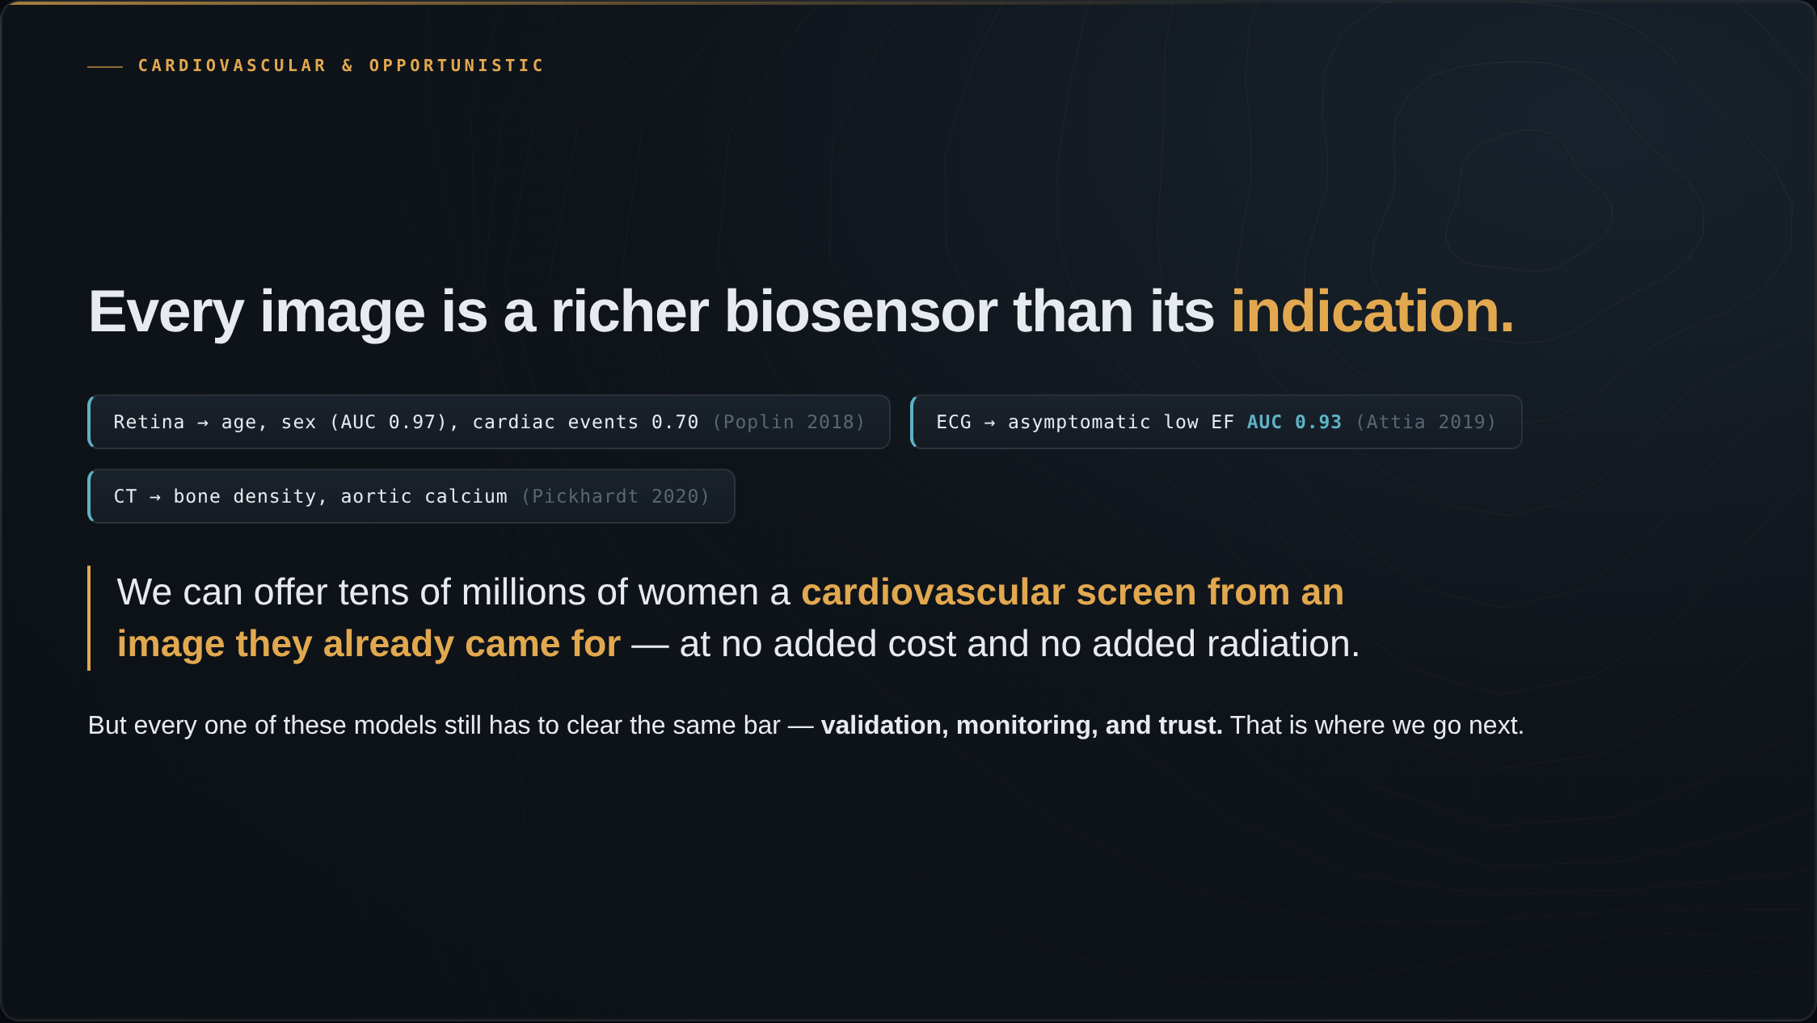
Notes:
And this is not specific to mammography. The same pattern appears across modalities. From a retinal photo, deep learning reads age, sex, blood pressure, and major cardiac events — signals no ophthalmologist reads. A ten-second ECG detects asymptomatic low ejection fraction at an AUC of 0.93. Routine CT yields bone density and aortic calcium. Every medical image is a richer biosensor than the question we ordered it to answer — AI is the first tool that can read the rest of it. We can now offer tens of millions of women a cardiovascular screen from an image they already came for, at no added cost and no added radiation. But every one of these models still has to clear the same bar — validation, monitoring, and trust. That is where we go next.

