Slide 1

International Workshop on Breast Imaging · 2026
Thirty Years,
Three Eras.
AI in Breast Imaging — from CAD to Clinical Intelligence
Hari Trivedi, MD · Emory University
Notes:
[Title card] Thirty Years, Three Eras: AI in Breast Imaging, from CAD to Clinical Intelligence. — Hari Trivedi, Emory University.

Slide 2
DISCLOSURES
Disclosures
FOUNDER
Avera AI
Lightbox AI
ASSOCIATE CMIO
HOPPR
ADVISOR
croviz.ai
Solis Mammography
Sirona Medical
Flatiron Health
Coefficient
Verily Life Sciences
Biodata Consortium
INDUSTRY / FOUNDATION SUPPORT
Simbiosys
HOPPR
Clairity
Lunit
DeepLook Medical
Kheiron Medical
GE
IBIS
Radicait
Voio
Appelai
Georgia CTSA
RSNA
SIR
Nightingale Open Science
Lacuna Fund
Meridian Foundation
Gates Ventures
Notes:
Quickly, my disclosures. I'm a founder of Avera AI and Lightbox AI, Associate CMIO at HOPPR, and I advise croviz.ai, Solis Mammography, Sirona Medical, Flatiron Health, Coefficient, Verily Life Sciences, and the Biodata Consortium. My research and the work in this talk have received industry and foundation support from the organizations listed on the right. None of these relationships dictated the content of this talk.

Slide 3
R MLO · screening
AI —
A normal screening mammogram — read as normal.
[ de-identified Emory screening case ]
Notes:
As you all know, this is a screening mammogram. In fact, a normal one — and it was read as normal. This is a real, de-identified exam from Emory. This is what we do today.

Slide 4
R MLO · screening
AI ✓✓✓
What are we not seeing?
AI reads this same mammogram and her biopsy slide — not just the lesion, but the patient.
[ de-identified Emory screening case ]
Notes:
Two radiologists read this and were right — there is no cancer to see today. So the question I want to pose is: what are we not seeing? What I want to describe by the end of this talk is how AI models — past, present, and future — read this same mammogram, and her eventual biopsy slide, and extract information that is not visible to us. The first estimates a high probability of breast cancer within about five years — which she did develop. The second quantifies calcification in her breast arteries — an independent cardiovascular risk marker, with a measurable dose-response. The third, applied to the slide from her eventual biopsy, estimates a recurrence score we currently send to a genomics lab for about four thousand dollars. None of these is hypothetical. Each is published and externally validated, and one is already in this year's screening guidelines.

Slide 5
From lesions to patients.
01
PAST
Lesion
find & characterize
02
PRESENT
Image
risk & opportunistic signal
03
FUTURE
Patient
pathology + integration
Notes:
So over the next thirty minutes or so, I want to take you on a short journey of how we got here and where we can expect to go: from the lesion, to the image, to the patient. And I'll start with a cautionary tale, because this field has overpromised before.

Slide 6
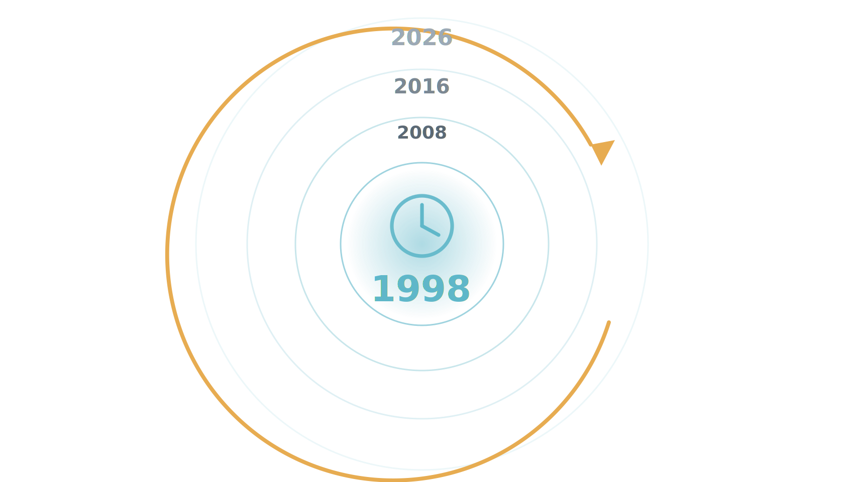
Let's step into a time machine.
This field has overpromised before. Let's start there — in 1998.
Notes:
To understand where this is going, we have to start with where it has been — because this field has overpromised before. So let's step into a time machine and go back to the beginning, to 1998.

