Slide 1

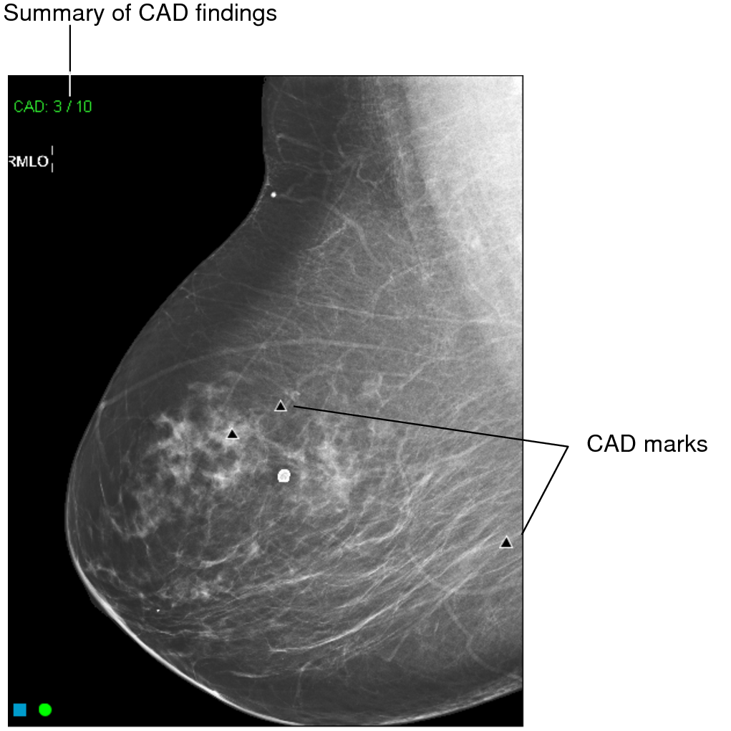
ERA I · 1998 · LESION → IMAGE → PATIENT
The year is 1998.
Computer-aided detection has just arrived — a mark on every mammogram flagging a possible cancer. A second set of eyes, automatically. It feels like the future.
Notes:
The year is 1998 — the year the FDA cleared the first CAD system for mammography. Computer-aided detection has just arrived: software that puts a mark on every mammogram to flag a possible cancer. A second set of eyes, automatically. It feels like the future.

Slide 2
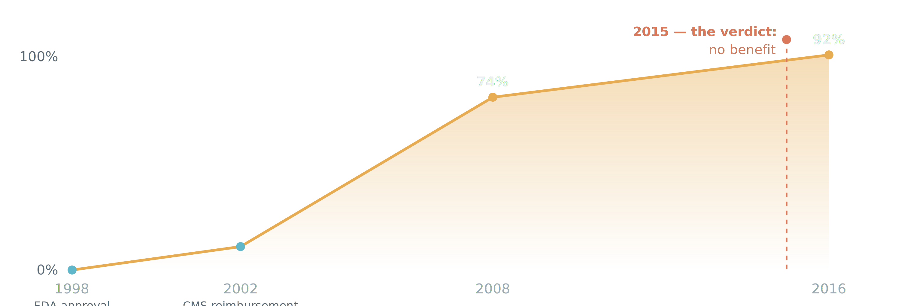
ERA I
Within a decade, CAD was used on most US mammograms.
A 2002 reimbursement code drove adoption — not evidence of benefit. The definitive study landed in 2015 — after CAD already ran on ~9 in 10 mammograms.
Notes:
And within a decade, it is everywhere. A reimbursement code in 2002 — not an outcomes trial — drove adoption from nothing to about 74% of US screening mammograms by 2008, and 92% by 2016. We adopted it on a billing code, not a clinical trial.

Slide 3
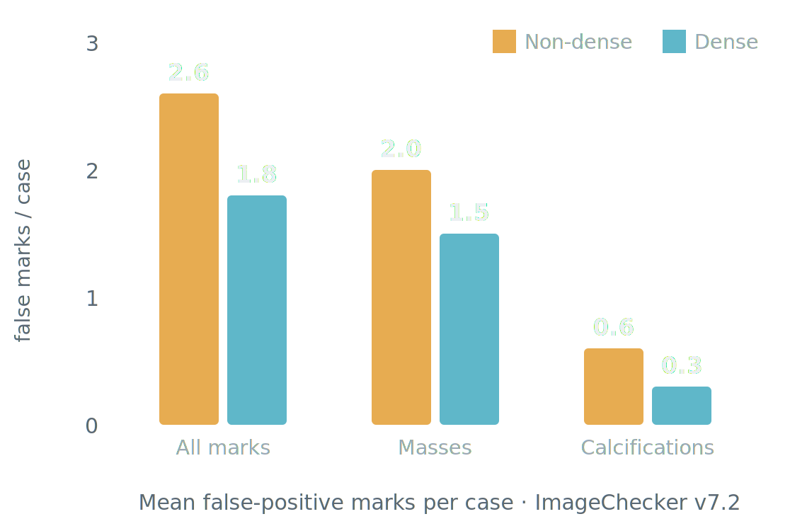
ERA I
Conventional CAD put a false-positive mark on most normal exams.
70–85%
of normal mammograms had ≥1 false positive
0.5–1.5
false positives per image — about 2–4 per 4-view case
Mean false-positive marks per case · ImageChecker v7.2 — Mahoney & Meganathan, J Digit Imaging 2011 (Table 4) · PMC3180536.
Kim 2009 · Mahoney 2011 · Watanabe 2019 · Leon 2009
Notes:
And the reading room is not convinced — because conventional CAD produced false positives constantly. Across independent series, seventy to eighty-five percent of normal mammograms carried at least one false-positive mark: Kim seventy, Mahoney up to eighty-five, Watanabe eighty-three — versus fifty-two percent for an AI-based CAD. In per-image terms that is roughly half a mark to one and a half false marks on every image. Mahoney measured about two to three false marks on a normal case — and more on non-dense breasts, where there is more to flag. After enough false alarms, radiologists learned to tune the marks out.

Slide 4
ERA I
$400M /yr
−47% odds
U.S. spend ≈ $1 of every $10,000 in health care
odds of detecting a malignant lesion — CAD on vs off, same readers (OR 0.53)
When the definitive study finally ran, CAD added cost and, for the same readers, lowered the odds of catching a cancer.
Lehman et al., JAMA Internal Medicine 2015 · 323,973 women · 271 radiologists
Notes:
Then the data came in. The United States was spending over four hundred million dollars a year — roughly one dollar of every ten thousand in US healthcare. And among radiologists who read both with and without CAD, the odds of detecting a malignant lesion were 47 percent lower with CAD on — same readers, same images. That is quite remarkable. For the radiologists in the audience: every breast radiologist I have spoken with essentially ignores the CAD marks, or finds them disruptive — so this paper was not much of a surprise.

Slide 5
ERA I
“Computer-aided detection does not improve diagnostic accuracy of mammography. These results suggest that insurers pay more for CAD with no established benefit to women.”
85.3% vs 87.3%
sensitivity — with vs without CAD
4.1 = 4.1 /1,000
cancer detection — identical
0.871 vs 0.919
AUC — with vs without (Fenton, NEJM 2007)
— Lehman et al., JAMA Internal Medicine 2015
Notes:
The conclusion is worth reading verbatim. It had been foreshadowed years earlier — Fenton, in the New England Journal in 2007, already showed CAD lowered accuracy and raised the biopsy rate.

Slide 6
ERA I
What went wrong.
01 It flagged only what we can already describe.
Hand-tuned features are limited to what we can design — so it added marks, not new information.
02 Readers learned to ignore it.
70–85% of normal exams carried at least one false-positive mark — eroding trust.
03 It was deployed at scale before it was ever validated.
Reimbursed in 2002 and run on ~92% of US screening mammograms by 2016; the definitive accuracy study didn't arrive until 2015 — and found no benefit.
Lehman CD, et al. JAMA Intern Med 2015;175(11):1828–1837 · Keen JD, et al. J Am Coll Radiol 2018 (adoption ~92%)
Notes:
Why did it fail? Three reasons. First, it could only flag what we already know how to describe — the features were hand-tuned, so it was limited to what we could design, and it added marks rather than new information. Second, it marked most normal studies — 70 to 85 percent carried at least one false-positive mark — so readers learned to ignore it, and trust eroded. And third, the deeper problem: it was deployed at scale, reimbursed and run on nearly every screening mammogram in the country, before it was ever validated. The definitive accuracy study didn't arrive until 2015 — and found no benefit.

Slide 7
ERA I
A paradigm shift.
TRADITIONAL CAD
Programmed
We wrote the rules for what cancer looks like. It pointed at spots for a human to check.
MODERN DEEP LEARNING
Trained
The model learns the patterns from the images themselves. It can read the image — as a second reader, or on its own.
→
Notes:
The lesson from Era I is that CAD was reimbursed before it was proven, and was never shown to help. Around 2012 the technology changed. Traditional CAD was programmed — we wrote the rules. Modern deep learning is trained — it learns the patterns from the images. Traditional CAD pointed at spots; modern models can read the image. Sixteen years later.

