Slide 1

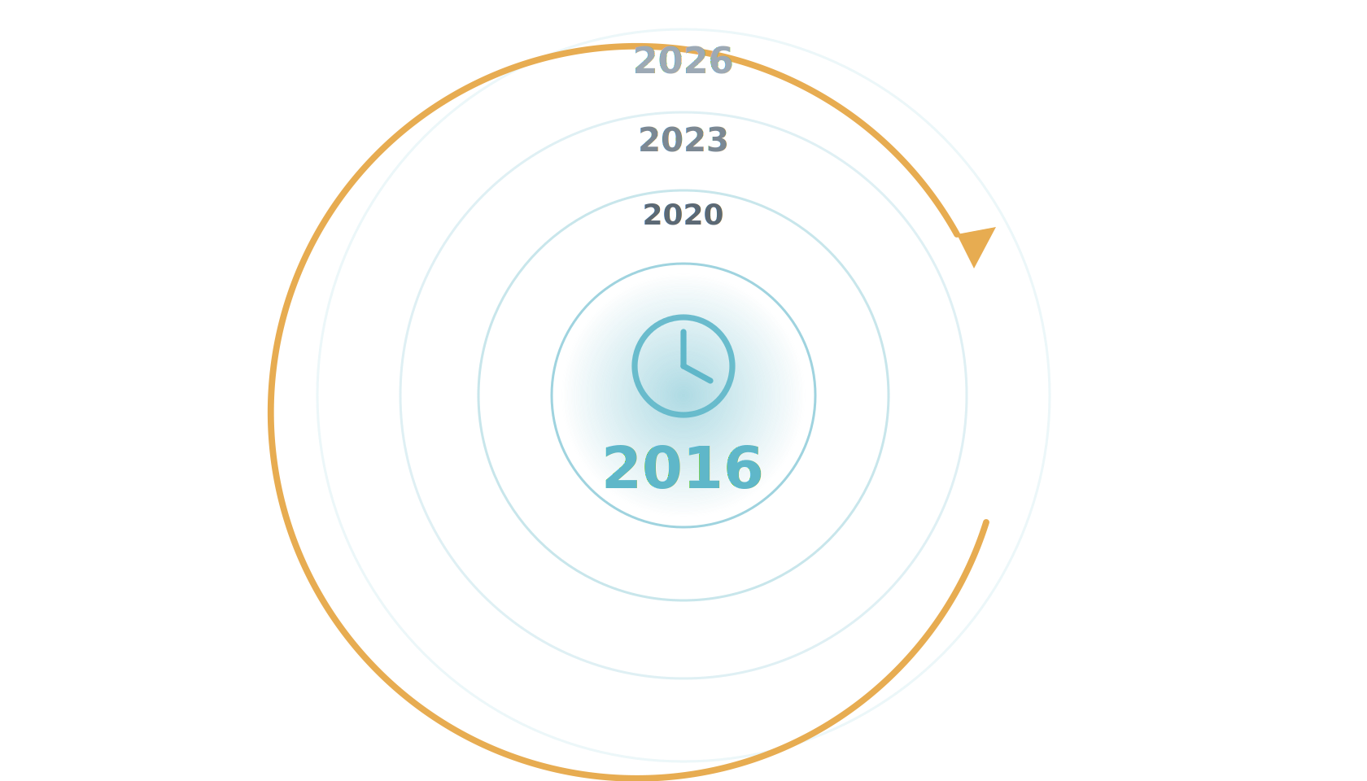
ERA II
The year is 2016.
You're beginning to hear about AI — but still feeling the burn from CAD.
Notes:
The year is 2016. You're a radiologist, you're just beginning to hear about AI for breast imaging — and the reading room is still feeling the burn from CAD. So what does mammography AI actually look like, and what is the evidence?

Slide 2
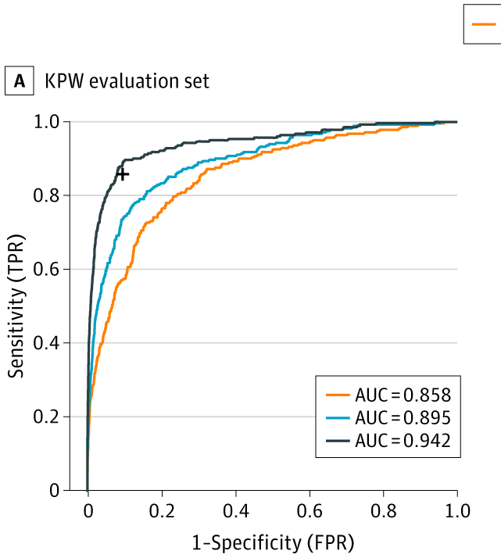
ERA II
2016: the first large-scale push — and a surge of optimism.
The Digital Mammography DREAM Challenge was the first large-scale effort to build breast-cancer AI — and we took part. The hope was that a crowdsourced competition would simply solve it.
1,000+ participants · 126 teams · 44 countries
~640,000 mammograms
Schaffter et al., JAMA Network Open 2020;3(3):e200265.
Notes:
The optimism wasn't new in 2020. Back in 2016 came the first large-scale effort to build breast-cancer AI: the Digital Mammography DREAM Challenge. Over a thousand participants, 126 teams from 44 countries, on roughly 640,000 mammograms; we took part. There was an incredible surge of optimism that this would simply solve breast AI. On the held-out evaluation set, the best single model reached an AUC of 0.858; the ensemble of the eight best models reached 0.895; and the ensemble plus a single radiologist reached 0.942.

Slide 3
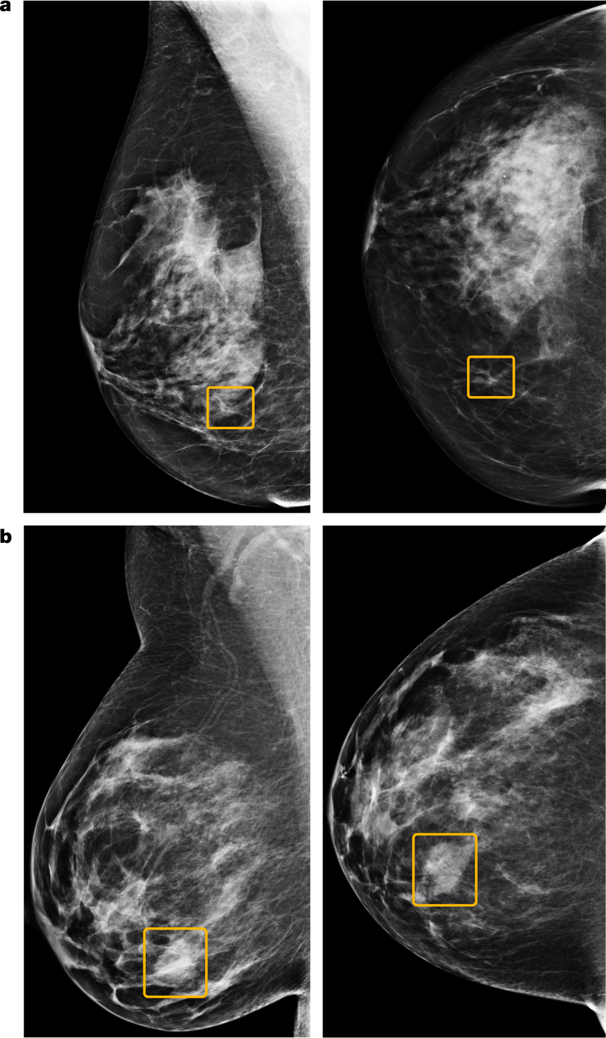
ERA II
2020: Google publishes its breast-cancer AI model.
McKinney et al., Nature 2020 (Google Health, UK + US) — a deep-learning system read screening mammograms stand-alone.
false positives −5.7% US / −1.2% UK
false negatives −9.4% US / −2.7% UK
AUC +11.5% vs avg radiologist
2nd-reader workload −88%
Results are promising — but again, only on clean, curated data.
McKinney et al., Nature 2020;577:89–94.
Notes:
So what was the early evidence? In 2020, McKinney and colleagues at Google Health, in Nature, reported an AI that on US data cut false positives by 5.7% and false negatives by 9.4%, exceeded the average radiologist's AUC by over 11 points, and could cut a second reader's workload by 88%. The figure shows example cases the model localized. On paper, superhuman — but only on clean, curated data.

Slide 4
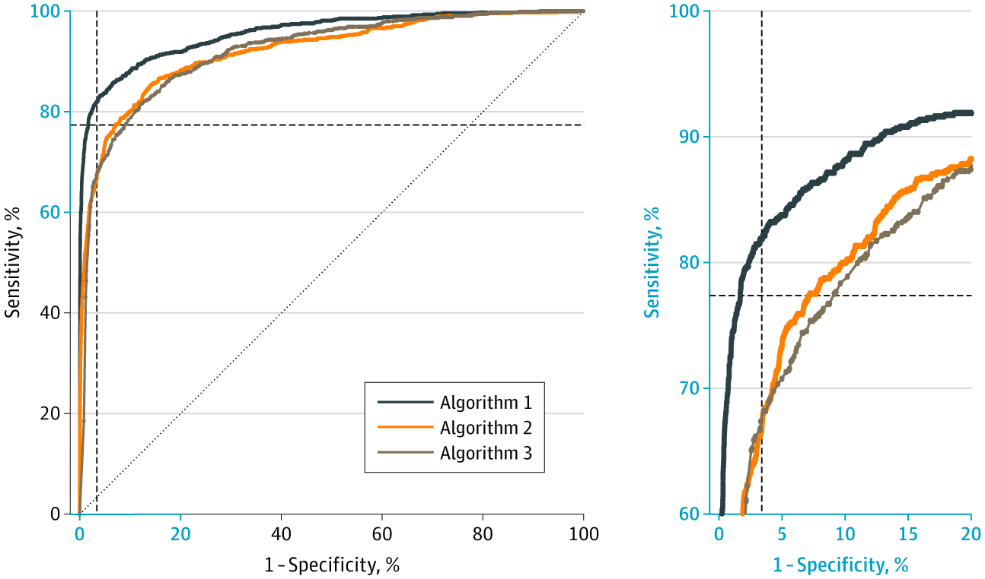
ERA II
2020: three commercial models, independently validated on 8,800 women.
Salim et al., JAMA Oncology 2020 tested three commercial algorithms on an external Stockholm cohort.
AUC — AI-1 0.956 · AI-2 0.922 · AI-3 0.920
at readers' specificity (96.6%): AI-1 81.9% sens vs readers 77.4%
AI + reader: +77% abnormal calls for +8% detection
The combination's recall cost is the operating-point tension in miniature.
Salim et al., JAMA Oncology 2020 (Stockholm, 8,805 women).
Notes:
And it held up independently. Salim and colleagues, in JAMA Oncology, took three commercial AI algorithms and tested them on an external Stockholm cohort of about 8,800 women. The AUC for cancer detection was 0.956 for AI-1, 0.922 for AI-2, and 0.920 for AI-3. To compare against radiologists fairly, they fixed the decision threshold at the radiologists' own level — the mean specificity of the first-reader radiologists, 96.6%. At that matched specificity, AI-1 reached 81.9% sensitivity, against the first readers' mean of 77.4%, in a simulated population of 113,663 screening examinations derived from the original 8,805 women. Combining AI with a first reader added detection, but at a cost: roughly 77% more abnormal calls for about 8% more cancers detected. That recall cost is the operating-point tension in miniature.

Slide 5
ERA II
2023: MASAI publishes its safety analysis.
A randomized trial, ~80,000 women (≈40,000 per arm) — AI-supported reading vs standard double reading.
6.1 vs 5.1 CDR per 1,000 · ratio 1.2 (95% CI 1.0–1.5)
Measure
AI
Control
Recall rate
2.2%
2.0%
False-positive rate
1.5%
1.5%
PPV of recall
28.3%
24.8%
Invasive cancers
75%
81%
Lång et al., Lancet Oncology 2023 — above the lowest acceptable detection limit for safety.
Notes:
In 2023, MASAI published its clinical safety analysis — a randomized trial of about eighty thousand women, roughly forty thousand per arm. Cancer detection was 6.1 per thousand with AI versus 5.1 in controls, a ratio of 1.2, above the lowest acceptable safety limit. Recall was essentially identical, 2.2 versus 2.0 percent; the false-positive rate was 1.5 percent in both; and the positive predictive value of recall was higher with AI, 28 versus 25 percent. Three-quarters of detected cancers were invasive. So: safe, and detecting more — the green light to continue.

Slide 6
ERA II
Data isn't enough to drive adoption.
Enriched cases, lab conditions, no real workflow — CAD had good numbers too. The bar is prospective deployment, and real-world uptake has been slow.
48%
13.7%
~2%
European radiologists use AI (2024) — up from 20% in 2018
of them, for breast imaging — about 1 in 8
of US practices, by one estimate
ESR EuroAIM/EuSoMII survey, Insights Imaging 2024 (n=572) · US estimate: industry report.
Notes:
But here is the discipline this talk runs on. Reader studies have well-known limits: enriched case sets, lab conditions, no real workflow. CAD had good numbers too. That kind of data is not enough to drive adoption. And it shows: a 2024 European survey found about 48% of radiologists use AI, but of those only 13.7% use it for breast imaging, about one in eight. In the US, by one estimate, only around 2% of practices use it at all.

