Slide 1

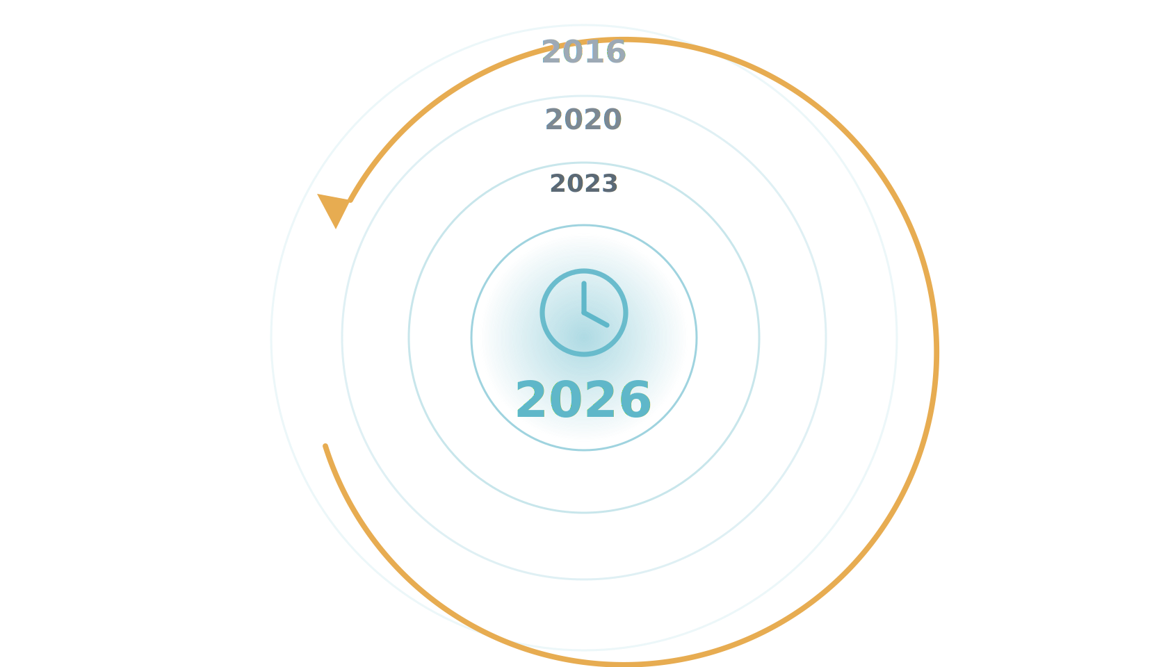
ERA II · 2026
The year is 2026.
Ten years on, the early promise has been put to the test — prospectively, in real screening programs.
Notes:
So step back into the time machine and come forward ten years, to 2026. The early promise we just saw was retrospective and lab-based. By 2026 that has changed: AI screening has been tested where it counts — prospectively, in real screening programs — and the picture is much clearer.

Slide 2
ERA II · 2026
2026: two prospective studies show AI screening works.
MASAI · SWEDEN · RCT (~105,000)
Interval cancers non-inferior (ratio 0.88)
Sensitivity 80.5% vs 73.8% at matched specificity · ~44% less reading workload.
Gommers/Lång et al., Lancet 2026;407:505–514
PRAIM · GERMANY · REAL-WORLD (463,000)
+17.6% cancers detected
Recall non-inferior · 6.7 vs 5.7 CDR / 1,000 · 12 sites, 119 radiologists.
Eisemann et al., Nature Medicine 2025
A third is underway: PRISM — the first large randomized trial of screening AI in the United States (Transpara; $16M PCORI; 7 sites; announced Sept 2025, recruiting). It tests the US single-reader workflow directly.
Notes:
And here is where it stands in 2026: there are now two large prospective studies showing AI works in a real screening program. MASAI, the Swedish randomized trial of about 105,000 women, reported its interval-cancer result — non-inferior, with a ratio of 0.88, at a sensitivity of 80.5 versus 73.8 percent for the same specificity, and it cut reading workload by about 44 percent. PRAIM, a real-world German deployment of 463,000 women across twelve sites and 119 radiologists, found 17.6 percent more cancers detected with AI support and no increase in recall. Two prospective studies, two countries, the same direction. And a third is underway: PRISM, the first large randomized trial of screening AI in the United States — a sixteen-million-dollar PCORI-funded, seven-site study using Transpara, announced in September 2025 and recruiting now. Results are years away, but for the first time the US single-reader workflow will be tested directly. — MASAI detail, for reference: the population was 80,033 women aged 40 to 80 screened at four sites in southwest Sweden, randomized one-to-one between April 2021 and July 2022 to AI-supported reading versus standard double reading by two radiologists without AI. There were 244 screen-detected cancers, 6.1 per 1,000 participants, from 46,345 screen readings in the intervention group of 39,996 participants, versus 203 in the control group — detection went up, not down, the opposite of the feared scenario. The widely quoted framing is a roughly 20 percent relative increase in detection, 6.1 versus about 5.1 per 1,000, at this interim stage; the Lancet Digital Health companion analysis later reported a 29 percent increase in cancer detection without an increase in false positives. The workload number: AI support reduced radiologists' screen-reading workload by 44 percent — nearly halving the reading burden while detection held up or improved. — PRAIM detail, for reference: PRAIM was embedded in Germany's national program, so the existing standard was already a two-reader system. For each woman, four 2D mammograms are taken — CC and MLO of each breast — read independently by two radiologists, sometimes with a third supervising. If at least one radiologist deems the case suspicious, a consensus conference is held, attended by at least the two initial readers plus a head radiologist, and that consensus step decides recall. This matters because both arms of PRAIM kept this double-reading-plus-consensus structure — the only variable being whether AI was present. Cancer detection rate: 6.7 per 1,000 in the AI arm versus 5.7 per 1,000 in control — a 17.6 percent relative increase, 95 percent CI plus 5.7 to plus 30.8 percent, statistically superior. Recall rate: 37.4 per 1,000 in the AI arm versus 38.3 in control — a minus 2.5 percent difference, 95 percent CI minus 6.5 to plus 1.7 percent, noninferior and numerically lower. PPV of recall: 17.9 percent in the AI arm versus 14.9 percent in control. PPV of biopsy: 64.5 percent versus 59.2 percent.

Slide 3
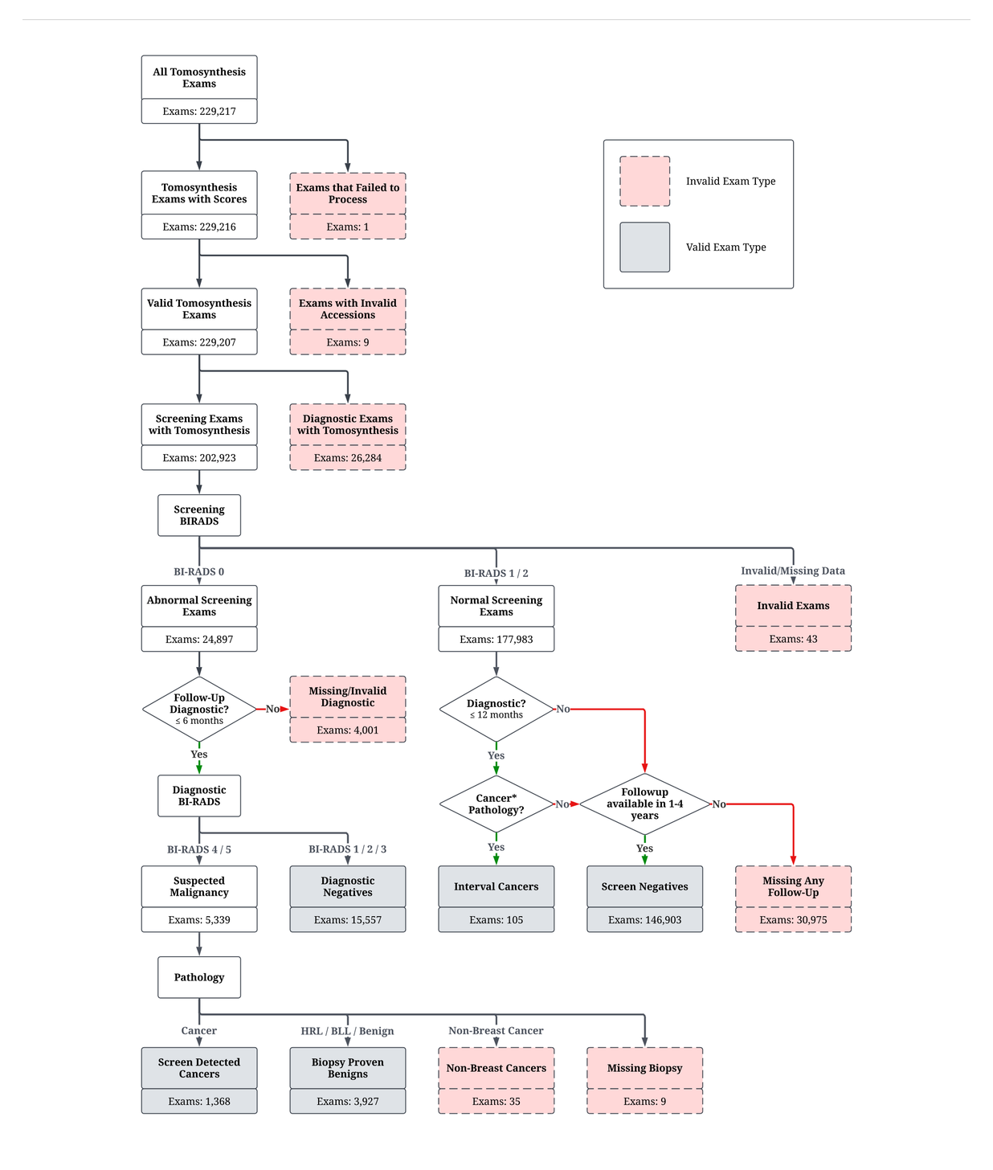
ERA II · 2026
The averages look strong — but what counts as the truth?
The label is not in the image — it comes from follow-up and pathology. Assigning it is a cascade of judgment calls (~163,000 EMBED exams, AUC 0.91), and it sets the denominator for every downstream number.
Notes:
Before we ask where the model fails, we have to ask a harder question: what are we even measuring against? A screening mammogram carries no label in the image — the ground truth comes from what happens next. We link each exam to follow-up imaging and to pathology, and only then assign an outcome. But that assignment is full of judgment calls. How long do you follow a woman before you are willing to call an exam truly negative? A high-risk lesion — atypical ductal hyperplasia, LCIS, a papilloma — is neither clearly benign nor cancer; which bucket does it go in? Do you pool DCIS, which is non-invasive, with invasive cancer, when their clinical meaning is so different? Every one of these choices changes the denominator, and therefore every AUC, every sensitivity, every subgroup number that follows. Defining the outcome is the hard part — and it is rarely shown.

Slide 4
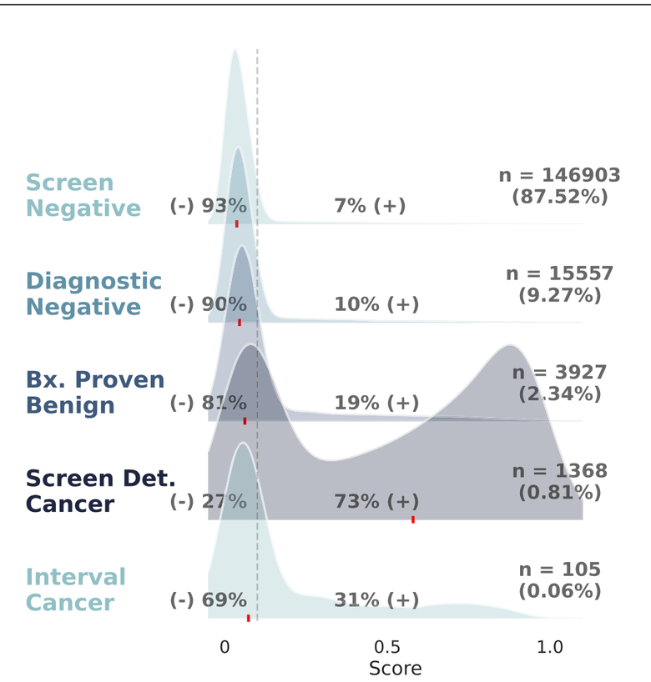
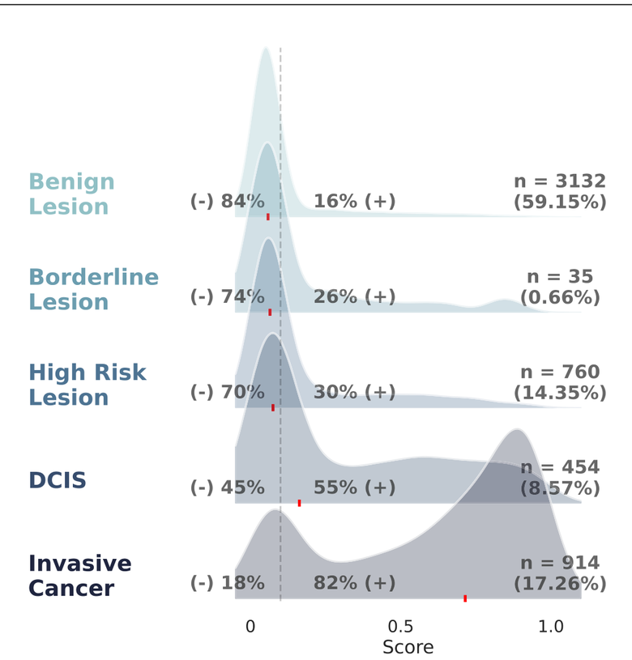
ERA II · 2026
Performance across outcomes and cancer types.
By clinical outcome (Fig. 2)
By pathology (Fig. 3)
[your group], Nat Commun 2026 (DOI 10.1038/s41467-026-70637-3), Figs. 2–3.
Notes:
Once the labels are set, the average breaks down by outcome and by cancer type. On the left, by clinical outcome: the model scores screen-detected cancers positive about 73 percent of the time, but interval cancers — the ones that surface between screens — only 31 percent. On the right, by pathology: positive-score rates climb from benign lesions at 16 percent, borderline at 26, high-risk lesions at 30, DCIS at 55, to invasive cancer at 82 percent. So non-invasive disease and high-risk lesions are flagged far less often than invasive cancer — a single headline AUC averages over categories the model handles very differently.

Slide 5
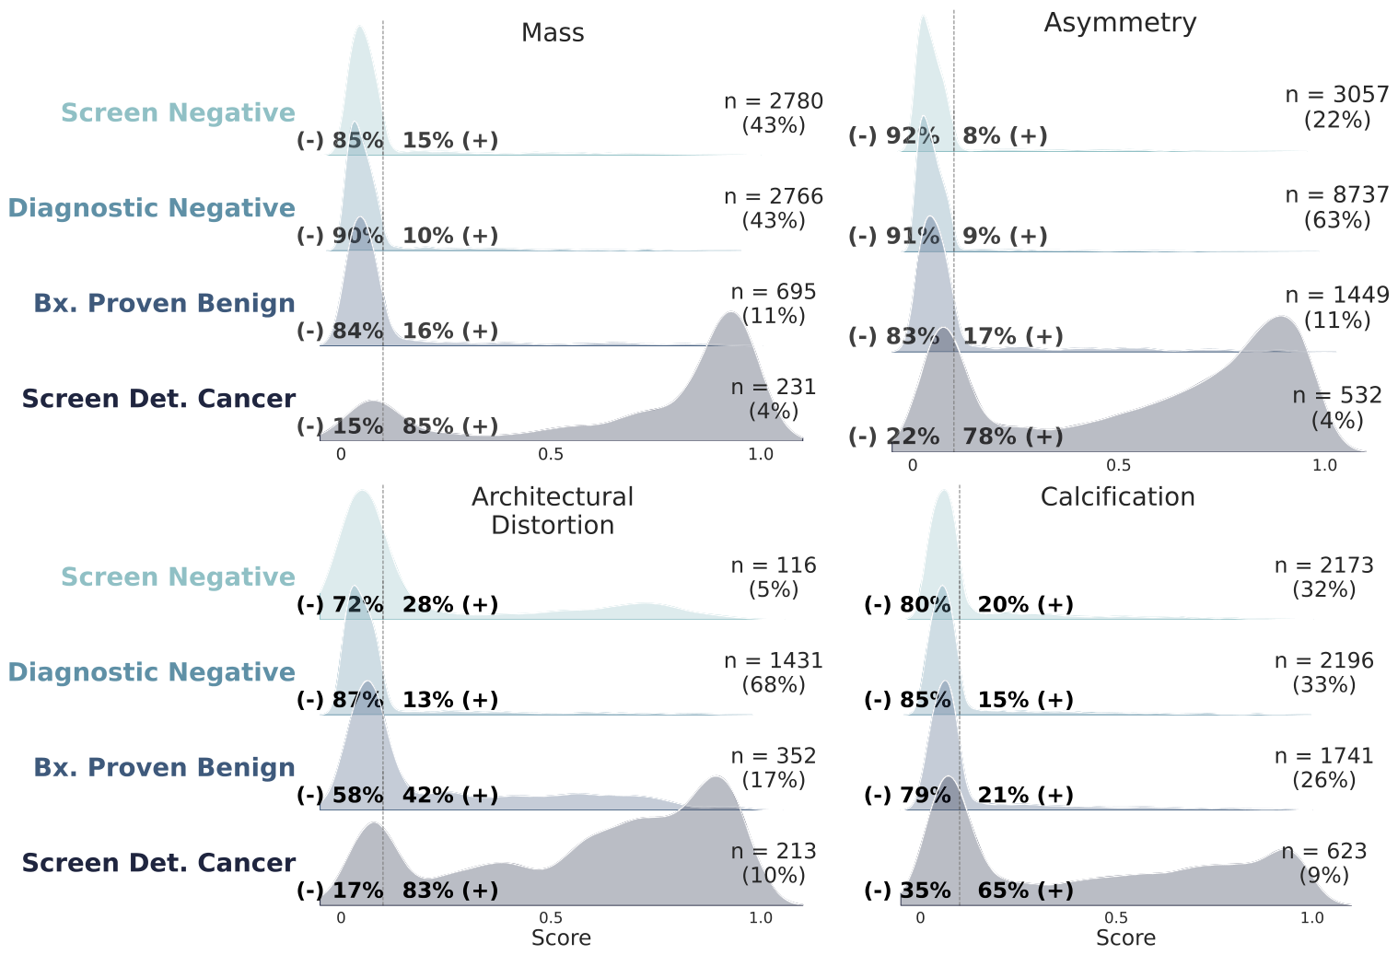
ERA II · 2026
Performance across imaging findings.
Exam-level model-score distributions by imaging feature, across clinical outcome.
[your group], Nat Commun 2026 (DOI 10.1038/s41467-026-70637-3), Fig. 6.
Notes:
The second breakdown is by imaging feature. Look at how the same model's scores split by what the finding looks like. Masses, asymmetries, and calcifications are correctly predicted negative in 60 to 81 percent of exams. But architectural distortions behave very differently: even screen-detected cancers split into a bimodal high-and-low distribution, and many benign distortions score high — so the model both misses cancers and over-flags benign findings in that one category. Performance depends on what the finding looks like, not just the headline AUC.

Slide 6
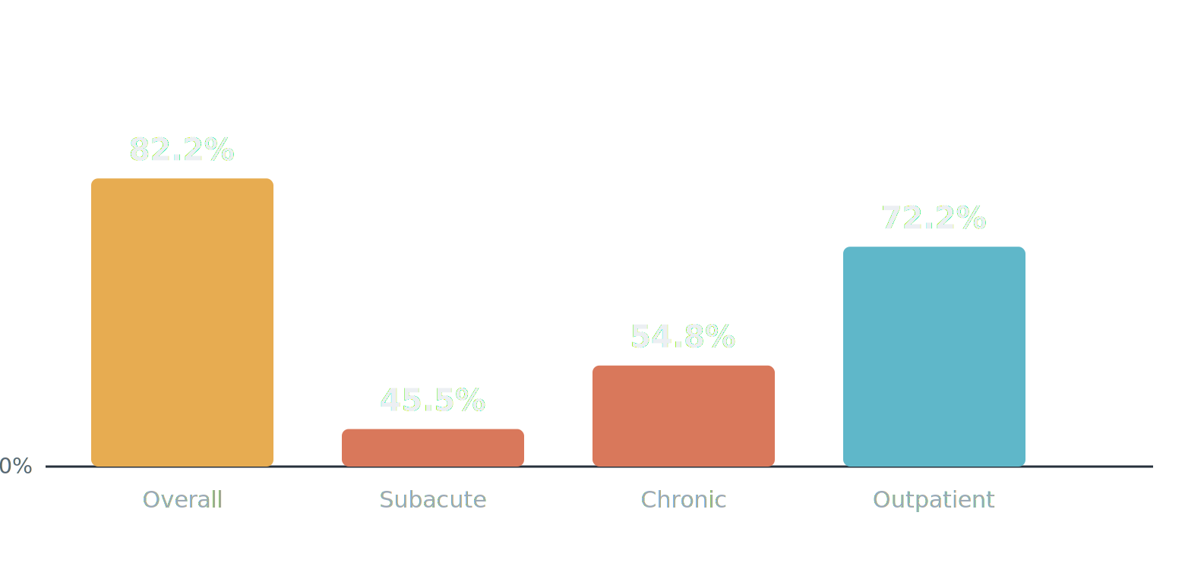
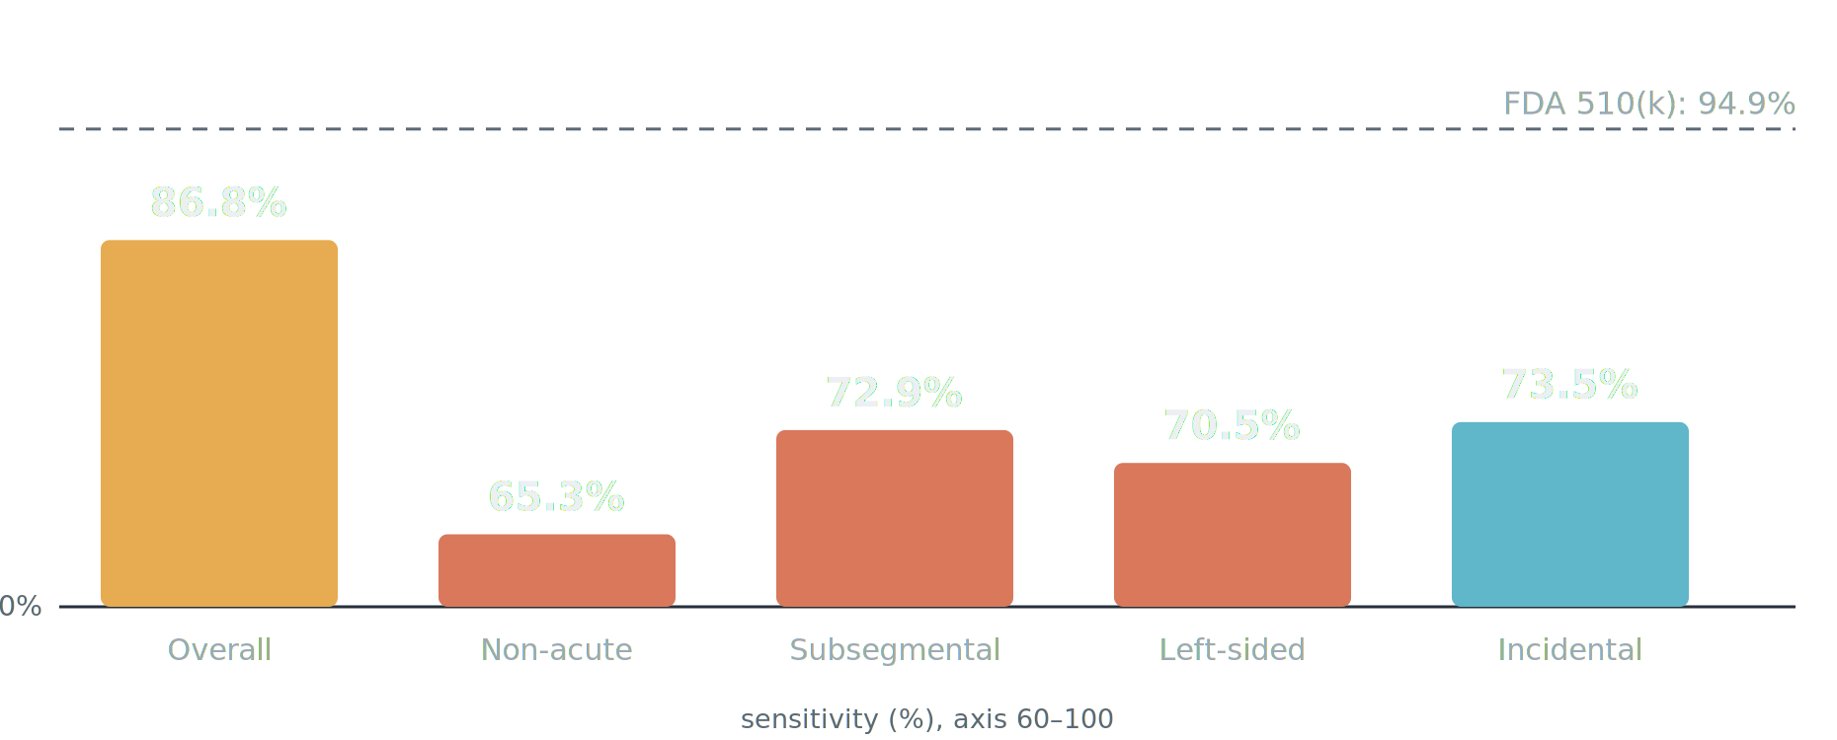
ERA II · 2026 · NOT ONLY BREAST
The same fragility — beyond breast.
Two FDA-relevant tools, two organs: overall sensitivity looks strong — then it collapses in the hard subgroups.
HEAD CT · INTRACRANIAL HEMORRHAGE
CHEST CT · PULMONARY EMBOLISM
ICH: [your group], npj Digital Medicine 2025 · PE: [your group], unpublished (Aidoc PE/iPE, 30,678 CTPA).
Notes:
Two organs beyond breast, same story. On head CT, a commercial intracranial-hemorrhage detector looked strong overall at 82.2 percent — but by the age of the bleed it collapsed: subacute 45.5 percent, chronic 54.8 percent, and in the outpatient setting 72.2 percent. On chest CT, an FDA-cleared pulmonary-embolism model cleared at 94.9 percent reached 86.8 percent overall across two years of real-world CT angiograms, then fell apart on the hard cases — non-acute 65.3 percent, subsegmental 72.9 percent, left-sided 70.5 percent, and incidental PE on routine scans just 73.5 percent (354 of 538). Same shape as breast: a strong average, weak exactly where it matters.

Slide 7
ERA II · 2026 · OPEN DATA
Emory Breast Imaging Dataset (EMBED).
MAP — EMBED USERS BY COUNTRY
[ drop in PNG ]
Free to researchers through the AWS Open Data Program.
EMBED V2 — IN PROGRESS
~300,000 patients
~1M exams (2D · DBT · US · MRI)
Free-text reports
Patient risk data
Outcomes registry-harmonized
v1: [your group], Radiology: Artificial Intelligence 2023 (Fig. 1) · aws.amazon.com/opendata
opt: EMBED v1 schematic — Radiology: AI, Fig. 1
Notes:
Before we cross into Era III, one plug. All of this work runs on EMBED — the Emory Breast Imaging Dataset — which we have made free to researchers worldwide through the AWS Open Data Program. The first release is described in our Radiology: Artificial Intelligence paper. And we are finishing EMBED version two: nearly 300,000 patients, about a million exams, both 2D and tomosynthesis, 50,000 ultrasound and 25,000 MRI studies, outcomes harmonized with state and local cancer registries, the free-text radiology reports, and patient risk data. The map gives a sense of the reach — researchers on every continent are already using it.

Slide 8
ERA II · 2026 → ERA III
We are at the brink of Era III.
Detection is proven. But the same 2026 image — and the tissue that follows it — already tells us more than “is there cancer today?” From one screening mammogram and its biopsy: a future-risk estimate, a cardiovascular signal, and a molecular recurrence score — the shift from finding the lesion to characterizing the patient.
Notes:
So detection works — we now have the prospective evidence. But here is what is striking: it is still 2026, and the very same mammogram — and the tissue that follows it — already tells us far more than whether there is a cancer today. From this one screening image we can read a woman's future risk and a cardiovascular signal; from her biopsy slide, a molecular recurrence score. We are standing at the brink of Era III — the shift from finding the lesion to characterizing the patient — and, remarkably, much of it is available right now.

Slide 9
ERA III · 2026
For 40 years, the only risk signal we could read off the image was density. The clinical models layered on top — Gail and Tyrer-Cuzick — were hardly better than a coin flip.
~0.62
Tyrer-Cuzick v8 · 5-yr AUC
~0.55–0.58
Gail model · 5-yr AUC
Coin flip is 0.50. For the woman in front of you, barely above it.
Gail · Tyrer-Cuzick · BCSC — questionnaire + density models
Notes:
For forty years, the only risk signal we could read off the image was breast density — coarse and subjective. The clinical models we layered on top, Gail and Tyrer-Cuzick, were weak: Tyrer-Cuzick predicts five-year risk at an AUC around 0.62, barely better than chance at the level of the individual.

Slide 10
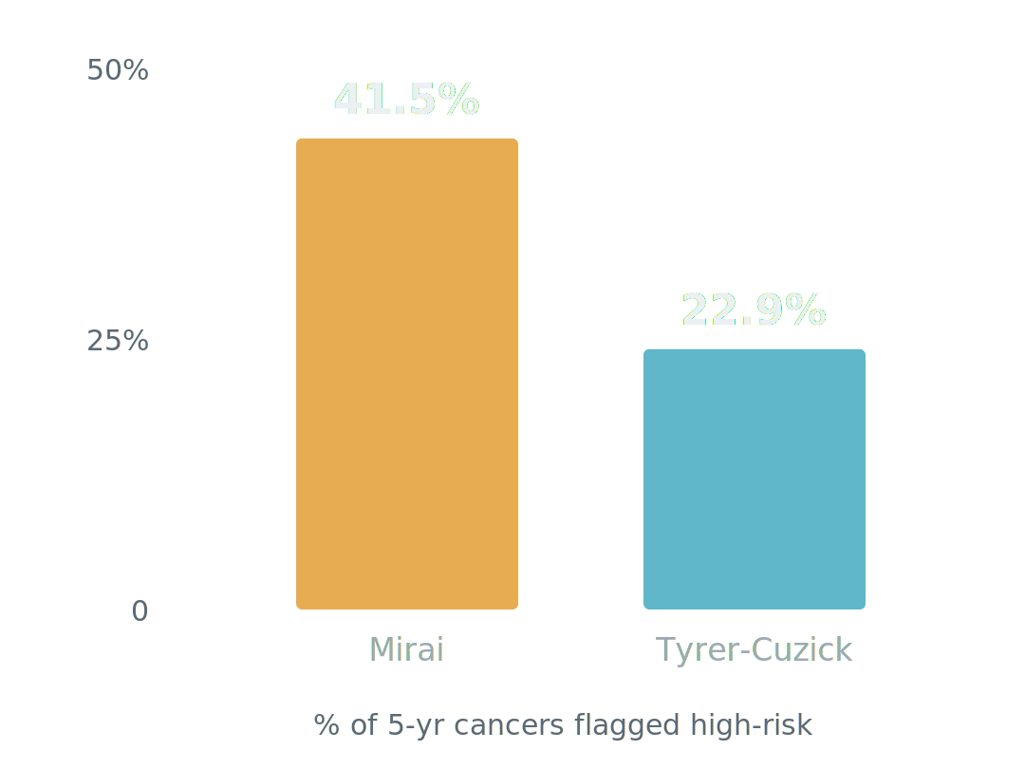
ERA III · 2026
Image-based risk — Mirai and a de novo FDA clearance.
0.76–0.81
Mirai C-index · 3 countries
< 5 yr
research → cleared → guideline
Notes:
The image itself carries risk. Yala and colleagues at MIT and MGH showed a deep network reading the mammogram out-predicts the questionnaire models — Mirai, externally validated across three countries at a C-index of 0.76 to 0.81. Among women who developed cancer within five years, it flagged 41.5 percent as high-risk versus 22.9 percent for Tyrer-Cuzick. And this is no longer just research: in June 2025 Clairity received FDA De Novo authorization — the first tool to predict five-year breast-cancer risk from a routine screening mammogram alone, and it was added to the 2026 NCCN guidance. Research model to cleared product to guideline in under five years. There is not yet a primary peer-reviewed validation paper for Clairity.

Slide 11
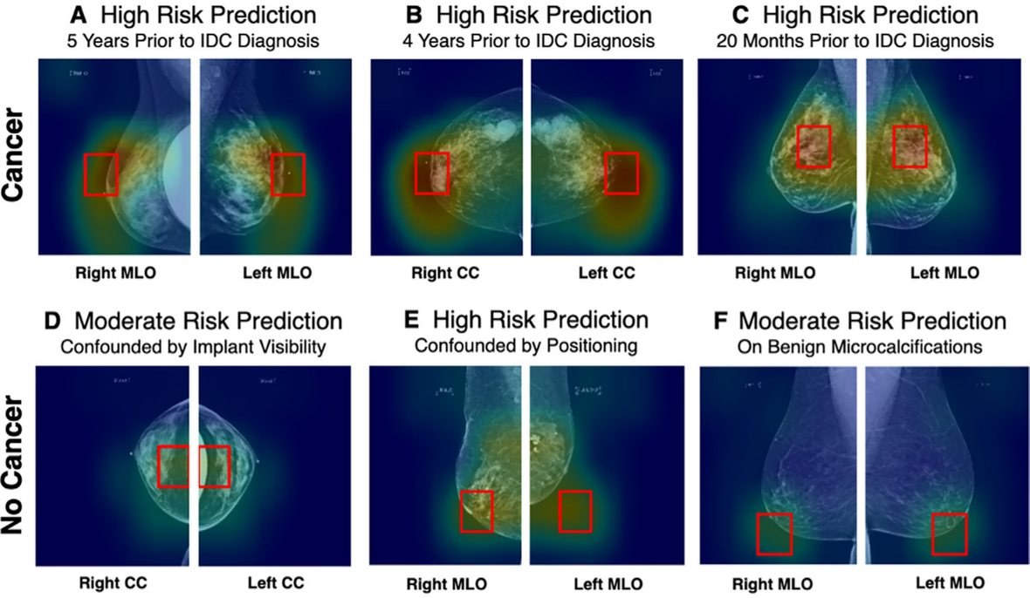
ERA III · 2026
AsymMirai — an explainable risk model.
1-yr AUC 0.79 vs Mirai 0.84 · 3-yr AUC 0.92 (stable tissue)
Notes:
Here is explainability done right, and it is our group's work with Duke. We asked what Mirai was actually keying on. The answer was surprisingly simple: local bilateral dissimilarity — the difference between left and right breast tissue in the same region. A transparent model built only on that asymmetry nearly matched the black box: one-year AUC 0.79 versus 0.84, and in stable-tissue subgroups three-year AUC 0.92. A risk signal you can point to on the image, and audit for where it fails.

Slide 12
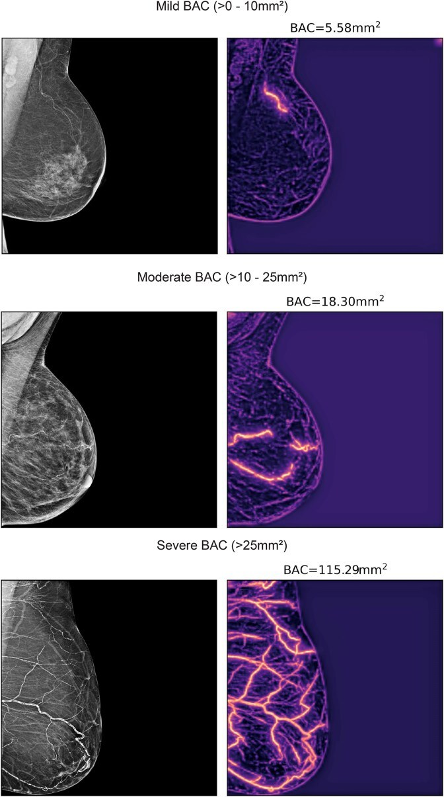
ERA III · 2026
Breast Arterial Calcification (BAC) as a continuous measurement (mm²).
A transformer segments breast arterial calcification on the routine mammogram and quantifies its area — turning an incidental finding into a graded, quantitative risk marker.
Segmentation: SCU-Net (your group). Dapamede et al., Eur Heart J 2026;47(18):2206–2220.
Notes:
Here is what the model does. A transformer segments the breast arterial calcification on the routine mammogram and reports its burden as an area, in square millimeters — the original image on the left, the model's segmentation on the right. You can see it scale, from mild calcification at about five square millimeters, to moderate at eighteen, to severe at over a hundred. That continuous number is what turns an incidental finding into a graded, quantitative risk marker. Our group built the segmentation model behind this, SCU-Net.

Slide 13
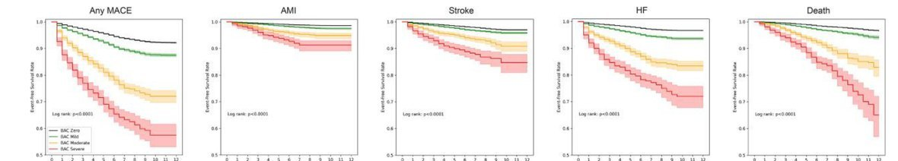
ERA III · 2026
BAC predicts MACE — more calcium, more risk.
~120,000 women, two sites, racially diverse. Dose-response: mild HR 1.18–1.22 · moderate 1.38–1.47 · severe 2.03–2.22.
Event-free survival by BAC severity — MACE, AMI, stroke, HF, death. Dapamede et al., Eur Heart J Open 2025.
Notes:
Now the outcomes. In a multi-site cohort of more than 120,000 women across Emory and Mayo, AI-quantified BAC independently predicted major adverse cardiovascular events in a graded, dose-response fashion: mild hazard ratios around 1.2, moderate around 1.4, severe around 2.0 to 2.2. And the risk held across every component endpoint within PREVENT categories — heart attack, stroke, heart failure, and all-cause mortality. Crucially, the signal persists in women under 50, a group traditionally deemed low-risk in whom coronary calcium has usually not yet developed. An age-adjusted nomogram from Nerlekar showed a 17 percent increase in MACE per 10 percentiles of BAC and reclassified about 5 percent of women beyond standard scoring, improving the C-statistic from 0.67 to 0.71. And BAC is dynamic, not static: in 41,621 women with serial mammograms, current BAC stayed predictive throughout 8.6 years of follow-up. The commercial FDA-cleared tool reports only presence or absence; quantification is what turns a weak binary flag into an actionable, graded risk marker.

Slide 14
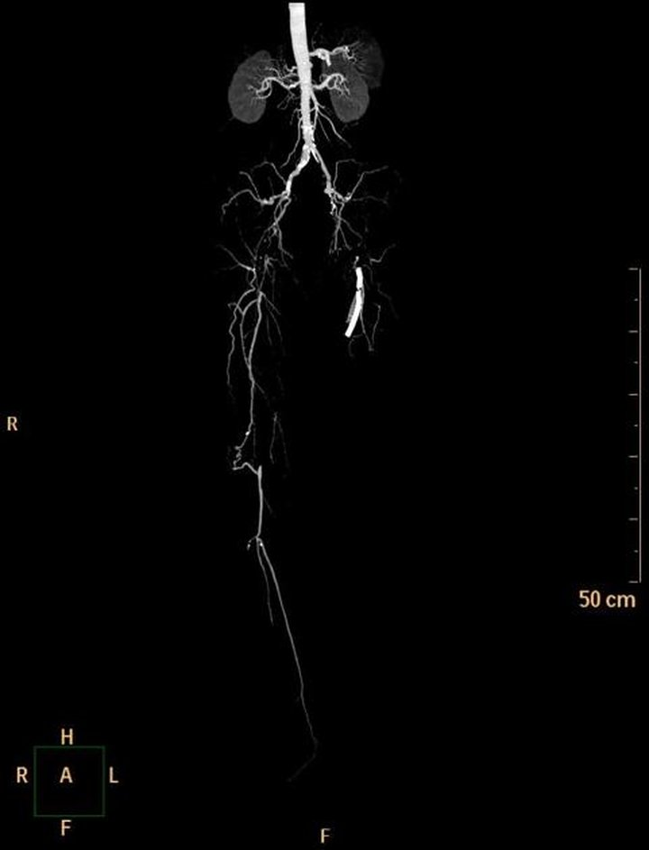
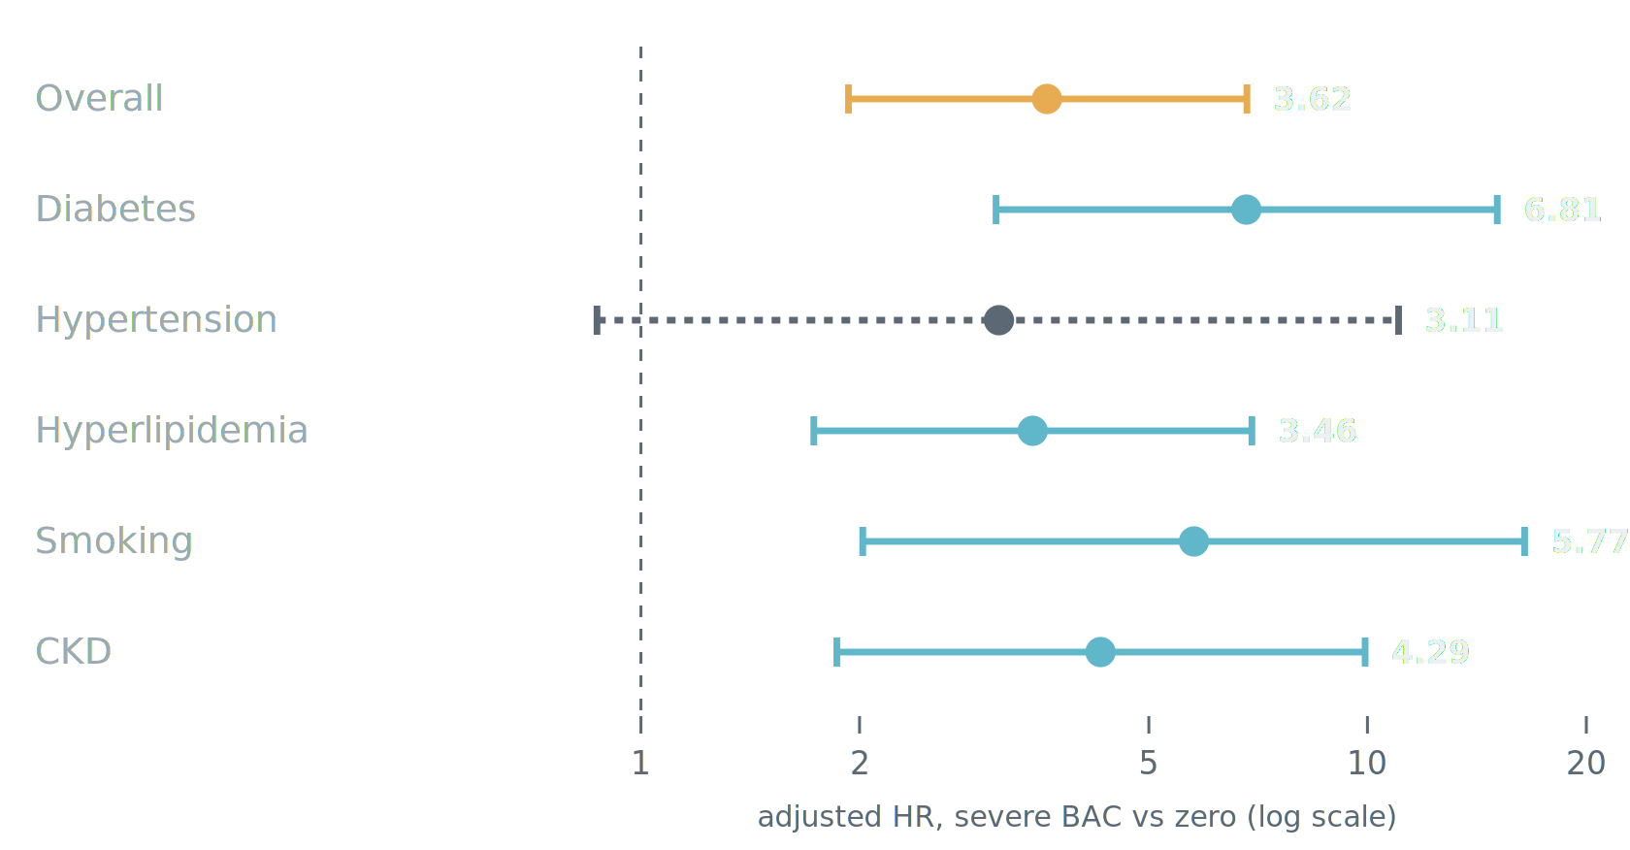
ERA III · 2026
BAC and PAD.
BAC is medial calcification (Mönckeberg's) — the pattern that dominates PAD. In 59,854 women (~8-yr follow-up), it graded the risk of vascular intervention overall and within every high-risk subgroup.
[your group], abstract — adj. age, DM, HTN, HLD, CKD, smoking. Angiogram: Radiopaedia.org (CC).
Notes:
The same calcium biology shows up in the legs. BAC is medial arterial calcification — Mönckeberg sclerosis — the dominant pattern in peripheral arterial disease, distinct from coronary intimal atherosclerosis. In 59,854 women over a median eight years, severe BAC versus zero predicted needing a vascular intervention for PAD: overall adjusted hazard ratio 3.62, and it held across risk-factor subgroups — diabetes 6.81, smoking 5.77, CKD 4.29, hyperlipidemia 3.46, hypertension 3.11 though not significant there. In women under 50 the effect was extreme, a hazard ratio over a hundred, off this scale. The point: BAC refines who actually progresses to needing an intervention, on top of the usual risk factors.

Slide 15
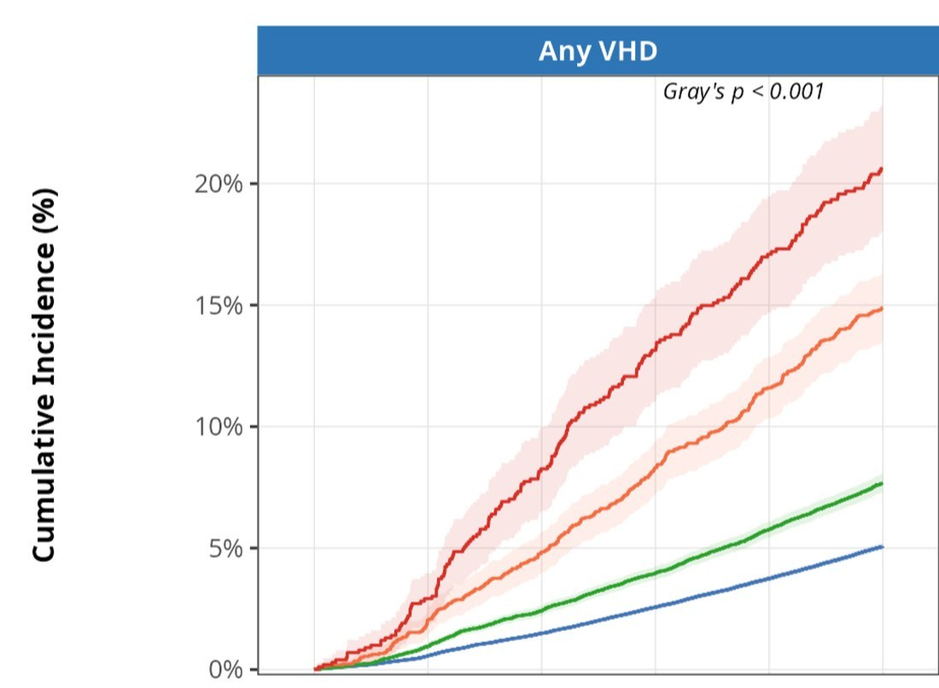
ERA III · 2026
BAC and valvular disease.
122,011 women. Severe BAC vs none — AS 11.4 · AR 3.1 · MR 2.6 · TR 2.3; mitral stenosis null (negative control). 5-yr any-VHD 19.3% vs 4.6% (NNS 7).
Any VHD by BAC severity. Dapamede et al., Fig. 1. Valve MRI: ECR 2024 EPOS #166904 (used w/ permission).
Notes:
It is not only arteries. In 122,011 women, BAC predicted incident valvular heart disease in a dose-response fashion, with strong discrimination — a C-index around 0.80. For severe BAC versus none: aortic stenosis 11.4, aortic regurgitation 3.1, mitral regurgitation 2.6, tricuspid regurgitation 2.3. Mitral stenosis showed no association, p about 0.97 — a built-in negative control, because mitral stenosis is rheumatic, not calcific. Severe BAC carried a five-year incidence of any mild-or-greater valve disease of 19.3 percent versus 4.6 percent — a number-needed-to-scan of seven.

Slide 16
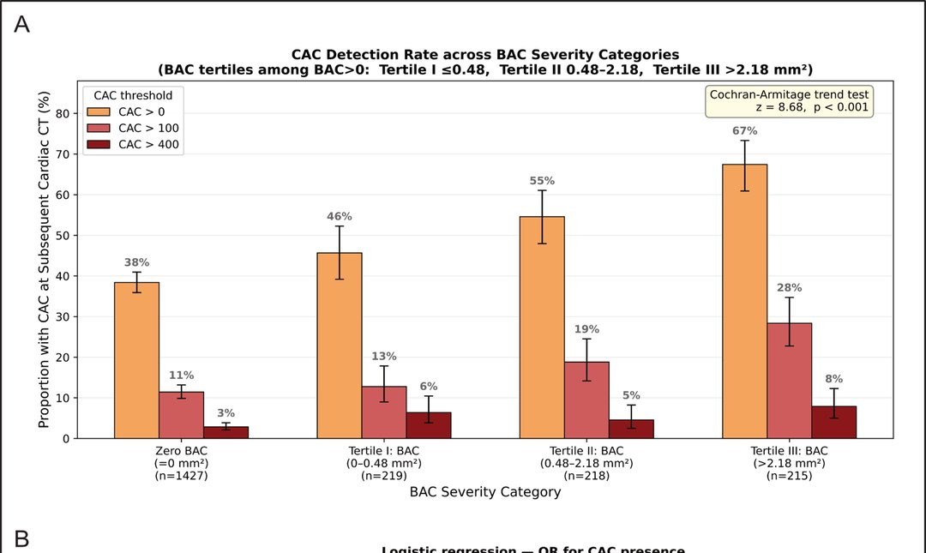
ERA III · 2026
BAC and CAC.
In 2,079 women who later had a cardiac CT, detectable coronary calcium rose 38% → 67% across BAC tiers; CAC>100 up 2.5×. BAC independently predicted CAC (OR 1.32 / SD). The mammogram previews the coronary CT.
[your group], RSNA 2026 abstract (BAC–CAC). CAC detection by BAC tier (n=2,079).
Notes:
Step back, and BAC starts to look like an index of a body-wide calcification tendency. First, coronary artery calcium: in 2,079 women who later had a cardiac CT, the rate of detectable coronary calcium rose stepwise with BAC severity — from 38 percent up to 67 percent — with CAC-over-100 rates two-and-a-half times higher, and BAC independently predicting coronary calcium after adjusting for age. The mammogram is previewing the coronary CT.

Slide 17
ERA III · 2026
BAC and costochondral calcification.
COSTOCHONDRAL CALCIFICATION
[ drop in — confirm reuse rights ]
A non-vascular marker — calcification in the costal cartilage on chest CT (n=1,311). Correlated with BAC (ρ=0.089, p=0.001).
HIGH BAC VS ZERO (ΔCCC)
ADJ. P
Median (q0.50)
NS · 0.47
75th pct (q0.75) +3,408 mm³
<0.001
Vascular + valvular + skeletal — one free mammographic finding.
[your group], RSNA 2026 abstract (BAC–CCC) · quantile regression, adj. age + DM.
Illustrative. Source: Sarıyıldız et al., via ResearchGate.
Notes:
And more surprising, a non-vascular marker: costal cartilage calcification. In 1,311 women with both a mammogram and a chest CT, BAC correlated with costal cartilage calcification — and at the 75th percentile, high BAC was associated with about 3,400 cubic millimeters more cartilage calcification, adjusted for age and diabetes; the median effect was not significant. So BAC indexes calcification that is vascular, valvular, and even skeletal — one free finding pointing to a systemic propensity.

Slide 18
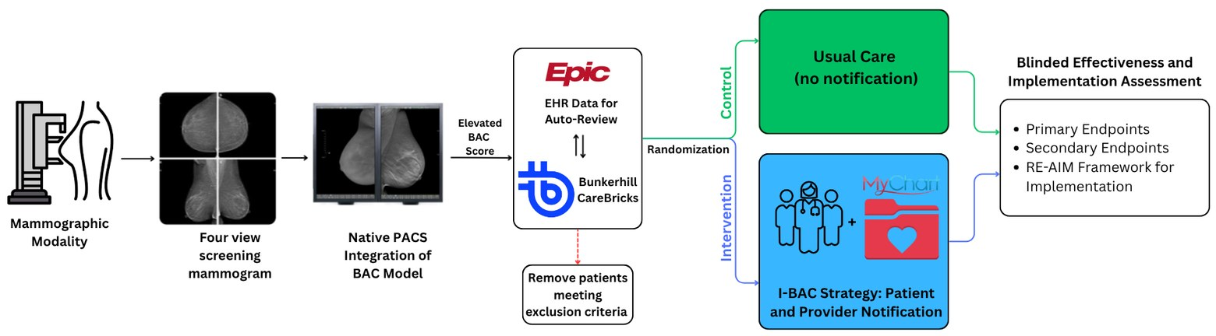
ERA III · 2026
Closing the loop: the I-BAC pragmatic trial.
The gap: <7% (Emory) / 15% (Mayo) of women had the chart data to even compute a PREVENT/ASCVD score. I-BAC (R01HL167811) is a Hybrid Type 1 pragmatic RCT across Emory + Mayo AZ. Primary endpoint: 6-mo composite of lipid panel · preventive-med change · CAC testing.
Deployment + pragmatic-trial structure (Aim 2). Precedent: NOTIFY-PICTURE — BAC has no guideline yet.
Notes:
So how do we close the loop — from a validated model to changed care? Here is the gap: fewer than 7 percent of women at Emory and 15 percent at Mayo even had the chart data needed to compute a standard PREVENT or ASCVD risk score — including women with severe BAC. Detection without action is a missed opportunity at the scale of four to six million women a year. So we built I-BAC, an NIH-funded pragmatic randomized trial — a hybrid effectiveness-implementation design across Emory and Mayo Arizona, about 225,000 screening mammograms a year combined. Aim 1 is formative work with patients and providers to design the notification. Aim 2 randomizes 6,000 women with moderate or severe BAC to notification versus usual care, with patient filtering automated through our Carebricks agentic-AI pipeline. Aim 3 is a RE-AIM evaluation — reach, adoption, fidelity, and harms like anxiety or low-value testing. The primary endpoint is a six-month composite of lipid-panel completion, preventive-medication change, or CAC testing. Our precedent is NOTIFY-PICTURE for incidental coronary calcium — but BAC is harder, because it has no established management guideline yet.

Slide 19
ERA III · 2026 → 2035
And we are on the verge of multimodal, multi-omics.
Everything so far is still one model, one modality — the image, or the calcium, or the tissue, read separately. The frontier is to combine them — imaging + pathology + genomics + the clinical record — into a single model of the patient. To see where that goes, we have to leave 2026.
Notes:
Step back and notice what every one of these has in common. Risk from the image, a cardiovascular signal from the calcium, a molecular score from the tissue — each is still one model reading one modality. The real frontier is to stop doing that: to combine the image, the pathology, the genome, and the clinical record into a single model of the patient. We are right at the verge of that — multimodal, multi-omics AI. And to see where it goes, we have to leave 2026.

Slide 20

ERA III · 2035
The year is 2035.
From here, today's models are a decade old. The real question: what happens when imaging, pathology, and omics finally converge — on one patient.
Notes:
So get back in the time machine, and come forward another ten years — to 2035. From here, everything we just saw — image-based risk, the cardiovascular signal, the molecular score — is a decade old. The question now is what we can do when all of it finally comes together, on one patient.

