Slide 1

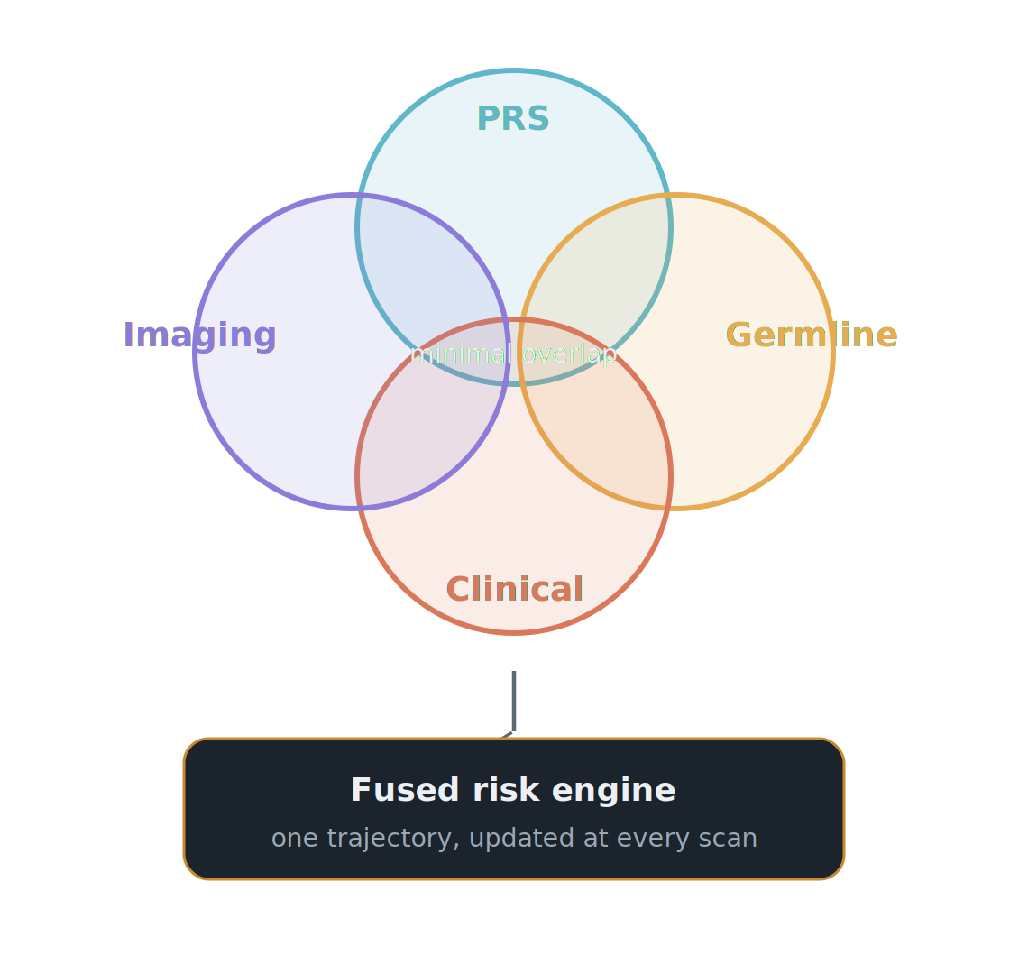
ERA III · 2035 · THE WHOLE PATIENT
She knows her risk before she ever lies down.
Risk in 2035 is built from four independent inputs — polygenic, germline, clinical, and imaging (prior mammograms) — fused into one engine and updated at every scan.
Shieh, JAMA Oncol 2026 · Esserman (WISDOM), JAMA 2025 · Yala (Mirai), Sci Transl Med 2021 · Clairity FDA 2025
Notes:
PRS alone is not enough, and the evidence is now unambiguous. The PRS313 score established the genomic baseline, and women in the top PRS decile reach the average 50-year-old's five-year risk by their mid-thirties — so a uniform age-40 start is biologically indefensible. But PRS and germline testing measure almost entirely different populations: in a WISDOM secondary analysis (Shieh, JAMA Oncology 2026), only 0.9 percent of high-penetrance pathogenic-variant carriers — BRCA1, BRCA2, PALB2 — would have been correctly assigned to high-risk screening by clinical risk plus PRS alone. PRS catches one population, germline another, clinical risk a third — all three layers are non-negotiable. The PRS architecture itself is being rebuilt: PRS-Net (Li, Genome Research 2025) is a graph neural network modeling gene-gene interactions and epistasis, a fundamental shift from the additive PRS313. And imaging and genomics update each other: Rothwell (Br J Cancer 2026) showed Mirai plus PRS313 beats either alone. WISDOM (JAMA 2025, 46,000 women) was non-inferior on advanced cancers with a one-third reduction in Stage IIB in the personalized arm, and PERSPECTIVE I&I showed risk communication did not raise anxiety. Extrapolated to 2035: at 30, one workup returns a non-linear genomic score, a germline panel, and a clinical integration; at every mammogram the imaging engine updates the genomic baseline and sets the next appointment — 7 months for top-quintile risk, longer for persistently low risk. Never again driven by a calendar. And imaging itself is a fourth, largely independent axis: a deep network reading the mammogram — Mirai, externally validated across three countries at a C-index of 0.76 to 0.81 — flags about 41.5 percent of the women who go on to develop cancer within five years as high-risk, versus 22.9 percent for Tyrer-Cuzick, and Clairity took image-based five-year risk to FDA clearance in 2025. So a woman's prior mammograms and imaging history feed the same risk engine.

Slide 2
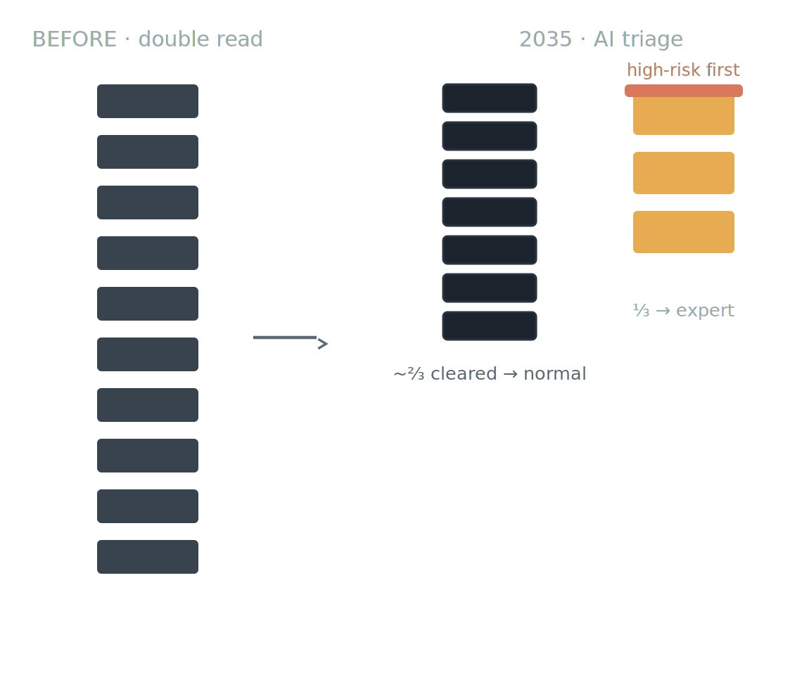
ERA III · 2035 · THE WHOLE PATIENT
The second reader is now software.
Double reading has been replaced — not by one study, but by convergent RCT evidence across four continents. AI clears roughly two-thirds of normal screens; the radiologist takes the rest.
−44% / +29%
workload / cancers detected — MASAI (Lancet 2026)
−63.6%
radiologist workload — Elías-Cabot (Nat Med 2026)
~99.9%
NPV of AI-normal triage at ~6/1,000 prevalence
MASAI, Lancet 2026 · PRAIM, Nat Med 2025 · Elías-Cabot, Nat Med 2026 · AI-STREAM · GEMINI · ScreenTrustCAD
Notes:
Double reading has been replaced by convergent evidence across health systems on four continents. MASAI (Sweden, 105,934 women, Lancet 2026): 44 percent workload reduction, 29 percent more cancers, 12 percent fewer interval cancers. PRAIM (Germany, 463,094, Nature Medicine 2025): 17.6 percent higher detection, lower recall. Elías-Cabot (Spain, 31,301, Nature Medicine 2026): partially autonomous triage, CDR up 15.2 percent, workload down 63.6 percent. Plus AI-STREAM (Korea), GEMINI (Scotland), ScreenTrustCAD (Sweden/Denmark) — independent programs, vendors, and reading cultures, same conclusion. The mechanism: AI triages about two-thirds of cases away from the queue automatically; at a background prevalence near 6 per 1,000 the negative predictive value of AI-normal triage is about 99.9 percent. Combined with Mirai-class risk, high-risk women come back sooner — in a UK triennial program the top 20 percent of Mirai scores captured 42.4 percent of interval cancers. What this gives back to the radiologist is time and focus: she reviews the third the AI flagged, biopsies what AI localized, and consults the high-risk women the system has watched for years. The endgame was never replacement — it was practising at the top of her licence.

Slide 3
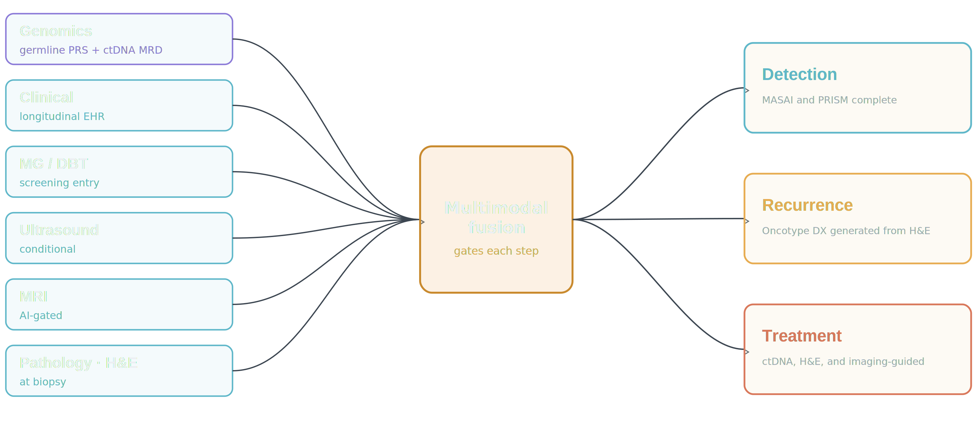
ERA III · 2035 · THE WHOLE PATIENT
From one score to a multimodal detection, treatment, and recurrence engine.
Each layer's 2025 evidence, and where 2035 takes it — no single image makes the call, and no modality is acquired unless the model expects it to change the answer.
MASAI (Lancet 2026) · PRAIM (Nat Med 2025) · ScreenTrustMRI (Nat Med 2024) · BMU-Net · UNI · BINDS · ctDNA MRD.
Notes:
This is the synthesis. On the left, the inputs, each with real 2025 evidence and a 2035 trajectory. Genomics is now an always-on layer: germline polygenic risk as a standing prior, and post-treatment ctDNA detecting molecular recurrence about fifteen months before imaging — by 2035 that triggers pre-emptive therapy, not watchful waiting. Clinical context selects the modality. Mammography is the entry point. Ultrasound is conditional; BMU-Net fuses B-mode, Doppler, and elastography. MRI is AI-gated — ScreenTrustMRI used an AI score, not density, to pick the top seven percent of negative mammograms for MRI and found 64 cancers per thousand versus 16.5. Pathology enters at biopsy, on foundation models like UNI pretrained on a hundred thousand slides. In the center, one multimodal foundation model — BINDS, 27,048 participants across eight centres, where every fusion beat any single modality — and by 2035 it decides which modality to acquire next. On the right, three outputs: detection, where MASAI is the first randomized trial — sensitivity 80.5 versus 73.8 percent, 29 percent more cancers, 44 percent less workload; recurrence, a continuously updated risk fusing imaging, ctDNA, and clinical, with Oncotype-class information coming off routine images; and treatment, with pathologic-complete-response predicted before the first cycle and ctDNA-guided escalation or de-escalation standard. The rule for 2035: no single image makes the call, and no modality is acquired unless the model already expects it to change the answer.

Slide 4
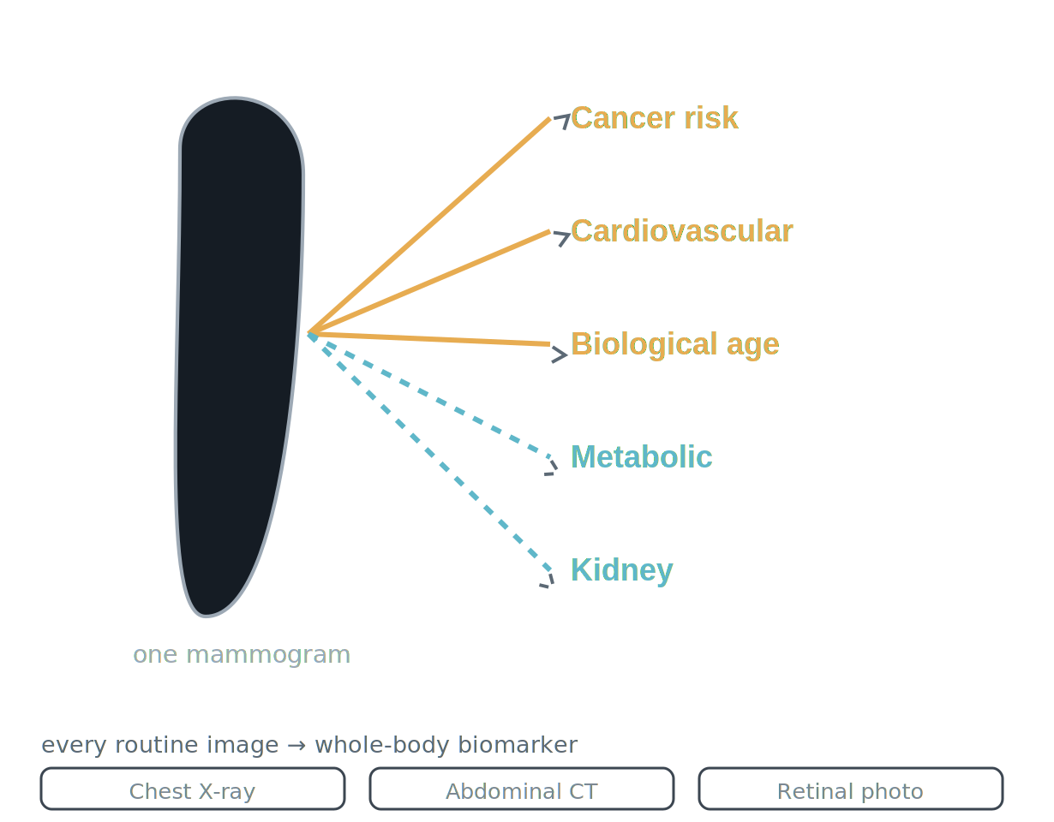
ERA III · 2035 · THE WHOLE PATIENT
The mammogram is now a whole-body health visit.
We built a cancer screen and found a window into the entire body — and we are not the only ones.
2.8×
5-yr mortality, severe BAC — 123,762 (Eur Heart J 2026)
49,196
women: CVD from the image alone (Heart 2026)
biological age
from the mammogram, ±4–6 yr — Mammo-AGE
~40M US mammograms/yr — often her only reliable preventive touchpoint. By 2035 the modality stops mattering: one model, any routine image, one systemic-risk profile.
Dapamede, Eur Heart J 2026 · Barraclough, Heart 2026 · Pan (Mammo-AGE), Nat Commun 2025 · RETFound, Nature 2023
Notes:
We built a cancer-screening system and discovered a window into the entire body — and we are not the only ones. The cardiovascular signal was there all along: AI-quantified breast arterial calcification predicts cardiac events and mortality beyond the PREVENT score across 123,762 women at Emory and Mayo, severe BAC carrying a 2.8-fold higher five-year risk of death; and Barraclough predicted cardiovascular events from mammographic features alone in 49,196 women, rivaling the Pooled Cohort Equations. By 2035 a cardiovascular estimate is an automatic, reimbursed output of every mammogram, routing high-risk women into prevention. The image also encodes biological age — Mammo-AGE estimates breast age to within four to six years and the age gap stratifies risk independent of density; by 2035 it personalizes screening intervals. And the mammogram is not alone: the chest X-ray estimates ten-year cardiovascular risk, the abdominal CT yields a longevity model, a retinal photo reads cardiovascular, renal, and neurodegenerative risk. By 2035 the modality stops mattering: one multimodal foundation model ingests whatever images a patient already has and returns one longitudinal systemic-risk profile — Merlin on 3D CT, OCTCube-M predicting seven systemic diseases from an eye scan, MOSCARD fusing chest X-ray and ECG. Metabolic and renal risk are the next frontier — BAC correlates with diabetes, hypertension, and cholesterol, peripheral-artery and kidney disease named as the next targets, but these remain associations, not yet validated. And the equity implication is why it matters: about forty million US mammograms a year, plus mobile units, make it often the only preventive touchpoint a woman reliably gets — so this can close access gaps rather than widen them, if we engineer against demographic shortcuts.

Slide 5
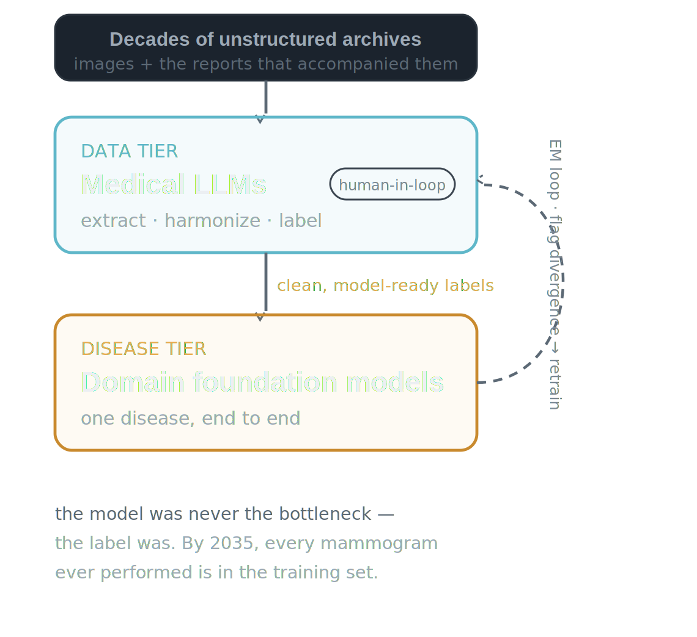
ERA III · 2035 · THE WHOLE PATIENT
The frontier plateaued. The specialists compounded.
Scale was no silver bullet — the failure was architectural.
Frontier models aced the exam, then degraded on real clinical data — a model trained on the whole internet reasons from text priors, not the pixels in front of it. By 2035 that hardened into market structure: generalists won the data tier (extract, harmonize, label — human signs off); domain models own the disease tier.
Wu, JMIR 2025 (e84120) · Raji/Daneshjou/Alsentzer, NEJM AI 2025 · RadFlag · Abdullah & Kim, JMIR 2025 · ScaleMAI · Mammo-CLIP.
Notes:
Look past the leaderboard. From 2024 to 2026, frontier models posted spectacular exam scores — and then degraded the moment they touched real clinical data. The gap was structural, not cosmetic. A systematic review of 39 medical LLM benchmarks found knowledge-based exam tasks held 85 to 93 percent accuracy, but practice-based real-world tasks collapsed to 45 to 69 percent, and safety-critical scenarios sat at 40 to 50 percent — Wu and colleagues, JMIR 2025; 'it's time to bench the medical exam benchmark' became the field's refrain. Hallucination did not go away — it hid in the findings: about 22 percent of vision-language-model imaging reports still carried factual errors, and high-performing report generators hallucinated findings in roughly 40 percent of sentences, because text-heavy pretraining made them pattern-match priors instead of reading the image. Across 12,197 diagnostic outputs, frontier models omitted relevant clinical guidelines in up to 46 percent of cases and invented non-existent ones up to 9 percent — and the error rate shifted with patient sex, ethnicity, and location. Citation accuracy stayed the worst task family: the models pitched to generate the labels couldn't reliably cite them. So the generalist bubble burst. The one-model-for-everything assumption never survived a health system's budget or a reading room's latency, and a leaner generation of smaller, cheaper, medically-focused models replaced the giants. That shift never made the generalists better doctors — it made them better librarians. Their lasting contribution was turning decades of unstructured reports into clean, structured, model-ready labels at a scale expert annotation could never reach, with a human in the loop holding the floor on quality. The two-tier architecture that won: medical LLMs do the data work — extract, harmonize, and label the archive, reaching average F1 0.90 across 14 thoracic pathologies, human-validated; domain foundation models do the disease work, trained on those labels to understand one disease end to end. The virtuous cycle — ScaleMAI's EM loop, Mammo-CLIP for mammography — trains on current labels, flags divergence for targeted human review, retrains. What we extrapolate to 2035: the benchmark-practice gap never closed by scaling generalists, because the failure was architectural — a model trained on the whole internet reasons from text priors, not from the pixels in front of it. So the labor split hardened. Generalists won the data tier, where retrieval cut their citation errors 75 to 90 percent and a human still signs off. The disease tier went to domain foundation models that genuinely reason over one disease. None of the datasets behind the prior slides — BINDS 27,048; BMU-Net 5,025; Mammo-AGE 95,826; Barraclough 49,196 — existed as clean training sets before the teams built them from archives and the reports that accompanied them; EMBED, 3.5 million exams, is the local example. In 2035, every mammogram ever performed is in the training set — we just needed the medical LLMs to read the labels that were always there.

