Slide 1

SPECIALIST vs GENERALIST · AN OPEN QUESTION
Will the generalists absorb the field?
Every model in this talk was purpose-built. The frontier models from OpenAI, Google, and Anthropic were not built for medicine — yet they improve every few months. Do we still build our own?
Notes:
We have seen what purpose-built models can do — across risk, detection, tissue, and the heart. There is one question left before we close. I have shown you a dozen specialist models — Mirai for risk, Transpara for detection, Virchow for tissue, the breast arterial calcium model. Each was built for one job. The general-purpose frontier models from the large labs — GPT, Gemini, Claude — were not built for radiology, yet they improve faster than any medical model, and each generation handles tasks we assumed required a custom build. So the question to end the body of the talk on: in five years, do we still build our own models, or do we ask the general one? And if it is the latter, who owns it?

Slide 2
FRONTIER MODELS
Where the generalists already perform well.
Medical knowledge: frontier models score ~90%+ on USMLE-style exams (Med-Gemini 91.1%), across the breadth of medicine. Rapid adaptation: fine-tuned on small labeled sets they often exceed bespoke models, and generalize better across sites, scanners, and populations.
USMLE-style: ~91% (Med-Gemini)
2D CXR reports "equivalent or better" in 43–96% of cases
exceeded prior SOTA on 17/20 CXR tasks
Med-Gemini — Yang et al., arXiv:2405.03162, 2024 (preprint)
Notes:
Where do the generalists already perform well? On medical knowledge and text reasoning: frontier models score above ninety percent on USMLE-style exams — Med-Gemini at 91.1 — across the breadth of medicine. On report drafting in two dimensions: domain-adapted frontier models do well. Med-Gemini-2D chest-X-ray reports were rated equivalent to or better than the original radiologist's report in 43 to 96 percent of cases, depending on whether the film was abnormal or normal, and exceeded prior state of the art on 17 of 20 chest-X-ray tasks, in Google's 2024 work. And they adapt rapidly: fine-tuned on a small labeled set, foundation models often exceed bespoke task-specific models, and generalize better across sites, scanners, and populations — which is exactly the brittleness problem that limits the narrow models. I'll frame the current generation by trajectory, not by specific unpublished benchmark numbers.

Slide 3
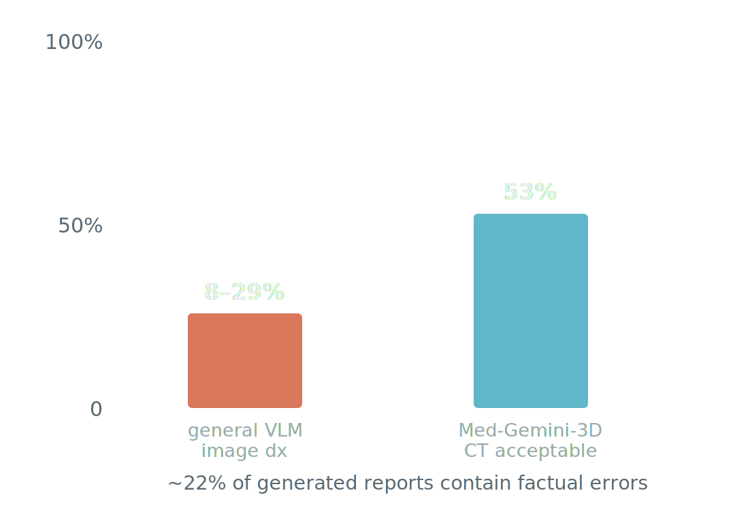
FRONTIER MODELS
Where they still fall short — the image itself.
Their strength is text, not image content. On radiology interpretation, general VLM diagnostic accuracy ranges only ~8–29%, and roughly 22% of reports contain factual errors. Purpose-built RadFM outperforms GPT-4V; Med-Gemini-3D CT reports were only 53% clinically acceptable.
Visual LLMs in Radiology, Life (MDPI) 2026;16(1):66 · RadFM — Wu et al., Nat Commun 2025 · Med-Gemini, 2024
Notes:
Where do they still fall short, for now? Their strength is text, not image content — the general vision-language models' edge comes from text knowledge rather than from actually reading the image. On radiology interpretation, diagnostic accuracy across general vision-language models ranges only about 8 to 29 percent, in a systematic evaluation published in Life this year, and roughly 22 percent of the AI-generated reports contain factual errors or hallucinations. Specialists still perform better on the image itself: the purpose-built RadFM model outperforms GPT-4V on radiology tasks. And three dimensions and localization lag: Med-Gemini-3D CT reports were only 53 percent clinically acceptable — adequate for a 2D chest film, much less so for a CT volume.

Slide 4
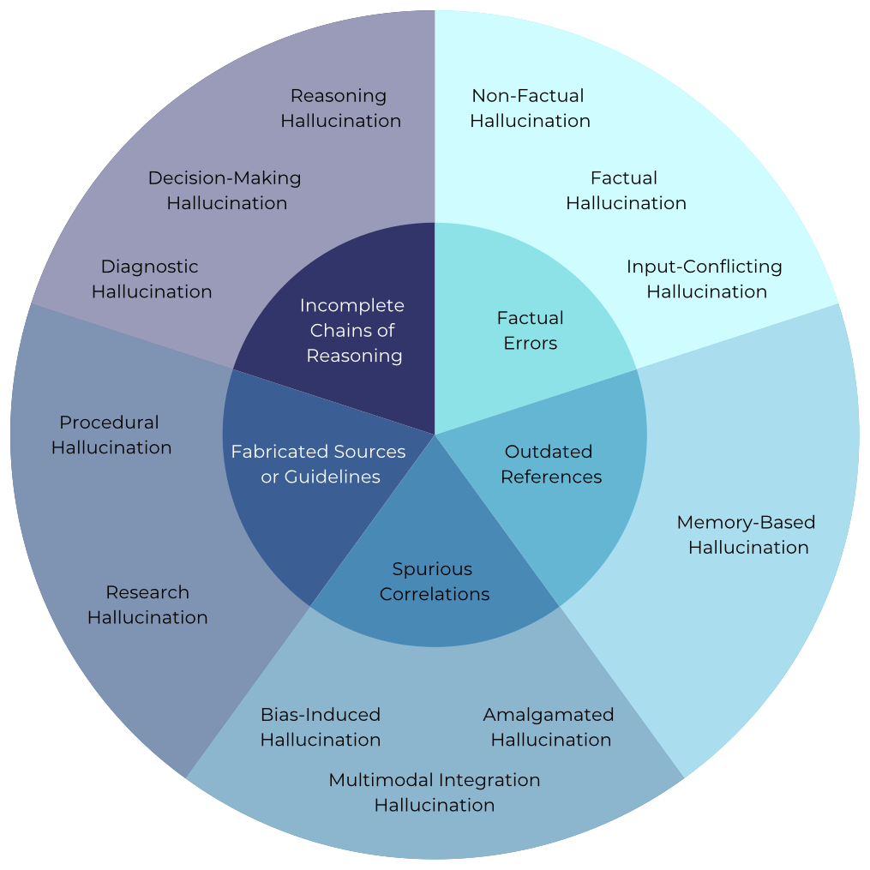
FRONTIER MODELS
Specializing a model does not make it safer.
Medical hallucination is not one failure but many — factual errors, outdated references, spurious correlations, fabricated sources, and broken chains of reasoning — across diagnosis, procedure, and research.
On a hallucination benchmark (Med-HALT, 2025), general models were hallucination-free 76.6% of the time vs only 51.3% for "specialized" models. The instinct to buy the medical one may be wrong.
Taxonomy: Kim, Jeong et al., "Medical Hallucination in Foundation Models," arXiv:2503.05777 · Med-HALT, arXiv:2307.15343
Notes:
And a counterintuitive result that complicates the procurement instinct. First, note that medical hallucination is not a single failure mode — this taxonomy, from Kim, Jeong and colleagues at MIT and Harvard this year, sorts it into five clusters: plain factual errors, outdated references, spurious correlations, fabricated sources or guidelines, and incomplete chains of reasoning — playing out across diagnostic, procedural, and research tasks. Now the counterintuitive part: fine-tuning on medical data does not automatically reduce any of this. On a hallucination benchmark, Med-HALT, in 2025, general-purpose models were hallucination-free 76.6 percent of the time, versus only 51.3 percent for the medically specialized models. Narrowing a model can erode its calibration. So the specialist-versus-generalist question is genuinely unsettled, and the procurement instinct — to buy the medical one — may be wrong.

Slide 5
FRONTIER MODELS
The thesis: the "bitter lesson."
Over decades, general methods that scale with data and compute have repeatedly outperformed systems built on handcrafted domain knowledge — in chess, in vision, in language.
Radiology AI has spent fifteen years handcrafting. The trajectory of other fields suggests the generalists eventually take over perception too. The open question is when — and what we build in the meantime.
Rich Sutton, "The Bitter Lesson," 2019 essay (an argument, not a study)
Notes:
Here is the thesis to pose, Rich Sutton's bitter lesson, from his 2019 essay — and I attribute it as an argument, not a study. Sutton argues that over decades, general methods that scale with data and compute have repeatedly outperformed systems built on handcrafted domain knowledge — in chess, in computer vision, in language. Radiology AI has spent fifteen years handcrafting. The trajectory of those other fields suggests the generalists eventually take over perception as well. The open question is when, and what we should build in the meantime.

Slide 6
FRONTIER MODELS
A likely answer: orchestration.
The probable future is a stack, not a replacement. A frontier model as the reasoning and orchestration layer — it reads the EHR, talks to the patient, writes the report, decides the next step — calling specialist models as instruments: the detector, the risk model, the BAC quantifier, the tissue model.
generalist = reasoning & orchestration
specialists = the instruments it calls
increasingly domain-adapted (Med-Gemini)
Measurement still rewards purpose-built precision and calibration. "Agentic radiology": the generalist conducts; the specialists play.
Notes:
A likely answer is orchestration. The probable future is not a generalist simply replacing the specialist. It is a stack: a frontier model as the reasoning and orchestration layer — it reads the EHR, talks to the patient, writes the report, decides the next step — and the specialist models as the instruments it calls: the detector, the risk model, the breast-arterial-calcium quantifier, the tissue model. Because measurement still rewards purpose-built precision and calibration. Call it agentic radiology: the generalist conducts, and the specialists play. And increasingly the generalists are themselves domain-adapted, like Med-Gemini, rather than raw.

Slide 7
FRONTIER MODELS
What it means for this room.
Value moves to data, validation, integration — not architecture
Concentration is a governance problem: cost, sovereignty, access
The radiologist shifts toward validator & orchestrator
Whether the result is a specialist model or a frontier generalist, built in Palo Alto or in this room, it does not change what makes it safe. The bar is the same one CAD failed and MASAI cleared.
Notes:
So what does this mean for this room? Three things. First, the locus of value moves. If the model becomes a commodity, durable value shifts to what the frontier labs do not have: proprietary, diverse, well-labeled data; rigorous validation; clinical integration; and the care pathway. Compete on data and evidence, not architecture. Second, concentration is a governance problem. A handful of US tech companies controlling the frontier raises issues of cost, dependence, data sovereignty, and access — particularly for Europe and for low- and middle-income countries, which connects back to the equity argument. Who owns the intelligence that reads the world's mammograms? Third, the radiologist's role shifts, from primary detector toward validator, orchestrator, and the source of clinical context and accountability the model cannot supply. And the bridge to the close: whether the result is a specialist model or a frontier generalist, built in Palo Alto or in this room, it does not change what makes it safe. The bar is the same one CAD failed and MASAI cleared.

