Slide 1
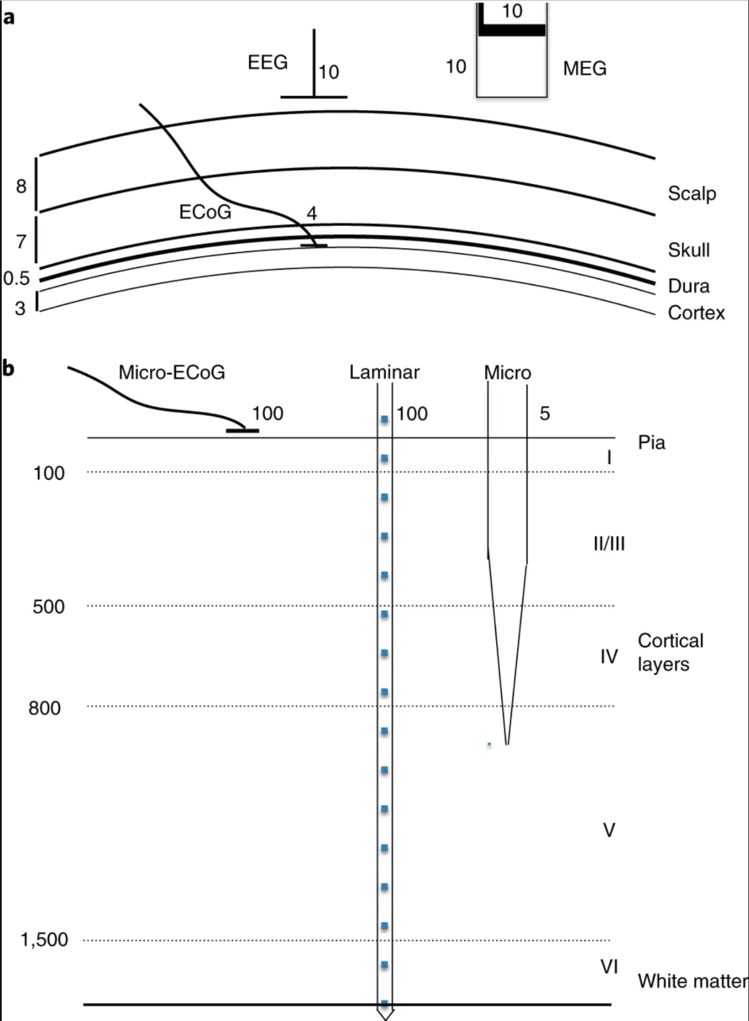
Pesaran, et al. (2019)

Slide 2
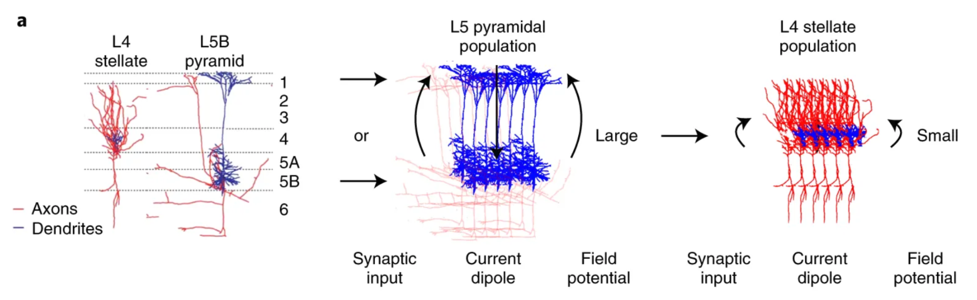
Pesaran, et al. (2019)

Slide 3
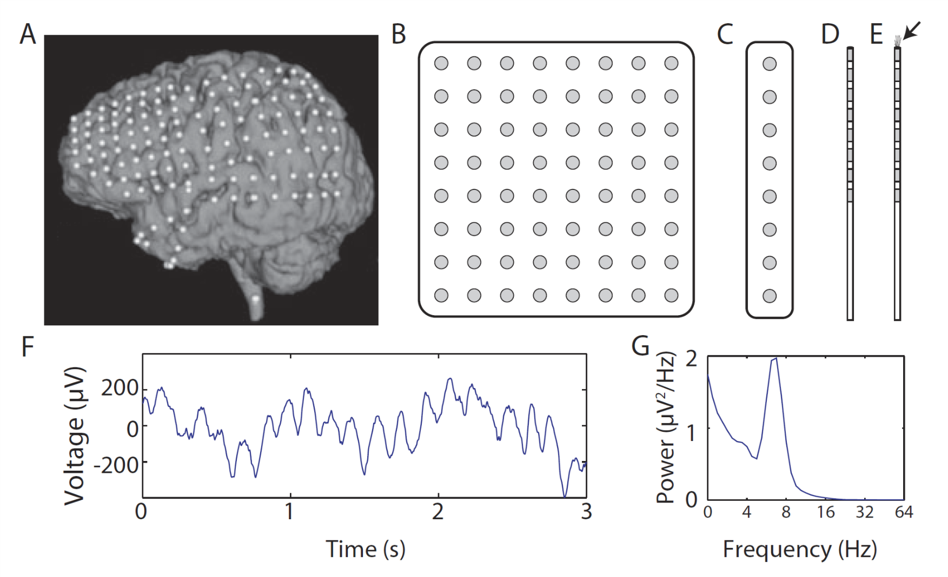

Slide 4
