Slide 1
Data Visualization Menu
EICC Fall 2020

Slide 2
RNA Seq (bulk) analysis
Principal Components Analysis plot
Heat map
Volcano plot
Gene-specific dot plot
Venn Diagram

Slide 3
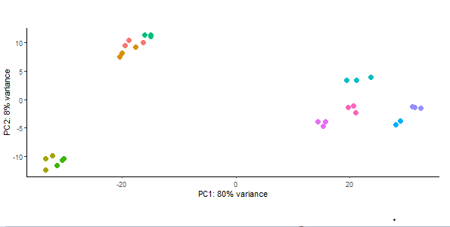
Principal Components Analysis plot (R- ggplot2)

Slide 4
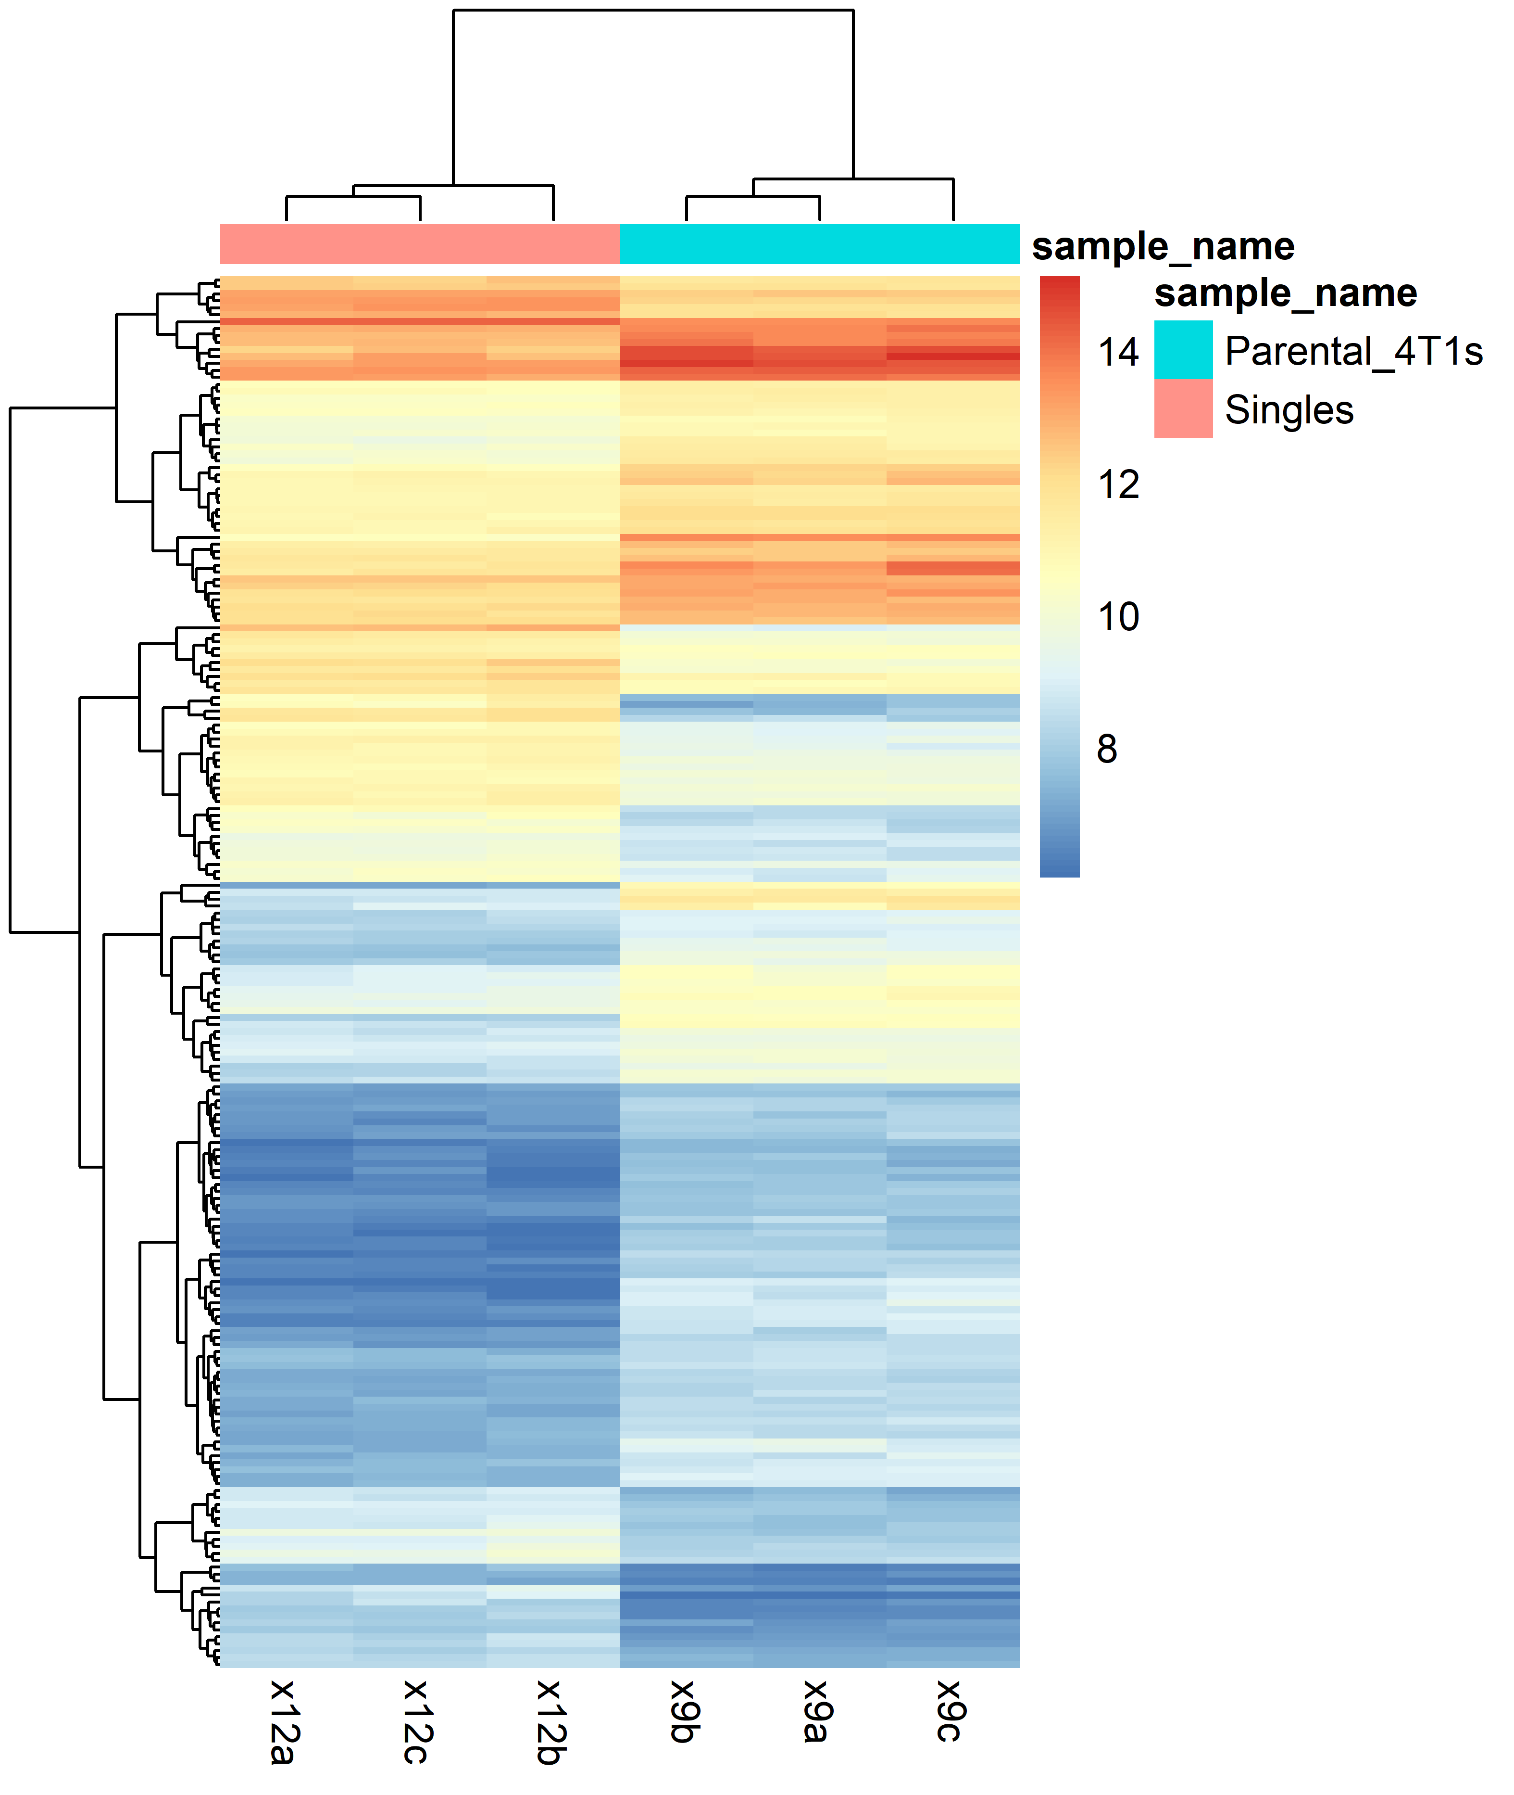
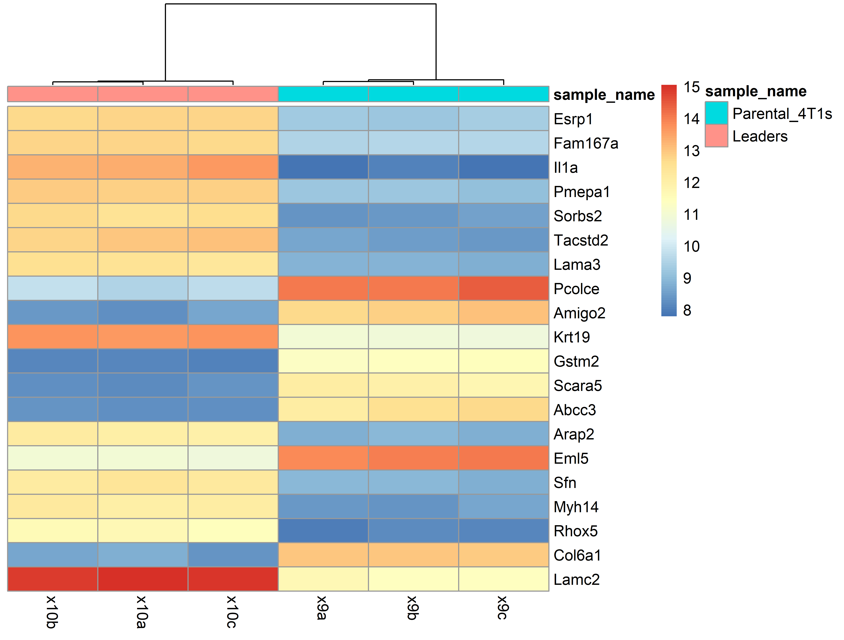
Heat map (R-pheatmap)
sample
Genes sorted by smallest FDR
Group 1
Group 2
sample
Gp2_SampleA Gp2_SampleB Gp2_Sample C GP1_Sample D GP1_Sample E GP1_Sample F
sample

Slide 5
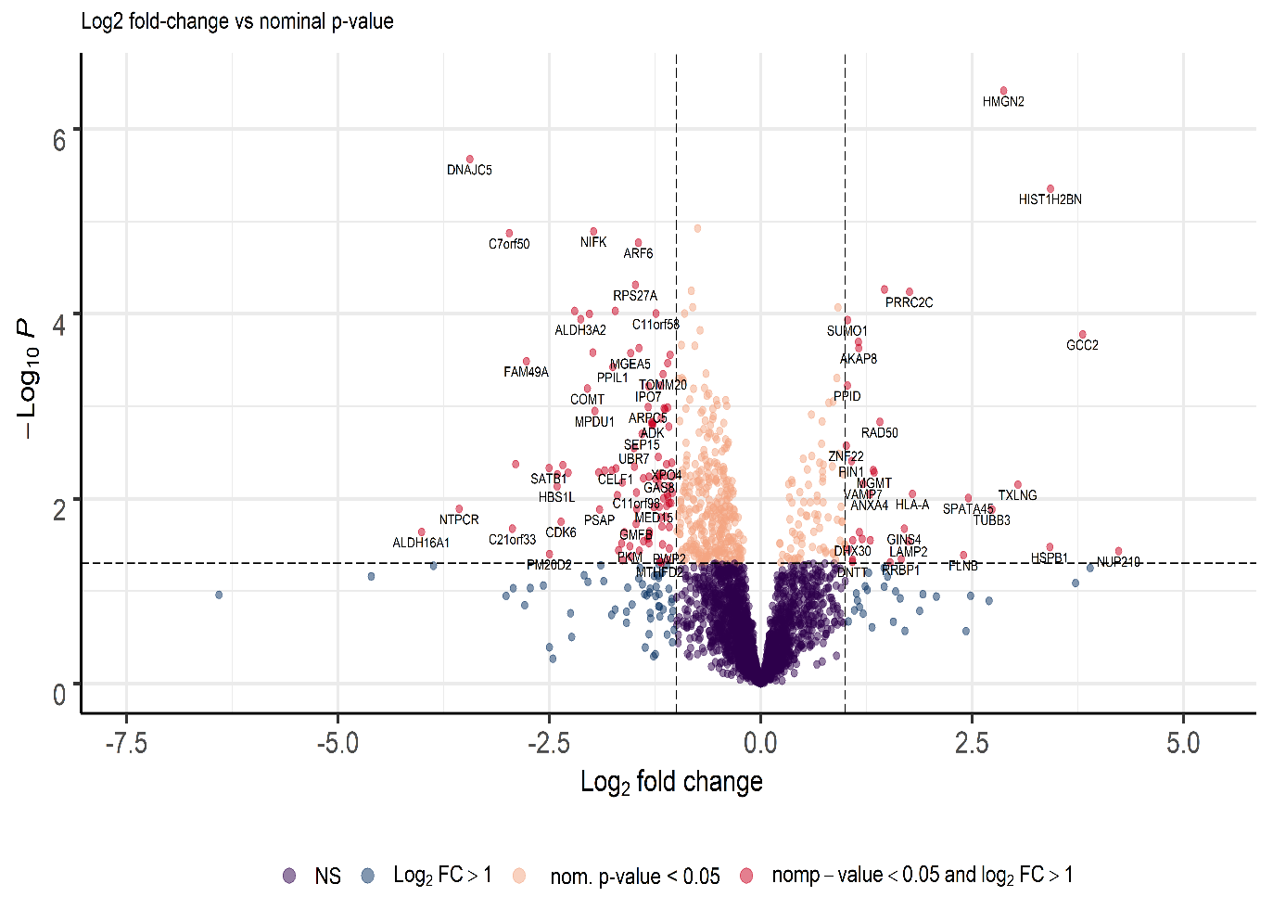
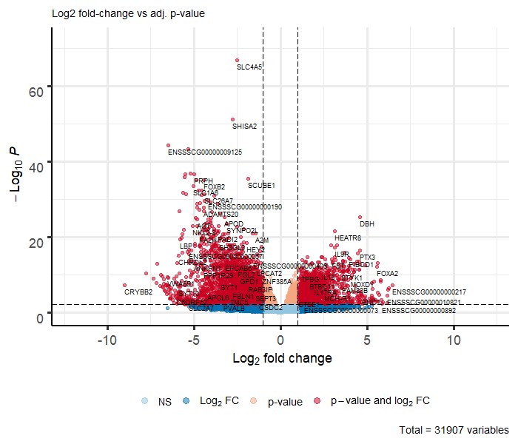
Volcano plot (R-EnhancedVolcano)

Slide 6
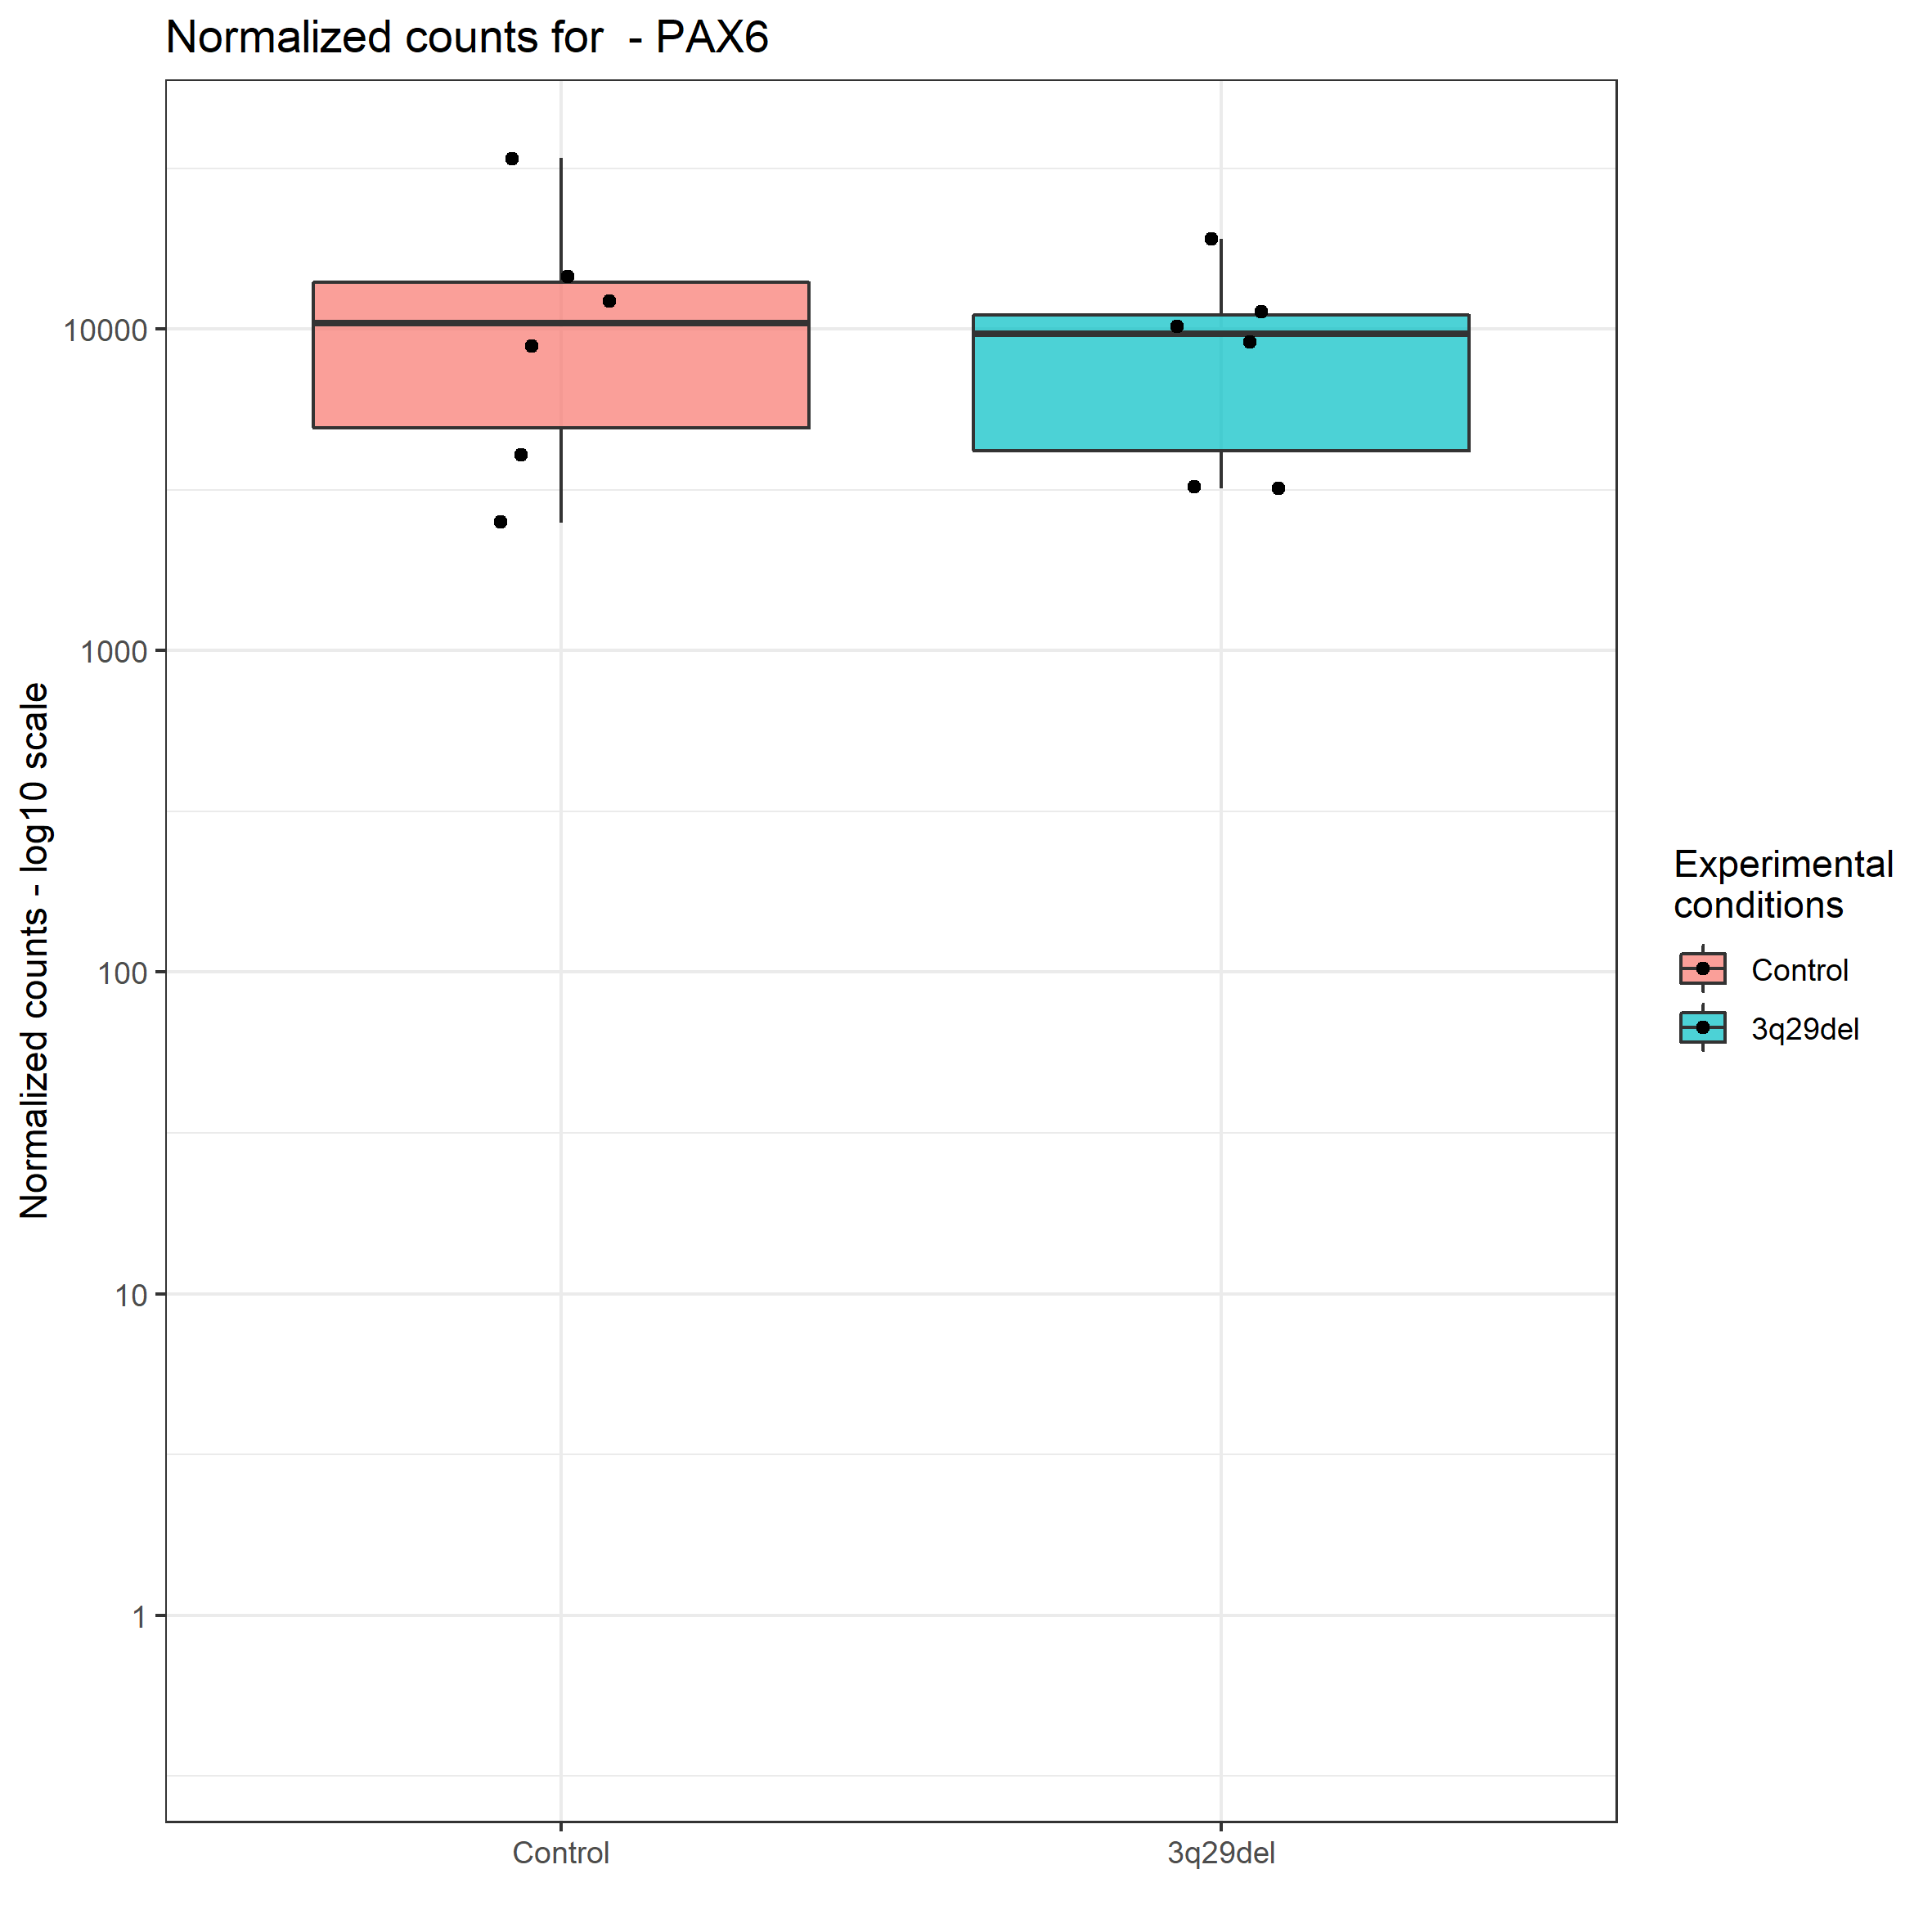
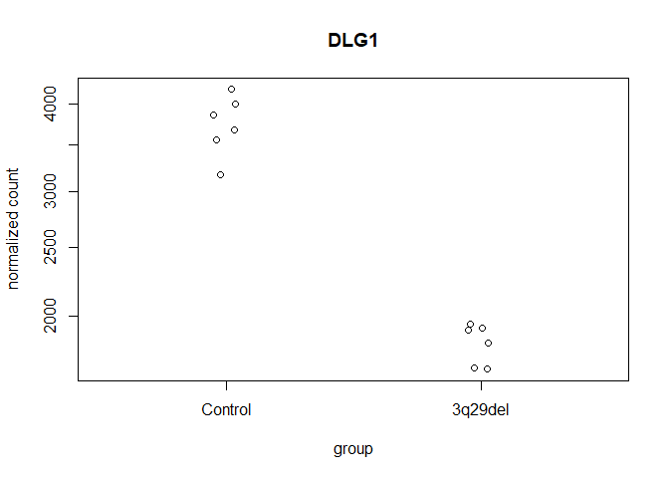
Gene-specific plots (R-ggplot2)

Slide 7
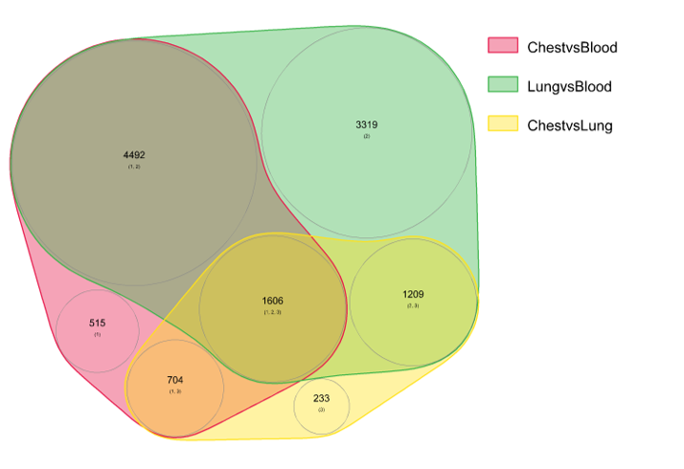
Venn Diagram
Group 1
Group 2
Group 3

Slide 8
16s Microbiome analysis
Taxonomic bar plot (QIIME2)
Taxonomic bar plot (phyloseq)
Alpha Diversity plot
Beta Diversity Principal Coordinates Analysis plot
Taxa level-specific bar plot (phyloseq)
ASV-specific box plot
Principal Components Analysis plot (LDM)

Slide 9
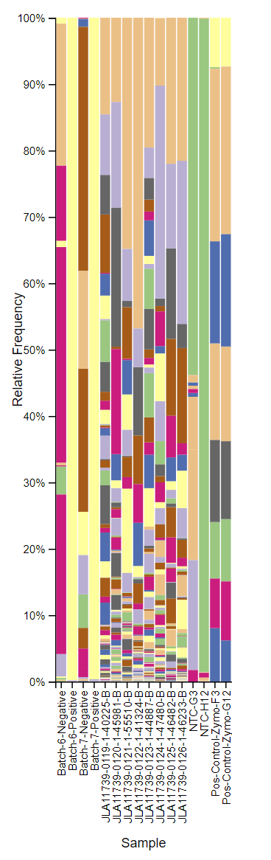
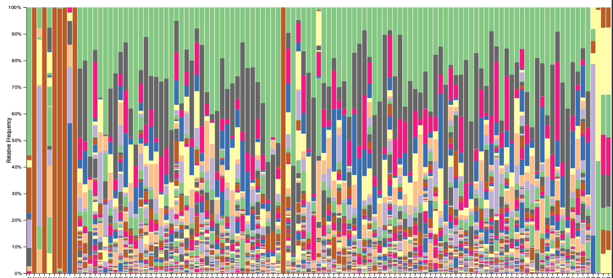
Taxonomic bar plot (QIIME2)

Slide 10
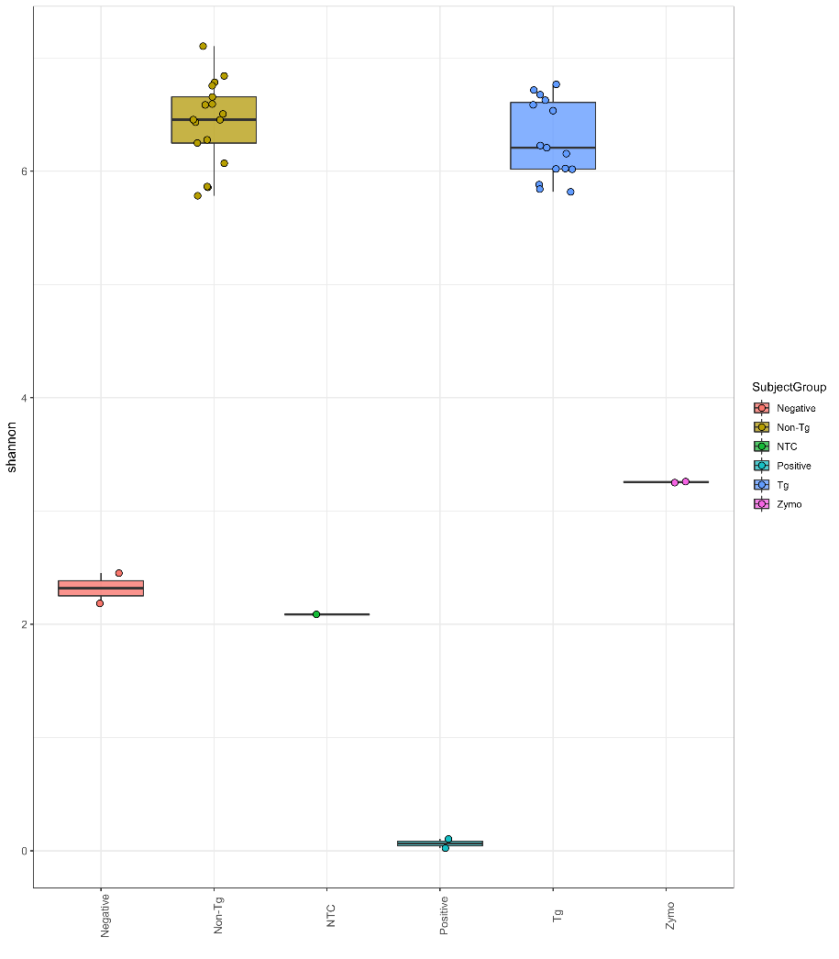
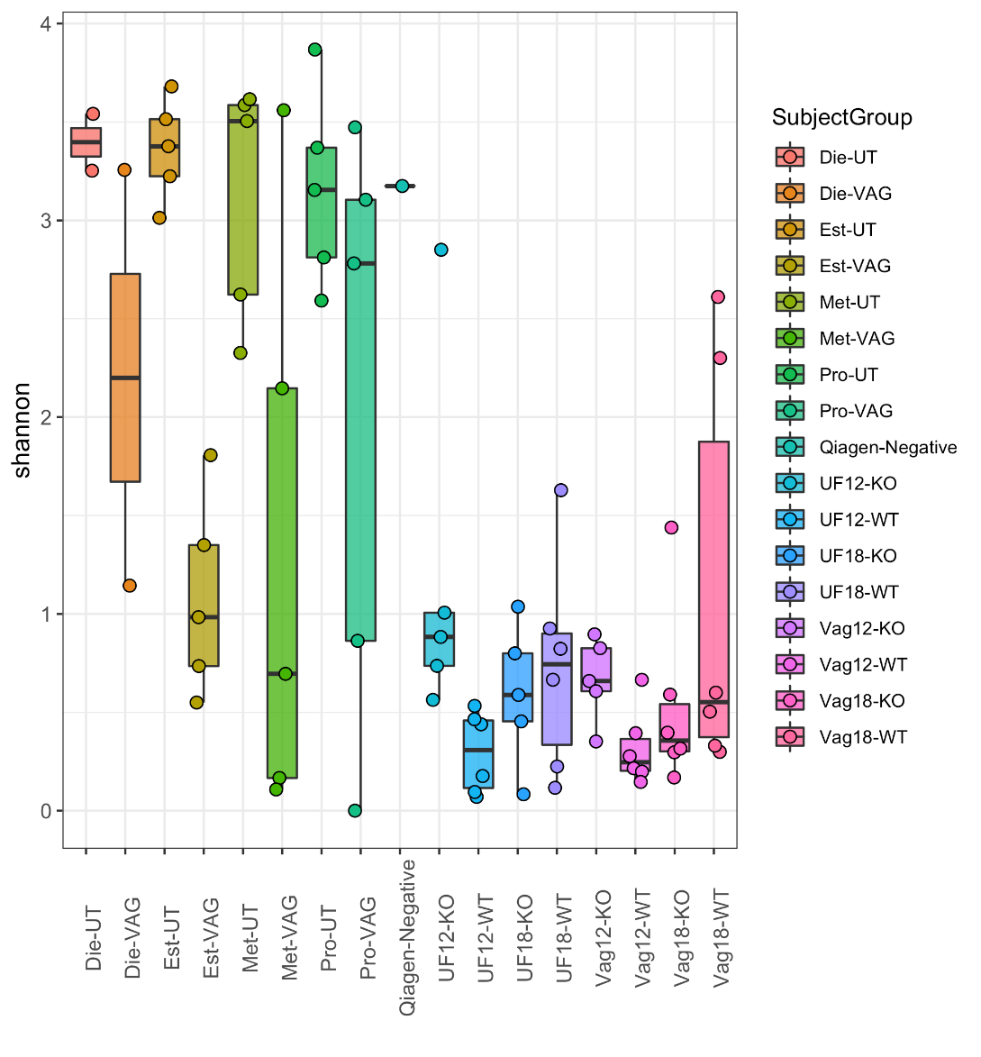
Alpha Diversity plot (R-ggplot2)

Slide 11
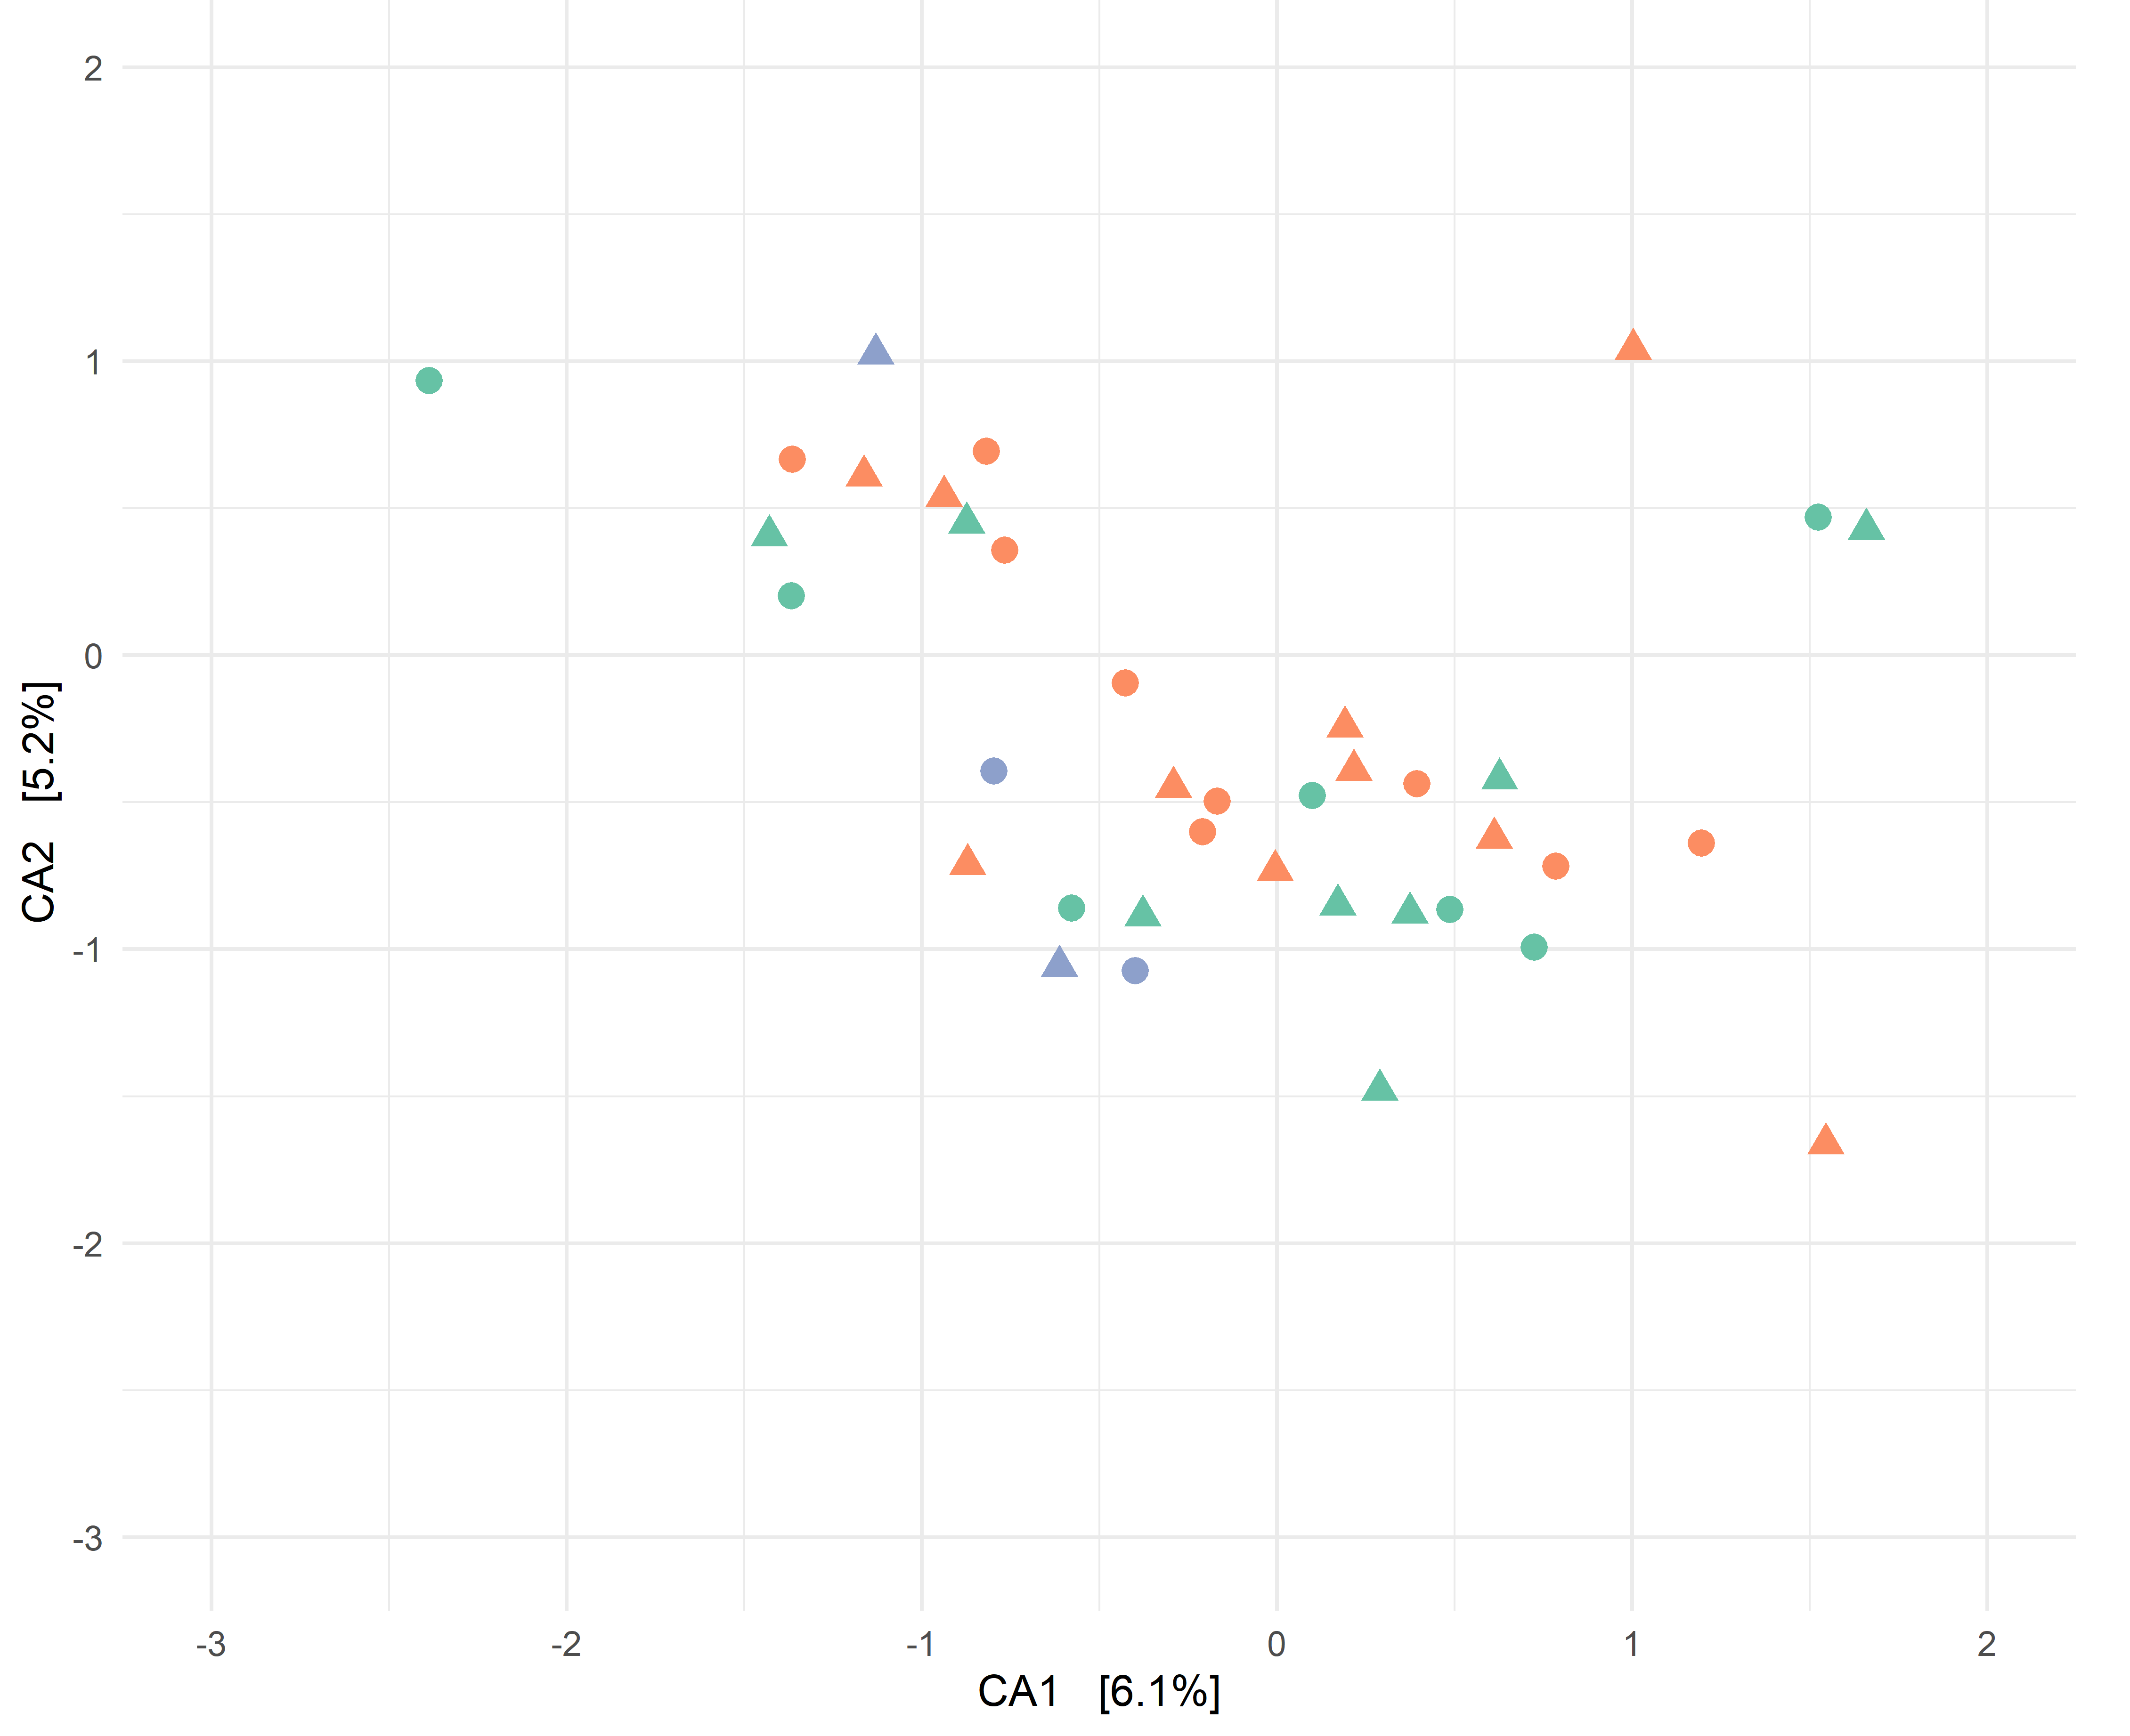
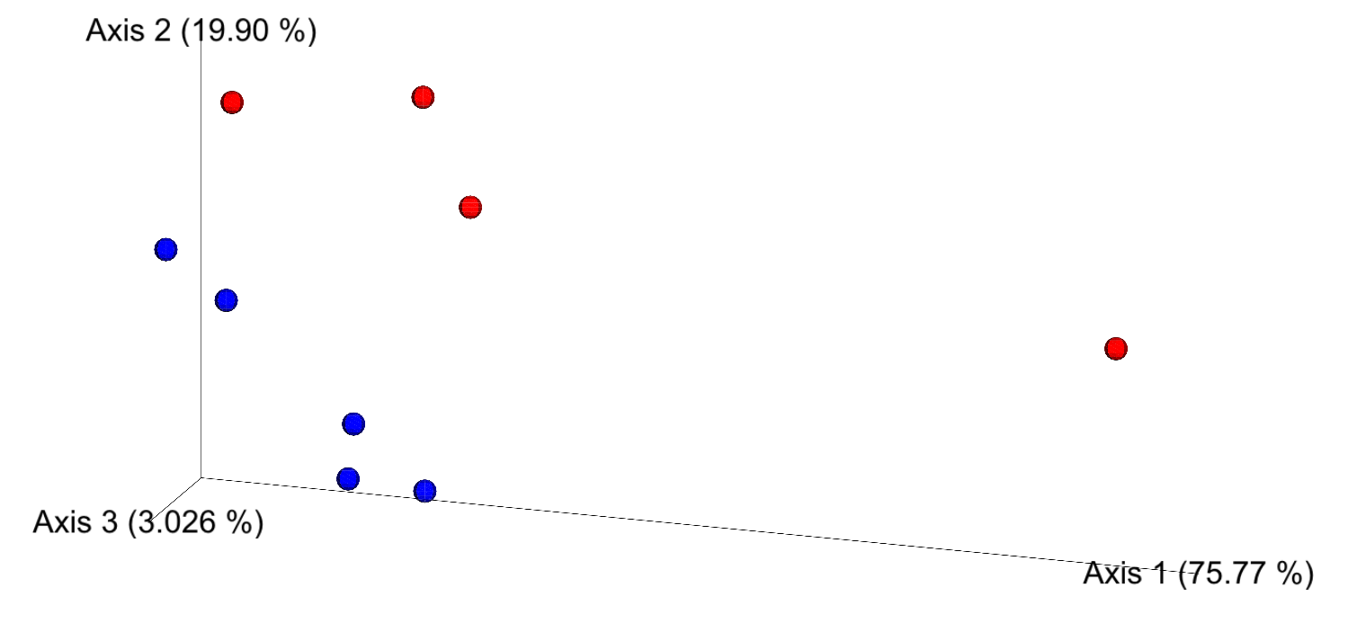
Beta Diversity Principal Coordinates Analysis plot (QIIME2 and R- ggplot2)

Slide 12
Taxa level-specific bar plot (R-ggplot2)

Slide 13
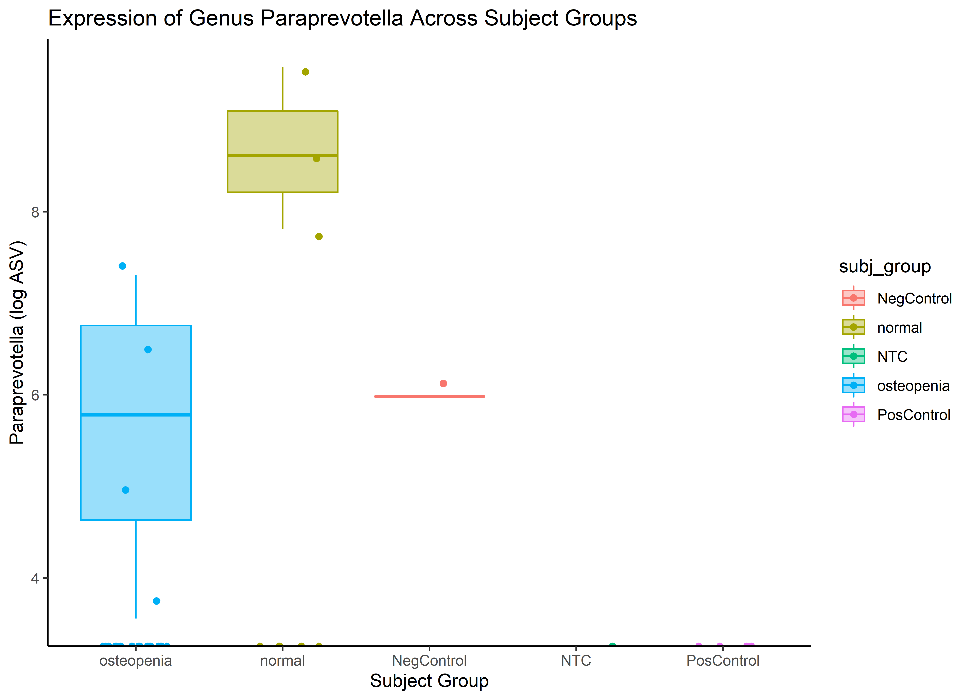
ASV-specific box plot(R-ggplot2)

