Slide 1
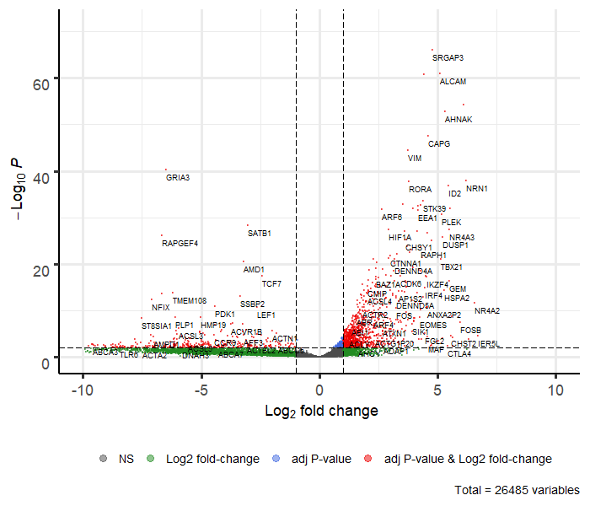
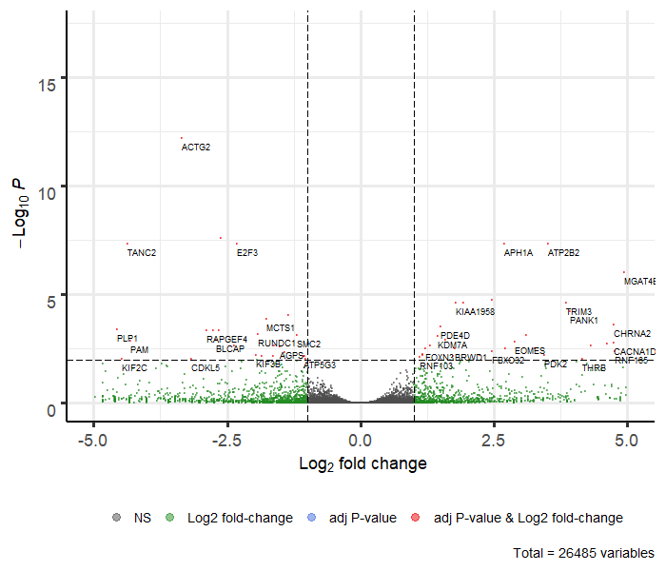
Transcriptomic profile of NP-CD8⁺ T cell. NP-CD8 ⁺ T cells from mice immunized with 1x10⁶ or 1x10⁹ HAd-NP or F5 TCR transgenic mice were sorted by FACS, and RNA content was sequenced with the illumine platform. Volcano plots from the DESeq2 analysis were presented. (A) The 1446 differentially expressed genes between 1x10⁹ HAd-NP group and F5 TCR group are represented in red (adjusted p value <0.01, log2 fold change >1.0 from the DESeq2 analysis. (B) The 67 differentially expressed genes between 1x10⁹ HAd-NP group and 1x10⁶ group are represented in red (adjusted p value <0.01, log2 fold change >1.0 from the DESeq2 analysis.

