Slide 1
Weiping Cao & Samuel Amoah RNAseq Study
EICC Project ID: SSU11755
Prepared by Jessica Randall, MPH

Slide 2
RNASeq Analysis Workflow
QC at .fastq stage
FastQC , Fastq-Screen, MultiQC, & Trimmomatic if necessary
Alignment to reference genome
STAR – mm10 genome for M. musculus, UCSC
Sort and index .bam files
Generation of raw counts from alignment .bam files
HTSeq
Differential Expression Analysis
DESeq2
Pathway Analysis (KEGG)
Notes: Please see our RNASeq (bulk) analysis page in our Methods section for a publication-friendly write-up of our workflow

Slide 3
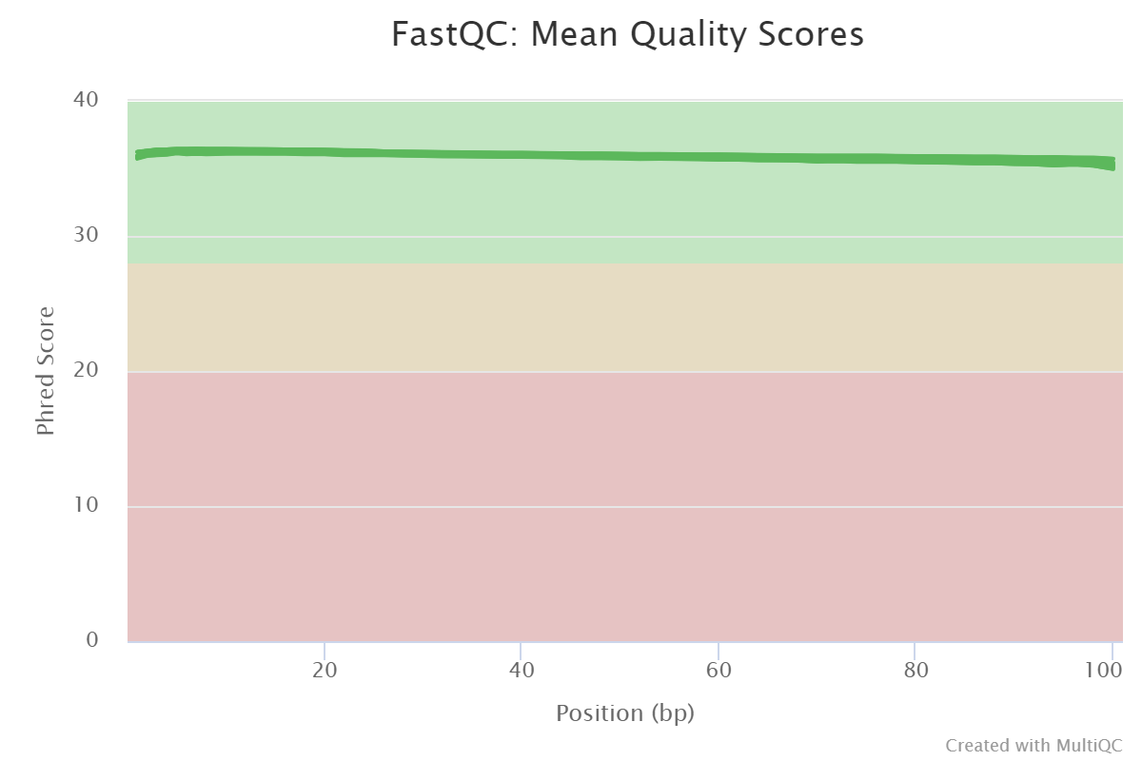
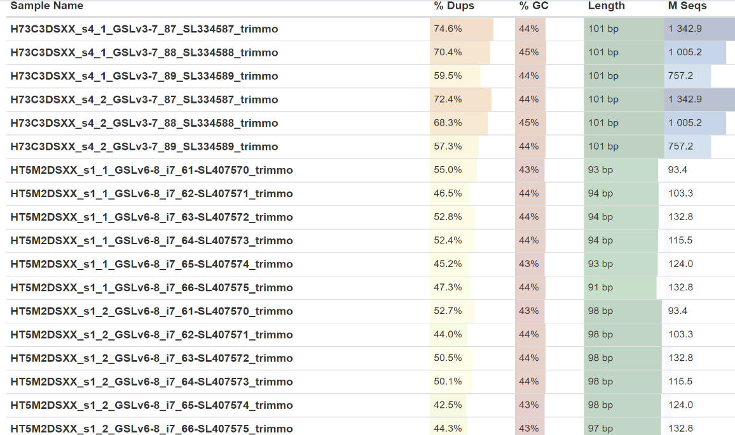
FastQC / Contaminant Screening
Mean Quality Scores
Data yields were between 93-1342M reads/samples
Samples sequenced last year were very deeply sequenced
This did not improve the length and did not ultimately affect comparisons between libraries
FastQ Screen
Data appear to be from mice (good!)

Slide 4
STAR alignment
STAR was run to align compressed *.fastq.gz files against mm10 reference genome downloaded via UCSC
Annotations from UCSC were also used to determine gene content that would later be used to derive counts
Using samtools, resulting .sam alignment files converted to sorted .bam and then indexed prior to running through HTSeq to capture raw RNAseq “counts” per gene

Slide 5
HTSeq – Counts generation
The .bam files from the STAR alignment step were taken and were run through HTSeq (via UCSC gene-id method with UCSC annotation GFFs) to convert gene annotation and alignment information into a counts table for each sample
Proprietary scripts used to combine all sample .count files into one overall raw counts file for all of your sample data
The resulting raw counts file was then used for differential expression and pathway analyses.
See our Methods section for a publication-friendly format of our workflow

Slide 6
Data
9 samples from NP-specific mice
Samples were run in 2 batches
3 comparison groups
3 Concentration B (1x10^6) vs 3 Concentration A (0)
3 Concentration C (1x10^9) vs 3 Concentration A (0)
3 Concentration C (1x10^9) vs 3 Concentration B (1x10^6)

Slide 7
Hypothesis:
With DEG analysis using the Wald test we are looking to reject the idea that the variances (s) in two groups of samples are the same.
Hnull: s in group A = s in group B (no difference)
Halternative: s in group A ≠ s in group B (difference)
Testing this hypothesis will tell us if the differences between the groups are statistically significant. Statistical significance is necessary but not sufficient for clinical significance.

Slide 8
False Discovery Rate (or adjusted p-value)
Each gene in typical DE analysis has a p-value generated as a single hypothesis test but it was one of multiple genes/hypotheses tested
Adjusting the p-value corrects for the multiple hypotheses tested by scaling each p-value by the number of genes/hypotheses tested starting at the smallest p-value
If more than one gene is examined for DE analysis, FDR (adjusted p-value) should be reported instead of p-value and not in combination

Slide 9
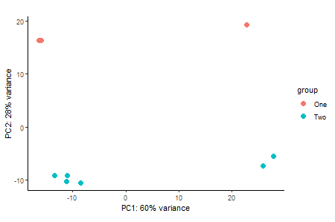
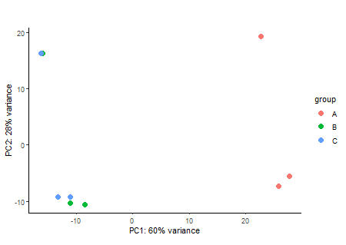
PCA plots by Batch and Dose Group
60% of the differences between these samples is due to them having either concentration A (0) B, (1x10⁶) or C (1x10⁹)
Second most important variable in determining differences in gene expression was Batch in which the samples were run, those 3 samples run in Batch 1 cluster similarly by concentration but differently from Batch 2
Suggests that we will be able to identify statistically significant differences between the samples if they exist between these groups but that much of the difference could also be due to being run in 2 batches
Since within-group variance was smaller than between-group variance, we have performed a likelihood ratio test for comparisons of multiple groups

Slide 10
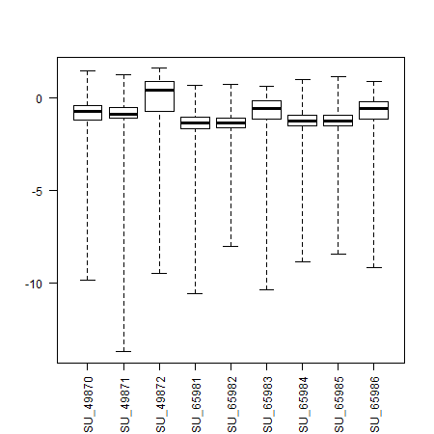
Comparison of Library Sizes
DESeq2’s normalization of library sizes appears to have worked to account for the orders of magnitude differences between sequencing depth
Those samples with more widely dispersed Cook’s distances (a measure of being an outlier) were not those with extremely high sequencing depths

Slide 11
Contents
Concentration B vs A
MA plot
Volcano Plot
Concentration C vs A
MA plot
Volcano Plot
Concentration C vs B
MA plot
Volcano Plot
Note: Other comparison of possible interest may include batch 2 vs batch 1

Slide 12
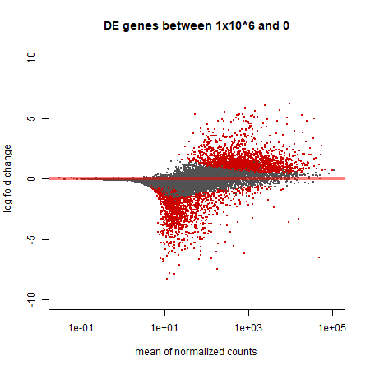
Concentration B vs A: MA plot
Results FDR <0.01
1519 DE genes (6%)
1209 (4.8%) up regulated
310 (1.2%) down regulated
16066 (64%) of genes filtered for mean normalized counts <7
As compared to previous run of analyses, more DE genes were identified but the member genes of top 20 DE genes stayed approximately the same
Controlling for batch effects gave us greater power to identify more DE genes at FDR threshold
MA plot
Many more up regulated than down regulated genes

Slide 13
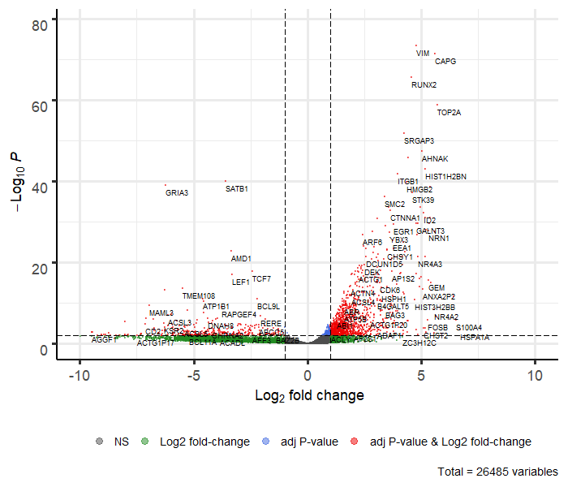
Concentration B vs A: Volcano plot
Fold change cut-off was set at 1.0, FDR was 0.01
Top 5 DE genes were as follows:
VIM (LFC: 4.78 , FDR: 5.03E-74 )
CAPG (LFC: 5.59 , FDR: 3.80E-72)
RUNX2 (LFC: 4.57 , FDR: 2.69E-66)
TOP2A (LFC: 5.71 , FDR: 1.75E-59)
SRGAP3 (LFC: 4.24, FDR: 1.46E-52)
All of these genes also have low s-values/local FDRs indicating that they are very unlikely to be false-positive findings

Slide 14
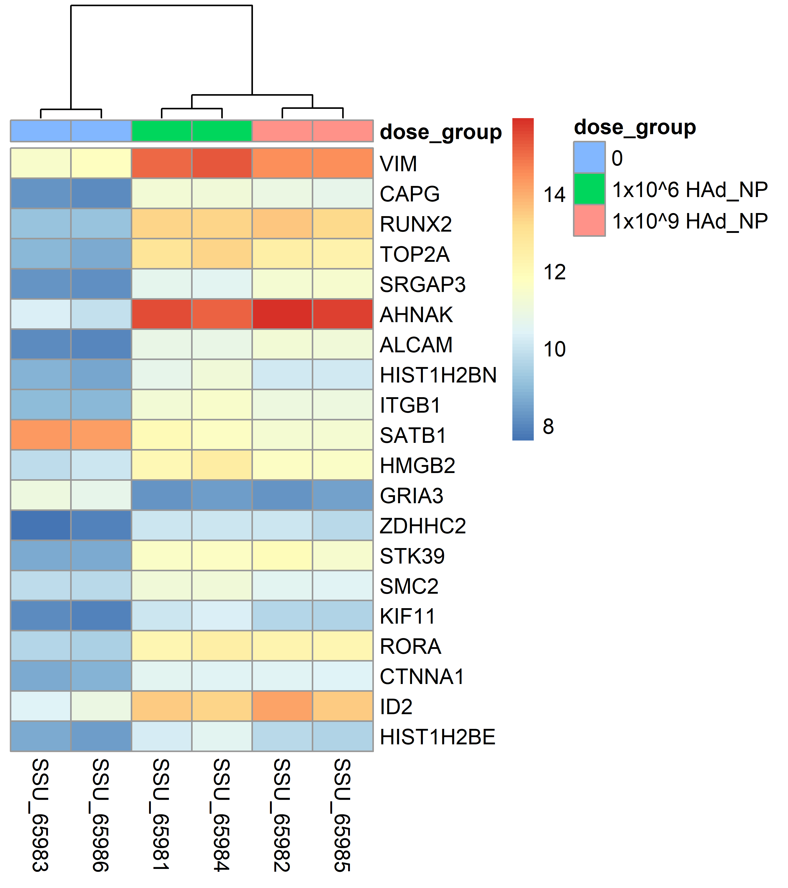
B vs A: Heat map
Color and intensity of the boxes represent counts transformed using a variance stabilizing transformation (vst) which is similar to a log2 transformation but accounts for the sampling variability of genes with low counts
Red indicates vst transformed counts closer to 16 and blue indicates vst transformed counts closer to 8
Genes are sorted by lowest adjusted p-value (FDR)
Samples are grouped by concentration and it is evident that the two viral concentrations are more similar to each other than they are to the naïve concentration

Slide 15
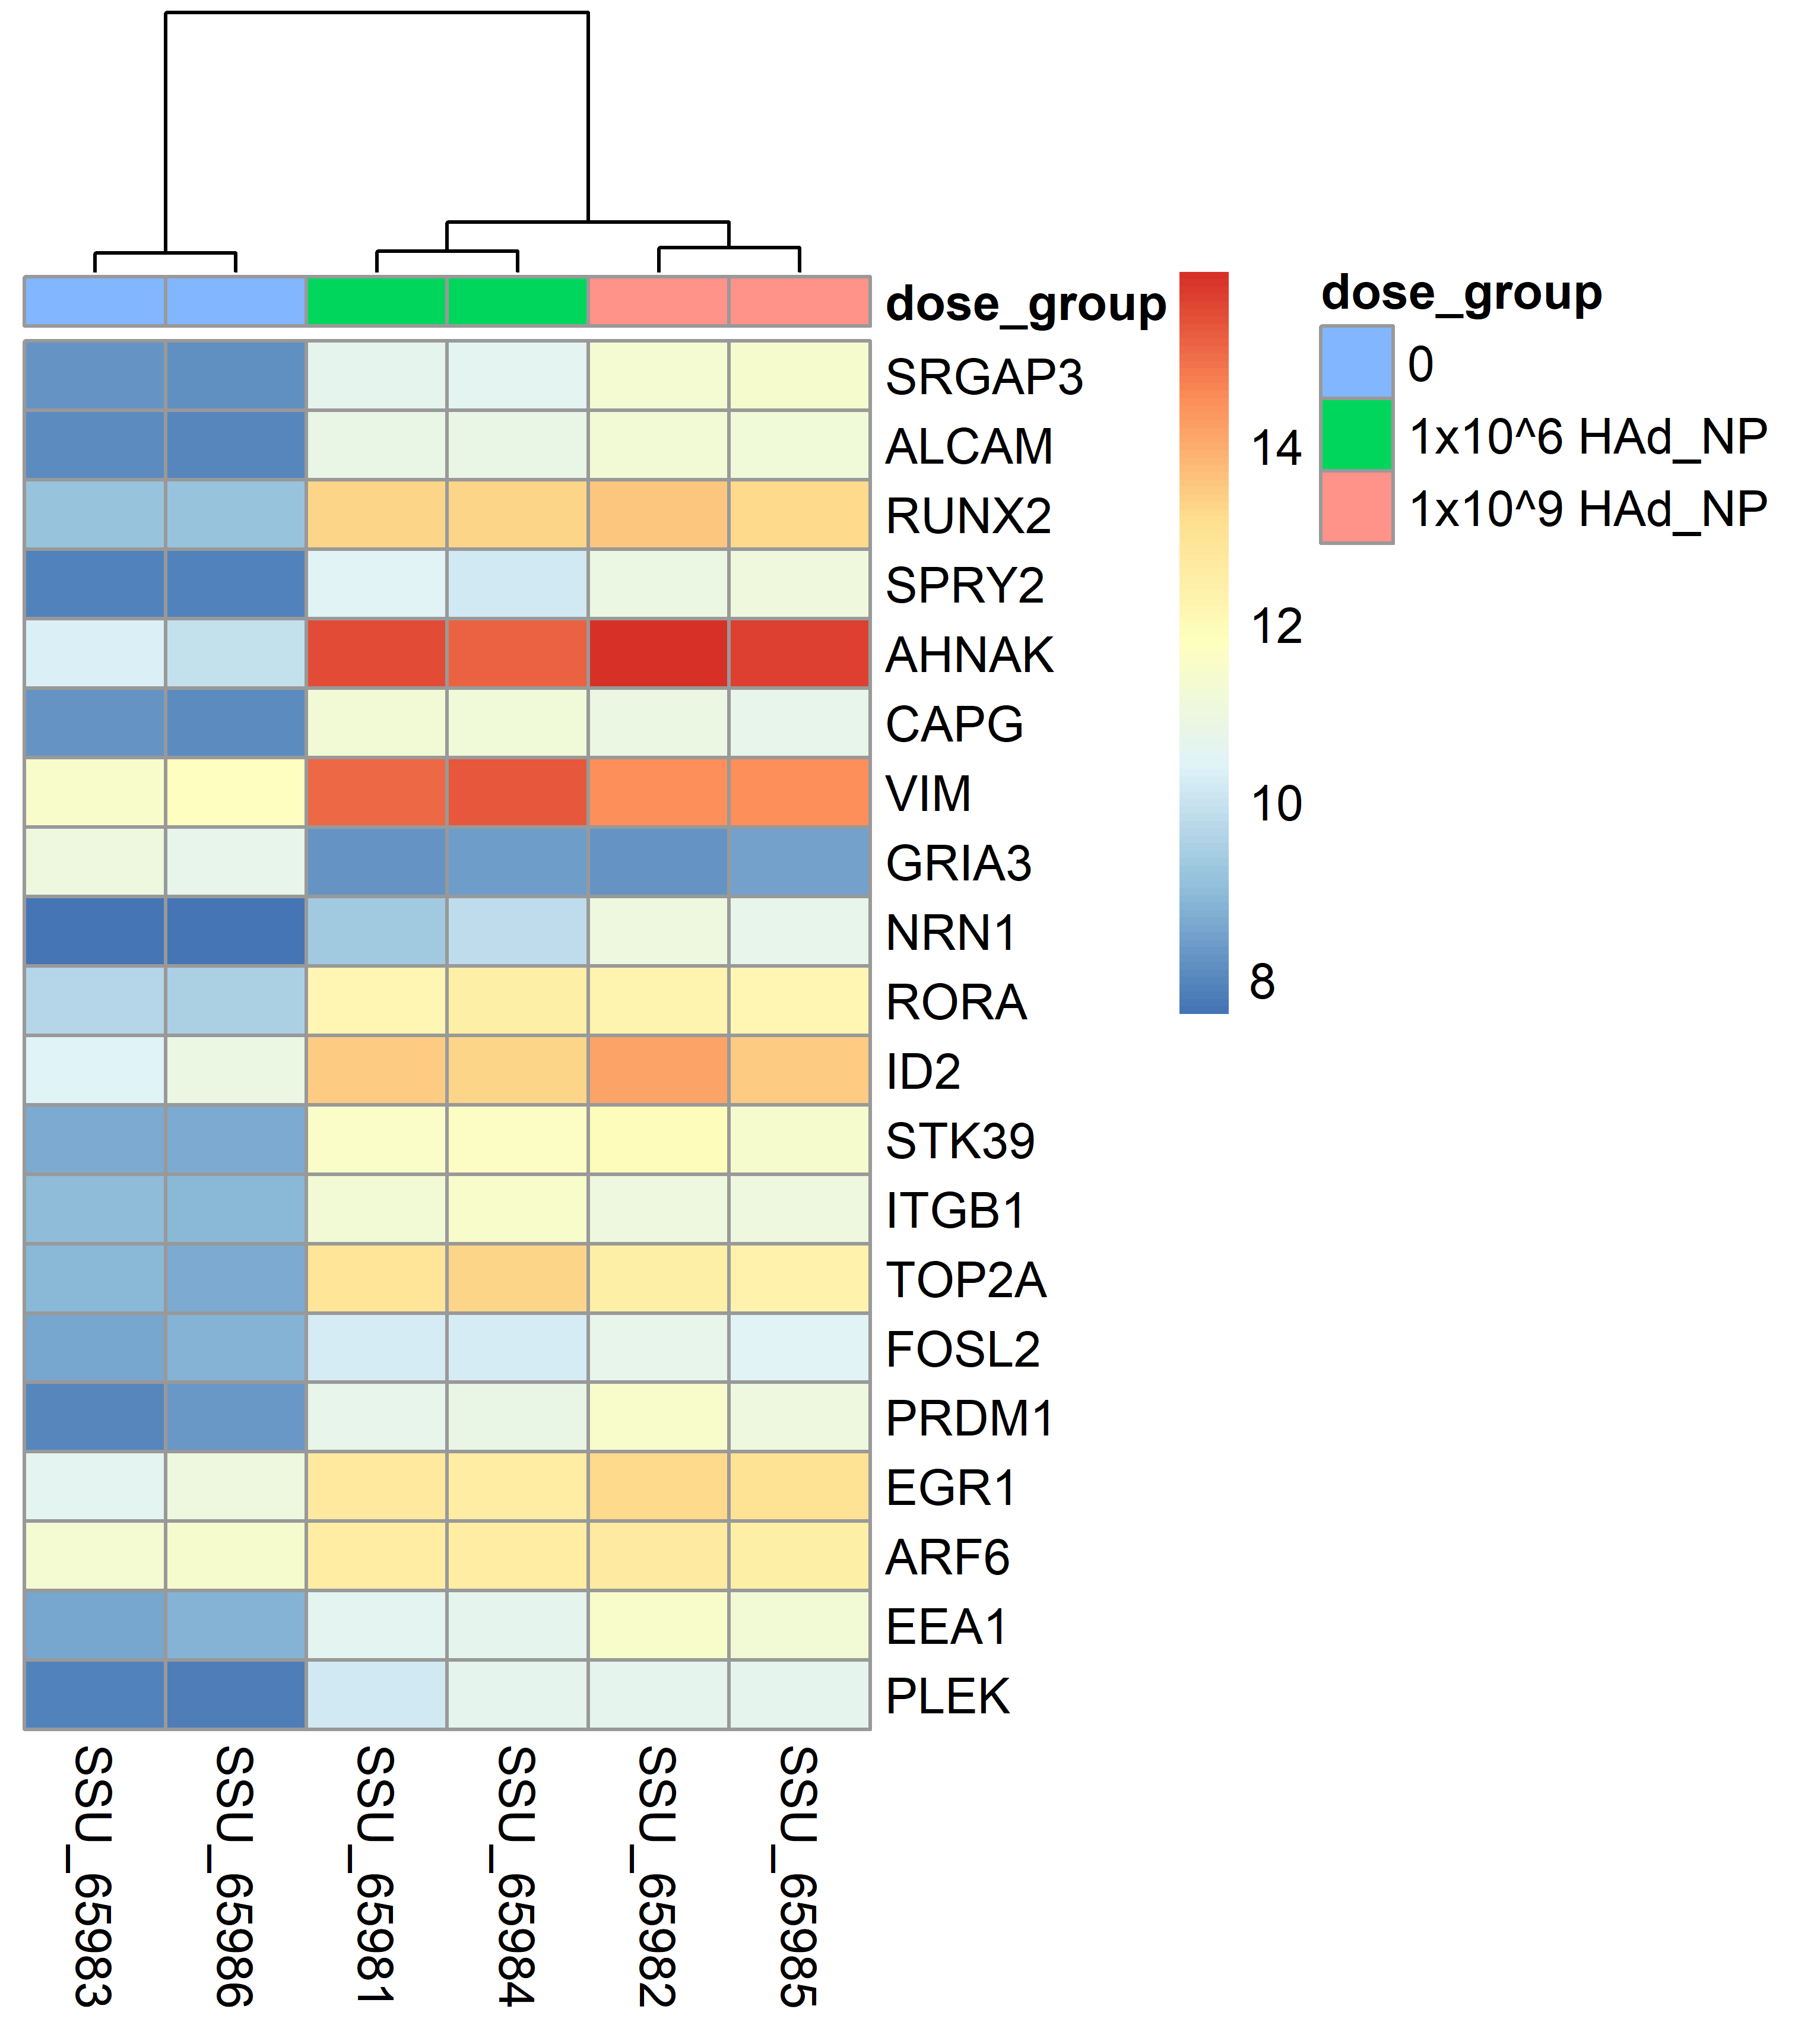
C vs A: Heat map
Color and intensity of the boxes represent counts transformed using a variance stabilizing transformation (vst) which is similar to a log2 transformation but accounts for the sampling variability of genes with low counts
Red indicates vst transformed counts closer to 16 and blue indicates vst transformed counts closer to 8
Genes are sorted by lowest adjusted p-value (FDR)
Samples are grouped by concentration and it is evident that the two viral concentrations are more similar to each other than they are to the naïve concentration

Slide 16
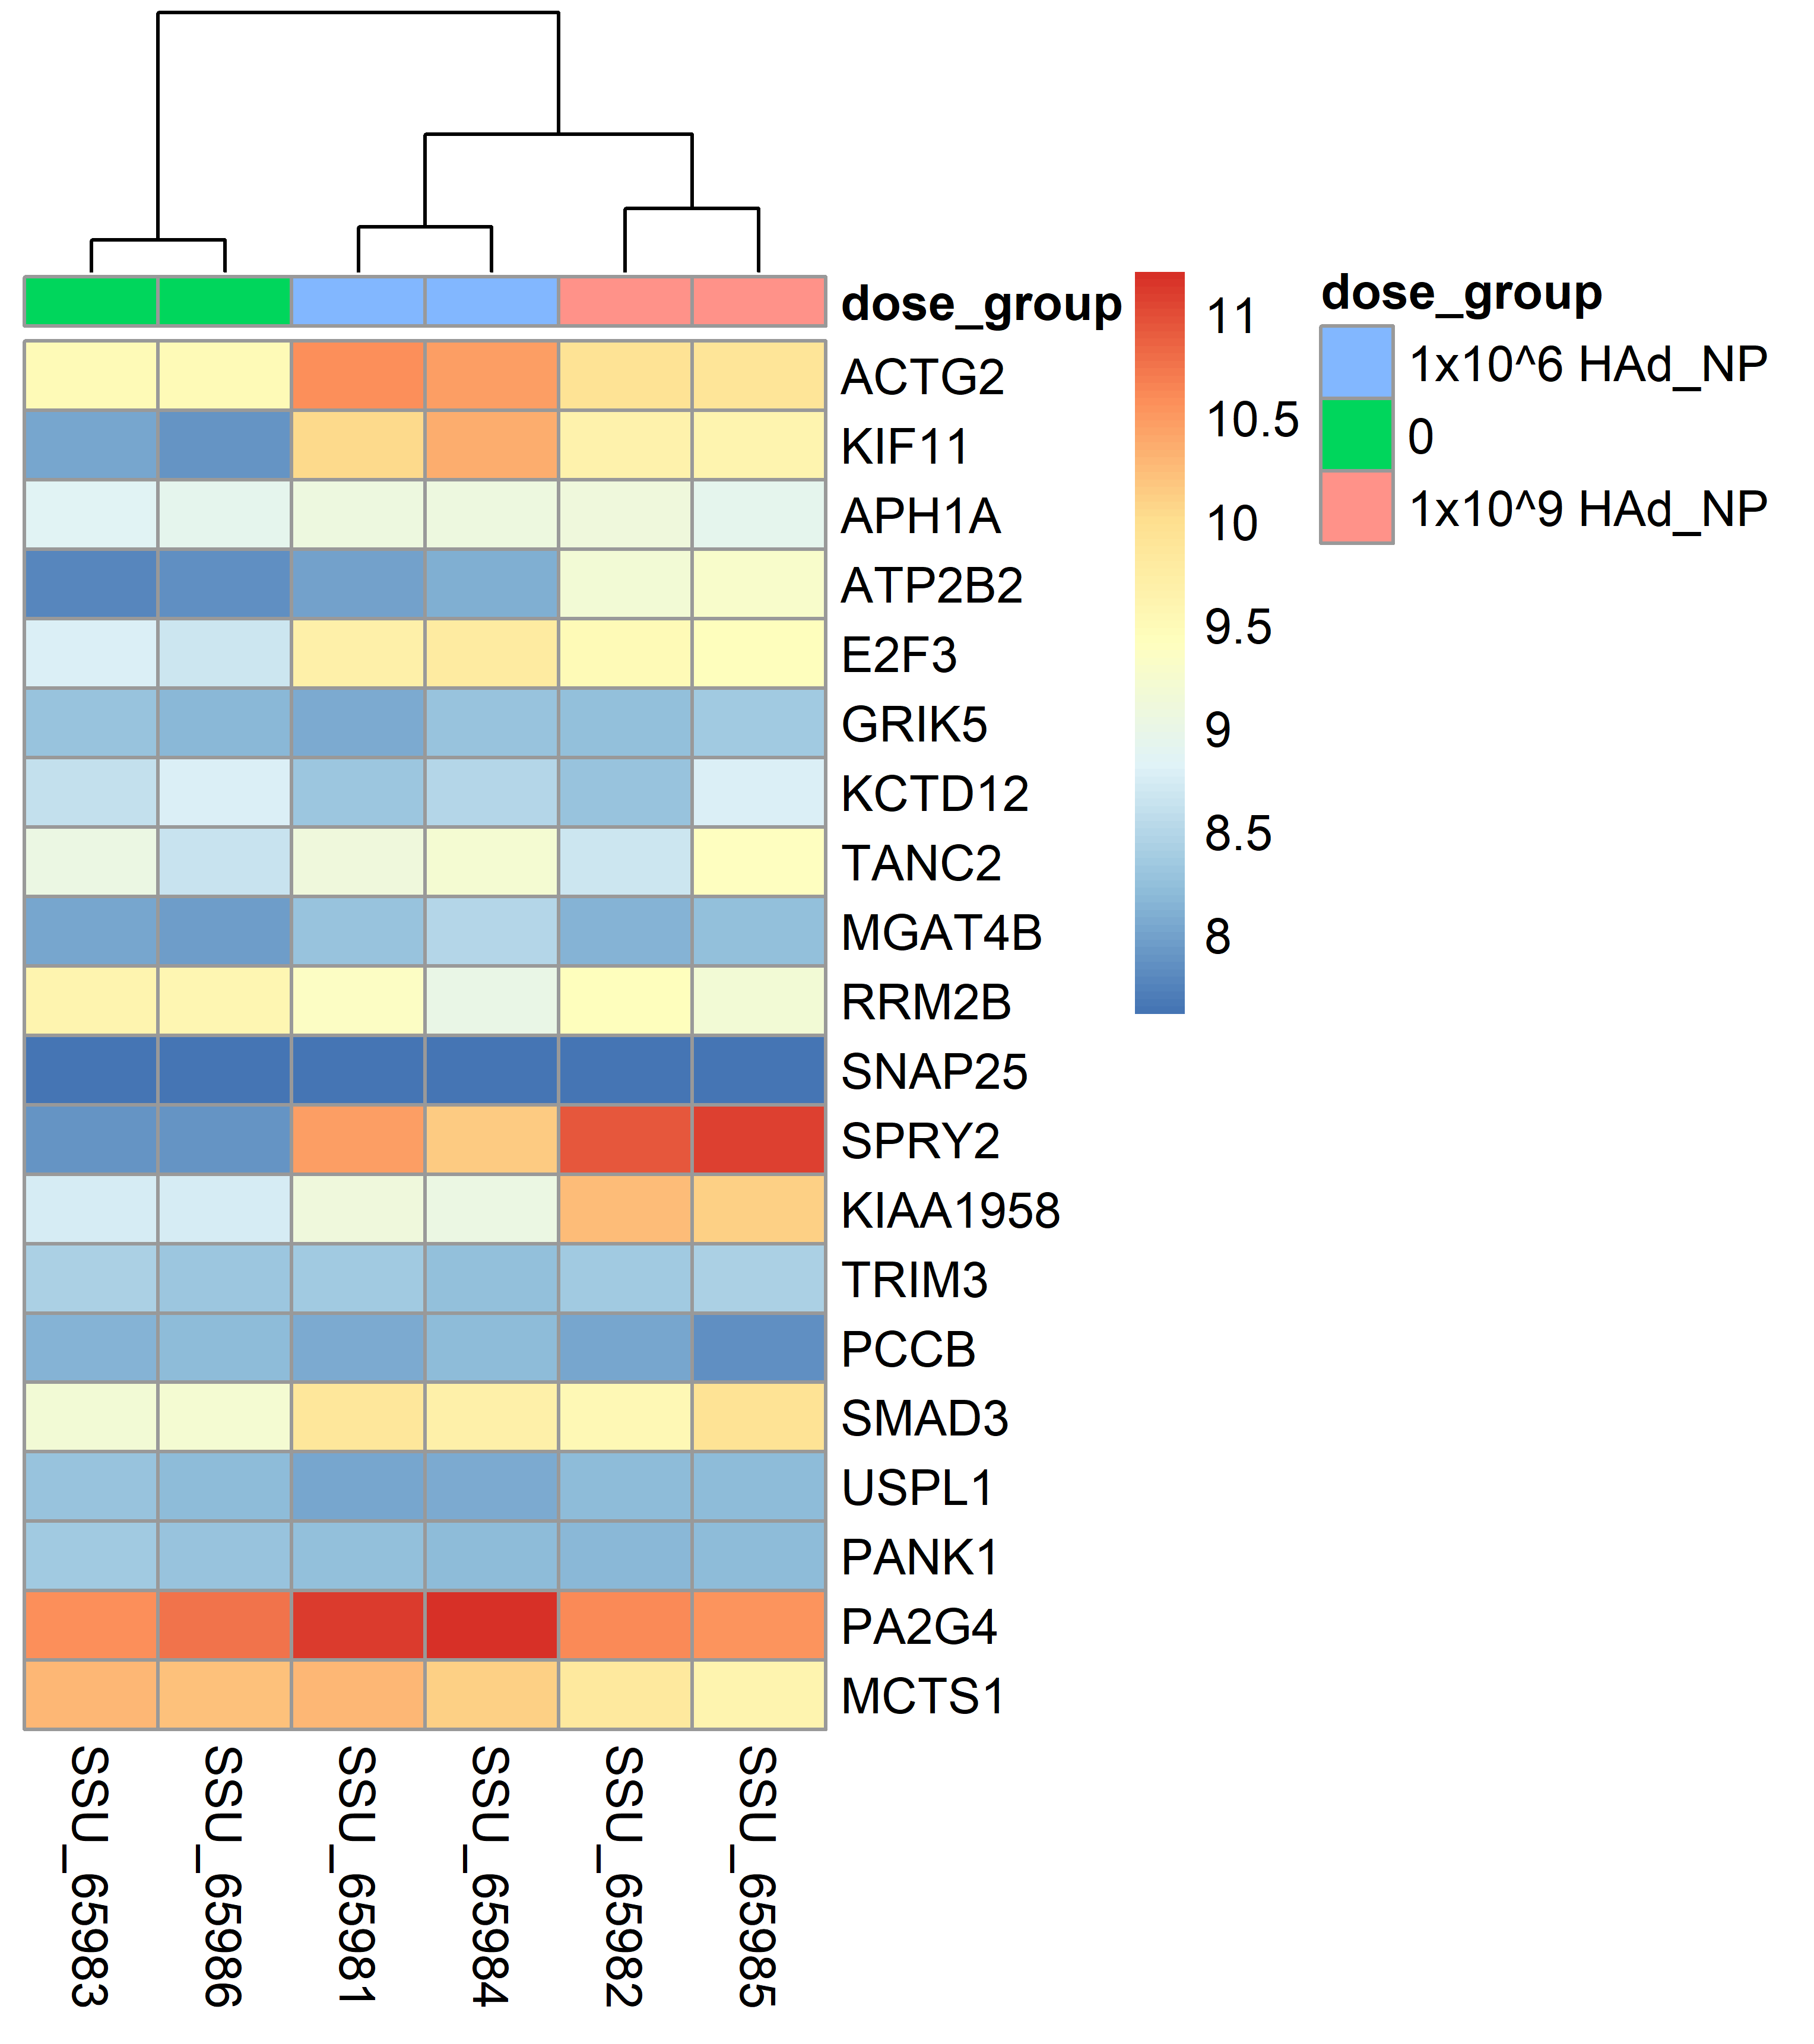
C vs B: Heat map
Color and intensity of the boxes represent counts transformed using a variance stabilizing transformation (vst) which is similar to a log2 transformation but accounts for the sampling variability of genes with low counts
Red indicates vst transformed counts closer to 11 and blue indicates vst transformed counts closer to 8
Genes are sorted by lowest adjusted p-value (FDR)
Samples are grouped by concentration and it is evident that the two viral concentrations are more similar to each other than they are to the naïve concentration

Slide 17
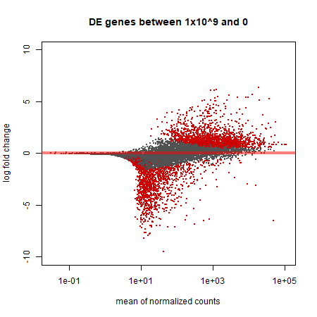
Concentration C vs A: MA plot
Results FDR <0.01
1446 DE genes (5.7%)
1116 (4.4%) up regulated
330 (1.3%) down regulated
16066 (64%) of genes filtered for mean normalized counts <7
As compared to previous run of analyses, more DE genes were identified but the member genes of top 20 DE genes stayed approximately the same
Controlling for batch effects gave us greater power to identify more DE genes at FDR threshold
MA plot
Many more up regulated than down regulated genes

Slide 18
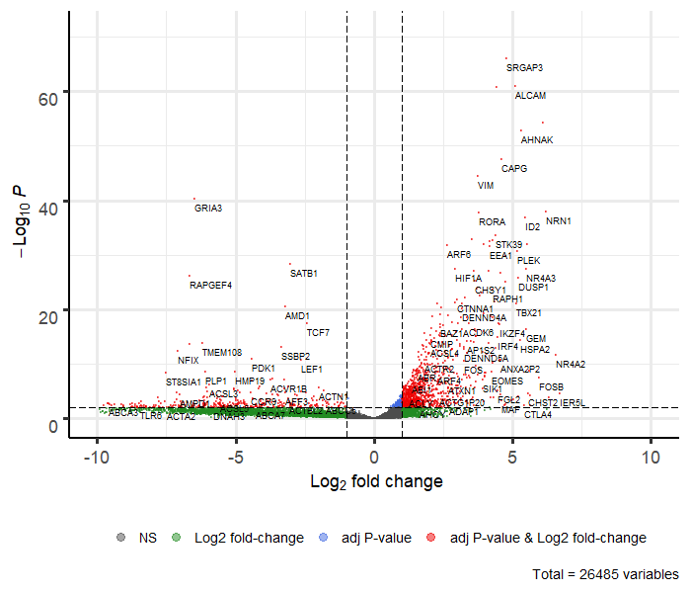
Concentration C vs A: Volcano plot
Fold change cut-off was set at 1.0, FDR was 0.01
Top 5 DE genes were as follows:
SRGAP (LFC: 4.797 , FDR: 8.57E-67)
ALCAM (LFC: 5.09 , FDR: 1.05E-61)
RUNX2 (LFC: 4.41 , FDR: 1.46E-61)
SPRY2 (LFC: 6.11 , FDR:6.61E-55)
AHNAK (LFC: 5.31, FDR: 1.51E-53)
All of these genes also have low s-values/local FDRs indicating that they are very unlikely to be false-positive findings

Slide 19
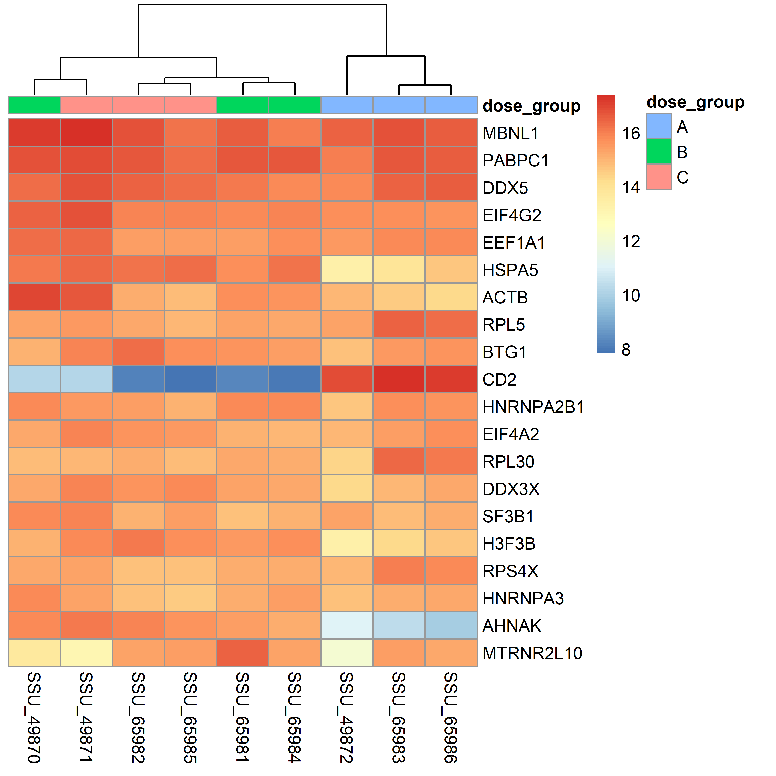
C vs A: Heat map
Color and intensity of the boxes represent changes of gene expression as quantified by row means of the normalized counts
The genes listed are in decreasing order of the mean normalized counts across all samples
Red indicates log fold changes close to 16 and blue indicates log fold changes close to 8
Samples are grouped by dose group for simplified visual comparison and appear to have somewhat consistent expression within site groups
As expected, both concentrations are more similar to one another than they are to concentration of 0

Slide 20
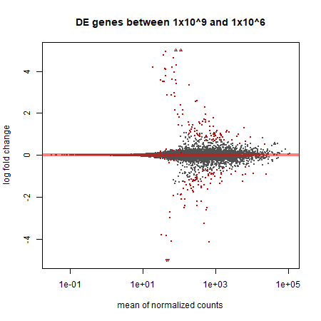
Concentration C vs B: MA plot
Results FDR <0.01
67 DE genes (0.48%)
73 (0.289%) up regulated
48 (0.194%) down regulated
15579 (62%) of genes filtered for mean normalized counts <6
Controlling for batch effects gave us greater power to correctly reject genes which were truly not differentiated between these concentrations at FDR threshold
MA plot (pre-threshold)
Many more up regulated than down regulated genes
Many were around zero and cluster on the line so are impossible to see.

Slide 21
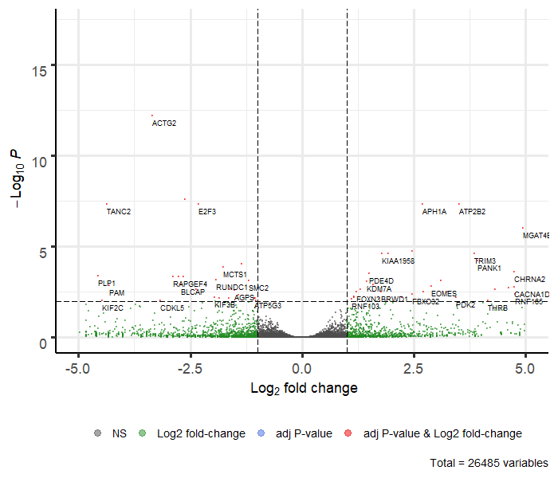
Concentration C vs B: Volcano plot
Fold change cut-off was set at 1.0, FDR was 0.01
Top 5 DE genes were as follows:
ACT2 (LFC:-3.34, FDR: 6.77E-13)
KIF11(LFC: -2.61, FDR: 2.63E-08)
APH1A (LFC: 2.70, FDR: 4.76E-08)
ATP2B2(LFC: 3.52, FDR: 4.76E-08)
E2F3(LFC: -2.32, FDR: 4.76E-08)
Note that the x axis is ~ 1/4 of previous Volcano plots suggesting much smaller differences in LFC between groups

Slide 22
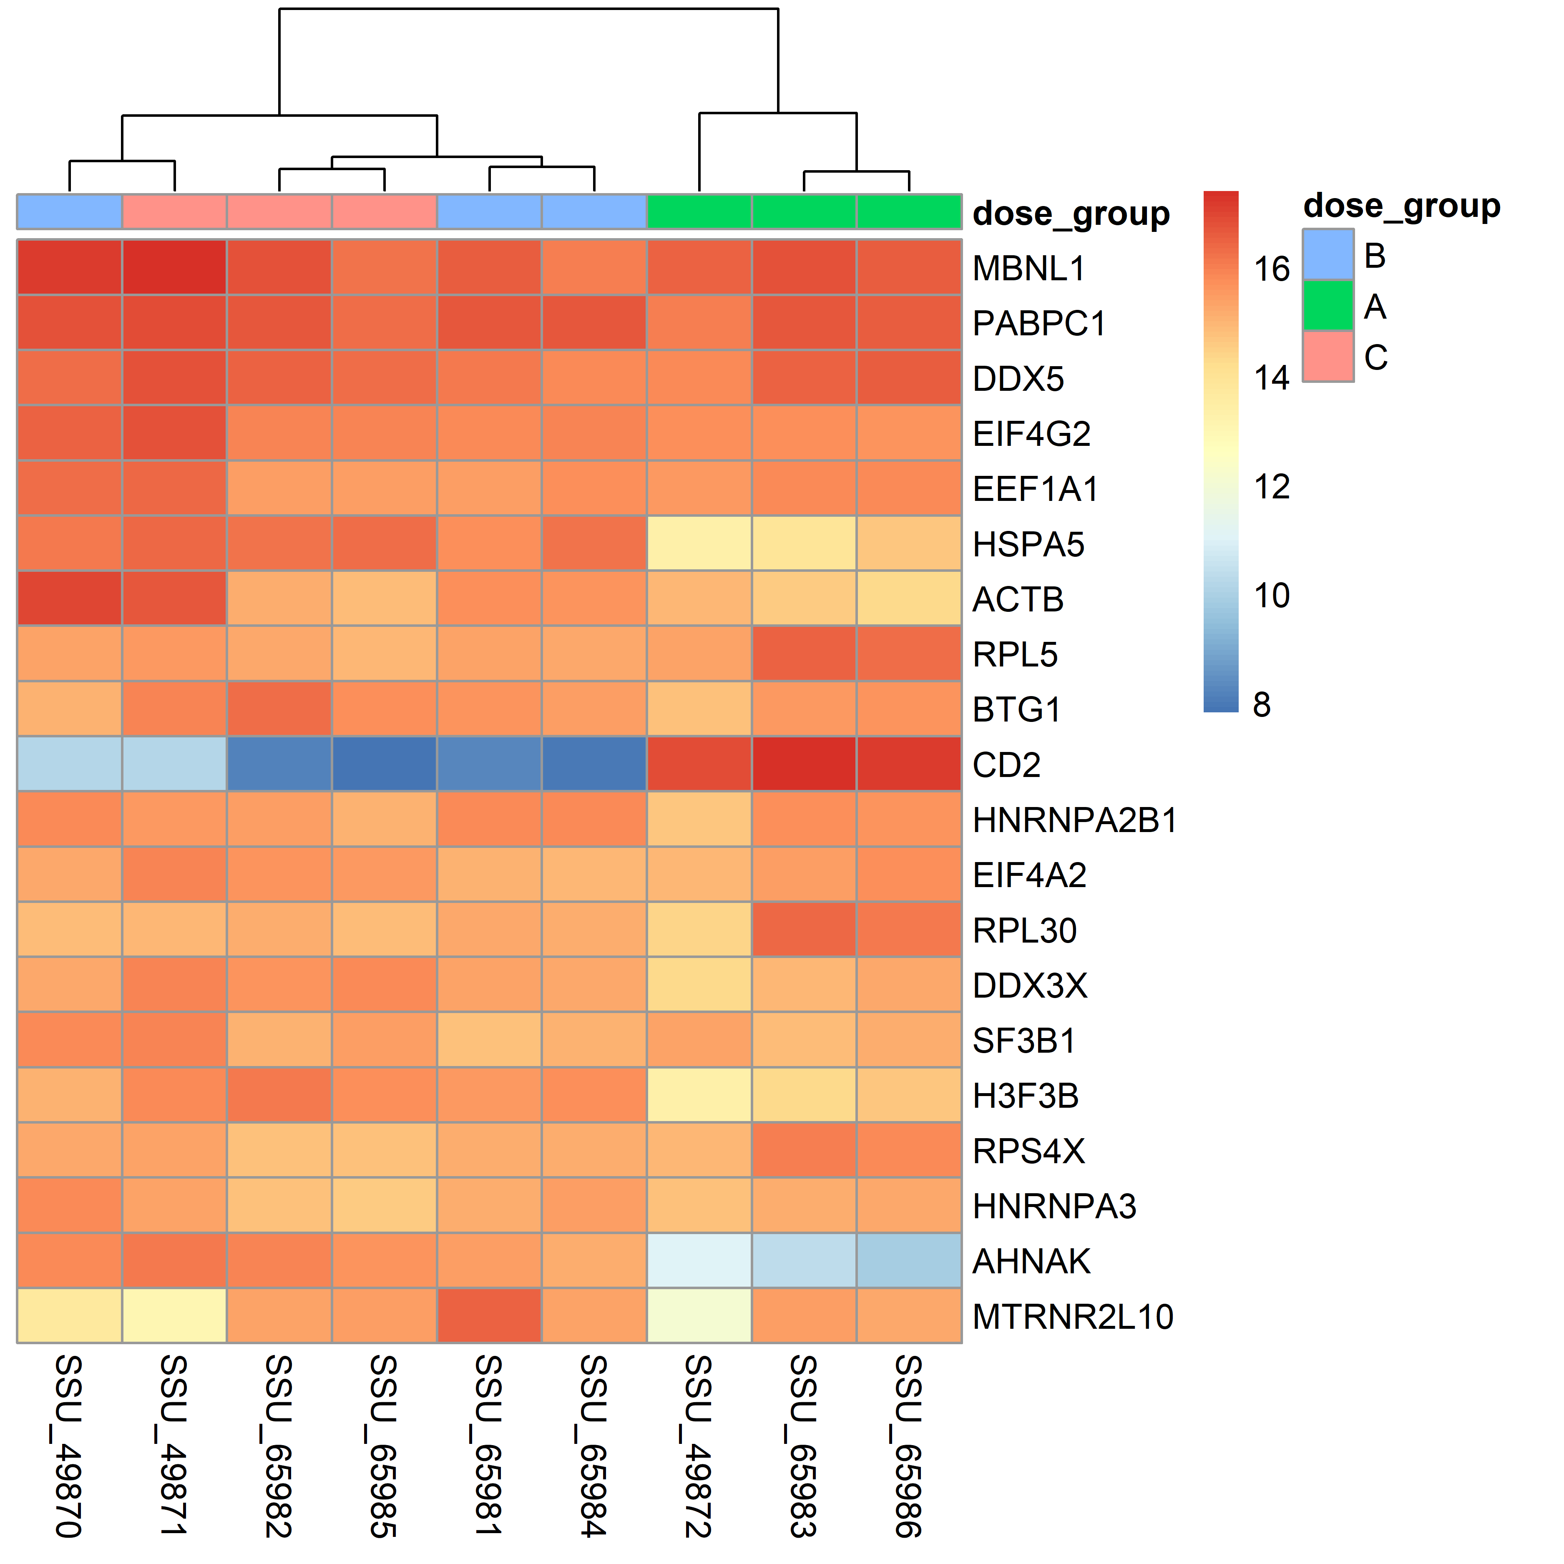
C vs B: Heat map
Color and intensity of the boxes represent changes of gene expression as quantified by row means of the normalized counts
The genes listed are in decreasing order of the mean normalized counts across all samples
Red indicates log fold changes close to 16 and blue indicates log fold changes close to 8
Samples are grouped by dose group for simplified visual comparison and appear to have somewhat consistent expression within site groups
As expected, both concentrations are more similar to one another than they are to concentration of 0

Slide 23
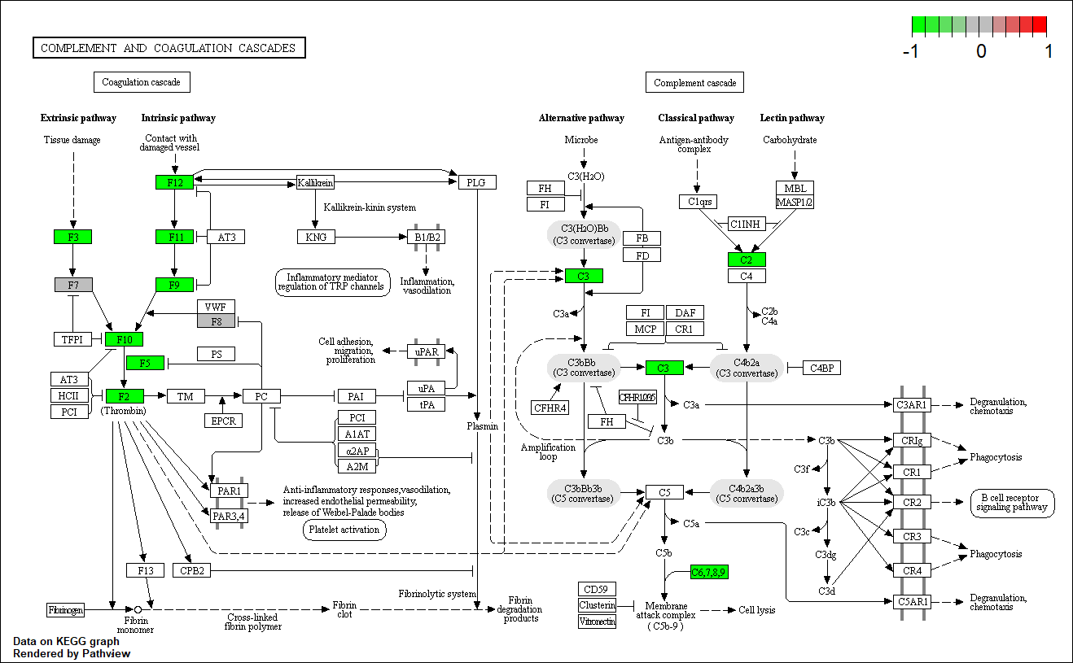
DE Pathway in B vs A and C vs A comparisons
1 down regulated pathway at FDR = 0.12
Complement and coagulation cases (local FDR=0.13)

Slide 24
Files in Box folder
Summary Presentation
R code
Raw data
Counts
sample manifest
Reports & Results
Results
QAQC
Differential Expression
Plots
PCA plots
MA plots
Volcano Plots
Heatmap

Slide 25
References
Anders, S., Pyl, P. T. & Huber, W. HTSeq-A Python framework to work with high-throughput sequencing data. Bioinformatics (2015). doi:10.1093/bioinformatics/btu638
Blighe, K., (2019). EnhancedVolcano: Publication-ready volcano plots with enhanced colouring and labeling. R package version 1.2.0. https://github.com/kevinblighe/EnhancedVolcano
Boxuan Cui (2019). DataExplorer: Automate. Data Exploration and Treatment. R package. version 0.8.0.. https://CRAN.R-project.org/package=DataExplorer
Carlson, M. org.Hs.eg.db: Genome wide annotation for Human. R package version 3.8.2. (2019).
Dobin, A. et al. STAR: Ultrafast universal RNA-seq aligner. Bioinformatics (2013). doi:10.1093/bioinformatics/bts635
Ewels, P., Magnusson, M., Lundin, S. & Käller, M. MultiQC: Summarize analysis results for multiple tools and samples in a single report. Bioinformatics 32, 3047–3048 (2016).
Harrow, J. et al. GENCODE: The reference human genome annotation for the ENCODE project. Genome Res. (2012). doi:10.1101/gr.135350.111
Huntley, M.A., Larson, J.L., Chaivorapol, C., Becker, G., Lawrence, M., Hackney, J. A., Kaminker, J., ReportingTools: an automated result processing and presentation toolkit for high throughput genomic analyses. Bioinformatics.
Luo, W. and Brouwer C., Pathview: an R/Bioconductor package for pathway-based data integration and visualization. Bioinformatics, 2013, 29(14): 1830-1831, doi: 10.1093/bioinformatics/btt285
Love, M. I., Anders, S. & Huber, W. Differential analysis of count data - the DESeq2 package. Genome Biology (2014). doi:110.1186/s13059-014-0550-8
Pagès, H., Carlson, M. , Falcon, S., and Li, Nianhua. AnnotationDbi: Manipulation of SQLite-based annotations in Bioconductor. R package version 1.46.1. (2019).
Wickham, H., François, R., Henry, L., and Müller, K., dplyr: A Grammar of Data Manipulation. R package version 0.8.3. (2019). https://CRAN.R-project.org/package=dplyr
H. Wickham. ggplot2: Elegant Graphics for Data Analysis. Springer-Verlag New York, 2016.
Zhu A, Ibrahim JG, Love MI (2018). “Heavy-tailed prior distributions for sequence count data: removing the noise and preserving large differences.” Bioinformatics. doi: 10.1093/bioinformatics/bty895.

