Slide 1
Local Git and Remote Repository
On Windows cmd, change directories to the folder where the Python Lab code will be downloaded
Create directory ‘PythonLab’ and cd into the directory
Type git init to create local git repo
Type git remote add origin <your github repo url>
Type git pull origin master
Type git add . to add all files in the current directory to the local repo
Type git commit and enter a commit message
Type git push –u origin master to push your files to your Github remote repo
Any changes to files in this folder can be pushed to the remote repo by repeating steps 6-8

Slide 2
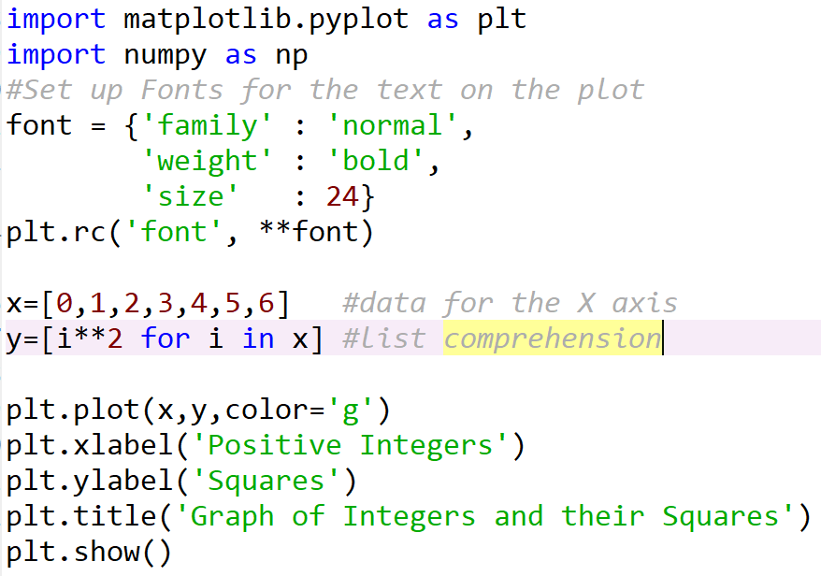
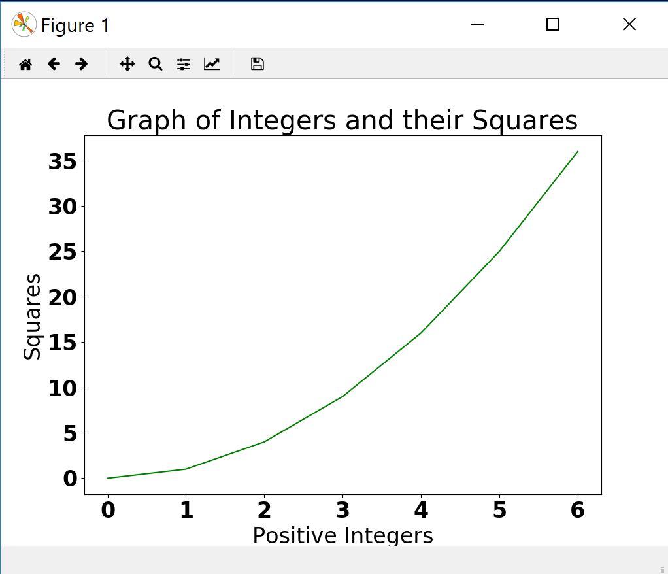
Python and Plotting/Graphing
Matplotlib, ggplot, plotly etc.
We’ll use matplotlib to plot sample data sets – A simple line graph

Slide 3
Python and Plotting/Graphing
Pandas: Python Data Analysis Library (https://pandas.pydata.org/)
Free library specifically tailored to data structuring and analysis
Data input can be CSV or a SQL Database, and output is a Python object with rows and columns – a Dataframe
The dataframe can be saved as a CSV, Excel, JSON or SQL table
Once read in, data can be transformed in multiple ways:
Mean of columns
Group, filter and sort
Min, max, median of columns

Slide 4
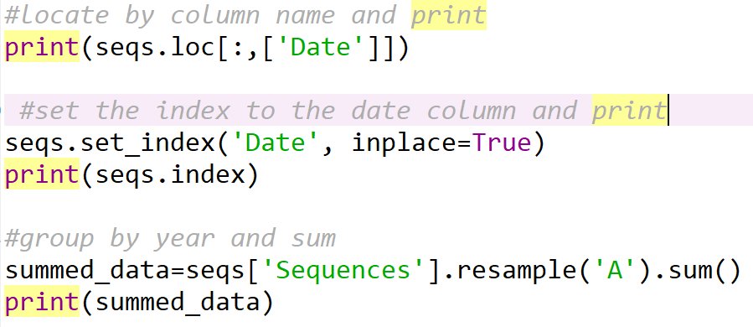
Python and Plotting/Graphing

Slide 5
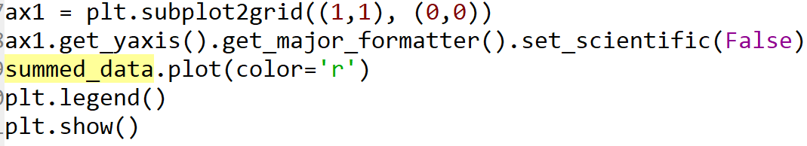
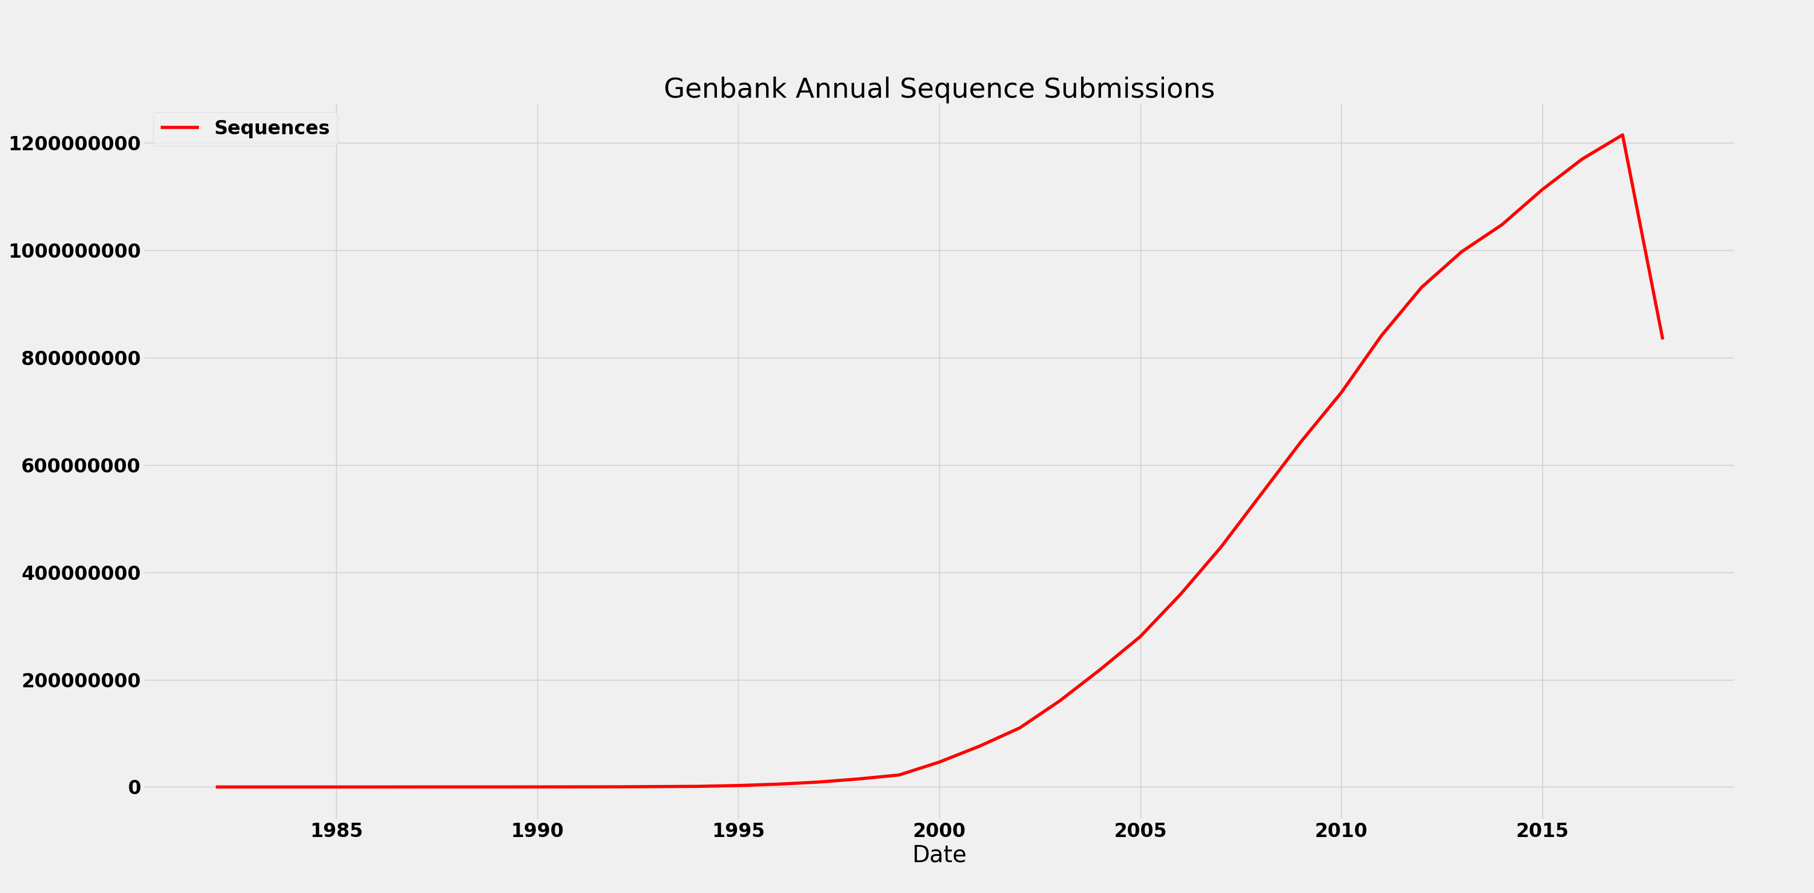
Python and Plotting/Graphing
Once the data is ready, we can plot it using Matplotlib:

Slide 6
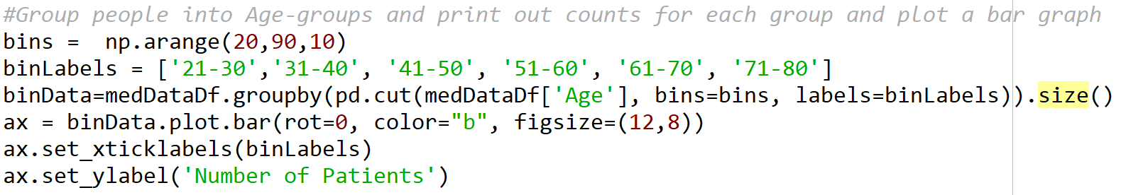
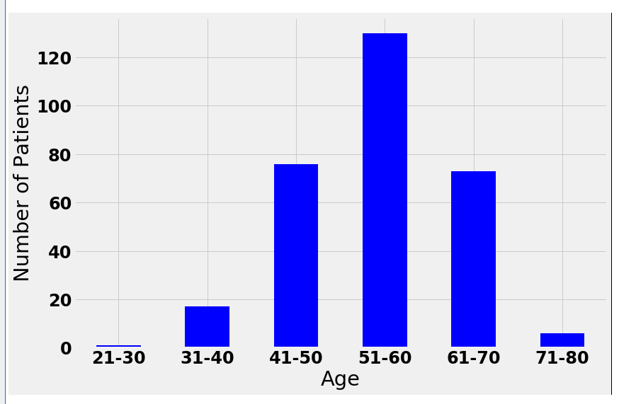
Python and Plotting/Graphing
Data Analysis: Add a new column containing calculated data Ex:

