Slide 1
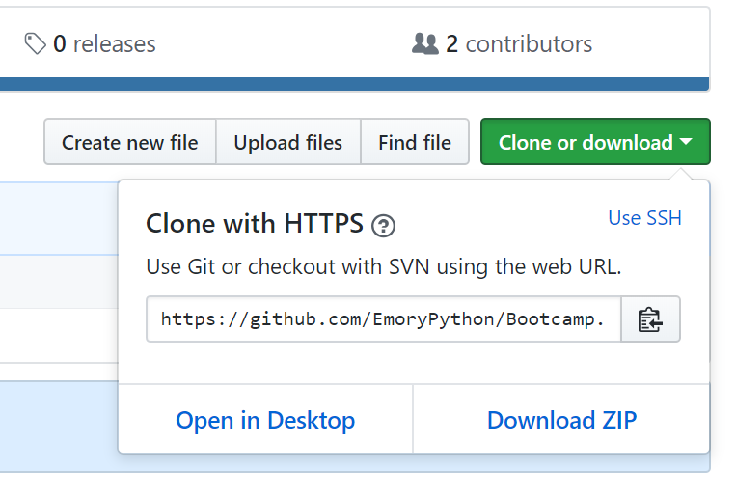
Python Lab – Code Download and Setup
In your browser, open https://github.com/EmoryPython/Bootcamp
Click on the green ‘Clone or Download’ button and ‘Download ZIP’:
Create directory ‘PythonLab’ and extract the downloaded files into this directory
On Git, create your repository if you don’t already have one: https://github.com/

Slide 2
Local and Remote Git Repository Setup
On Windows, open a cmd prompt window, change directories to the folder ‘PythonLab’ you just created
Type git init to create local git repo
Type git remote add origin <your github repo url>
Type git pull origin master
Type git add . to add all files in the current directory to the local repo
Type git commit and enter a commit message
Type git push –u origin master to push your files to your Github remote repo
Any changes to files in this folder can be pushed to the remote repo by repeating steps 5-7

Slide 3
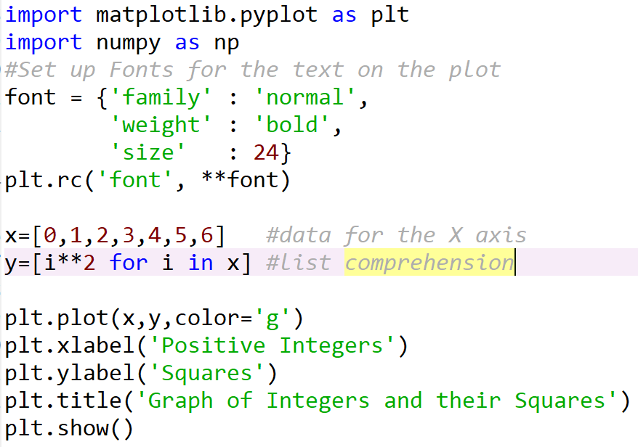
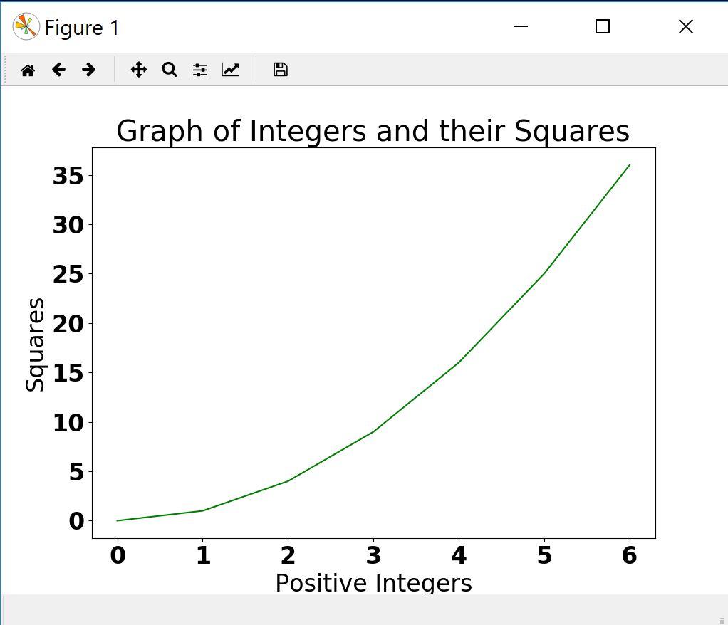
Python and Plotting/Graphing
Matplotlib, ggplot, plotly etc.
We’ll use matplotlib to plot sample data sets – A simple line graph

Slide 4
Python and Plotting/Graphing
Pandas: Python Data Analysis Library (https://pandas.pydata.org/)
Free library specifically tailored to data structuring and analysis
Data input can be CSV or a SQL Database, and output is a Python object with rows and columns – a Dataframe
The dataframe can be saved as a CSV, Excel, JSON or SQL table
Once read in, data can be transformed in multiple ways:
Mean of columns
Group, filter and sort
Min, max, median of columns

Slide 5
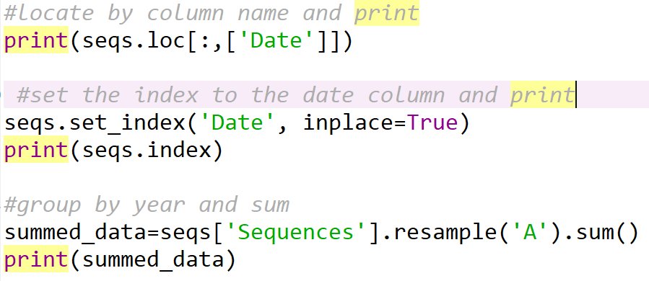
Python and Plotting/Graphing
Resample is a convenience method for resampling of a time series, and among the arguments, accepts one to indicate the periodicity – A being annual. A sum of submissions per year is calculated.

Slide 6
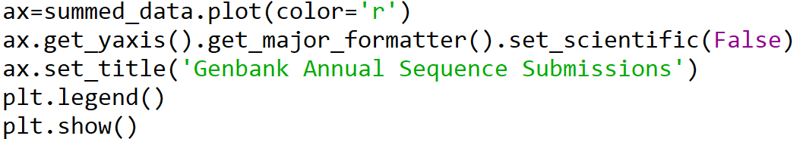
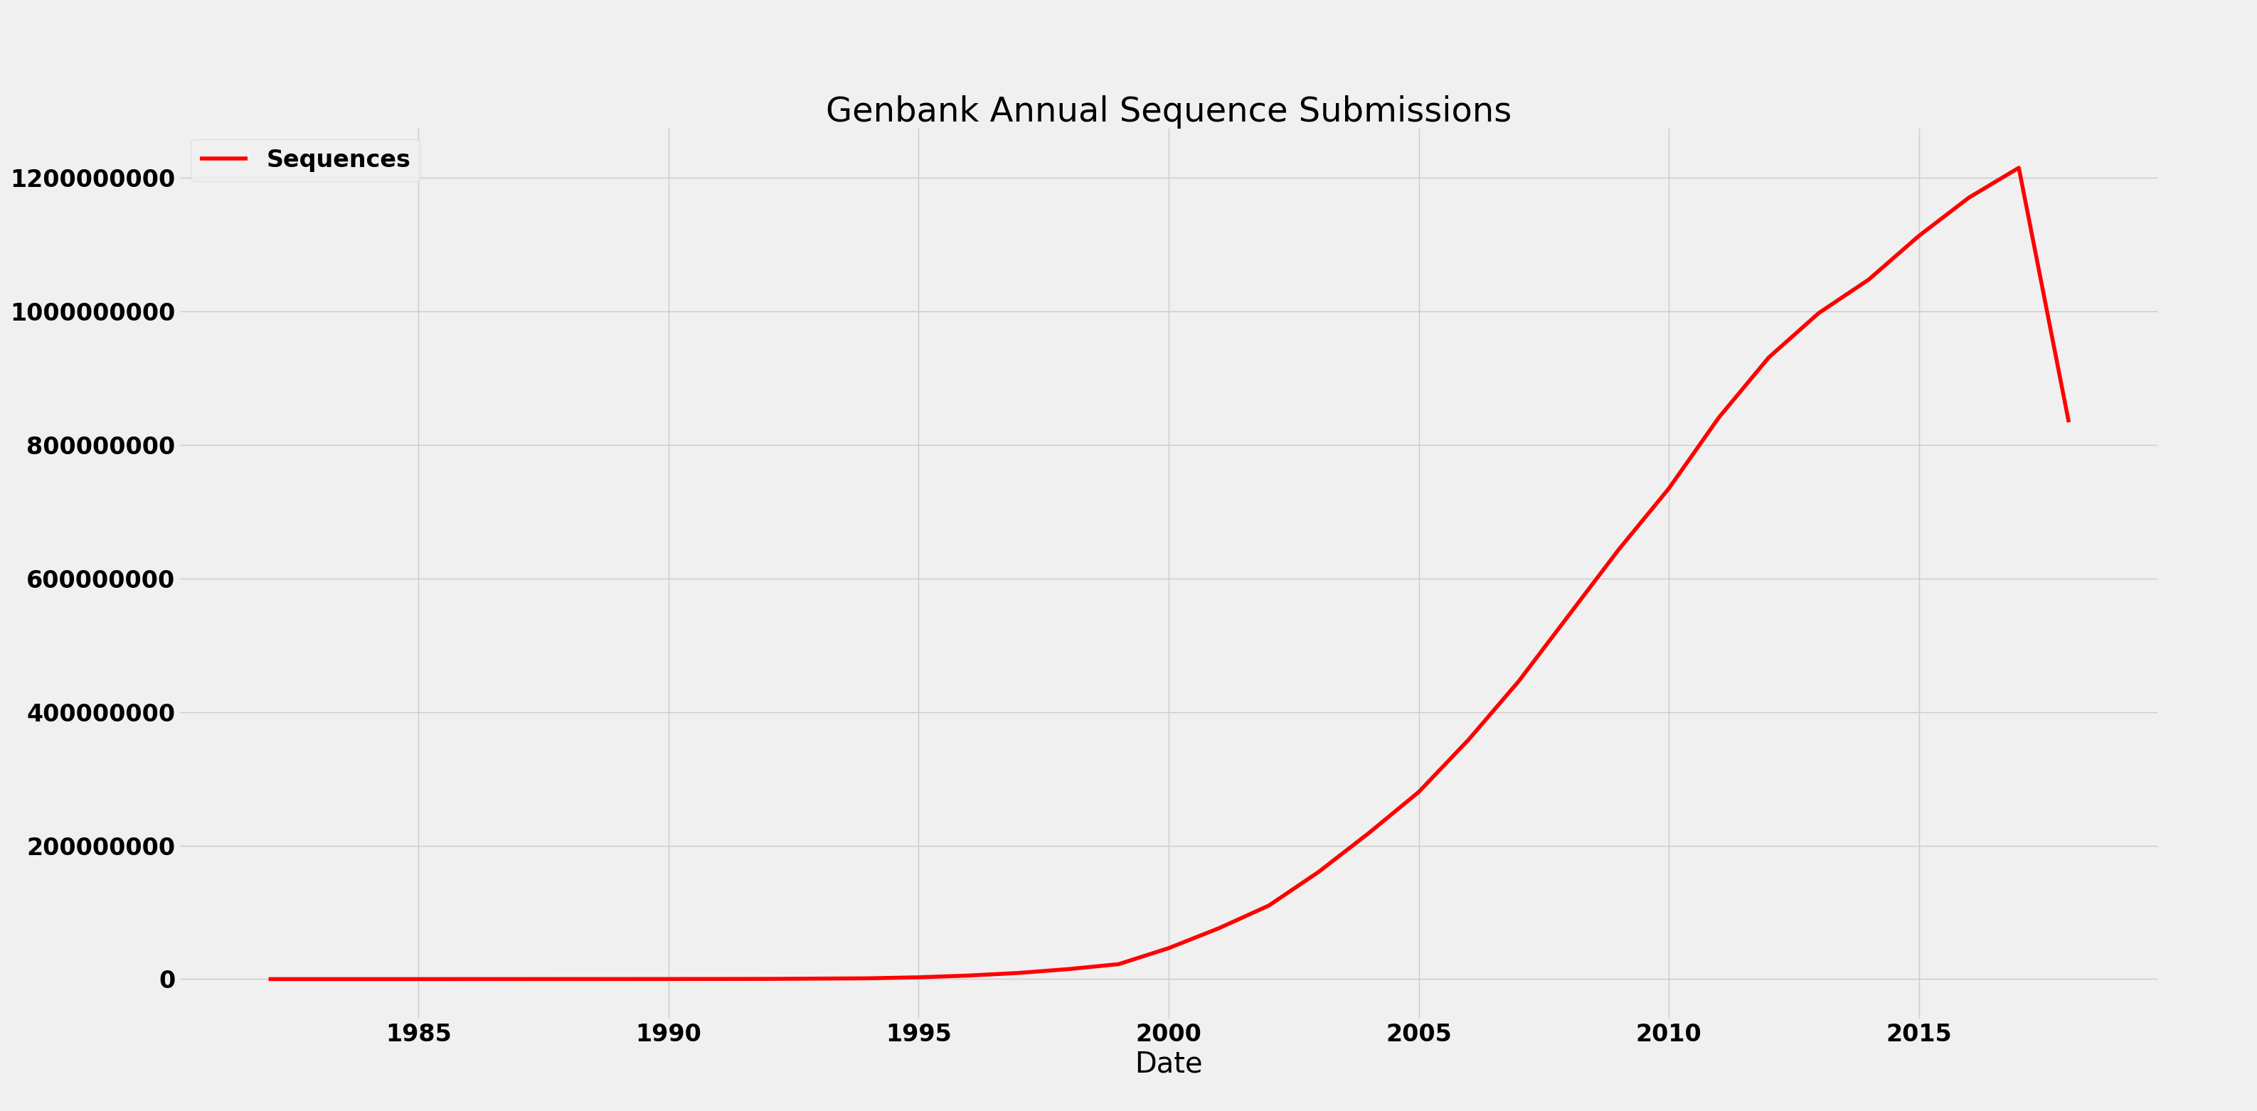
Python and Plotting/Graphing
Once the data is ready, we can plot it using Matplotlib:

Slide 7
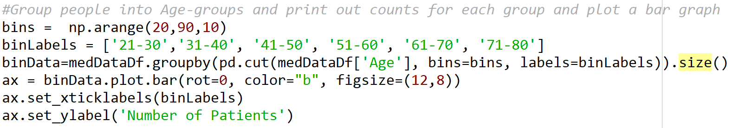
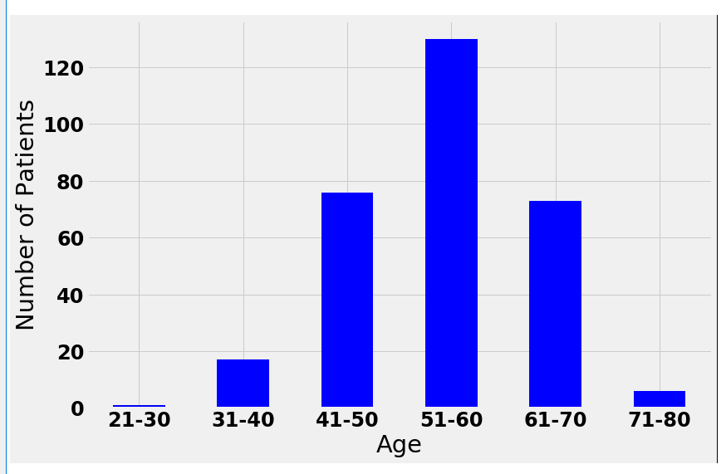
Python and Plotting/Graphing
Binned data such as Age, is best represented using a Histogram. Matplotlib can be used to automatically bin continuous data and display the distribution using a Histogram.

Slide 8
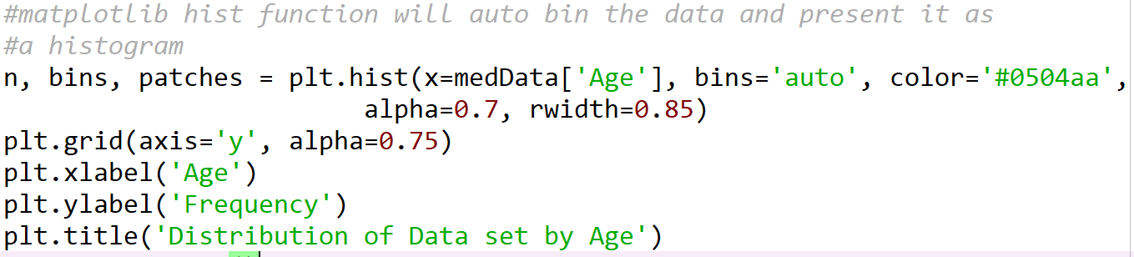
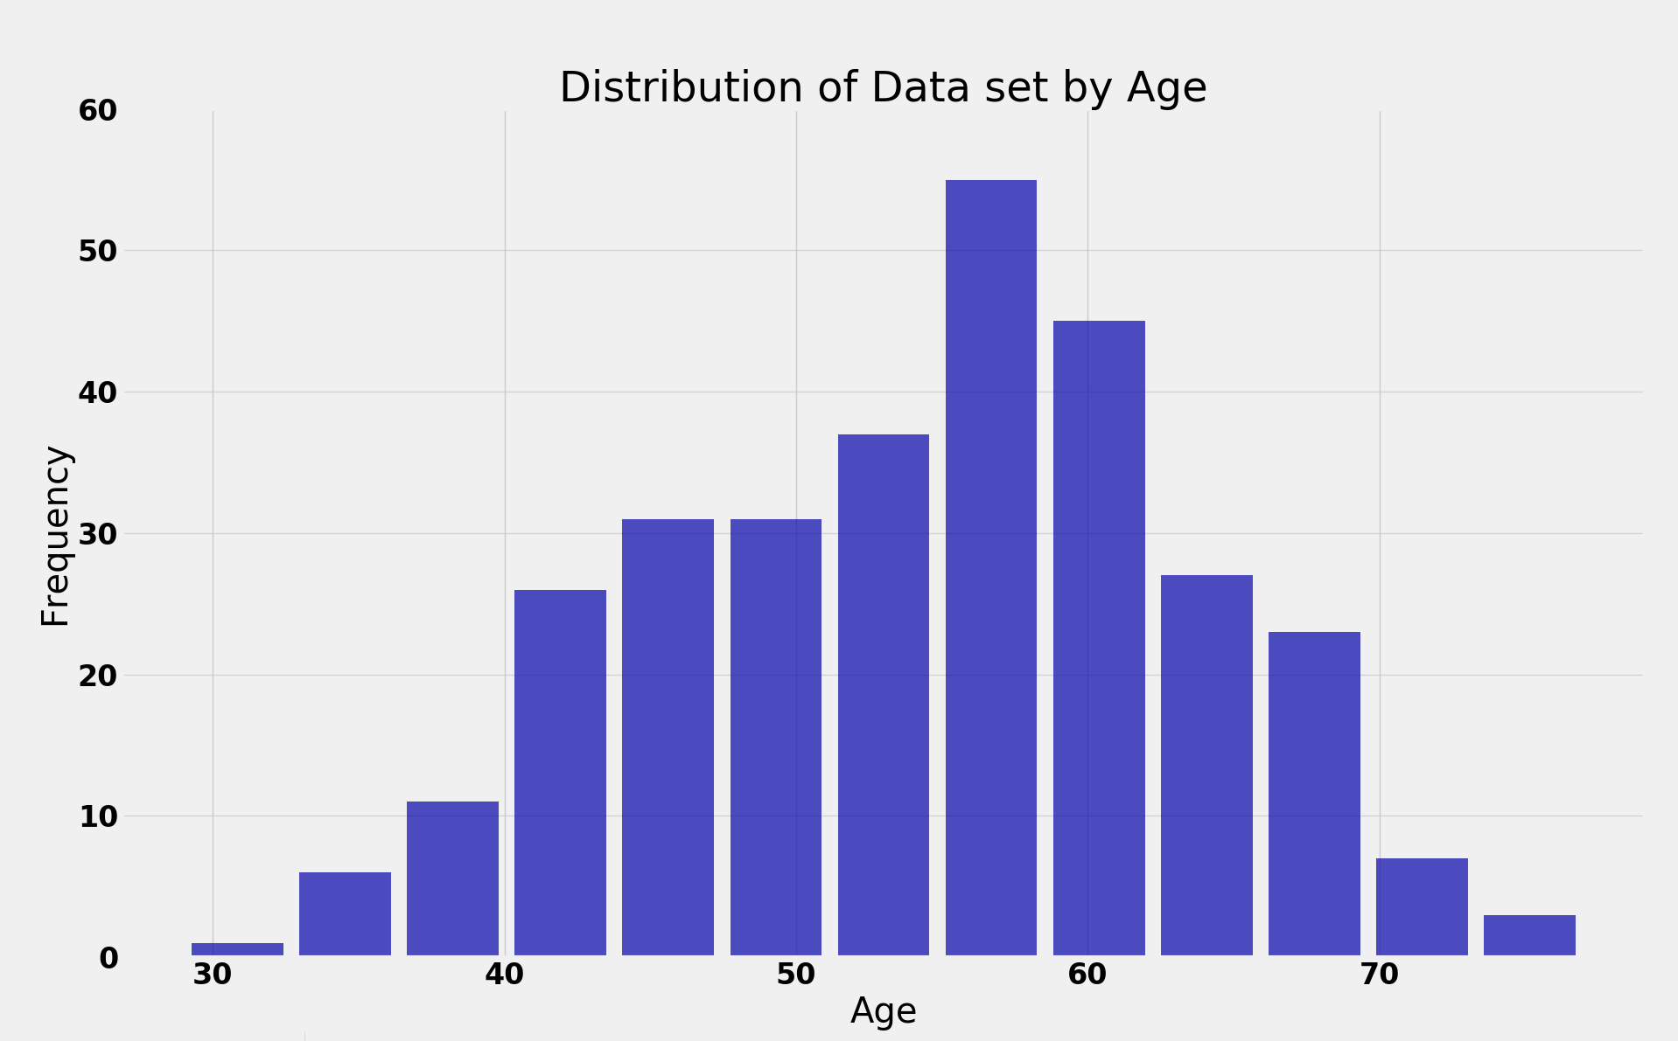
Python and Plotting/Graphing
n is the number of items per bin
bins is the left edge of each bin
patches are the rectangles that are displayed on the histogram, and can be used to control their properties, such as color, border etc.

Slide 9
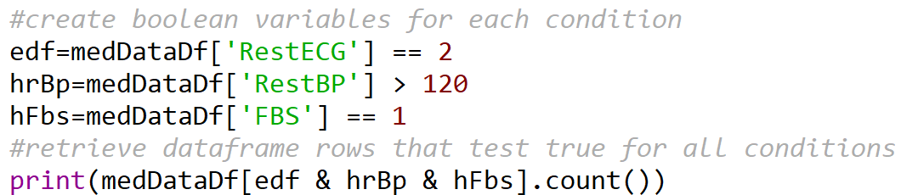
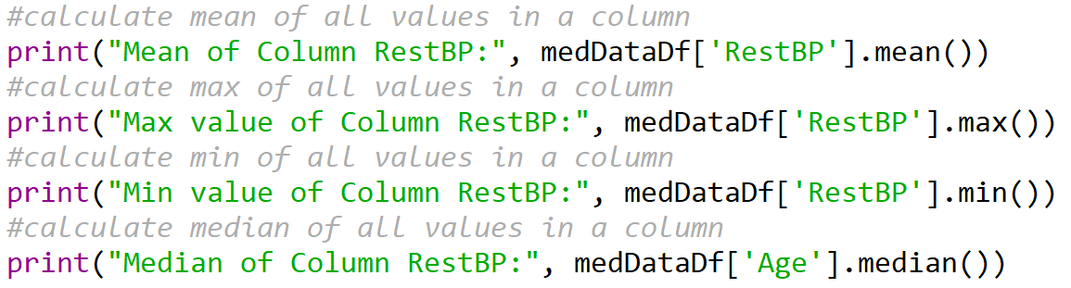
Python and Plotting/Graphing
Identify rows with High Resting BP (>120 mm Hg) using apply and a lambda function
Filter rows in a dataframe based on a condition(s)
Calculate column level stats

Slide 10
Python Graphing/Plotting Resources
https://matplotlib.org/tutorials/introductory/pyplot.html
https://docs.scipy.org/doc/numpy/user/quickstart.html
https://pandas.pydata.org/pandas-docs/stable/tutorials.html

