Slide 1
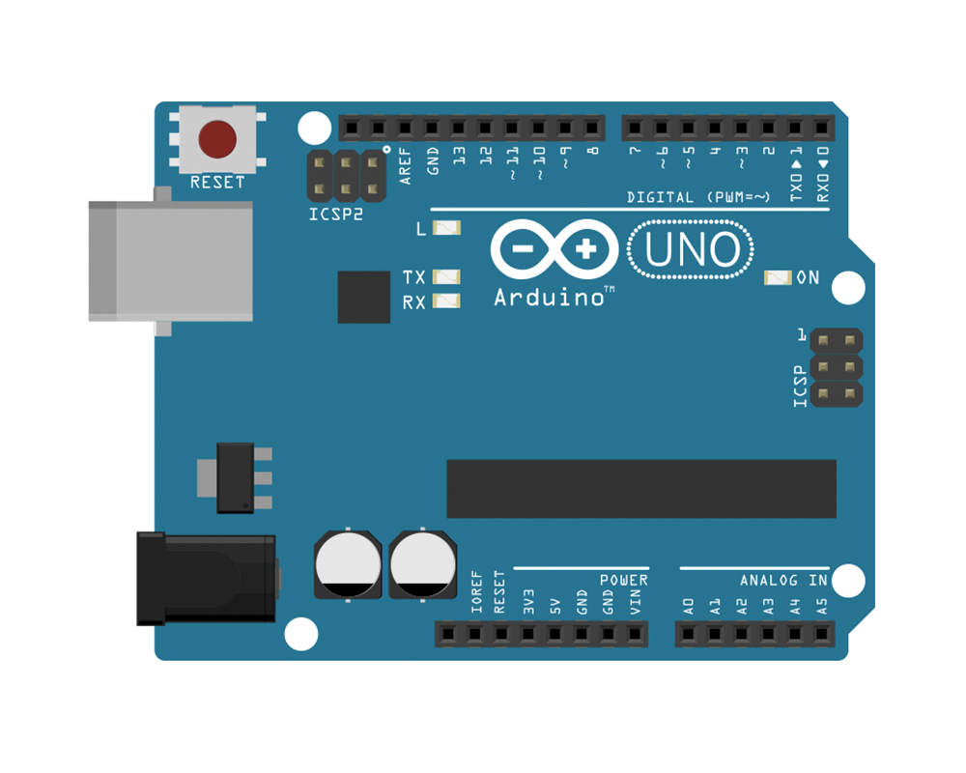
PIN10 CS
VCC
MISO
GND
SCK
SCX
VCC
SDX
MOSI
SDO
BMI160
CSB
GND

Slide 2
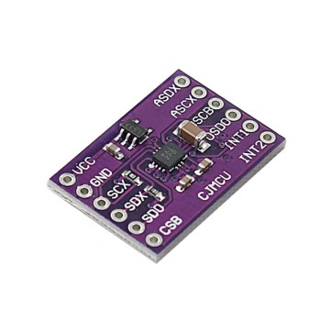
VCC
GND
SCX
SDX
SDO
CSB

