Slide 1
Rocket iCluster HA solution for IBM System i

Slide 2
基于IBM System i的高可用技术
IBM PowerHA Solution [基于DS8K的存储复制技术]
  Metro-Mirror [同步镜像]
  Metro-Global-Mirror [同步-异步镜像]
Software HA solution[基于日志的软件复制技术]
  Vision solution
    MIMIX 7.1
    OMS 9.1/ODS 5.1
    ITera
  Rocket solution
    iCluster 7.1 TL1

Slide 3
评估高可用方案的指标
RPO & RTO[恢复点指标和恢复时间指标]
Reliability 可靠稳定
Small Workload 轻负载
Good Performance 高性能
Simple Operation & Easy maintain 操作简便/易维护
Strong support structure 支持到位
Reliable product roadmap 产品稳步升级

Slide 4
高可用方案的着眼点
Disaster Recovery 故障恢复
Load Balance 负载均衡
Scalability 可扩展
Management 管理
Support/Maintain 支持/维护
Price/efficiency 性价比
Confirmed solution 被验证的方案

Slide 5
基于日志高可用方案的技术体现
Journal management 日志管理
Journal entry apply strategy 日志项复制方案
Transaction management 事务的控制
Planned switch-over/un-planned switch-over 计划切换/非计划切换
Sync check strategy 同步检查
Sync/duplicate for un-sync objects 对象同步技术
Backup consolidation 整合备份方案

Slide 6
Duplication Object Type 复制对象类型
File 文件[Physical file, logical file]
Data Queue 数据队列
Data Area 数据区
IFS 集成文件

Slide 7
Journal Apply 处理的日志类型
Audit Journal 系统审计日志
One or more user journal 用户日志

Slide 8
选择Rocket iCluster的理由
操作快捷简便，快速实现复杂配置
扩展性强，从轻量级到企业级，适合各种级别的客户需求
高效集成审计日志和用户数据库日志的处理
数据复制速度达到企业级要求
与IBM Rochester实验室保持20年的合作关系，技术达到世界领先
高性价比，提供企业级质量和服务支持
与IBM中国保持密切合作关系

Slide 9

基于本地日志的数据复制技术
Normal mode
Target receive jobs
Production
system
Recovery
system
System audit
journal
Primary role
Data journal
PF
Secondary role
OBJ
Staging
library
SEQ. DATA
SEQ. DATA
PF
OBJ
Target
apply
PF
PF
OBJ
OBJ

Slide 10
基于远程日志的数据复制技术
Normal mode
Production
system
Remote
Journal (active)
Recovery
system
Primary role
SEQ. DATA
Local
journal
Secondary role
SEQ. DATA
PF
OBJ
PF
OBJ
Target
apply
The HADDJSR job scrapes the remote journal & places them into the staging library
The OS sends changes from production to recovery using the remote journal feature
OBJ
OBJ

Slide 11
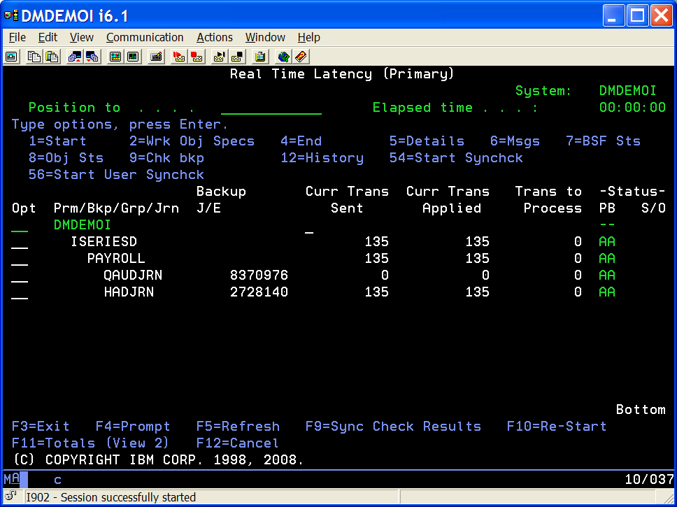
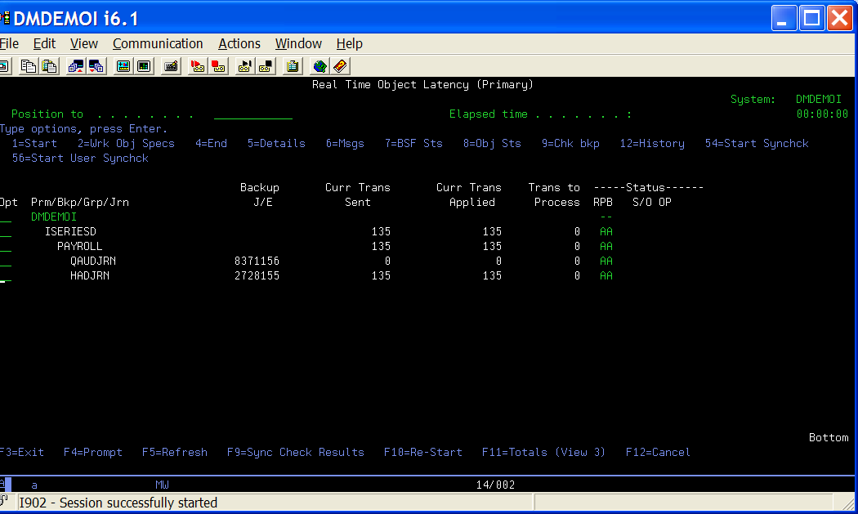
实施监控iCluster复制效率(Source)
(view 1)
(view 2)
(view 3)
(view 4)
F11=Overall Latency
F11=Object Latency
F11=Object Position & Totals
F11=Object Throughput
Remember to set session screen width to 132.
NOTE: At IBM iCluster 5.2 a screen width of 80 shows a truncated monitor (no OP or R field in Status) and no Overall Latency View.
27 X 132
27 X 80
11

Slide 12
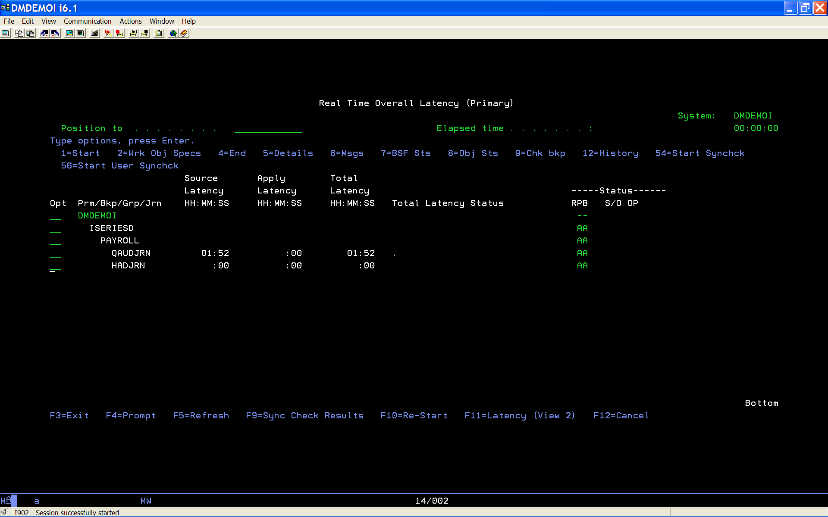
实施监控iCluster复制效率: View 1

Slide 13
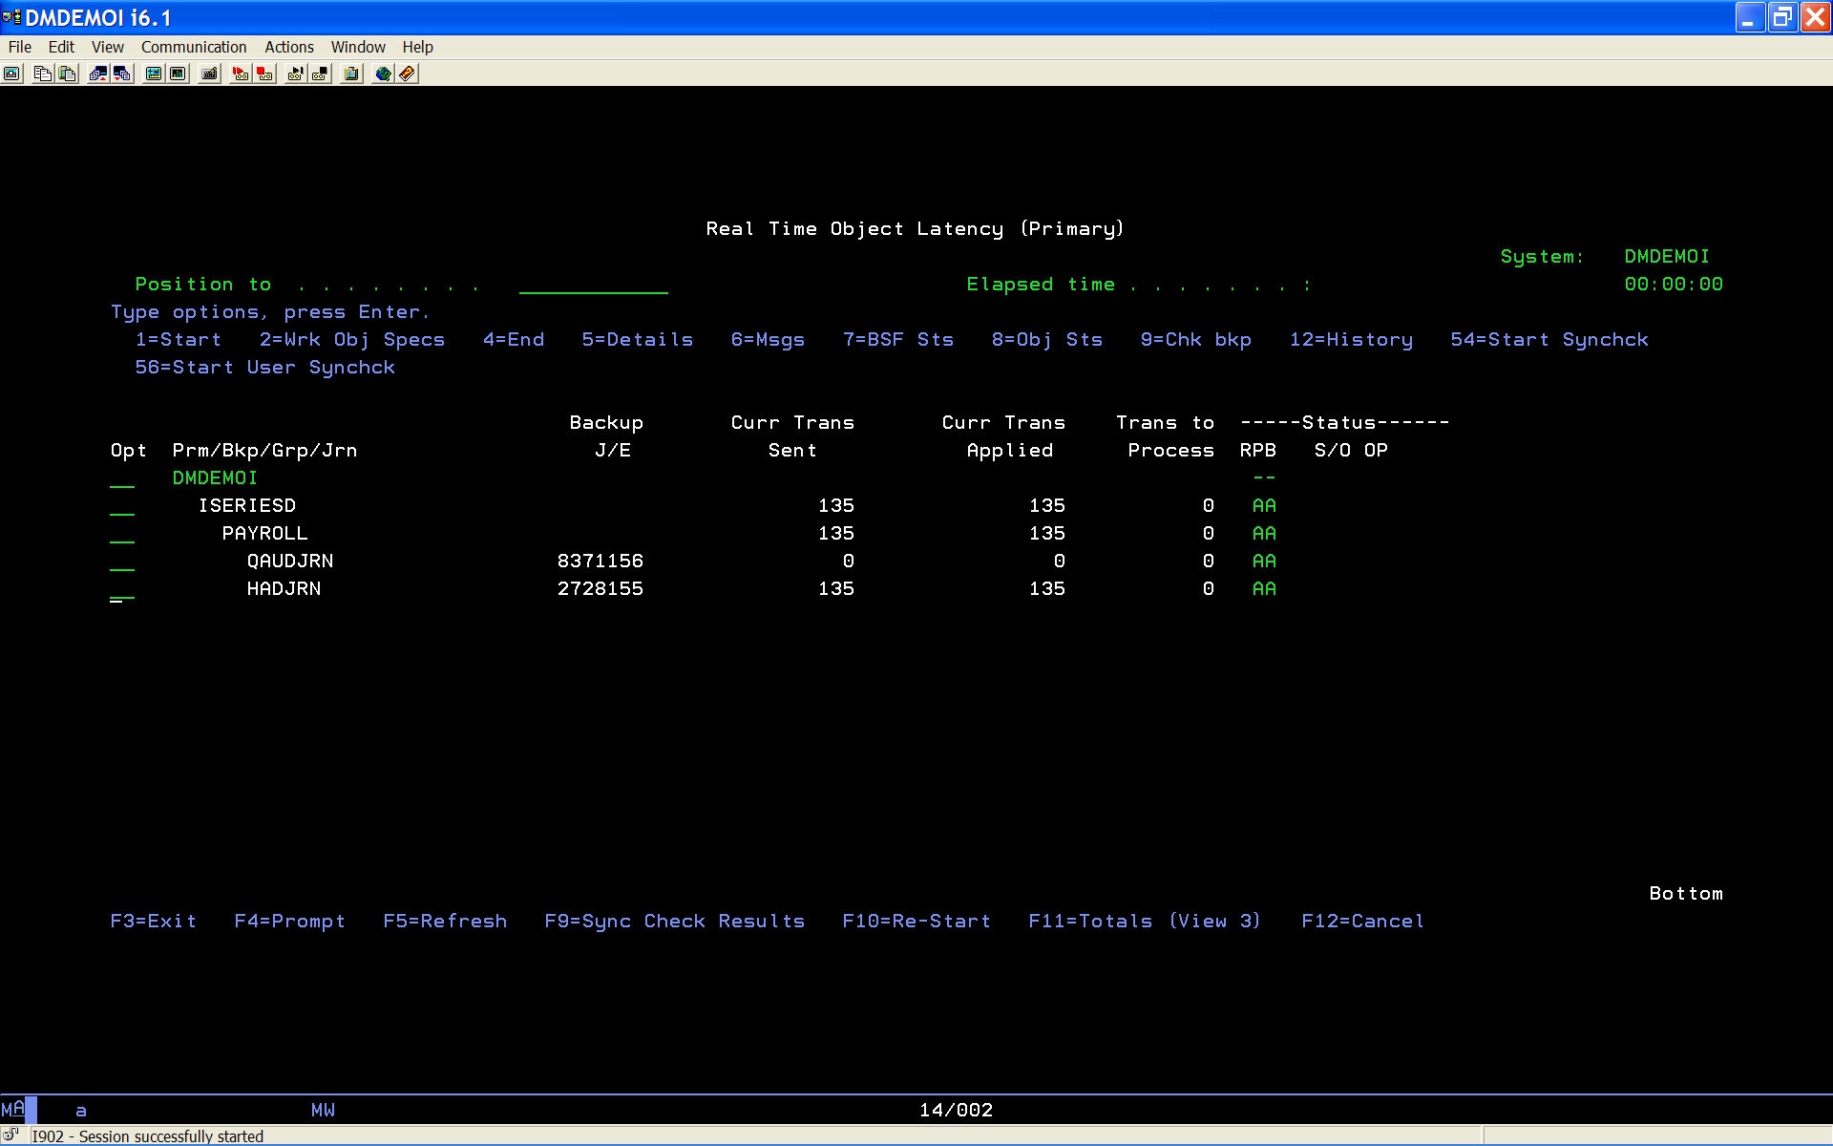
实施监控iCluster复制效率: View 2

Slide 14
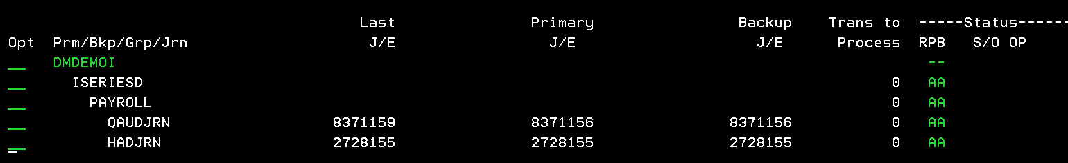
检查iCluster复制链路的处理情况：
Select F11 for the Totals View (view - 3)
The last journal receiver sequence number that was written to the journal on the primary system for both active and inactive targets.
The journal receiver sequence number that the primary system process is currently scraping. For inactive targets, it’s the last known scraping position.
These values should
be changing and close
The last journal receiver sequence number that was applied to backup system database by the apply process. This will only be displayed for active nodes.
TIP: Monitor Historical Statistics by keying in option 12- History in the Opt field beside the node group/journal combination whose historical object latency you want to view.

Slide 15
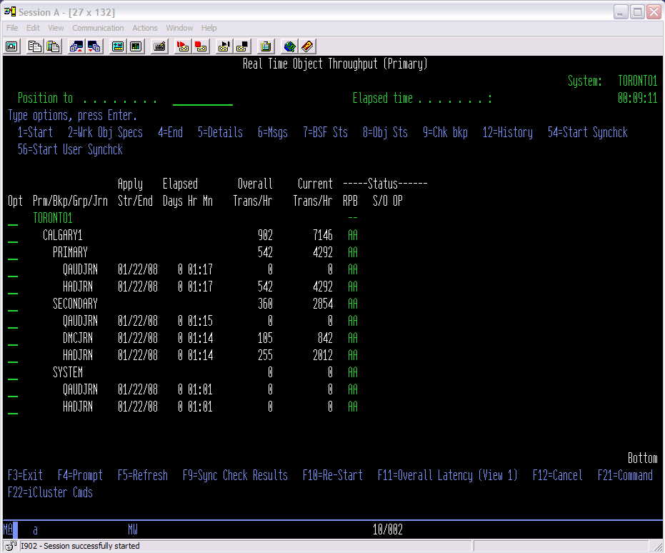
实施监控iCluster复制效率: View 4

Slide 16
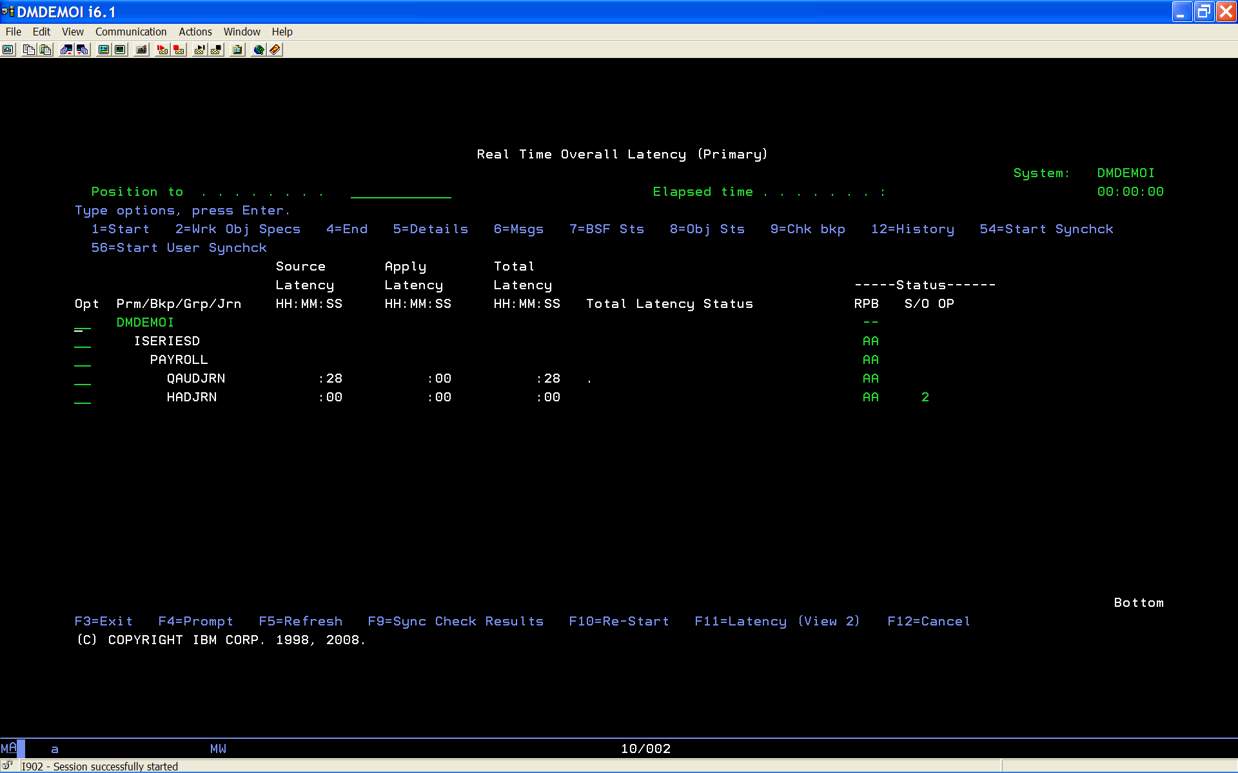
检查不一致的对象 - 1
You have two objects suspended. Investigate by selecting Option 8 - Object Status

Slide 17
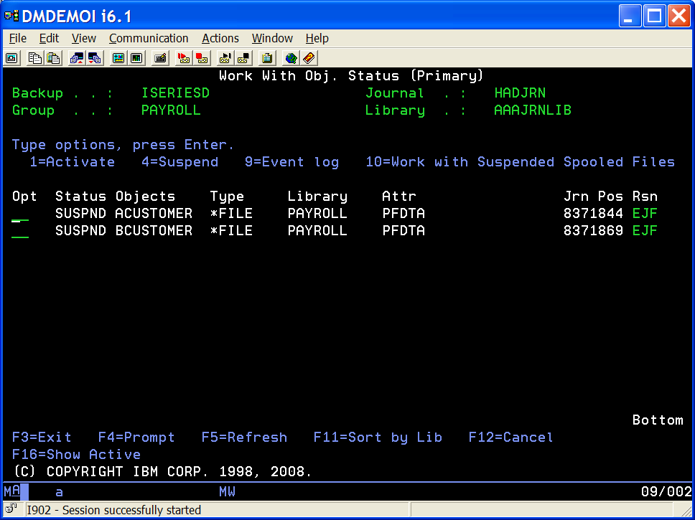
检查不一致的对象 - 2
You have one object suspended with reason code EJF. What does this mean? (F1 will give you a description)

Slide 18
iCluster 产品版本线路图：
5.2 - 2008
5.2 TL1 - 2010
7.1 - 2012
7.1 TL1 - 2013

Slide 19
iCluster License & MA
Simple, machine-based licensing, plus the ease of use of iCluster makes HA/DR affordable for SMB through Enterprise businesses. iCluster is licensed by server rather than each LPAR or by processor. Customers can add LPARS and protect them with iCluster without the need for additional licensing. In addition, development environments can now be protected with no additional logical replication costs.
Our comprehensive, easy-to-use customer portal provides what you need, when you need it.
Try before you buy - find out if iCluster meets your needs with free, hands-on experience by downloading the free iCluster trial.
As a trusted IBM partner for over 20 years we are committed to products for the IBM i environment.

Slide 20
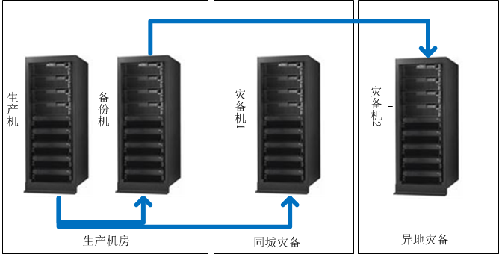
iCluster 实施案例 1 – 甘肃农信高可用架构
两地三中心，4节点，使用Rocket iCluster 7.1/i5OS R611构建基于日志的高可用架构。
从2010年实施至今运行稳定，每年至少2次计划切换。

Slide 21
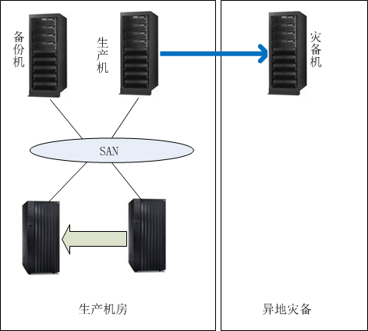
iCluster 实施案例 2 – 青岛银行高可用方案
青岛机房2台i780通过PowerHA Metro-Mirror存储复制技术搭建高可用方案。
在主机房生产机和上海灾备机房灾备机MMA之间通过Rocket iCluster 7.1 TL1 搭建基于数据库日志的复制链路。
当i780之间发生计划/非计划切换的时候，在备机到灾备机MMA之间启用备用iCluster复制链路。
iCluster
MM

Slide 22
国内iCluster客户名单
甘肃农信
东莞农信
顺德农信
宁波银行
青岛银行
信诚人寿
广汽本田

Slide 23
谢谢！

