Slide 1

한 손으로 하는 머신러닝

Slide 2
참고문헌
Python Machine Learning: Machine Learning and Deep Learning with Python, scikit-learn,
and TensorFlow, 2nd Edition Paperback – September 20, 2017
Python Machine Learning By Example: The easiest way to get into machine learning Paperback – May 31, 2017
Statistics for Machine Learning: Techniques for exploring supervised, unsupervised,
and reinforcement learning models with Python and R
scikit-learn Cookbook - Second Edition: Over 80 recipes for machine learning in Python with scikit-learn 2nd Revised edition Edition
https://machinelearningmastery.com/a-tour-of-machine-learning-algorithms/

Slide 3
왜 머신러닝인가?
“
(대충 인공지능이 중요하다는 내용)
Google’s self-driving cars and robots get a lot of press, but the company’s real future is in machine learning, the technology that enables computers to get smarter and more personal.
– Eric Schmidt, Google Chairman –

Slide 4
왜 머신러닝인가?
근데 왜 머신러닝이 아니라 딥러닝을?

Slide 5
지도학습 (supervised Learning)
Labeled Data : 라벨링 된 데이터
Direct feedback : 이미 답을 알기에 바로 오차를 측정 가능
Predict outcome/future : 결과/ 미래를 예측
Training Data
And Labels
Machine Learning
Test Data
Model
Prediction

Slide 6
지도학습 (supervised Learning)
Regression Algorithms
Linear Regression
Logistic Regression
Softmax Regression
Instance-based Algorithms
k-Nearest Neighbor (kNN)
Support Vector Machines (SVM)
Decision Tree Algorithms | 의사 결정 나무
Classification and Regression Tree (CART)
iterative Dichotomiser 3 (ID3)
C4.5 and C5.0 (different versions of a powerful approach)

Slide 7
지도학습 (supervised Learning)
Bayesian Algorithms
Naive Bayes
Gaussian Naive Bayes
Artificial Neural Network Algorithms
Perceptron

Slide 8
비지도학습 (unsupervised Learning)

Slide 9
Regression Algorithms
Linear Regression

Slide 10
Instance-based Algorithms
k-Nearest Neighbor (kNN)
#0 직관적 이해 : 사회생활 잘하는 알고리즘
주위에 어떤 데이터들이 있는지 눈치를 보고 결정
(실제로는 이렇지 않지만) 사각형과 원으로 데이터를 분류할 때, ?은 무엇인가(k=2)
?
K=2

Slide 11
Instance-based Algorithms
k-Nearest Neighbor (kNN)
#1 동작방식
Choose the number of k and a distance metric.
Find the k-nearest neighbors of the sample that we want to classify.
Assign the class label by majority vote.
> 거리 계산을 통해 가까운 k개의 샘플을 선정하고, 이를 기반으로 분류한다.

Slide 12
Instance-based Algorithms
k-Nearest Neighbor (kNN)
#2 scikit-Learn
from sklearn import datasets
from sklearn.model_selection import train_test_split
from sklearn.neighbors import KNeighborsClassifier
from sklearn.model_selection import cross_val_score
iris = datasets.load_iris()
X = iris.data[:, :2]
y = iris.target
X_train, X_test, y_train, y_test = train_test_split(X, y,stratify=y, random_state = 0)
knn_3_clf = KNeighborsClassifier(n_neighbors = 3)
knn_5_clf = KNeighborsClassifier(n_neighbors = 5)
knn_3_scores = cross_val_score(knn_3_clf, X_train, y_train, cv=10)
knn_5_scores = cross_val_score(knn_5_clf, X_train, y_train, cv=10)
print (knn_3_scores.mean(),knn_3_scores.std())
print (knn_5_scores.mean(),knn_5_scores.std())

Slide 13
Instance-based Algorithms
k-Nearest Neighbor (kNN)
#3 응용
1. 반복문 돌리면서 최적의 해를 구해보기
2. 여러가지 거리 계산 알고리즘 적용 (p인자)

Slide 14
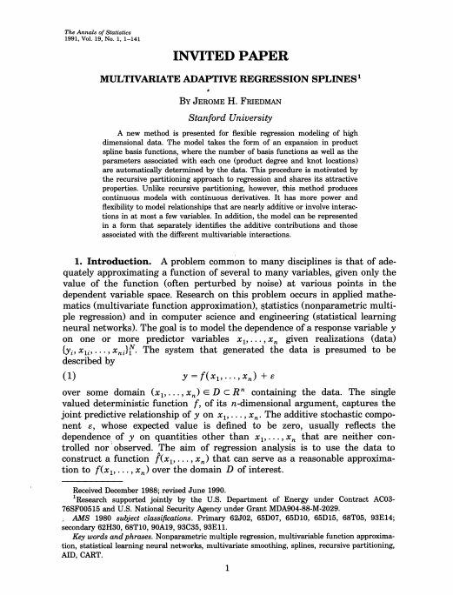
Multivariate adaptive regression spline (MARS)
Jerome H. Friedman, 1991
http://ddmix.blogspot.com/2015/06/cppalgo-27-regression-spline.html
https://en.wikipedia.org/wiki/Multivariate_adaptive_regression_spline
https://bradleyboehmke.github.io/HOML/mars.html#fitting-a-basic-mars-model
https://contrib.scikit-learn.org/py-earth/content.html
https://www.depends-on-the-definition.com/multivariate-adaptive-regression-splines/

