Slide 1
1. Read the raw pupil data from the eye-tracking file into a Matlab data structure
2. Remove blinks and other artifacts using this GUI
3. Parse the reconstructed data into sub-fields that correspond to stimuli events
4. Perform stats or create figures using the parsed pupil data

Slide 2
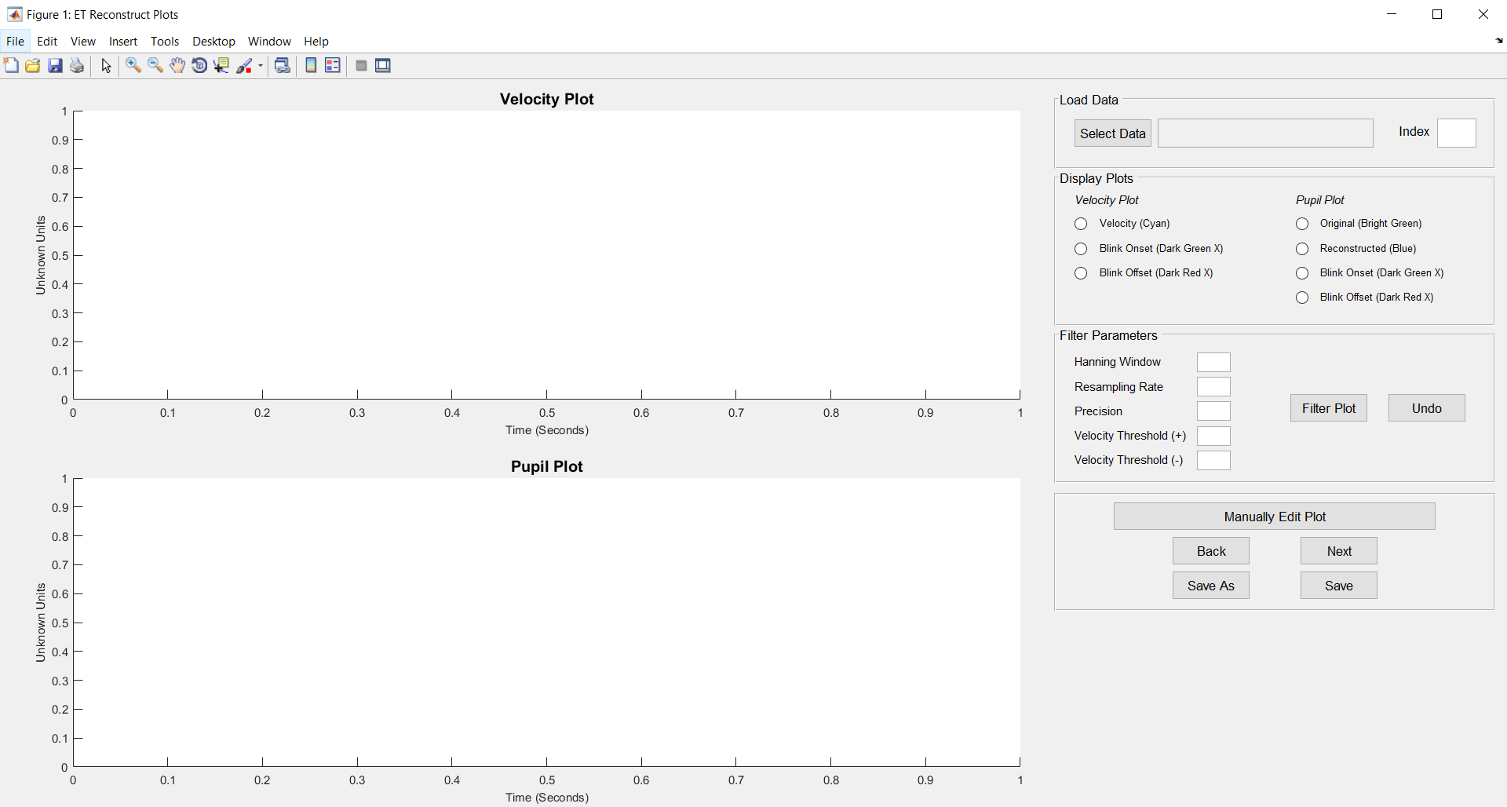
Click here to load your data

Slide 3
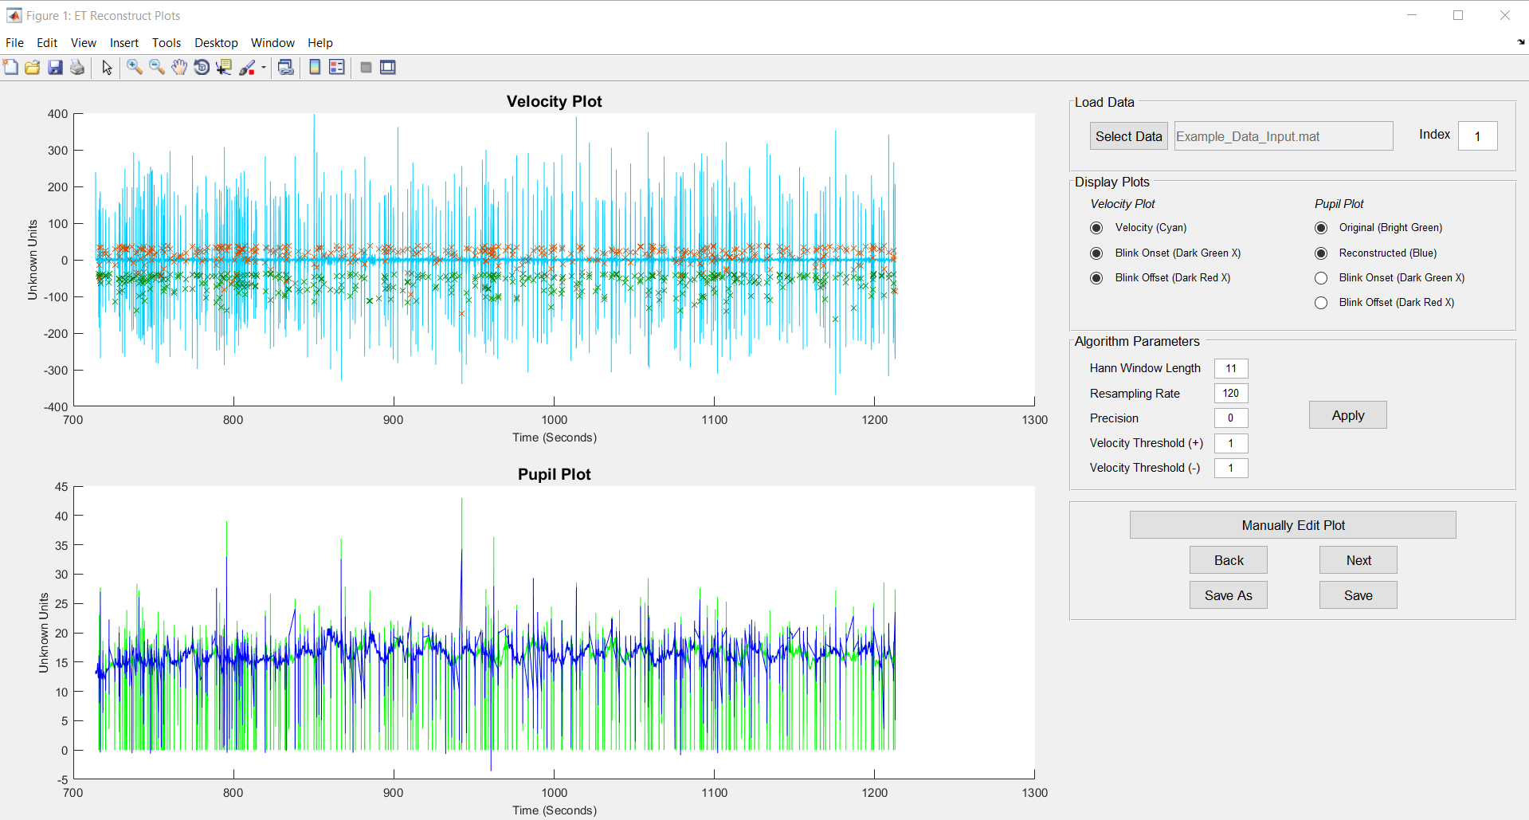
These tools can be used on the plots
Default parameters
With the default algorithm parameters, the reconstructed plot still looks quite noisy. Let’s increase the smoothing by increasing the Hann Window Length.

Slide 4
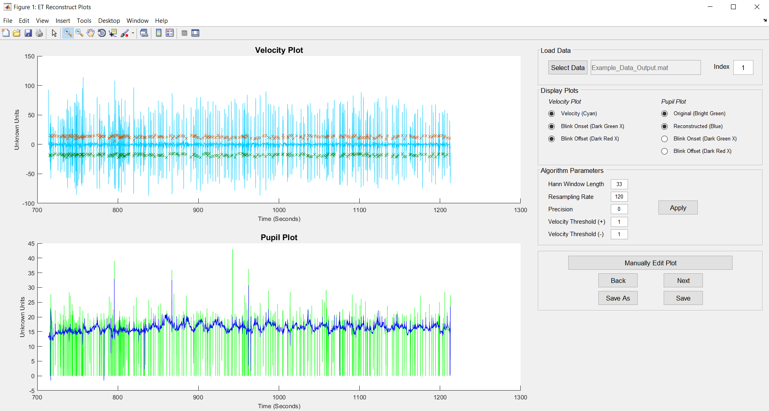
The plot look much better after changing the Hann Window Length to 33 points. However, it’s still not perfect. We touch this up with the plot editor.

Slide 5
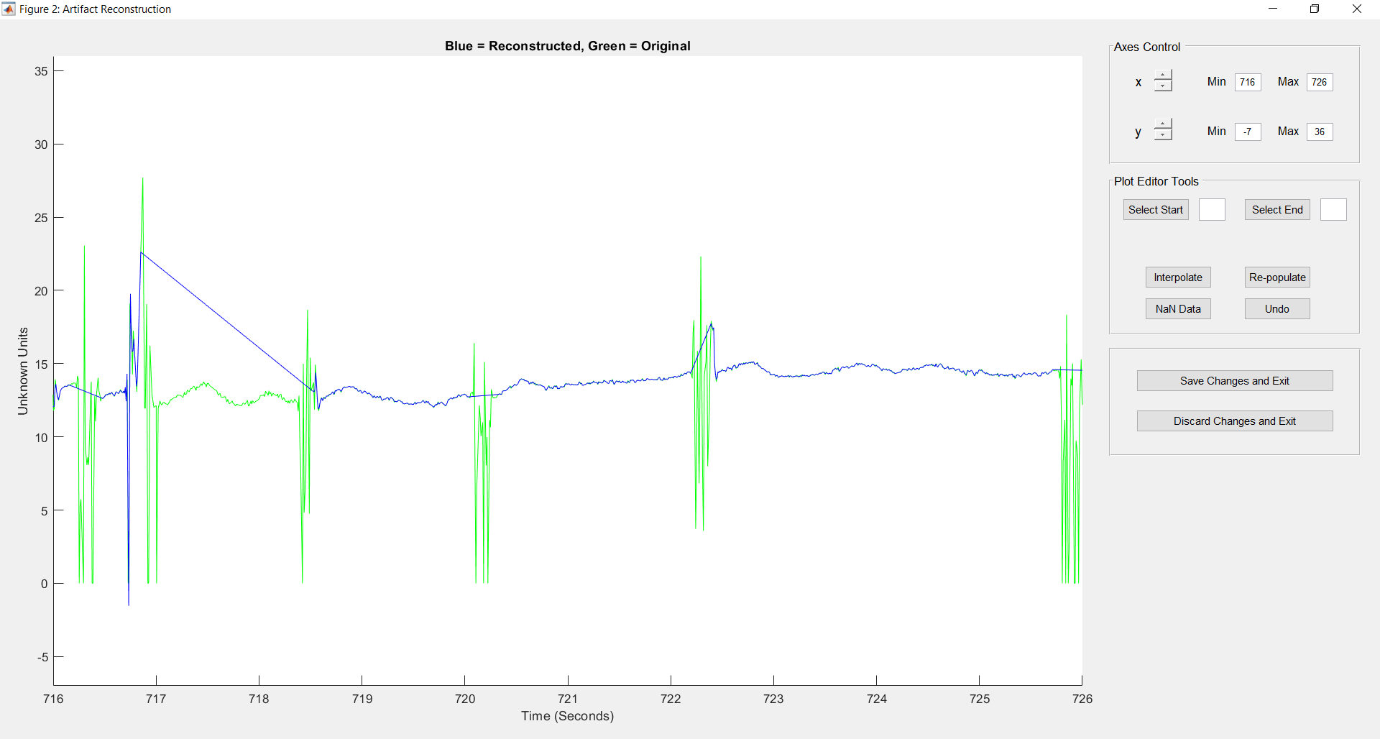
We come across a “blink” artifact with an unusual “messy” characteristic. The algorithm did a poor job in this region. It seems to conflate two blinks as one and over-interpolated.
We come across a blink artifact that was properly detected, but the end data point selected by the algorithm is still part of the artifact.

Slide 6
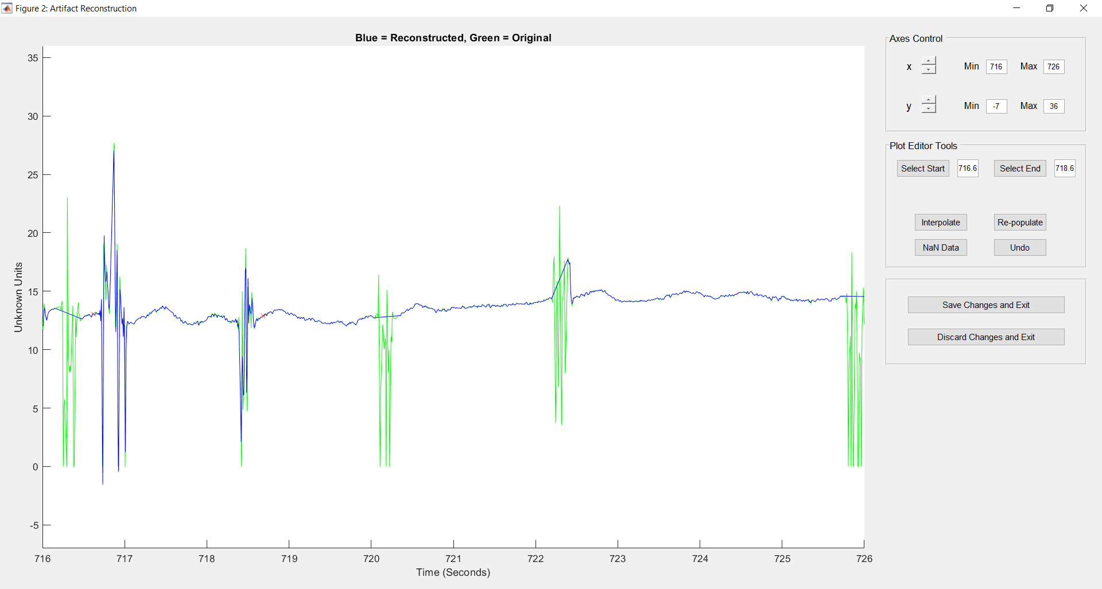
First, select start and endpoints that cover this entire region. Then re-populate the data. The region that should not have been interpolated is restored.
After re-populating, we have three artifact events that needs to be manually interpolated.

Slide 7
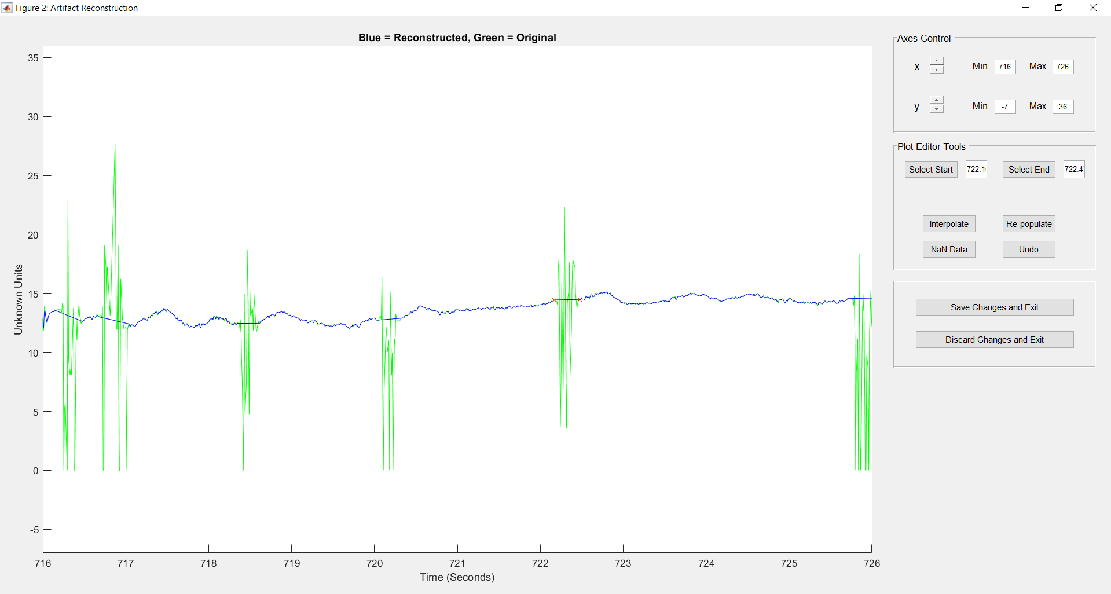
For the three artifact events, select a reasonable start and endpoint around the artifact and interpolate. Your plot should then look like this:
Remember to save your work!!!!

Slide 8
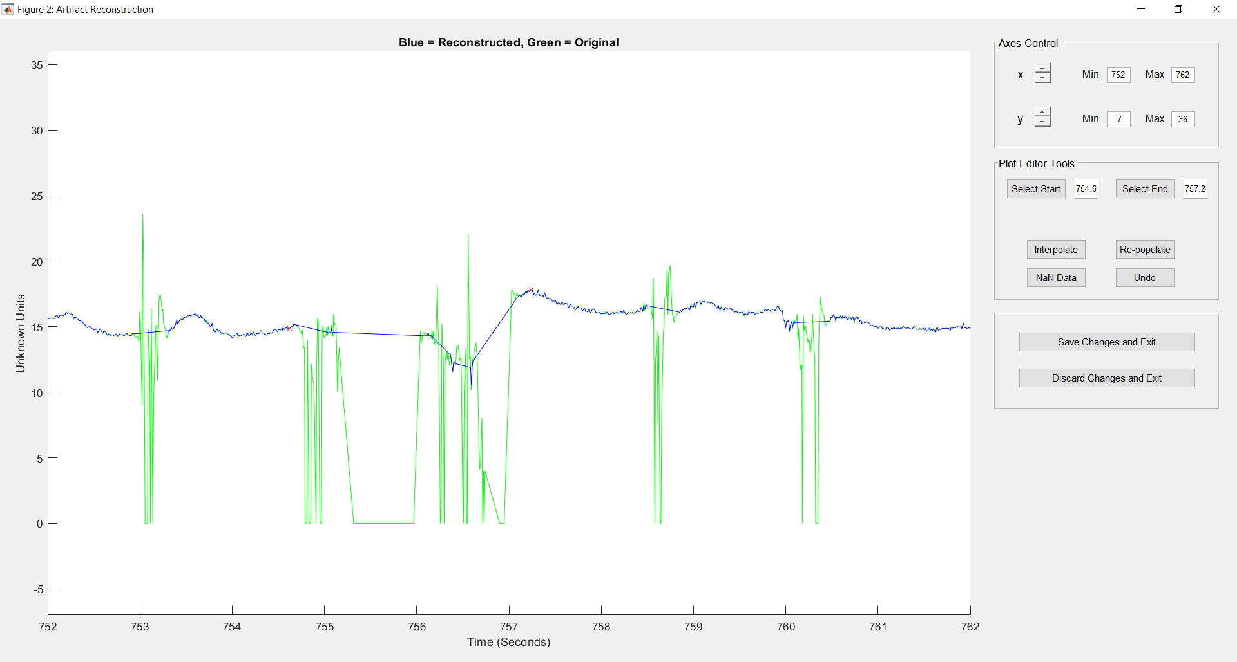
Here, we find a > 2s region of “messy” signal. Instead of interpolating over this region, I recommend replacing the data with NaNs (missing data).

Slide 9
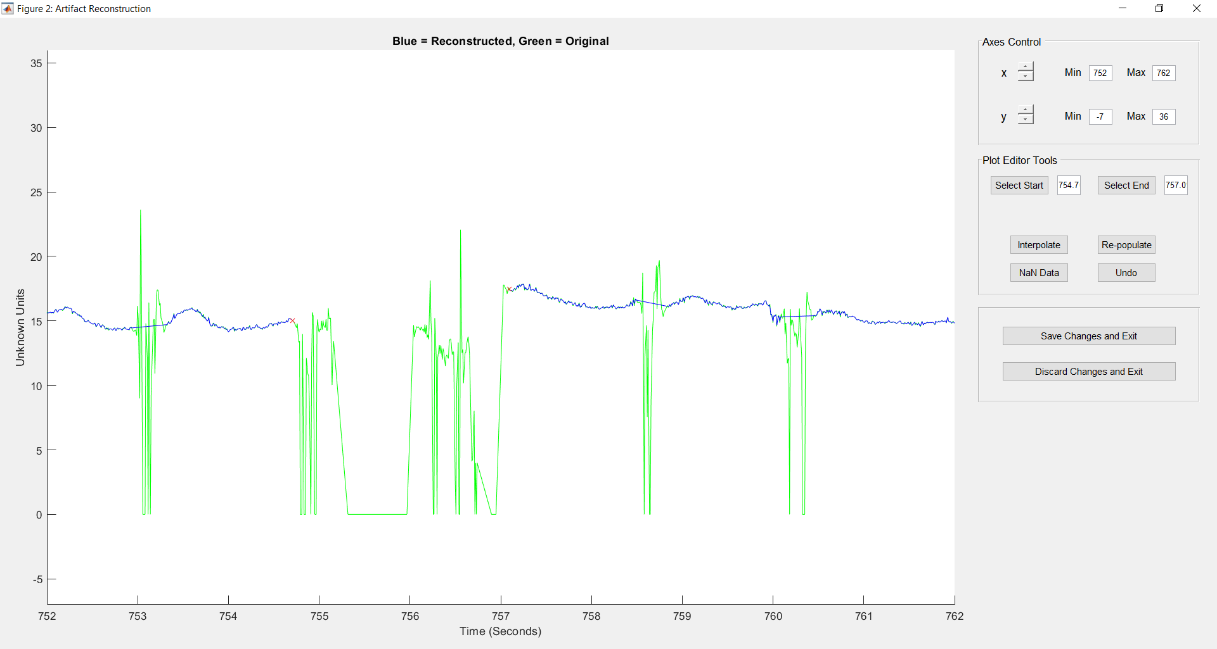
Select a reasonable start and end point before and after this noisy region. Then “NaN Data”

Slide 10
Gif 1 Images:

Slide 11
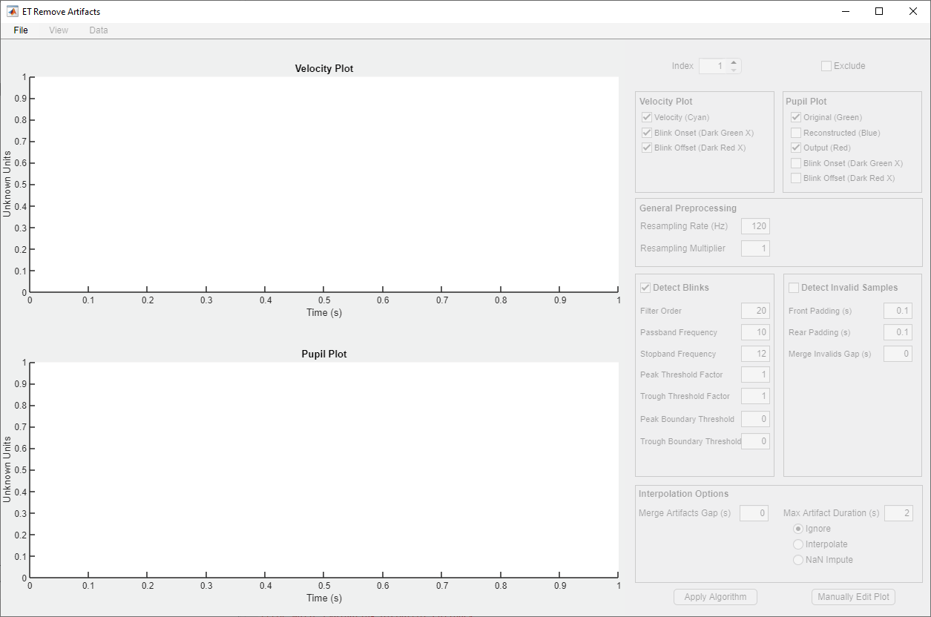

Slide 12
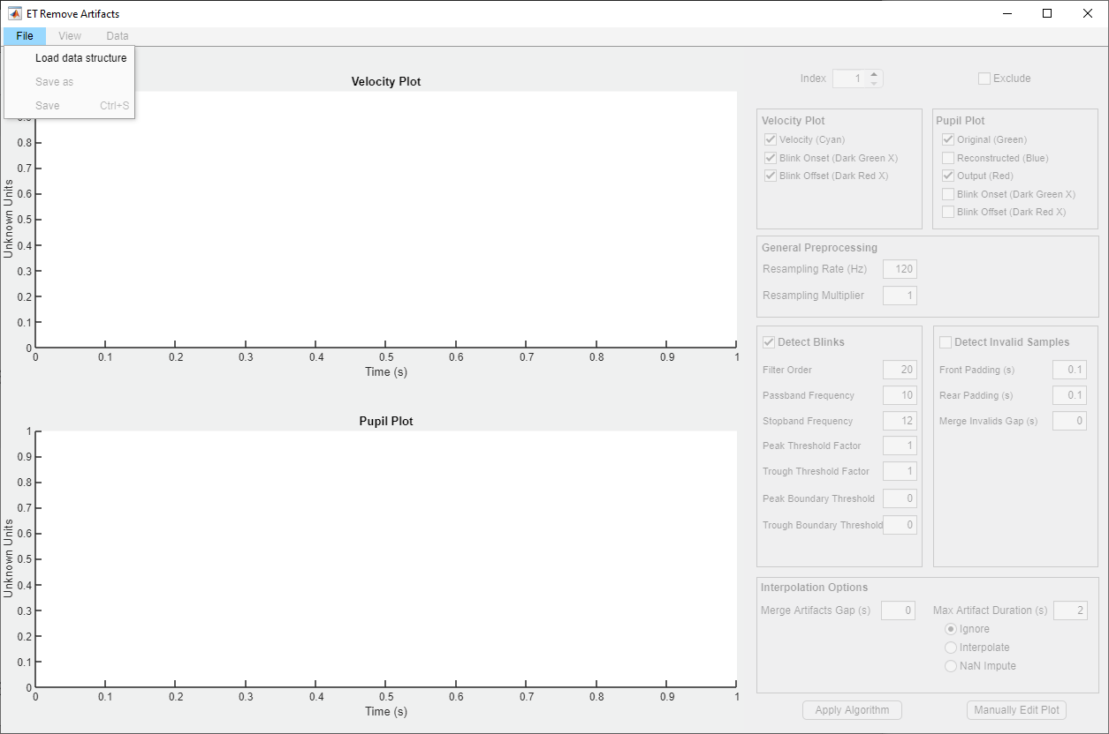

Slide 13
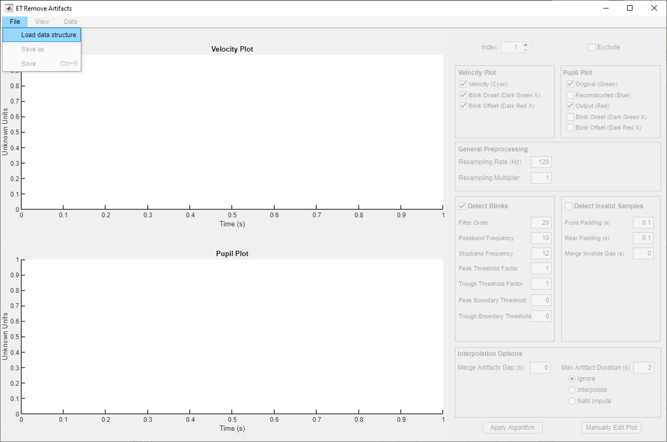

Slide 14
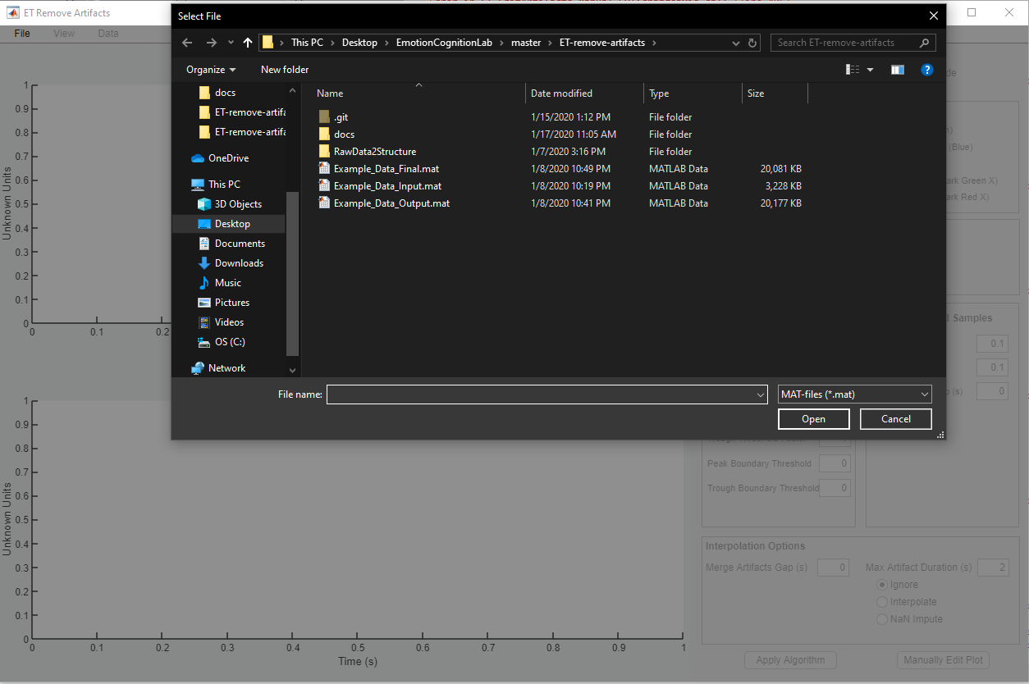

Slide 15
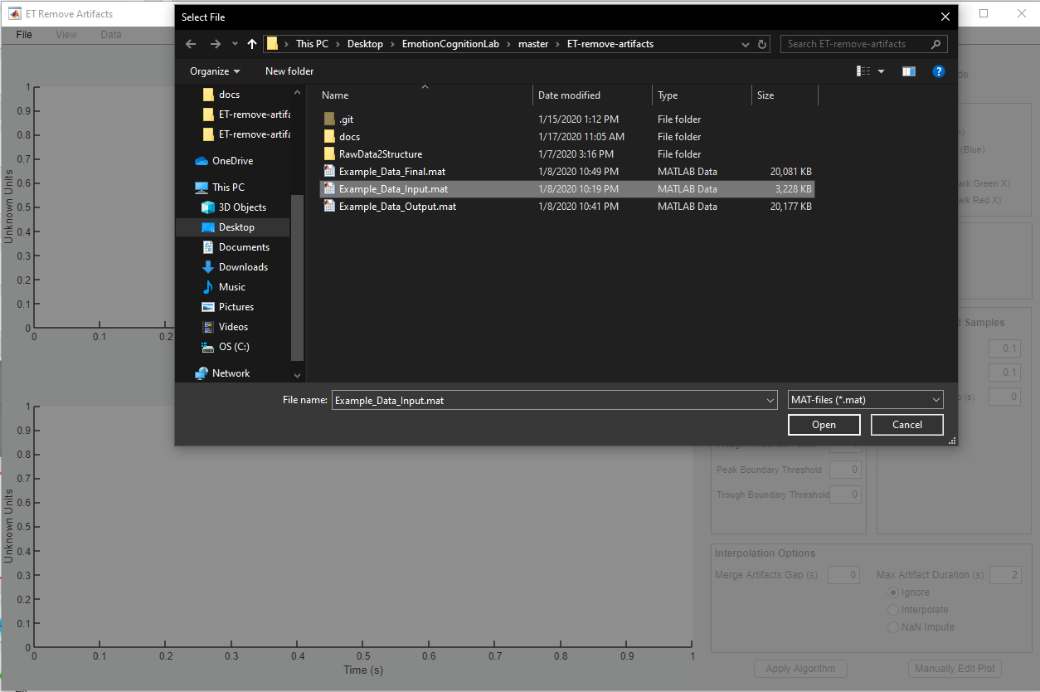

Slide 16
