Slide 1
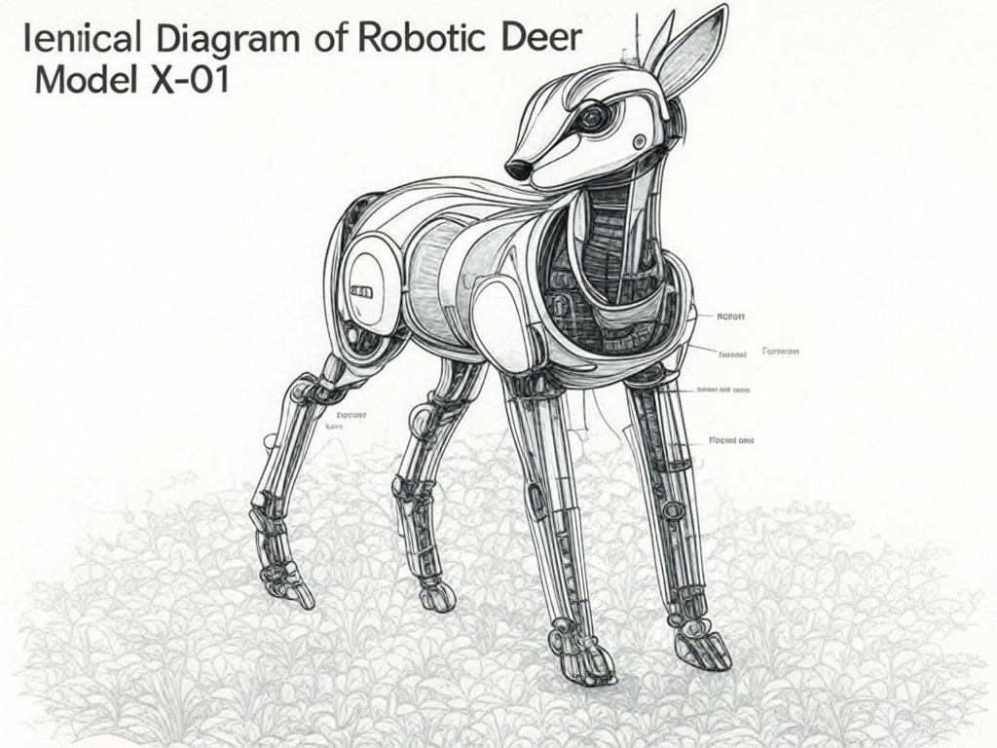
Cartheur Research “Letty”
Model A-1

