Slide 1
Evidence for a Change to Aerosol Fractions: In a Gobi Town
Munkhtsetseg. E, Shimizu. A, Matsuki. A, Batdorj. D, Matsui. H, Bayanjargal. D

Slide 2
1 Introduction
Aerosols from cold arid areas, (Gobi Desert in Asia), constitute the second most substantial global source of atmospheric aerosols (Fitzgerald et al., 2015).
These dust particles considerably impact Earth's radiative equilibrium by directly scattering solar radiation ... (Advanced)
A large uncertainties in the global dust model has existed so for climate models; limits our understanding the climate system and shaping the issues of global warming.
the lack of parameterization and the complex nature of its aerosol composition
the significant contribution of the Gobi Desert to global dust aerosols is not fully recognized; and their is the rapid growing changes controlled by the natural forces and anthropogenic drivings.

Slide 3
1 Introduction - Hypothesis
Driven by industrial progress in the mining sector, household coal combustion has increased significantly in Mongolia since the 2000s.
Demographic evidence has revealed an ongoing reduction in rural-nomadic lifestyle and a rise in urban population, which may gradually extend household winter heating as a major source of fine particulate matter (PM2.5).
In conjunction with a stagnant atmosphere and observations that winter fine pollutants (PM2.5 and PM10) are persistently trapped within the boundary layer and can be exacerbated by stagnant weather or emission sources, these results have led to hypotheses that fine aerosols may be subject to suspension in the near-surface atmosphere, potentially available for emission via dust storms in the spring.

Slide 4
Research questions
Do concentrations of particulate matters differ in between urban and rural sites, and even within Gobi sites?
Do distinct temporal variations has existed among the sites?
Do PM2.5 particulates has contributed to the PM10 annual variations?
- If yes, how much, and when and where?
- What is the sd, mean, and median
- box plot
- violin
- scatter points, epidemic, sporadic
- Daily variations to examine it related to the heating
- 2 peaks: smaller and bigger
- compare the t-duration exceeds 50 mug/m3/hour
4. Does it has distinct patterns among the sites regarding to the drivings
- How PMs varies with the wind speed and visibility
- Do they differently explained with variables and changes in drivings (with PCA analysis)
5. Is there any significant changes in time-series of PMs at 4 seasons
6. Is there any significant changes in ratio in the spring in respect
to winter pollutions?

Slide 5
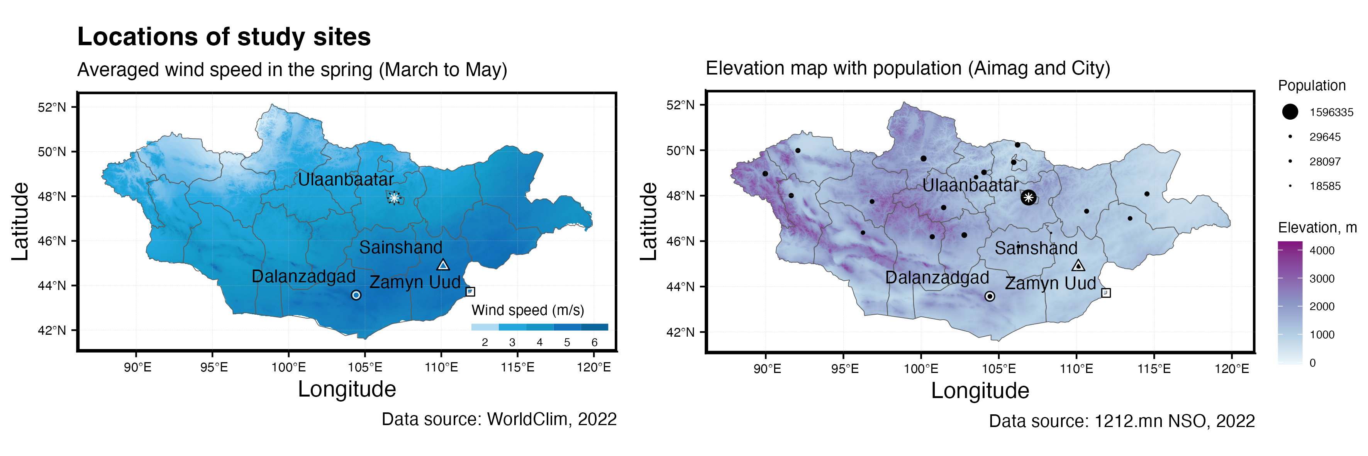
2 Study sites and data
2.1 Study sites
UB (urban, in capital city, at center)
DZ (gobi, inside town, at center)
SS (gobi, outside town, at edge)
ZU (gobi, inside village, at center)
Geographic locations of study sites
In this study, Spatio-temporal distinct patterns in variations of $PM_{10}$ and $PM_{2.5}$ relative to the recent drivings of emission sources in Mongolia we investigated the temporal variations of PM2.5 and PM10 concentrations at the 4 sites of rural and urban those located along the the wind corridor.

Slide 6
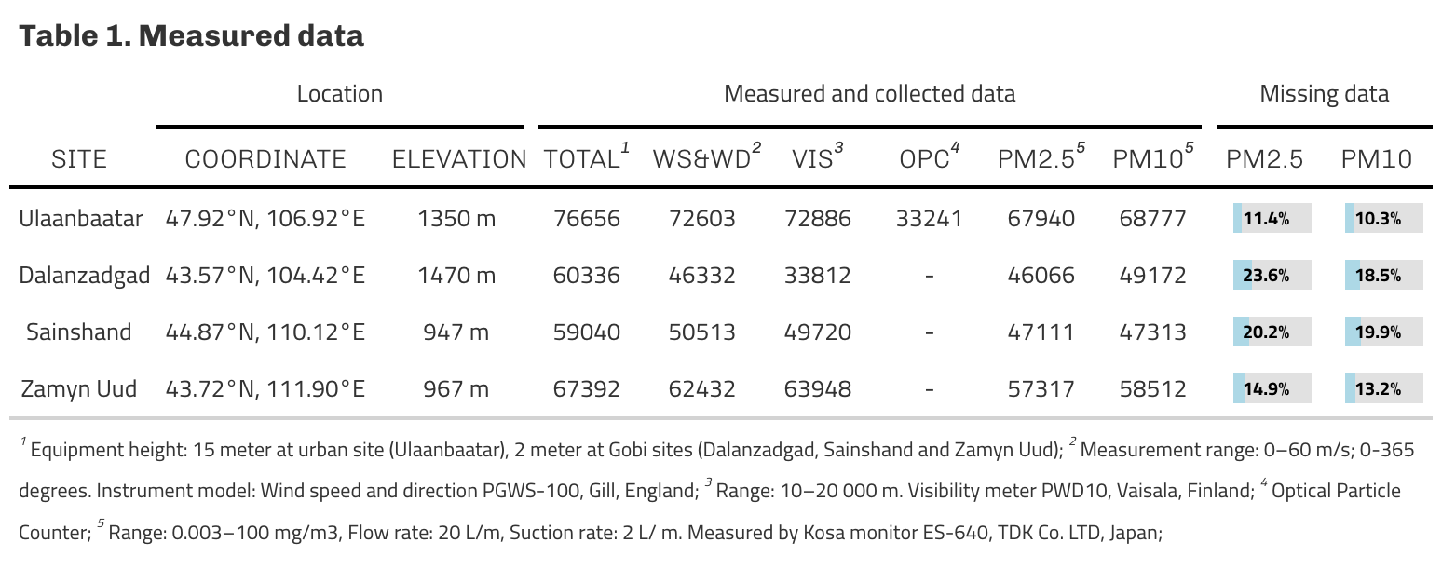
2 Materials and Data
2.2 Data
A description of datasets obtained at the sites

Slide 7
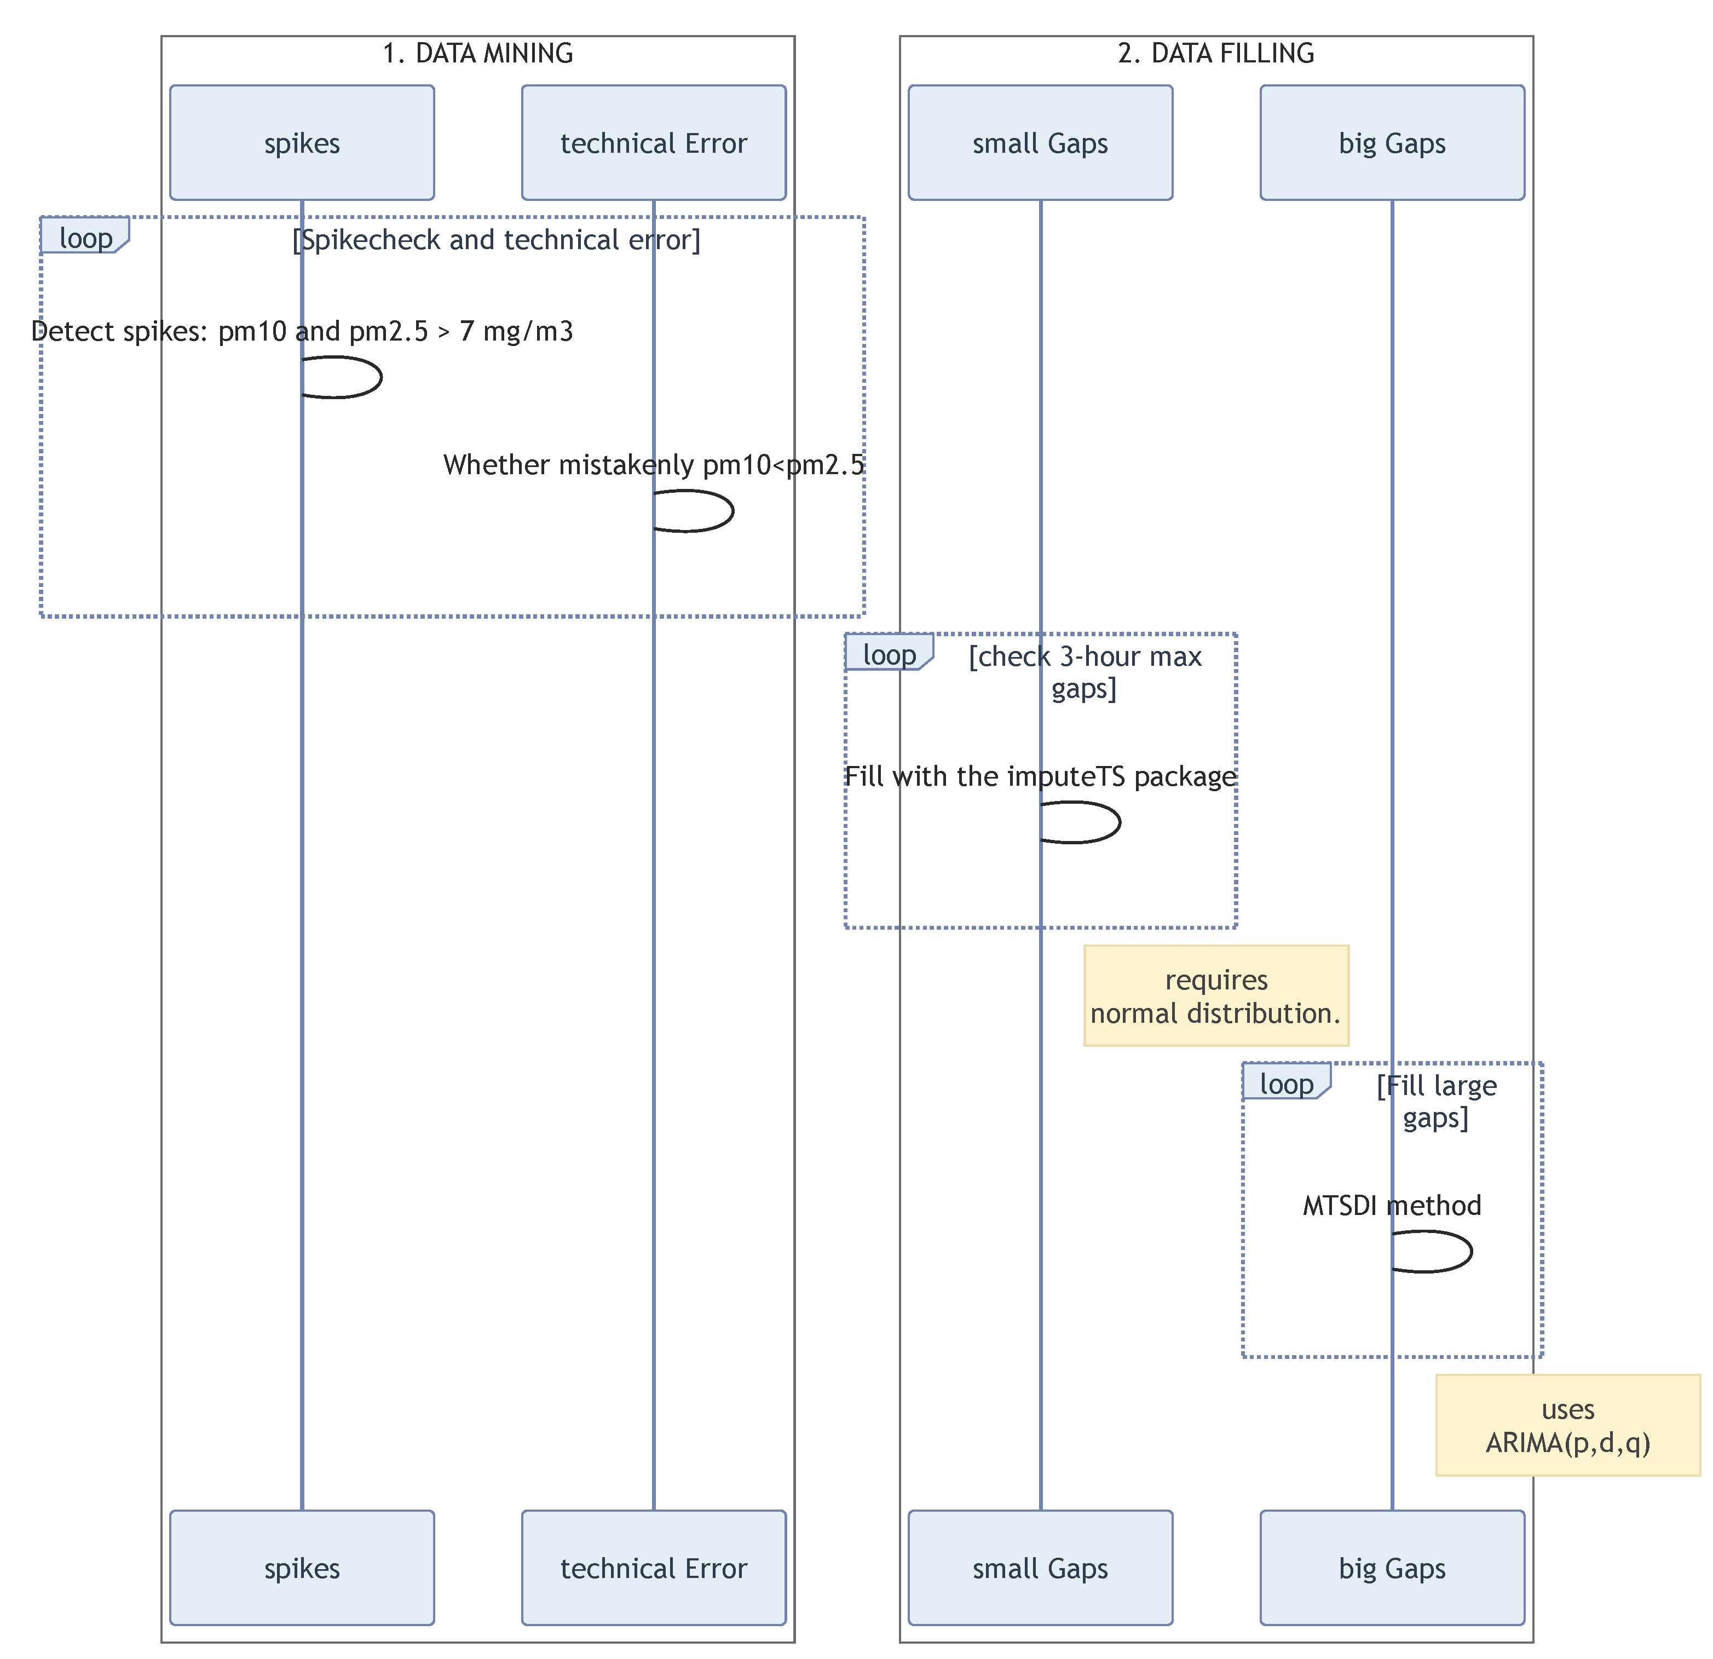
2.3 Data cleaning
To improve the data quality, we removed spikes exceeding above 7 mu g/m3 considering the reported extreme values (XXXXX Jugder, XXXX Tsatsral),
unrealistic PM2.5 values exceed PM10 (pm2.5 > pm10 *1.1) and
detected signals that invariate with an extended period caused by electricity shortage and equipment malfunctions for all sites.
Further, we handled data each stations separately to remove suspective data, carefully.
Scheme 1. Data handling procedure

Slide 8
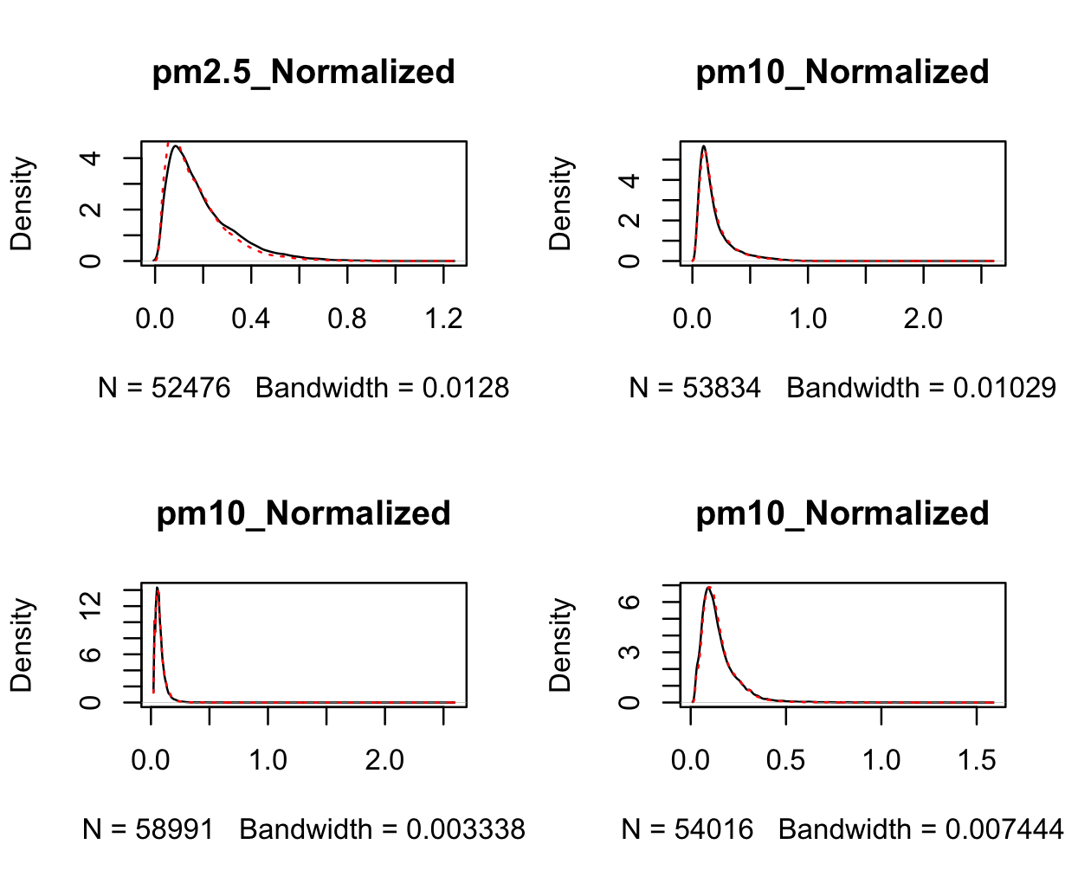
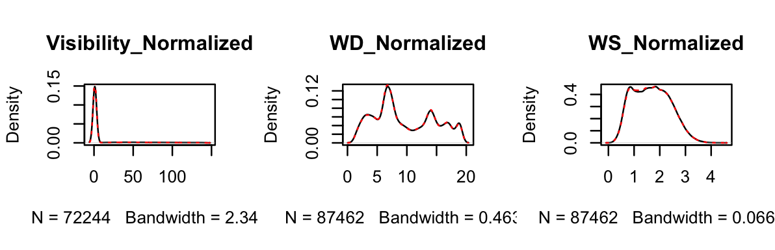
2 Materials and Data
2.4 Data filling
Figure 2. Data gap filling
Figure 2b. Data gap filling

Slide 9
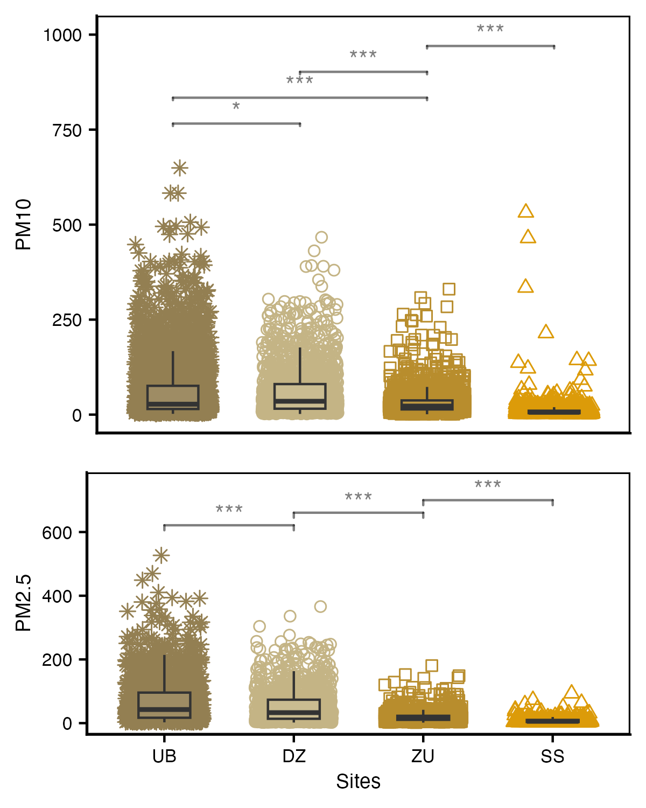
3 Results
3.1 Comparisons
Distinct concentrations of coarse and fine particulates among sites

Slide 10
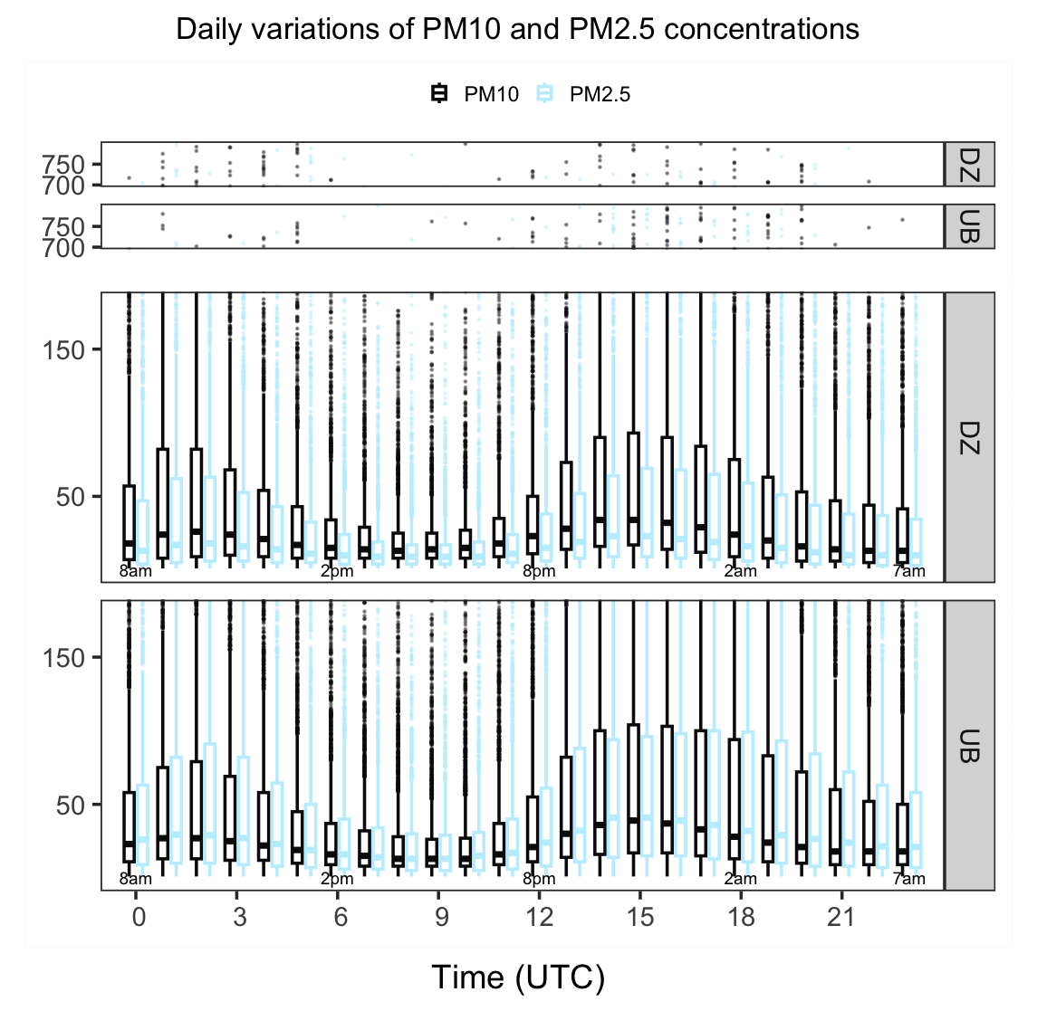
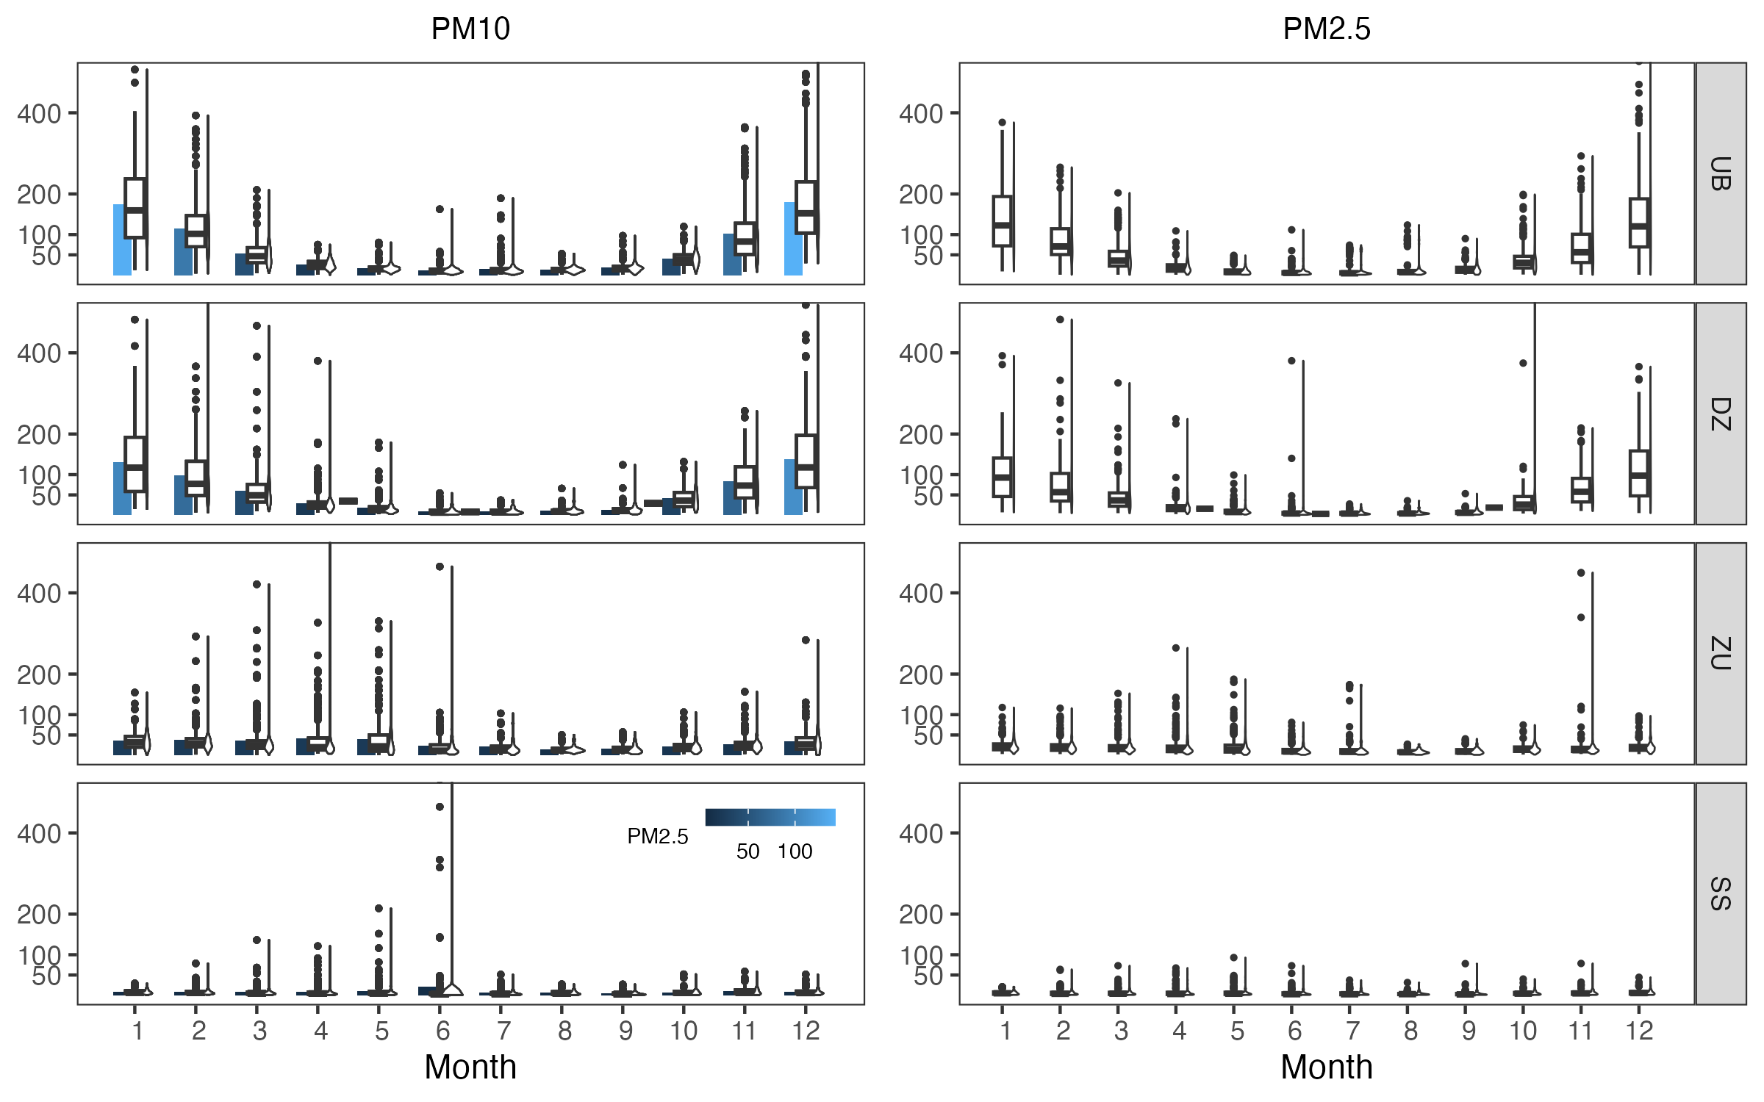
3 Results
3.2 Temporal variations
Annual variations of PM10 and PM2.5
Daily variations of PM10 and PM2.5 at UB and DZ sites

Slide 11
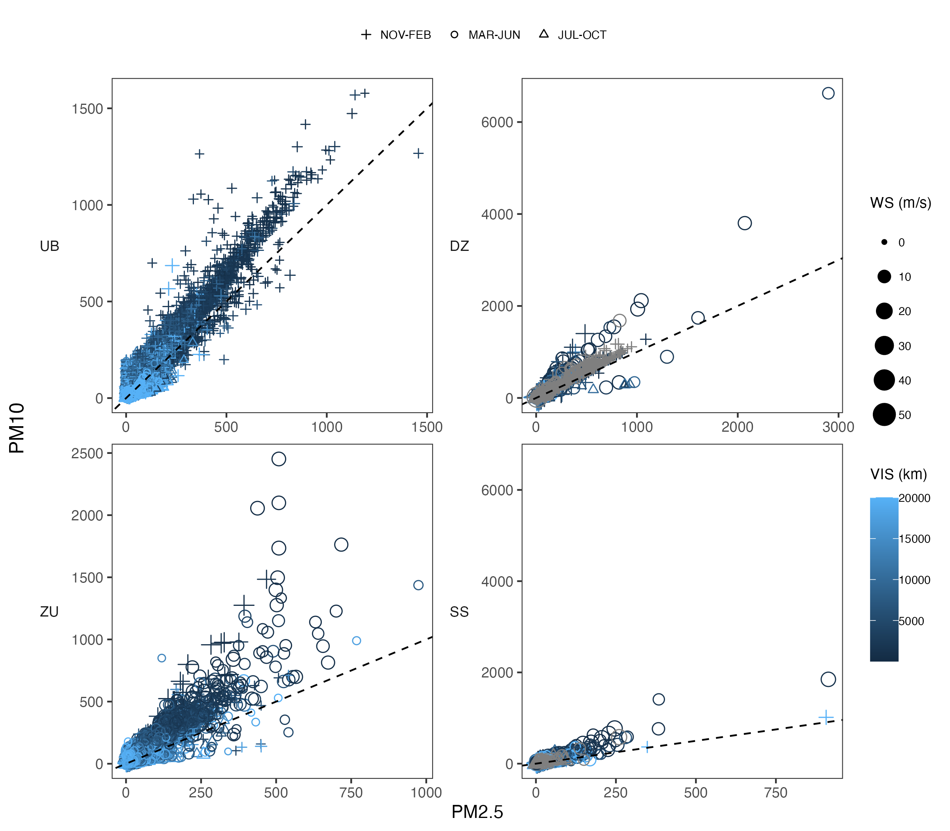
3 Results
3.3 Meteorological influence on PM10 and PM2.5 variations
Relationships between meteorological major factors and variations of PM10 and PM2.5

Slide 12
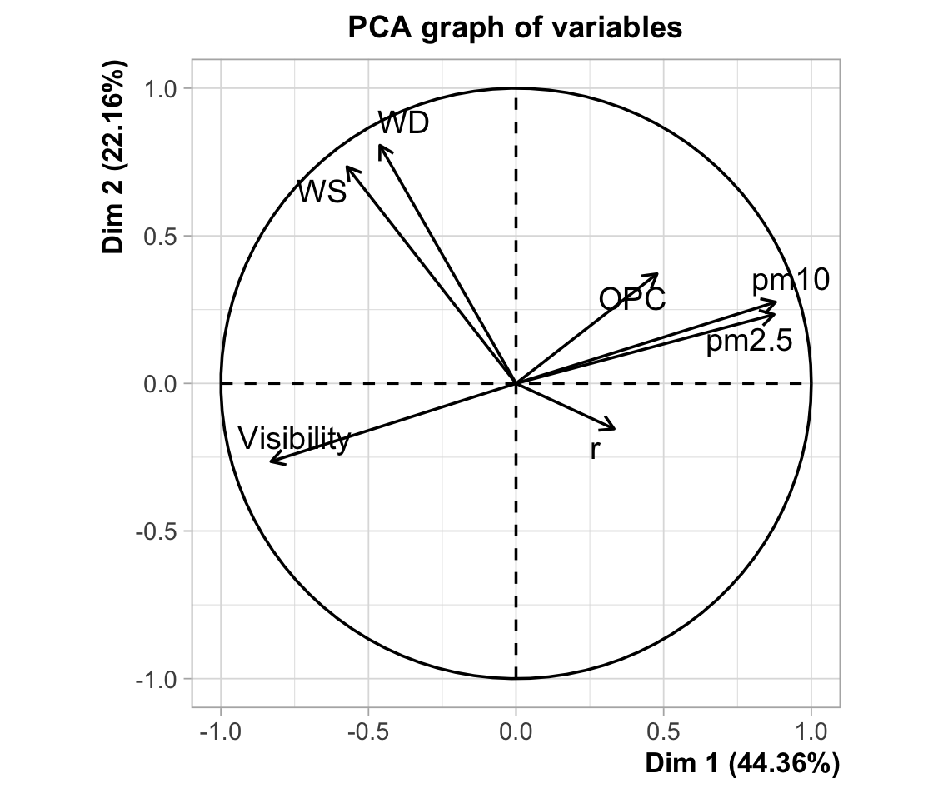
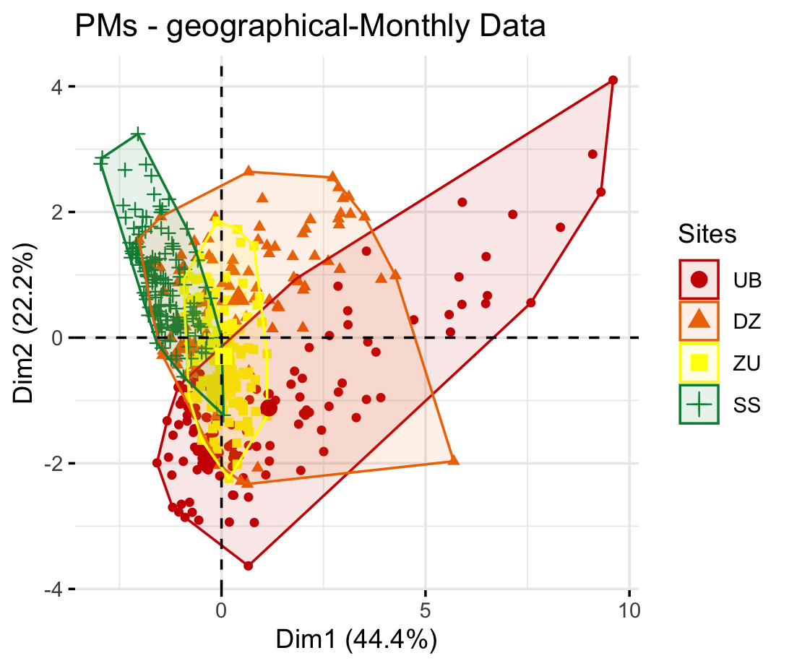
3 Results
Spatio-temporal distinct feature of variations of PM10 and PM2.5 with PCA analysis
Patterns of meteorology and PMs at the 4 sites

Slide 13
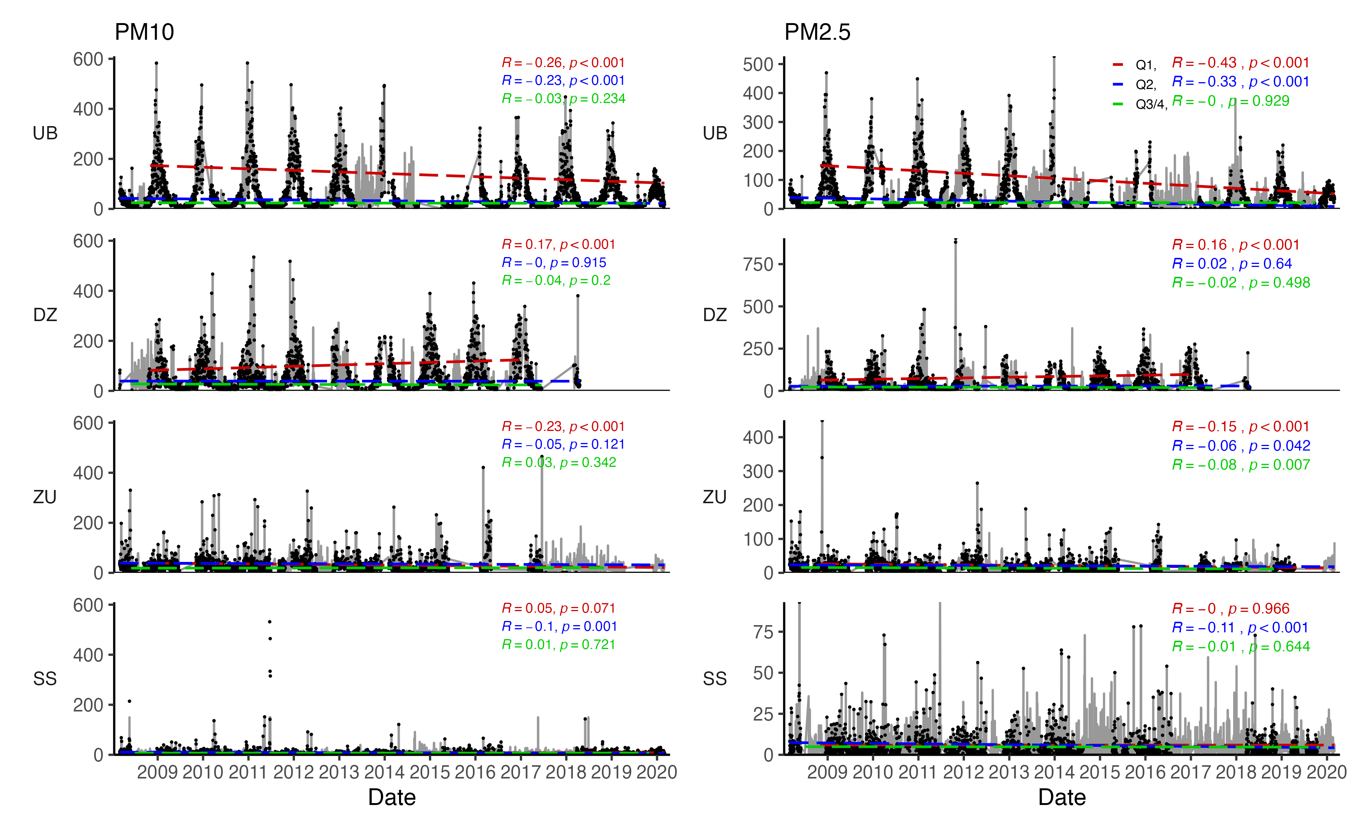
3 Results
3.5 Trends
Interannual and seasonal trends of PM10 and PM2.5 variations

Slide 14
3 Results
3.5 Ratio
Interannual and seasonal trends of PM10 and PM2.5 variations

Slide 15
4 Conclusions
Three distinct variations has been detected.()
A new pattern is emerged. It is evident of the new emission patterns in Mongolia. With recent growing interest in urban life style, and combustion of coal/oyutolgoi for heating winter conditions results a highly increase in not only in capital city but also in town.
We found spring fine to coarse fraction has increased in a Gobi town, suggesting winter fine pollutants is permanently stayed in the source area due to stagnant atmosphere (might related to AO), is emitted in the spring with the dust.
This indicates the Mongolian Gobi dust aerosol fractions has changed with a more fine pollutants, so does may have an altered aerosol radiation effects.

Slide 16
# Suggest areas for future research
Winter pollutants stayed in the land surface go under chemical reaction as soil thawing process in the spring or invoke the airborne infection?
Black carbon, has a death records.
In winter, it has detrimental effects on local;
in spring, it will bring the effect on the downwind regions.
More dangerously, how much it changed its initial form during the depositions and transportation period.
More, research has focused on the direct emission of black carbon to the atmosphere. However, it is not clear the changed form of black carbon on its properties, and chemical compositions so on.
Other environmental problems assocolated with the condition might exist.
If the country use of coal continue on, with the population increase result the more and more pm2.5, and affect climate system.

Slide 17
# Practical applications on national level
Meteorological impact is large. ...
On the other hand, it is ... with the towns where has sparsely populated.
This points that air quality will be poor whether it is changed fuel, .. unless to change heating system.
Therefore, it is not the reason to move the capital city. Only solution is to change the heating system, do not burn any type of the coal.

