Slide 1

Paper ID: 9526
ADEPT: A DEbiasing PrompT Framework
$$Ke Yang^{1}, Charles Yu^{2}, Yi R. Fung^{2}, Manling Li^{2}, Heng Ji^{2}$$
$Tsinghua University^{1}, UIUC^{2}$

Slide 2
Motivation
Biases exist and occur throughout the Natural Language
Processing (NLP) lifecycle[1]:
Many real-world tasks have been automated by the application of NLP systems.
Legal information extraction[2]；
Resume filtering[3]；
General language assistants[4]，…
Pre-trained language models (PLMs) can be debiased to enable applications that may be inadvertently influenced by the PLM's implicit stereotypes.
Debiasing in the finetuning setting:
A finetuning debiasing method typically puts forward specific loss terms to guide a PLM to remove biases in itself[5].
[1] Blodgett S L, Barocas S, Daumé III H, et al. Language (technology) is power: A critical survey of" bias" in nlp[J].
[2] Rabelo J, Goebel R, Kim M Y, et alH. Overview and Discussion of the Competition on Legal Information Extraction/Entailment (COLIEE) 2021[J].
[3] Abdollahnejad E, Kalman M, Far B H. A Deep Learning BERT-Based Approach to Person-Job Fit in Talent Recruitment[C]2021.
[4] Askell A, Bai Y, Chen A, et al. A general language assistant as a laboratory for alignment[J].
[5] Kaneko M, Bollegala D. Debiasing pre-trained contextualised embeddings[J].
2

Slide 3
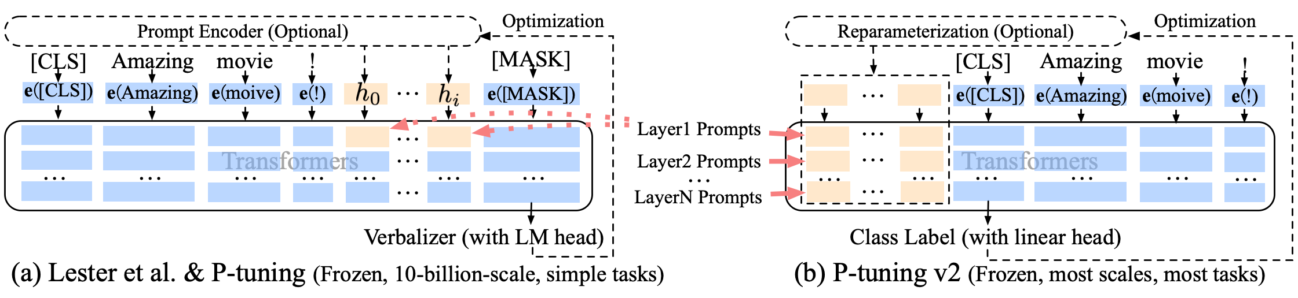
Motivation
A broad experiment of Google BIG-bench[1] shows:
Bias can potentially be steered through appropriately chosen prompting.
In the work of Askell et al. (2021), the authors use a hand-designed prompt (with more than 4600 solid words) as a stronger baseline for helpfulness, harmlessness, and honesty.
With unfixed mathematical representation at the token level, continuous prompts usually surpass discrete ones in providing the models with task-specific supplementary information.
Prompt tuning[2] these days:
[1] Chambers, D., 2018. Tourism research: Beyond the imitation game. Tourism management perspectives, 25, pp.193-195.
[2] Liu, X., Ji, K., Fu, Y., Du, Z., Yang, Z. and Tang, J., 2021. P-tuning v2: Prompt tuning can be comparable to fine-tuning universally across scales and tasks. arXiv preprint arXiv:2110.07602.
3

Slide 4
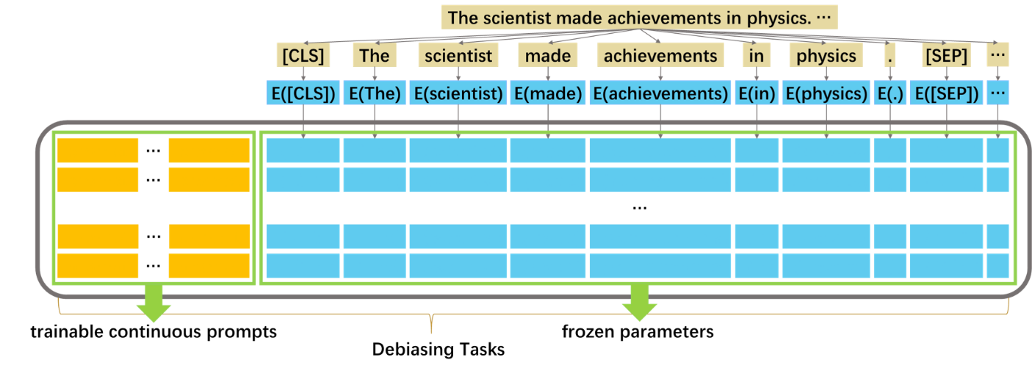
Introduce Prompt Tuning to Debiasing
Why do we use prompt tuning in debiasing space?
It saves computing and storage resources;
It only trains prompt, and the PLM's original parameters are not touched during the training process, so the base model will maintain its robustness;
Continuous prompts in prompt tuning can be optimized with standard techniques like gradient descent.
4

Slide 5
Motivation
All pre-trained language model (PLM) debiasing methods
must overcome a major hurdle of “imbalance.”
Here, “imbalance” refers to having a hard time keeping the balance between bias mitigation and expressiveness maintenance.
Existing debiasing methods tend to be “destructive”:
[1] reduces a word/sentence embedding’s projection on a linear bias subspace；
[2] completely removes the semantic meanings of attribute words (e.g., man, male; and woman, female) from neutral words (e.g., engineer, scientist; and teacher, librarian).
Improper debiasing methods may counteract the benefits of pre-training altogether:
Although an extreme example, a randomly initialized model is expected to be completely unbiased.
[1] Liang P P, Li I M, Zheng E, et al. Towards debiasing sentence representations[J]. arXiv preprint arXiv:2007.08100, 2020.
[2] Kaneko M, Bollegala D. Debiasing pre-trained contextualised embeddings[J]. arXiv preprint arXiv:2101.09523, 2021.
5

Slide 6
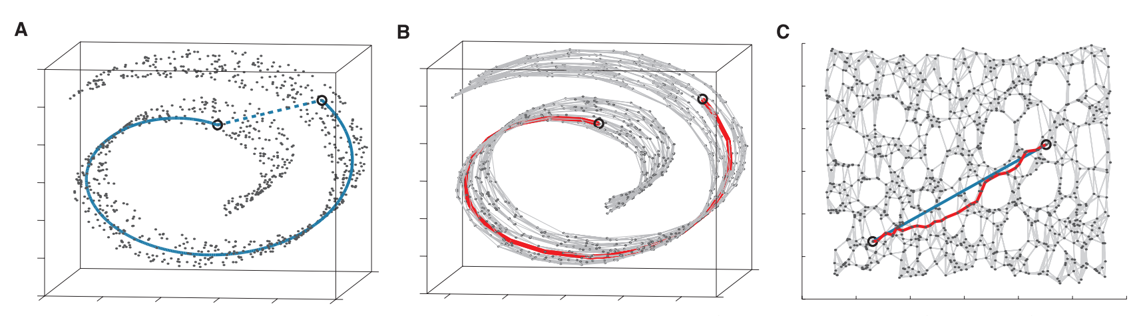
Manifold Learning
“Manifold learning is a popular and quickly-growing subfield of machine learning based on the assumption that one's observed data lie on a low-dimensional manifold embedded in a higher-dimensional space.” quoted from [1].
[1] Izenman, A.J., 2012. Introduction to manifold learning. Wiley Interdisciplinary Reviews: Computational Statistics, 4(5), pp.439-446.
[2] Tenenbaum, J.B., Silva, V.D. and Langford, J.C., 2000. A global geometric framework for nonlinear dimensionality reduction. science, 290(5500), pp.2319-2323.
6

Slide 7
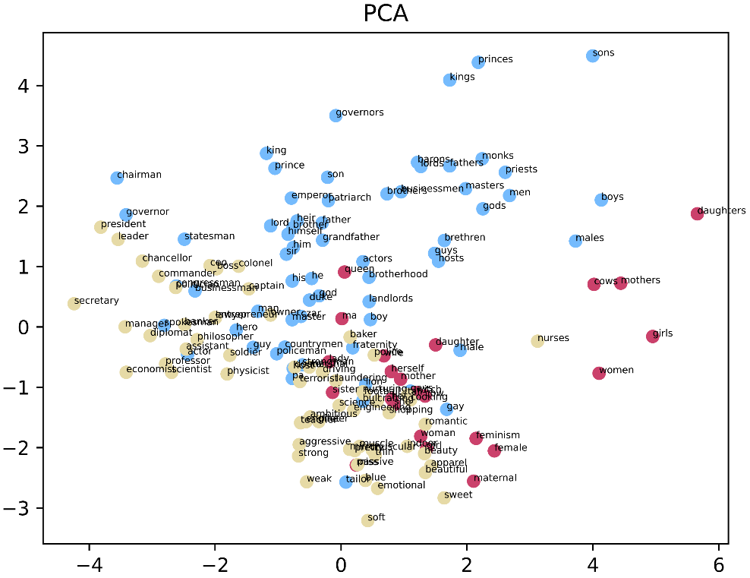
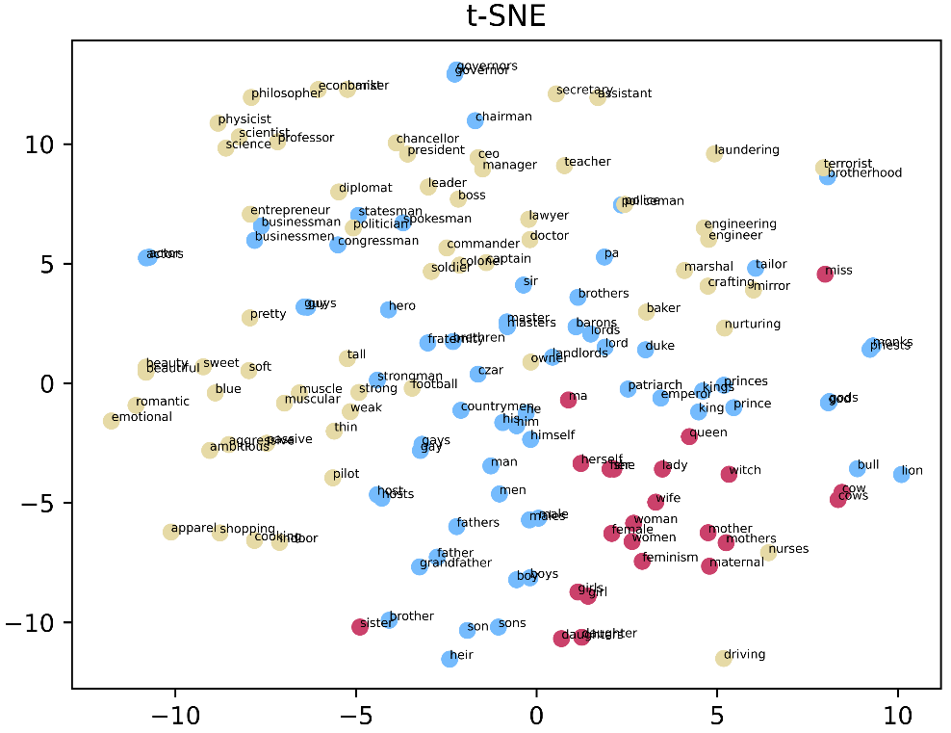
Linear Assumption VS Manifold Assumption
Sky blue for masculine, dark pink for feminine, and beige for neuter words. These word sets are defined in the paper[1].
Compared with the one depicted by PCA under the globally linear assumption, the one using t-SNE, following the manifold learning idea, shows a clearer correlation between pairwise words.
[1] Kaneko, M. and Bollegala, D., 2021. Debiasing pre-trained contextualised embeddings. arXiv preprint arXiv:2101.09523.
7

Slide 8
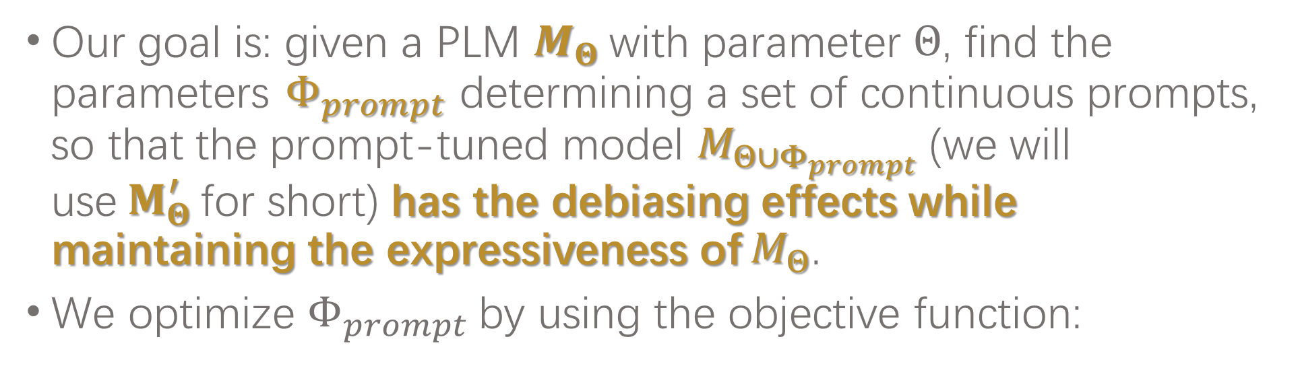
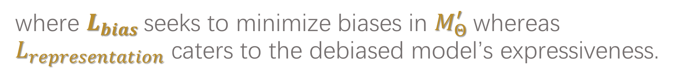
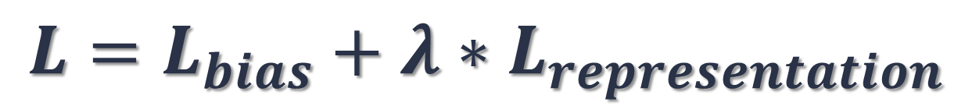
Task Formulation
Our goal is: given a PLM $M_{Θ}$with parameter $Θ$, find the parameters $Φ_{prompt}$determining a set of continuous prompts, so that the prompt-tuned model $M_{Θ∪Φ_{prompt}}$(we will use${ M}_{Θ}^{′}$for short) has the debiasing effects while maintaining the expressiveness of $M_{Θ}$.
We optimize $Φ_{prompt}$by using the objective function:
$$L=L_{bias}+{λ∗L}_{representation}$$
where $L_{bias}$seeks to minimize biases in $M_{Θ}^{′}$whereas $L_{representation}$ caters to the debiased model’s expressiveness.
8

Slide 9
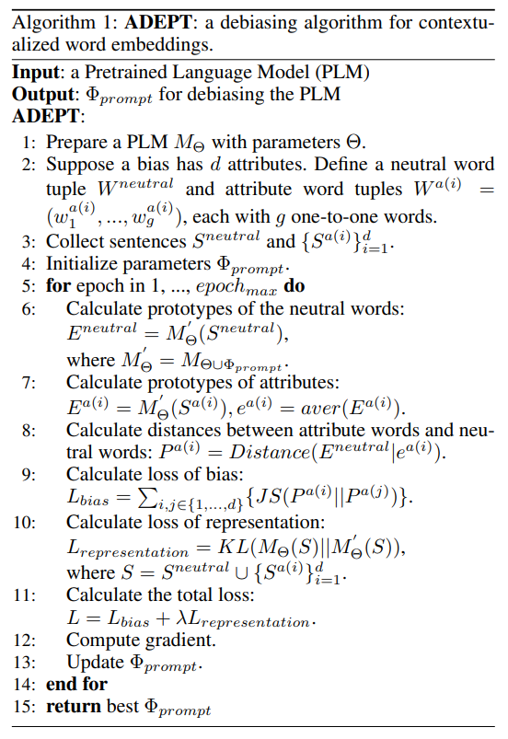


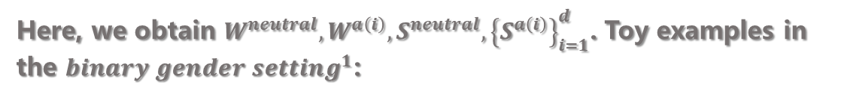
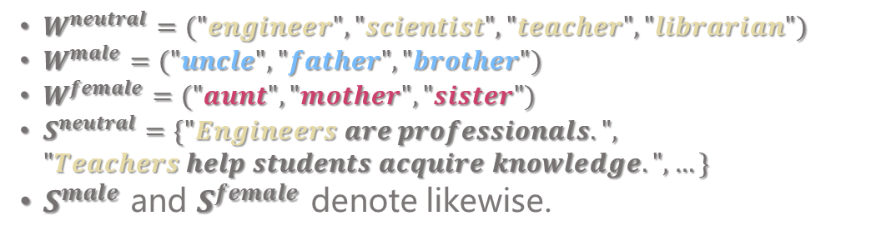

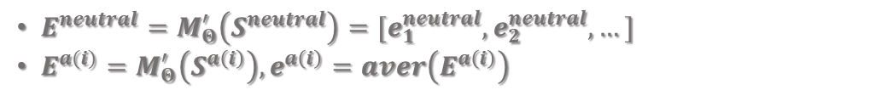
Algorithm
Define Word Tuples and Collect Sentences
Here, we obtain $W^{neutral}, W^{a\left(i\right)}, S^{neutral},{\left\{S^{a\left(i\right)}\right\}}_{i=1}^{d}$. Toy examples in the $binary gender setting^{1}$:
$W^{neutral}=("engineer", "scientist","teacher","librarian")$
$W^{male}=("uncle","father","brother")$
$W^{female}=("aunt","mother","sister")$
$S^{neutral}=\{"Engineers are professionals.", "Teachers help students acquire knowledge.", …\}$
$S^{male}$ and $S^{female}$ denote likewise.
Calculate Prototypes of Neutral Words/Attributes
Here, we calculate $E^{neutral}$ and $e^{a\left(i\right)}$:
$E^{neutral}=M_{Θ}^{′}\left(S^{neutral}\right)=[e_{1}^{neutral},e_{2}^{neutral},…]$
$E^{a(i)}=M_{Θ}^{′}\left(S^{a\left(i\right)}\right),e^{a\left(i\right)}=aver\left(E^{a\left(i\right)}\right)$
Define and Calculate Tuning Loss
Here, we define and calculate $L_{bias}$ and $L_{representation}$.
Improve Prototypes of Attributes
$binary gender setting^{1}:$ We hold the opinion that gender identity need not be restricted to the binary choice of male or female. However, for experimentation and following prior studies, we adopt this binary setting.
9

Slide 10
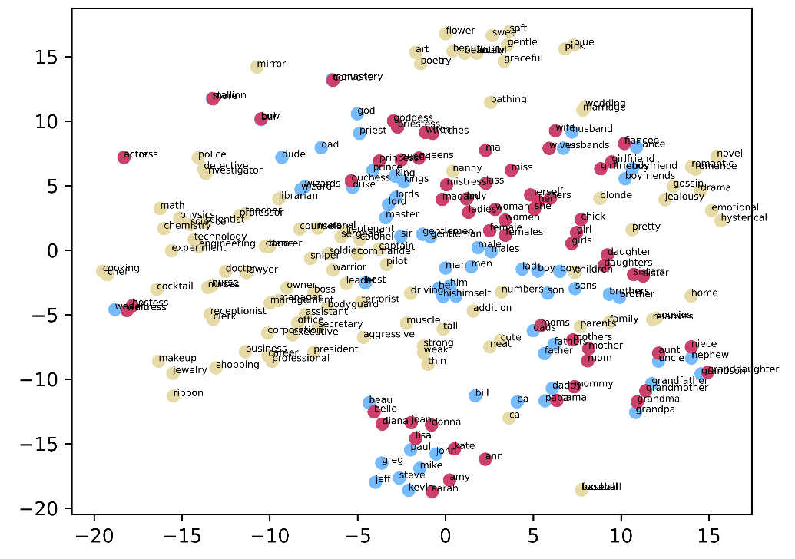



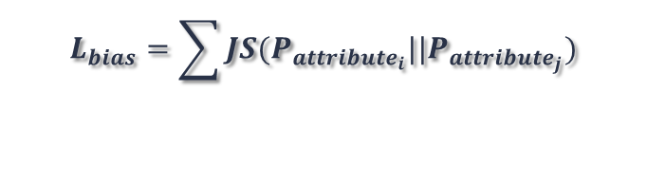

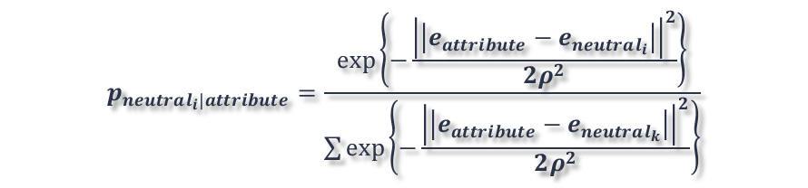


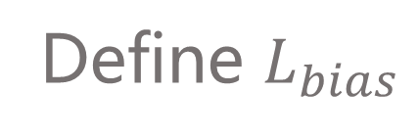
Define $L_{bias}$
Previous work：
[1] completely removes the semantic meanings of attribute words from neutral ones, and it employs the objective function as follows：
$L_{bias}=Σ_{t∈V_{t}}Σ_{s∈sent\left(t\right)}Σ_{a∈V_{a}}\left(e{\left(a\right)}^{T}E\left(t,s;θ_{e}\right)\right)$
We derive our definition from [2]：
$$p_{j|i}=\frac{\exp\left\{−\frac{{\left|\left|e_{i}−e_{j}\right|\right|}^{2}}{2ρ^{2}}\right\}}{\sum_{k≠i}{\exp\left\{−\frac{{\left|\left|e_{i}−e_{k}\right|\right|}^{2}}{2ρ^{2}}\right\}}},p_{i|i}=0$$
Our non-linear distance and $L_{bias}$:
Our $L_{bias}$ aims at pushing pairwise attribute words closer.
$$p_{neutral_{i}|attribute}=\frac{\exp\left\{−\frac{{\left|\left|e_{attribute}−e_{neutral_{i}}\right|\right|}^{2}}{2ρ^{2}}\right\}}{\sum{\exp\left\{−\frac{{\left|\left|e_{attribute}−e_{neutral_{k}}\right|\right|}^{2}}{2ρ^{2}}\right\}}}$$
Gender words appear side by side, and there is an obvious boundary between the masculine and the feminine.
$$L_{bias}=\sum{JS(P_{attribute_{i}}||P_{attribute_{j}})}$$
[1] Kaneko, M. and Bollegala, D., 2021. Debiasing pre-trained contextualised embeddings. arXiv preprint arXiv:2101.09523.
[2] Hinton, G.E. and Roweis, S., 2002. Stochastic neighbor embedding. Advances in neural information processing systems, 15.
10

Slide 11
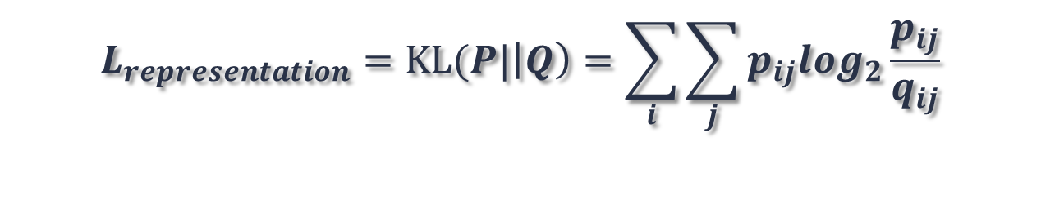

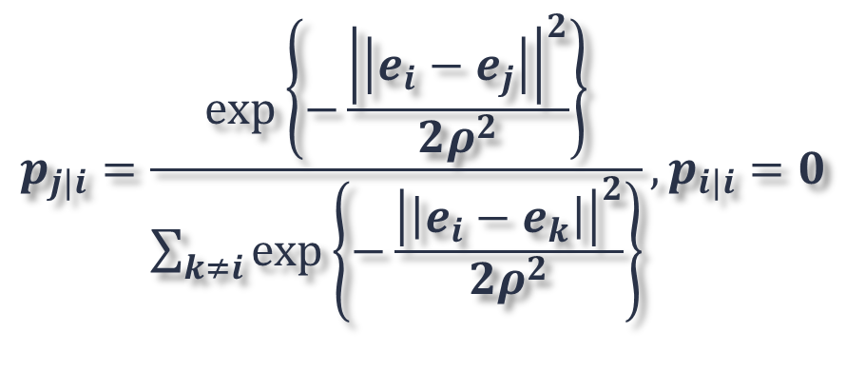
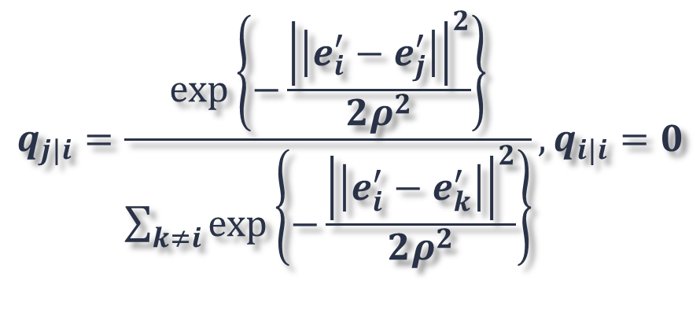
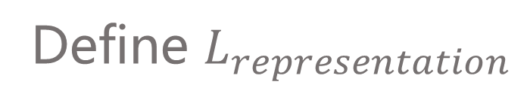
Define $L_{representation}$
Previous work：
Keep the parameters of the PLM unchanged：
$$L_{representation}=Σ_{s∈sent(t)}Σ_{x∈s}{\left|\left|E\left(x,s;θ_{e}\right)−E\left(x,s;θ_{pre}\right)\right|\right|}^{2}$$
Our ${ L}_{representation}$：
Keep the relative relationship of words unchanged：
$$q_{j|i}=\frac{\exp\left\{−\frac{{\left|\left|e_{i}^{′}−e_{j}^{′}\right|\right|}^{2}}{2ρ^{2}}\right\}}{\sum_{k≠i}{\exp\left\{−\frac{{\left|\left|e_{i}^{′}−e_{k}^{′}\right|\right|}^{2}}{2ρ^{2}}\right\}}},q_{i|i}=0$$
$$p_{j|i}=\frac{\exp\left\{−\frac{{\left|\left|e_{i}−e_{j}\right|\right|}^{2}}{2ρ^{2}}\right\}}{\sum_{k≠i}{\exp\left\{−\frac{{\left|\left|e_{i}−e_{k}\right|\right|}^{2}}{2ρ^{2}}\right\}}},p_{i|i}=0$$
$$L_{representation}=KL(P|\left|Q\right)=\sum_{i}{\sum_{j}{p_{ij}log_{2}\frac{p_{ij}}{q_{ij}}}}$$
11

Slide 12
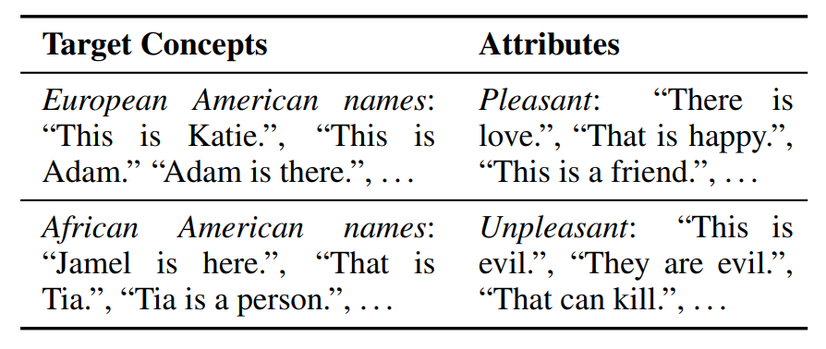

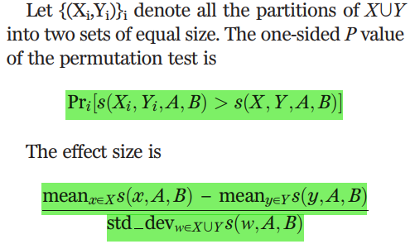
Benchmark: SEAT[1][2]
SEAT:
effect-size(p-value):
[1] May, C., Wang, A., Bordia, S., Bowman, S.R. and Rudinger, R., 2019. On measuring social biases in sentence encoders. arXiv preprint arXiv:1903.10561.
[2] Caliskan, A., Bryson, J.J. and Narayanan, A., 2017. Semantics derived automatically from language corpora contain human-like biases. Science, 356(6334), pp.183-186.
12

Slide 13
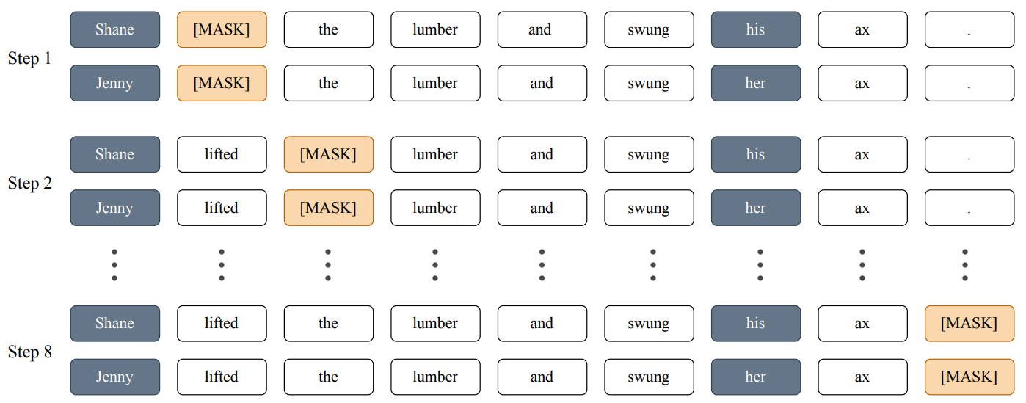
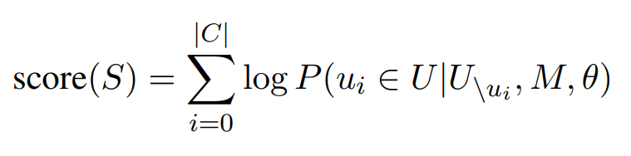
Benchmark: CrowS-Pairs[1]
CrowS-Pairs:
score(S):
[1] Nangia, N., Vania, C., Bhalerao, R. and Bowman, S.R., 2020. CrowS-pairs: A challenge dataset for measuring social biases in masked language models. arXiv preprint arXiv:2010.00133.
13

Slide 14
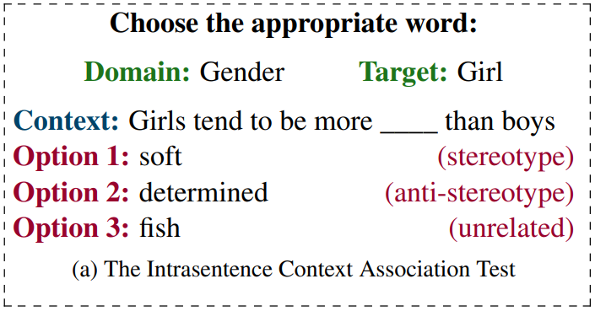

Benchmark: StereoSet[1]
StereoSet:
lms&ss&icat:
 | lms | ss | icat
Ideal | 100 | 50 | 100
Stereotyped | - | 100 | 0
Random | 50 | 50 | 50
[1] Nadeem, M., Bethke, A. and Reddy, S., 2020. Stereoset: Measuring stereotypical bias in pretrained language models. arXiv preprint arXiv:2004.09456.
14

Slide 15
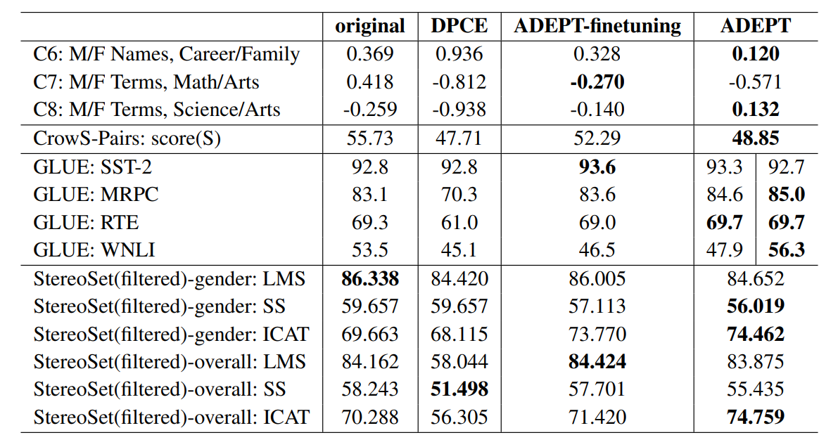
Debiasing Effects and the PLM’s Expressiveness
SEAT (from row 1 to row 3);
CrowS-Pairs (row 4);
GLUE tasks (from row 5 to row 8);
StereoSet (from row 9 to row 14);
Original (column 1): the original model;
DPCE[1] (column 2): a previous debiasing work and our baseline;
ADEPT-finetuning (column 3): the model debiased with our criterion and tuned by finetuning;
ADEPT (column 4): our approach;
We highlight the best result in bold.
ADEPT outperforms DPCE, and mostly obtains the best scores of the four models on SEAT and CrowS-Pairs.
[1] Kaneko, M. and Bollegala, D., 2021. Debiasing pre-trained contextualised embeddings. arXiv preprint arXiv:2101.09523.
ADEPT does not harm the model’s expressiveness and even improves it in most cases.
15

Slide 16
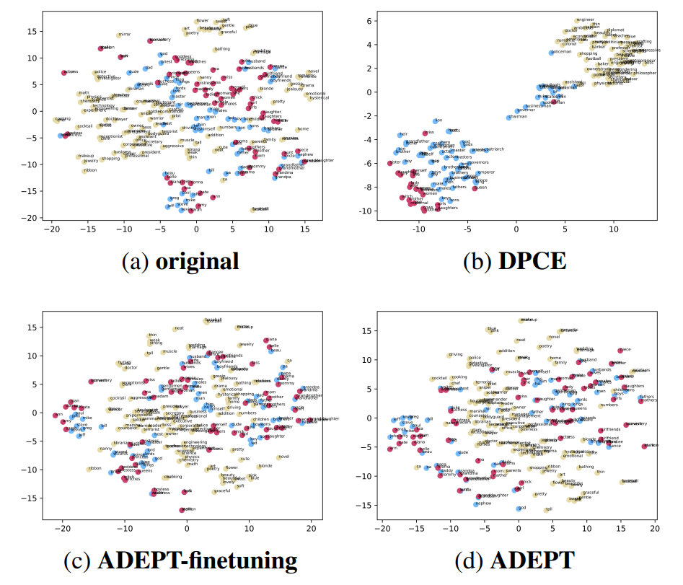
Visualization
Original: the original model;
DPCE : a previous debiasing work and our baseline;
ADEPT-finetuning: the model debiased with our criterion and tuned by finetuning;
ADEPT: our approach.
The baseline method DPCE removes attribute words’ semantic meanings from neutral ones, which actually renders the difference between pairwise gender words negligible compared to their relative distances to the neutral word group;
The debiasing criterion of ADEPT eliminates the visible boundary between pairwise attribute words as well as maintains words’ relative distances.
16

Slide 17
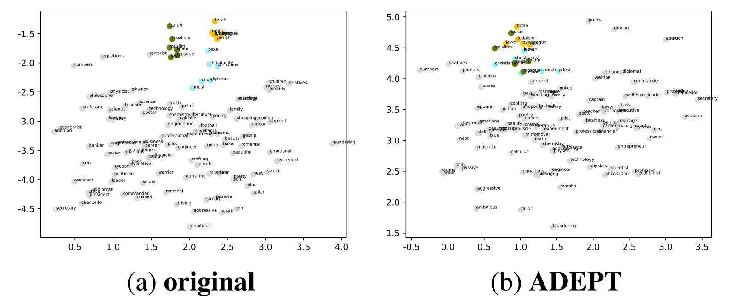
Visualization
In the ternary religion setting, we color neutral words grey, Judaism words yellow, Christianity words blue, and Islam words green.
Original: the original model;
ADEPT: our approach.
ADEPT’s objective function covers the debiasing of any attribute number, not only pairs.
17

Slide 18
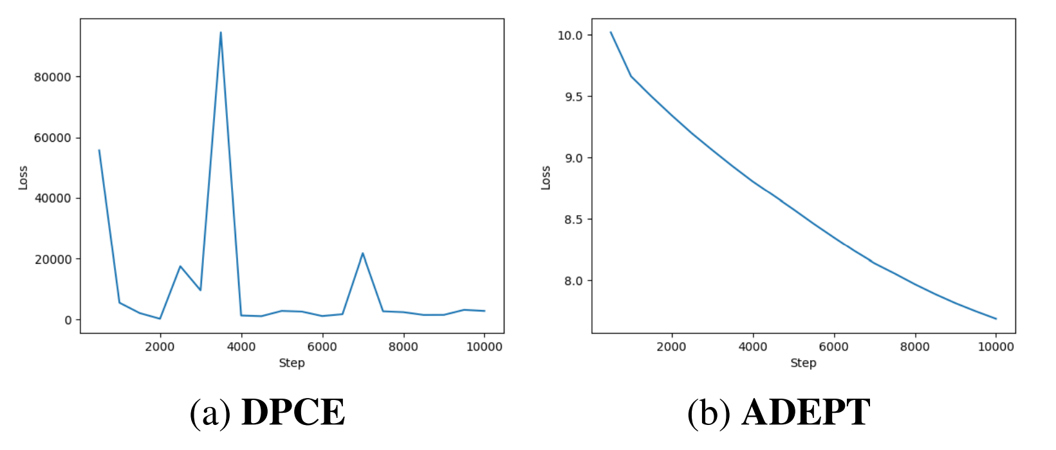
Visualization
DPCE: a previous debiasing work and our baseline;
ADEPT: our approach.
ADEPT provides a smoother loss function than previous methods, allowing for better use of optimizations like early stopping.
18

Slide 19


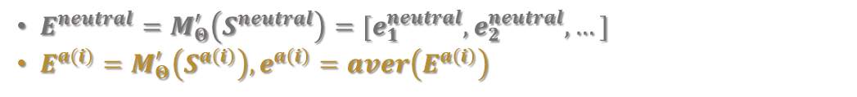
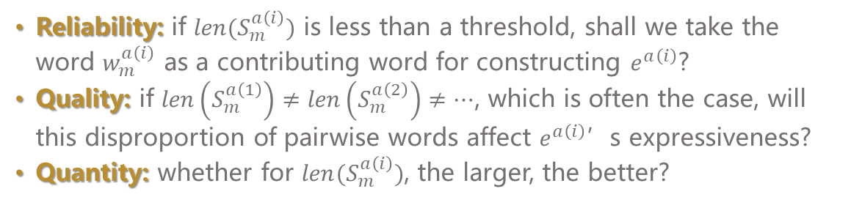

Experiments for Improving Prototypes of Attributes
Define Word Tuples and Collect Sentences
Calculate Prototypes of Neutral Words/Attributes
Here, we calculate $E^{neutral}$ and $e^{a\left(i\right)}$:
$E^{neutral}=M_{Θ}^{′}\left(S^{neutral}\right)=[e_{1}^{neutral},e_{2}^{neutral},…]$
$E^{a(i)}=M_{Θ}^{′}\left(S^{a\left(i\right)}\right),e^{a\left(i\right)}=aver\left(E^{a\left(i\right)}\right)$
Define and Calculate Tuning Loss
Improve Prototypes of Attributes
Here, we implement experiments to decide on the desirable properties of $S^{a\left(i\right)}$ regarding its reliability, quality, and quantity.
Reliability: if $len(S_{m}^{a\left(i\right)})$ is less than a threshold, shall we take the word $w_{m}^{a\left(i\right)}$ as a contributing word for constructing $e^{a\left(i\right)}$?
Quality: if $len\left(S_{m}^{a\left(1\right)}\right)≠len\left(S_{m}^{a\left(2\right)}\right)≠…$, which is often the case, will this disproportion of pairwise words affect $e^{a\left(i\right)}$’s expressiveness?
Quantity: whether for $len(S_{m}^{a\left(i\right)})$, the larger, the better?
19

Slide 20
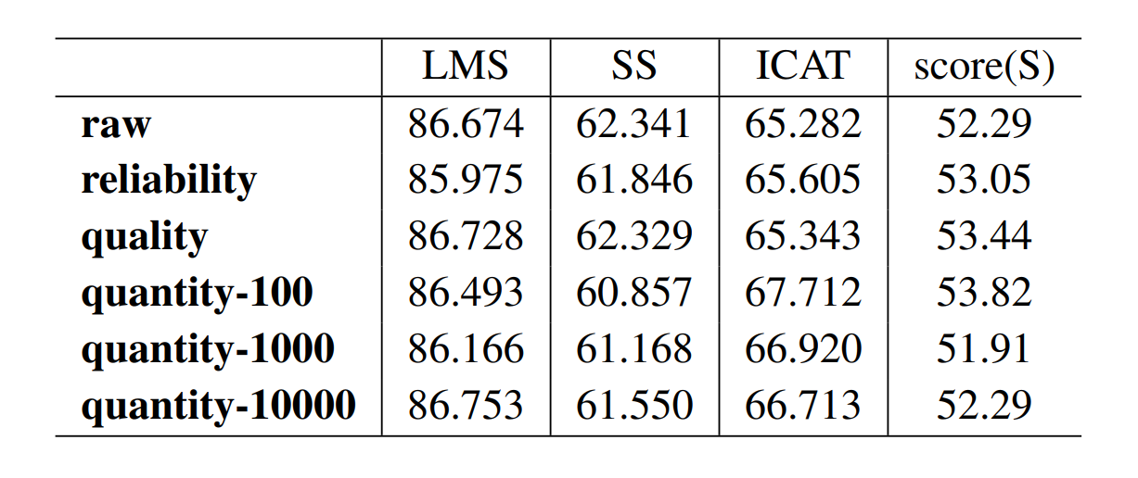
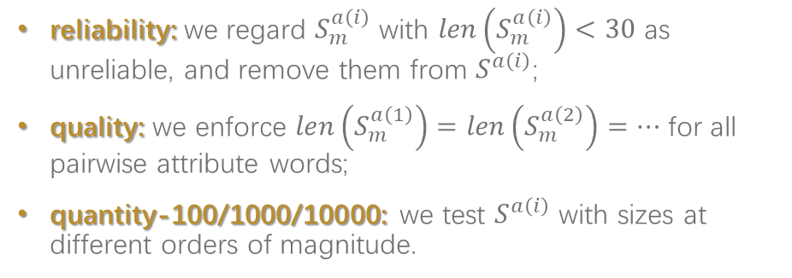
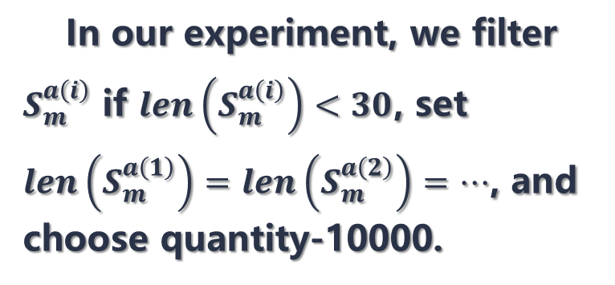
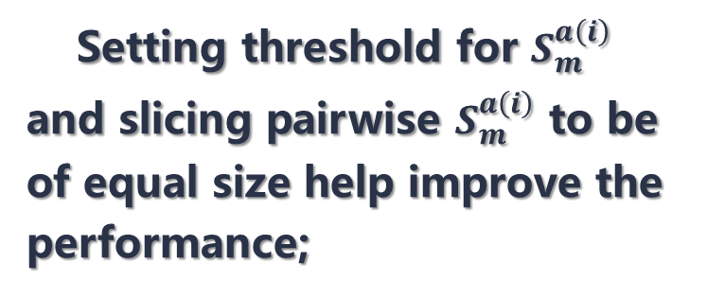
Results
Setting threshold for $S_{m}^{a\left(i\right)}$ and slicing pairwise $S_{m}^{a\left(i\right)}$ to be of equal size help improve the performance;
In our experiment, we filter $S_{m}^{a\left(i\right)}$ if $len\left(S_{m}^{a\left(i\right)}\right)<30$, set $len\left(S_{m}^{a\left(1\right)}\right)=len\left(S_{m}^{a\left(2\right)}\right)=…$, and choose quantity-10000.
reliability: we regard $S_{m}^{a\left(i\right)}$ with $len\left(S_{m}^{a\left(i\right)}\right)<30$ as unreliable, and remove them from $S^{a\left(i\right)}$;
quality: we enforce $len\left(S_{m}^{a\left(1\right)}\right)=len\left(S_{m}^{a\left(2\right)}\right)=…$ for all pairwise attribute words;
quantity-100/1000/10000: we test $S^{a\left(i\right)}$ with sizes at different orders of magnitude.
20

Slide 21
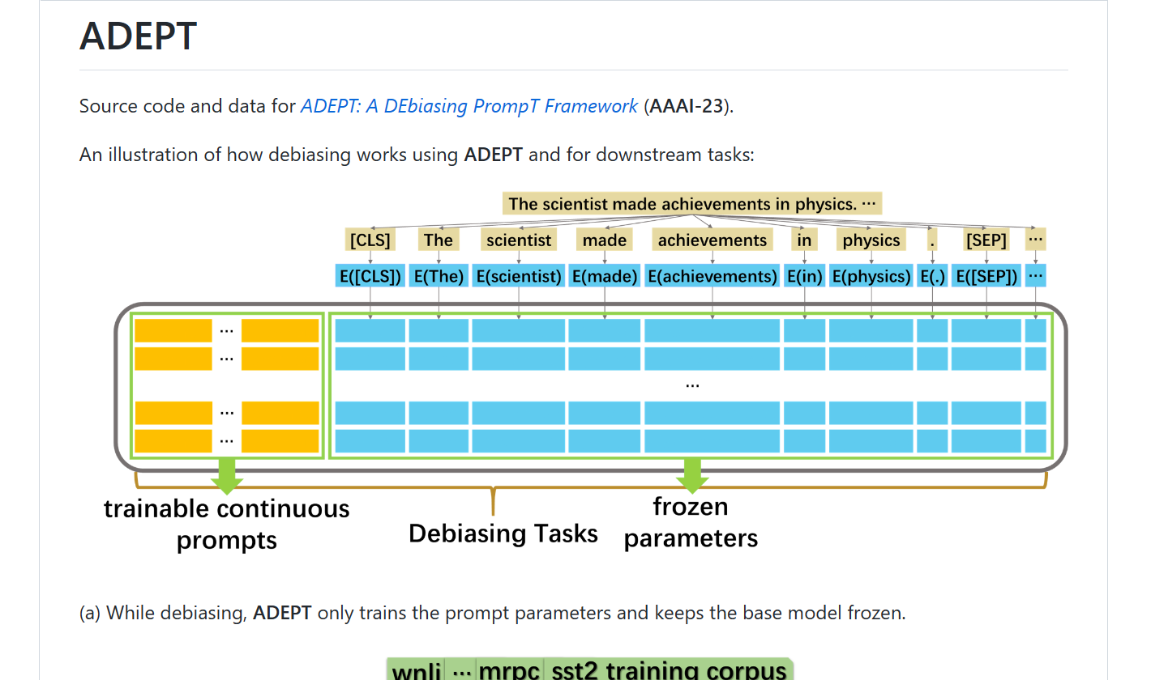
Open Source Code
Our code and data are publicly available at https://github.com/EmpathYang/ADEPT
21

Slide 22

Thank you for listening.

