Slide 1

Hangman
Guess the word game

Slide 2
INTRODUCTION
Hangman is a classic word-guessing game where players try to identify a hidden word by correctly guessing its letters. This code implements a text-based version of Hangman in C.

Slide 3
OBJECTIVES
The objective of the code is to create a playable Hangman game for a single user. The user has a limited number of attempts (defined by MAX_TRIES) to guess the letters in a randomly chosen word from a predefined list. The game provides feedback on guessed letters and displays the current state of the word, helping the user deduce the correct word.

Slide 4
METHODOLOGY
Initialization
Include necessary header files (stdio.h, string.h, stdlib.h, ctype.h).
Define constants for maximum tries (MAX_TRIES) and maximum word length (MAX_WORD_LENGTH).
Create an array of words (words) containing potential secret words.
Seed the random number generator using srand(time(NULL)).
Initialize variables:
secretWord: pointer to the randomly chosen word.
wordLength: length of the secret word.
guessedLetters: array to store guessed letters (initialized with zeros for null termination).
numTries: number of incorrect guesses made (initialized to 0).

Slide 5
METHODOLOGY
Game Loop
Enter a loop (while (1)) that continues until the game is won or lost.
Display the Word:
Call printWord to display the current state of the secret word, showing guessed letters and underscores for unguessed letters.
Check for Winning Condition:
Iterate through secretWord. If any character is not found in guessedLetters using strchr, set allGuessed to 0.
If allGuessed remains 1 after the loop, the player has guessed the word.
Print a congratulatory message with the guessed word.
Exit the loop.
Prompt for a Guess:
Print "Enter a letter: "
Use scanf to get the user's guess and store it in guess.
Convert the guess to lowercase using tolower.
Check for Duplicate Guess:
If strchr(guessedLetters, guess) is not NULL, the letter has already been guessed.
Print "You've already guessed that letter. Try again."
Continue to the next iteration of the loop.
Store the Guess:
Store the guess in guessedLetters[numTries].
Null-terminate the guessedLetters array to ensure it's a valid string.
Check for Correct Guess:
If strchr(secretWord, guess) is NULL, the guess is incorrect.
Print "Incorrect guess!"
Increment numTries.
If numTries reaches MAX_TRIES, the player has run out of tries.
Print "You ran out of tries! The word was: %s\n", printing the secret word.
Exit the loop.

Slide 6
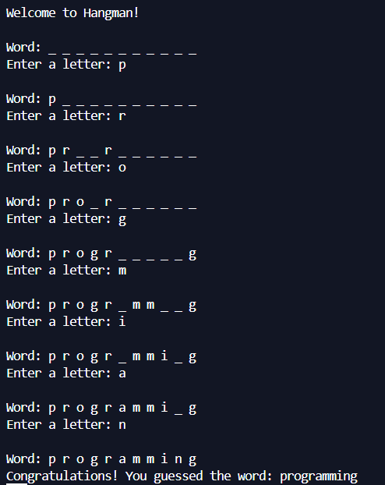
RESULTS

Slide 7
CONCLUSIION
The code effectively implements a playable text-based Hangman game in C. Users can interact with the game, guess letters, and receive feedback. The game ends upon either successful guessing of the word or running out of tries.

Slide 8
TOOLS USED
Programming Language: C
Header Files:
stdio.h: For standard input/output functions (e.g., printf, scanf)
string.h: For string manipulation functions (e.g., strlen, strchr)
stdlib.h: For random number generation function (rand)
ctype.h: For character type conversion function (tolower)
Additional Tools (Not Directly Used in Code):
Text editor or IDE for code development and debugging
Compiler (e.g., GCC) to translate C code into machine code

Slide 9

REFERENCE
Geeks for Geeks
Chat GPT
Gemini

