Slide 1

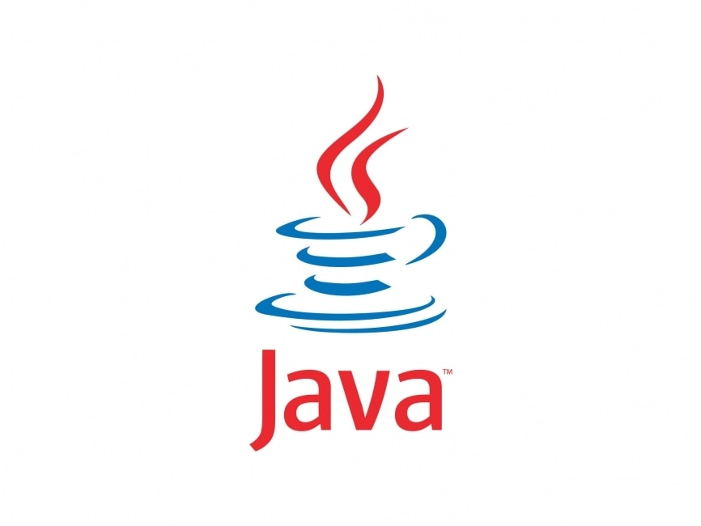
Queues in Java
COP 3330
Department of Computer Science
University of Central Florida
Dr. Bacanli

Slide 2
What is a Queue?
A queue is a sequence of nodes in which we can only access the first item. We add to the last item
Ex: People in the free pizza line
Removing from queue is called dequeue
34
3
46
7
Adding to queue is called enqueue
Queue uses FIFO.
Getting the first element without removal is called peek

Slide 3
Implementation
Enqueue, dequeue and peek, all have O(1) run time complexity
  There is no traversal of elements in queue, as a standard operation
Queue can be implemented with arrays and Linked Lists.
What are the advantages and disadvantages of those implementations?
Queue is used in
  Networking (serving packets)
  Printers getting print orders
  cases where first element/case has priority among others

Slide 4
Queue as a linked list
In a singly linked list we store the elements as shown below in a queue. We need to store the tail and head. We remove from head. Add to the tail. What if we don’t store the tail?
3
1
3
5
head
tail

Slide 5
Enqueue to Queue
Node newNode=new Node(3);
What does this operation look like, remembering the Linked List operations we have done?
tail.setNext(newNode);
tail = newNode;
3
1
3
5
tail
newNode

Slide 6
Dequeue from Queue
returnedElem = head.getItem(); // store the item somewhere
head = head.getNext(); // make head node unreachable
3
1
3
5
What does this operation look like, remembering the Linked List operations we have done?
head

Slide 7
Enqueue to Queue
tail = 4;
What happens if we filled all the positions of our starting array (queueArr)?
queueArr[tail+1] = 9;
tail = tail+1;
1 | 4 | 7 | 3 | 2
9
index: 0 1 2 3 4 5
How can we get away from this problem? Will runtime change?

Slide 8
Dequeue from Queue
head = 0;
We need to check if the queue is empty!
head and tail always increase!
returnedElem = queueArr[head];
head = head + 1;
9
1 | 4 | 7 | 3 | 2
index: 0 1 2 3 4 5
What happens to 1 when we dequeue?
public int peek(){
return queueArr[head];
}

