Slide 1
Midterm Review
Binary Conversions, Combinational Logic Design, Arithmetic Hardware, Binary Arithmetic
Notes:
There will be 9 questions in total. You will just type the right answer in a text box. Only 2 questions will be multiple choice, Karnaugh map questions.

Slide 2
Notes
This exam requires the Respondus LockDown Browser. Your Camera on.
9 questions
No open notes.
Materials to use
Pen/Pencil
A non-graphing calculator
Scratch paper

Slide 3
Sample Question.1
Let A = (1100 1111)₂. What decimal value does this represent if A is unsigned?
Solution:
A = a_{k}b^{k}+ a_{k-1}b^{k-1}+ …. + a₁b¹+ a₀b⁰
A = 1*b⁷+ 1*b⁶+ 0*b⁵+0*b⁴+1*b³+1*b²+ 1*b+ 1
A = 128 + 64 + 0 + 0 + 8 + 4 + 2 + 1
A = 207
Notes:
Place the bits of A into the equation with b as the base. “k” is zero for the least significant bit and increases by 1 until it reaches the most significant bit.

Slide 4
Sample Question.2
Convert (55)₁₀ to binary (unsigned). Show your answer using 8 bits.
Solution:
55 = 2*27 + 1 ← the remainder here is the least significant bit.
27 = 2*13 + 1
13 = 2*6 + 1
6 = 2*3 + 0
3 = 2*1 + 1
1 = 2*0 + 1 ← continue until the quotient becomes 0.
(55)₁₀= (0011 0111)₂

Slide 5
Sample Question.3
Let A = (0100 1111)₂. What decimal value does this represent if A is represented with the 2’s Complement representation?
Solution:
A = a_{k}b^{k} + a_{k-1}b^{k-1}+ …. + a₁b¹+ a₀b⁰
A = 1*b⁶ + 0*b⁵ + 0*b⁴ + 1*b³ + 1*b² + 1*b+ 1
A = 64 + 0 + 0 + 8 + 4 + 2 + 1
A = 79
Notes:
2’s Complement is the standard representation for signed integers. To convert between positive and negative values, we calculate a bitwise inverse and add 1 to the result. The first bit is the sign bit and indicates whether the number is positive or negative. A 1 means the number is negative. A 0 in the most significant position means the number is positive or zero.
For this question:
Examine the most significant bit. Since it is 0, this number is positive. Place the bits into the conversion equation with b as the base. “k” is zero for the least significant bit and increases by 1 until it reaches the most significant bit. Since the MSB is 0 there is no need to modify the result.

Slide 6
Sample Question.4
Let A = (1100 1111)₂. What decimal value does this represent if A is represented with the 2’s Complement representation?
Solution:
0011 0001
n = a_{k}b^{k} + a_{k-1}b^{k-1}+ …. + a₁b¹+ a₀b⁰
n = 0*b⁷+ 0*b⁶+ 1*b⁵+1*b⁴+0*b³+0*b²+ 0*b+ 1
n = 32 + 16 + 0 + 0 + 0 + 1
n = 49
A = -49
Notes:
Examine the most significant bit. Since it is 1, this number is negative. Perform a bitwise inverse and add 1.
Place the modified bits into the conversion equation with b as the base. “k” is zero for the least significant bit and increases by 1 until it reaches the most significant bit. Since the original MSB was 1, multiply the result by -1.

Slide 7
Sample Question.5
Convert (49)₁₀ to binary using the 2’s complement representation of signed integers. Show your answer using 8 bits.
Solution:
49 = 2*24 + 1
24 = 2*12 + 0
12 = 2*6 + 0
6 = 2*3 + 0
3 = 2*1 + 1
1 = 2*0 + 1
(49)₁₀= (110001)₂ = (0011 0001)₂
Notes:
Convert 49 to binary and expand to 8 bits. Since this number is positive, no modifications are needed.

Slide 8
Sample Question.6
Convert (-55)₁₀ to binary using the 2’s complement representation of signed integers. Show your answer using 8 bits.
Solution:
55 = 2*27 + 1
27 = 2*13 + 1
13 = 2*6 + 1
6 = 2*3 + 0
3 = 2*1 + 1
1 = 2*0 + 1
(55)₁₀= (110111)₂
(55)₁₀= (110111)₂
(55)₁₀= (0011 0111)₂
(-55)₁₀= (1100 1001)₂
Notes:
First, calculate the positive form of -55.
Second, expand the positive form of -55 to 8 bits.
Finally, since the original value is negative, perform a bitwise inverse and add 1.

Slide 9
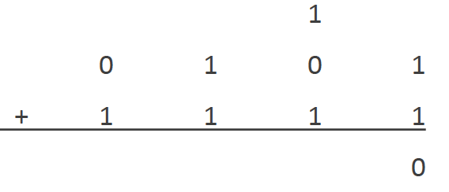
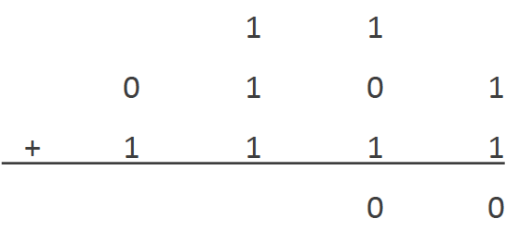
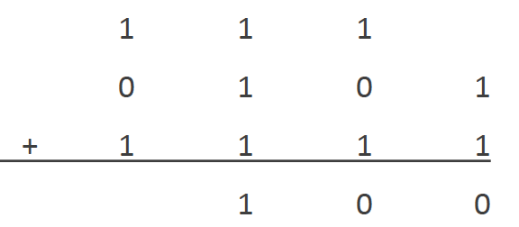
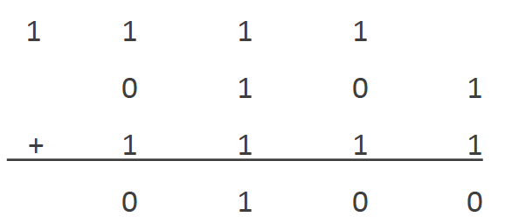
Sample Question.7
Suppose A = 0101 and B = 0001. Calculate A-B and show your answer using 4 bits. State whether or not overflow has occurred.
Solution:
-B → 1110 (bitwise inverse) + 1 → 1111
Result: 0100
Overflow: No
Notes:
Review: Binary Subtraction
2’s complement binary numbers are subtracted by adding their negative equivalent. A–B becomes A + -B. No changes are made to A. B must be converted to a negative number: we invert each bit of B and then add 1 to the result.
Solution:
First, Calculate -B in order to calculate A + -B. Perform a bitwise inverse on B and then add 1.
Now, add A and –B. Start with the least significant bit.
To check for overflow, compare the carry-in and the carry-out of the most significant bit. Since they are both 1, we determine that no overflow has occurred.
So, in the exam, there will be 2 text boxes, one for the result of the subtraction, one for overflow which you will type yes or no.

Slide 10
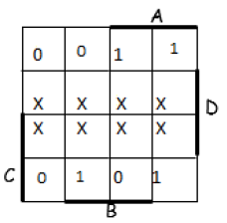
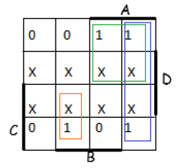
Sample Question.8
Consider the following Karnaugh map. Which of the following equations represents a most simplified sum-of-products equation for F?
F = AC’ + AB’ + A’BC
Notes:
In our case, let’s just find the answer. But in the exam will be multiple choice, and you will select the correct answer.

Slide 11
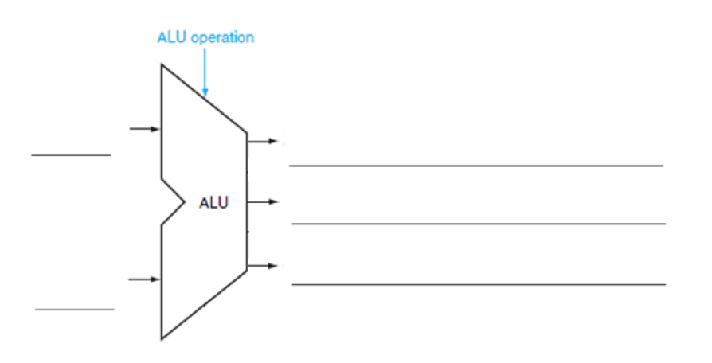
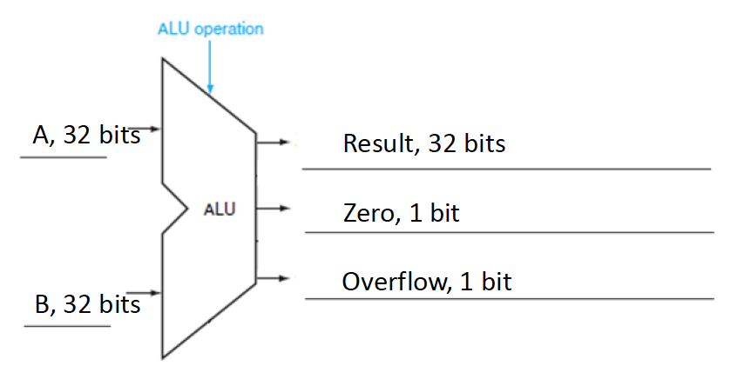
Sample Question.9
Label the inputs and outputs of the following 32-bit Arithmetic Logic Unit. Identify how many bits would be used to represent each value.
Notes:
ALU
2 binary values (signed)
Performs arithmetic operations (addition, subtraction)
Performs logical operations (AND, OR, NOR)
Performs logical comparisons (Less Than, Equal To)
The two register inputs are commonly called A and B
A and B must be the same width.
The ALU operation determines which operation’s result will be output
ALU operation is 2-4 bits.
The ALU has three primary outputs:
The Result must be the same width as A and B. In a 32-bit ALU, Result is 32 bits. In a 16-bit ALU, Result will be 16 bits, etc.
Zero is 1-bit. It will be 1, if all of the bits of Result are 0s. It will be 0 if any bit of Result is not 0. Could be used for “Equal to”.
Overflow is also a 1-bit signal. It will be 1 if overflow is detected.
Here is some info about overflow:
Overflow occurs when the size of the inputs is such that there is a carry which changes the most-significant sign bit.
The ALU will always output overflow, but makes sense when the operation is add or subtract.
When we are doing the logical operations (AND and OR), the values on overflow outputs have no meaning.
As overflow is only Maths related, this should be implemented in the ADD/SUBTRACT unit.
The logic is as follows: when adding, if the sign of the two inputs is the same, but the result sign is different, then we have an overflow.
So- for the question here:
Since the ALU is shown in isolation, we can give the inputs generic placeholders like A and B, X and Y, or Input 1 and Input 2. The only thing to keep in mind is that our labels should indicate the two inputs are distinct. There are two separate input buses.
The number of bits used to represent A and B are referred to as the “width” of those buses. The width of the input buses has to match the width of the ALU itself. In this case, we’re told that this is a 32-bit ALU.
There are three outputs we want to represent in our ALU diagram. The first is the result. Remember, the ALU will calculate the result of several operations at once, but only one will be sent to the output bus. This result is also the same width as the ALU.
Our other two outputs are Overflow and Zero. Zero indicates if the result is equal to zero or not. This output only needs 1 bit as it will either be asserted or deasserted.
Overflow indicates if there was an overflow error in the arithmetic. This output only needs 1 bit as it will either be asserted or deasserted.
In the exam, you will have 5 text boxes to place your answers.

Slide 12
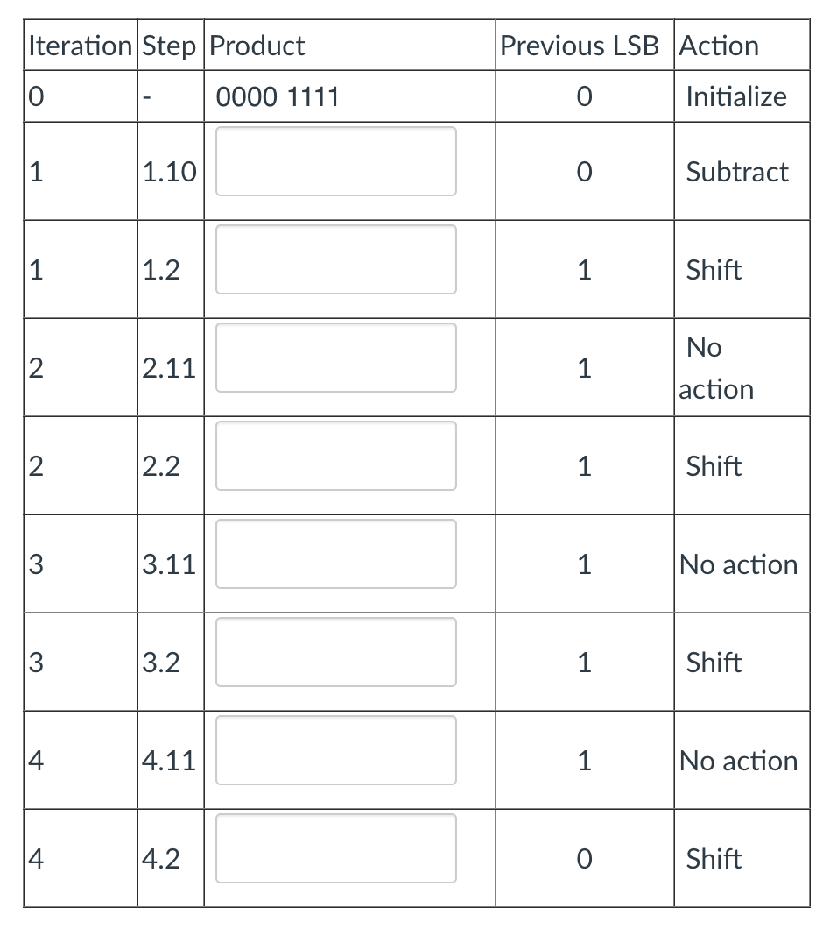
Sample Question.10
Multiply 2 x -5 using Booth’s algorithm. Use 4-bit for multiplicand (2) and multiplier (-5).
Multiplier: 1011
Multiplicand: 0010
-Multiplicand: ?
0000 1011
1110 1011
1111 0101
1111 0101
1111 1010
3.01
0001 1010
Add
Solution:
0000 1101
0
-Multiplicand = 1110
1110 1101
Subtract
(0000 1001)₂ + 1 = 10
1111 0110
Notes:
When using Booth's Algorithm:
You will need twice as many bits in your product as you have in your original two operands.
The leftmost bit of your operands (both your multiplicand and multiplier) is a SIGN bit, and cannot be used as part of the value.
Decide which operand will be the multiplier and which will be the multiplicand
Convert both operands to two's complement representation using X bits
X must be at least one more bit than is required for the binary representation of the numerically larger operand
Begin with a product that consists of the multiplier with an additional X leading zero bits
For our example, let's multiply 2 x -5
The numerically larger operand (5) would require 3 bits to represent in binary (101). So we must use AT LEAST 4 bits to represent the operands, to allow for the sign bit.
Use the LSB (least significant bit) and the previous LSB to determine the arithmetic action.
If it is the FIRST pass, use 0 as the previous LSB.
Possible arithmetic actions:
00 → no arithmetic operation
01 → add multiplicand to left half of product
10 → subtract multiplicand from left half of product
11 → no arithmetic operation
Perform an arithmetic right shift (ASR) on the entire product.
NOTE: For X-bit operands, Booth's algorithm requires X passes.
Now begin the solution…

Slide 13
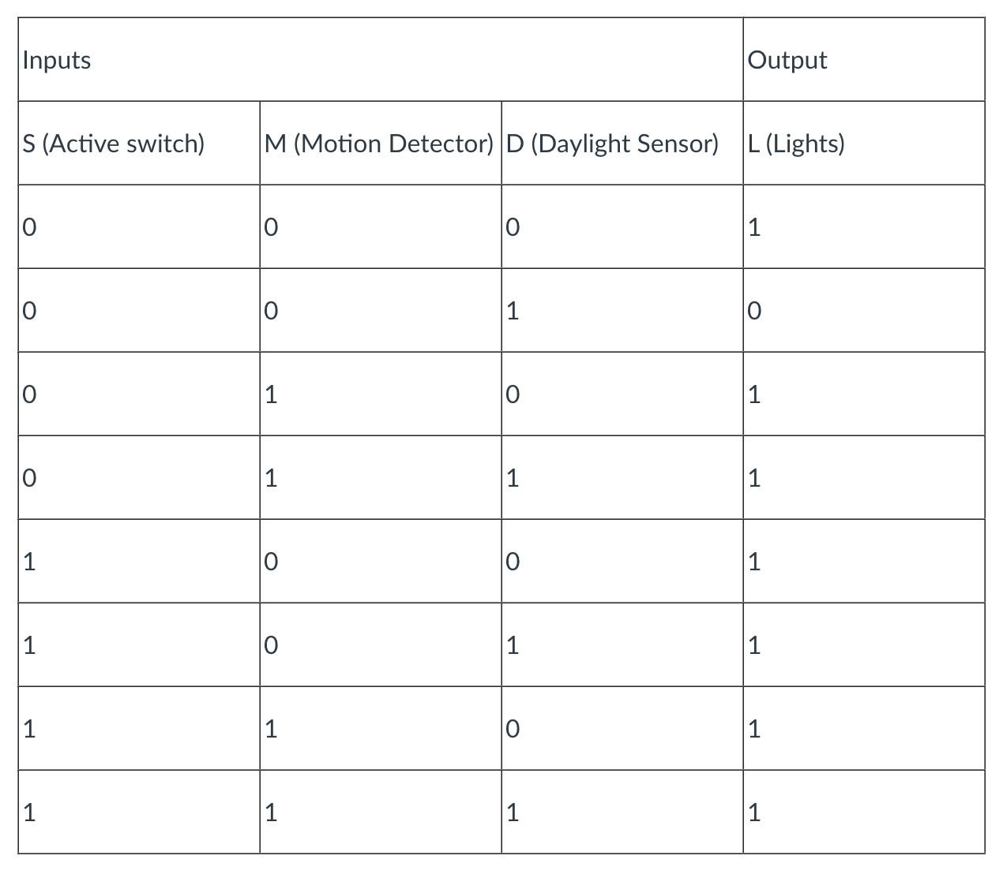
Sample Question.11
Automatic Light with Motion Detection
Consider the design of an automatic outdoor light for a house. This light will be on if there is not enough light to see by otherwise or if motion is detected near the light. This requires two sensors: a motion sensor and a daylight sensor. The light can also be turned on and off by a light switch.
The basic operation of the light and the inputs and outputs of the controller are shown below.
The inputs and outputs are: L = Light (1 = On, 0 = Off) D = Daylight Sensor (1 = do not need light, 0 = dark, light is required) M = Motion Detector (1 = Motion Detected, 0 = No Motion Detected) S = Active switch (1 = light is on manually, 0 = light is off, rely on sensors)
The basic operation of the alarm can be described as: If active switch is off, check daylight sensor and motion detector. If daylight sensor is “dark” (W=0) or motion detector detects motion (M=1), turn on lights (L=1).
Notes:
First, you will type the 0 or 1s for the L output in the boxes.

Slide 14
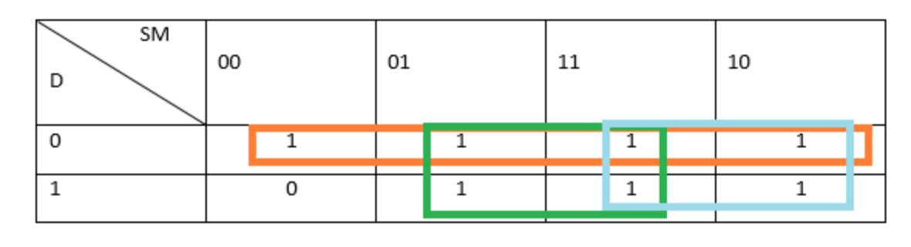
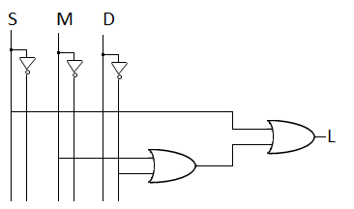
Sample Question.11 (Cont’d)
L = S + M + D'
Notes:
Use a Karnaugh map to reduce. (you will place 0s or 1s inside the cells.)
Then, Identify the minterm expansion for L. (multiple choice, you will select the correct one.)
Draw the gate diagram. (multiple choice, you will select the correct one.)

