Slide 1
CDA 3103
Recitation 2 – Logic Gates

Slide 2
Question 1
Show that the following statement is true using perfect induction.
X NAND Y = (X’ NOR Y’)’
X | Y | X’ | Y’ | X AND Y | X NAND Y | X’ OR Y’ | X’ NOR Y’ | (X’ NOR Y’)’
0 | 0 | 1 | 1 | 0 | 1 | 1 | 0 | 1
0 | 1 | 1 | 0 | 0 | 1 | 1 | 0 | 1
1 | 0 | 0 | 1 | 0 | 1 | 1 | 0 | 1
1 | 1 | 0 | 0 | 1 | 0 | 0 | 1 | 0

Slide 3
Question 1
Show that the following statement is true using perfect induction.
X NOR Y = (X’ NAND Y’)’
X | Y | X’ | Y’ | X OR Y | X NOR Y | X’ AND Y’ | X’ NAND Y’ | (X’ NAND Y’)’
0 | 0 | 1 | 1 | 0 | 1 | 1 | 0 | 1
0 | 1 | 1 | 0 | 1 | 0 | 0 | 1 | 0
1 | 0 | 0 | 1 | 1 | 0 | 0 | 1 | 0
1 | 1 | 0 | 0 | 1 | 0 | 0 | 1 | 0

Slide 4
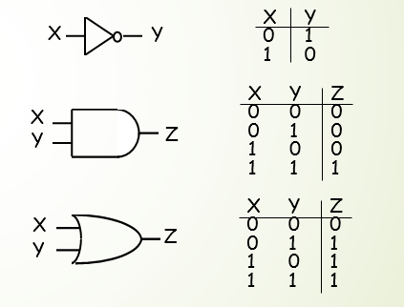
Review: Logic Gates
NOT X' X ~X
AND X • Y X ∧ Y
OR X + Y X ∨ Y
X Y 0 1 1 0
X
Y
X Y Z 0 0 0 0 1 0 1 0 0
1 1 1
X
Y
Z
X Y Z 0 0 0 0 1 1 1 0 1
1 1 1
X
Z
Y

Slide 5
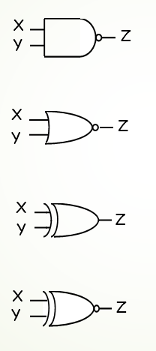
Review: Logic Gates
X Y Z 0 0 1 0 1 1 1 0 1
1 1 0
X
Y
Z
NAND
NOR
XOR X ⊕ Y
XNOR X ⊕ Y
X Y Z 0 0 1 0 1 0 1 0 0
1 1 0
X
Z
Y
X Y Z 0 0 0 0 1 1 1 0 1
1 1 0
X xor Y = X Y' + X' Y X or Y but not both ("inequality", "difference")
X
Y
Z
X Y Z 0 0 1 0 1 0 1 0 0
1 1 1
X
X xnor Y = X Y + X' Y' X and Y are the same ("equality", "coincidence")
Y
Z

Slide 6
Question 2
Represent the function F = ABC + ACD’ + A’BC + BCD using
Any combination of logic gates
Only NAND gates
Only NOR gates

Slide 7
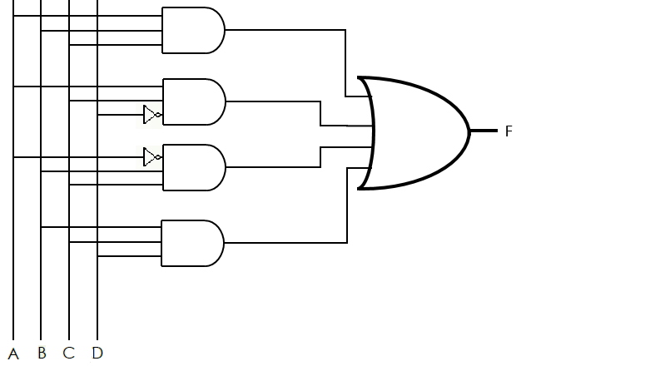
Question 2.1
Represent the function F = ABC + ACD’ + A’BC + BCD using any combination of logic gates

Slide 8
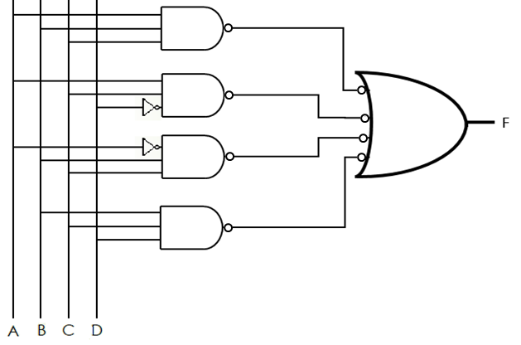
Question 2.2
Represent the function F = ABC + ACD’ + A’BC + BCD using only NAND gates
Step 1: Convert AND gates to NAND gates by inverting the output of the AND gates and the input of the OR gate.

Slide 9
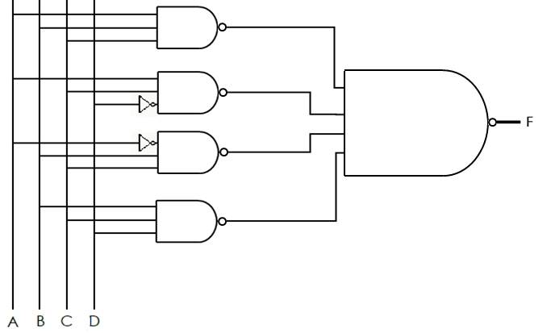
Question 2.2
Represent the function F = ABC + ACD’ + A’BC + BCD using only NAND gates
Step 2: Convert the OR gate with inverted inputs to a NAND gate.

Slide 10
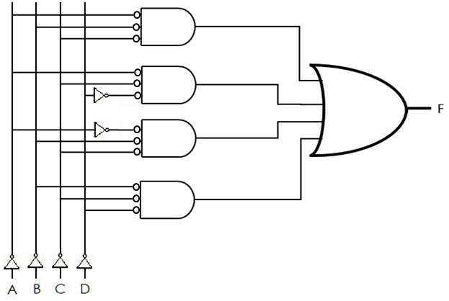
Question 2.3
Represent the function F = ABC + ACD’ + A’BC + BCD using only NOR gates
Step 1: Invert all input signals and the inputs to the AND gates

Slide 11
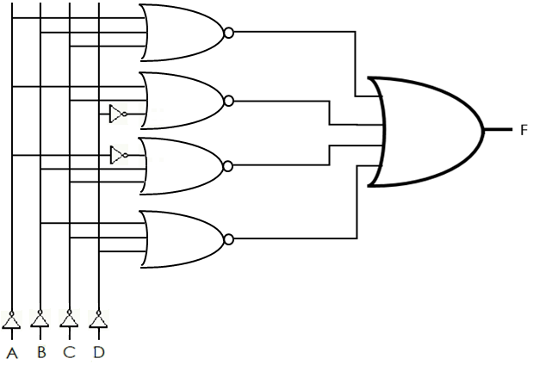
Question 2.3
Represent the function F = ABC + ACD’ + A’BC + BCD using only NOR gates
Step 2: Convert the AND gates to NOR gates

Slide 12
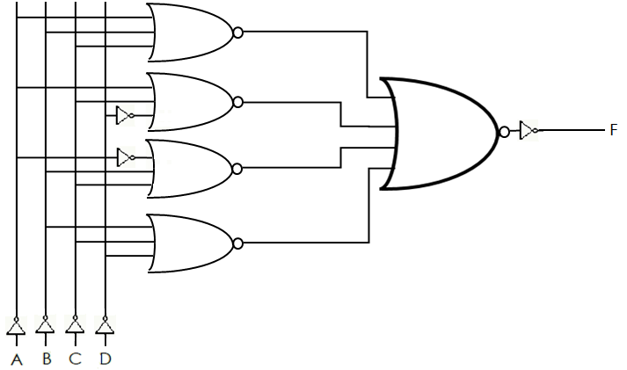
Question 2.3
Represent the function F = ABC + ACD’ + A’BC + BCD using only NOR gates
Step 2: Convert the OR gate to a NOR gate and add an inverter

Slide 13
Question 3
Consider the following truth table. Identify the function represented by the truth table and reduce it. Show the gate implementation for the original and the reduced function in AND, OR, and NOT gates
A | B | C | F
0 | 0 | 0 | 0
0 | 0 | 1 | 0
0 | 1 | 0 | 0
0 | 1 | 1 | 1
1 | 0 | 0 | 1
1 | 0 | 1 | 0
1 | 1 | 0 | 1
1 | 1 | 1 | 1

Slide 14
Question 3
Consider the following truth table. Identify the function:
F = A’BC + AB’C’ + ABC’ + ABC
A | B | C | F
0 | 0 | 0 | 0
0 | 0 | 1 | 0
0 | 1 | 0 | 0
0 | 1 | 1 | 1
1 | 0 | 0 | 1
1 | 0 | 1 | 0
1 | 1 | 0 | 1
1 | 1 | 1 | 1

Slide 15
Question 3
Reduce the function:
F = A’BC + AB’C’ + ABC’ + ABC
= A’BC + ABC + AB’C’ + ABC’ Commutative
= (A’ + A)BC + AB’C’ + ABC’ Distributive
= (1)BC + AB’C’ + ABC’ Inverse
= BC + AB’C’ + ABC’ Identity
= BC + (B + B’)AC’ Distributive
= BC + (1)AC’ Inverse
= BC + AC’ Identity

Slide 16
Question 3
Show the gate implementation for each function.
F = A’BC + AB’C’ + ABC’ + ABC
F = BC + AC’
F
F
A B C
A B C

