Slide 1
Tribhuvan University | NIST College | BCA 6th Semester
THRIFT STORE
An Online Second-Hand Goods Marketplace
Submitted by: Santosh Shrestha (6-2-1014-26-2022)
Supervisor: Samish Shrestha
Department of Computer Application | April, 2026

Slide 2
Introduction & Problem Statement
OVERVIEW
PROBLEMS ADDRESSED
Nepal's second-hand goods market is fragmented and unstructured — relying on informal channels, social media, and cash-based transactions.
Thrift Store is a full-stack e-commerce platform built specifically for Nepal's growing thrift economy.
No centralized marketplace for second-hand goods
Absence of trust & seller verification
No digital payment integration
Inefficient buyer-seller communication
No product quality control
No order tracking system

Slide 3
Objectives & Scope
🔐
JWT authentication with role-based access control (USER/ADMIN)
📦
Product management with multi-image uploads & admin approval workflow
💳
eSewa payment integration
💬
Real-time bidirectional chat using Socket.io
📋
Order management with item-level status tracking
⭐
Seller rating & review system (1-5 stars)
📱
Phone OTP verification via Firebase

Slide 4
Technology Stack
Backend
Database
Frontend
Node.js (LTS)
PostgreSQL 15+
HTML5 / CSS3
Express.js 5.2.1
Prisma ORM 6.4.1
Tailwind CSS 3.x
TypeScript 5.9.3
Vanilla JavaScript
Auth & Security
Real-Time
Integrations
JWT (2-day token)
Socket.io 4.8.3
eSewa RC-Epay
Bcrypt (salt 10)
WebSocket rooms
Firebase OTP
HMAC-SHA256
JWT auth on socket
Multer (file upload)

Slide 5
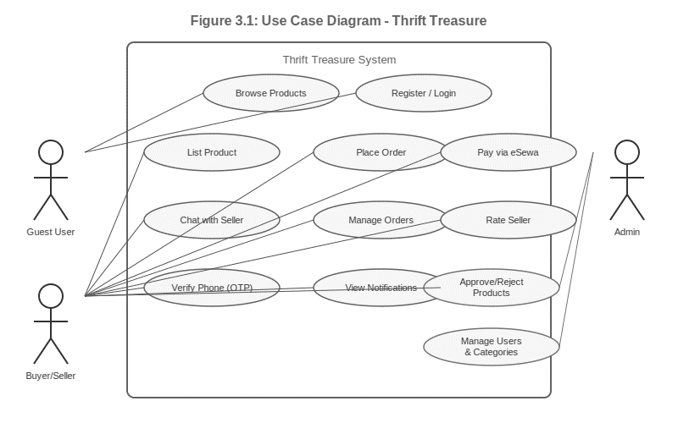
Figure 3.1: Use Case Diagram — Thrift Store

Slide 6
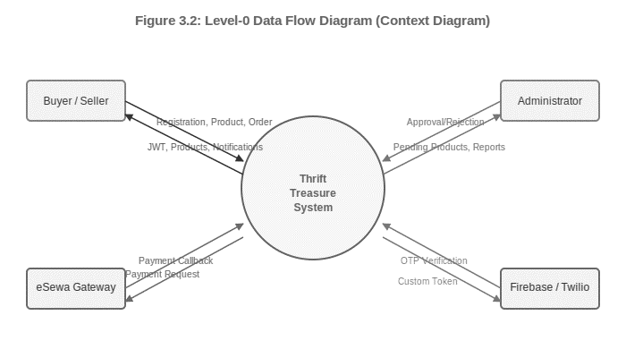
Figure 3.2: Level-0 Data Flow Diagram (Context Diagram)

Slide 7
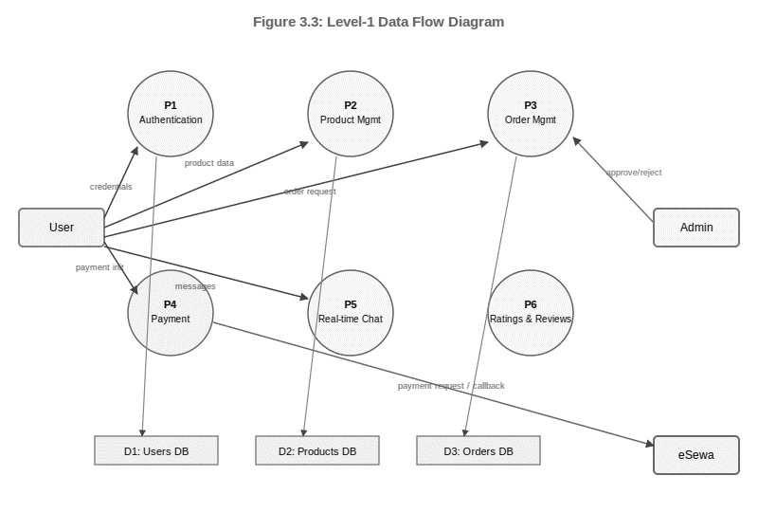
Figure 3.3: Level-1 Data Flow Diagram

Slide 8
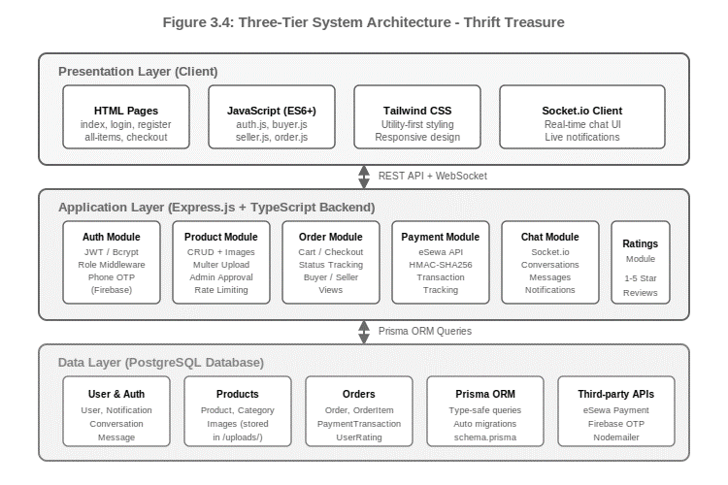
System Architecture & Design
Presentation Layer
HTML5 + Tailwind CSS
Multi-page responsive UI
Vanilla JS + Socket.io Client
Application Layer
Express.js REST API
Socket.io real-time server
MVC + Service pattern (TypeScript)
Data Layer
PostgreSQL 15+ | Prisma ORM
13 models / 30+ REST endpoints
Schema-driven migrations
Fig 3.4: Three-Tier Architecture

Slide 9
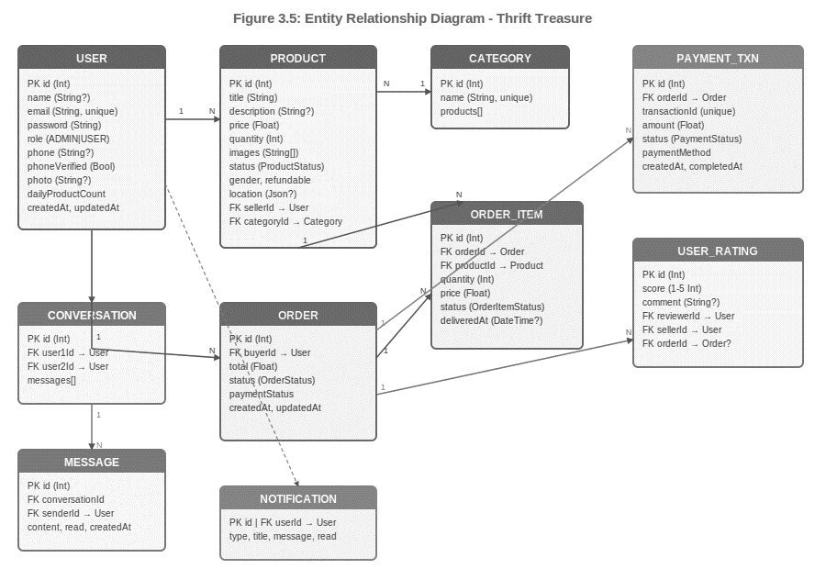
Figure 3.5: Entity Relationship Diagram — Thrift Store

Slide 10
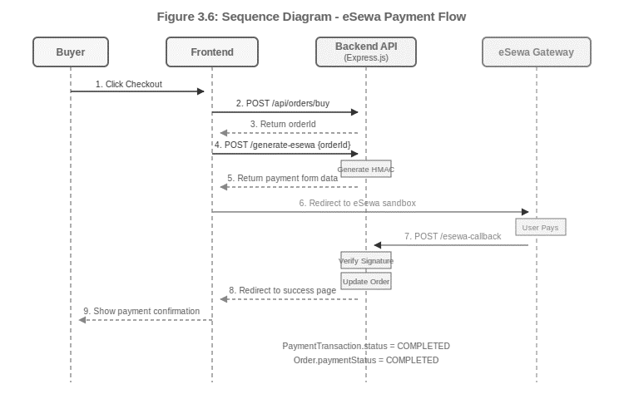
Figure 3.6: Sequence Diagram — eSewa Payment Flow

Slide 11
Key Features & Algorithms
eSewa Payment
Real-Time Chat
HMAC-SHA256 signature verification. Sandbox integration with callback handling for COMPLETED/FAILED states.
Socket.io with JWT auth at connection level. Messages persisted before broadcast — no data loss for offline users.
Admin Workflow
Order State Machine
Product approval pipeline: PENDING → APPROVED/REJECTED. Role-based access prevents unauthorized actions.
Item-level tracking: PENDING → PROCESSING → SHIPPED → DELIVERED → RECEIVED. Multi-item order support.
Algorithms Implemented:
Haversine Distance
Product Search
Rating Aggregation
Content-Based Filtering

Slide 12
Conclusion & Future Work
CONCLUSION
FUTURE RECOMMENDATIONS
Successfully achieved all functional objectives
📱
Mobile App (React Native)
22 test cases — 100% pass rate
🔍
Full-Text Search (Elasticsearch)
Production-ready e-commerce solution for Nepal
🤖
AI-Based Recommendations
Full TypeScript backend with type-safe DB access
💳
Live eSewa + Khalti + ConnectIPS
Real payment gateway with cryptographic security
🚚
Delivery Logistics Integration
Real-time messaging + notification system
🌐
PWA with Offline Browsing
MVC + service layer — clean & maintainable code
🇳🇵
Nepali Language Support

Slide 13
Thank You
Santosh Shrestha
BCA 6th Semester | Roll No: 6-2-1014-26-2022
Department of Computer Application, NIST College
Tribhuvan University
Supervised by: Samish Shrestha

