Slide 1

Tribhuvan University — NIST College
THRIFT STORE
An Online Second-Hand Goods Marketplace
Submitted by: Santosh Shrestha (6-2-1014-26-2022)
Supervisor:
Samish Shrestha
BCA 6th Semester | April 2026

Slide 2
INTRODUCTION & PROBLEM STATEMENT
Introduction
Problems Identified
Nepal's second-hand market is fragmented relying on physical stores and social media
No centralized trusted digital marketplace
Growing eSewa/Khalti adoption makes digital thrift commerce more easier.
No seller verification or rating system
Thrift Store fills the gap with a structured, secure, feature-rich platform
Cash-only — lacks digital payment support
No direct buyer-seller communication channel
No product quality control or order tracking

Slide 3
OBJECTIVES
Secure Auth
eSewa Payment
JWT + Bcrypt role-based access control (USER & ADMIN)
HMAC-SHA256 signature-based digital payment integration
Real-Time Chat
Seller Rating
Socket.io bidirectional buyer-seller messaging
1–5 star review system linked to verified purchases
Phone Verification
Admin Panel
Firebase OTP before product listing
Product approval management and platform oversight

Slide 4
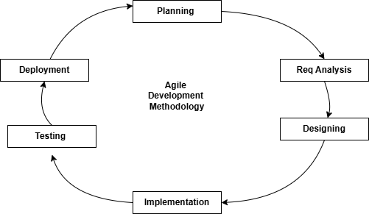
DEVELOPMENT METHODOLOGY
Agile Methodology
Iterative, flexible development with early validation and continuous feedback to reduce rework
Dedicated handling of high-risk features while staying adaptable to mid-project changes

Slide 5
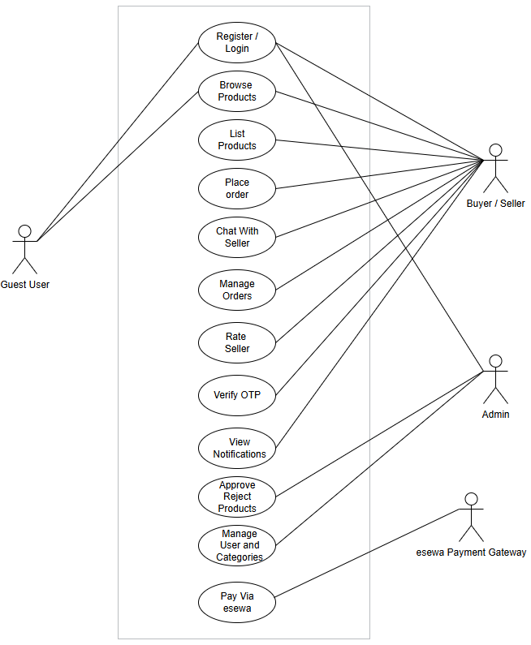
FIGURE 3.1 — USE CASE DIAGRAM

Slide 6
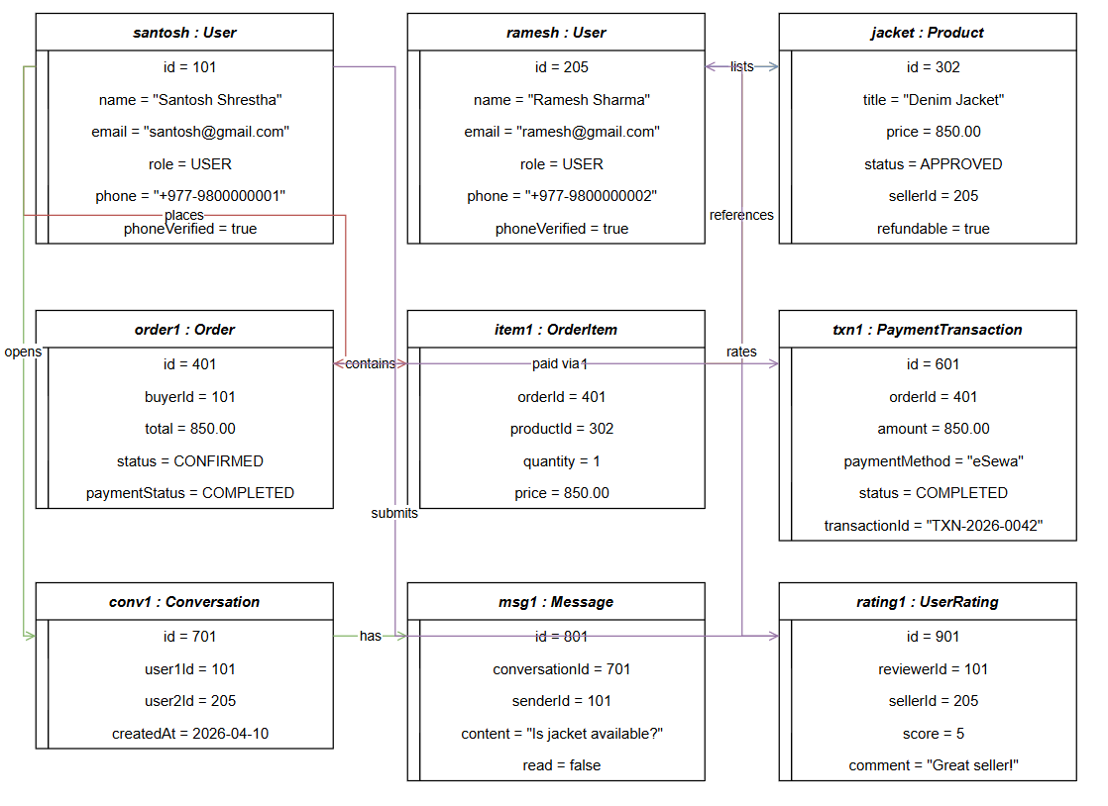
FIGURE 3.2 — OBJECT AND CLASS DIAGRAM

Slide 7
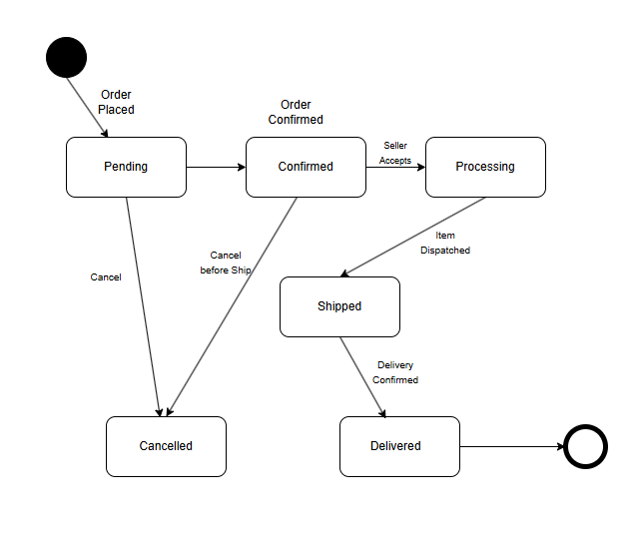
FIGURE 3.3 — STATE DIAGRAM: ORDER LIFECYCLE
Order States
Pending
Confirmed
Processing
Shipped
Delivered
Cancelled

Slide 8
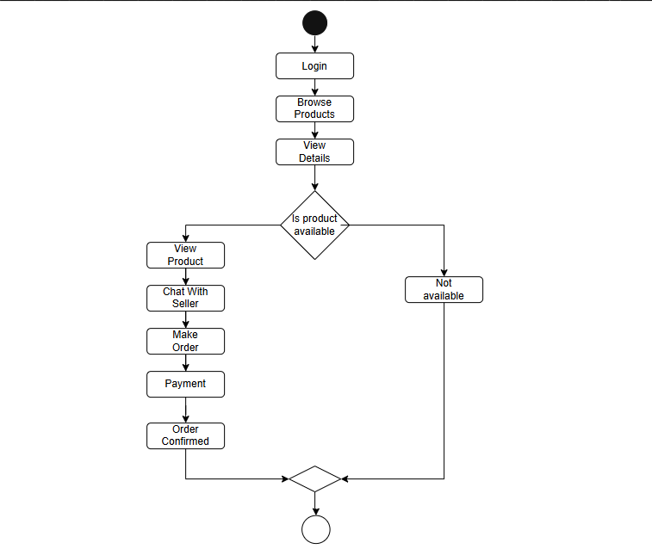
FIGURE 3.4— Activity Diagram of User

Slide 9
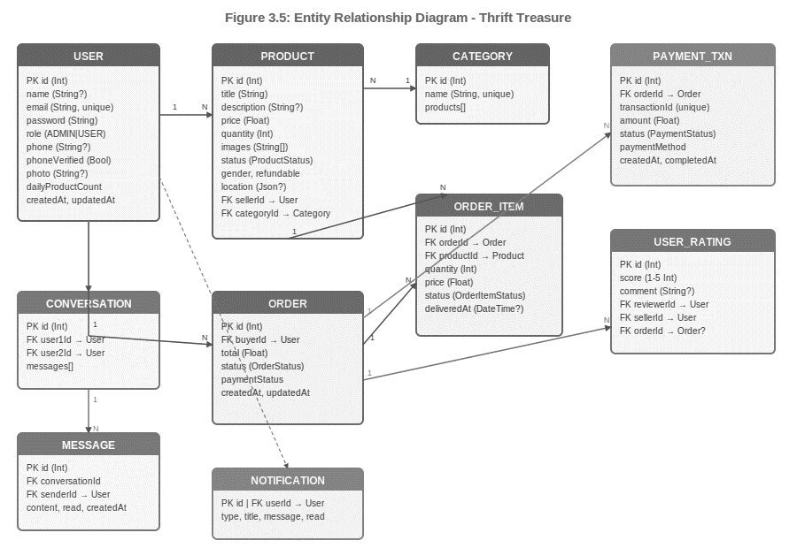
FIGURE 3.4 — DATABASE SCHEMA DESIGN

Slide 10
TABLE 3.1 — TECHNOLOGY STACK
Component | Technology | Version | Purpose
Runtime | Node.js | LTS | JavaScript server execution
Backend | Express.js | 5.2.1 | REST API + static file serving
Language | TypeScript | 5.9.3 | Type-safe backend development
Database | PostgreSQL | 15+ | Relational data persistence
ORM | Prisma | 6.4.1 | Type-safe DB access + migrations
Auth | JWT + Bcrypt | 9.0.3 / 6.0.0 | Token auth + password hashing
File Upload | Multer | 2.1.1 | Product & profile image handling
Real-Time | Socket.io | 4.8.3 | WebSocket chat & notifications
Payment | eSewa RC-Epay | Sandbox | Nepali digital payment gateway
Phone OTP | Firebase Admin SDK | Latest | Custom OTP token generation
Frontend CSS | Tailwind CSS | 3.x | Utility-first responsive styling

Slide 11
CONCLUSION & FUTURE WORK
Conclusion
Future Recommendations
All objectives met — auth, payments, real-time chat, ratings, admin panel
Mobile app — React Native (iOS & Android)
Production-ready e-commerce solution for Nepal
Live eSewa + Khalti + ConnectIPS integration
AI-based product recommendation engine
Real-time messaging + notification system
Real-time GPS delivery tracking via WebSockets
Production-capable solution for Nepal's thrift economy

Slide 12
Thank You
Santosh Shrestha
BCA 6th Semester | Roll No: 6-2-1014-26-2022
Department of Computer Application, NIST College
Tribhuvan University
Supervised by: Samish Shrestha

