Slide 1
Mobile App Statistics
Analyzing Apple App statistics collected from July 2017.
Source: https://www.kaggle.com/ramamet4/app-store-apple-data-set-10k-apps
Collection Date July 2017
Technologies Used: Pandas, Matplotlib, Seaborn
Notes:
7000+ Apple iOS mobile application details
Main details include user ratings, rating counts, currency, price, supporting devices, genre
appleStore.csv
"id" : App ID
"track_name": App Name
"size_bytes": Size (in Bytes)
"currency": Currency Type
"price": Price amount
"ratingcounttot": User Rating counts (for all version)
"ratingcountver": User Rating counts (for current version)
"user_rating" : Average User Rating value (for all version)
"userratingver": Average User Rating value (for current version)
"ver" : Latest version code
"cont_rating": Content Rating
"prime_genre": Primary Genre
"sup_devices.num": Number of supporting devices
"ipadSc_urls.num": Number of screenshots showed for display
"lang.num": Number of supported languages
"vpp_lic": Vpp Device Based Licensing Enabled

Slide 2
Thoughts going in..
Plenty of info in the dataset
No preconceived thoughts or expectations regarding Mobile Apps
Notes:
I did not have many preconceived notions when it came to mobile apps.
I had to look up what cont_rating was.
I was not surprised to see that there are more mobile game apps than any other category
I was surprised to see a price for one shopping app. When you think of a shopping app you think of amazon or ebay.
I don’t remember ever seeing any app at 300 dollars. I suppose it was not that surprising that it’s an education app.

Slide 3
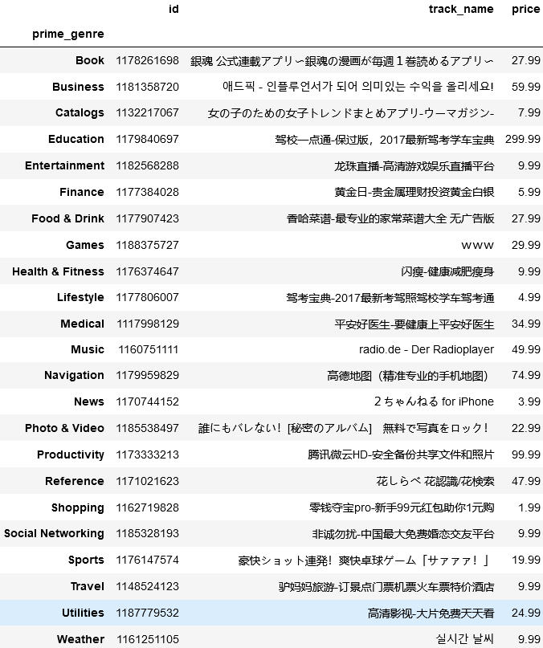
Cleaning
No null or Nan characters found
Non English text has been the only real aversion
For each Genre, what is the highest priced app? →
Notes:
Checking my Data
Have not found any null characters or NAN
The non English text has been my only real aversion
There are over 7000 records and I knew I wanted to try and tackle translating these.

Slide 4
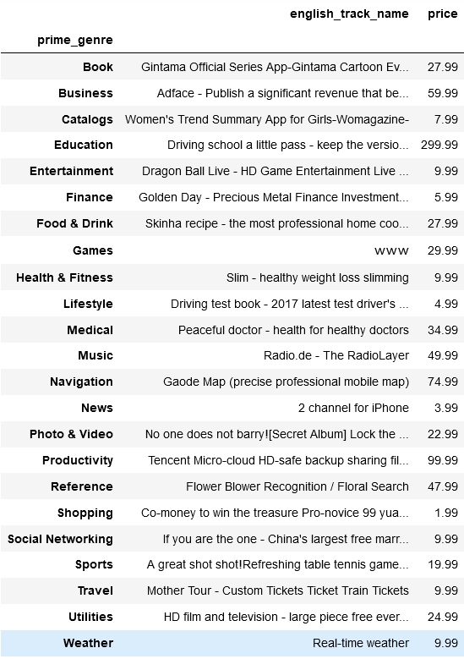
Before and after

Slide 5
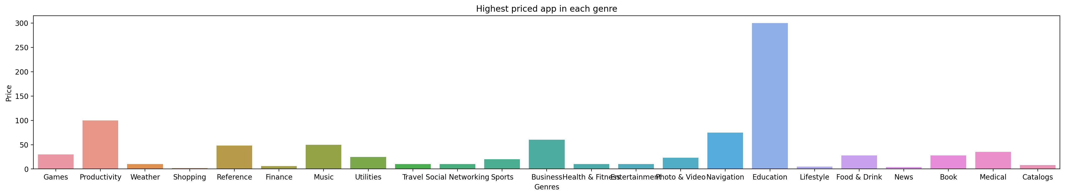
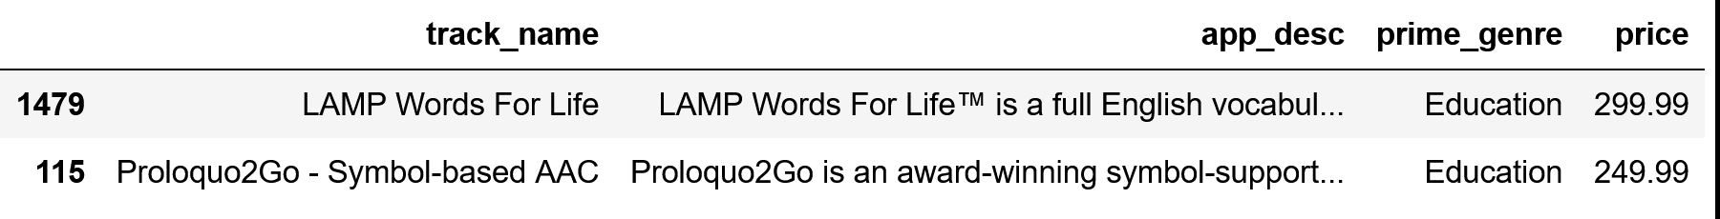
Findings
Notes:
I was a little surprised to see that an education app could be so high.
Another data set that was included by this author had the description for each of the apps. So I was able to join the two data sets and recreate a dataframe with the columns I wanted.
Incase if you’re curious like I was. Lamp Words for Life is a speech therapy app.
Proloquo2Go is a symbol-supported communication app. To help others communicate who may not be able to use their voice as well.

Slide 6
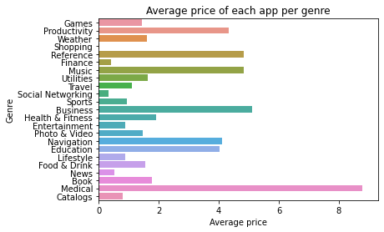
Findings Continued
Notes:
But also the average price for medical apps was much higher than education.
Move to Jupyter Notebook and show some other charts.

Slide 7
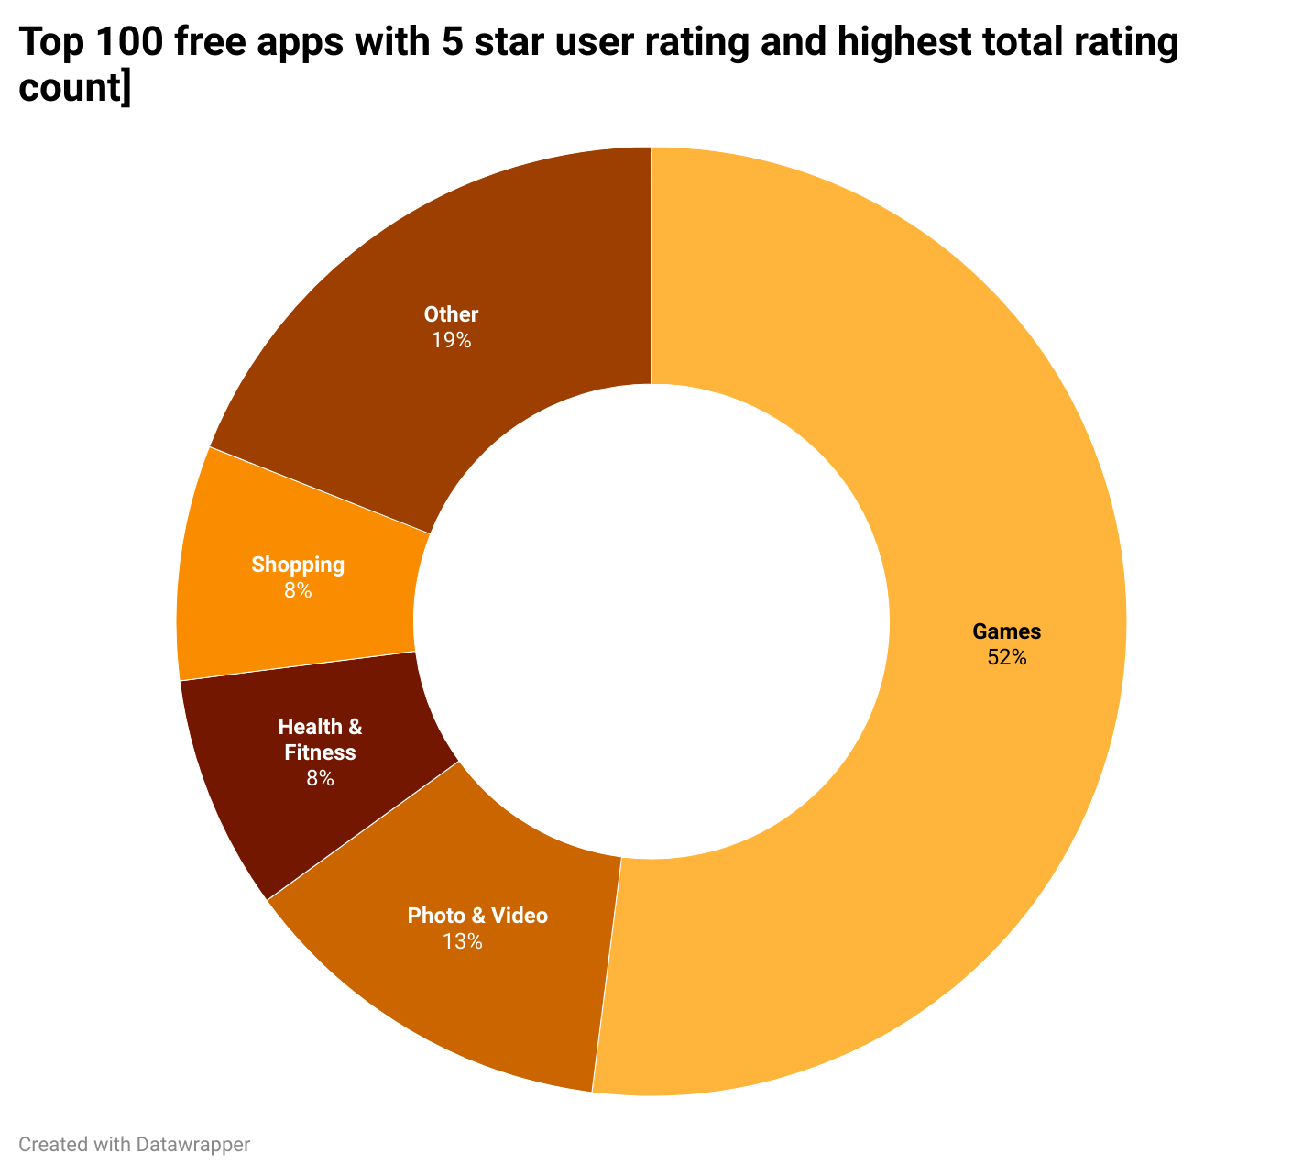
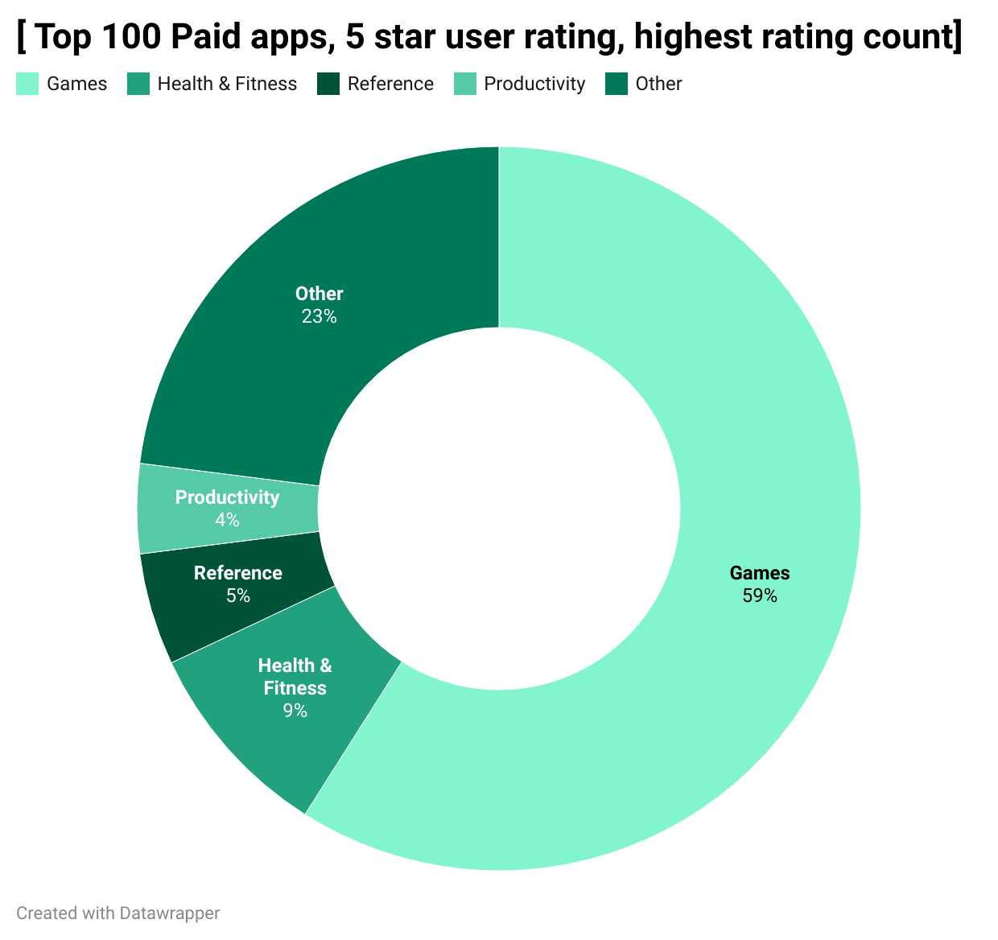
Outside Visualization Tools - DataWrapper
Notes:
I did a little conditional filter on Top free apps and Top paid apps.
I was able to create a pie chart at one time using seaborn but instead I went to an outside source and implemented my code via csv to help me with this.
These represent the 5 star user_rating, with the highest rating counts, of the top 100 free or paid apps.
Not familiar with outside data visualization tools but I wanted to give it a try. I have some data that a pie chart would be great for.
So I went to datawrapper and inputted some .csv files

Slide 8
Challenges
Hard to find datasets on my original ideas or they were behind a paywall
Many free data sets only had a few Columns
My attempt to update a whole column caused timeouts.
Trying to learn different ways to export images without using save as

Slide 9
Room for improvement
Google Translate – Looking forward to utilizing this and seeing the outcome on large datasets
Compare this 2017 data to 2020 for any surprising outcomes

Slide 10
Further research…
evaluate if the number of language supported has any effect on user rating or rating content total.
Compare this 2017 Data to 2020.
Compare this data to Similar data with Google Apps

Slide 11
Summary
There are a total of 7197 apps on this data set collected in July 2017
Education had two of the highest priced apps
However medical apps on average cost more
There are 3862 Game apps

Slide 12

This Photo by Unknown Author is licensed under CC BY-ND

