Slide 1
Mobile App Statistics
Analyzing Apple App statistics collected from July 2017.
Source: https://www.kaggle.com/ramamet4/app-store-apple-data-set-10k-apps
Collection Date July 2017
Technologies Used: Pandas, Matplotlib, Seaborn
Notes:
7000+ Apple iOS mobile application details
Main details include user ratings, rating counts, currency, price, supporting devices, genre
appleStore.csv
"id" : App ID
"track_name": App Name
"size_bytes": Size (in Bytes)
"currency": Currency Type
"price": Price amount
"ratingcounttot": User Rating counts (for all version)
"ratingcountver": User Rating counts (for current version)
"user_rating" : Average User Rating value (for all version)
"userratingver": Average User Rating value (for current version)
"ver" : Latest version code
"cont_rating": Content Rating
"prime_genre": Primary Genre
"sup_devices.num": Number of supporting devices
"ipadSc_urls.num": Number of screenshots showed for display
"lang.num": Number of supported languages
"vpp_lic": Vpp Device Based Licensing Enabled

Slide 2
I did not have many preconceived notions when it came to mobile apps.
I had to look up what cont_rating was.
I was not surprised to see that there are more mobile game apps than any other category
I was surprised to see a price for one shopping app. When you think of a shopping app you think of amazon or ebay.
I don’t remember ever seeing any app at 300 dollars. I suppose it was not that surprising that it’s an education app.

Slide 3
Quick Glance

Slide 4
Checking my Data
Have not found any null characters or NAN
The non English text has been my only real aversion

Slide 5
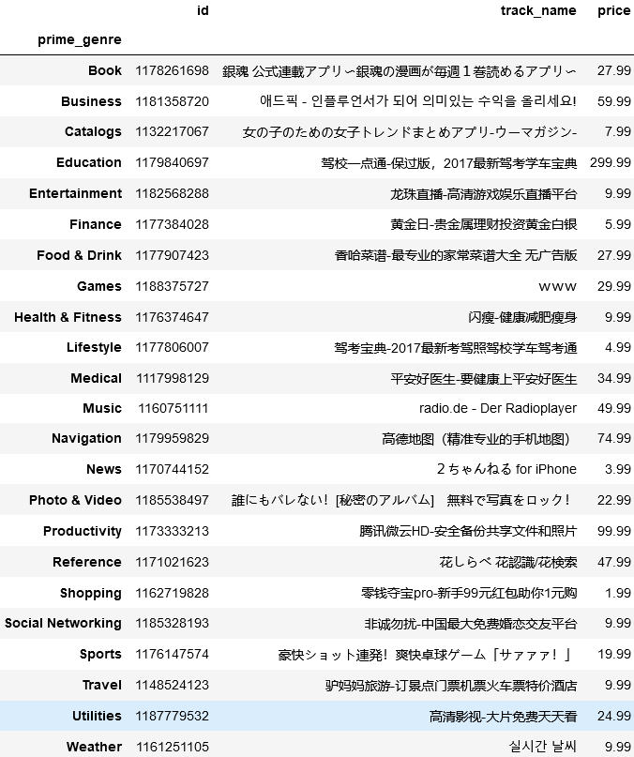
Cleaning
For each genre these are the highest priced apps.
There are over 7000 records and I knew I wanted to try and tackle translating these.

Slide 6
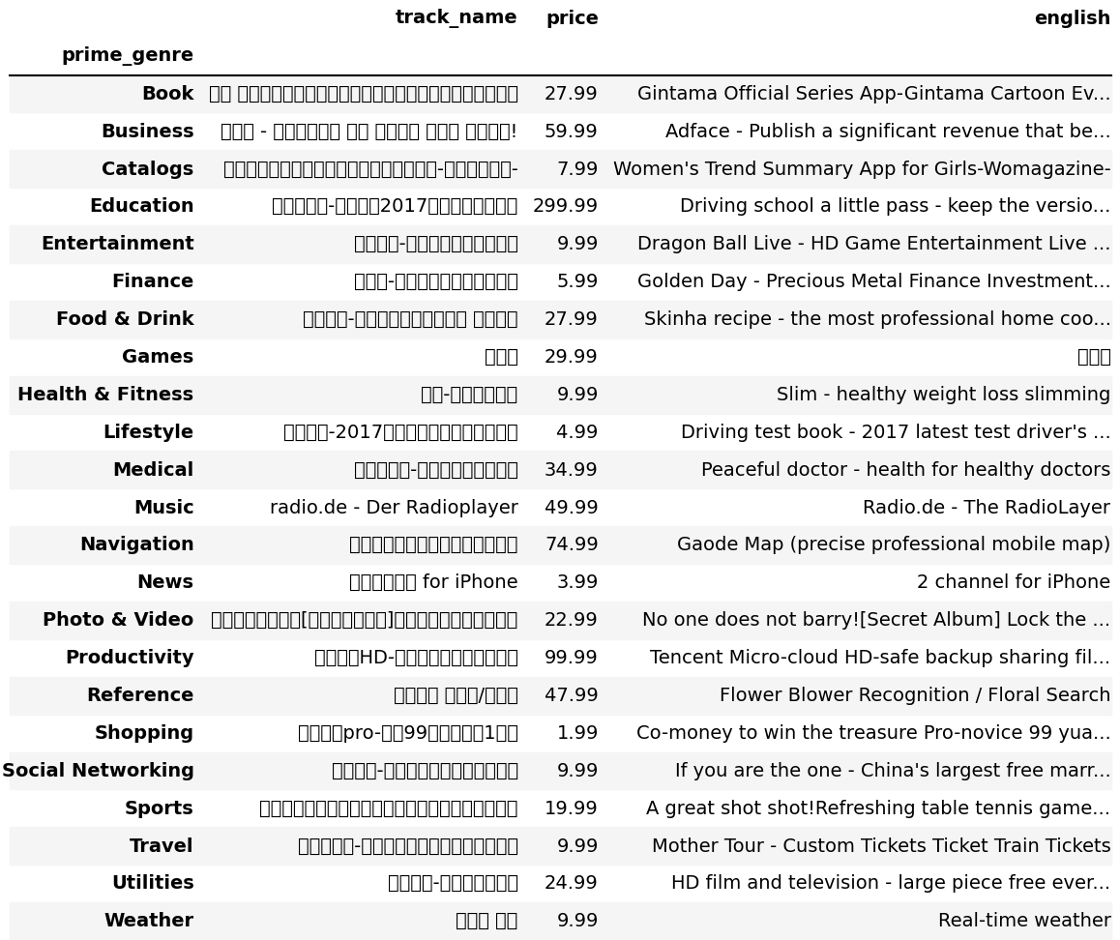
Comparison

Slide 7
Analyze
I used Matplotlib and Seaborn to analyze and graph some of what I found.

Slide 8
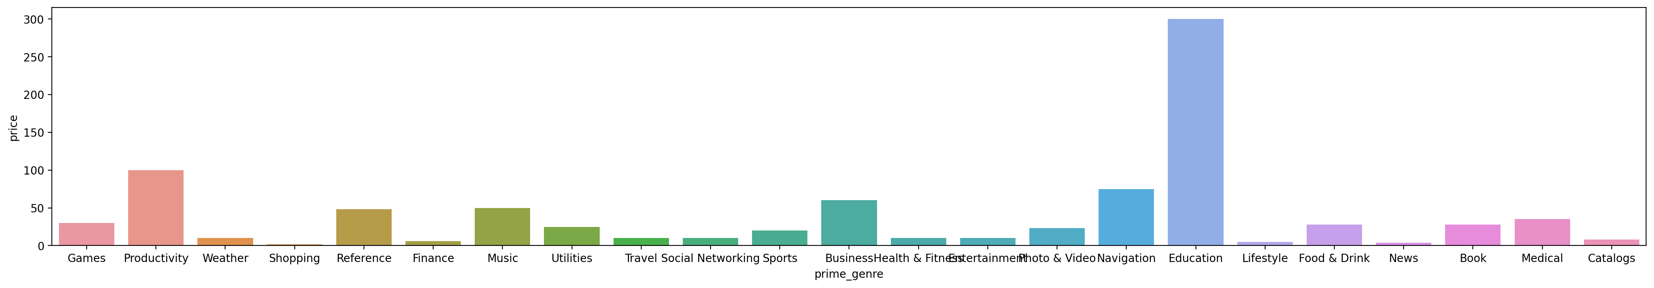
Findings
Notes:
What surprised me when I did a search to see what was the highest priced app in each category

Slide 9
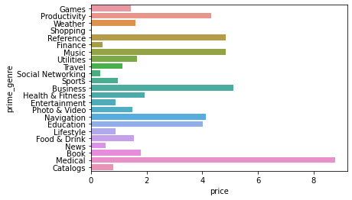
Average price for apps
Notes:
But also the average price for medical apps was much higher than education

Slide 10
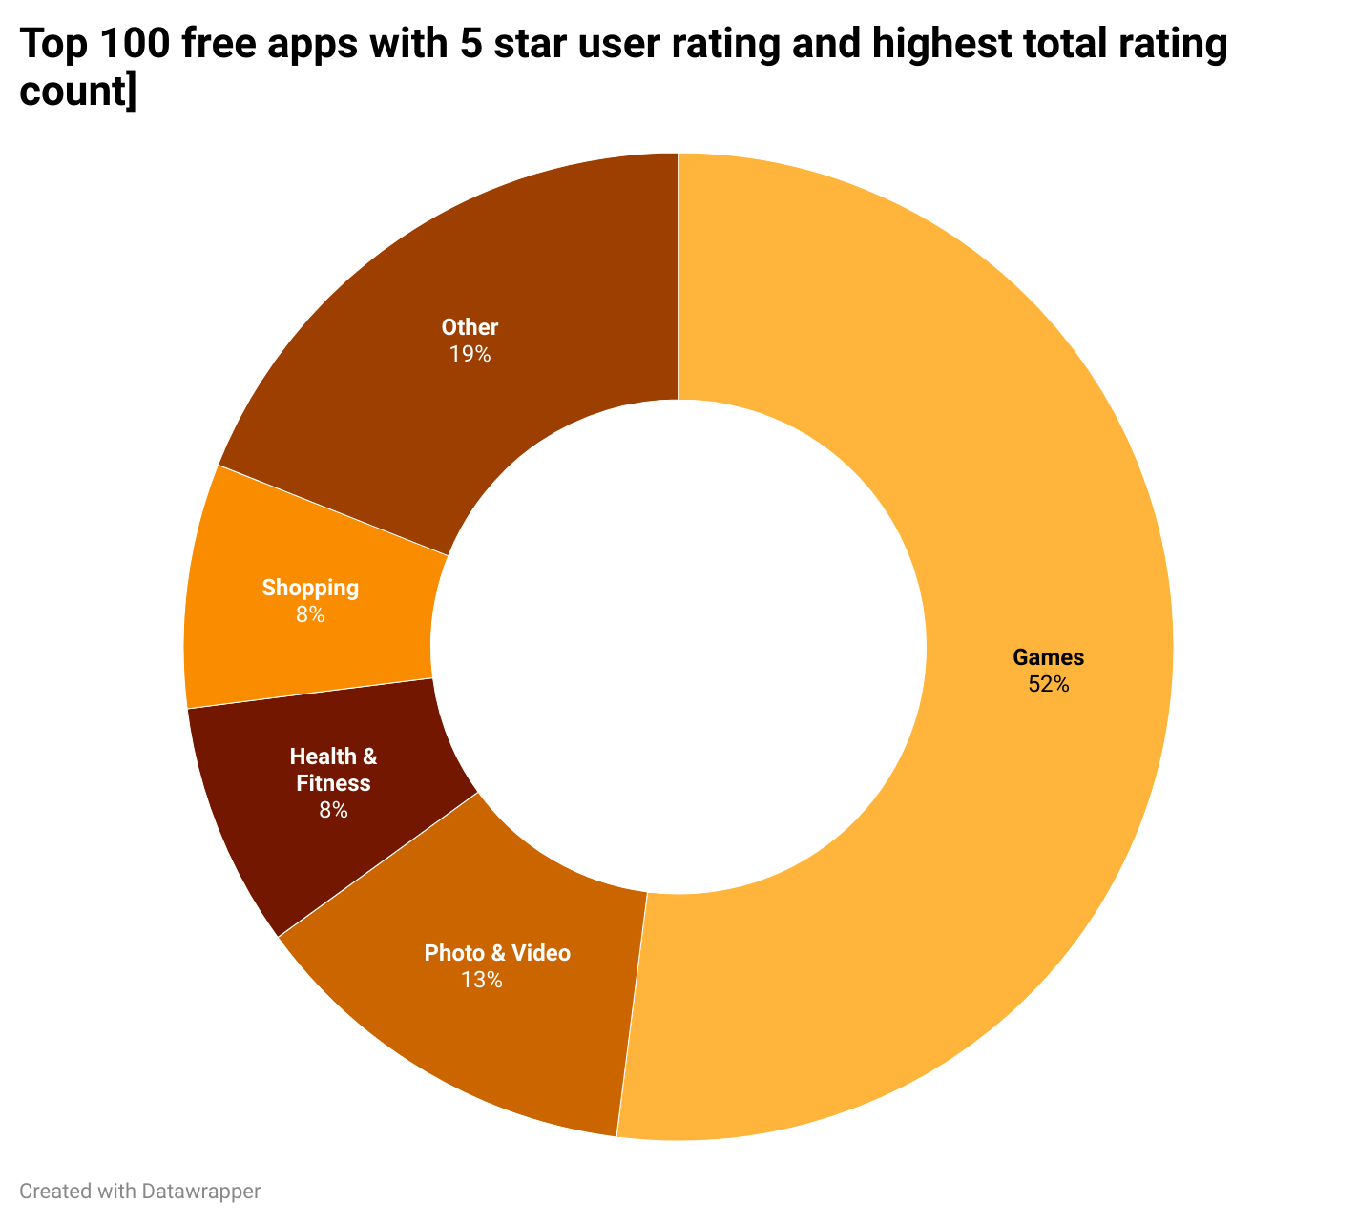
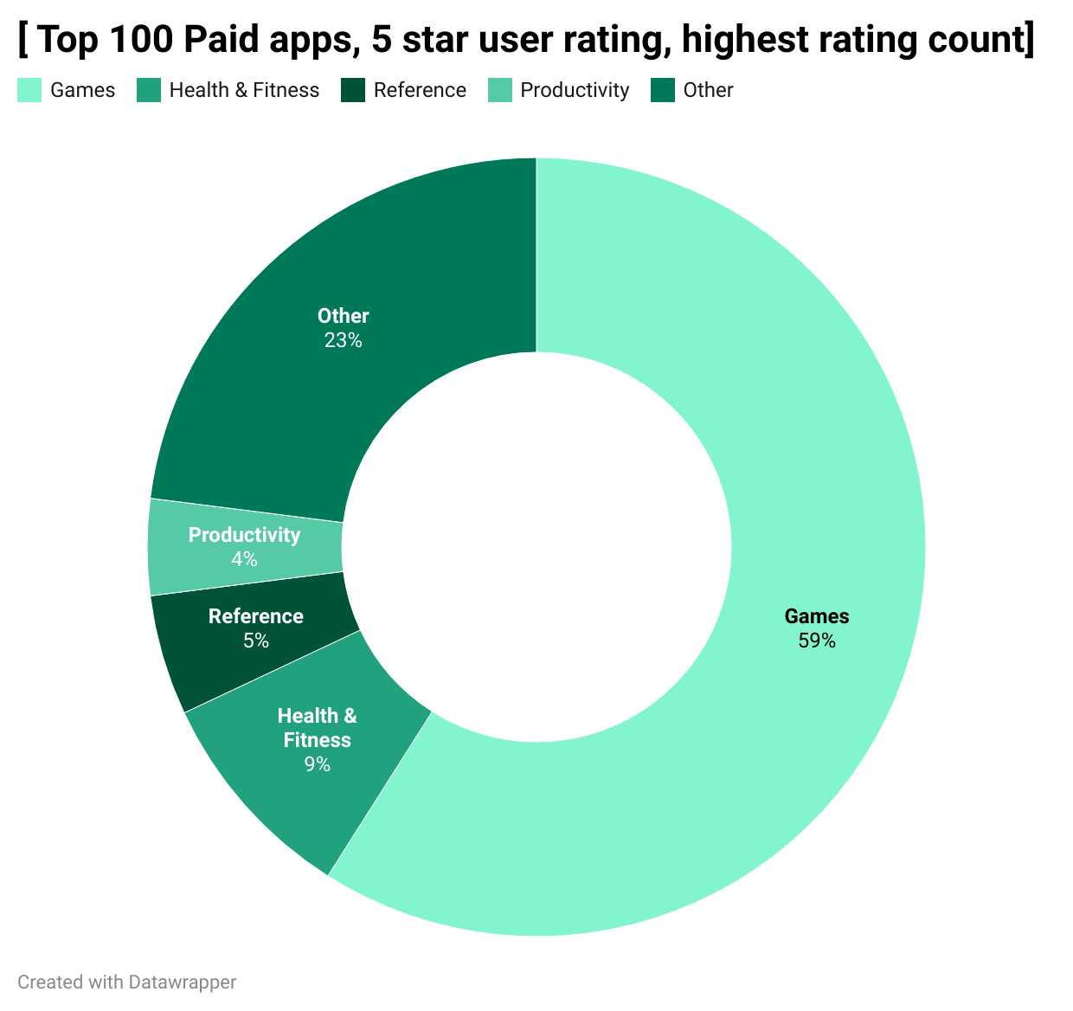
Outside Visualization Tools - DataWrapper
Notes:
Not familiar with outside data visualization tools but I wanted to give it a try. I have some data that a pie chart would be great for.
So I went to datawrapper and inputted some .csv files

Slide 11
Utilizing dataWrapper

Slide 12
Finding a DataSet that I could utilize
I adjusted my final project based on a dataset that I could find that correlated with technology in some way.

Slide 13
Challenges
Hard to find datasets on my original ideas
Many data sets only had a few columns others were behind a paywall
Trying to update a whole column caused timeouts.
Trying to learn different ways to export images without using save as

Slide 14
Room for improvement
Google translate – Looking forward to utilizing this and seeing the outcome on large datasets
Compare this 2017 data to 2020 for any surprising outcomes

Slide 15
Further research…
evaluate if the number of language supported has any effect on user rating or rating content total.

Slide 16
I had fun with this
I had room to ask myself silly questions
I learned a little of what works and doesn’t work

Slide 17
Summary
There are a total of 7197 apps on this data set collected in July 2017

