Slide 1



EMPRESTA.ME
Final Bachelor’s Project
CheckPoint
2022/2023

Slide 2
Checkpoint: sprint 3
What we have already done:
What we are currently doing:
What still need to start:
Mobile App Prototype
Backend Structure
API endpoints definition
Model Diagram
Backend
Mobile App
Desktop App
Node Graph Visualization
Technical Report
Documentation Website
Reputation System
Communication between Frontend and Backend

Slide 3
1
What we have done
Notes:
https://www.dn.pt/dinheiro/portugal-e-o-sexto-pais-europeu-onde-o-consumo-mais-cresce-11309082.html

Slide 4
Mobile App Prototype

Slide 5
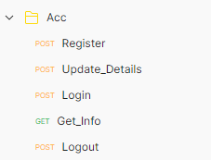
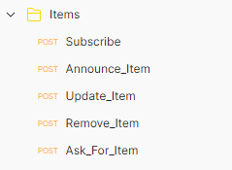

Defining API EndPoints

Slide 6
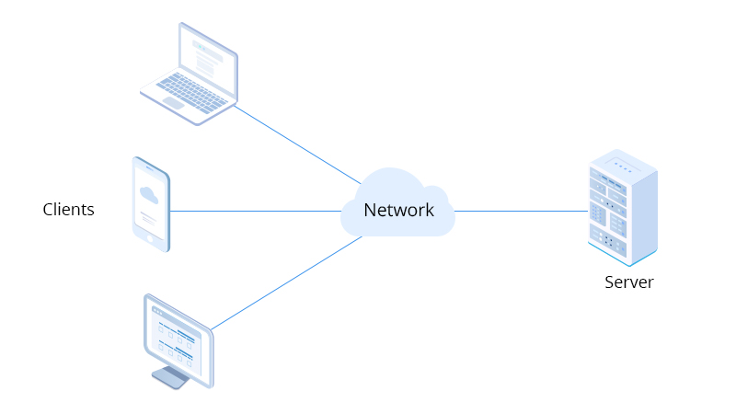
Backend
Protocol for Client-Server communication
Association
Authorization (without IDP)
Authentication
Auxiliary methods

Slide 7
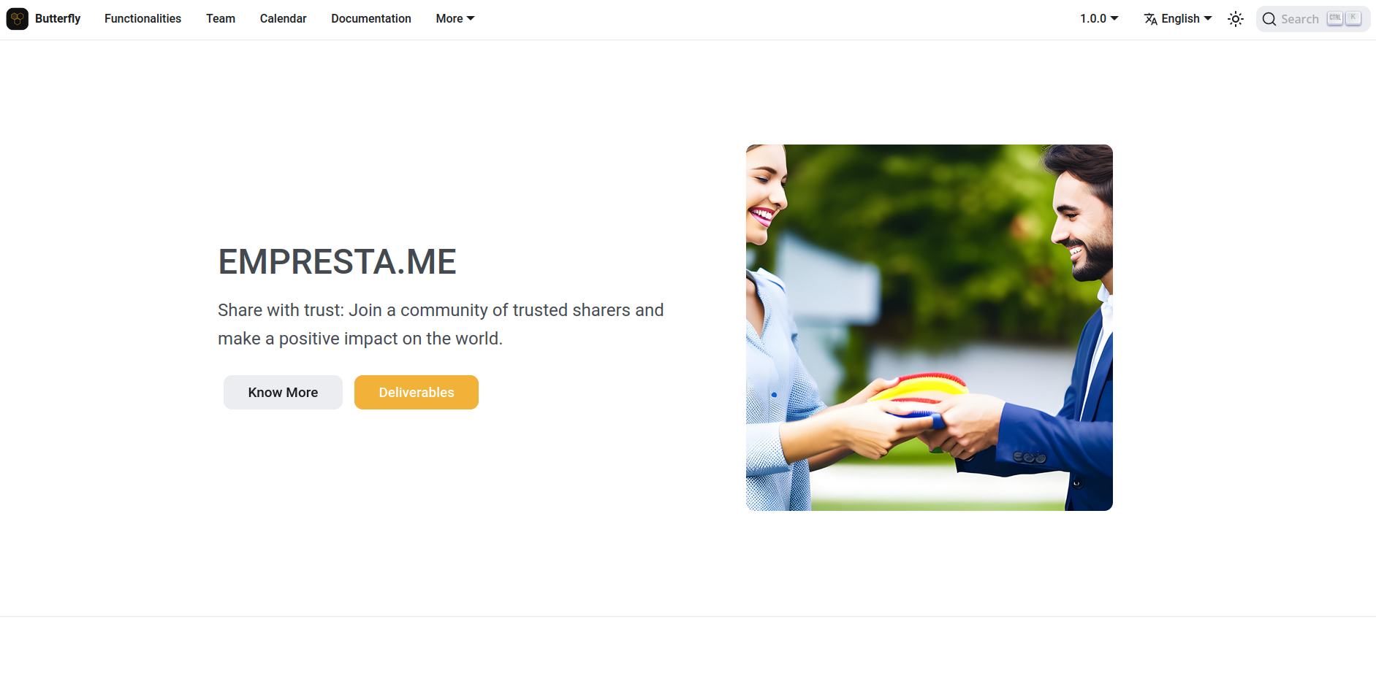
Project Website Refactoring

Slide 8
2
What we are doing
Notes:
https://www.dn.pt/dinheiro/portugal-e-o-sexto-pais-europeu-onde-o-consumo-mais-cresce-11309082.html

Slide 9
Frontend
Finish Desktop App Mockup
Mobile App Prototype
Desktop App Prototype
Integrating Network Visualization

Slide 10
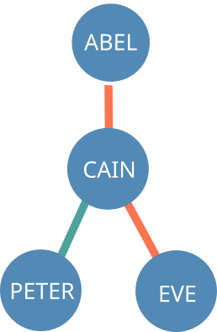
Backend
Message broker (Pub/Sub)
Message routing
Login and registration process
Vouching (algorithm + protocol)

Slide 11
Network Visualization Tool

Slide 12
3
What we still
have to do
Notes:
https://www.dn.pt/dinheiro/portugal-e-o-sexto-pais-europeu-onde-o-consumo-mais-cresce-11309082.html

Slide 13

Backend
Continue developing the Client-Server communication
Caching
Fault tolerance
General protocol hardening
Security concerns we want to bring to our mentor
Challenge-Response authentication
E2E Encryption

Slide 14
Frontend
Continue the development of the Mobile App
Integration
QR-code reader and generator
Continue the development of the Network Visualization Tool
Integration in Front End
Desktop App Prototype

Slide 15
amogus
Thank you!

Slide 16
Links
Git Repository: https://github.com/Empresta-me/EMPRESTA.ME
JIRA Dashboard: https://empresta-me.atlassian.net/jira/software/projects/EM/boards/1
Project Website:https://empresta-me.netlify.app/
Project Calendar: https://docs.google.com/document/d/1ojUC0AnJ4vfHKHjLPlKtDW71YiPjcCQm_ghkLE9YLKU/edit?usp=sharing

