Slide 1
Text Analysis with R:
From raw data to AI assistant insights
  Hyeseon Seo | UVA Library

Slide 2
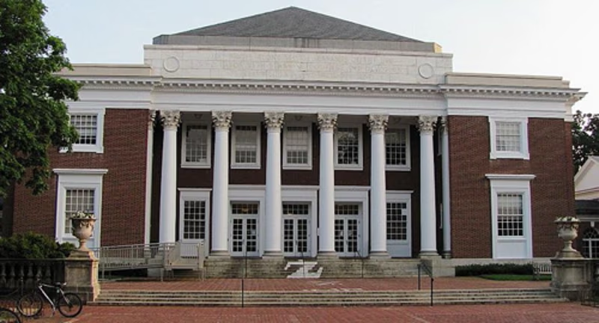
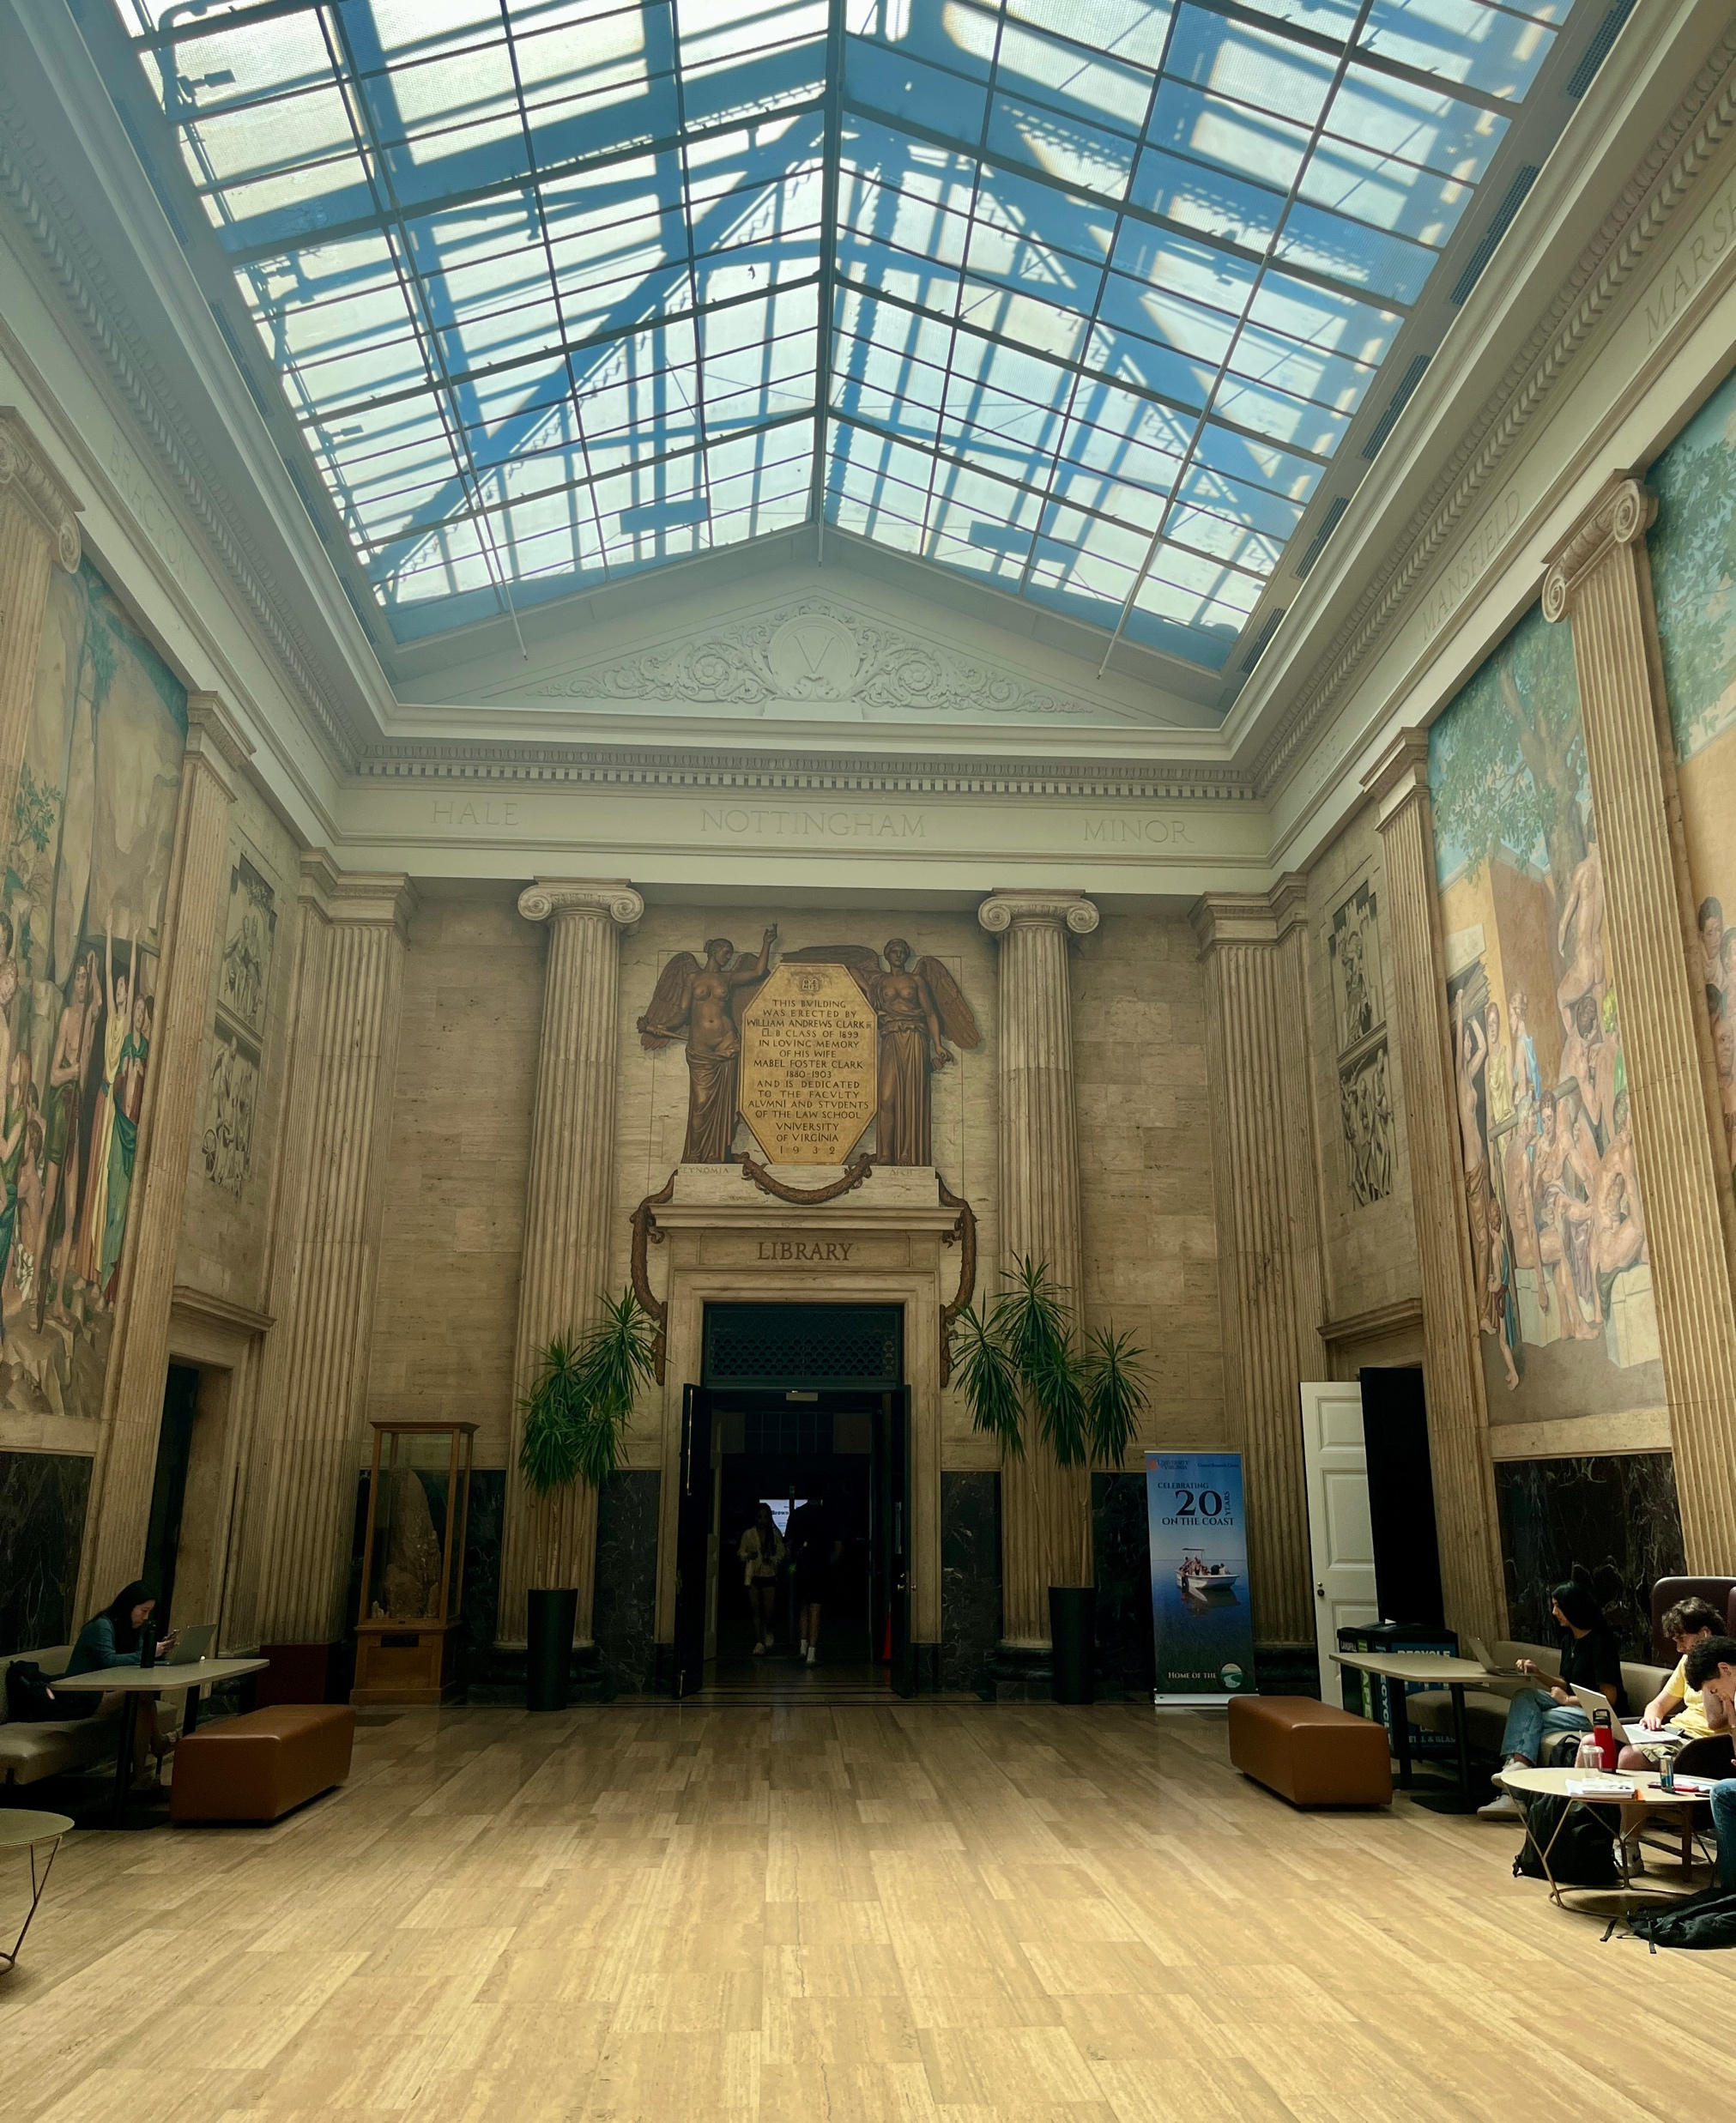
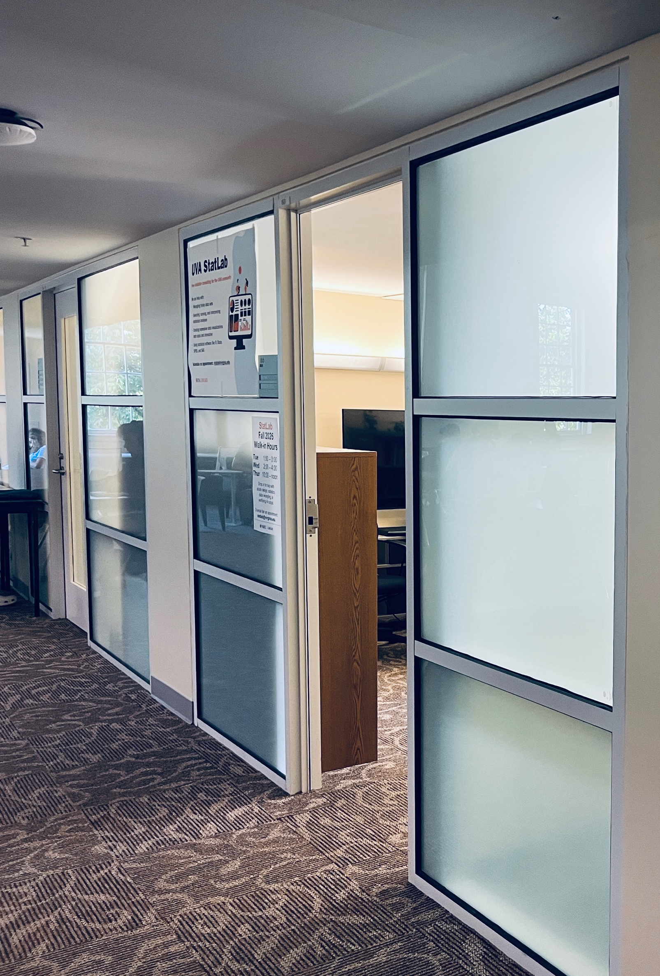
StatLab
Room 152 &153
Our Location Brown Library
Walk Through The Mural Area
Notes:
Thank you for coming to today’s text analysis workshop!
My name is Hyeseon, and I work with StatLab at the UVA Library. StatLab is a statistical support team within the Research Data Services division of the UVA Library. We provide free statistical consulting and workshops, so please feel free to contact us if you need any help.
Our team has four people, including me and Clay, who will be helping me with today’s workshop, as well as two PhD student associates.
Our offices are located in Brown Library. If you enter through the main entrance and walk through this beautiful mural area, turn right and you’ll find us in Rooms 152 and 153.

Slide 3
Why Text Analysis?
1. Too much text to read: What are people talking about overall?
Government documents
Social media
Digital archives
Books, News, letters, speeches, transcripts...
2. Objectivity : Reduce subjective impressions
Text analysis provides evidence based on the entire corpus
3. Discover hidden patterns:
Recurring themes
Associations between words
Differences between groups
Sentiment trends

Slide 4
About this workshop
A transcription : 2025 City of Charlottesville council meeting on ordinance on encamping and storge in property of the city.​
You will learn to:
  Collect and clean transcript data
  Five text analysis methods
  Create basic visualizations
We also look at how AI can support this work — and its limitations and ethics.

Slide 5
Three parts
Collect & Clean
  Scrape the raw transcript from the web page into a tidy table.
  Tokenize, remove stopwords, subset to the ordinance, attach speaker names.
Analyze & Visualize
  Explore the text and test pilot hypotheses across four groups.
  Faceted Horizontal bar graphs.
AI support
  Where and how—and its limitations and ethics

Slide 6
PART A
Collecting and cleaning the data

Slide 7
File 01 — Data collection
Can we scrape this?
  Check robots.txt, prefer an API, be a polite guest (identify yourself, throttle).
Look before you code
  Is the text in the page? Find the repeating pattern: transcript ⊃ turns ⊃ caption lines.
HTML → tidy table
  Use meaningful CSS selectors (li.speaker-chunk) to pull the 457 turns into rows.
Check & save
  Sanity-check the parse, save the raw HTML and a clean CSV.

Slide 8
File 01 — subset & clean
Slice by time — keep only the three discussion periods on the ordinance.
Rebuild turns — combine caption lines back into complete speaking turns.
Attach identities — join a hand-coded speaker roster for names and stakeholder groups.
Drop off-topic speakers (manually verified).
Output: ordinance.csv — a clean, labeled dataset ready to analyze.

Slide 9
PART A (cont.)
Analyzing the transcript

Slide 10
File 02 — the question
How do four stakeholder groups talk about the ordinance differently?
  Police Chief — explains the proposed ordinance
  City Council — deliberates and votes
  Business representatives — public speakers for business
  Public — other members of the public

Slide 11
Five methods
Each answers a different question about how they talked
Relative word frequency — word rates per 1,000 words (fair across groups).
N-grams — recurring 2–3word phrases (“affordable housing”).
Keyness — words distinctive to one group vs. the rest.
KWIC — keyword in context: read behind the numbers.
Sentiment — dictionary-based tone by group and over time.

Slide 12
Basic visualizations
Bar chart of top words by group (relative frequency).
Keyness plot for one group's distinctive words.
Sentiment by stakeholder, and across the three comment phases.
Goal: make the numbers readable.

Slide 13
PART B
Using AI in text analysis

Slide 14
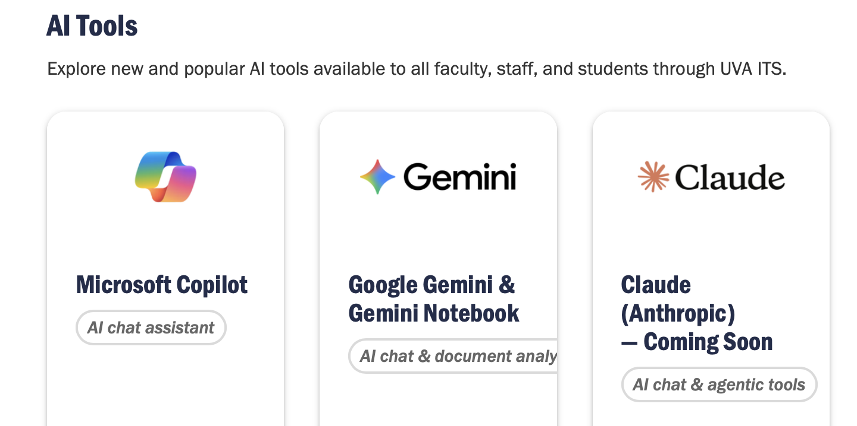
Five places AI fit in
Not to replace your thinking — to speed up the parts around it
Brainstorm the topic and source
Finding references
Explore your data and scope the analysis
Code support:
- Write, fix and understand the code
- Analysis, trouble shooting and visualization
Writing
AI tools that enable through UVA IT

Slide 15
Brainstorm, scope, references
Brainstorm topic & source
Relevant to the community, meaningful, free of content restrictions.
Explore the content
AI can summarize the contents (e.g., transcripts)
identify themes, suggest connections among ideas, concepts, events.
Scope the analysis
AI offered many options; we chose one theme — e.g., comparing four groups.
Search references
  AI also useful finding references, but verify each one (AI invents citations)
  Reliable AI search tools grounded in peer-reviewed papers: Consensus and LeapSpace (UVA subscribe)

Slide 16
Coding support: how to ask
This is AI as an assistant — not full agentic coding (Codex, etc.).
Give AI context — and the context is your data structure
  Screenshots are useful!
    Lighter memory — a small screenshot or output of str(data) conveys the shape without a huge paste.
    Safer — keeps the actual data out of the tool.
  Ask precisely – the more specific, explict prompt, the better the code
    .

Slide 17
Coding support: fixing & understanding
Troubleshooting
  Screenshot your code AND the output together. Feed both.
Understand the code
  When you are unsure about specific code, paste the whole script ( context matters! ) and ask what each line does.
  Sometimes ask for an example what a specific part does.
Visualization
  Which chart best fits your data

Slide 18
Writing
Polish the writing
  Tighten wording and clarify; keep your own argument and voice.
Manage citations
  Format citations in different styles (e.g., APA, Chicago,) and organized reference in the appropriate order.

Slide 19
Limitations & ethics
AI invents citations — verify everything.
Understand what your codes does.
Protect your data — share structure, not raw data.
Check the AI rules that apply to you — your institution’s and your field’s (UVA AI Guidelines)
AI assists; you decide and stay accountable.

Slide 20
Thank you — questions?

Slide 21
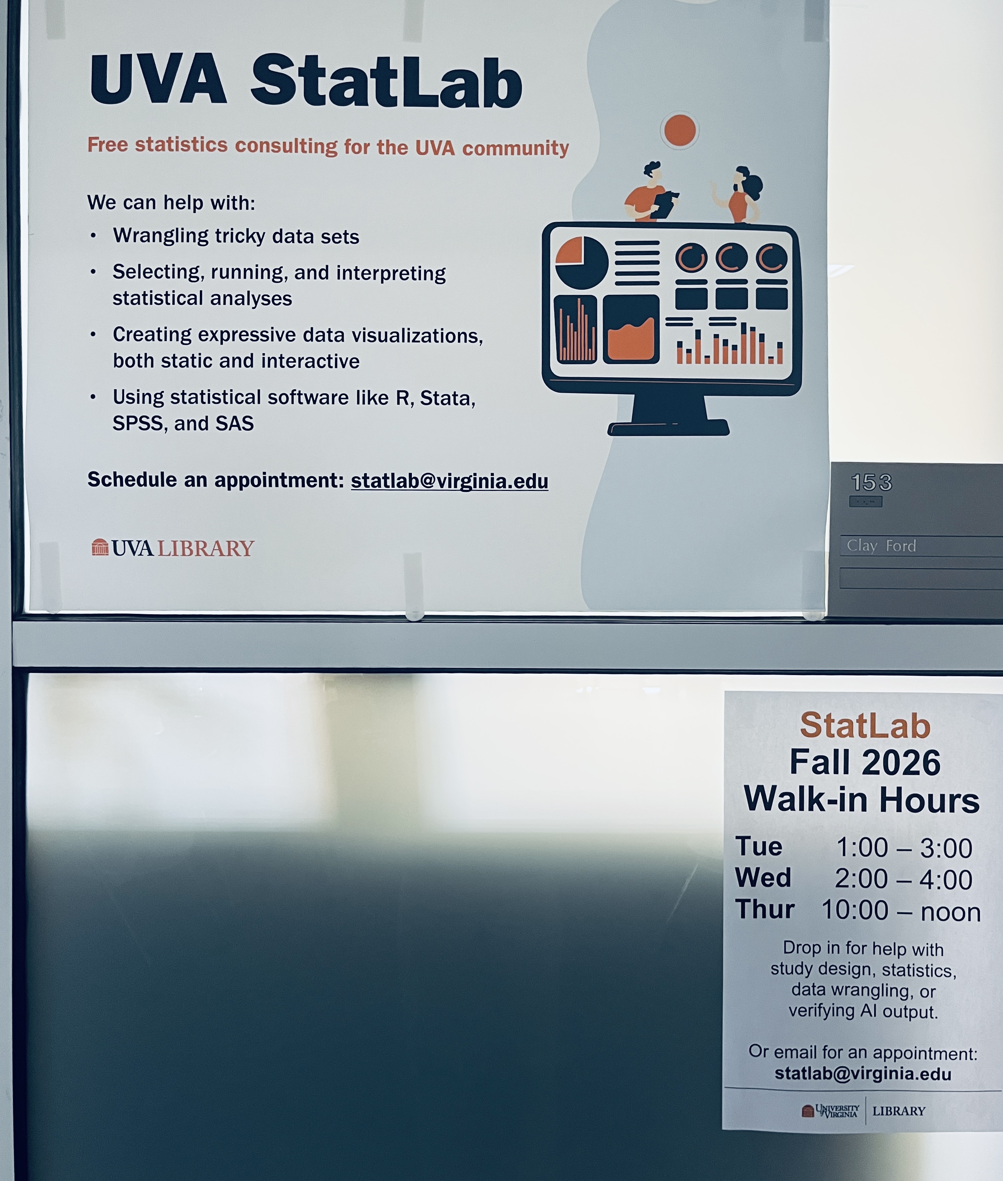
StatLab
Walk-in hours:
Tue 1–3
Wed 2–4
Thu 10–Noon
statlab@virginia.edu
https://library.virginia.edu/data/statlab
Notes:
We help researchers across every department pick the right analysis, run it correctly, and make sense of their results.
It's free, it's for students and faculty, and it's especially useful for independent research such as class projects, independent studies, and theses. You can come to us in person, over Zoom, or by email.
A lot of people don't know we exist — so consider this part public service announcement. Whatever your field, if you hit a statistics wall in your research, we're a resource you already have.

Slide 22
Appendix
AI Prompt Examples

Slide 23
1. Brainstorm topic & source
"I want to do a text-analysis workshop using something locally relevant and free of content restrictions. Suggest 3–4 public, scrapeable text sources relating to Charlottesville community. For each, note whether it's likely server-rendered HTML and whether a robots.txt would allow scraping."
2. Explore the content
"Here's the transcript of the Sept 2, 2025 Charlottesville City Council meeting Summarize the main topics, then identify the distinct discussion periods and who the key stakeholder groups are. Suggest 2–3 themes worth analyzing quantitatively."
3. Scope the analysis
"This meeting covers many topics over 6 hours. I want to narrow to one theme, give me possible themes.”

Slide 24
4. Search references (verify each one!)
"I'm comparing how stakeholder groups use language in a public-meeting transcript. Recommend peer-reviewed methods papers on relative word frequency, keyness (chi-squared), and sentiment lexicons for small corpora."
5. Give AI context = your data structure (use screenshots or str())
"Here's the shape of my data [paste output of str(data) or a screenshot of head(data).
Keep this structure in mind for the code I ask for next."
Then ask for the code : “The speaker column is a mix of real names ('Michael Kochis') and automatic labels ('SPEAKER_45'). Some rows have NA. Write a code: fill NA with the speaker label, replace any name with 'unidentified' (case-insensitive) with the speaker label, and otherwise keep the name."
6. Ask specifically
Vague: “Analyze this transcript.”
Precise: “Compare the four stakeholder groups in this City Council transcript. Identify differences in relative word frequency, key terms, and sentiment, and summarize the main patterns.”

Slide 25
7. Troubleshooting (feed code + output together)
"[Screenshot of my unnest_tokens code AND the error/output below it.] fix it.
8. Understand the code "Here's my full tokenizing script [paste the code block]. Walk me through what each line does, especially anti_join(stop_words), the filter(str_detect(word, "^[a-z]+$")), and why case_when() is used to collapse 'visitor'/'visitors’.”
Or focus part on one part you don’t understand more specifically
"Give me an example of what reorder_within() does to a two-group dataset — show the before and after."
9. Visualization (which chart fits)
"I have three per-group measures — number of speakers, turns per person, and median words per turn — for four stakeholder groups. What chart type best shows all three at once for comparison across groups?"
10. Polish the writing (keep your voice)
"Here's my interpretation paragraph for the relative-frequency chart [paste your draft]. Tighten the wording and fix flow, but keep my argument and voice” and fact check.

Slide 26
11. Manage citations
”Citate these three references to APA 7th edition, then give me the same list in Chicago author-date. Sort each list alphabetically by author surname."

