Slide 1

Exploratory Data Analysis
Hyeseon Seo

Slide 2
Session Overview
Research Approaches
What Exploratory Data Analysis(EDA) Is
EDA vs CDA(Confirmatory Data Analysis)
EDA Techniques (by data type & object)
Practice 1: Steps & BMI Data
Practice 2: Charlottesville Parking Ticket Data

Slide 3
How Do You Research?
Two ways to research
Confirmatory Research (Classical Scientific Method):
Hypothesis → Study Design → Collect Data → Analyze → Conclusion
Exploratory Research (Data-Driven Approach):
Vague Idea → Explore Data(EDA) → Generate Hypothesis →
Hypothesis test ( with a separate dataset!)

Slide 4
However, EDA involves both!

Slide 5
What is EDA?
What the data might be trying to say, rather than trying to prove something we already believe.
Understand the data before applying formal modeling or statistical inference.
Approach it with curiosity, openness, and very few assumptions.
Visualizations are a key aspect of EDA!

Slide 6
Aspect | EDA | CDA ​
Primary Goal | Explore, discover patterns, generate questions | Test a specific hypothesis or claim
Timing | Before formal modeling | After a hypothesis is defined
Starting Point | Open-minded curiosity | A clear, pre-stated research question
Methods | Visualizations, summaries, clustering, descriptive comparisons | Statistical tests: t-tests, ANOVA, regression, confidence intervals, p-values
Flexibility | Highly flexible; iterative and creative | Structured; follows a predefined plan
Interpretation | Suggestive (“this might be interesting…”) | Inferential (“this pattern is statistically supported”)
Typical Outputs | Graphs, descriptive statistics, notes, insights | Test statistics, effect sizes, p-values, model estimates
Mindset | “Let the data speak first.” | “Does the evidence support this specific idea?”
EDA vs. CDA
Adopted from Fife, D. A., & Rodgers, J. L. (2022).

Slide 7
EDA vs. CDA (Confirmatory Data Analysis)
“In EDA the goal is not to draw conclusions regarding guilt and innocence but rather to investigate …
The goal of EDA is indictment; the goal of CDA is conviction.
(Behrens, 1997).”

Slide 8
The Goal
1. Get familiar with the data
Distributions, ranges, shapes and key features.
2. Assess Data quality
Missing values, Outliers and anomalies, Data entry or measurement errors
3. Reveal underlying structure
Groups, clusters, trends, and relationships among variables.
4. Guide further analysis
Hypothesis generation and model selection.

Slide 9
EDA Techniques by Data Type and Objective

Slide 10
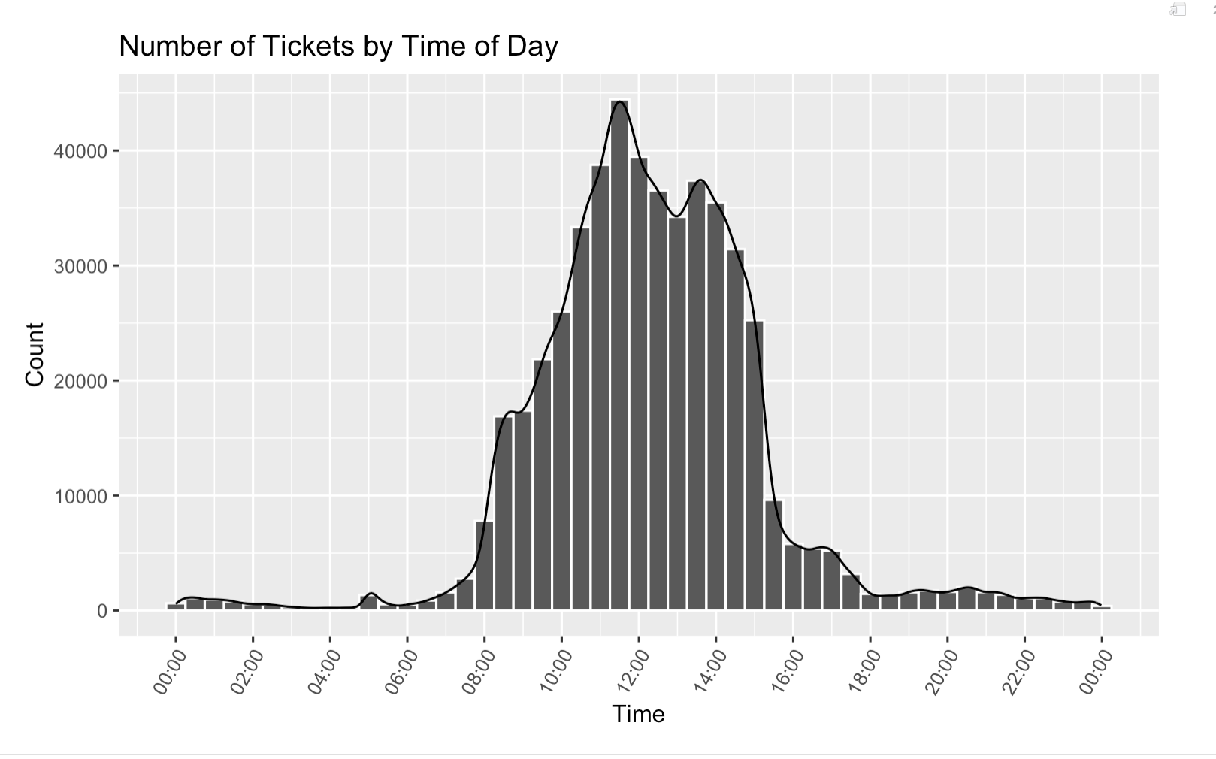
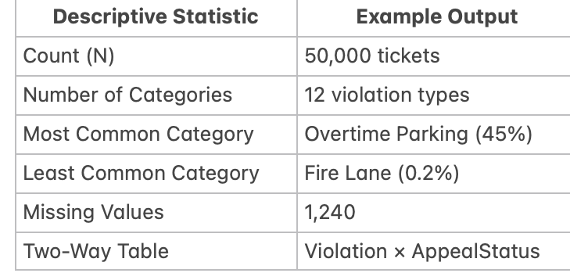
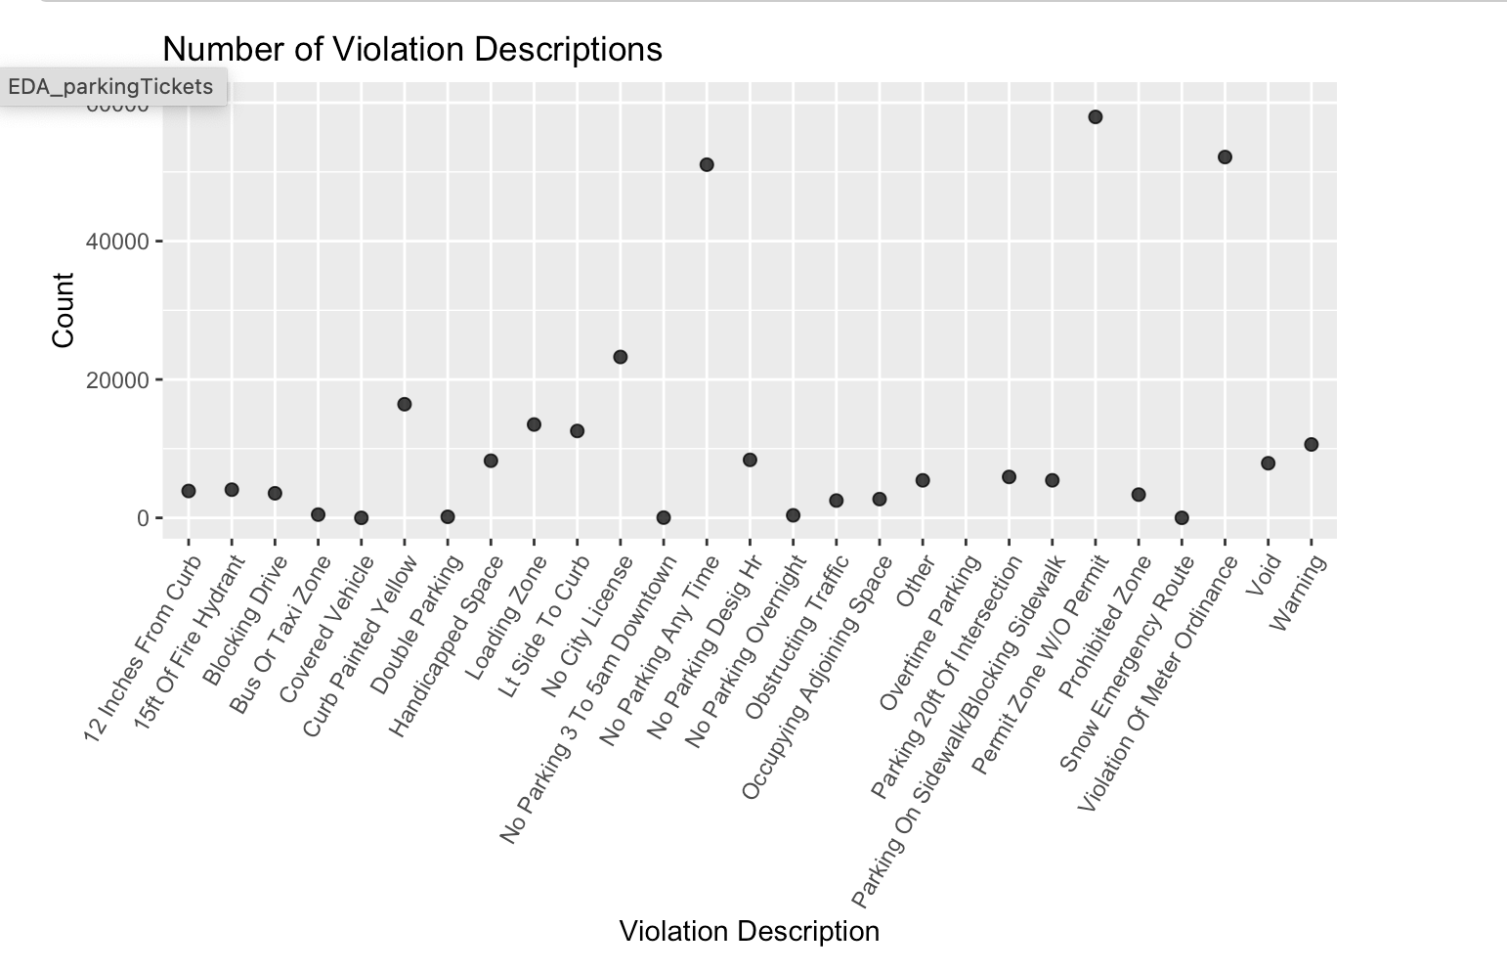
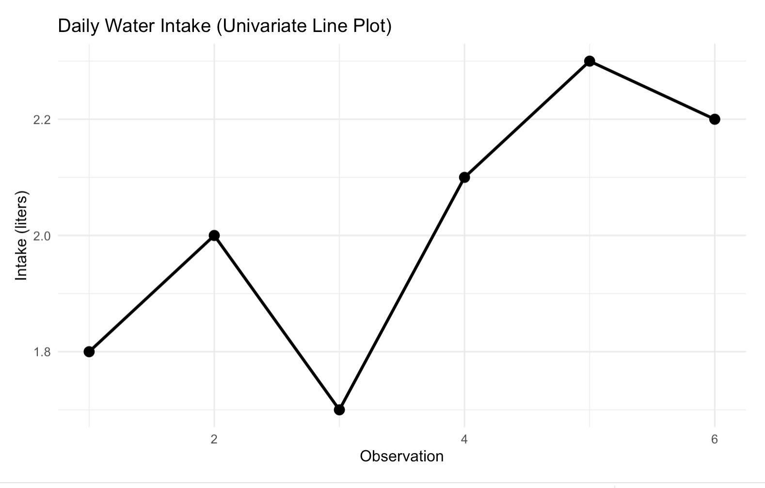
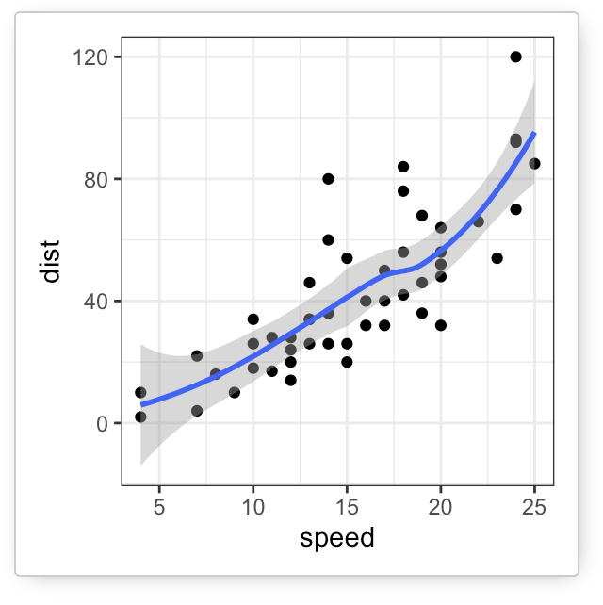
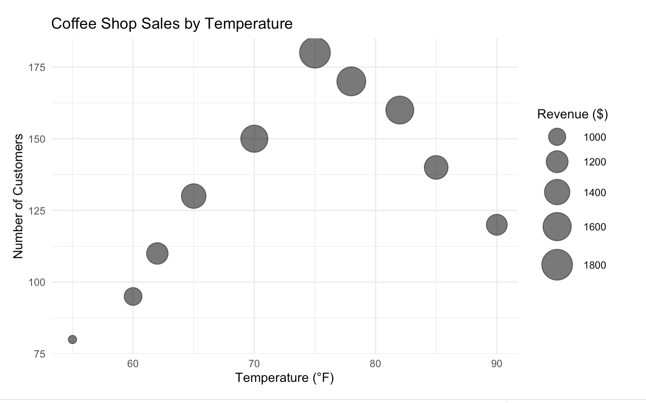
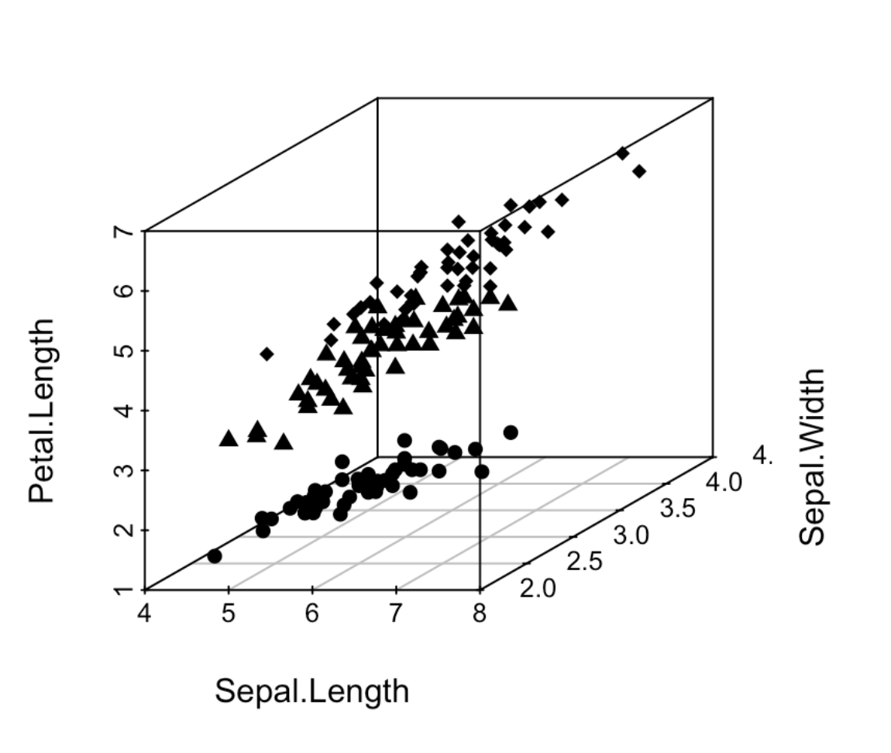
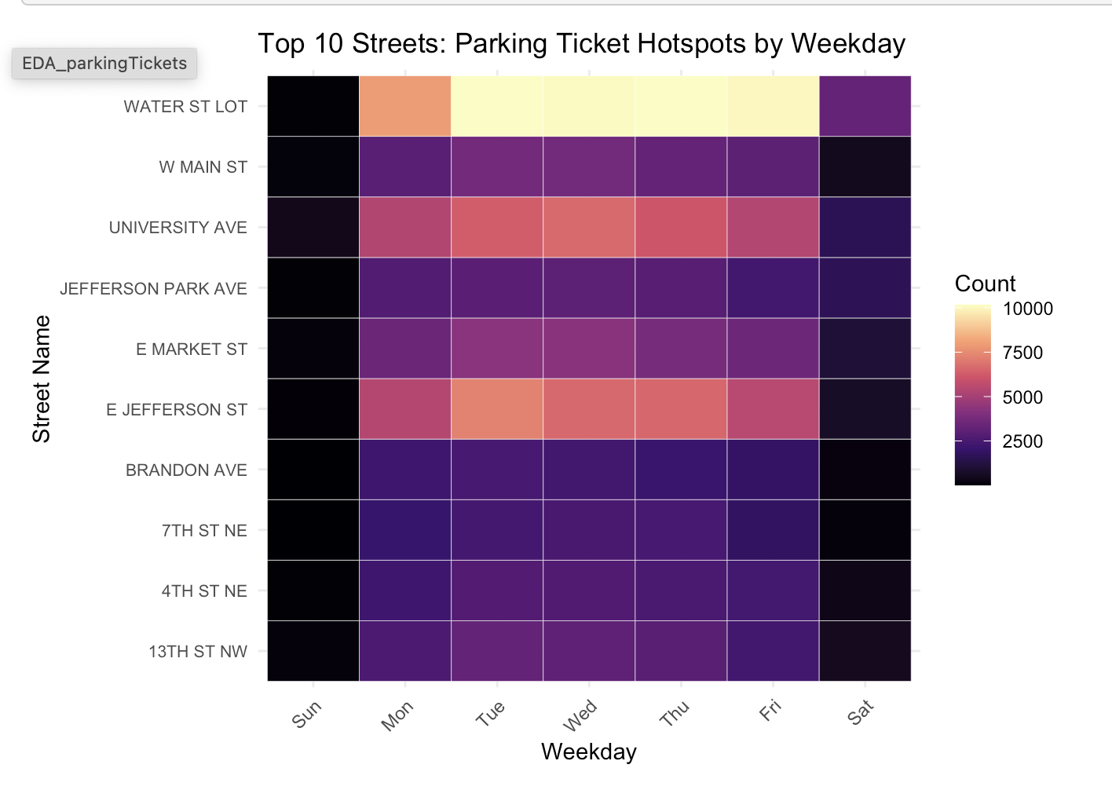
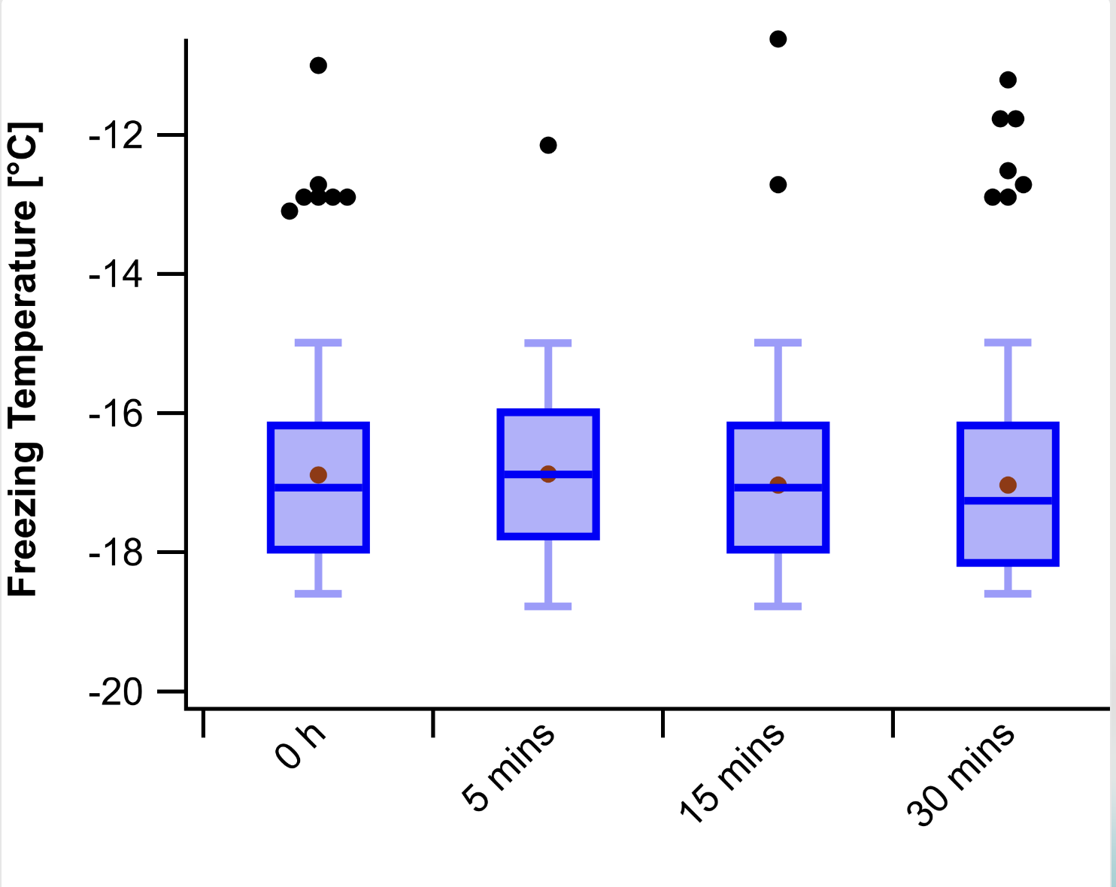
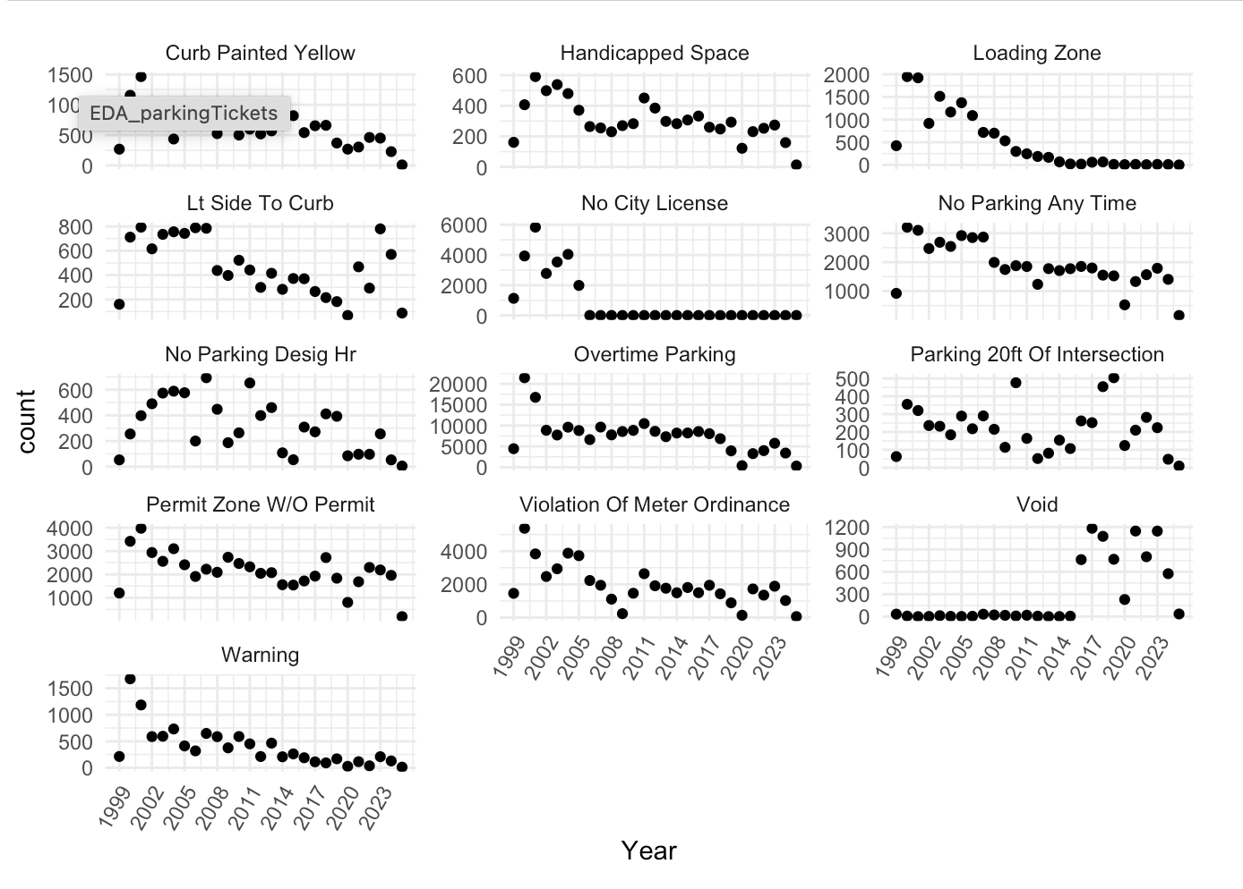
Categorical
Univariate continuous
Bivariate
continuous
Multivariate:
trivariate
Multiple groups
2D arrays
Adopted from
Komorowski et al. (2016).

Slide 11
Let’s move from concepts to hands-on EDA.

Slide 12
Practice Part 1
A Mini EDA with the Steps & BMI dataset

Slide 14
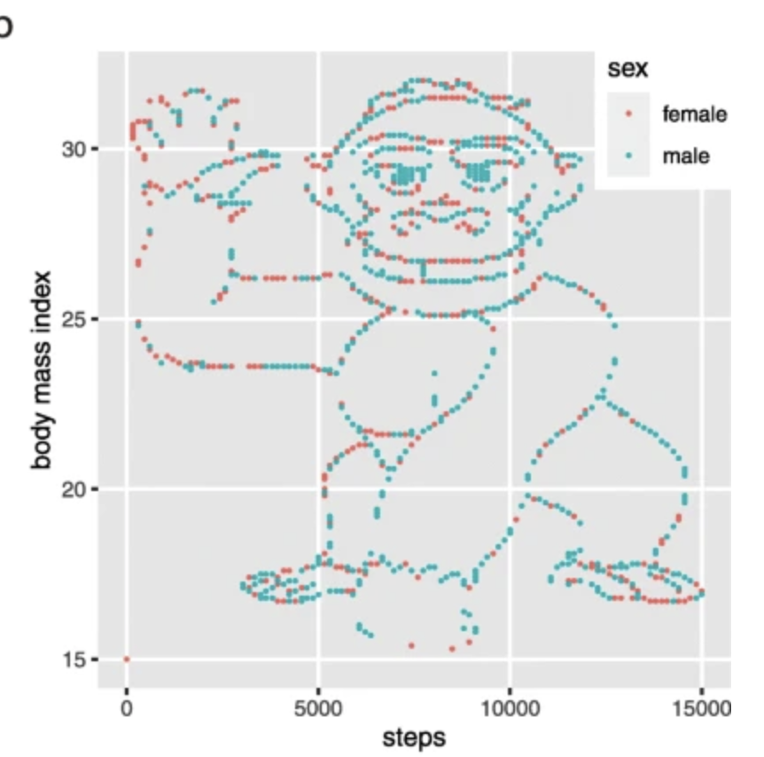
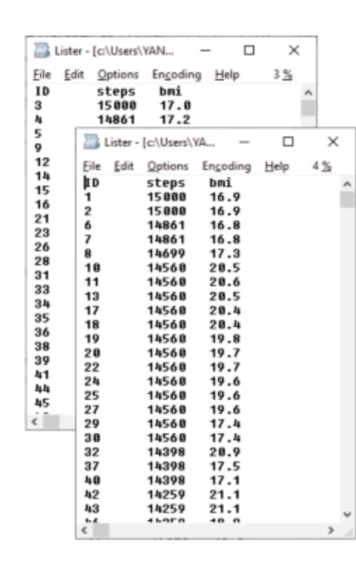
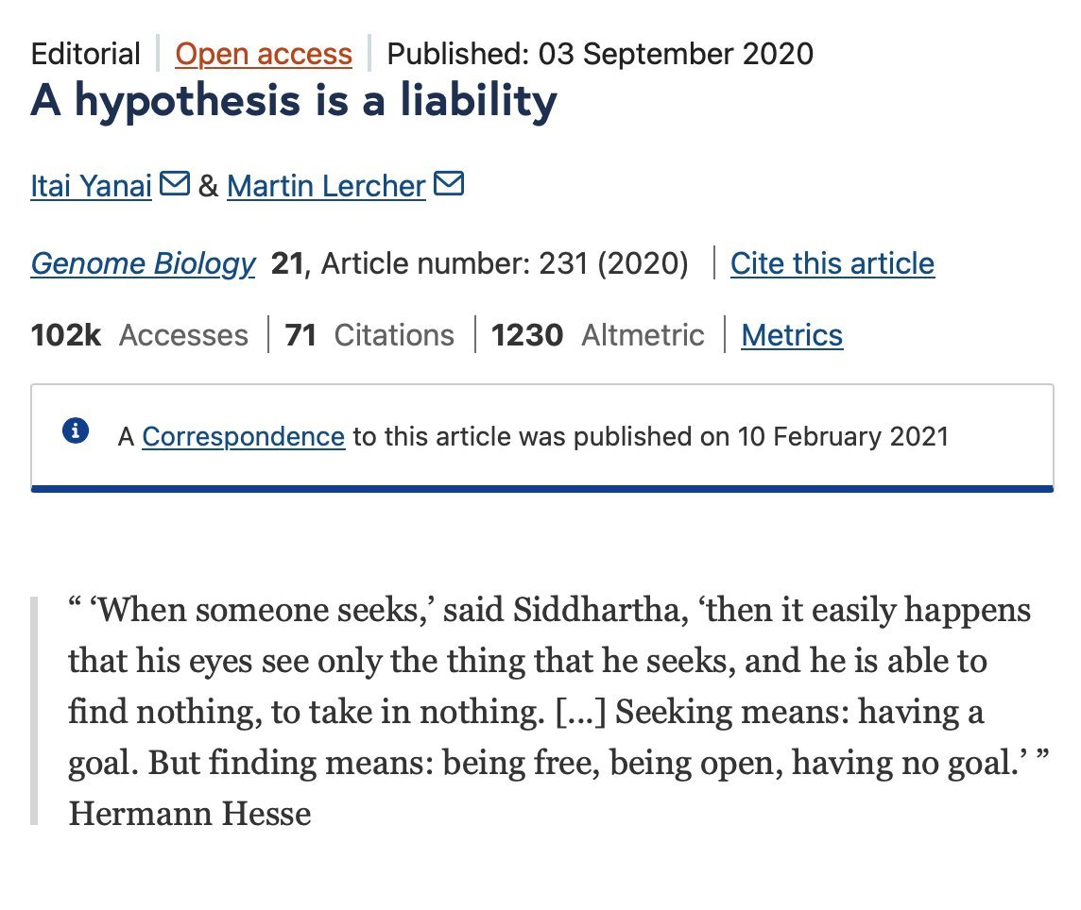
Let the Data Speak First:
The gorilla experiment

Slide 15
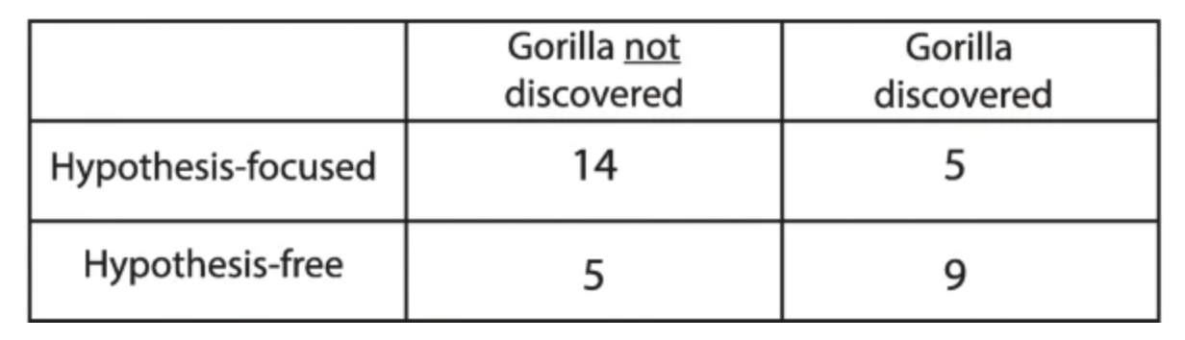
The Striking Result!
​
5/19 =0.263
9/14 =0.643
‘Hypothesis free group’ noticed the hidden pattern :
2.5 x higher discovery rate ( 26% vs 64%).

Slide 16
Practice Part 2
EDA with
Charlottesville Parking Ticket Dataset

Slide 17
Workflow Summary
Structural Checks
Data Cleaning
Time/Date Corrections
Entry error detect / handling
Univariate exploration :
Time( seasonality, weekday, hour), Violation Types
Bivariate exploration :
Violation types over time
Appeals and Grant rates

Slide 18
Reference
Behrens, J. T. (1997). Principles and procedures of exploratory data analysis. Psychological Methods, 2(2), 131–160. https://doi.org/10.1037/1082-989X.2.2.131
Fife, D. A., & Rodgers, J. L. (2022). Understanding the exploratory/confirmatory data analysis continuum: Moving beyond the “replication crisis.” American Psychologist, 77(3), 453–466. https://doi.org/10.1037/amp0000886
In S. L. Stern, P. J. Bakken, & M. K. Nguyen (Eds.), Secondary analysis of electronic health records (pp. 185–207). Springer. https://doi.org/10.1007/978-3-319-43742-2_15
Komorowski, M., Marshall, D. C., Salciccioli, J. D., & Crutain, Y. (2016). Exploratory data analysis.
Lange, F., Wilcke, J., Hoffmann, S., Herrmann, M., & Boulesteix, A. (2025). On “confirmatory” methodological research in statistics and related fields. In press.
Tukey, J. W. (1977). Exploratory Data Analysis.
Yanai, I., & Lercher, M. J. (2020). A hypothesis is a liability. Genome Biology, 21, 231. https://doi.org/10.1186/s13059-020-02133-w
Original cognitive psychology experiment
Simons, D. J. (2009, November 20). The original gorilla experiment [Video]. YouTube. https://www.youtube.com/watch?v=vJG698U2Mvo
How to draw a gorilla scatterplot
StatQuest with Josh Starmer. (2023). How to draw a gorilla scatter plot [Video]. YouTube. https://www.youtube.com/watch?v=T-kxUB29t0o

Slide 19
Thanks for coming!
Contact us for free statistical consulting:
statlab@virginia.edu
Sign up for more workshops or see past workshops:
https://library.virginia.edu/data/training
Register for the Research Data Services newsletter
(get notified of new workshops):
https://library.virginia.edu/data/newsletters

Slide 20
EDA techniques by data type
Type of data | Suggested EDA Technique
Categorical | Descriptive statistics ( e.g., frequency count, proportions/ percentages, mode, 2-way table )
Univariate continuous | Dot/Line plot, Histograms
Bivariate continuous | 2D scatter plots
2D arrays | Heatmap
Multivariate: trivariate | 3D scatter plot or 2D scatter plot with a 3rd variable represented in different color, shape or size
Multiple groups | Side-by-side boxplot, Faceted plots
Adopted from Komorowski et al. (2016).
Notes:
At first, for the categorical variables such as
** 2 arrays( Two categorical/ordinal variables forming a grid, and one value per cell (matrix)
Matrix vs Dataframe:
Matrix : all elements must be the same data type ( all numeric, or all character, all logical)
Data frame : each column can have its own data -> Each cell in the matrix contains a value on the same scale, so higher or lower values correspond to different color intensities in the heatmap. For example, suppose we have two categorical variables that define the rows and columns, and each cell contains a count. A higher number represents a higher frequency.

Slide 21
EDA Techniques by Objective
Objective | Suggested EDA techniques
Getting an idea of the distribution of a variable | Histogram, Density plot, Box plot
Finding outliers | Histogram, scatterplots, box-and-whisker plots
Quantify the relationship between two variables (one exposure (x) and one outcome (y) ) | 2D scatter plot + curve fitting ( e.g., LOESS smoothing, GAM smoothing) , Covariance and correlation
Visualize the relationship between two exposure(x1 and X2) variables and one outcome (y) variable | Heatmap, Faceted 2D plots
Visualization of high-dimensional data | PCA + 2D/3D scatterplot
Adopted from Komorowski et al. (2016).
Notes:
** t-SNE (t-Distributed Stochatic Neighbor Embedding) : Nonlinear dimensionality reduction technique widely used for visualizing high dimensional data in 2D or 3D
X -> y : Hours studied → exam score / Temperature → electricity usage
X1, X2 -> Y : Age group, Gender → Blood pressure / Region, Pollution level → Asthma rate : heatmap visualize three variables : outcome variables are expressed color fill.

