Slide 1
Predicting Air Quality in Milan
blurb
Dan Herweg
May 2019

Slide 2
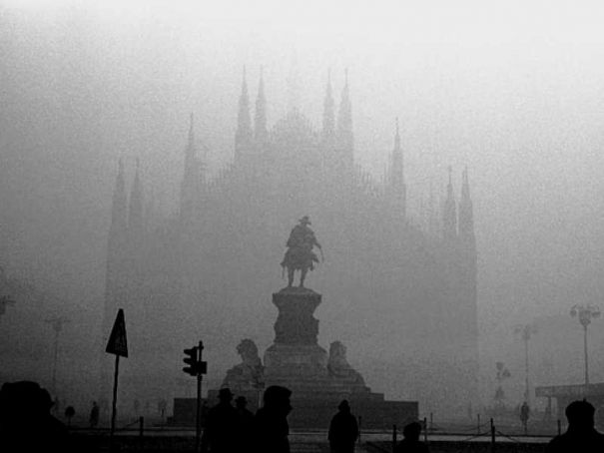

Slide 3
Contents
Summary
Background
Motivation
Data
Methodology
Feature Construction
Data Exploration
Model
Feature Selection
Air Quality Index Prediction
Bonus: Is smoothed data better?
Conclusion
Predict Pollutants, NMSE, AQI, Acc
Predict AQI, Accuracy, Class, ACC
Predict Class directly

Slide 4
Summary sentence Summary
Summary
A summary of results
Pursuing hypothesis that it will work
This deck is a brief documentation of the project

Slide 5
II. Background
Motivation

Slide 6
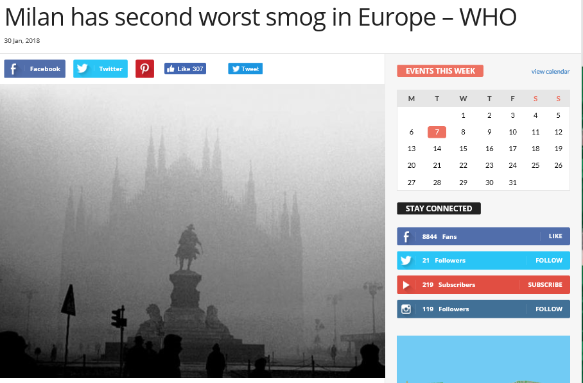
Milan has poor air quality Motivation
Background
A report by the World Health Organization has placed Milan just behind Turin and just before Naples as the three European cities with the worst levels of atmospheric pollution.
Article based on WHO report using 2016 data
https://www.wantedinmilan.com/news/milan-has-second-worst-smog-in-europe-who.html

Slide 7
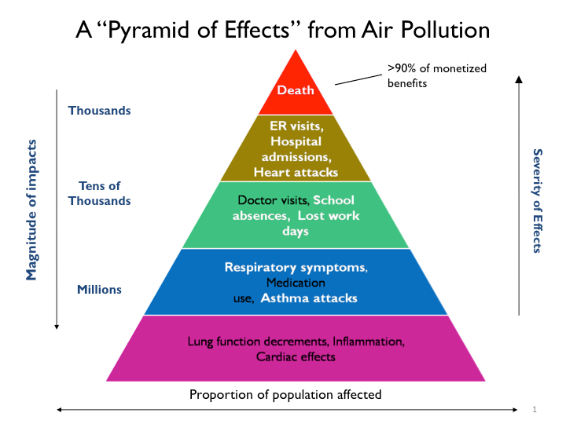
Poor air quality affects citizens’ health Motivation
Background
Fine particles can enter deep into the lungs and enter the blood stream. Health impacts from particles include:
Premature death
Non-fatal heart attacks
Aggravated asthma
US Environmental Protection Agency
https://www.epa.gov/benmap/how-benmap-ce-estimates-health-and-economic-effects-air-pollution

Slide 8
Background
Predicting AQI could help decision makers introduce interventions that are predicted to manage air quality in real time improving citizens’ health

Slide 9
III. Data
Methodology
Feature Construction
Data Exploration

Slide 10
We will take sensor data from weather and traffic to predict AQI using machine learning methods, selecting on accuracy Methodology
Data
The process will be the following:
Features will be constructed, including the target
Features will be selected based on a variety of dimensionality reduction techniques and intuition
Train and test sets (Validation?) will be created
Multiple prediction models will be trained and tested with these variables
The model with the most accurate predictions in the test period will be selected

Slide 11
Data had to be extracted from files generated by sensors, cleaned and merged Feature Construction
Data
The data had three main sources
Weather Sensors
Traffic Gates
Pollution Sensors (used to calculate AQI)
Sensors measuring the same thing were averaged
Source of this data was X
Picture: https://www.123rf.com/photo_20237672_turtle-on-money.html

Slide 12
Missing data was an issue Feature Construction
Data
We wished to predict on the hourly level of data, which was not always available. Additionally, in some periods data was just missing. The data was either recorded hourly for the whole period, or imputed to hourly with the appropriate covariates
Noisy time series data with potential for measurement errors was smoothed (alpha=.2)
Picture: https://www.123rf.com/photo_20237672_turtle-on-money.html

Slide 13
Some features were constructed somewhat arbitrarily Feature Construction
Data
The vehicle length was selected by visually guessing where a tri modal distribution was best separated into small, medium and large cars
We took the 15 minute traffic counts
Picture: https://www.123rf.com/photo_20237672_turtle-on-money.html

Slide 14
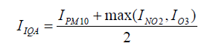
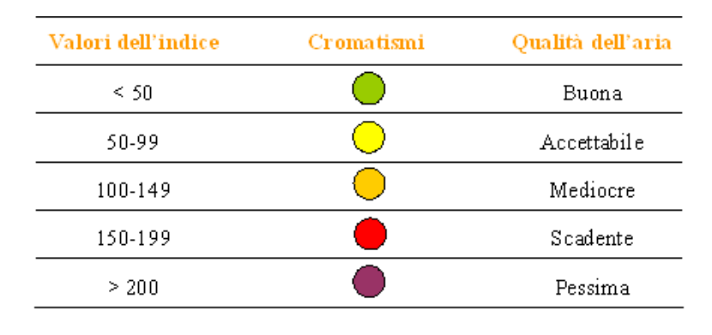
AQI had to be calculated and then transformed to a classifier to serve as the target variable Feature Construction
Data
Everybody’s favorite equation
Graphic of Scale from poor to good
Picture: https://www.123rf.com/photo_20237672_turtle-on-money.html

Slide 15
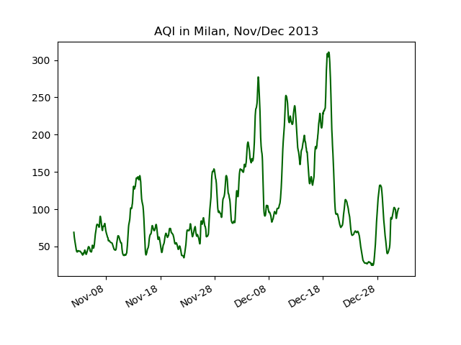
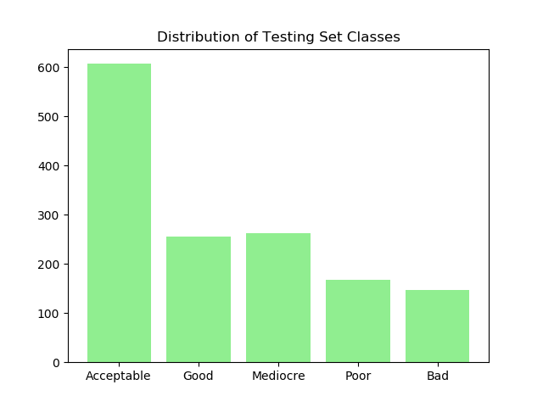
Air Quality Index score and class distribution Feature Construction
Data
Picture: https://www.123rf.com/photo_20237672_turtle-on-money.html

Slide 16
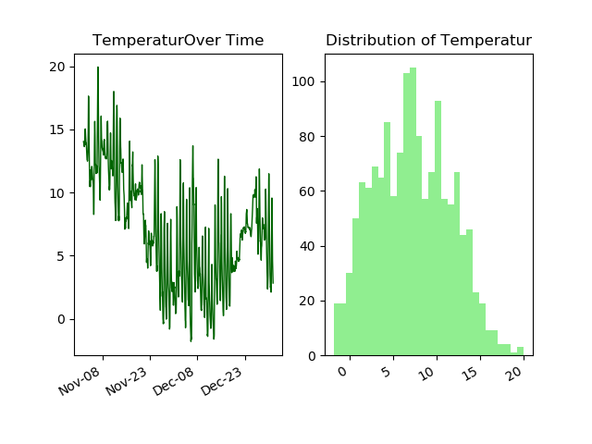
Temperature had a normal distribution and declined into year end Data Exploration
Data
Picture: https://www.123rf.com/photo_20237672_turtle-on-money.html

Slide 17
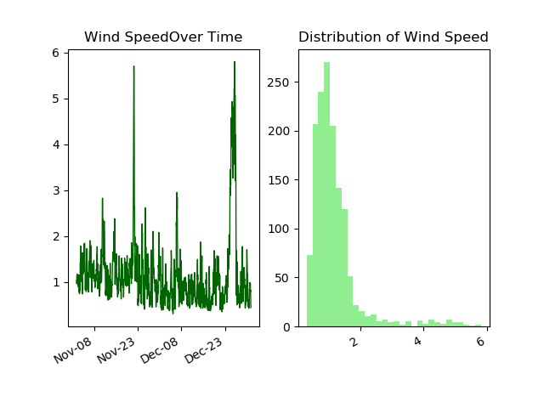
Wind speed was very right skewed, with large peaks Data Exploration
Data
Picture: https://www.123rf.com/photo_20237672_turtle-on-money.html

Slide 18
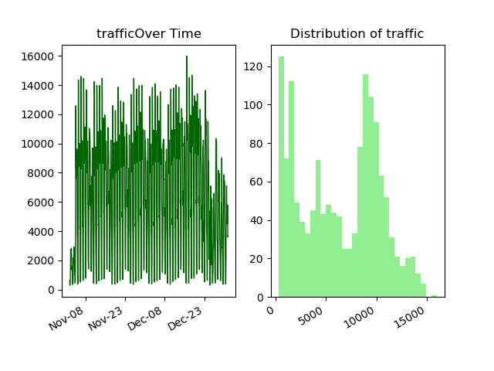
Traffic had obvious daily/weekly pattern and a “tri-modal” distribution Data Exploration
Data
Picture: https://www.123rf.com/photo_20237672_turtle-on-money.html

Slide 19
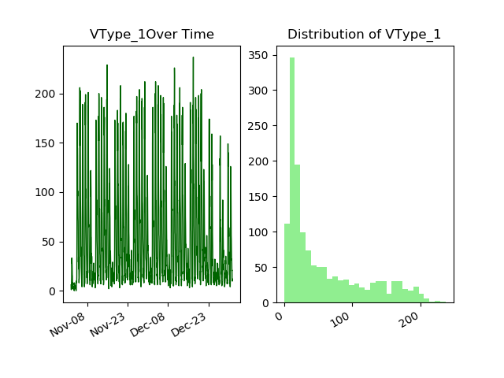
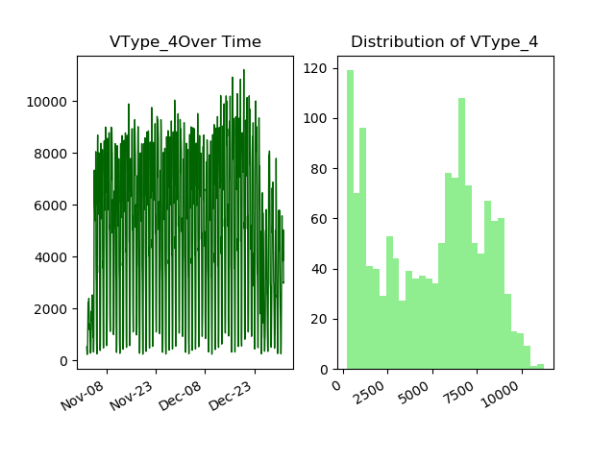
Different Vehicle types had different distributions Data Exploration
Data
Can see weekends in 1
Dist more bimodal or uniform in 4, more power lawish in 1
What are the vtypes and can we tell a story?
Picture: https://www.123rf.com/photo_20237672_turtle-on-money.html

Slide 20
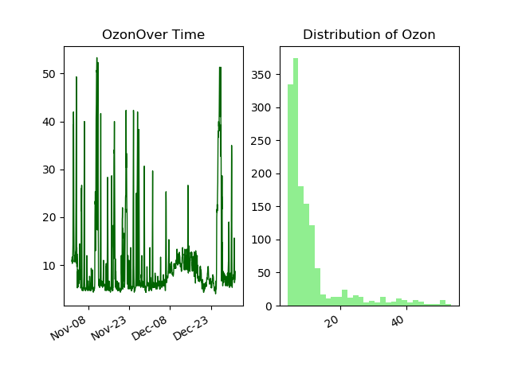
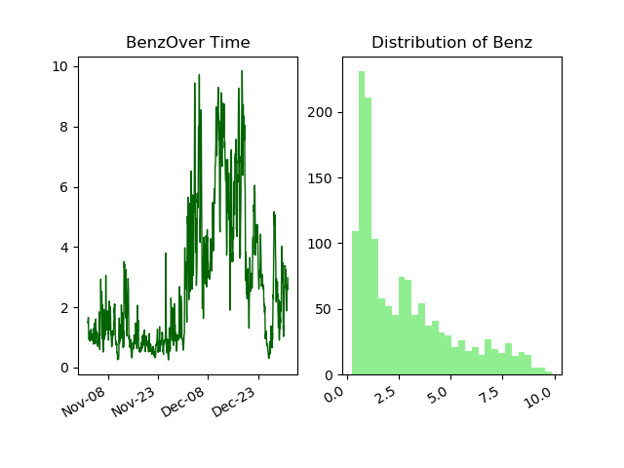
Pollutants looked a lot like AQI pollutants, Ozone least so Data Exploration
Data
Show example of correlated, least correlated, most anticorrelated pollutants
Picture: https://www.123rf.com/photo_20237672_turtle-on-money.html

Slide 21
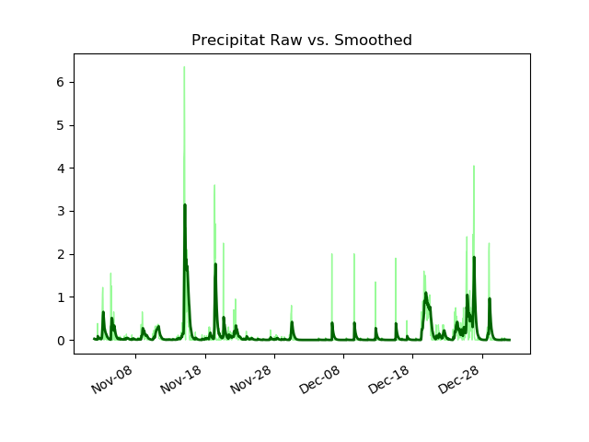
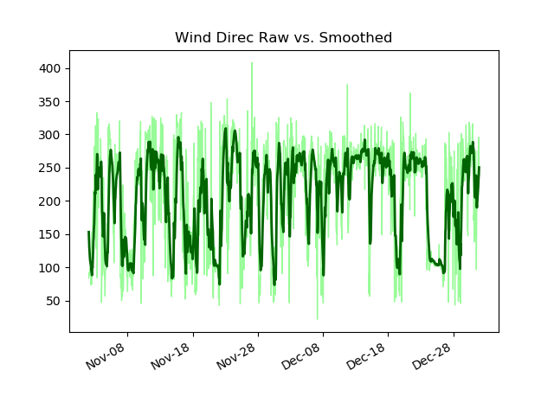
Smoothing eliminates noise from the features Data Exploration
Data
Picture: https://www.123rf.com/photo_20237672_turtle-on-money.html

Slide 22
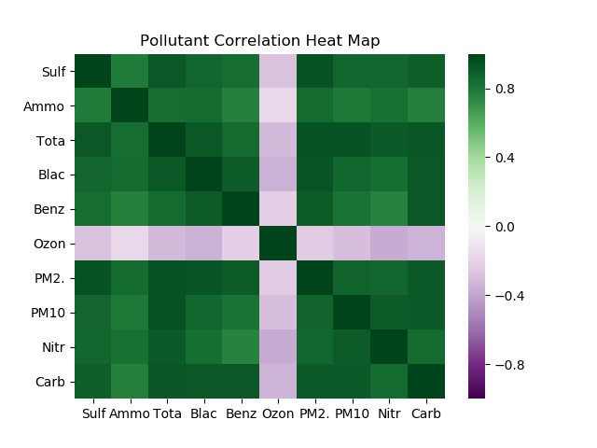
Pollutants are very correlated except ozone. This is good for imputation Data Analysis - Multivariate
Data
Picture: https://www.123rf.com/photo_20237672_turtle-on-money.html

Slide 23
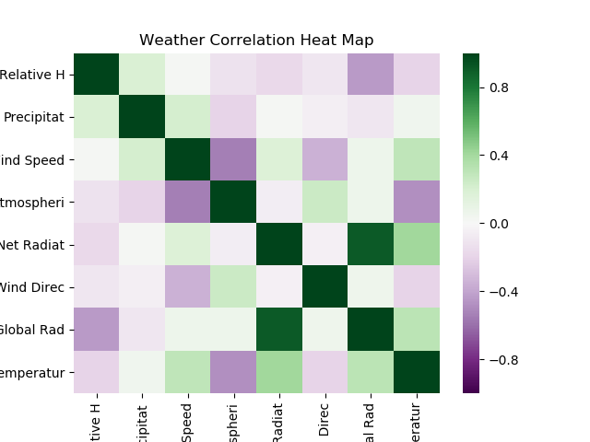
Weather data is not super correlated except the two radiation measures, which is to be expected Data Exploration
Data
Picture: https://www.123rf.com/photo_20237672_turtle-on-money.html

Slide 24
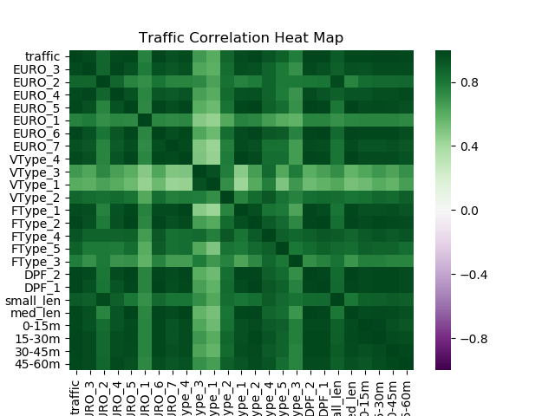
Traffic data is more correlated, and all positively correlated Data Exploration
Data
Picture: https://www.123rf.com/photo_20237672_turtle-on-money.html

Slide 25
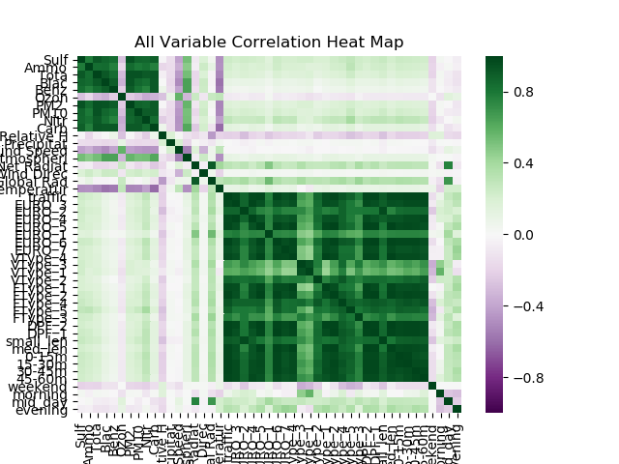
All data ( should make this just features?) Data Exploration
Data
Picture: https://www.123rf.com/photo_20237672_turtle-on-money.html

Slide 26
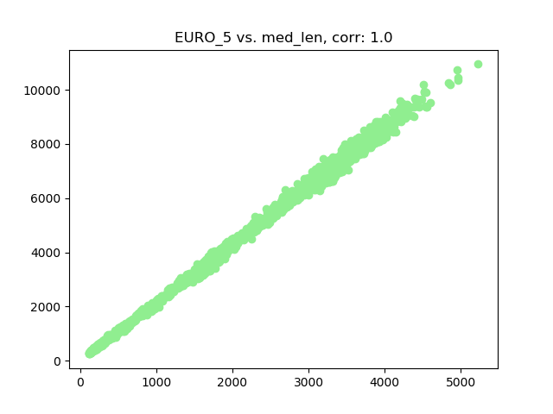
Apparently Euro5 vehicles tend to be medium length Data Exploration
Data
Though correlation rounds to 1, coefficient is about .5 so not 1:1
Still, a good model should probably not have both of these variables
Picture: https://www.123rf.com/photo_20237672_turtle-on-money.html

Slide 27
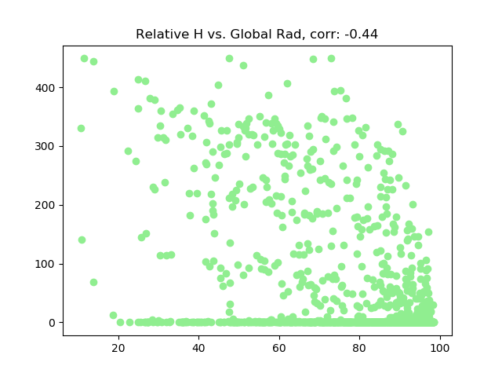
There were negatively correlated variables, but not as striking Data Exploration
Data
Picture: https://www.123rf.com/photo_20237672_turtle-on-money.html

Slide 28
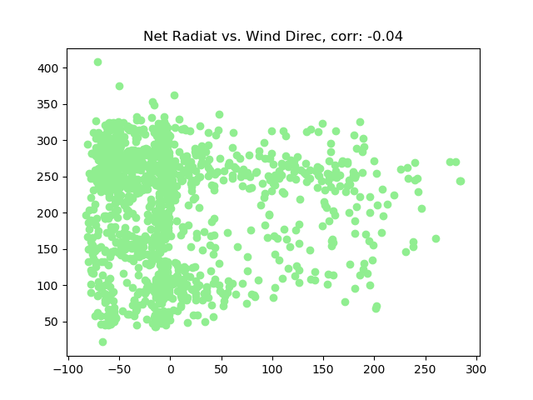
Some variables not correlated Data Exploration
Data
Picture: https://www.123rf.com/photo_20237672_turtle-on-money.html

Slide 29
IV. Model
Train/Test Split
Predicting Pollutants
Predicting AQI
Bonus: Is smoothed data better?

Slide 30
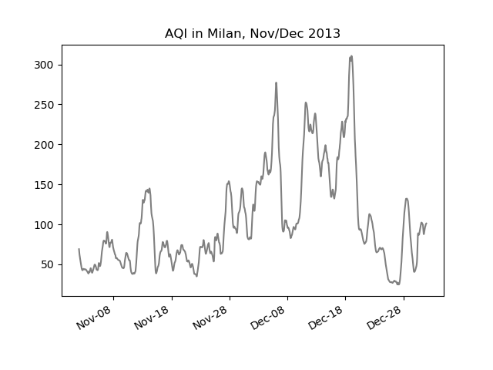
Before we predict we need a train and test set Train/Test Split
Model
Training Set
Test Set
Picture: https://www.123rf.com/photo_20237672_turtle-on-money.html

Slide 31
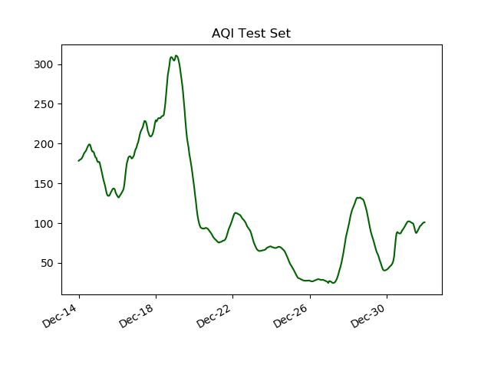
Before we predict we need a train and test set Train/Test Split
Model
Picture: https://www.123rf.com/photo_20237672_turtle-on-money.html

Slide 32
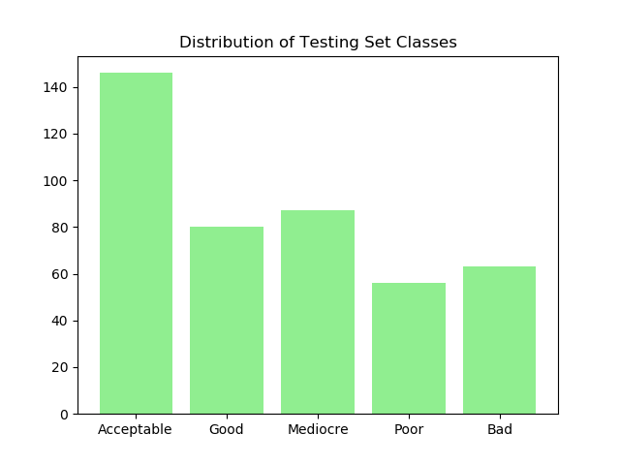
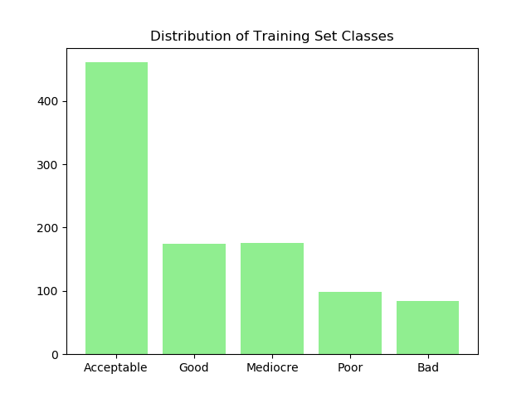
The distributions of the classes in the train and test sets Train/Test Split
Model
Picture: https://www.123rf.com/photo_20237672_turtle-on-money.html

Slide 33
In case our client wants all pollutants predicted, we did a regression to predict them all, then predicted AQI Predicting Pollutants
Model
adsf
Picture: https://www.123rf.com/photo_20237672_turtle-on-money.html

Slide 34
We have many variables, but some Feature Selection
Model
Some techniques to do feature selection:
Penalization: Lasso
Embedded: Tree-based methods
Algorithmic: Forward, backward or stepwise selection
What variables are common to these methods?
Picture: https://www.123rf.com/photo_20237672_turtle-on-money.html

Slide 35
Variables from each method Feature Selection
Model
Table
Lets select the variables we want to use and try some methods that don’t select for variables as well
Picture: https://www.123rf.com/photo_20237672_turtle-on-money.html

Slide 36
Picking the modal training classification for the test data sets a “naive” benchmark Prediction
Model
The amount of
Picture: https://www.123rf.com/photo_20237672_turtle-on-money.html

Slide 37
Each of our variables alone does not match the “naive” accuracy Prediction
Model
Bar chart of variables’ accuracy
Picture: https://www.123rf.com/photo_20237672_turtle-on-money.html

Slide 38
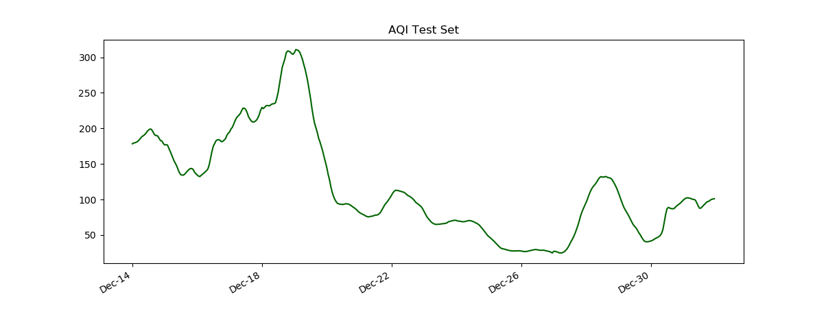
Each of our variables alone does not match the “naive” accuracy Prediction
Model
Time series visualization of test data
Picture: https://www.123rf.com/photo_20237672_turtle-on-money.html

Slide 39
Using the variables together yields better results, best in random forest probably with X% Prediction
Model
asdf
Picture: https://www.123rf.com/photo_20237672_turtle-on-money.html

Slide 40
Using the variables together yields better results Prediction
Model
Visualization of test set
Picture: https://www.123rf.com/photo_20237672_turtle-on-money.html

Slide 41
Final selection of data and model Prediction
Model
asdf
Picture: https://www.123rf.com/photo_20237672_turtle-on-money.html

Slide 42
Rerunning the data on the nonsmoothed versions was better or worse Noisy Data
Model
Wow I am surprised
Picture: https://www.123rf.com/photo_20237672_turtle-on-money.html

Slide 43
V. Conclusion

Slide 44
X model with Y variables performed prediction best Conclusion
Conclusion
Why it was selected
Weaknesses
Noisy data conclusion
Picture: https://www.123rf.com/photo_20237672_turtle-on-money.html

Slide 45
Resources
Picture: https://www.123rf.com/photo_20237672_turtle-on-money.html

