Slide 1
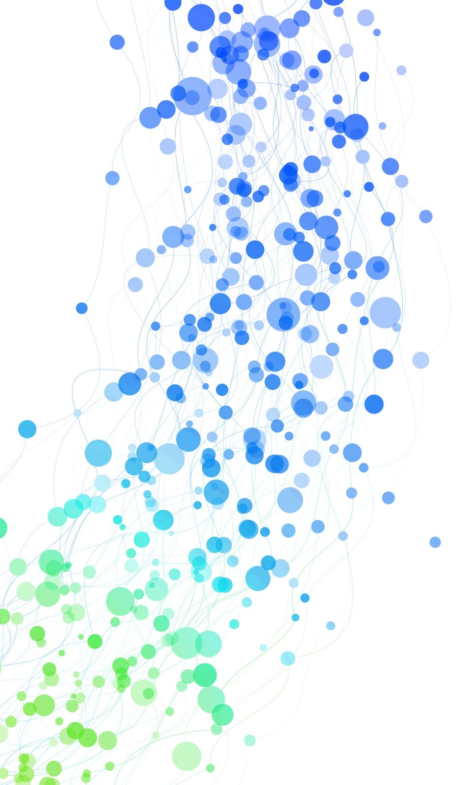
Instantaneous Preliminary Kick Return Analysis
The Importance of Performance Before the Kick is Received
Eric Rupinski, Rutgers University
Github: https://github.com/Emr89/Instantaneous-Preliminary-Kick-Return-Analysis

Slide 2
Introduction& Question:
Background:
Majority of kick return analysis tends to be heavily focused on performance after the kick is received
Forgotten importance of performance before kick return develops
Foundation of success encourages further success... but how do we determine success before the kick return develops?
Research Question:
What factors influence the length of the kick return before the return develops? And how predict its impact?

Slide 3
Methodology:
Data subset:
Tracking data subset to only kick off/return, no penalties, and at the instantaneous moment the returner had received the ball
Combination of factors analyzed:
Placement of individual player statistics (wide vs long orientation)
Pure tracking data, Euclidean distances, and statistical representation of player subsets within each unique play (mean, sd, etc.)
Response variable of either kick return yardage (plays data set), or ”x” position at the moment of tackle (only final model has x position response variable)

Slide 4
Modeling Techniques &Performance:
Type KRY Regr Type: | R2 Value:
Random Forest | 0.35
Neural Network | 0.298
General Elastic Net | 0.297
Elasic Net Regularization | 0.3
Ridge Regression | 0.296
Linear Model | 0.35
Random Forest
Neural Network (Traditional & Deep Learning in Keras)
Elastic-Net Regularized Generalized Linear Models
Elastic net regularization
Ridge Regression
Linear Models
Above are the highest R2 values with the with the kick return yardage response variable.

Slide 5
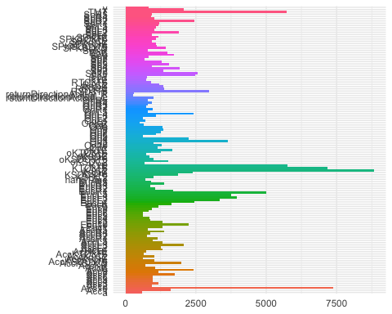
Best KRY Model:
Random Forest Model with an R2 Value = 0.35 with response variable kick return yardage
most influential variable = mean distance front 2 kicking players
Euclidean distance is a stronger predictor than raw tracking position
R5,L5,R4,R5 distance to the returner, and mean distance amongst these positions, are important, meaning cohesive movement to bridge open gaps is important.

Slide 6
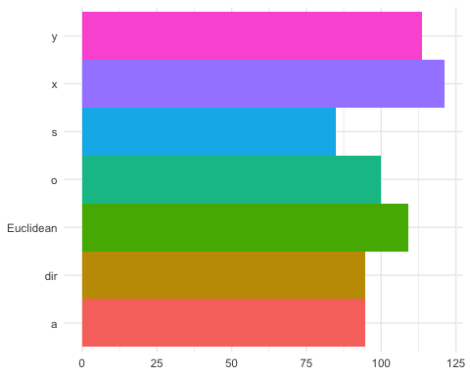
Best Resulting Model:
Random Forest Model with an R2 Value = 0.529, with 7 predictor variables
Response variable “x” value for returner when ball is received.
Created with spacetime folds in Cast package
purpose = measure location dependent impacts on the model to optimize hyperparameters

Slide 7
Final Notes:
Using best model overall to obtain relatively high R2 value of 0.529 reveals the importance of performance before the kick is returned
Using the best “explainable” model, performance metrics of importance can be stated specifically, such as:
Influential role of closest team players on kicking team
Importance of L5,L4,R5,R4 players and the mean of their Euclidean distances
Importance of Euclidean distances

