Slide 1

Computer Security
http://crypto.stanford.edu/cs155
CS155
Looking for undergrad research? Come see me!
Notes:
SISL

Slide 2
The computer security problem
Two factors:
Lots of buggy software (and gullible users)
Money can be made from finding and exploiting vulns.
Marketplace for vulnerabilities
Marketplace for owned machines (PPI)
Many methods to profit from owned client machines
current state of computer security

Slide 3
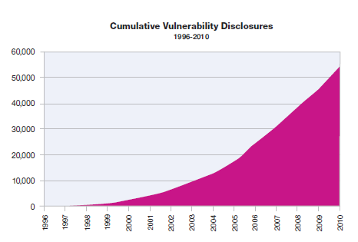
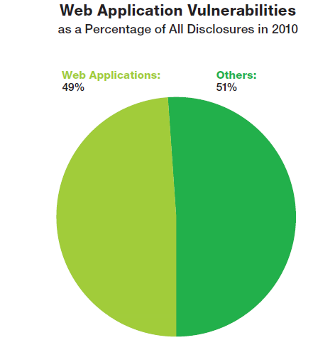
MITRE tracks vulnerability disclosures
Cumulative Disclosures
Percentage from Web applications
2010
Source: IBM X-Force, Mar 2011
Data: http://cve.mitre.org/

Slide 4
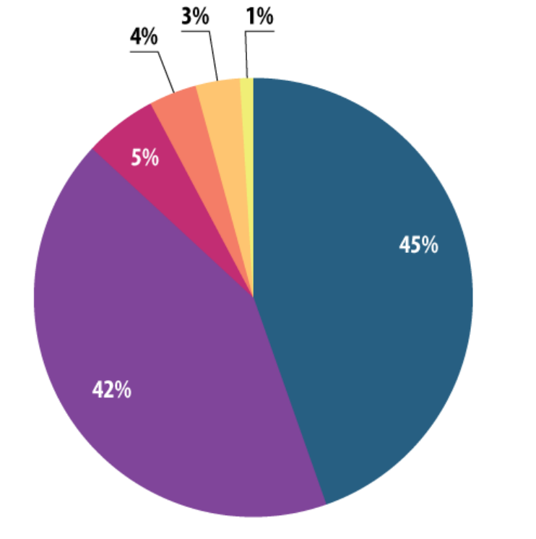
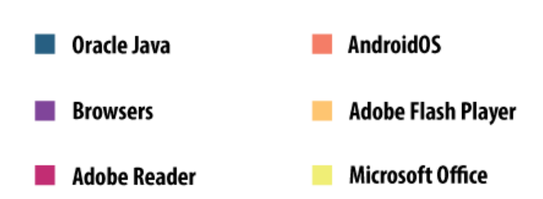
Vulnerable applications being exploited
Source: Kaspersky Security Bulletin 2014

Slide 5
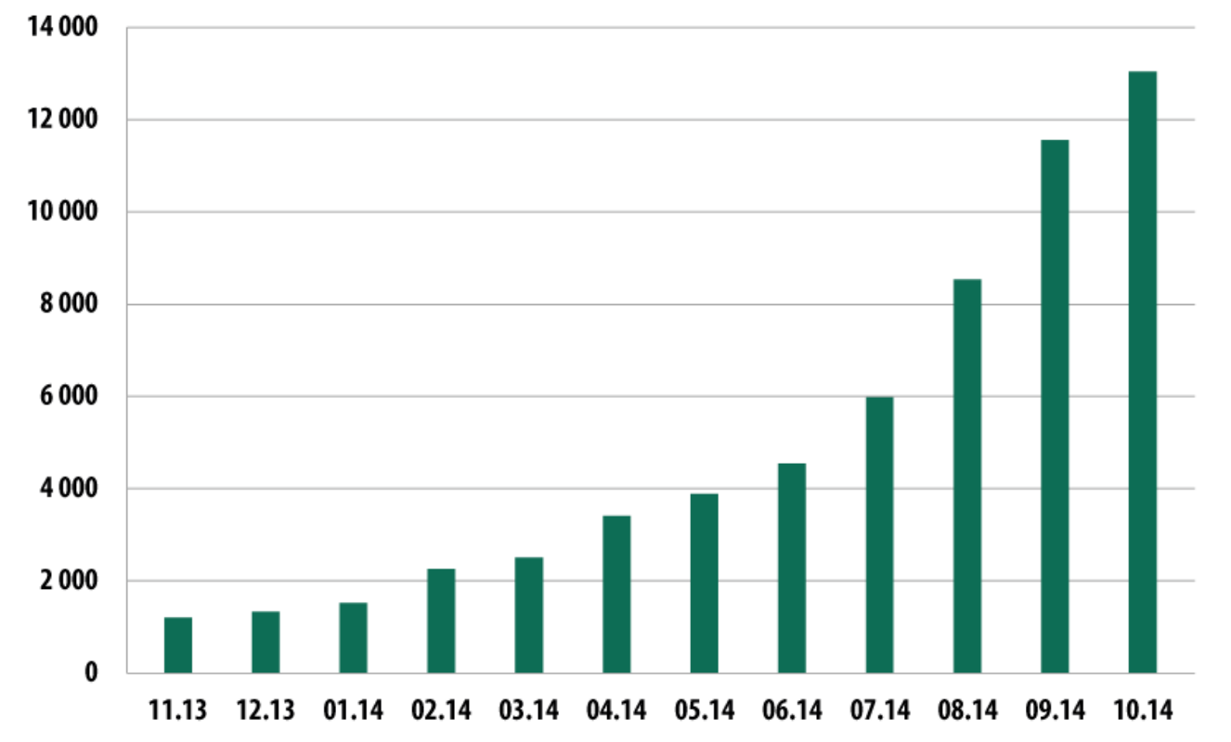
Mobile malware (Nov. 2013 – Oct. 2014)
date
The rise of mobile banking Trojans (Kaspersky Security Bulletin 2014)

Slide 6
Sample attacks
Introduction
Notes:
In this segment we will describe a few sample attacks. We will come back to this and discuss malware in far greater detail later on in the course. Here we give a few examples to illustrate the state of the world.

Slide 7
The computer security problem
Two factors:
Lots of buggy software (and gullible users)
Money can be made from finding and exploiting vulns.
Marketplace for vulnerabilities
Marketplace for owned machines (PPI)
Many methods to profit from owned client machines
current state of computer security

Slide 8
Why own machines: 1. IP address and bandwidth stealing
Attacker’s goal: look like a random Internet user
Use the IP address of infected machine or phone for:
Spam (e.g. the storm botnet)
Spamalytics: 1:12M pharma spams leads to purchase
1:260K greeting card spams leads to infection
Denial of Service: Services: 1 hour (20$), 24 hours (100$)
Click fraud (e.g. Clickbot.a)
Notes:
DDoS service from hack-shop.org.ru
Source: http://www.defcon.org/images/defcon-15/dc15-presentations/dc-15-holt.pdf
Mobile bot-nets: more reliable because phones are always on

Slide 9
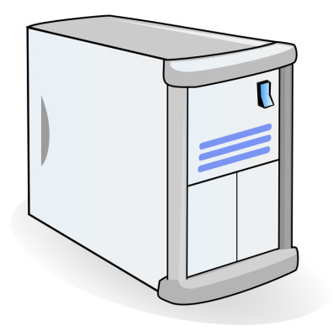
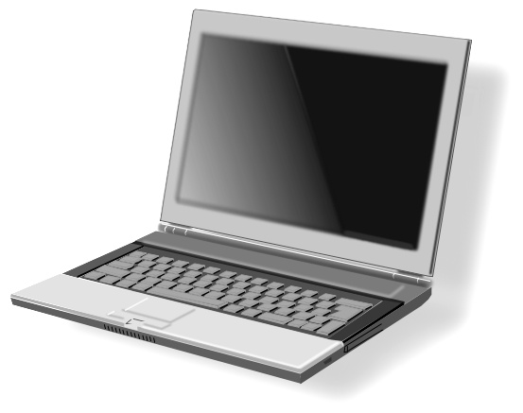

Why own machines: 2. Steal user credentials and inject ads
keylog for banking passwords, web passwords, gaming pwds.
Example: SilentBanker (and many like it)
User requests login page
Malware injects Javascript
Bank sends login page needed to log in
Bank
When user submits information, also sent to attacker
Similar mechanism used by Zeus botnet

Slide 10
Why own machines: 3. Spread to isolated systems
Example: Stuxtnet
Windows infection ⇒
Siemens PCS 7 SCADA control software on Windows ⇒
Siemens device controller on isolated network
More on this later in course

Slide 11
Server-side attacks
Financial data theft: often credit card numbers
Example: Target attack (2013), ≈ 140M CC numbers stolen
Many similar (smaller) attacks since 2000
Political motivation:
Aurora, Tunisia Facebook (Feb. 2011), GitHub (Mar. 2015)
Infect visiting users

Slide 12
Example: Mpack
PHP-based tools installed on compromised web sites
Embedded as an iframe on infected page
Infects browsers that visit site
Features
management console provides stats on infection rates
Sold for several 100$
Customer care can be purchased, one-year support contract
Impact: 500,000 infected sites (compromised via SQL injection)
Several defenses: e.g. Google safe browsing

Slide 13
Insider attacks: example
Hidden trap door in Linux (nov 2003)
Allows attacker to take over a computer
Practically undetectable change (uncovered via CVS logs)
Inserted line in wait4()
Looks like a standard error check, but …
if ((options == (__WCLONE|__WALL)) && (current->uid = 0))
retval = -EINVAL;
See: http://lwn.net/Articles/57135/

Slide 14
Many more examples
Access to SIPRnet and a CD-RW: 260,000 cables ⇒ Wikileaks
SysAdmin for city of SF government. Changed passwords, locking out city from router access
Inside logic bomb took down 2000 UBS servers
⋮
Can security technology help?
Notes:
SIPRnet = Secret Internet Protocol Router Network
Sysadmin: Terry Childs
Third example: Roger Duronio

Slide 15
The Marketplace for Vulnerabilities
Introduction
Notes:
In this segment I want to tell you about market places that have evolved around exploits and vulnerabilities

Slide 16
Marketplace for Vulnerabilities
Option 1: bug bounty programs (many)
Google Vulnerability Reward Program: up to 100K $
Microsoft Bounty Program: up to 100K $
Mozilla Bug Bounty program: 500$ - 3000$
Pwn2Own competition: 15K $
Option 2:
ZDI, iDefense: 2K – 25K $
Notes:
There are many people who work on finding vulnerabilities in software, such as Windows or software that runs on top of windows. Finding an explotable vulnerability can take months and the question is what to do when they find one. Most likely they publish an article in a security conference like Blackhat and boost their reputation. But it shouldn’t be too surprising that they can also make money from selling the vulnerability before announcing it at a conference. There are three options.

Slide 17
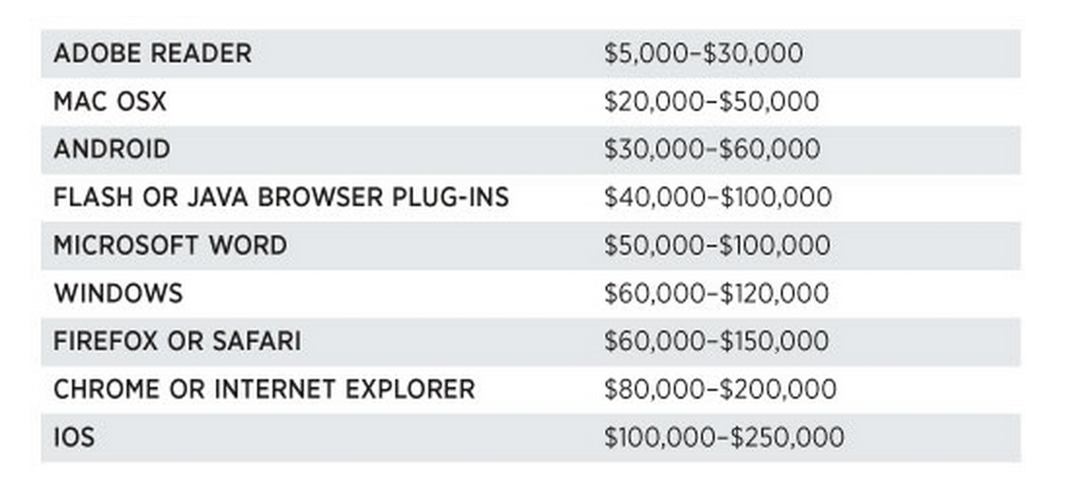
Marketplace for Vulnerabilities
Option 3: black market
Source: Andy Greenberg (Forbes, 3/23/2012 )
Notes:
Now, the 3rd option is to go to the black market. We don’t quite know the value of vulns. there, but I list here a few quotes that suggest that prices could be higher than with the other two options.

Slide 18
Marketplace for owned machines
Pay-per-install (PPI) services
PPI operation:
Own victim’s machine
Download and install client’s code
Charge client
clients
spam bot
keylogger
PPI service
Victims
Source: Cabalerro et al. (www.icir.org/vern/papers/ppi-usesec11.pdf)

Slide 19
Marketplace for owned machines
clients
spam bot
keylogger
Cost: US - 100-180$ / 1000 machines
Asia - 7-8$ / 1000 machines
PPI service
Victims
Source: Cabalerro et al. (www.icir.org/vern/papers/ppi-usesec11.pdf)

Slide 20
This course
Goals:
Be aware of exploit techniques
Learn to defend and avoid common exploits
Learn to architect secure systems

Slide 21
This course
Part 1: basics (architecting for security)
Securing apps, OS, and legacy code Isolation, authentication, and access control
Part 2: Web security (defending against a web attacker)
Building robust web sites, understand the browser security model
Part 3: network security (defending against a network attacker)
Monitoring and architecting secure networks.
Part 4: securing mobile applications

Slide 22
Don’t try this at home !

Slide 23
Ken Thompson’s clever Trojan

