Slide 1

The confinement principle
CS155: Computer Security
Isolation

Slide 2
Running untrusted code
We often need to run buggy/unstrusted code:
programs from untrusted Internet sites:
apps, extensions, plug-ins, codecs for media player
exposed applications: pdf viewers, outlook
legacy daemons: sendmail, bind
honeypots
Goal: if application “misbehaves” ⇒ kill it

Slide 3


Approach: confinement
Confinement: ensure misbehaving app cannot harm rest of system
Can be implemented at many levels:
Hardware: run application on isolated hw (air gap)
⇒ difficult to manage
app 1
app 2
Network 2
air gap
network 1

Slide 4
Approach: confinement
Confinement: ensure misbehaving app cannot harm rest of system
Can be implemented at many levels:
Virtual machines: isolate OS’s on a single machine
OS₁
OS₂
app1
app2
Virtual Machine Monitor (VMM)

Slide 5

Approach: confinement
Confinement: ensure misbehaving app cannot harm rest of system
Can be implemented at many levels:
Process: System Call Interposition
Isolate a process in a single operating system
process 1
process 2
Operating System

Slide 6
Approach: confinement
Confinement: ensure misbehaving app cannot harm rest of system
Can be implemented at many levels:
Threads: Software Fault Isolation (SFI)
Isolating threads sharing same address space
Application: e.g. browser-based confinement

Slide 7
Implementing confinement
Key component: reference monitor
Mediates requests from applications
Implements protection policy
Enforces isolation and confinement
Must always be invoked:
Every application request must be mediated
Tamperproof:
Reference monitor cannot be killed
… or if killed, then monitored process is killed too
Small enough to be analyzed and validated

Slide 8
A old example: chroot
Often used for “guest” accounts on ftp sites
To use do: (must be root)
chroot /tmp/guest root dir “/” is now “/tmp/guest”
su guest EUID set to “guest”
Now “/tmp/guest” is added to file system accesses for applications in jail
open(“/etc/passwd”, “r”) ⇒ open(“/tmp/guest/etc/passwd” , “r”)
application cannot access files outside of jail

Slide 9
Jailkit
Problem: all utility progs (ls, ps, vi) must live inside jail
jailkit project: auto builds files, libs, and dirs needed in jail env
jk_init: creates jail environment
jk_check: checks jail env for security problems
checks for any modified programs,
checks for world writable directories, etc.
jk_lsh: restricted shell to be used inside jail
note: simple chroot jail does not limit network access

Slide 10
Escaping from jails
Early escapes: relative paths
open( “../../etc/passwd”, “r”) ⇒ open(“/tmp/guest/../../etc/passwd”, “r”)
chroot should only be executable by root.
otherwise jailed app can do:
create dummy file “/aaa/etc/passwd”
run chroot “/aaa”
run su root to become root
(bug in Ultrix 4.0)

Slide 11
Many ways to escape jail as root
Create device that lets you access raw disk
Send signals to non chrooted process
Reboot system
Bind to privileged ports

Slide 12
Freebsd jail
Stronger mechanism than simple chroot
To run: jail jail-path hostname IP-addr cmd
calls hardened chroot (no “../../” escape)
can only bind to sockets with specified IP address and authorized ports
can only communicate with processes inside jail
root is limited, e.g. cannot load kernel modules
Notes:
Can run web server inside of jail. If web server is compromised, damage is limited.

Slide 13
Not all programs can run in a jail
Programs that can run in jail:
audio player
web server
Programs that cannot:
web browser
mail client
Notes:
VertLeftWhiteCheck1

Slide 14
Problems with chroot and jail
Coarse policies:
All or nothing access to parts of file system
Inappropriate for apps like a web browser
Needs read access to files outside jail (e.g. for sending attachments in Gmail)
Does not prevent malicious apps from:
Accessing network and messing with other machines
Trying to crash host OS

Slide 15

System Call Interposition
Isolation

Slide 16
System call interposition
Observation: to damage host system (e.g. persistent changes) app must make system calls:
To delete/overwrite files: unlink, open, write
To do network attacks: socket, bind, connect, send
Idea: monitor app’s system calls and block unauthorized calls
Implementation options:
Completely kernel space (e.g. GSWTK)
Completely user space (e.g. program shepherding)
Hybrid (e.g. Systrace)
Notes:
GSWTK: generic software wrapper toolkit

Slide 17
Initial implementation (Janus) [GWTB’96]
Linux ptrace: process tracing
process calls: ptrace (… , pid_t pid , …)
and wakes up when pid makes sys call.
Monitor kills application if request is disallowed
user space
monitored
application
(browser)
monitor
open(“/etc/passwd”, “r”)
OS Kernel

Slide 18
Complications
cd(“/tmp”)
open(“passwd”, “r”)
cd(“/etc”)
open(“passwd”, “r”)
If app forks, monitor must also fork
forked monitor monitors forked app
If monitor crashes, app must be killed
Monitor must maintain all OS state associated with app
current-working-dir (CWD), UID, EUID, GID
When app does “cd path” monitor must update its CWD
otherwise: relative path requests interpreted incorrectly

Slide 19
Problems with ptrace
Ptrace is not well suited for this application:
Trace all system calls or none
inefficient: no need to trace “close” system call
Monitor cannot abort sys-call without killing app
Security problems: race conditions
Example: symlink: me ⟶ mydata.dat
proc 1: open(“me”)
monitor checks and authorizes
proc 2: me ⟶ /etc/passwd
OS executes open(“me”)
Classic TOCTOU bug: time-of-check / time-of-use
time
not atomic

Slide 20
Alternate design: systrace [P’02]
user space
monitored
application
(browser)
monitor
policy file
for app
open(“etc/passwd”, “r”)
OS Kernel
sys-call
gateway
systrace
permit/deny
systrace only forwards monitored sys-calls to monitor (efficiency)
systrace resolves sym-links and replaces sys-call path arguments by full path to target
When app calls execve, monitor loads new policy file
Notes:
Efficiency: saves context switches

Slide 21
Ostia: a delegation architecture [GPR’04]
Previous designs use filtering:
Filter examines sys-calls and decides whether to block
Difficulty with syncing state between app and monitor (CWD, UID, ..)
Incorrect syncing results in security vulnerabilities (e.g. disallowed file opened)
A delegation architecture:
user space
monitored
application
agent
policy file
for app
open(“etc/passwd”, “r”)
OS Kernel
Notes:
Direct sys-calls are blocked. open(…) request forwarded to agent who makes the request and returns the fd to the app.

Slide 22
Ostia: a delegation architecture [GPR’04]
Monitored app disallowed from making monitored sys calls
Minimal kernel change (… but app can call close() itself )
Sys-call delegated to an agent that decides if call is allowed
Can be done without changing app
(requires an emulation layer in monitored process)
Incorrect state syncing will not result in policy violation
What should agent do when app calls execve?
Process can make the call directly. Agent loads new policy file.

Slide 23
Policy
Sample policy file:
path allow /tmp/*
path deny /etc/passwd
network deny all
Manually specifying policy for an app can be difficult:
Systrace can auto-generate policy by learning how app behaves on “good” inputs
If policy does not cover a specific sys-call, ask user
… but user has no way to decide
Difficulty with choosing policy for specific apps (e.g. browser) is the main reason this approach is not widely used

Slide 24
NaCl: a modern day example
Browser
HTML
JavaScript
game
NPAPI
NaCl runtime
game: untrusted x86 code
Two sandboxes:
outer sandbox: restricts capabilities using system call interposition
Inner sandbox: uses x86 memory segmentation to isolate application memory among apps
Notes:
More info on NaCl: http://nativeclient.googlecode.com/svn/data/docs_tarball/nacl/googleclient/native_client/documentation/nacl_paper.pdf

Slide 25
Isolation via Virtual Machines
Isolation

Slide 26
Virtual Machines
VM2
VM1
Apps
Apps
Guest OS 2
Guest OS 1
Virtual Machine Monitor (VMM)
Host OS
Hardware
Example: NSA NetTop
single HW platform used for both classified and unclassified data

Slide 27
Why so popular now?
VMs in the 1960’s:
Few computers, lots of users
VMs allow many users to shares a single computer
VMs 1970’s – 2000: non-existent
VMs since 2000:
Too many computers, too few users
Print server, Mail server, Web server, File server, Database , …
Wasteful to run each service on different hardware
More generally: VMs heavily used in cloud computing

Slide 28
VMM security assumption
VMM Security assumption:
Malware can infect guest OS and guest apps
But malware cannot escape from the infected VM
Cannot infect host OS
Cannot infect other VMs on the same hardware
Requires that VMM protect itself and is not buggy
VMM is much simpler than full OS
… but device drivers run in Host OS

Slide 29
Problem: covert channels
Covert channel: unintended communication channel between isolated components
Can be used to leak classified data from secure component to public component
Classified VM
Public VM
listener
secret
doc
malware
covert
channel
VMM

Slide 30
An example covert channel
Both VMs use the same underlying hardware
To send a bit b ∈ {0,1} malware does:
b= 1: at 1:00am do CPU intensive calculation
b= 0: at 1:00am do nothing
At 1:00am listener does CPU intensive calc. and measures completion time
b = 1 ⇔ completion-time > threshold
Many covert channels exist in running system:
File lock status, cache contents, interrupts, …
Difficult to eliminate all

Slide 31
Suppose the system in question has two CPUs: the classified VM runs on one and the public VM runs on the other.
Is there a covert channel between the VMs?
There are covert channels, for example, based on the time needed to read from main memory

Slide 32
VMM Introspection: [GR’03] protecting the anti-virus system

Slide 33
Intrusion Detection / Anti-virus
Runs as part of OS kernel and user space process
Kernel root kit can shutdown protection system
Common practice for modern malware
Standard solution: run IDS system in the network
Problem: insufficient visibility into user’s machine
Better: run IDS as part of VMM (protected from malware)
VMM can monitor virtual hardware for anomalies
VMI: Virtual Machine Introspection
Allows VMM to check Guest OS internals
Notes:
IDS = Intrusion Detection System

Slide 34
Infected VM
malware
Guest OS
VMM
IDS
Hardware

Slide 35
Sample checks
Stealth root-kit malware:
Creates processes that are invisible to “ps”
Opens sockets that are invisible to “netstat”
1. Lie detector check
Goal: detect stealth malware that hides processes and network activity
Method:
VMM lists processes running in GuestOS
VMM requests GuestOS to list processes (e.g. ps)
If mismatch: kill VM

Slide 36
Sample checks
2. Application code integrity detector
VMM computes hash of user app code running in VM
Compare to whitelist of hashes
Kills VM if unknown program appears
3. Ensure GuestOS kernel integrity
example: detect changes to sys_call_table
4. Virus signature detector
Run virus signature detector on GuestOS memory

Slide 37
Subvirting VM Isolation
Isolation

Slide 38
Subvirt [King et al. 2006]
Virus idea:
Once on victim machine, install a malicious VMM
Virus hides in VMM
Invisible to virus detector running inside VM
anti-virus
anti-virus
⇒
OS
OS
VMM and virus
HW
HW

Slide 39

The MATRIX

Slide 40
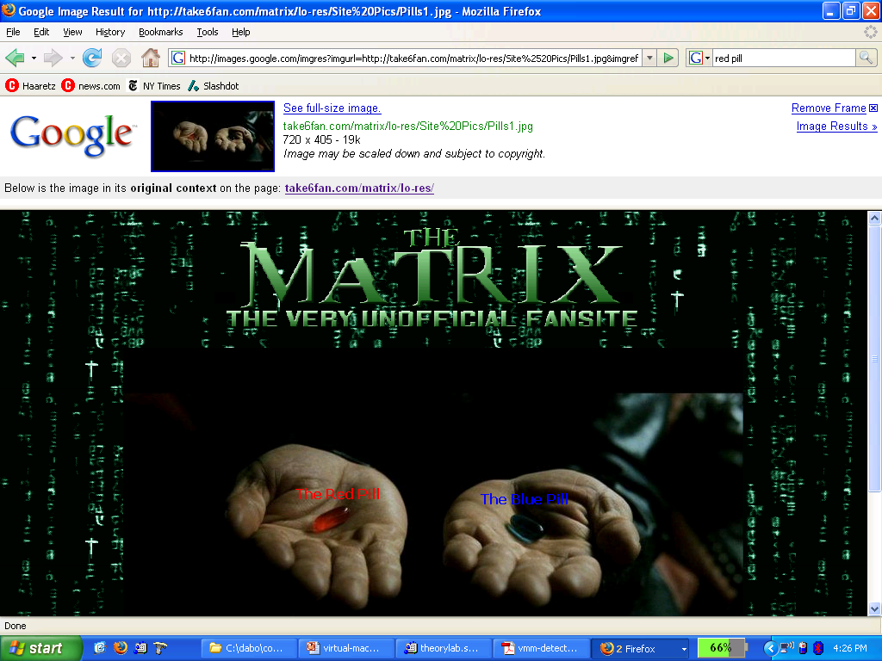

Slide 41
VM Based Malware (blue pill virus)
VMBR: a virus that installs a malicious VMM (hypervisor)
Microsoft Security Bulletin: (Oct, 2006)
Suggests disabling hardware virtualization features by default for client-side systems
But VMBRs are easy to defeat
A guest OS can detect that it is running on top of VMM
Notes:
http://www.microsoft.com/whdc/system/platform/virtual/CPUVirtExt.mspx

Slide 42
VMM Detection
Can an OS detect it is running on top of a VMM?
Applications:
Virus detector can detect VMBR
Normal virus (non-VMBR) can detect VMM
refuse to run to avoid reverse engineering
Software that binds to hardware (e.g. MS Windows) can refuse to run on top of VMM
DRM systems may refuse to run on top of VMM

Slide 43
VMM detection (red pill techniques)
VM platforms often emulate simple hardware
VMWare emulates an ancient i440bx chipset
… but report 8GB RAM, dual CPUs, etc.
VMM introduces time latency variances
Memory cache behavior differs in presence of VMM
Results in relative time variations for any two operations
VMM shares the TLB with GuestOS
GuestOS can detect reduced TLB size
… and many more methods [GAWF’07]
Notes:
http://www.usenix.org/event/hotos07/tech/full_papers/garfinkel/garfinkel.pdf

Slide 44
VMM Detection
Bottom line: The perfect VMM does not exist
VMMs today (e.g. VMWare) focus on:
Compatibility: ensure off the shelf software works
Performance: minimize virtualization overhead
VMMs do not provide transparency
Anomalies reveal existence of VMM

Slide 45
Software Fault Isolation
Isolation

Slide 46
Software Fault Isolation [Whabe et al., 1993]
Goal: confine apps running in same address space
Codec code should not interfere with media player
Device drivers should not corrupt kernel
Simple solution: runs apps in separate address spaces
Problem: slow if apps communicate frequently
requires context switch per message

Slide 47
Software Fault Isolation
SFI approach:
Partition process memory into segments
Locate unsafe instructions: jmp, load, store
At compile time, add guards before unsafe instructions
When loading code, ensure all guards are present
code
segment
data
segment
code
segment
data
segment
app #1
app #2

Slide 48
Segment matching technique
Guard ensures code does not load data from another segment
Designed for MIPS processor. Many registers available.
dr1, dr2: dedicated registers not used by binary
compiler pretends these registers don’t exist
dr2 contains segment ID
Indirect load instruction R12 ← [R34] becomes:
dr1 ← R34
scratch-reg ← (dr1 >> 20) : get segment ID
compare scratch-reg and dr2 : validate seg. ID
trap if not equal
R12 ← [dr1] : do load

Slide 49
Address sandboxing technique
dr2: holds segment ID
Indirect load instruction R12 ← [R34] becomes:
dr1 ← R34 & segment-mask : zero out seg bits
dr1 ← dr1 | dr2 : set valid seg ID
R12 ← [dr1] : do load
Fewer instructions than segment matching
… but does not catch offending instructions
Similar guards places on all unsafe instructions

Slide 50
Problem: what if jmp [addr] jumps directly into indirect load?
(bypassing guard)
Solution:
jmp guard must ensure [addr] does not bypass load guard
Notes:
Defense: clear low order bits of jump address.

Slide 51
Cross domain calls
caller
domain
callee
domain
call stub
draw:
return
call draw
br addr
br addr
ret stub
br addr
br addr
br addr
br addr
Only stubs allowed to make cross-domain jumps
Jump table contains allowed exit points
Addresses are hard coded, read-only segment

Slide 52
SFI Summary
Shared memory: use virtual memory hardware
map same physical page to two segments in addr space
Performance
Usually good: mpeg_play, 4% slowdown
Limitations of SFI: harder to implement on x86 :
variable length instructions: unclear where to put guards
few registers: can’t dedicate three to SFI
many instructions affect memory: more guards needed

Slide 53
Isolation: summary
Many sandboxing techniques:
Physical air gap, Virtual air gap (VMMs),
System call interposition, Software Fault isolation
Application specific (e.g. Javascript in browser)
Often complete isolation is inappropriate
Apps need to communicate through regulated interfaces
Hardest aspects of sandboxing:
Specifying policy: what can apps do and not do
Preventing covert channels

Slide 54
THE END

