Slide 1
Internet Security: How the Internet works and some basic vulnerabilities
CS 155
Spring 2014
Dan Boneh

Slide 2
Internet Infrastructure
Backbone
ISP
ISP
Local and interdomain routing
TCP/IP for routing and messaging
BGP for routing announcements
Domain Name System
Find IP address from symbolic name (www.cs.stanford.edu)

Slide 3
TCP Protocol Stack
Application protocol
Application
Application
Transport
TCP protocol
Transport
Network
IP protocol
IP
IP protocol
Network
Link
Data Link
Network Access
Data Link
Link

Slide 4
Data Formats
TCP Header
Application
Application message - data
message
Transport (TCP, UDP)
segment
TCP
data
TCP
data
TCP
data
Network (IP)
packet
IP
TCP
data
Link Layer
frame
ETH
IP
TCP
data
ETF
IP Header
Link (Ethernet)
Header
Link (Ethernet)
Trailer

Slide 5
Internet Protocol
IP
Connectionless
Unreliable
Best effort
Notes:
src and dest ports not parts of IP hdr
Version
Header Length
Type of Service
Total Length
Identification
Flags
Fragment Offset
Time to Live
Protocol
Header Checksum
Source Address of Originating Host
Destination Address of Target Host
Options
Padding
IP Data

Slide 6


IP Routing
Meg
Office gateway
Packet
Source
121.42.33.12
Tom
121.42.33.12
Destination
132.14.11.51
132.14.11.1
ISP
132.14.11.51
121.42.33.1
Typical route uses several hops
IP: no ordering or delivery guarantees

Slide 7
IP Protocol Functions (Summary)
Routing
IP host knows location of router (gateway)
IP gateway must know route to other networks
Fragmentation and reassembly
If max-packet-size less than the user-data-size
Error reporting
ICMP packet to source if packet is dropped
TTL field: decremented after every hop
Packet dropped f TTL=0. Prevents infinite loops.

Slide 8
Problem: no src IP authentication
Client is trusted to embed correct source IP
Easy to override using raw sockets
Libnet: a library for formatting raw packets with arbitrary IP headers
Anyone who owns their machine can send packets with arbitrary source IP
… response will be sent back to forged source IP
Implications: (solutions in DDoS lecture)
Anonymous DoS attacks;
Anonymous infection attacks (e.g. slammer worm)

Slide 9
Transmission Control Protocol
TCP
Connection-oriented, preserves order
Sender
Break data into packets
Attach packet numbers
Receiver
Acknowledge receipt; lost packets are resent
Reassemble packets in correct order
Book
Mail each page
Reassemble book
1
19
1
5
1

Slide 10
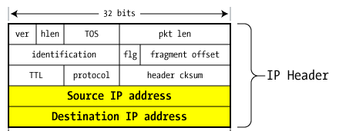
TCP Header (protocol=6)
Source Port
Dest port
SEQ Number
ACK Number
U
R
G
A
C
K
P
S
H
P
S
R
S
Y
N
F
I
N
TCP Header
Other stuff

Slide 11
Review: TCP Handshake
C
S
SYN:
SN_{C}←rand_{C}
AN_{C}←0
Listening
SN_{S}←rand_{S}
AN_{S}←SN_{C}
Store SN_{C} , SN_{S}
SYN/ACK:
Wait
SN←SN_{C}+1
AN←SN_{S}
ACK:
Established
Received packets with SN too far out of window are dropped

Slide 12
Basic Security Problems
1. Network packets pass by untrusted hosts
Eavesdropping, packet sniffing
Especially easy when attacker controls a machine close to victim (e.g. WiFi routers)
2. TCP state easily obtained by eavesdropping
Enables spoofing and session hijacking
3. Denial of Service (DoS) vulnerabilities
DDoS lecture

Slide 13
Why random initial sequence numbers?
Suppose initial seq. numbers (SN_{C} , SN_{S} ) are predictable:
Attacker can create TCP session on behalf of forged source IP
Breaks IP-based authentication (e.g. SPF, /etc/hosts )
Random seq. num. does not block attack, but makes it harder
TCP SYN
Server
attacker
srcIP=victim
Victim
SYN/ACK dstIP=victim
SN=server SN_{S}
ACK
srcIP=victim
AN=predicted SN_{S}
server thinks command is from victim IP addr
command
Notes:
Example commands: send spam email on behalf of victim IP address
SPF: Sender Policy Framework

Slide 14
Example DoS vulnerability: Reset
Attacker sends a Reset packet to an open socket
If correct SN_{S} then connection will close ⇒ DoS
Naively, success prob. is 1/2³² (32-bit seq. #’s).
… but, many systems allow for a large window of acceptable seq. #‘s. Much higher success probability.
Attacker can flood with RST packets until one works
Most effective against long lived connections, e.g. BGP

Slide 15
Routing Security
ARP, OSPF, BGP

Slide 16
Interdomain Routing
(AS#32)
Stanford.edu
BGP
earthlink.net
(AS#4355)
Autonomous System
OSPF
connected group of one or more Internet Protocol prefixes under a single routing policy (aka domain)
Notes:
OSPF: open shortest path first

Slide 17
Routing Protocols
ARP (addr resolution protocol): IP addr ⟶ eth addr Security issues: (local network attacks)
Node A can confuse gateway into sending it traffic for Node B
By proxying traffic, node A can read/inject packets into B’s session (e.g. WiFi networks)
OSPF: used for routing within an AS
BGP: routing between Autonomous Systems Security issues: unauthenticated route updates
Anyone can cause entire Internet to send traffic for a victim IP to attacker’s address
Example: Youtube-Pakistan mishap (see DDoS lecture)
Anyone can hijack route to victim (next slides)
Notes:
OSPF: open shortest path first

Slide 18
BGP example [D. Wetherall]
1
3
3 2 7
4
2 7
2 6 5
2 6 5
3 2 6 5
5
8
2
2 7
6 5
7 2 6 5
7
2 7
7
6 2 7
5
2 6 5
6
7
5

Slide 19
Security Issues
BGP path attestations are un-authenticated
Anyone can inject advertisements for arbitrary routes
Advertisement will propagate everywhere
Used for DoS, spam, and eavesdropping (details in DDoS lecture)
Often a result of human error
Solutions:
RPKI: AS obtains a certificate (ROA) from RIR and attaches ROA to path advertisements. Advertisements without a valid ROA are ignored. Defends against a malicious AS (but not a network attacker)
SBGP: sign every hop of a path advertisement
Notes:
RIR: Regional Internet Registries (assign IP blocks to AS’s)
ROA: Route Origin Authorizations. Contains: AS number (ASN), validity date range, IP prefixes.
ROA says that an ASN is authorized to advertise for specific prefixes.

Slide 20
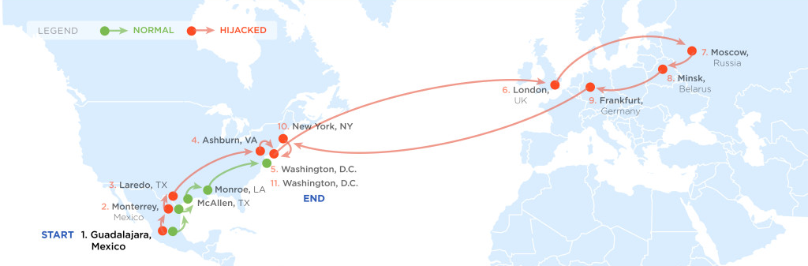
Example path hijack (source: Renesys 2013)
Feb 2013: Guadalajara ⟶ Washington DC via Belarus
route in effect
for several hours
Normally: Alestra (Mexico) ⟶ PCCW (Texas) ⟶ Qwest (DC)
Reverse route (DC ⟶ Guadalajara) is unaffected:
Person browsing the Web in DC cannot tell by traceroute that HTTP responses are routed through Moscow
Notes:
Path from DC to Guadalajara is unchanged. Only return path is changed.

Slide 21
OSPF: routing inside an AS
Link State Advertisements (LSA):
Flooded throughout AS so that all routers in the AS have a complete view of the AS topology
Transmission: IP datagrams, protocol = 89
Neighbor discovery:
Routers dynamically discover direct neighbors on attached links --- sets up an “adjacenty”
Once setup, they exchange their LSA databases

Slide 22




Example: LSA from Ra and Rb
Ra LSA
Net-1
Rb LSA
Ra
Rb
R3
LSA DB:
Net-1
Net-1
Ra
Ra
Rb
2
2
Rb
3
1
1
3
1
Notes:
Ra and Rb send an LSA about the connection between them. That LSA is received by R3 and it updates its own LSA database.

Slide 23
Security features
OSPF message integrity (unlike BGP)
Every link can have its own shared secret
Unfortunately, OSPF uses an insecure MAC:
MAC(k,m) = MD5(data ll key ll pad ll len)
Every LSA is flooded throughout the AS
If a single malicious router, valid LSAs may still reach dest.
The “fight back” mechanism
If a router receives its own LSA with a newer timestamp than the latest it sent, it immediately floods a new LSA
Links must be advertised by both ends

Slide 24


Still some attacks possible [NKGB’12]
Threat model:
single malicious router wants to disrupt all AS traffic
Example problem: adjacency setup need no peer feedback
Victim (DR)
a remote attacker
adjacency
False Hello and DBD messages
phantom router
adjacency
LAN
adjacency
net 1
Result: DoS on net 1
Notes:
A router can setup an adjacency with a peer router without ever hearing back from the peer. Therefore, a remote attacker can cause a victim router to setup an adjacency with a phantom peer, resulting in DoS.

Slide 25
Domain Name System

Slide 26
Domain Name System
DNS
Hierarchical Name Space
root
org
net
edu
com
uk
ca
wisc
ucb
stanford
cmu
mit
cs
ee
www

Slide 27
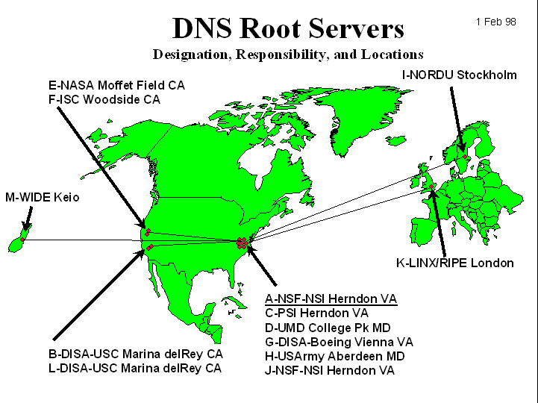
DNS Root Name Servers
Hierarchical service
Root name servers for top-level domains
Authoritative name servers for subdomains
Local name resolvers contact authoritative servers when they do not know a name

Slide 28
DNS Lookup Example
root & edu
DNS server
www.cs.stanford.edu
www.cs.stanford.edu
NS stanford.edu
stanford.edu
DNS server
Local DNS resolver
NS cs.stanford.edu
Client
A www=IPaddr
cs.stanford.edu
DNS server
DNS record types (partial list):
- NS: name server (points to other server)
- A: address record (contains IP address)
- MX: address in charge of handling email
- TXT: generic text (e.g. used to distribute site public keys (DKIM) )

Slide 29
Caching
DNS responses are cached
Quick response for repeated translations
Useful for finding servers as well as addresses
NS records for domains
DNS negative queries are cached
Save time for nonexistent sites, e.g. misspelling
Cached data periodically times out
Lifetime (TTL) of data controlled by owner of data
TTL passed with every record

Slide 30
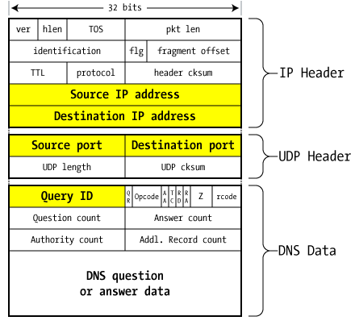
DNS Packet
Query ID:
16 bit random value
Links response to query
(from Steve Friedl)

Slide 31
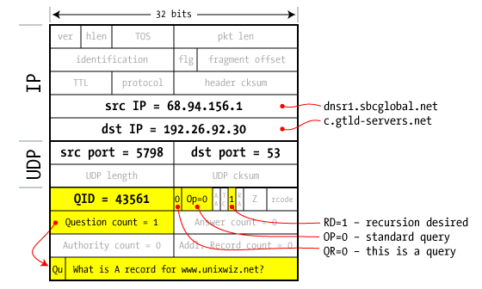
Resolver to NS request
Notes:
SBCglobal DNS resolver wants www.unixwiz.net. First queries C tld server.

Slide 32
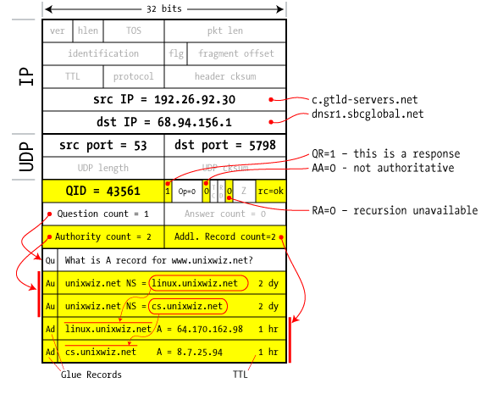
Response to resolver
Response contains IP addr of next NS server
(called “glue”)
Response ignored if unrecognized QueryID
Notes:
Response points to two name servers.

Slide 33
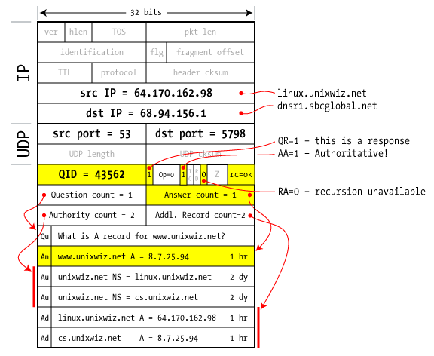
Authoritative response to resolver
bailiwick checking:
response is cached if it is within the same domain of query (i.e. a.com cannot set NS for b.com)
final answer
Notes:
NS linux.unixwiz.net provides the final answer. Response passes bailiwick checking and will be cached.

Slide 34
Basic DNS Vulnerabilities
Users/hosts trust the host-address mapping provided by DNS:
Used as basis for many security policies:
Browser same origin policy, URL address bar
Obvious problems
Interception of requests or compromise of DNS servers can result in incorrect or malicious responses
e.g.: malicious access point in a Cafe
Solution – authenticated requests/responses
Provided by DNSsec … but few use DNSsec

Slide 35
DNS cache poisoning (a la Kaminsky’08)
Victim machine visits attacker’s web site, downloads Javascript
Query:
a.bank.com
a.bank.com
QID=x₁
user
browser
local
DNS
resolver
ns.bank.com
IPaddr
256 responses:
Random QID y₁, y₂, …
NS bank.com=ns.bank.com
A ns.bank.com=attackerIP
attacker wins if ∃j: x₁ = y_{j}
response is cached and attacker owns bank.com
attacker

Slide 36
If at first you don’t succeed …
Victim machine visits attacker’s web site, downloads Javascript
Query:
b.bank.com
b.bank.com
QID=x₂
user
browser
local
DNS
resolver
ns.bank.com
IPaddr
256 responses:
Random QID y₁, y₂, …
NS bank.com=ns.bank.com
A ns.bank.com=attackerIP
attacker wins if ∃j: x₂ = y_{j}
response is cached and attacker owns bank.com
attacker
success after ≈ 256 tries (few minutes)
Notes:
Birthday paradox: success once x_{i} = y_{j} for some i,j .
Success probability after each try is 1/256 ⇒ needs 256 tries on average until success

Slide 37
Defenses
Increase Query ID size. How?
Randomize src port, additional 11 bits
Now attack takes several hours
Ask every DNS query twice:
Attacker has to guess QueryID correctly twice (32 bits)
… but Apparently DNS system cannot handle the load

Slide 38
DNS poisoning attacks in the wild
January 2005, the domain name for a large New York ISP, Panix, was hijacked to a site in Australia.
In November 2004, Google and Amazon users were sent to Med Network Inc., an online pharmacy
In March 2003, a group dubbed the "Freedom Cyber Force Militia" hijacked visitors to the Al-Jazeera Web site and presented them with the message "God Bless Our Troops"

Slide 39
DNS Rebinding Attack
[DWF’96, R’01]
<iframe src="http://www.evil.com">
DNS-SEC cannot
stop this attack
Firewall
www.evil.com?
ns.evil.com
DNS server
171.64.7.115 TTL = 0
192.168.0.100
www.evil.com
web server
corporate
web server
171.64.7.115
192.168.0.100
Read permitted: it’s the “same origin”

Slide 40
DNS Rebinding Defenses
Browser mitigation: DNS Pinning
Refuse to switch to a new IP
Interacts poorly with proxies, VPN, dynamic DNS, …
Not consistently implemented in any browser
Server-side defenses
Check Host header for unrecognized domains
Authenticate users with something other than IP
Firewall defenses
External names can’t resolve to internal addresses
Protects browsers inside the organization

Slide 41
Summary
Core protocols not designed for security
Eavesdropping, Packet injection, Route stealing, DNS poisoning
Patched over time to prevent basic attacks
(e.g. random TCP SN)
More secure variants exist (next lecture) :
IP ⟶ IPsec
DNS ⟶ DNSsec
BGP ⟶ SBGP

