Slide 1
ESE 2020
Exercise hour introduction

Slide 2
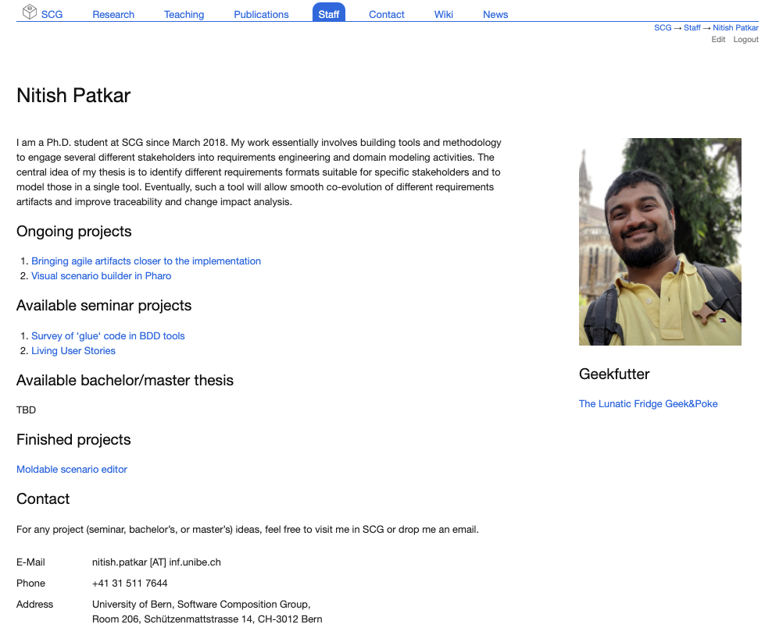
Student assistants Pascal Marc André Manuel Schüpbach Olivier Stähli
Myself Find me here!

Slide 3
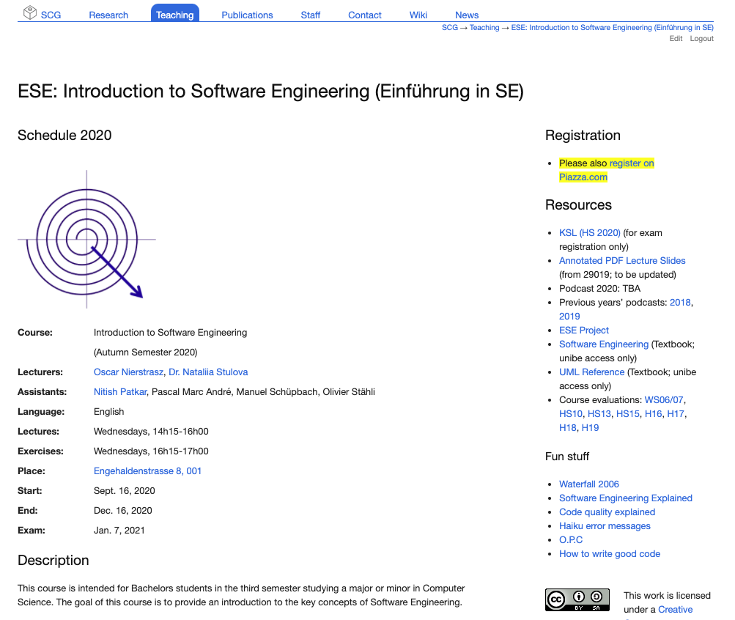
How to find the project? http://scg.unibe.ch/teaching/ese

Slide 4

First steps
Register yourself on Piazza
Fill the registration form

Slide 5
Project and organisation 1
Brief introduction
Web application to sell/buy goods and services online
Total duration is 12 weeks
Will be built in small teams of 4-5 students
Will be built as a series of total four features
Each team will have one student assistant to clear doubts and for technical advice
More information in project wiki!

Slide 6
Project and organisation 2
Frontend in Angular
Backend in Express
Both frameworks use TypeScript language that extends JavaScript
Detailed introduction in the next exercise hour
Teams can decide to choose any other technologies if they wish
Technologies

Slide 7
Exercise hour schedule
Various activities to apply theoritical concepts from lectures into practical context
We expect several deliverables
Deliverables must be submitted and will be graded

Slide 8
Milestones
Total three milestones
Each milestone has learning outcomes and advances in the overall implementation
Code freeze before the final presentation for fairness

Slide 9

Requirements to be implemented
Requirements will be discussed in detail by corresponding student assistants at appropriate stages

Slide 10

Reading list

Slide 11

Project grading
Deliverables,
Architecture and design,
Documentation,
Overall functionality,
Code style,
Teamwork,
Project management,
Final presentation
etc.

Slide 12

Meetings
Physical vs in-person meetings

Slide 13
Project scaffolding and demo

