Slide 1
HASKELL
HASKELL
CS305
Emre Arapcic-Uevak
Adna Kikanovic
Vedad Siljic
Selma Alic

Slide 2
Table of Content
Introduction
History of the Language
Structure & Features
Comparison with other languages
Code examples

Slide 3
Introduction
Haskell is a purely functional programming language
Distinguished by strong static typing, high level of abstraction, and lazy evaluation.
Inspired by the principles of lambda calculus
Named after the logician Haskell Curry

Slide 4
History and Evolution
1987
FPCA's Conference
1990
First Haskell Report
Haskell 2010 Release
Haskell.Org
Glasgow Haskell Compiler
1992
1994
1999
Haskell 98
2010

Slide 5
Features
Purely Functional Programming
Strong, Static Type System with Type Inference
Lazy Evaluation
Immutability
First-Class Functions
Pattern Matching
High-Level Abstractions

Slide 6
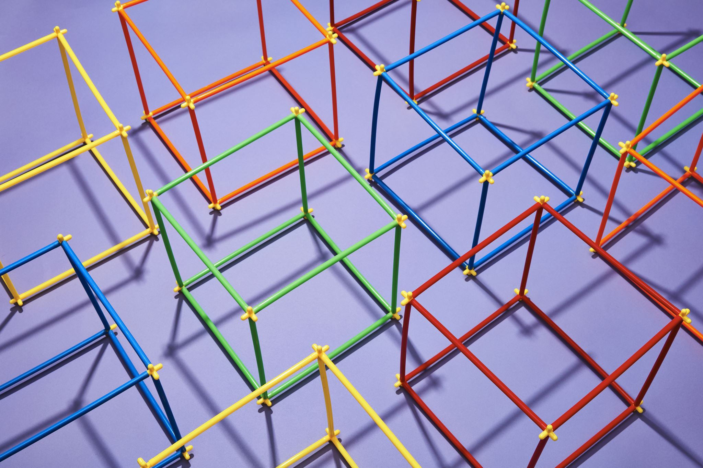
Structure
Features a Clean and Concise Syntax
Indentation-Sensitive
Allows both Infix and Prefix Notation for Functions
Most Common Types: Bool, Char, String, Int, Integer & Double
Comments denoted by braces- { }
Lists- Head, Tail, Length
Tuples- collections of finite, ordered and heterogeneous elements

Slide 7
Tuples- collections of finite, ordered and heterogeneous elements
Guards-convenient way to express branching in functions
Pattern matching -allows a way to deconstruct data structures and bind variables to values.

Slide 8
Haskell vs Java & C++
Haskell | Java | C++
Purely Functional | Object-Oriented, Imperative
Garbage Collector+ Type Inference | Garbage Collector | Deallocation of Memory Done Manually
Off-side rule syntax with indentation | C-style Syntax with Curly Braces
Immutable Values- Default | Mutable & Immutable Variables
Error handling by Either Type | Error Handling - Try-Catch Blocks

Slide 9

Code Examples

Slide 10
HASKELL
Thank You For Attention!

