Slide 1
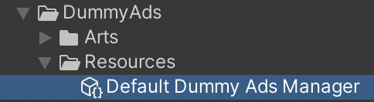
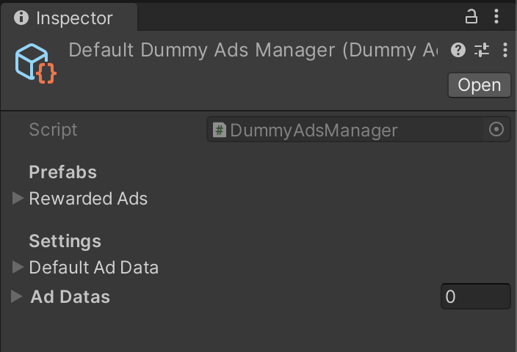
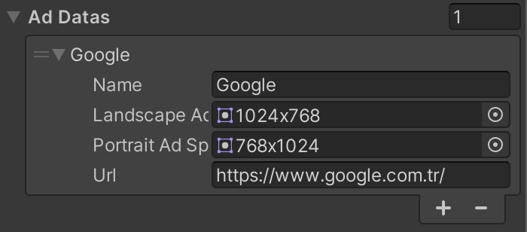
DummyAds
Settings
You can add Custom ads from Ad Datas section
If you leave the Ad Datas list empty, Default Ad Data will be used instead.
Example Custom Ad

Slide 2
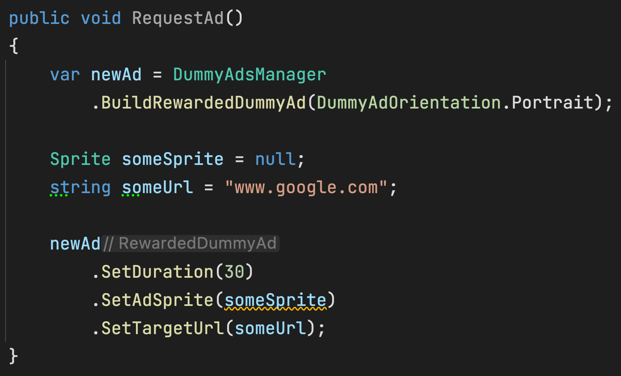
DummyAds
Overriding the Ad Settings (Optional)
SetDuration => Sets the Duration of the Ad.
If you don’t call this Default Duration will be used instead.
SetAdSprite => Sets the Sprite of the Ad.
You can use this for Showing the same Ad everytime.
SetTargetURL => Sets the Target URL of the Ad.
You can use this for Redirecting to same URL everytime.

Slide 3
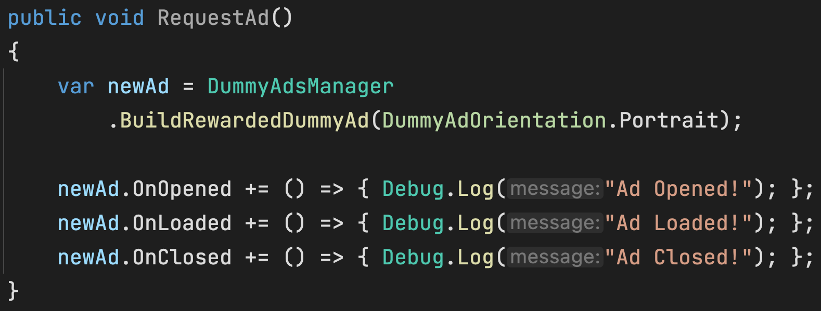
DummyAds
Subscribing the Events
All Ads have OnOpened, OnLoaded and OnClosed events.
Some Ads might have additional events.
For Example, RewardedDummyAd has OnFinished and
OnRewardGranted events.

Slide 4
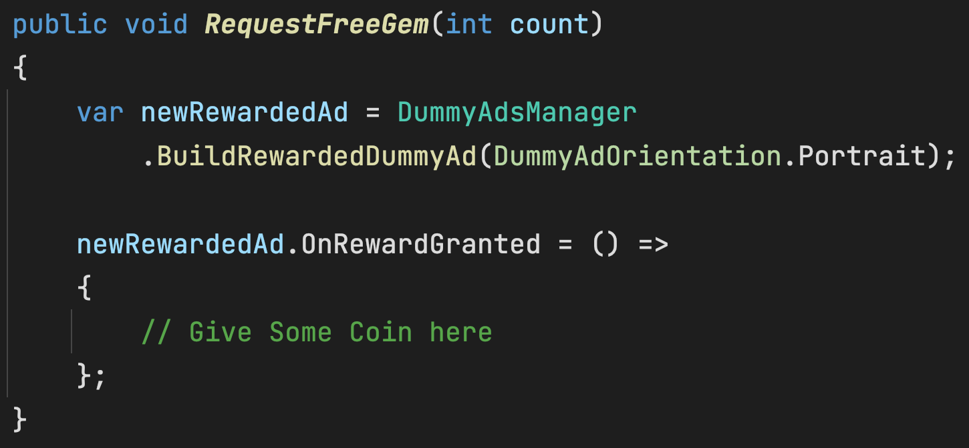
DummyAds
Requesting a Rewarded Ad

