Slide 1
Emre Cakmak
Inventory Management System

Slide 2
Introduction
The Objective:
Build an IMS
To Demonstrate:
Agile & Project Management
Databases & Cloud Fundamentals
Programming & Testing Fundamentals
Continuous Integration & Build Tools
My Journey as a Digital Consultant

Slide 3
Consultant Journey
Technologies learned
GCP
SQL
Java
Maven
Testing with JUnit
Git and Version Control
Project Management – Jira

Slide 4
Risk Assessment

Slide 5
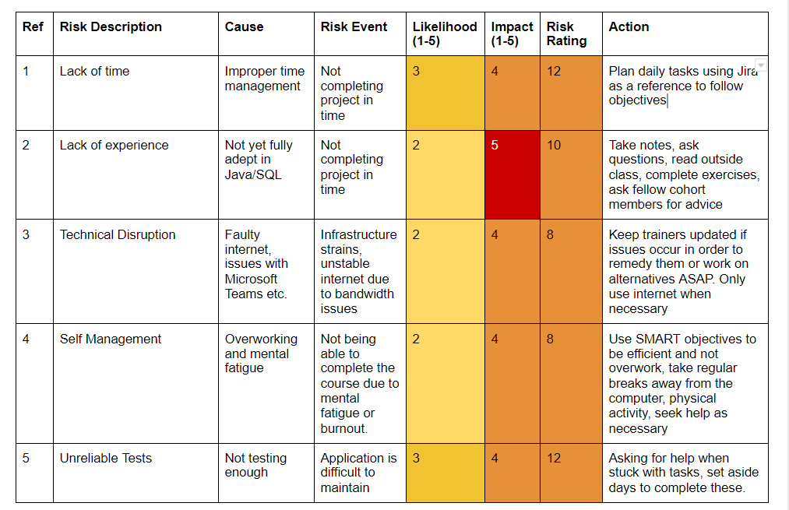
Risk Assessment – Initial Scores and Actions

Slide 6
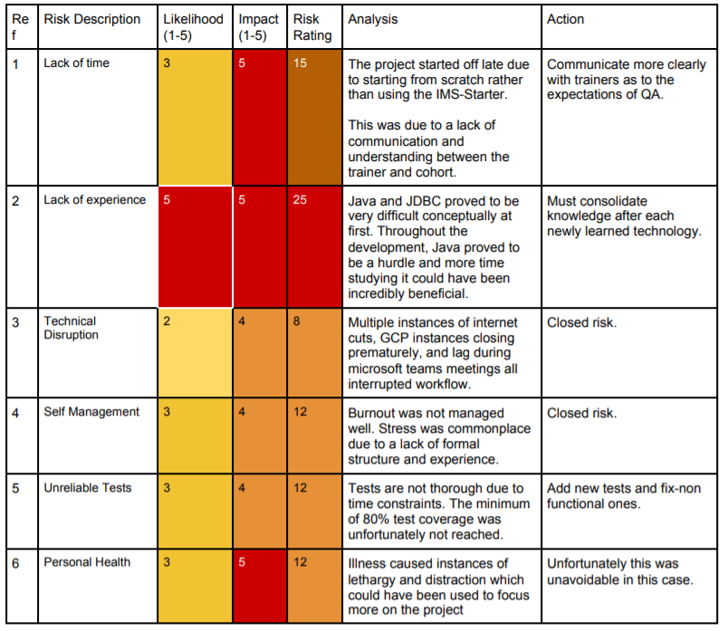
Risk Assessment – Initial Scores and Actions

Slide 7
Project Management
Jira
ERDs
User Stories
MoSCoWs

Slide 8
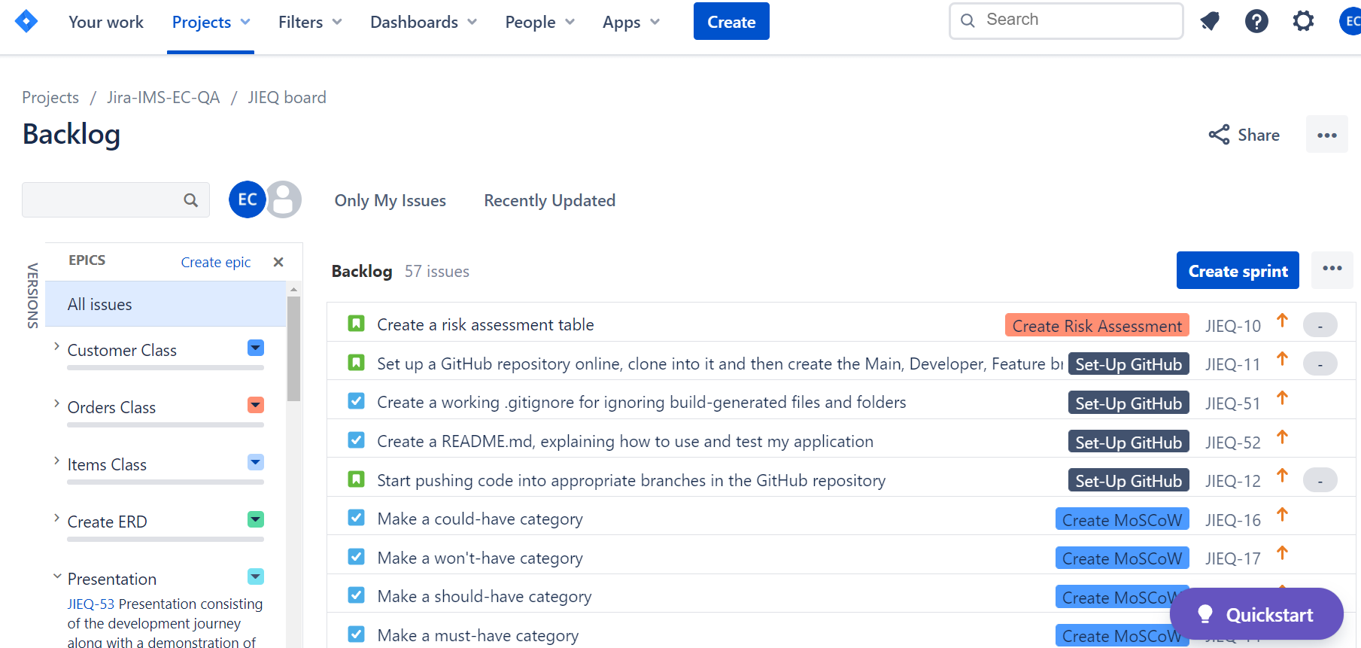
Jira Board

Slide 9
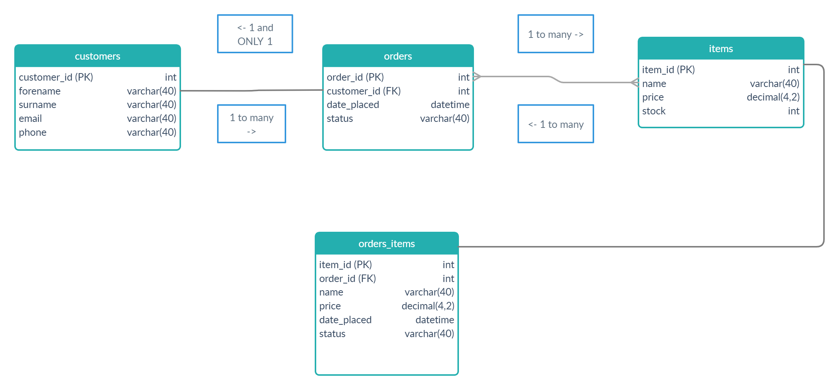
ERDs

Slide 10
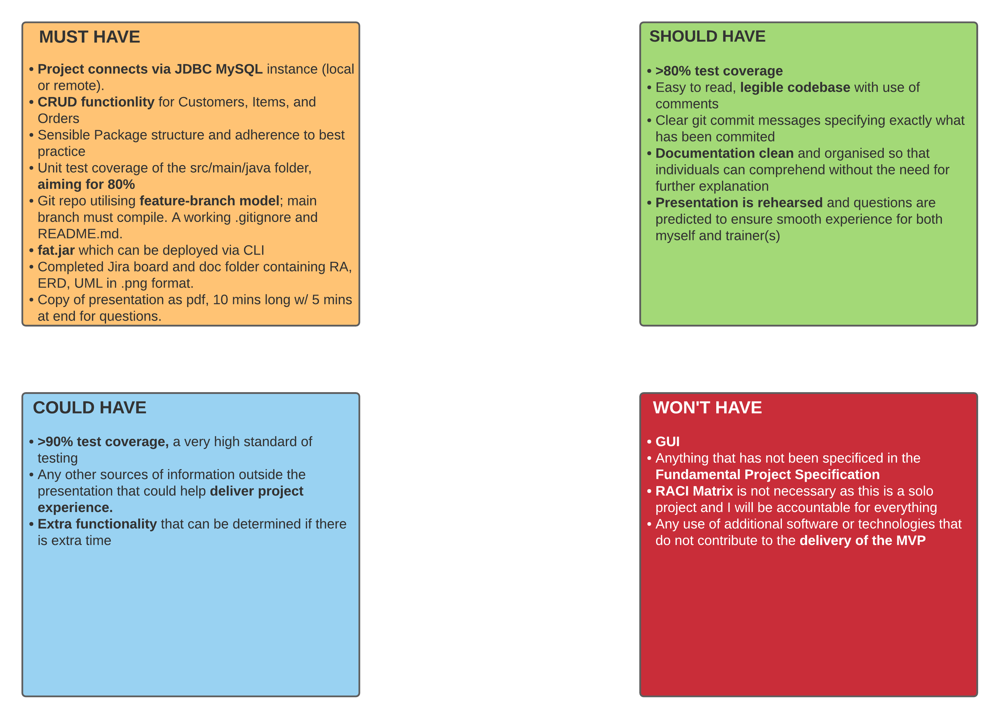

Slide 11
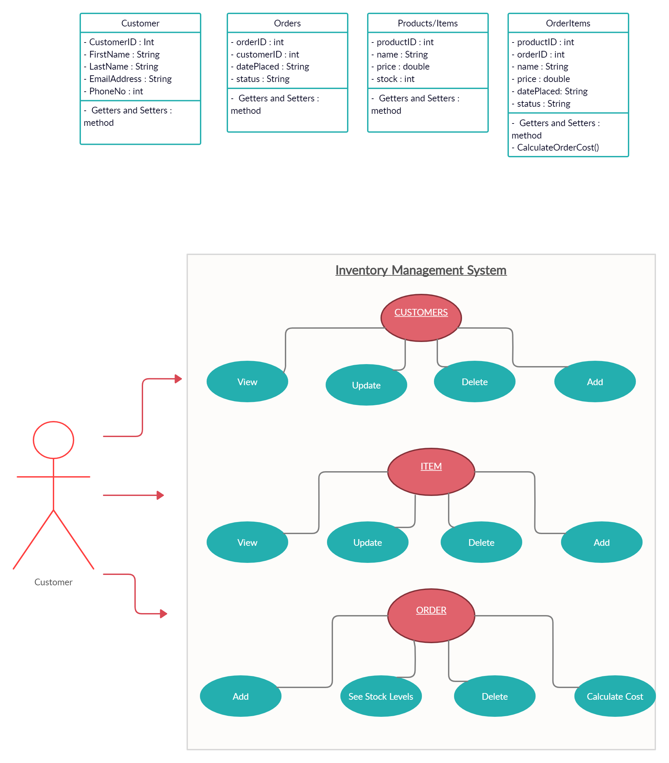
Customer User Stories - Functionality

Slide 12
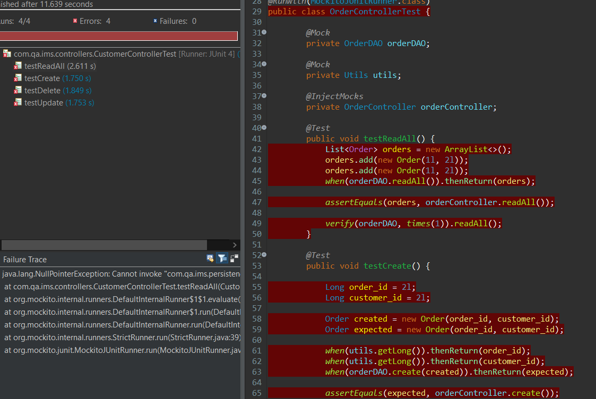
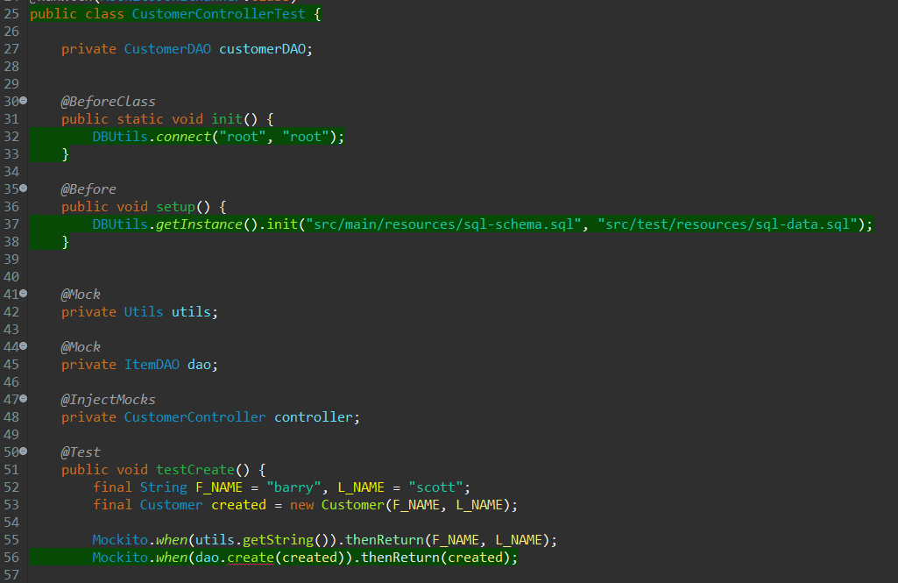
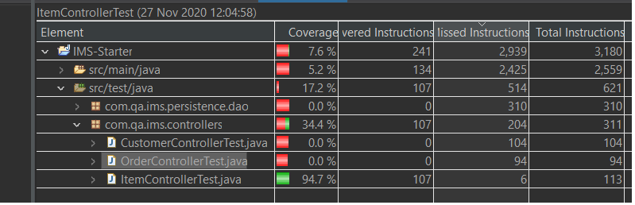
Testing

Slide 13
Retrospective
What went wrong?
Time constraints
Lack of experience
Beginning the project from scratch instead of IMS-Starter (not understanding the IMS-starter)
Lack of proper testing
Lack of .jar file
Losing a large chunk of my code base due to a crash
What went right?
The application is almost fully complete
I learned a lot, even if there is room for improvement
Application is still not fully functional
Given an extra week, the project could be fully finished.

Slide 14
Conclusion
The project is incredibly basic for now
Implement proper testing and Maven integration
Include a more informative and complete README.md
Aim for that >80% test coverage
Deploy a working executable version of the project as a .jar

